Slide 1

Performance Analysis of HPX using APEX and the
TAU Performance System®
Sameer Shende, Kevin Huck
sameer@cs.uoregon.edu, khuck@cs.uoregon.edu
http://tau.uoregon.edu
Download slides from: http://tau.uoregon.edu/APEX.pdf

Slide 2
Outline
Introduction to TAU
Instrumentation: PDT, MPI, OpenMP, tau_exec
I/O and Memory evaluation
PAPI
Demonstration of analysis tools: ParaProf, TAUdb and PerfExplorer, Vampir and Jumpshot
Introduction to APEX
Building HPX with APEX & TAU
Program Examples

Slide 3
Tutorial Goals
This tutorial is an introduction to portable performance evaluation tools. You should leave here with a better understanding of…
Concepts and steps involved in performance evaluation
Understanding key concepts in understanding code performance
How to collect and analyze data from hardware performance counters (PAPI)
How to instrument your programs with TAU
Measurement options provided by TAU
Environment variables used for choosing metrics, generating performance data
How to use ParaProf, TAU’s profile browser
General familiarity with TAU use for Fortran, C++, C, and mixed language
How to generate trace data in different formats

Slide 4

TAU Performance System®
Tuning and Analysis Utilities (20+ year project)
Comprehensive performance profiling and tracing
  Integrated, scalable, flexible, portable
  Targets all parallel programming/execution paradigms
Integrated performance toolkit
  Instrumentation, measurement, analysis, visualization
  Widely-ported performance profiling / tracing system
  Performance data management and data mining
  Open source (BSD-style license)
Integrates with application frameworks

Slide 5
Understanding Application Performance using TAU
How much time is spent in each application routine and outer loops? Within loops, what is the contribution of each statement?
How many instructions are executed in these code regions?
Floating point, Level 1 and 2 data cache misses, hits, branches taken?
What is the memory usage of the code? When and where is memory allocated/de-allocated? Are there any memory leaks?
What are the I/O characteristics of the code? What is the peak read and write bandwidth of individual calls, total volume?
What is the contribution of each phase of the program? What is the time wasted/spent waiting for collectives, and I/O operations in Initialization, Computation, I/O phases?
How does the application scale? What is the efficiency, runtime breakdown of performance across different core counts?

Slide 6
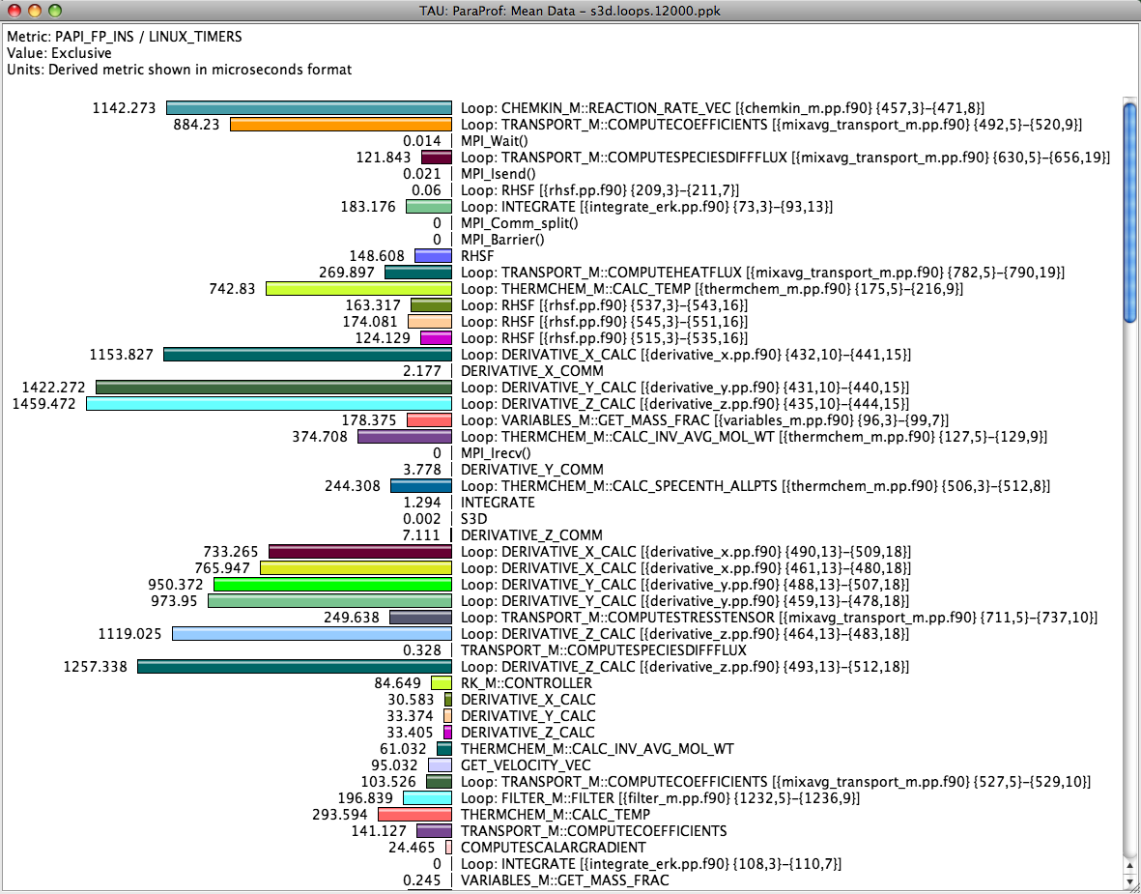
Identifying Potential Bottlenecks
low mflops in
loops?

Slide 7
What does TAU support?
OpenCL
C/C++
CUDA
UPC
GPI
Python
Fortran
OpenACC
MPI
Java
pthreads
Intel MIC
OpenMP
Intel
GNU
PGI
Sun
LLVM
Cray
MPC
HPX
AIX
Linux
Windows
Insert yours
here
Fujitsu
ARM64
BlueGene
NVIDIA
Power 8
OS X

Slide 8
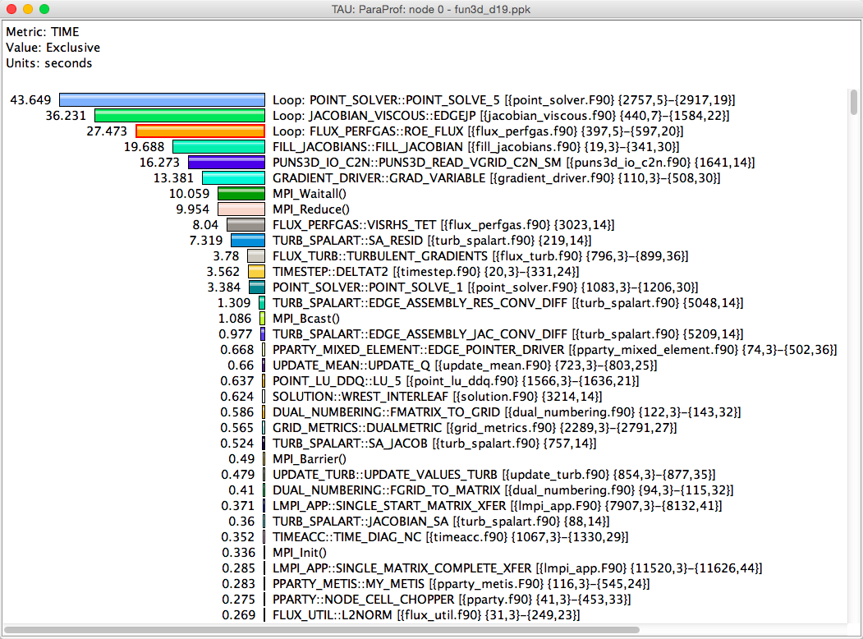
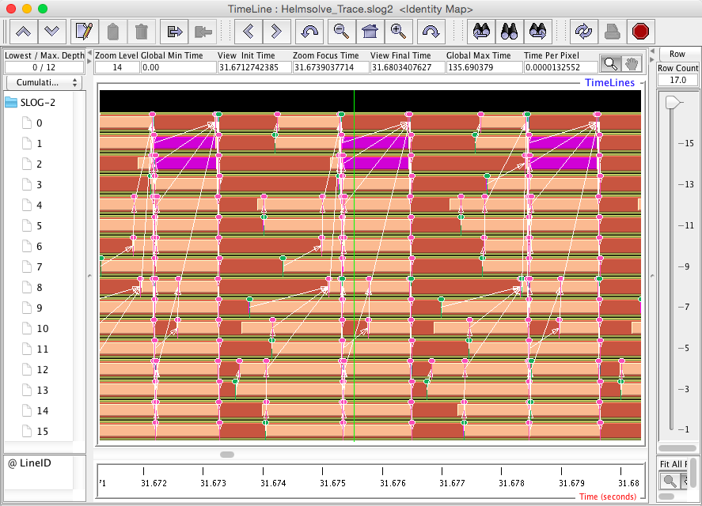
Profiling and Tracing
Profiling
Tracing
Profiling shows you how much (total) time was spent in each routine
Tracing shows you when the events take place on a timeline
Profiling and tracing
  Profiling shows you how much (total) time was spent in each routine
  Tracing shows you when the events take place on a timeline

Slide 9
Inclusive vs. Exclusive Measurements
Performance with respect to code regions
Exclusive measurements for region only
Inclusive measurements includes child regions
int foo()
{
int a;
a =a + 1;
bar();
a =a + 1;
return a;
}
inclusive
duration
exclusive
duration

Slide 10
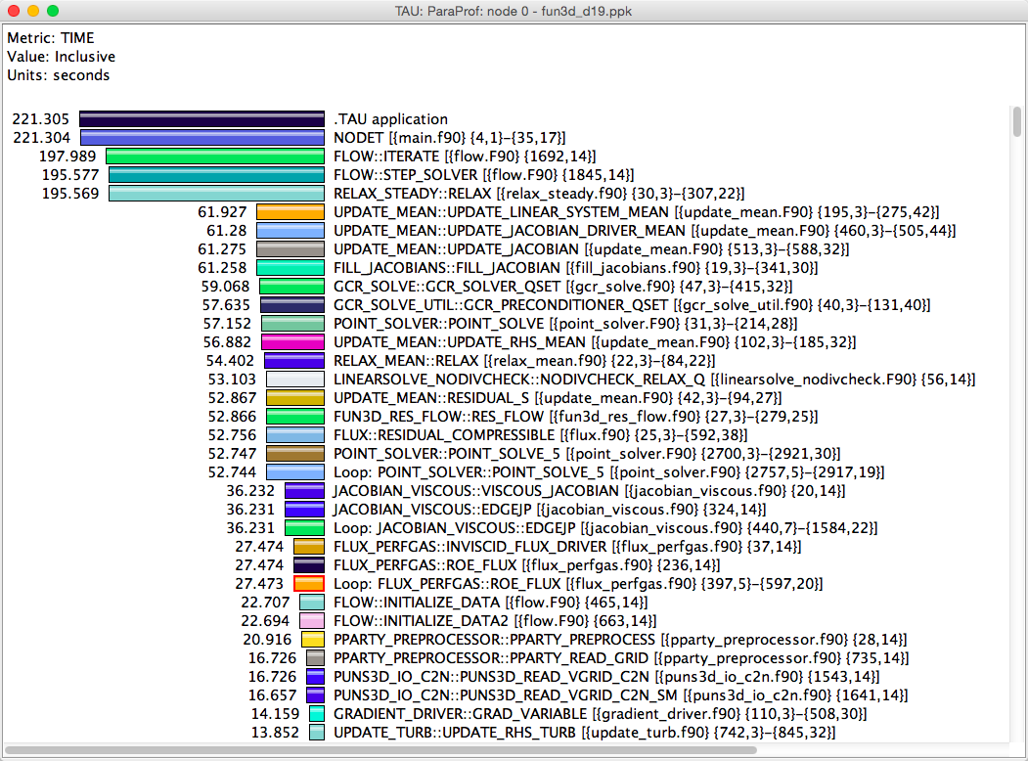
Inclusive vs. Exclusive Measurements
Inclusive time
Exclusive time

Slide 11
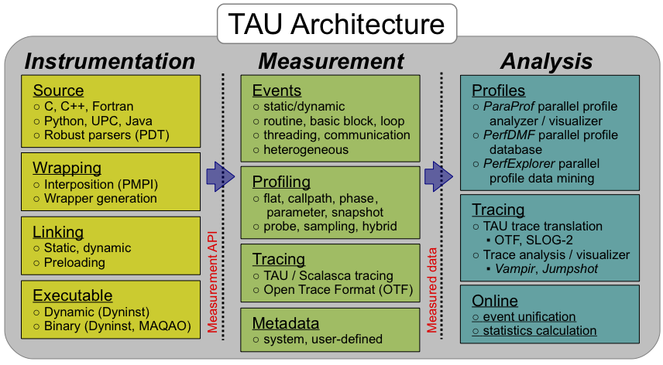
TAU Architecture and Workflow

Slide 12
TAU Architecture and Workflow
Instrumentation: Add probes to perform measurements
  Source code instrumentation using pre-processors and compiler scripts
  Wrapping external libraries (I/O, MPI, Memory, CUDA, OpenCL, pthread)
  Rewriting the binary executable
Measurement: Profiling or tracing using various metrics
  Direct instrumentation (Interval events measure exclusive or inclusive duration)
  Indirect instrumentation (Sampling measures statement level contribution)
  Throttling and runtime control of low-level events that execute frequently
  Per-thread storage of performance data
  Interface with external packages (e.g. PAPI hw performance counter library)
Analysis: Visualization of profiles and traces
  3D visualization of profile data in paraprof or perfexplorer tools
  Trace conversion & display in external visualizers (Vampir, Jumpshot, ParaVer)

Slide 13
Instrumentation
Direct and indirect performance observation
  Instrumentation invokes performance measurement
  Direct measurement with probes
  Indirect measurement with periodic sampling or hardware performance counter overflow interrupts
  Events measure performance data, metadata, context, etc.
User-defined events
  Interval (start/stop) events to measure exclusive & inclusive duration
  Atomic events take measurements at a single point
    Measures total, samples, min/max/mean/std. deviation statistics
  Context events are atomic events with executing context
    Measures above statistics for a given calling path

Slide 14
Direct Observation Events
Interval events (begin/end events)
  Measures exclusive & inclusive durations between events
  Metrics monotonically increase
  Example: Wall-clock timer
Atomic events (trigger with data value)
  Used to capture performance data state
  Shows extent of variation of triggered values (min/max/mean)
  Example: heap memory consumed at a particular point
Code events
  Routines, classes, templates
  Statement-level blocks, loops
  Example: for-loop begin/end

Slide 15
Direct Instrumentation Options in TAU
Source Code Instrumentation
  Automatic instrumentation using pre-processor based on static analysis of source code (PDT), creating an instrumented copy
  Compiler generates instrumented object code
  Manual instrumentation
Library Level Instrumentation
  Statically or dynamically linked wrapper libraries
  MPI, I/O, memory, etc.
  Wrapping external libraries where source is not available
Runtime pre-loading and interception of library calls
Binary Code instrumentation
  Rewrite the binary, runtime instrumentation
Virtual Machine, Interpreter, OS level instrumentation

Slide 16
TAU Execution Command (tau_exec)
Uninstrumented execution
% mpirun -np 256 ./a.out
Track GPU operations
% mpirun –np 256 tau_exec –cupti ./a.out
% mpirun –np 256 tau_exec –cupti -um ./a.out (for Unified Memory)
% mpirun –np 256 tau_exec –opencl ./a.out
% mpirun –np 256 tau_exec –openacc ./a.out
Track MPI performance
% mpirun -np 256 tau_exec ./a.out
Track OpenMP, I/O, and MPI performance (MPI enabled by default)
% mpirun -np 256 tau_exec –ompt -io ./a.out
Track memory operations
% export TAU_TRACK_MEMORY_LEAKS=1
% mpirun –np 256 tau_exec –memory_debug ./a.out (bounds check)
Use event based sampling (compile with –g)
% mpirun –np 256 tau_exec –ebs ./a.out
Also –ebs_source=<PAPI_COUNTER> -ebs_period=<overflow_count>

Slide 17
Configuration Tags for tau_exec
% ./configure –pdt=<dir> -mpi –papi=<dir>; make install
Creates in $TAU:
Makefile.tau-papi-mpi-pdt(Configuration parameters in stub makefile)
shared-papi-mpi-pdt/libTAU.so
% ./configure –pdt=<dir> -mpi; make install creates
Makefile.tau-mpi-pdt
shared-mpi-pdt/libTAU.so
To explicitly choose preloading of shared-<options>/libTAU.so change:
% mpirun -np 256 ./a.out to
% mpirun -np 256 tau_exec –T <comma_separated_options> ./a.out
% mpirun -np 256 tau_exec –T papi,mpi,pdt ./a.out
Preloads $TAU/shared-papi-mpi-pdt/libTAU.so
% mpirun -np 256 tau_exec –T papi ./a.out
Preloads $TAU/shared-papi-mpi-pdt/libTAU.so by matching.
% mpirun –np 256 tau_exec –T papi,mpi,pdt –s ./a.out
Does not execute the program. Just displays the library that it will preload if executed without the –s option.
NOTE: -mpi configuration is selected by default. Use –T serial for
Sequential programs.

Slide 18
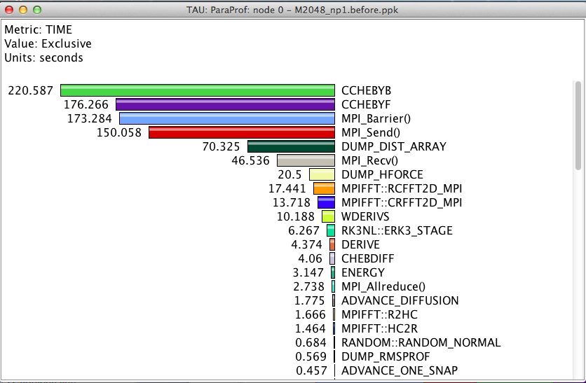
Routine Level Profile
How much time is spent in each application routine?

Slide 19
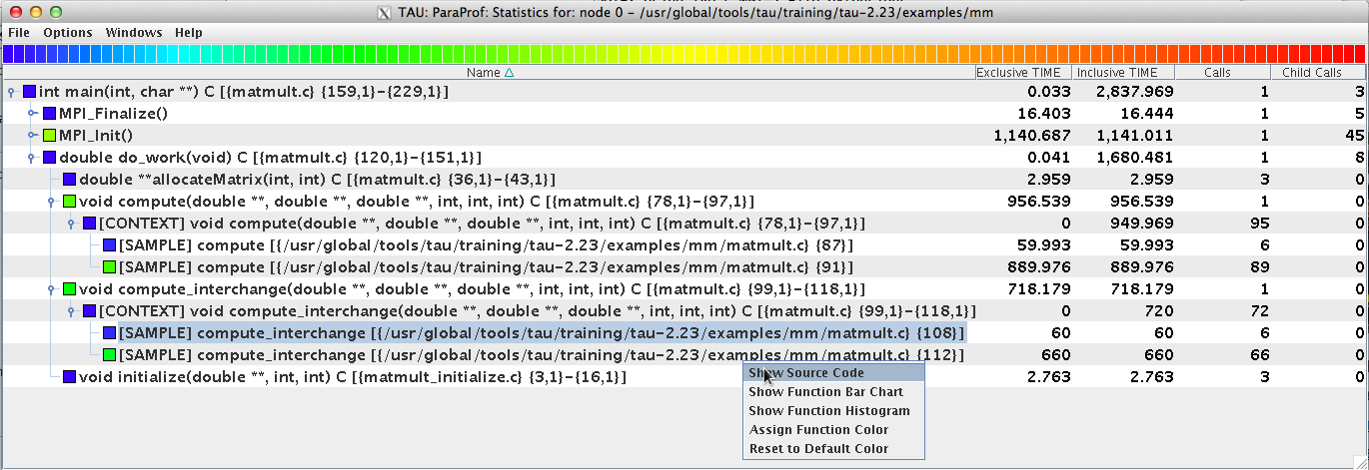
Event Based Sampling in TAU
% export TAU_MAKEFILE=$TAU/Makefile.tau-icpc-papi-mpi-pdt
% make CC=tau_cc.sh CXX=tau_cxx.sh
% export TAU_SAMPLING=1
% mpirun –np 256 ./a.out
% paraprof

Slide 20
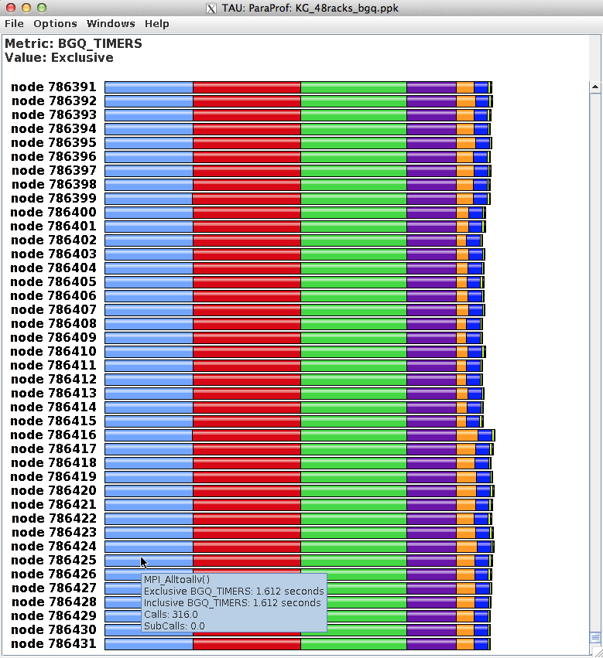
ParaProf Profile Browser

Slide 21
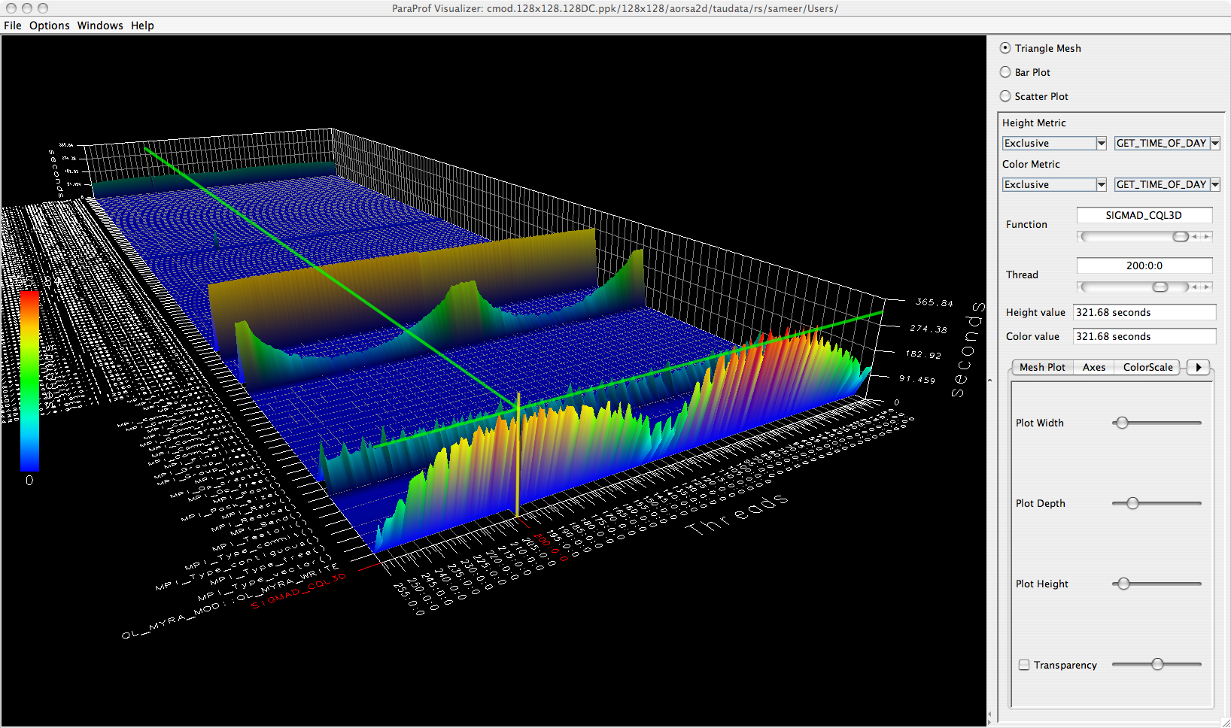
ParaProf 3D Profile Browser

Slide 22
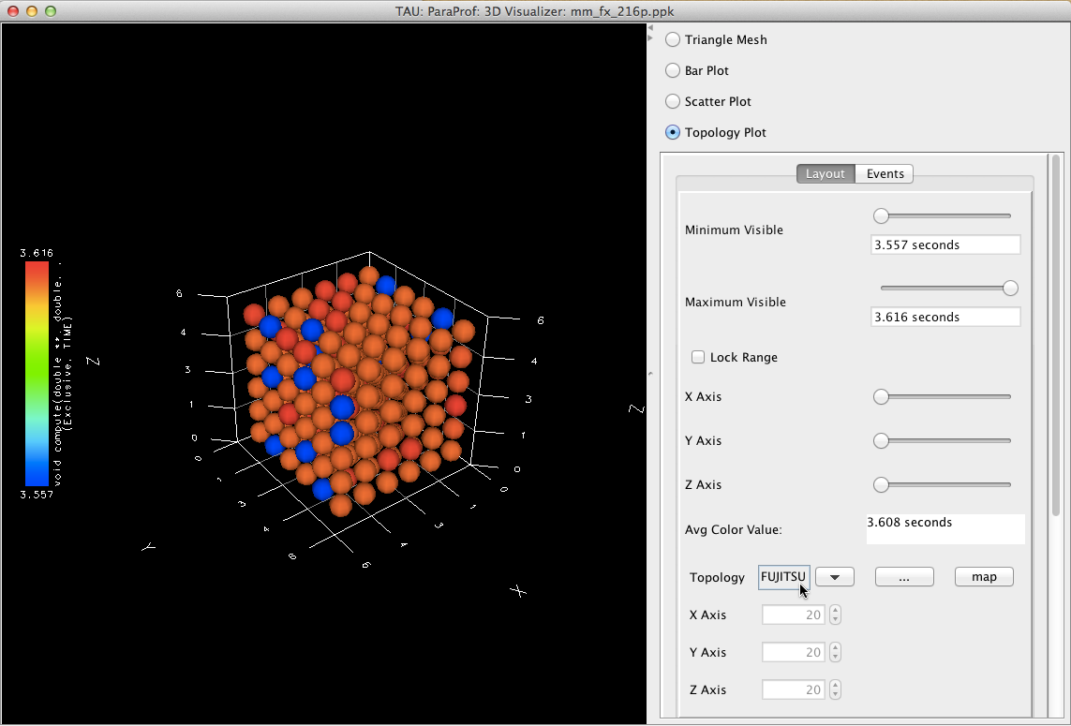
ParaProf Topology Display

Slide 23
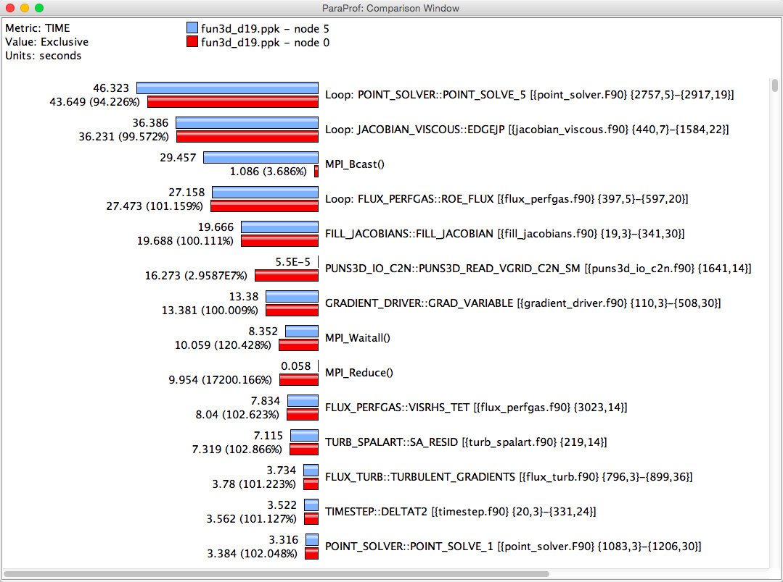
ParaProf Comparison Window
Comparing Rank 0 with 5 : Right click on “node 5” -> Add node to comparison window

Slide 24
Profiling with Multiple Counters
% source tau.bashrc
% export TAU_MAKEFILE=$TAU/Makefile.tau-icpc-papi-mpi-pdt
% export TAU_OPTIONS=‘-optTauSelectFile=select.tau –optVerbose’
% cat select.tau
BEGIN_INSTRUMENT_SECTION
loops routine=“#”
END_INSTRUMENT_SECTION
% make F90=tau_f90.sh
% mxterm 1 16 40
% export TAU_METRICS=TIME,PAPI_FP_INS,PAPI_L1_DCM
% mpirun -np 4 ./matmult
% paraprof -–pack app.ppk
Move the app.ppk file to your desktop.
% paraprof app.ppk
Choose Options -> Show Derived Panel -> Click PAPI_FP_INS,
Click “/”, Click TIME, Apply, Choose new metric by double clicking.

Slide 25
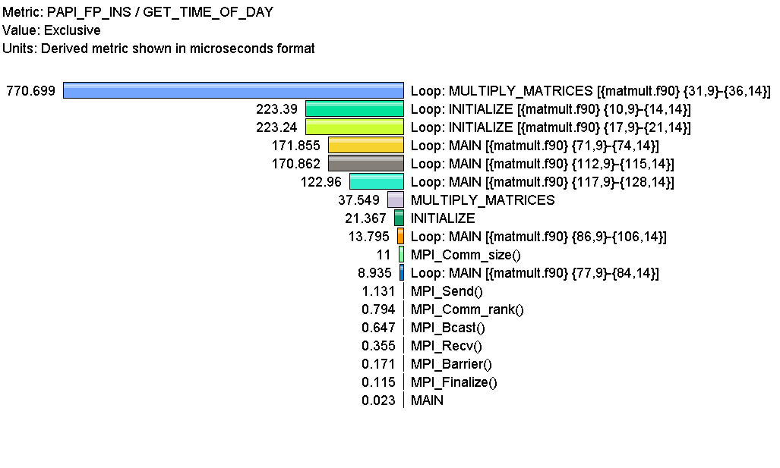
Computing FLOPS
Goal: What is the execution rate of my loops in MFLOPS?
Flat profile with PAPI_FP_INS and time with loop instrumentation:

Slide 26
Callpath Profiles
% source tau.bashrc
% export TAU_MAKEFILE=$TAU/Makefile.tau-icpc-papi-mpi-pdt
% make F90=tau_f90.sh
(Or edit Makefile and change F90=tau_f90.sh)
% mxterm 1 16 40
% export TAU_CALLPATH=1
% export TAU_CALLPATH_DEPTH=100
(truncates all calling paths to a specified depth)
% mpirun -np 4 ./a.out
% paraprof -–pack app.ppk
Move the app.ppk file to your desktop.
% paraprof app.ppk
(Windows -> Thread -> Call Graph)

Slide 27
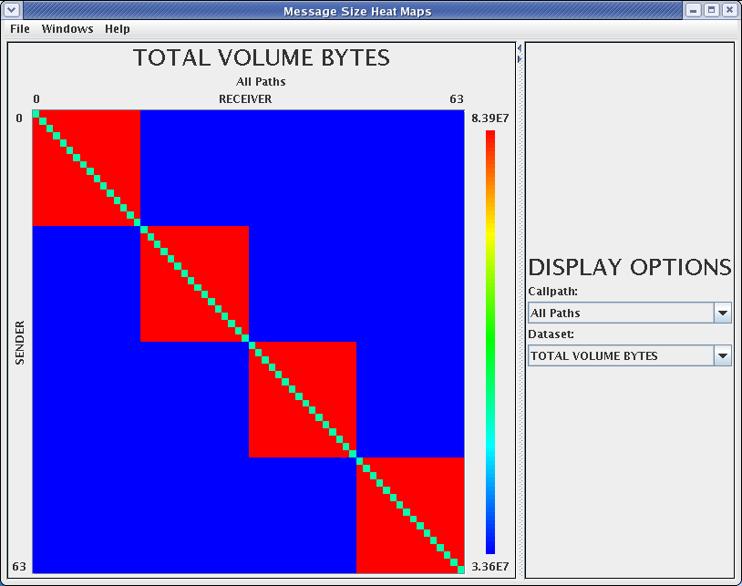
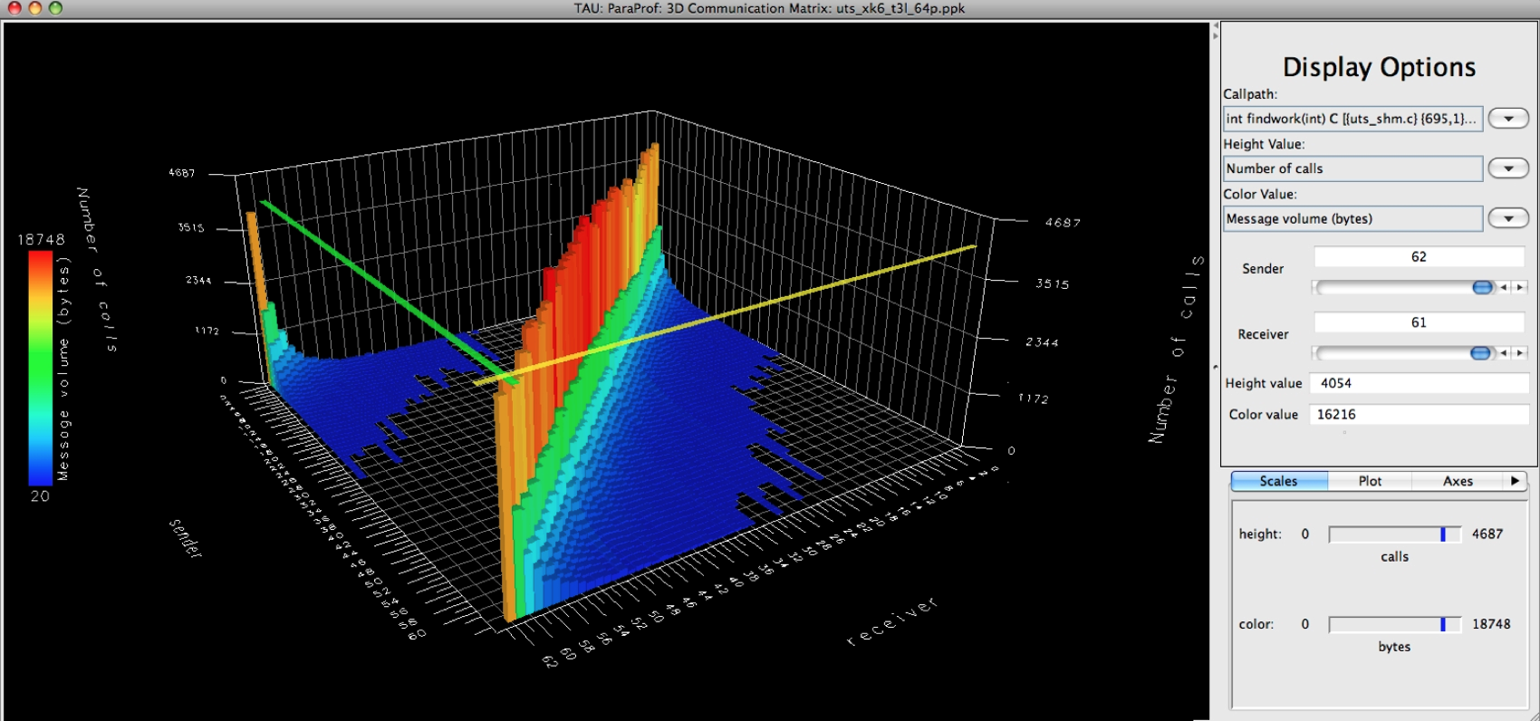
Comunication Matrix
% source tau.bashrc
% export TAU_MAKEFILE=$TAU/Makefile.tau-icpc-papi-mpi-pdt
% make F90=tau_f90.sh
(Or edit Makefile and change F90=tau_f90.sh)
% mxterm 1 16 40
% export TAU_COMM_MATRIX=1
% mpirun -np 4 ./a.out
% paraprof
(Windows -> Communication Matrix)
(Windows -> 3D Communication Matrix)
Goal: What is the volume of inter-process communication? Along which calling path?

Slide 28
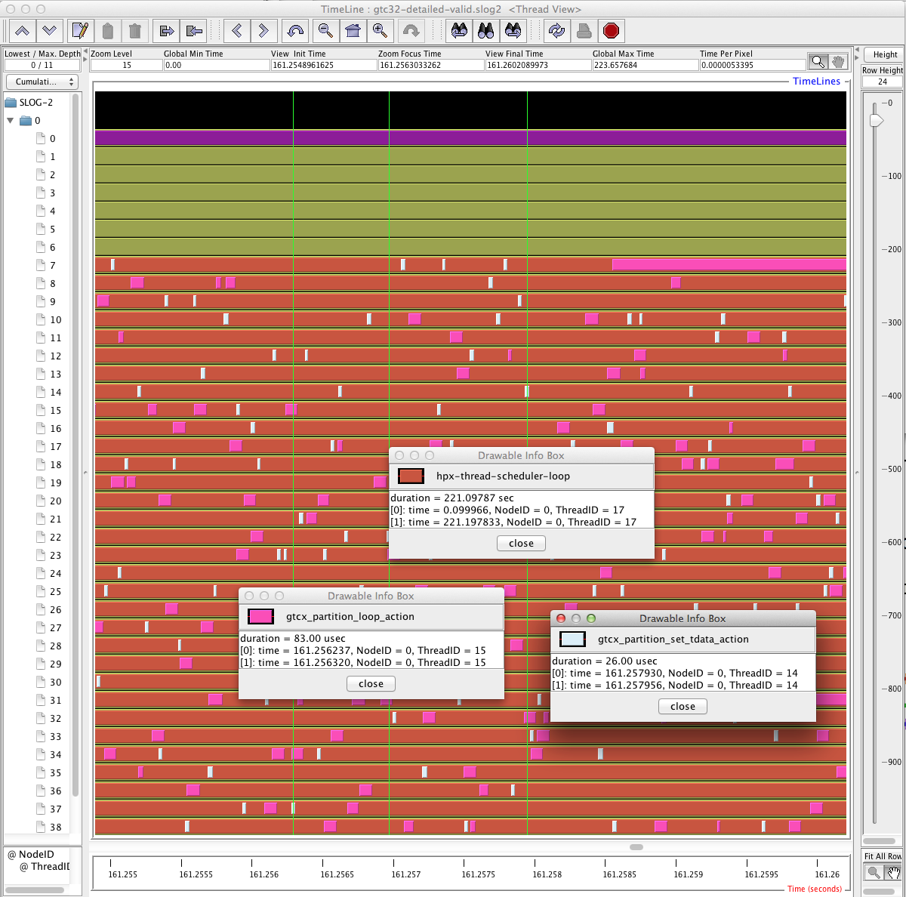
Jumpshot Trace Visualizer

Slide 29
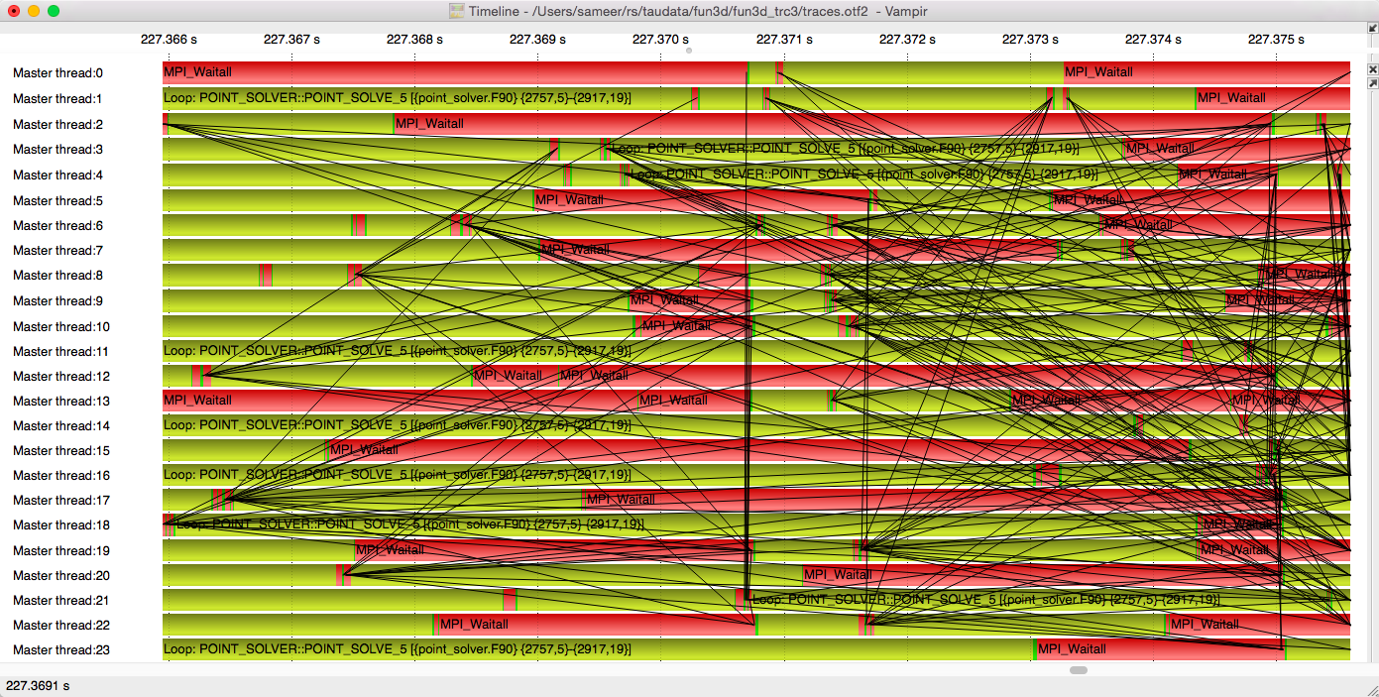
Vampir Trace Visualizer

Slide 30
APEX

Slide 31
APEX Runtime Adaptation : Motivation
Controlling concurrency
  Energy efficiency
  Performance
Parametric variability
  Granularity for this machine / dataset?
Load Balancing
  When to perform AGAS migration?
Parallel Algorithms (for_each…)
  Separate what from how
Address the “SLOW” performance model

Slide 32
Introduction to APEX
Performance awareness and performance adaptation
Top down and bottom up performance mapping / feedback
  Make node-wide resource utilization data and analysis, energy consumption, and health information available in real time
  Associate performance state with policy for feedback control
APEX introspection
  OS: track system resources, utilization, job contention, overhead
  Runtime (HPX): track threads, queues, concurrency, remote operations, parcels, memory management
  Application timer / counter observation

Slide 33
APEX architecture
APEX Introspection
Synchronous
Asynchronous
events
Application
meta-events
RCR Toolkit
APEX State
HPX
APEX Policy Engine
Triggered
Periodic
actuators

Slide 34
APEX Introspection
APEX collects data through “inspectors”
  Synchronous uses an event API and event “listeners”
    Initialize, terminate, new thread – added to HPX runtime
    Timer start, stop, yield*, resume* - added to HPX task scheduler
    Sampled value (counters from HPX-5, HPX-3)
    Custom events (meta-events)
  Asynchonous do not rely on events, but occur periodically
APEX exploits access to performance data from lower stack components
  Reading from the RCR blackboard (i.e., power, energy)
  “Health” data through other interfaces (/proc/stat, cpuinfo, meminfo, net/dev, self/status, lm_sensors, power*, etc.)

Slide 35
APEX Event Listeners
Profiling listener
  Start event: input name/address, get timestamp, return profiler handle
  Stop event: get timestamp, put profiler object in a queue for back-end processing, return
  Sample event: put the name & value in the queue
  Asynchronous consumer thread: process profiler objects and samples to build statistical profile (in HPX-3, processed/scheduled as a thread/task)
Concurrency listener (postmortem analysis)
  Start event: push timer ID on stack
  Stop event: pop timer ID off stack
  Asynchronous consumer thread: periodically log current timer for each thread, output report at termination
TAU Listener (postmortem analysis)
  Synchronously passes all measurement events to TAU to build an offline profile

Slide 36
APEX Policy Listener
Policies are rules that decide on outcomes based on observed state
  Triggered policies are invoked by introspection API events
  Periodic policies are run periodically on asynchronous thread
Polices are registered with the Policy Engine
  Applications, runtimes, and/or OS register callback functions
Callback functions define the policy rules
  “If x < y then…”
Enables runtime adaptation using introspection data
  Engages actuators across stack layers
  Could also be used to involve online auto-tuning support*

Slide 37
Building the tools…
Building TAU pre-requisites
  PDT
  PAPI?
Building TAU
Building APEX pre-requisites
  ActiveHarmony
Building HPX with TAU+APEX support

Slide 38
Building PDT for use with TAU
$ wget http://tau.uoregon.edu/pdt_lite.tgz
$ tar –xvzf pdt_lite.tgz
$ cd pdtoolkit-3.21
$ ./configure -GNU
-prefix=$HOME/install/pdtoolkit/3.21
$ make
$ make install
Notes:
Cerberus installation location: /usr/local/packages/src

Slide 39
Building TAU for use with HPX
$ wget http://tau.uoregon.edu/tau.tgz
$ tar -xvzf tau.tgz
$ cd tau-2.25
$ wget http://tau.uoregon.edu/ext.tgz
$ tar -xvzf ext.tgz
$ ./configure -pthread -bfd=download
-unwind=download -pdt=$HOME/install/pdtoolkit/3.21
$ make -j install
“pthread” ensures threading support, BFD and libunwind provide sampling support (if wanted)
Notes:
Cerberus installation location: /usr/local/packages/src

Slide 40
Building ActiveHarmony
$ wget http://www.dyninst.org/sites/default/files/downloads/harmony/ah-4.5.tar.gz
$ tar -xvzf ah-4.5.tar.gz
$ cd activeharmony-4.5
$ make CFLAGS=-O3
$ make install PREFIX=$HOME/local/harmony-4.5

Slide 41
Building HPX with APEX & TAU
$ cmake <usual HPX settings>…
  -DHPX_WITH_APEX=TRUE \
  -DAPEX_WITH_ACTIVEHARMONY=TRUE \
  -DACTIVEHARMONY_ROOT=/home/khuck/install/activeharmony/4.5 \
  -DHPX_WITH_TAU=TRUE \
  -DHPX_WITH_ITTNOTIFY=TRUE \
  -DTAU_ROOT=/home/khuck/install/tau \
  ..
$ make (as usual) i.e. “make –j 8 core examples tests”

Slide 42
Runtime Environment Variables - APEX
APEX_TAU : 1
APEX_POLICY : 1
APEX_MEASURE_CONCURRENCY : 0
APEX_MEASURE_CONCURRENCY_PERIOD : 1000000
APEX_SCREEN_OUTPUT : 0
APEX_PROC_CPUINFO : 0
APEX_PROC_MEMINFO : 0
APEX_PROC_NET_DEV : 0
APEX_PROC_SELF_STATUS : 0
APEX_PROC_STAT : 1
APEX_THROTTLE_CONCURRENCY : 0
APEX_THROTTLING_MAX_THREADS : 48
APEX_THROTTLING_MIN_THREADS : 1
APEX_THROTTLE_ENERGY : 0
APEX_THROTTLING_MAX_WATTS : 300
APEX_THROTTLING_MIN_WATTS : 150
APEX_TASKGRAPH_OUTPUT : 0 (experimental)
Notes:
Make this a table

Slide 43
Runtime Environment Variables - TAU
Environment Variable | Default | Description
TAU_TRACE | 0 | Setting to 1 turns on tracing
TAU_CALLPATH | 0 | Setting to 1 turns on callpath profiling
TAU_TRACK_MEMORY_FOOTPRINT | 0 | Setting to 1 turns on tracking memory usage by sampling periodically the resident set size and high water mark of memory usage
TAU_TRACK_POWER | 0 | Tracks instantaneous power usage by sampling periodically.
TAU_CALLPATH_DEPTH | 2 | Specifies depth of callpath. Setting to 0 generates no callpath or routine information, setting to 1 generates flat profile and context events have just parent information (e.g., Heap Entry: foo)
TAU_SAMPLING | 0 | Setting to 1 enables event-based sampling.
TAU_TRACK_SIGNALS | 0 | Setting to 1 generate debugging callstack info when a program crashes
TAU_COMM_MATRIX | 0 | Setting to 1 generates communication matrix display using context events
TAU_THROTTLE | 1 | Setting to 0 turns off throttling. Enabled by default to remove instrumentation in lightweight routines that are called frequently
TAU_THROTTLE_NUMCALLS | 100000 | Specifies the number of calls before testing for throttling
TAU_THROTTLE_PERCALL | 10 | Specifies value in microseconds. Throttle a routine if it is called over 100000 times and takes less than 10 usec of inclusive time per call
TAU_COMPENSATE | 0 | Setting to 1 enables runtime compensation of instrumentation overhead
TAU_PROFILE_FORMAT | Profile | Setting to “merged” generates a single file. “snapshot” generates xml format
TAU_METRICS | TIME | Setting to a comma separated list generates other metrics. (e.g., TIME,ENERGY,PAPI_FP_INS,PAPI_NATIVE_<event>:<subevent>)

Slide 44
Runtime Environment Variables - TAU
Environment Variable | Default | Description
TAU_TRACK_MEMORY_LEAKS | 0 | Tracks allocates that were not de-allocated (needs –optMemDbg or tau_exec –memory)
TAU_EBS_SOURCE | TIME | Allows using PAPI hardware counters for periodic interrupts for EBS (e.g., TAU_EBS_SOURCE=PAPI_TOT_INS when TAU_SAMPLING=1)
TAU_EBS_PERIOD | 100000 | Specifies the overflow count for interrupts
TAU_MEMDBG_ALLOC_MIN/MAX | 0 | Byte size minimum and maximum subject to bounds checking (used with TAU_MEMDBG_PROTECT_*)
TAU_MEMDBG_OVERHEAD | 0 | Specifies the number of bytes for TAU’s memory overhead for memory debugging.
TAU_MEMDBG_PROTECT_BELOW/ABOVE | 0 | Setting to 1 enables tracking runtime bounds checking below or above the array bounds (requires –optMemDbg while building or tau_exec –memory)
TAU_MEMDBG_ZERO_MALLOC | 0 | Setting to 1 enables tracking zero byte allocations as invalid memory allocations.
TAU_MEMDBG_PROTECT_FREE | 0 | Setting to 1 detects invalid accesses to deallocated memory that should not be referenced until it is reallocated (requires –optMemDbg or tau_exec –memory)
TAU_MEMDBG_ATTEMPT_CONTINUE | 0 | Setting to 1 allows TAU to record and continue execution when a memory error occurs at runtime.
TAU_MEMDBG_FILL_GAP | Undefined | Initial value for gap bytes
TAU_MEMDBG_ALINGMENT | Sizeof(int) | Byte alignment for memory allocations
TAU_EVENT_THRESHOLD | 0.5 | Define a threshold value (e.g., .25 is 25%) to trigger marker events for min/max

Slide 45
Example: Concurrency & Performance
Heat diffusion
1D stencil code
  Data array
  partitioned into
  chunks
1 node with
no hyperthreading
Performance increases to a point with increasing worker threads, then decreases
Notes:
UPDATE THIS FOR EDISON/BEACON

Slide 46
Example: Concurrency & Performance
Region of
maximum
performance
correlates with
thread queue
length runtime
performance counter
  Represents # tasks currently waiting to execute
Could do introspection on this to control concurrency throttling policy (*work in progress)
Runtime
Thread queue length
Notes:
UPDATE THIS FOR EDISON/BEACON

Slide 47
1d_stencil_4 Baseline
48 worker threads (with hyperthreading)
Actual concurrency much lower
  Implementation is memory bound
Large variation in concurrency over time
  Tasks waiting on prior tasks to complete
100,000,000 elements, 1000 partitions
138 secs
Where
calculation
takes place
Event-generated
metrics
Notes:
hpx::lcos::local::dataflow is the action that actually carries out the calculation

Slide 48
Run the example
$ export APEX_MEASURE_CONCURRENCY=1
(TAU OPTIONS?)
$ ./build/bin/1d_stencil_4_throttle –nx 100000 --np 1000 --nt 450 --hpx:queuing=throttle --hpx:threads 20 --hpx:print-counter /threadqueue/length --hpx:print-counter-interval 500
$ paraprof
Notes:
UPDATE THIS FOR EDISON/BEACON

Slide 49
Paraprof view of profile
Notes:
ITT notify events are missing. Need to debug this and find out why.

Slide 50
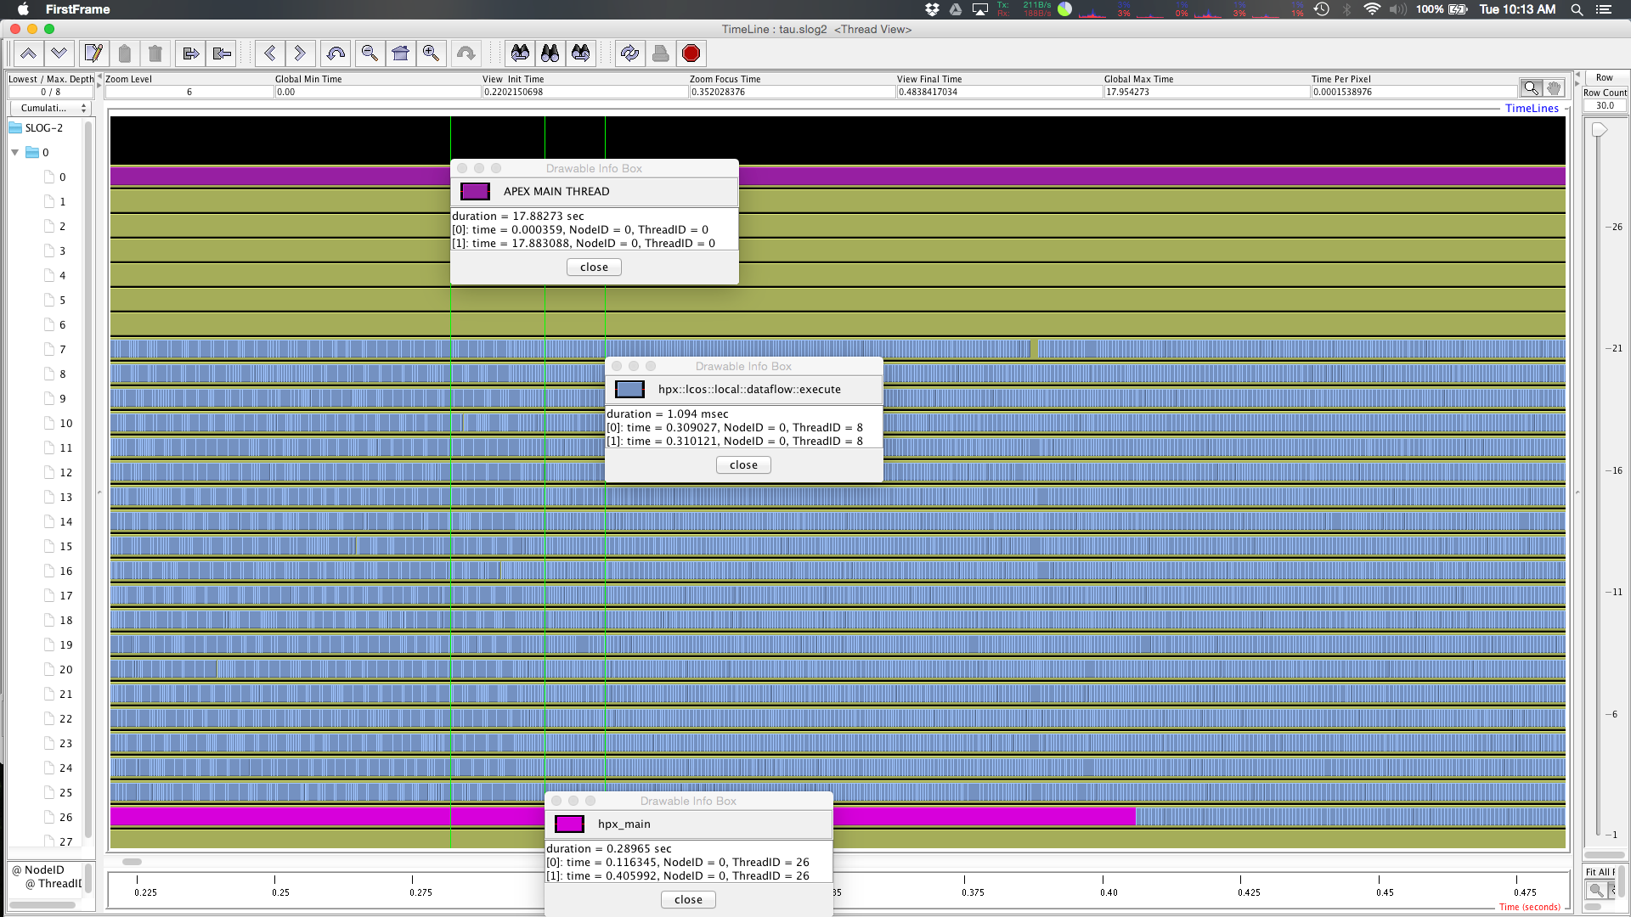
Jumpshot view of trace
Notes:
Counter not visible?

Slide 51
1d_stencil w/optimal # of Threads
12 worker threads
Greater proportion of threads kept busy
  Less interference between active threads and threads waiting for memory
Much faster
  61 sec. vs 138 sec.
100,000,000 elements, 1000 partitions
61 secs

Slide 52
Run the example:
$ export APEX_POLICY=1
$ export APEX_MEASURE_CONCURRENCY=1
$ export APEX_THROTTLE_CONCURRENCY=1
$ export APEX_THROTTLING_MIN_THREADS=8
$ export APEX_THROTTLING_MAX_THREADS=20
$ ./build/bin/1d_stencil_4_throttle –nx 100000 --np 1000 --nt 450 --hpx:queuing=throttle --hpx:threads 20
Notes:
Need to update this with the right thread counts for edison/beacon

Slide 53
1d_stencil Adaptation with APEX
Initially 48 worker threads
Discrete hill climbing search to minimize average #of pending tasks
Converges on 13 (vs. optimal of 12)
Nearly as fast as optimal
  64 seconds vs. 61 seconds
100,000,000 elements, 1000 partitions
64 secs

Slide 54
Profile of throttled execution

Slide 55
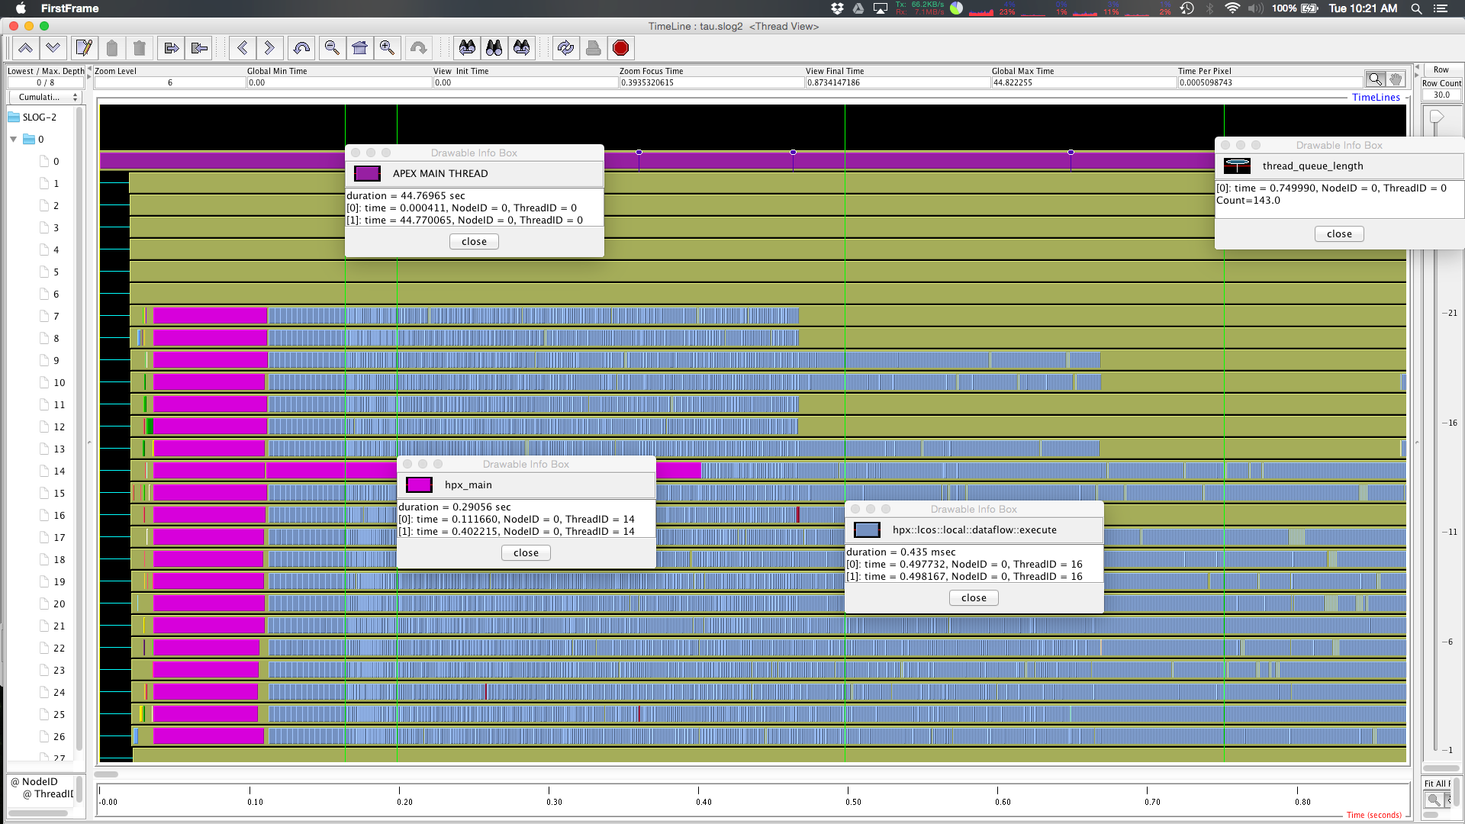
Trace of throttled execution

Slide 56
1d_stencil: adapting block size
Notes:
Also have experimental results using ActiveHarmony to adapt concurrency & granularity

Slide 57
Run the example
$ export APEX_POLICY=1
$ export APEX_THROTTLE_CONCURRENCY=0
$ export APEX_MEASURE_CONCURRENCY=1
$ ./build/bin/1d_stencil_4_repart –nx 100000 --np 1000 --nt 450 --hpx:queuing=throttle --hpx:threads 12

Slide 58
Example: adapt both?
Need updated example from Nick Chaimov

Slide 59
Throtting for Power
MiniGhost
  Mantevo finite different miniapp
  Implements a
  difference stencil across homogenous 3D domain
  Ported to HPX-3 from OpenMP+MPI
  HPX-3 has better performance than OpenMP version
Diminishing returns with added cores per node
  Can throttle for energy without substantial performance impact

Slide 60
MiniGhost baseline
92 seconds
total runtime
Notes:
If allowed to use 48 cores (all the logical cores on a node) not all cores are actually utilized (by worker threads at least; there are additional helper threads in the HPX3 runtime not shown on the chart and not affected by throttling).
(All actions in the code are getting represented as continutation::async because the functions are function objects from boost::bind and we can’t tell the name of the original function at present)

Slide 61
MiniGhost Throttled
103 seconds
total runtime
200 Watt power cap
12% slower, 33% less power
Notes:
IPC: 0.605227 (unthrottled)
IPC: 0.751752 (throttled)

Slide 62
Run the example

Slide 63
Wrap-up…

Slide 64



Support Acknowledgements
Support for this work was provided through Scientific Discovery through Advanced Computing (SciDAC) program funded by U.S. Department of Energy, Office of Science, Advanced Scientific Computing Research (and Basic Energy Sciences/Biological and Environmental Research/High Energy Physics/Fusion Energy Sciences/Nuclear Physics) under award numbers DE-SC0008638, DE-SC0008704, DE- FG02-11ER26050 and DE-SC0006925.
Sandia National Laboratories is a multi-program laboratory managed and operated by Sandia Corporation, a wholly owned subsidiary of Lockheed Martin Corporation, for the U.S. DOE’s National Nuclear Security Administration under contract DE- AC04-94AL85000.
This research used resources of the National Energy Research Scientific Computing Center, a DOE Office of Science User Facility supported by the Office of Science of the U.S. Department of Energy under Contract No. DE-AC02-05CH11231.

