Slide 1

TAU, ADIOS2, CAMTIMERS, etc.
Current and proposed integrations
Kevin Huck, Allen Malony, Sameer Shende
khuck@cs.uoregon.edu
http://tau.uoregon.edu

Slide 2
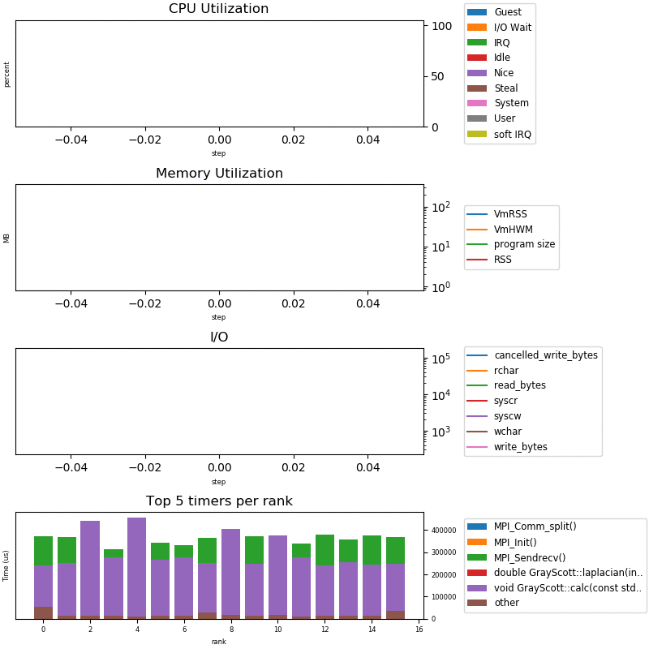
Current (possible) Integration
Codes use CAMTIMERS/other
CAMTIMERS periodically writes summary to disk
Codes use ADIOS2 for coupling
ADIOS2 has a TAU plugin adapter to measure ADIOS2 library
TAU has an ADIOS2 plugin to write/stream TAU data (including HW/OS monitoring data)
Application
CAMTIMERS library
ADIOS2 library
TAU Plugin
TAU library
ADIOS2 Plugin
Performance Data (BP4/SST)
Text
Notes:
The original implementation from 2018 used SOS to aggregate TAU data and write it to ADIOS. We’ve streamlined and eliminated the SOS staging.
XGC1 (and other codes) already use CAMTIMERS (or internal instrumentation) to measure key events. One of the outputs from XGC1 is the performance text files that are written after N timesteps that show the timer break down of the code. Unfortunately, it is just a text output.
The codes use ADIOS2 for coupling, and ADIOS2 uses TAU for performance measurement. TAU also optionally uses ADIOS2 to stream out profile data.
What is needed is to integrate the timers from XGC1 (and other codes) into the TAU data, and write it out as one ADIOS2 output stream for real-time consumption by EFFIS.

Slide 3
Proposed Integration
Add PerfStubs plugin adapter to CAMTIMERS library (and elsewhere as needed)
TAU will automatically register at startup, “listen” to timer events, dump to ADIOS2 when prompted
TAU data would now include CAMTIMERS timers
Python/VTK output to PNG, displayed by EFFIS
Application
CAMTIMERS library
PS Plugin
ADIOS2 library
TAU Plugin
TAU library
ADIOS2 Plugin
Performance Data (BP4/SST)
Text
Notes:
The proposed solution is to add a small plugin adapter to the CAMTIMERS library that will send timer events to TAU.
Then, when the CAMTIMERS files are written, TAU will also be triggered to push out another ADIOS2 step of profile data.
The profile data can be consumed downstream by EFFIS.

Slide 4
Additional Comments
PerfStubs “library” is one C file, one header file
  Adds 0 new build dependencies
  Works with dynamic or static linking
  https://github.com/khuck/perfstubs
Each application would have its own discrete ADIOS2 output from TAU (i.e. XGC1, Gene data are separated)
Could be integrated into other libraries if necessary
Macro interface can be compiled out entirely if desired

