Slide 1
The TAU Performance System
Kevin Huck, Sameer Shende, Allen Malony
khuck@cs.uoregon.edu
http://tau.uoregon.edu

Slide 2




The TAU Performance System®
Kevin Huck, Sameer Shende, Allen Malony
khuck@cs.uoregon.edu
http://tau.uoregon.edu

Slide 3

TAU : brief overview
Tuning and Analysis Utilities (28+ year project)
Integrated performance toolkit:
Multi-level performance instrumentation
Highly configurable
Widely ported performance profiling / tracing system
Portable (java, python) visualization / exploration / analysis tools
Supports all major HPC programming models
MPI/SHMEM, OpenMP/ACC, CUDA, HIP, OneAPI, Kokkos...

Slide 4
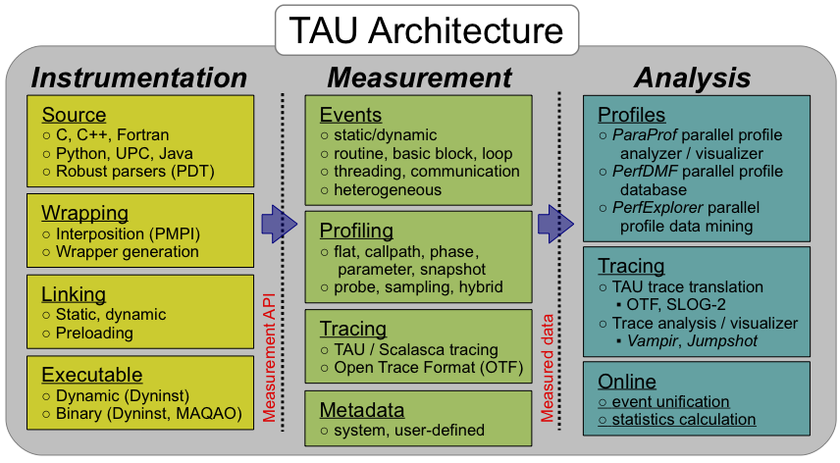
TAU : brief overview
New! ADIOS2 BP4
New! ADIOS2 SST

Slide 5
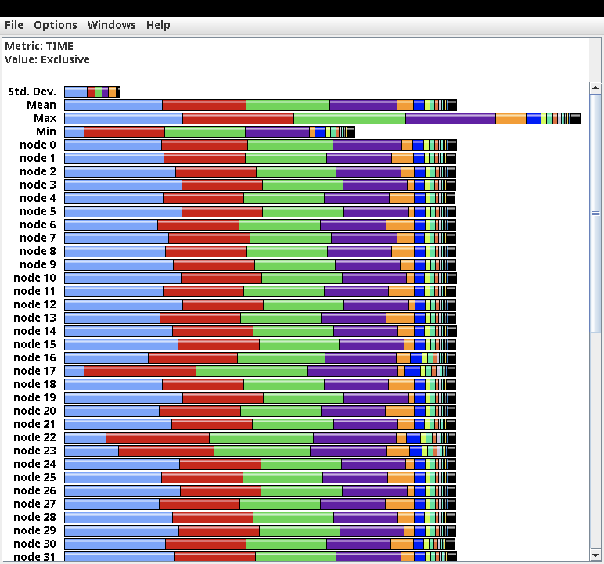
ParaProf Profile Browser
Each line is a different process/thread of execution, each color is a different function
% paraprof

Slide 6
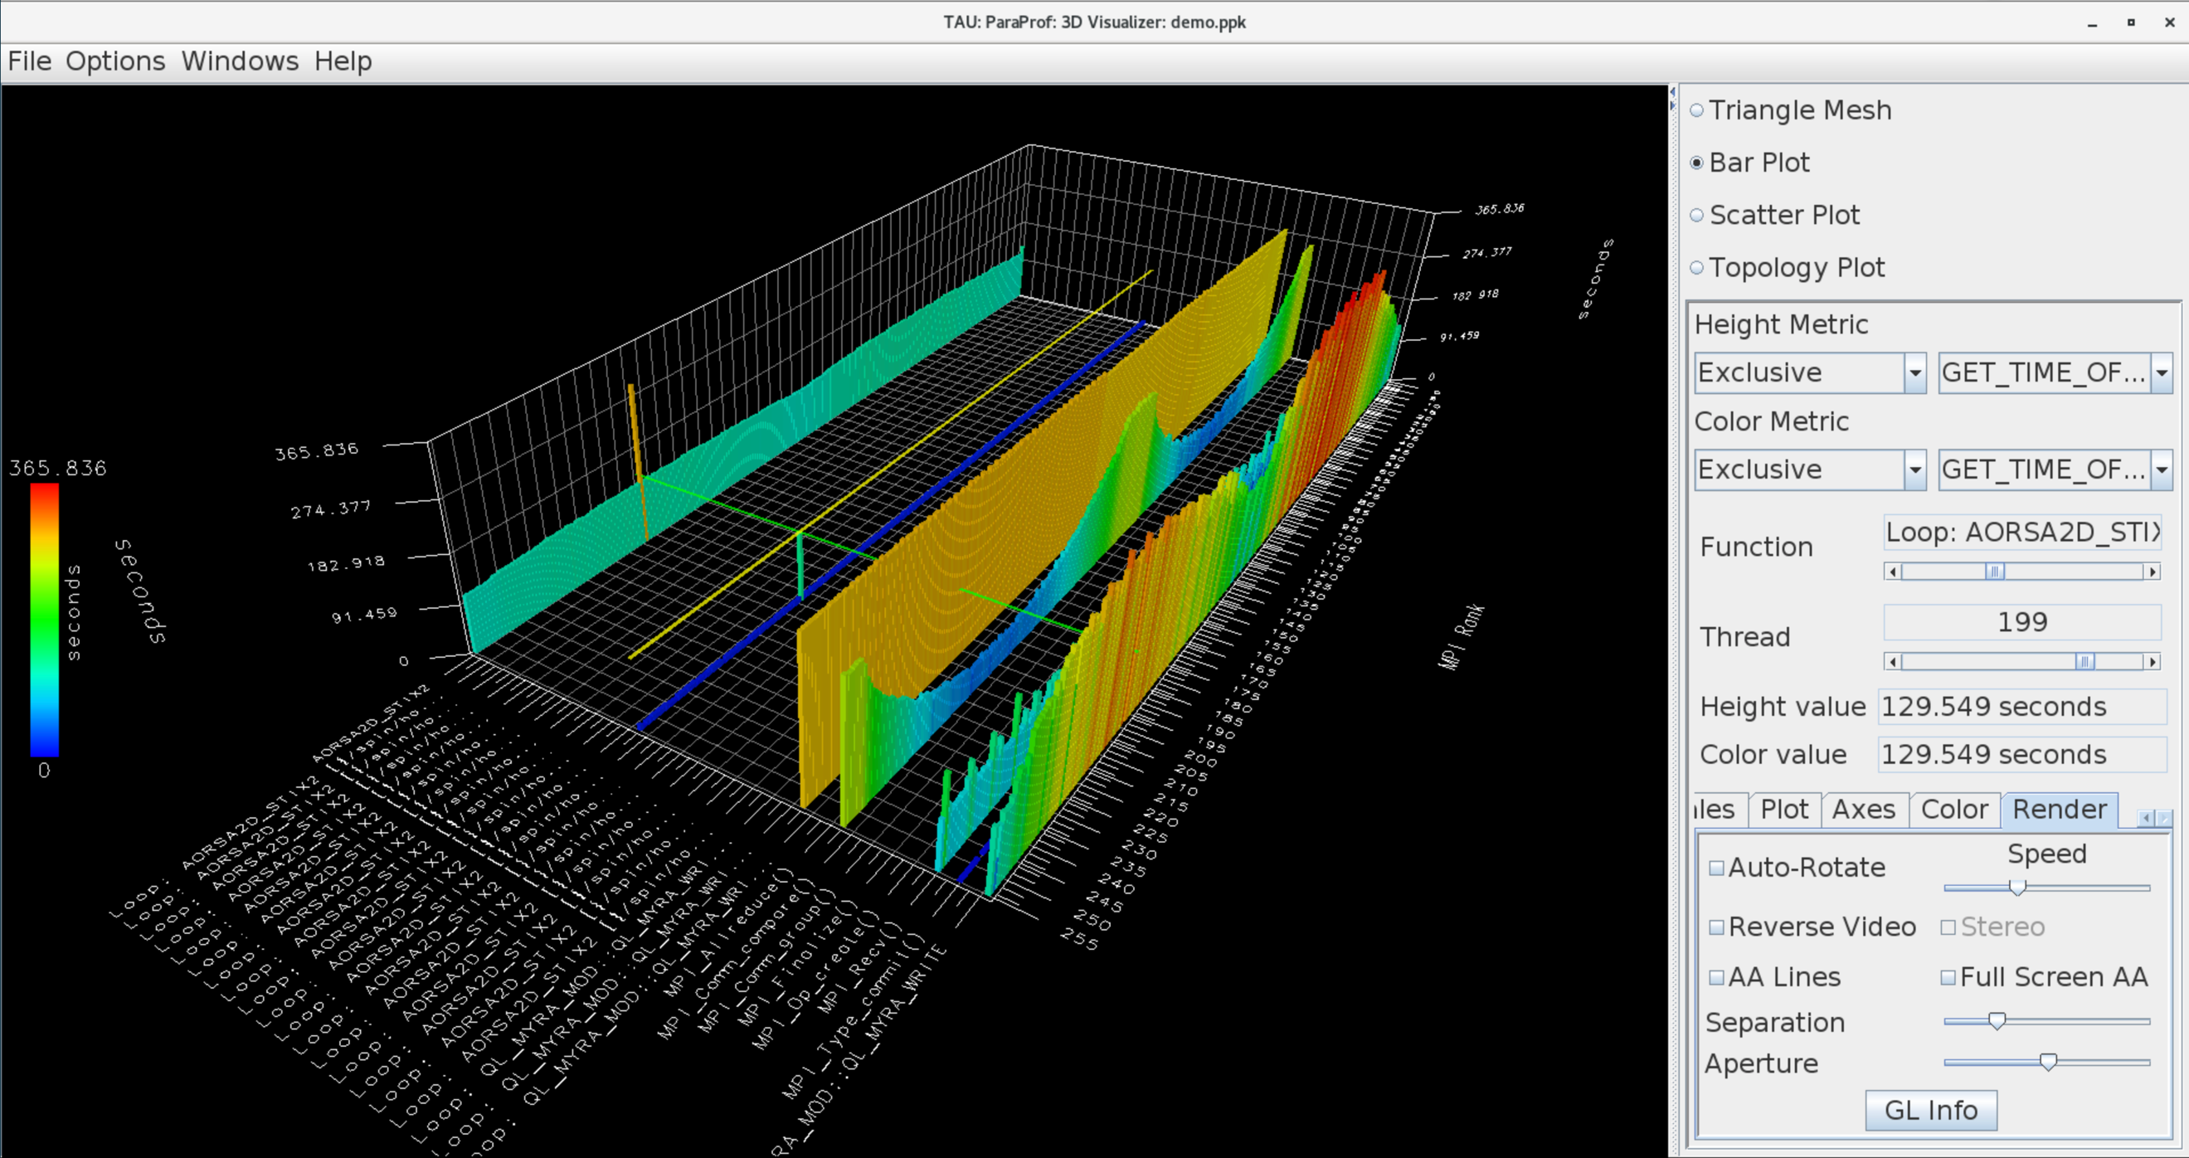
ParaProf 3D Profile Browser

Slide 7
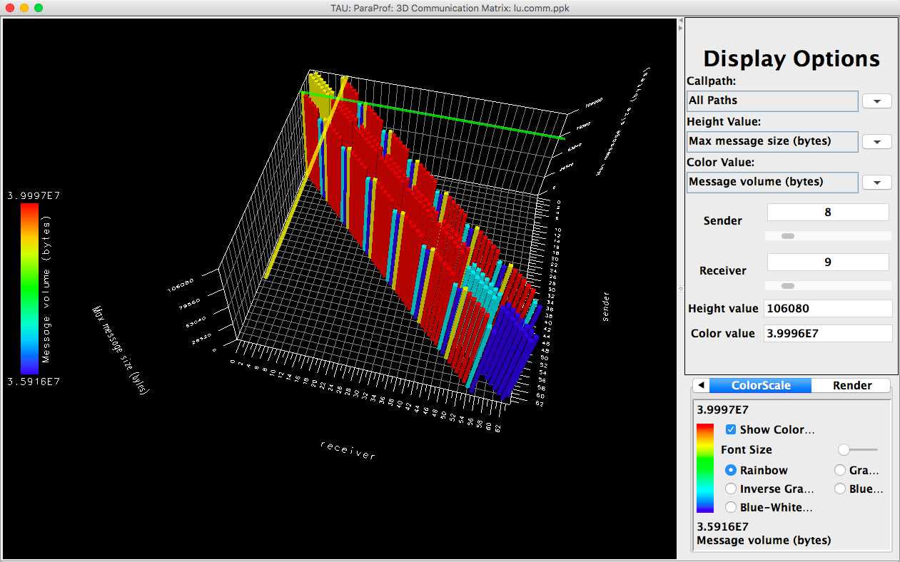
TAU – 3D Communication Window
% export TAU_COMM_MATRIX=1; mpirun … tau_exec ./a.out
% paraprof ; Windows -> 3D Communication Matrix
Notes:
Can visualize this heatmap in 2D too

Slide 8
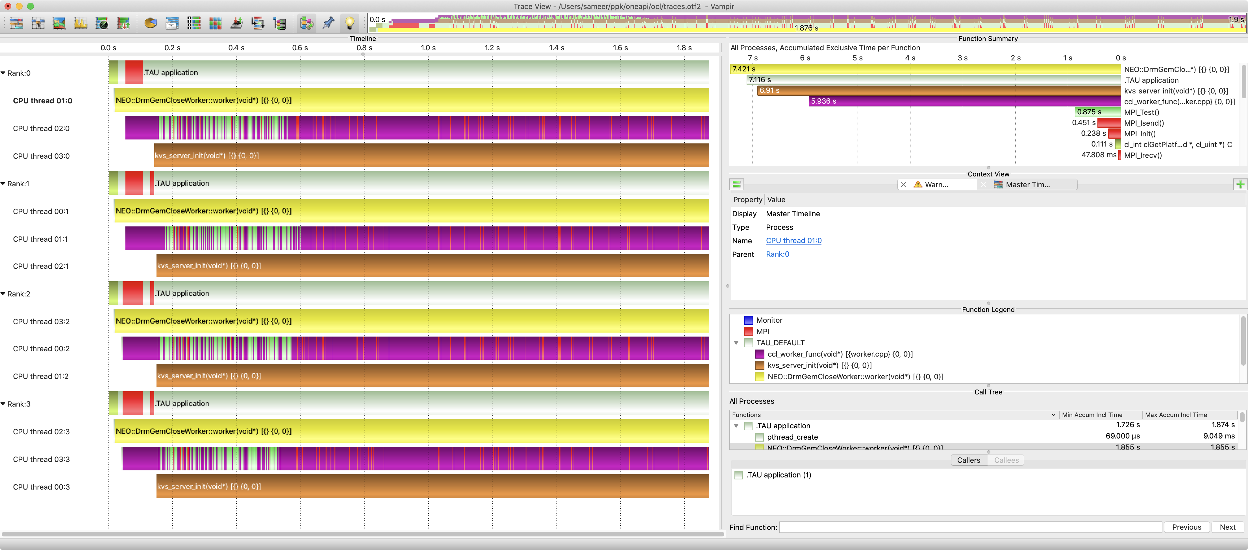
TAU and Vampir [TU Dresden]: Intel oneAPI OpenCL
% export TAU_TRACE=1; export TAU_TRACE_FORMAT=otf2
% mpirun –np 4 tau_exec –T level_zero –opencl ./a.out

Slide 9
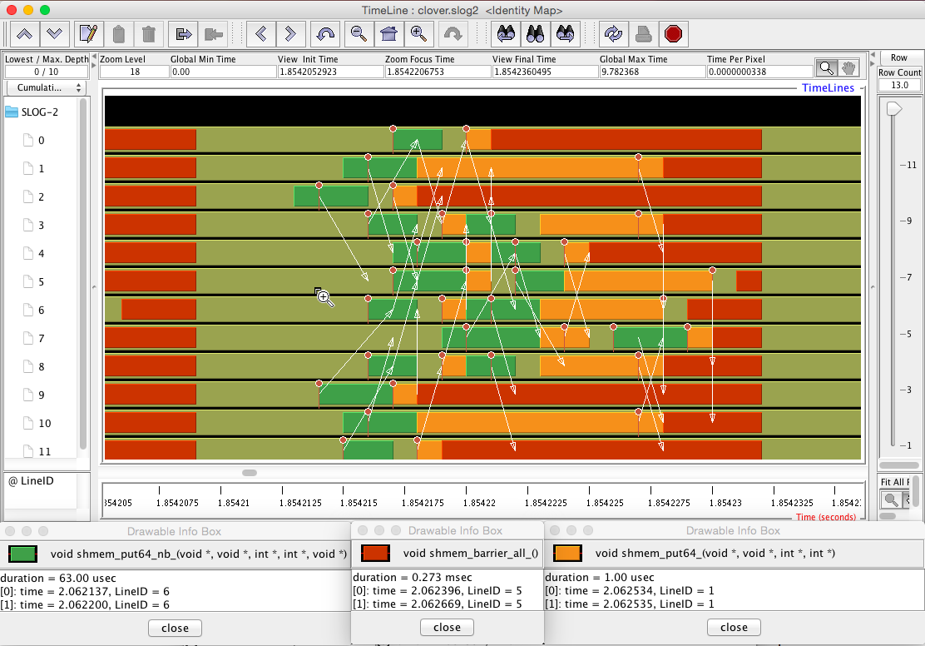
Tracing: Jumpshot (ships with TAU)

Slide 10
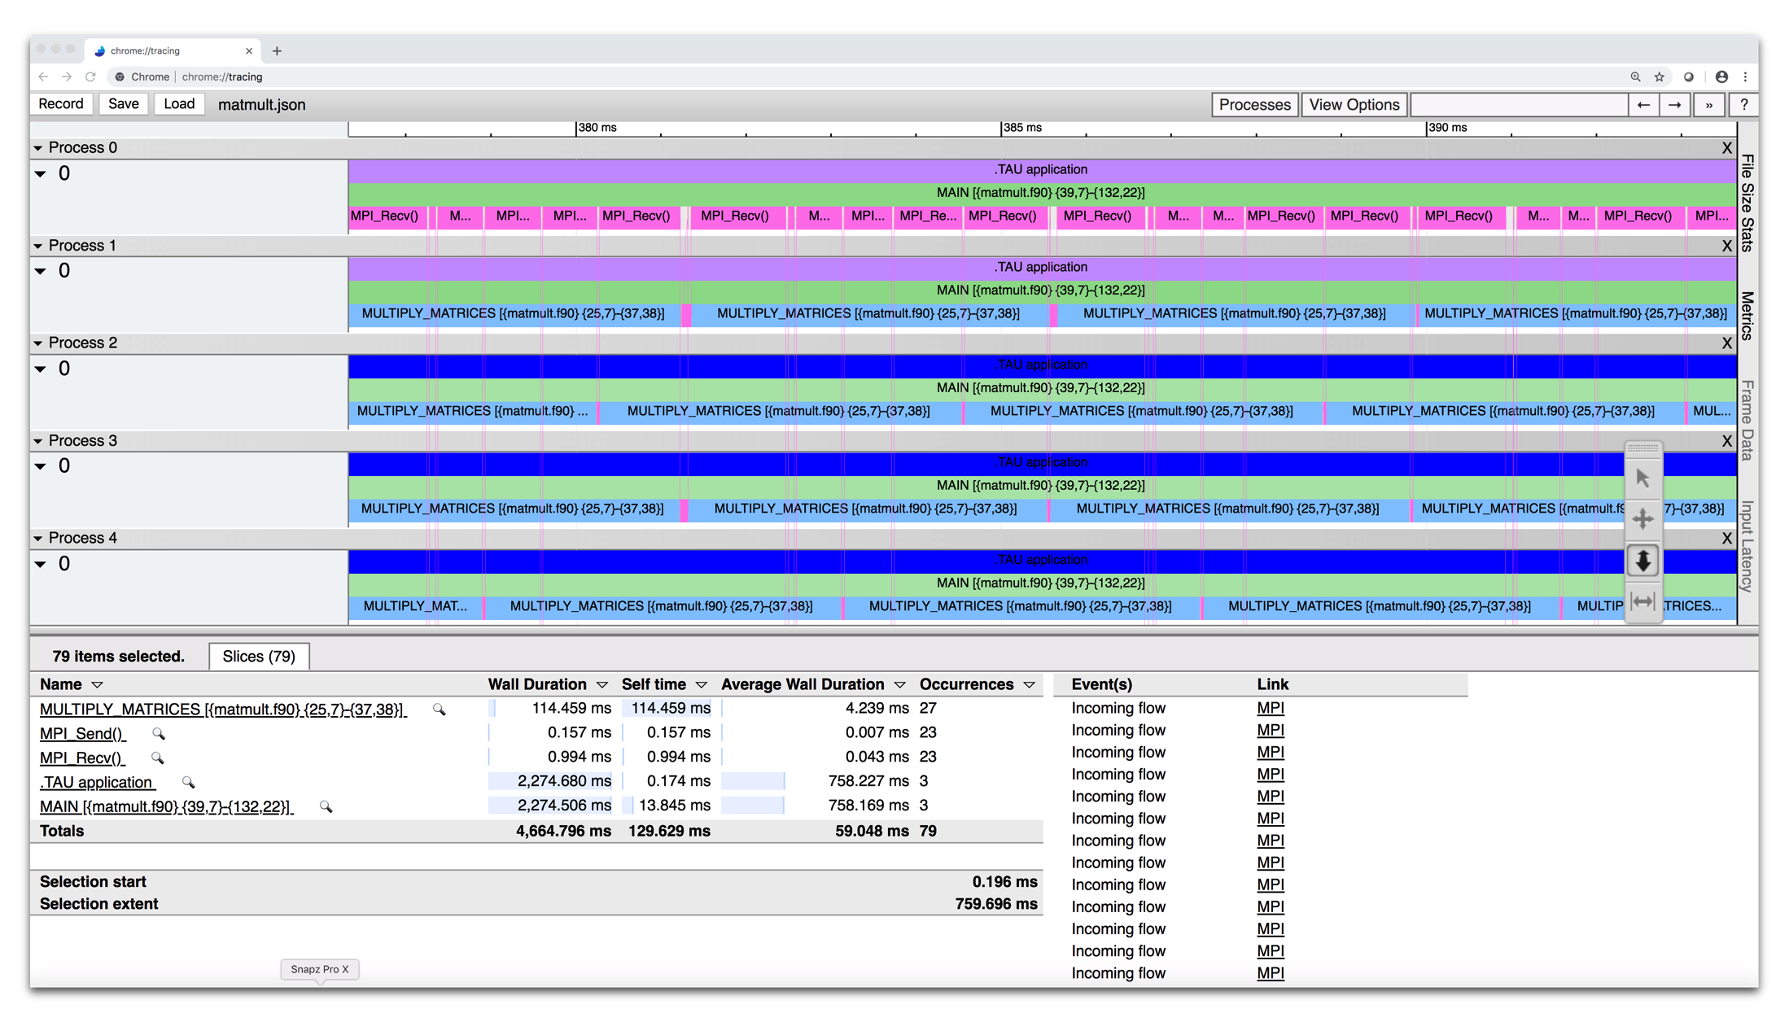
Tracing: Chrome Browser
% export TAU_TRACE=1
% mpirun –np 256 tau_exec ./a.out
% tau_treemerge.pl; tau_trace2json tau.trc tau.edf –chrome –ignoreatomic –o app.json
Chrome browser: chrome://tracing (Load -> app.json)
Or visit https://ui.perfetto.dev/ to use Perfetto
Notes:
10

Slide 11
Performance Measurement
Timers
Requires instrumentation of some kind
Manual, automated
Source, compiler provided, binary
Library callbacks, API wrappers, weak symbol replacement
Simple to implement
Sampling
Requires specialized system libraries / support
Periodic signals, signal handler
No modification to executable/library needed
Potential to interfere with system support (signal handlers)

Slide 12
Profiling and Tracing
Profiling: how much time was spent in each measured function on each thread in each process?
Collapses the time axis
No ordering or causal event information
Small summary per thread/process, regardless of execution time – only grows with number of timers & threads/processes
Tracing: record all function entry & exit events on a timeline
Detailed view of what happened
The longer the program runs, the bigger the trace

Slide 13
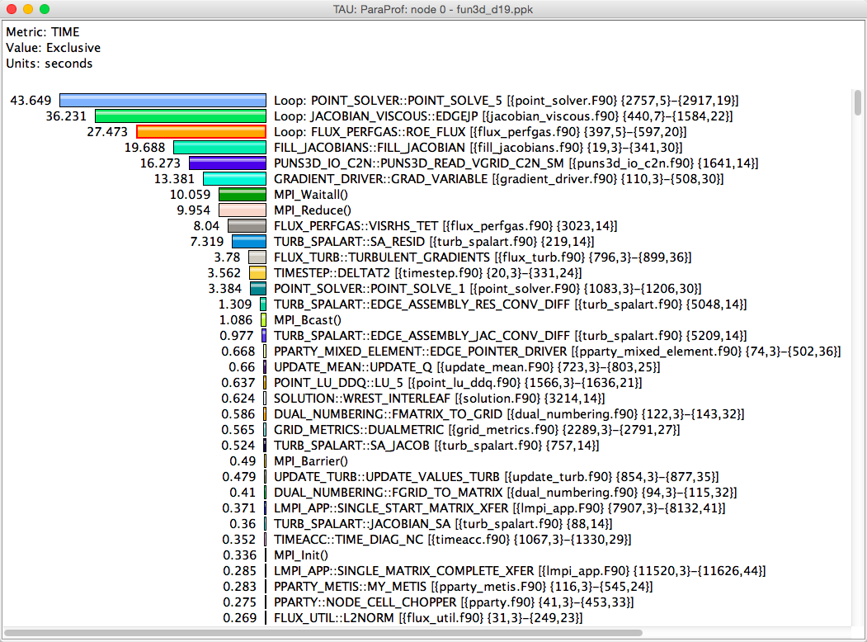
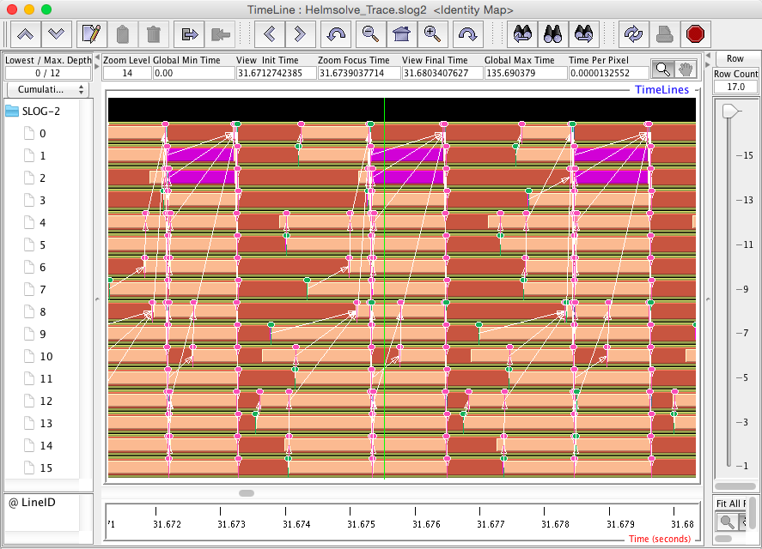
Profiling and Tracing
Profiling shows you how much (total) time was spent in each routine
Tracing shows you when the events take place on a timeline

Slide 14
Integrating TAU
Compile Time
Runtime
Compile with TAU compiler wrappers (see next slides)
Link with TAU libraries
Execute with tau_exec
Preloads the TAU shared object library and instantiates measurement support for different models
More later…

Slide 15
Instrumentation Approaches
Manual
Add TAU API calls to the code by hand: https://www.cs.uoregon.edu/research/tau/docs/newguide/bk05rn01.html
Automated:
PDT – optional TAU configuration
Compiler based instrumentation – comes with TAU
LLVM plugin – comes with TAU
Binary instrumentation - using Dyninst, PIN, or MAQAO
Optional TAU configuration, not covered in this tutorial
PerfStubs API: https://github.com/UO-OACISS/perfstubs
Used by ADIOS2

Slide 16
TAU compiler wrappers with PDT
tau_cc.sh, tau_cxx.sh, tau_f90.sh
Usually does 3 passes to compile:
PDT parses the source file, writes a .pdb file
tau_instrumentor reads the source file, the pdb file, writes an instrumented source file
The instrumented source file is passed to the regular compiler
The instrumented source file is deleted
Selective instrumentation by file, function (include/exclude)
At link time, tau_*.sh will add the TAU libraries to the link

Slide 17
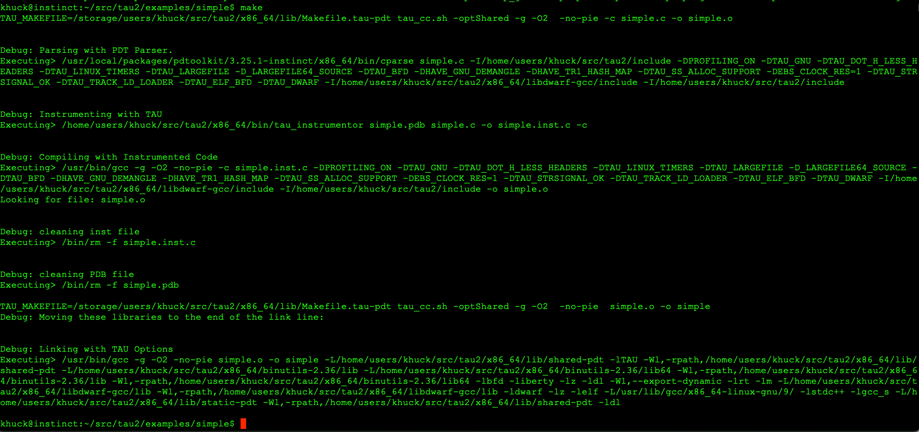
PDT Example
1
2
3
link

Slide 18
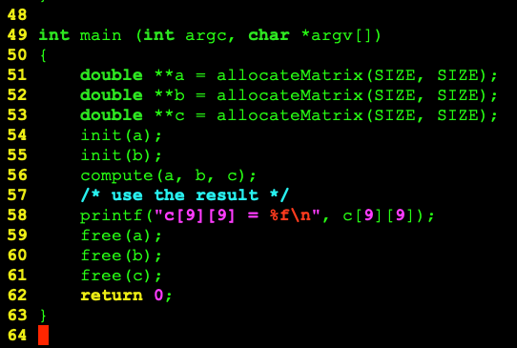
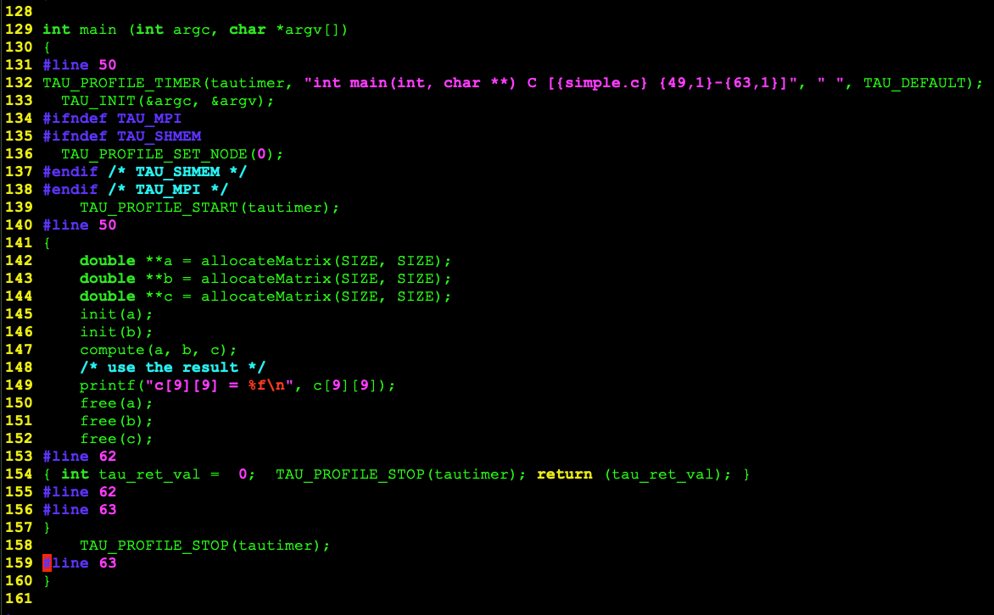
PDT Instrumentation Example
tau_cc.sh -optKeepFiles -g -O2 -c simple.c -o simple.o

Slide 19
TAU compiler wrappers without PDT
Same tau_cc.sh, tau_cxx.sh, tau_f90.sh
Usually does 1 pass to compile:
Extra flags are added to the compiler:
Compiler based instrumentation (-finstrument-functions)
Tool has to implement two special functions:
void __cyg_profile_func_enter (void *this_fn, void *call_site);
void __cyg_profile_func_exit (void *this_fn, void *call_site);
Call a compiler plugin (LLVM only)
tau_instrumentor adds TAU API calls directly
At link time, tau_*.sh will add the TAU libraries to the link
Can be forced with -optCompInst flag

Slide 20
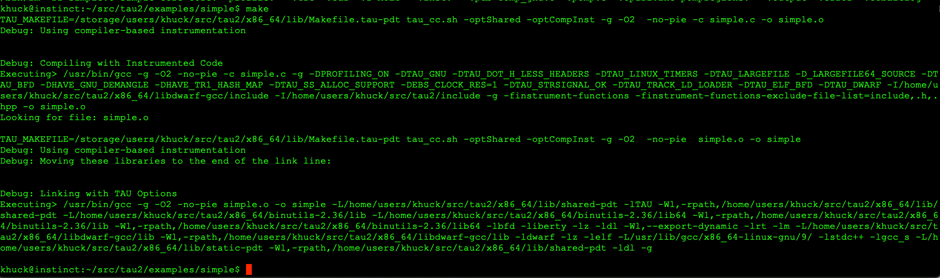
Compiler Based Example

Slide 21
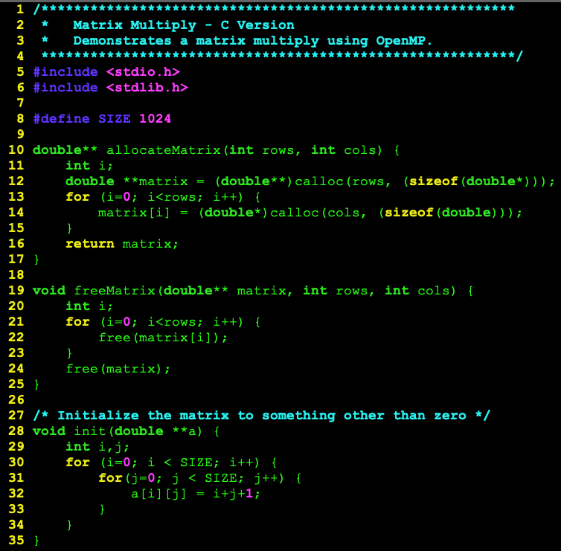
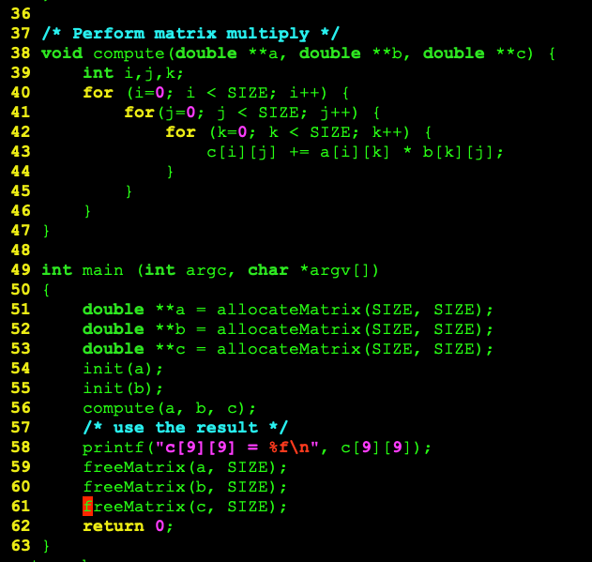
Simple example

Slide 22
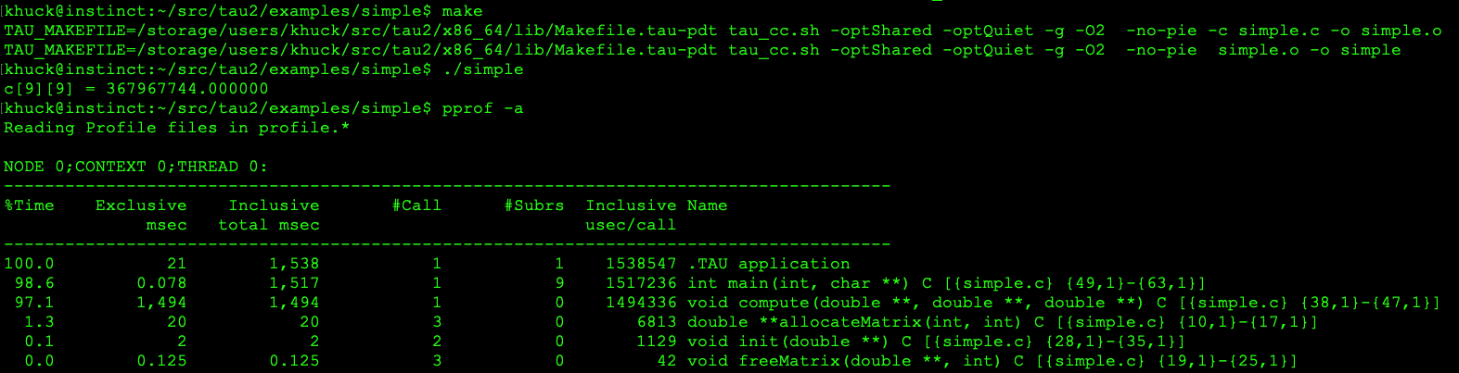
PDT Instrumentation
Timer names have full signatures, start & end lines/columns
- all information available from parsing original source file with PDT

Slide 23
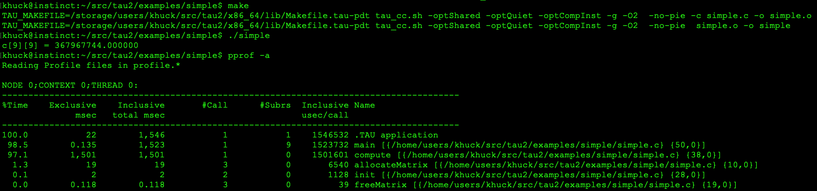
Compiler Instrumentation
Timer names have name only, start line only
- function entry/exit callback only has address of function and return address
- all source information retrieved during program execution with binutils (libbfd)

Slide 24
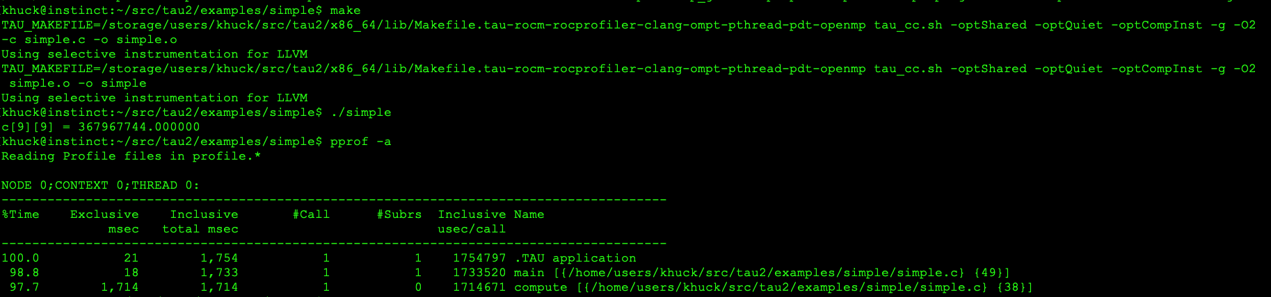
LLVM Plugin Instrumentation
Different TAU configuration with clang++/clang/flang
Where are the other timers?...
TAU_COMPILER_MIN_INSTRUCTION_COUNT defaults to 50, so they were filtered out

Slide 25
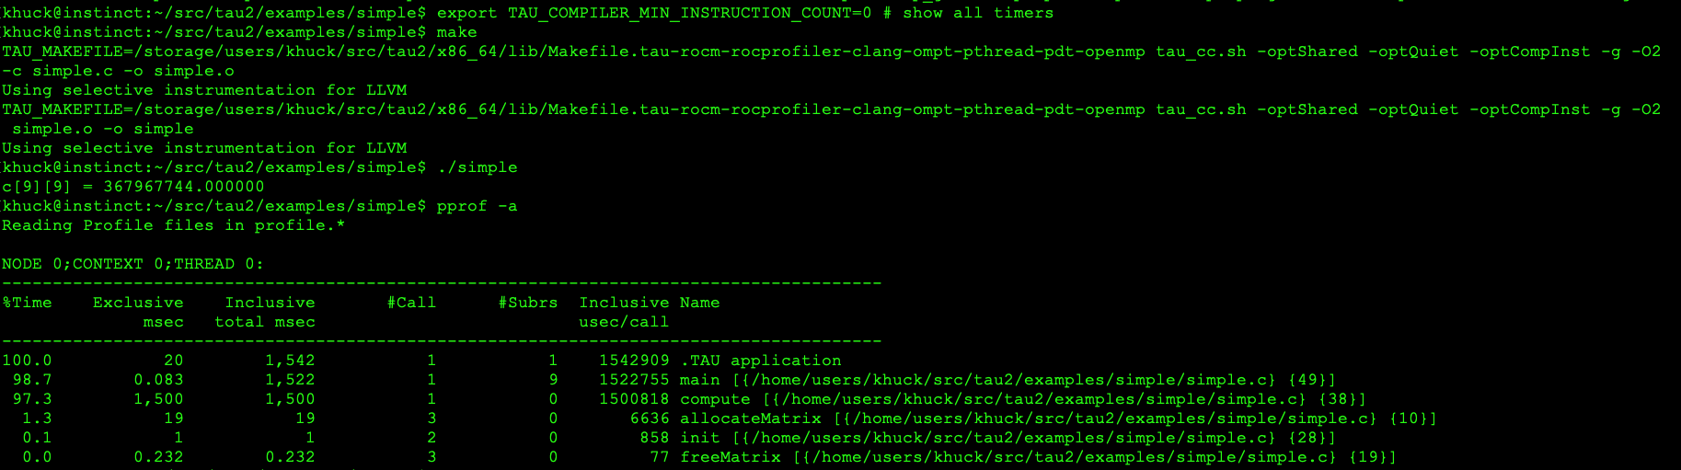
LLVM Plugin Instrumentation
Different TAU configuration with clang++/clang/flang
TAU_COMPILER_MIN_INSTRUCTION_COUNT=0 disables filtering

Slide 26
Instrumentation pros/cons
Pros
Cons
Simple to implement
Works universally
Instruments everything – no blind spots
Selective instrumentation available (by file or function name, or instruction count)
Instruments everything
Potentially high overhead – especially with C++
Changes program behavior
Potentially interferes with optimizations

Slide 27
Sampling
Run the application with tau_exec -ebs
Preloads the TAU library, instantiates a signal handler and periodic interrupt to process the signal
The signal handler will record the current instruction pointer, all requested metrics, and optionally unwind the callstack
At the end of execution, all addresses are resolved to symbols in the application using binutils/libdwarf
Some things that help:
For best support, build application with debug (-g) - all other optimizations are fine

Slide 28
Using TAU’s Runtime Preloading Tool: tau_exec
<mpirun> tau_exec -T <config> <options> <executable>
tau-config --list-matching <mpi/serial> will show available configs
Preload a wrapper that intercepts the runtime calls and substitutes with another (using dlsym() or weak symbol replacement)
MPI
OpenMP
POSIX I/O
Memory allocation/deallocation routines
Wrapper library for an external package
No modification to the binary executable
Enable other TAU options (communication matrix, OTF2, event-based sampling)

Slide 29
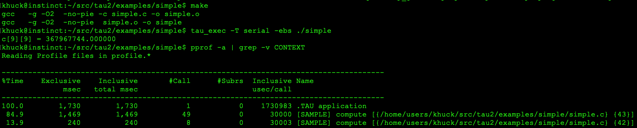
Sampled Measurement
Instrumentation example:
Sampling example:
Both more and less information at the same time…

Slide 30
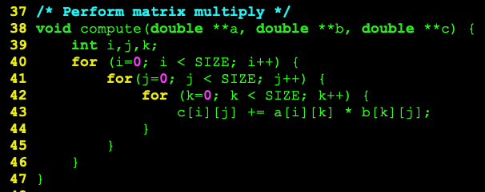
Sampled Measurement
14% spent here
85% spent here

Slide 31
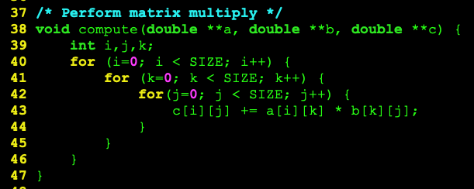
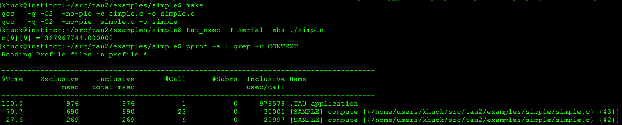
Simple Transformation – loop inversion
Reduced from 1.73 seconds

Slide 32
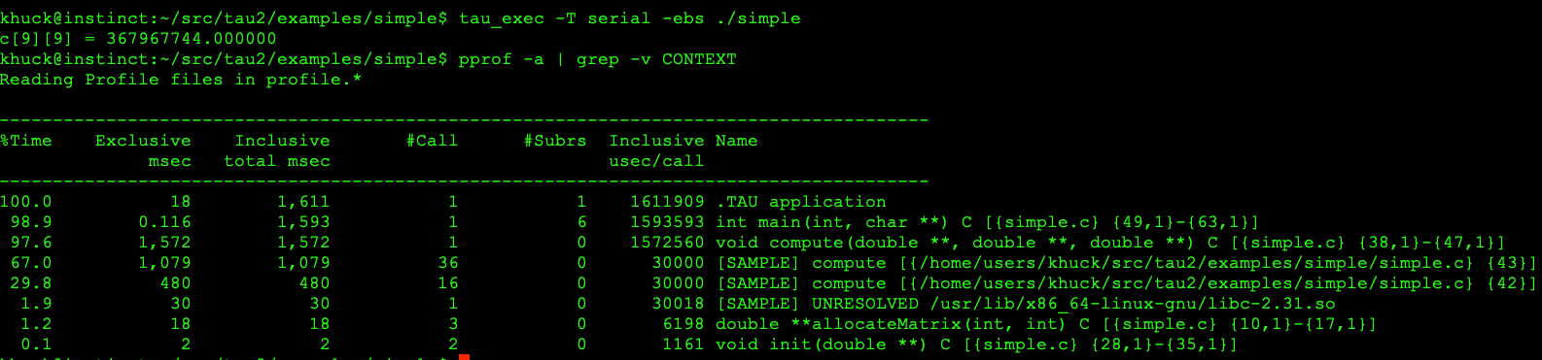
Both together!
Timers
Samples

Slide 33
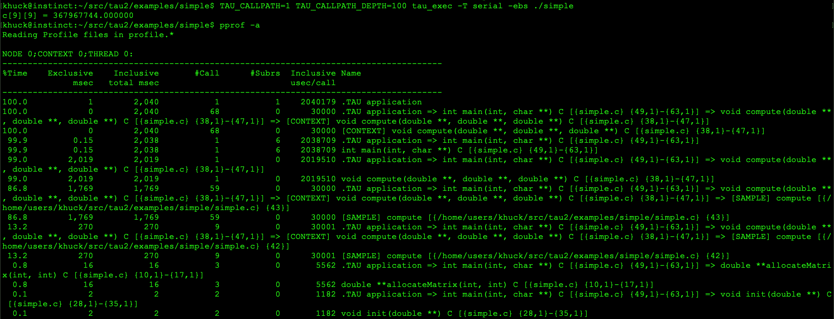
…with callpath profiling

Slide 34
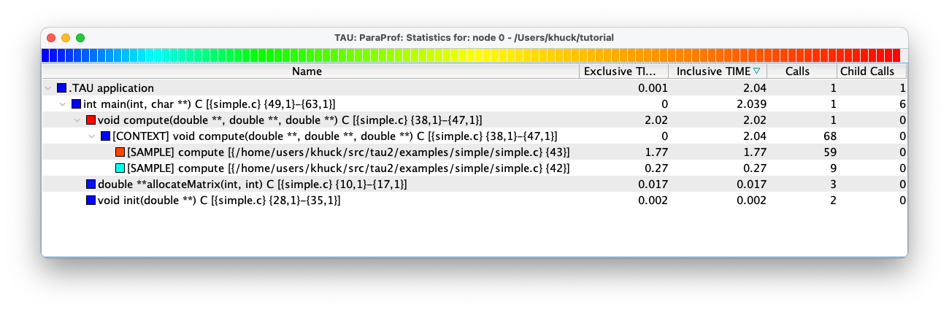
…easier to view in ParaProf

Slide 35
Other measurement support
Many programming models provide “hooks” for tools
Often, instrumentation isn’t necessary!
MPI, SHMEM, Charm++
Pthreads, OpenMP, Kokkos
CUDA, HIP/ROCm, OneAPI, OpenACC, OpenCL, OpenMP offload
Python
Wrappers: POSIX, Chapel, UPC, memory, ARMCI, GASNet…
Java

Slide 36
Other TAU features
Binary instrumentation
Dyninst, MAQAO, PIN
Hardware counter support
PAPI, LIKWID
Tracing support (native or converters)
Vampir (OTF2), Perfetto (JSON), Jumpshot (SLOG2), …
Plugins
OS/HW monitoring, ADIOS2, SOS, Mochi, SQLite3, …
NEW!

Slide 37
OpenMP
https://www.openmp.org
Pragma-based language extension to facilitate threading
OpenMP 5.0 standard includes OpenMP Tools (OMPT/OMPD) specification for providing callbacks from the runtime to performance/debugging tools
Provided by Intel, LLVM, IBM compilers
GCC can use drop-in replacement (LLVM 8.0 runtime)
TAU provides OPARI legacy support (when using PDT)

Slide 38
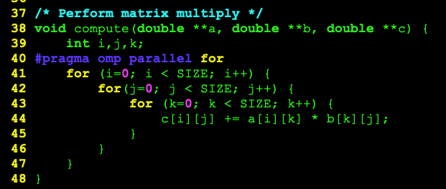
Adding OpenMP
If OMP_NUM_THREADS=4, SIZE=1024, then iteration space will be split into 4 of chunk size 256 each – 4x speedup

Slide 39
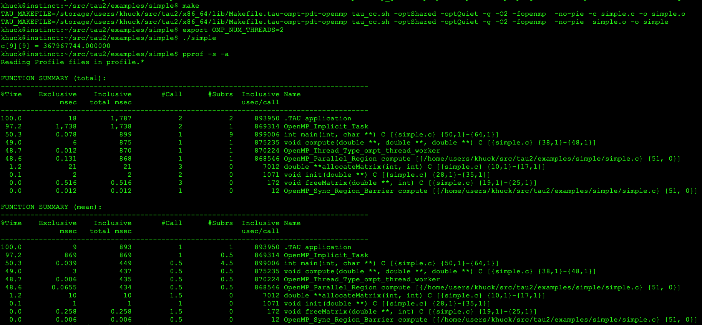
Compiling, Running, Reporting
Compiler flag to
Enable OpenMP
Thread lifetime
Worker lifetime
Region
Synchronization

Slide 40
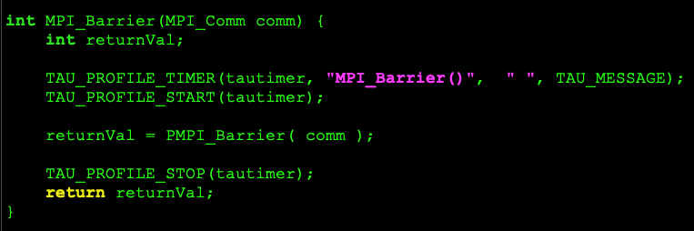
MPI Support
MPI standard includes tool support
MPI_* functions are thin, weak wrappers around PMPI_* API
Tools create their own wrappers to replace them and intercept MPI calls
Tool library is preloaded or linked ahead of MPI library(ies)
Example:

Slide 41
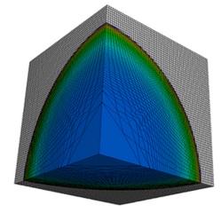
MPI example – Lulesh
Lulesh 2.0.3 https://asc.llnl.gov/codes/proxy-apps/lulesh
“The Shock Hydrodynamics Challenge Problem was originally defined and implemented by LLNL as one of five challenge problems in the DARPA UHPC program and has since become a widely studied proxy application in DOE co-design efforts for exascale.”
C++, Serial, OpenMP, MPI
CUDA, OpenACC, OpenCL, other models

Slide 42
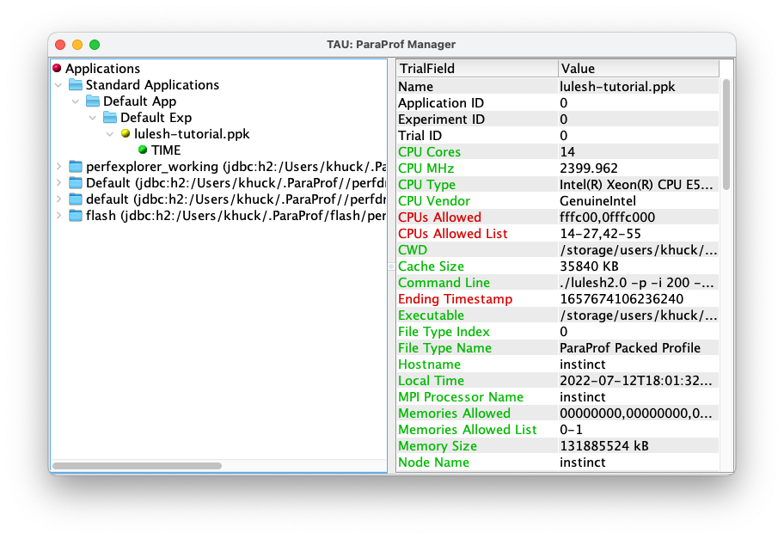
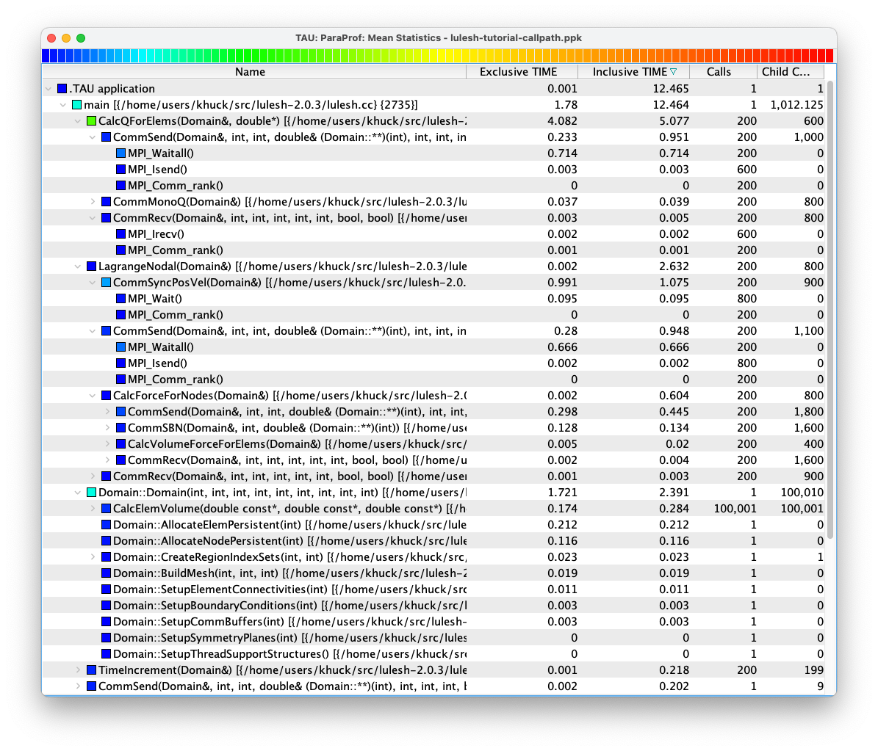
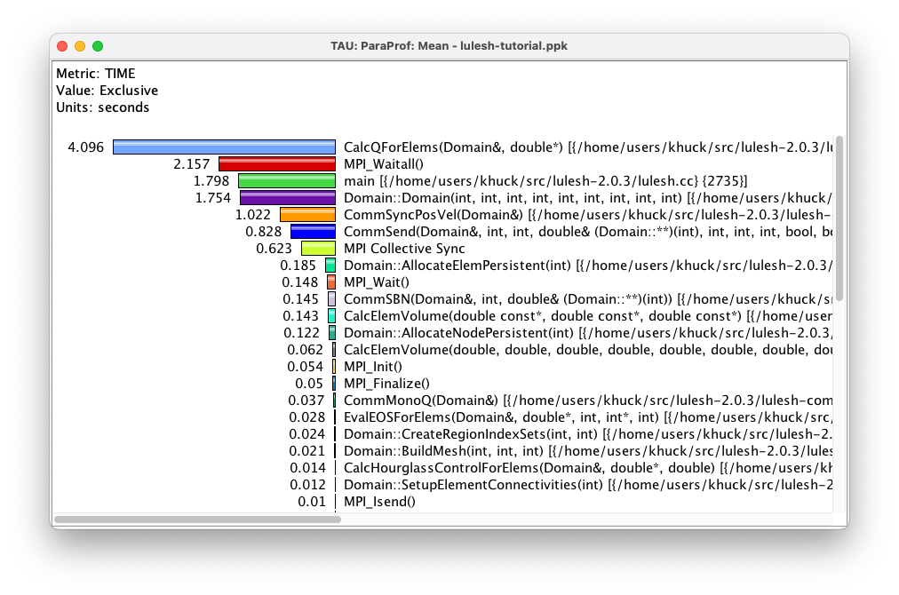
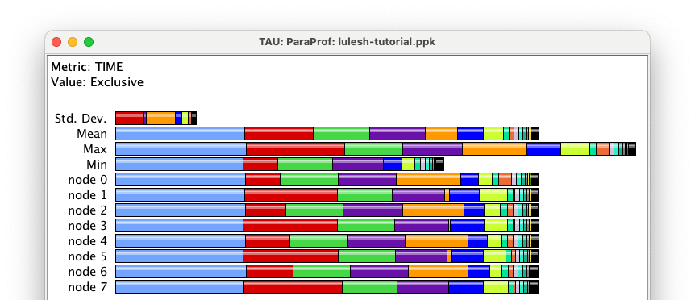
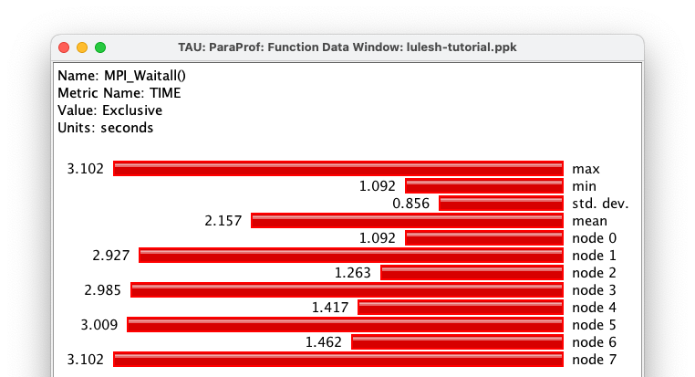
Lulesh Profile - ParaProf
Main window
Treetable of callpath data
Mean profile
Profile of one timer
Main Profile Window

Slide 43
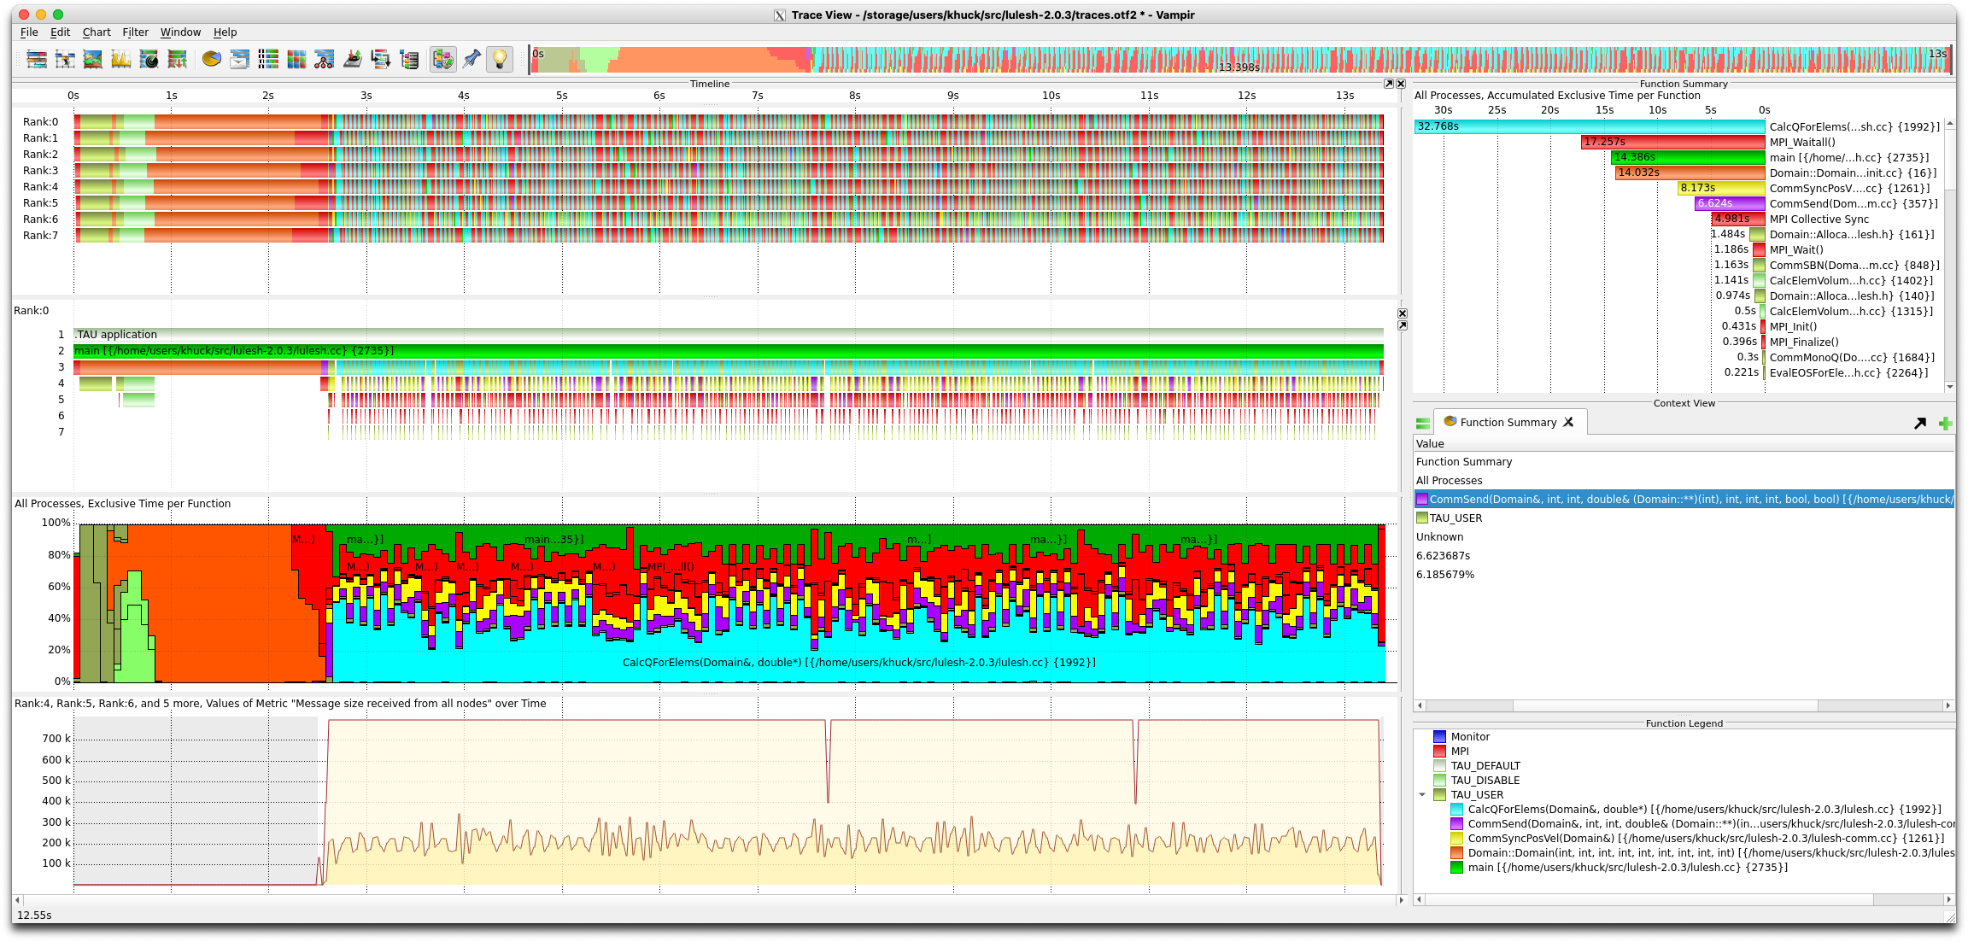
Lulesh Trace – Vampir
Master timeline
Profile
Process timeline
Summary timeline
Counter data timeline

Slide 44
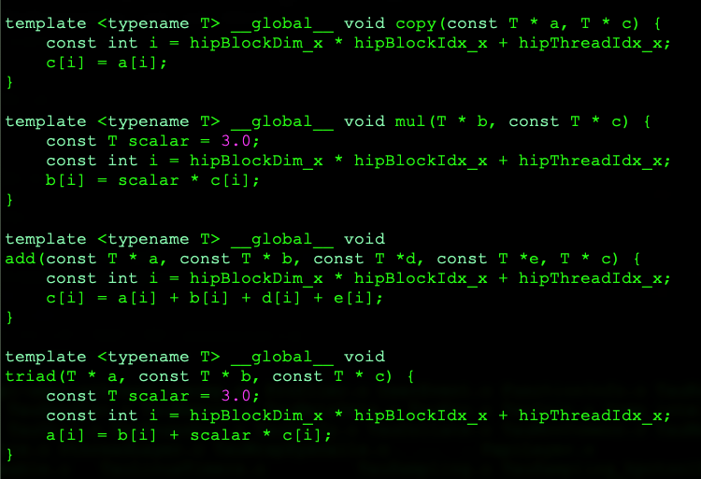
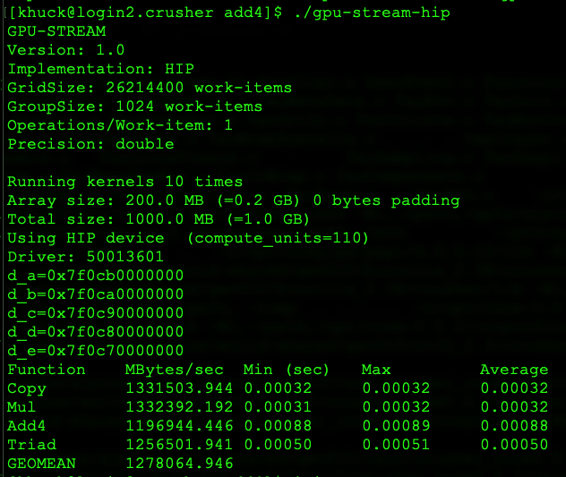
Measuring HIP kernel performance
Hip-stream – small program with 4+ kernels
Program output
HIP kernels

Slide 45
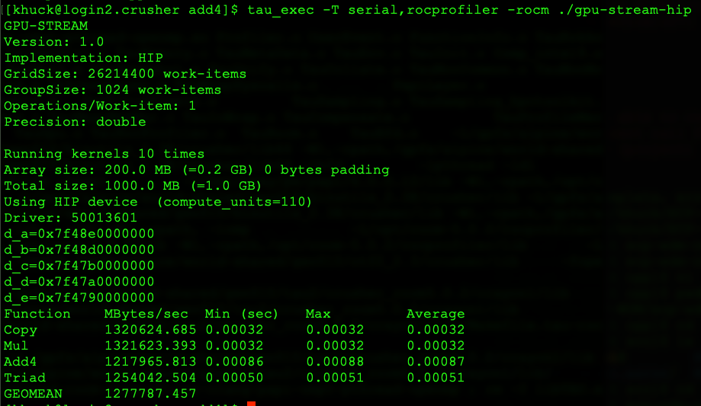
Measuring HIP kernel performance
Just add tau_exec and arguments to the command (between srun/mpirun and application when applicable)
tau-config shows available configs
“use serial,rocprofiler configuration with HIP/ROCm support enabled”

Slide 46
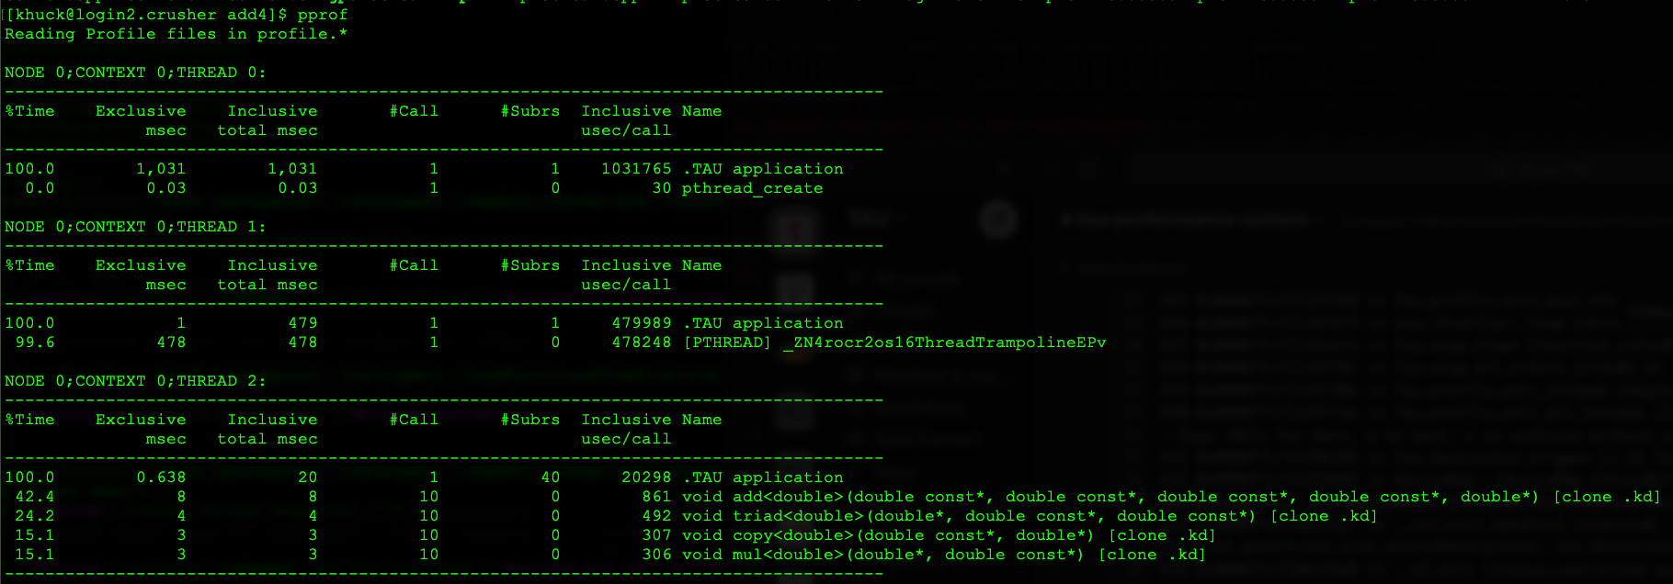
Pprof output, timers
Main Thread
Rocprofiler Thread
Device activity

Slide 47
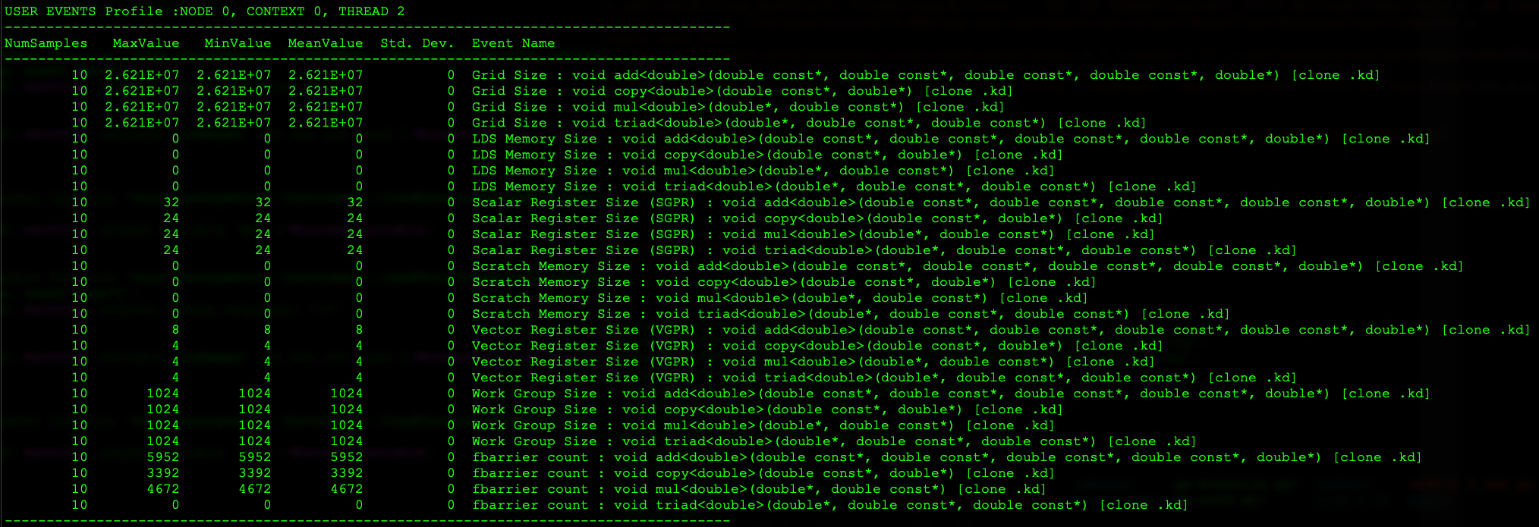
Pprof output, counters
Counters for measuring register pressure and occupancy
Notes:
Similar to Rocprofiler --stats

Slide 48
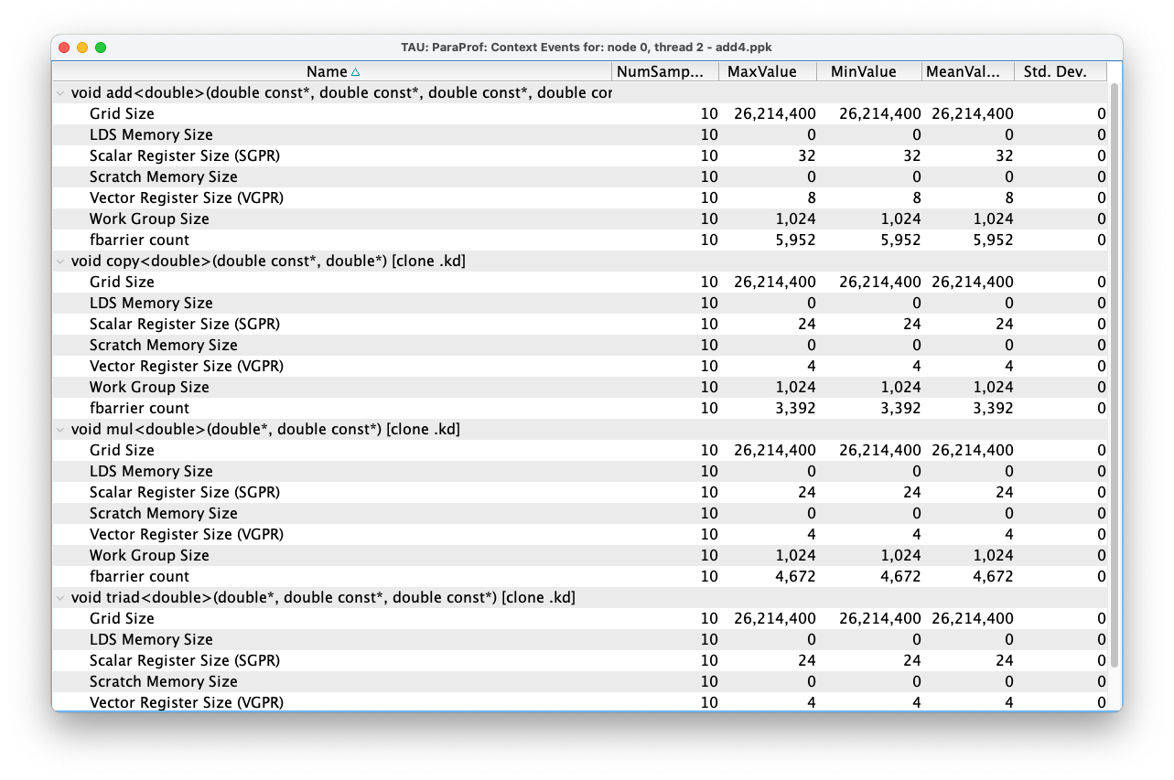
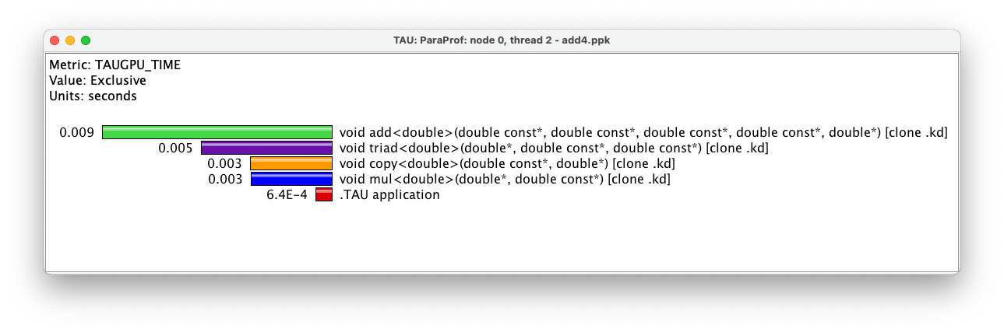
ParaProf view of same data
VERY helpful for understanding register pressure and occupancy

Slide 49
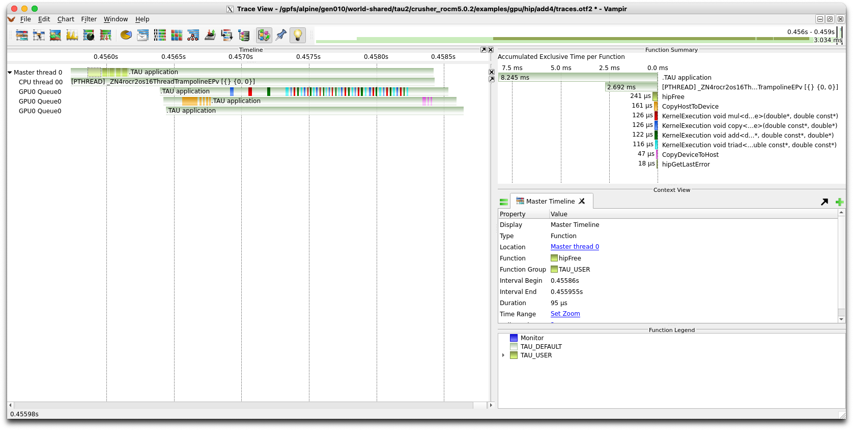
Tracing support uses Roctracer
Each device has 2-3 virtual threads:
1) kernels,
2) memory transfers
3) synchronization
(prevents overlapping timers)

Slide 50
tau_exec command reference
Uninstrumented execution
% mpirun -np 256 ./a.out
Track GPU operations
% mpirun –np 256 tau_exec –l0 ./a.out
% mpirun –np 256 tau_exec –opencl ./a.out
% mpirun –np 256 tau_exec –openacc ./a.out
% mpirun –np 256 tau_exec –cupti ./a.out
% mpirun –np 256 tau_exec –rocm ./a.out
Track MPI performance
% mpirun -np 256 tau_exec ./a.out
Track I/O, and MPI performance (MPI enabled by default)
% mpirun -np 256 tau_exec -io ./a.out
Track OpenMP and MPI execution (using OMPT for Intel v19+ or Clang 8+)
% export TAU_OMPT_SUPPORT_LEVEL=full;
% mpirun –np 256 tau_exec –T ompt,mpi -ompt ./a.out
Track memory operations
% export TAU_TRACK_MEMORY_LEAKS=1
% mpirun –np 256 tau_exec –memory_debug ./a.out (bounds check)
Use event based sampling (compile with –g)
% mpirun –np 256 tau_exec –ebs ./a.out
Also export TAU_METRICS=TIME,PAPI_L1_DCM… -ebs_resolution=<file | function | line>
Non-MPI execution: use –T serial
% tau_exec –T serial,level_zero –l0 –ebs ./a.out

Slide 51
TAU Runtime Environment Variables
Environment Variable | Default | Description
TAU_TRACE | 0 | Setting to 1 turns on tracing
TAU_CALLPATH | 0 | Setting to 1 turns on callpath profiling
TAU_TRACK_MEMORY_FOOTPRINT | 0 | Setting to 1 turns on tracking memory usage by sampling periodically the resident set size and high water mark of memory usage
TAU_TRACK_POWER | 0 | Tracks power usage by sampling periodically.
TAU_CALLPATH_DEPTH | 2 | Specifies depth of callpath. Setting to 0 generates no callpath or routine information, setting to 1 generates flat profile and context events have just parent information (e.g., Heap Entry: foo)
TAU_SAMPLING | 1 | Setting to 1 enables event-based sampling.
TAU_TRACK_SIGNALS | 0 | Setting to 1 generate debugging callstack info when a program crashes
TAU_COMM_MATRIX | 0 | Setting to 1 generates communication matrix display using context events
TAU_THROTTLE | 1 | Setting to 0 turns off throttling. Throttles instrumentation in lightweight routines that are called frequently
TAU_THROTTLE_NUMCALLS | 100000 | Specifies the number of calls before testing for throttling
TAU_THROTTLE_PERCALL | 10 | Specifies value in microseconds. Throttle a routine if it is called over 100000 times and takes less than 10 usec of inclusive time per call
TAU_CALLSITE | 0 | Setting to 1 enables callsite profiling that shows where an instrumented function was called. Also compatible with tracing.
TAU_PROFILE_FORMAT | Profile | Setting to “merged” generates a single file. “snapshot” generates xml format
TAU_METRICS | TIME | Setting to a comma separated list generates other metrics. (e.g., ENERGY,TIME,P_VIRTUAL_TIME,PAPI_FP_INS,PAPI_NATIVE_<event>:<subevent>)

Slide 52
TAU Runtime Environment Variables
Environment Variable | Default | Description
TAU_TRACE | 0 | Setting to 1 turns on tracing
TAU_TRACE_FORMAT | Default | Setting to “otf2” turns on TAU’s native OTF2 trace generation (configure with –otf=download)
TAU_EBS_UNWIND | 0 | Setting to 1 turns on unwinding the callstack during sampling (use with tau_exec –ebs or TAU_SAMPLING=1)
TAU_EBS_RESOLUTION | line | Setting to “function” or “file” changes the sampling resolution to function or file level respectively.
TAU_TRACK_LOAD | 0 | Setting to 1 tracks system load on the node
TAU_SELECT_FILE | Default | Setting to a file name, enables selective instrumentation based on exclude/include lists specified in the file.
TAU_OMPT_SUPPORT_LEVEL | basic | Setting to “full” improves resolution of OMPT TR6 regions on threads 1.. N-1. Also, “lowoverhead” option is available.
TAU_OMPT_RESOLVE_ADDRESS_EAGERLY | 1 | Setting to 1 is necessary for event based sampling to resolve addresses with OMPT. Setting to 0 allows the user to do offline address translation.

Slide 53
TAU Runtime Environment Variables
Environment Variable | Default | Description
TAU_TRACK_MEMORY_LEAKS | 0 | Tracks allocates that were not de-allocated (needs –optMemDbg or tau_exec –memory)
TAU_EBS_SOURCE | TIME | Allows using PAPI hardware counters for periodic interrupts for EBS (e.g., TAU_EBS_SOURCE=PAPI_TOT_INS when TAU_SAMPLING=1)
TAU_EBS_PERIOD | 100000 | Specifies the overflow count for interrupts
TAU_MEMDBG_ALLOC_MIN/MAX | 0 | Byte size minimum and maximum subject to bounds checking (used with TAU_MEMDBG_PROTECT_*)
TAU_MEMDBG_OVERHEAD | 0 | Specifies the number of bytes for TAU’s memory overhead for memory debugging.
TAU_MEMDBG_PROTECT_BELOW/ABOVE | 0 | Setting to 1 enables tracking runtime bounds checking below or above the array bounds (requires –optMemDbg while building or tau_exec –memory)
TAU_MEMDBG_ZERO_MALLOC | 0 | Setting to 1 enables tracking zero byte allocations as invalid memory allocations.
TAU_MEMDBG_PROTECT_FREE | 0 | Setting to 1 detects invalid accesses to deallocated memory that should not be referenced until it is reallocated (requires –optMemDbg or tau_exec –memory)
TAU_MEMDBG_ATTEMPT_CONTINUE | 0 | Setting to 1 allows TAU to record and continue execution when a memory error occurs at runtime.
TAU_MEMDBG_FILL_GAP | Undefined | Initial value for gap bytes
TAU_MEMDBG_ALINGMENT | Sizeof(int) | Byte alignment for memory allocations
TAU_EVENT_THRESHOLD | 0.5 | Define a threshold value (e.g., .25 is 25%) to trigger marker events for min/max

Slide 54
For more info…
https://tau.uoregon.edu
https://github.com/UO-OACISS/tau2
https://github.com/UO-OACISS/tau2/wiki
https://github.com/UO-OACISS/tau2/wiki/Frequently-Asked-Questions-%28FAQ%29
Email tau-bugs@cs.uoregon.edu

Slide 55
ADIOS2 Output
As discussed, tau_exec is the execution wrapper to attach ”inject” or ”attach” TAU to the application
TAU comes with a plugin API (see Malony, Allen D., et al. "A plugin architecture for the TAU performance system”, ICPP, 2019.)
Code is executed at TAU events (timer start/stop, profile dump, program start/stop, etc.), or periodically
TAU comes with an ADIOS2 plugin that will write the profile data to ADIOS2 instead of TAU profile files

Slide 56
ADIOS2 plugin events
PostInit – after MPI_Init, initialize ADIOS2 for writing
Dump – when the “Tau_dump()” function is called, update all available profile statistics, write to ADIOS2
PreEndOfExecution – before MPI_Finalize is executed, perform any final unification and write and close
EndOfExecution – cleanup

Slide 57
Using the ADIOS2 plugin
Just add the -adios2 flag to tau_exec
Useful environment variables
TAU_ADIOS2_PERIODIC: yes/true/on/1 – tells the plugin to write output periodically and asynchronously, (defaults to false)
TAU_ADIOS2_PERIOD: number in microseconds (default 2,000,000)
TAU_ADIOS2_ONE_FILE: write one ADIOS2 file, or each MPI rank writes their own (defaults to true)
TAU_ADIOS2_FILENAME: defaults to tauprofile-<executable name>.bp (can specify path with TAU $PROFILEDIR env var)
TAU_ADIOS2_ENGINE: (defaults to BPFile)
TAU_ADIOS2_CONFIG_FILE: for specifying all ADIOS2 settings (default: ./adios2.xml)

Slide 58
What data is stored?
TAU Metadata stored as ADIOS2 attributes (strings)
TAU Counters
Bytes sent, GPU registers used, etc.
TAU Timers
Time in foo(), bar(), etc.

Slide 59
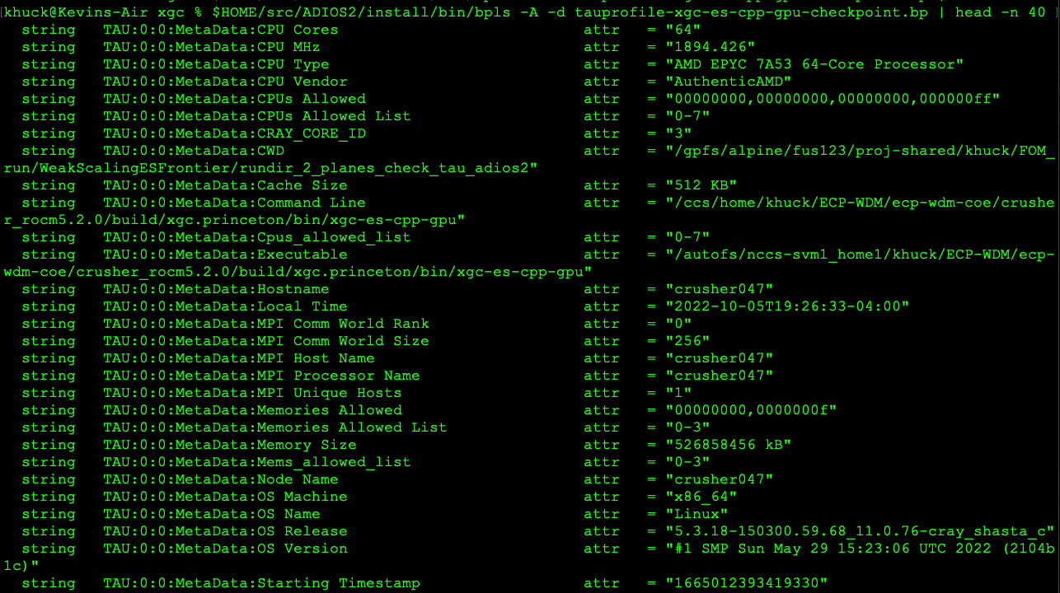
Metadata examples (bpls -A -d)

Slide 60
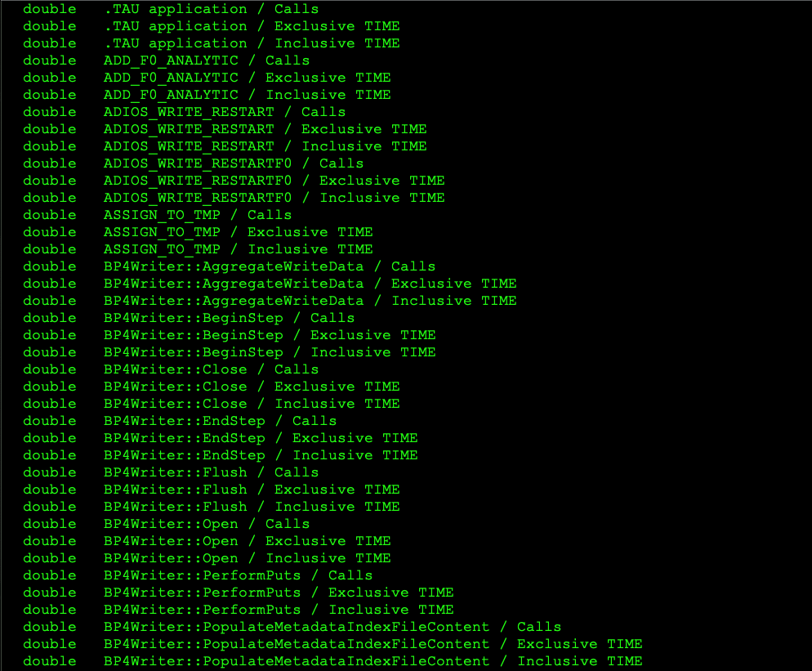
Timer Examples (bpls -l)

Slide 61
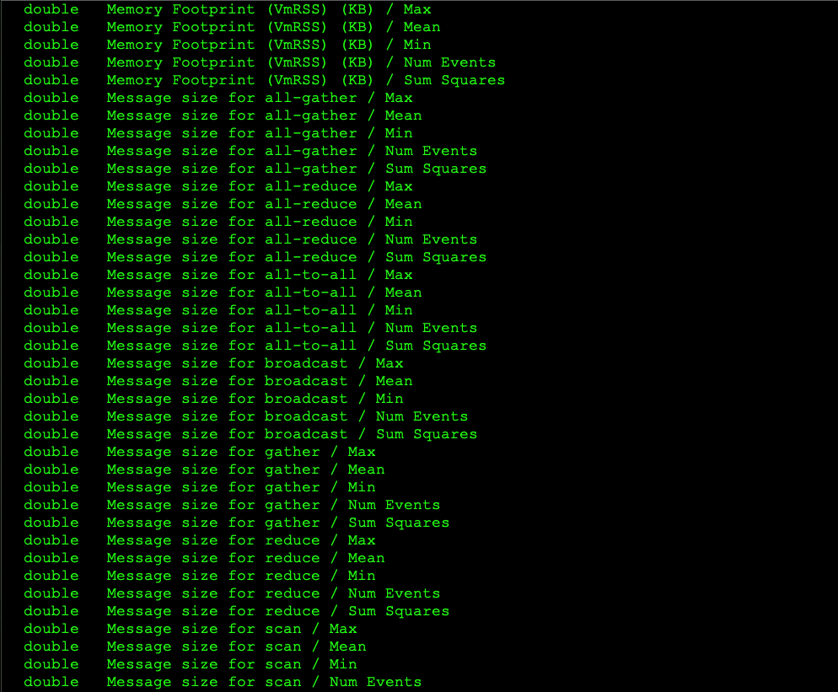
Counter Examples (bpls -l)

Slide 62
Visualizing the data
Using ADIOS2 Python API, we can read the data and visualize it

Slide 63
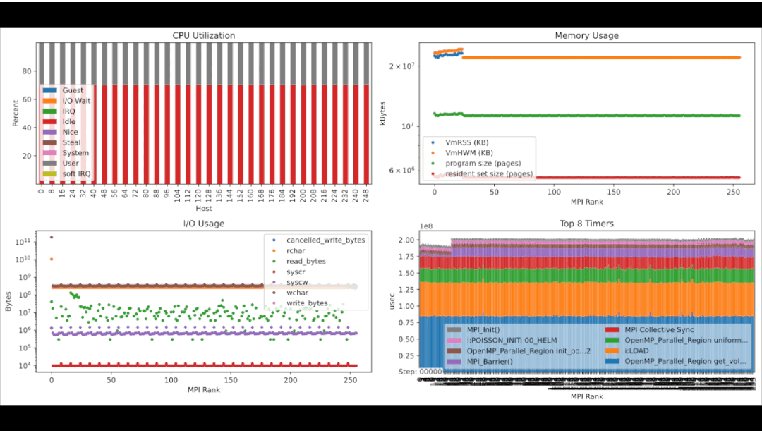
Monitoring of application data

Slide 64



Acknowledgements
Parts of this research was supported by the Exascale Computing Project (17-SC-20-SC), a joint project of the U.S. Department of Energy’s Office of Science and National Nuclear Security Administration, responsible for delivering a capable exascale ecosystem, including software, applications, and hardware technology, to support the nation’s exascale computing imperative.
This research used resources of the Oak Ridge Leadership Computing Facility at the Oak Ridge National Laboratory, which is supported by the Office of Science of the U.S. Department of Energy under Contract No. DE-AC05-00OR22725.

Slide 65





















Current/Previous Acknowledgements

Slide 66
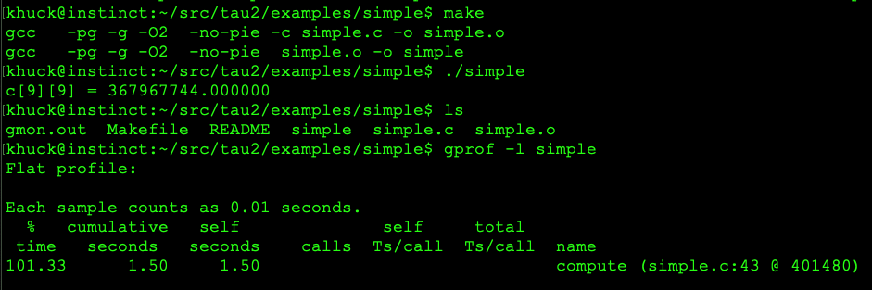
Quick gprof aside…
Quick and easy to do: just add -pg compiler flag
…however, it’s limited – optimized binaries are vague
Must disable -O2 to get callgraph output (which is incomplete, anyway)
Not thread safe/accurate
High overhead
“gprof: A Call Graph Execution Profiler”, Susan L. Graham, Peter B. Kessler, and Marshall K. Mckusick, PLDI, 1982

