Slide 1


Integrated Measurement for
Cross-Platform OpenMP
Performance Analysis
Kevin A. Huck, Allen D. Malony, Sameer Shende, Doug W. Jacobsen
IWOMP 2014 : Salvador, Brazil : September 30, 2014

Slide 2
OpenMP introspection: Motivation
OpenMP: programing language extensions requiring compiler interpretation, code transformation and runtime support
How can external tools observe the execution-time performance of resulting code?
Needed:
  Performance visibility
  Semantic context
Wanted: portable, robust, efficient, always-on/available approach to observe OpenMP concurrency, including internals

Slide 3
Approach
Evaluate four methods for OpenMP measurement:
  POMP
  ORA w/OpenUH
  ORA w/GOMP
  OMPT w/Intel
…All integrated into TAU (see next slide)
Compare performance visibility, semantic context, measurement overhead

Slide 4

TAU v2.23.2b3
Tuning and Analysis Utilities (20+ year project)
Performance problem solving framework for HPC
  Integrated, scalable, flexible, portable
  Target all parallel programming / execution paradigms
Integrated performance toolkit
  Multi-level performance instrumentation
  Flexible and configurable performance measurement
  Widely-ported performance profiling / tracing system
  Performance data management and data mining
  Open source (BSD-style license)
Broad use in complex software, systems, applications
http://tau.uoregon.edu

Slide 5
POMP & OPARI
POMP: “Profiling OpenMP”
OPARI: “OpenMP Pragma And Region Instrumentor”
Explicit instrumentation of OpenMP directives: Mohr et al., SC 2001
Pros
  Highly portable
  Full source context
Cons
  Requires instrumentation, recompile
  All barriers are explicit, extra barrier for all regions
  Lacks explicit sampling tool support
  Ignorance of OpenMP behavior in uninstrumented libraries
  Ignorance of runtime library internals
Runtimes: all Fortran and C/C++ compilers/runtimes
Tool examples: Vampir, Scalasca/KOJAK, TAU, ompP…

Slide 6
POMP Instrumentation Example
{ int pomp2_num_threads = omp_get_max_threads();
int pomp2_if = 1;
POMP2_Task_handle pomp2_old_task;
POMP2_Parallel_fork(&pomp2_region_1, pomp2_if, pomp2_num_threads, &pomp2_old_task, pomp2_ctc_1);
#pragma omp parallel POMP2_DLIST_00 firstprivate(pomp2_old_task) if (pomp2_if) num_threads(pomp2_num_threads)
{ POMP2_Parallel_begin(&pomp2_region_1 );
{ POMP2_For_enter(&pomp2_region_1, pomp2_ctc_1);
#pragma omp for nowait
for (i=nStart; i<=nEnd; ++i) {
foo();
}
{ POMP2_Task_handle pomp2_old_task;
POMP2_Implicit_barrier_enter( &pomp2_region_1, &pomp2_old_task );
#pragma omp barrier
POMP2_Implicit_barrier_exit( &pomp2_region_1, pomp2_old_task );
}
POMP2_For_exit( &pomp2_region_1 );
}
POMP2_Parallel_end( &pomp2_region_1 );
}
POMP2_Parallel_join( &pomp2_region_1, pomp2_old_task );
}

Slide 7
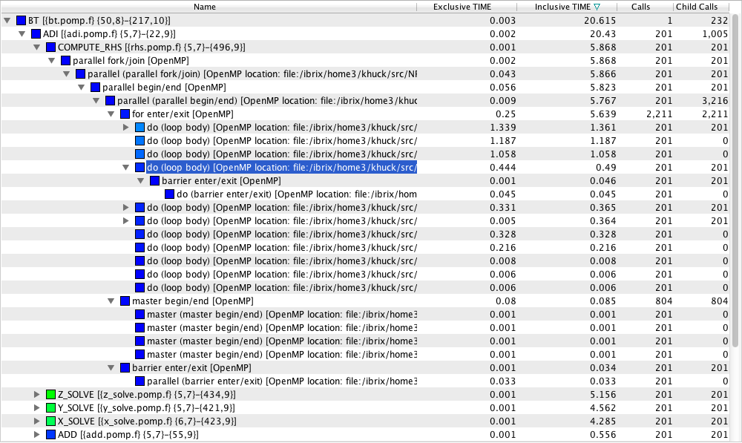
Profile Example NPB3.2 BT.B (32)
Notes:
OPARI adds instrumentation at all levels: region, worksharing, loops, iterations, barriers, etc.

Slide 8
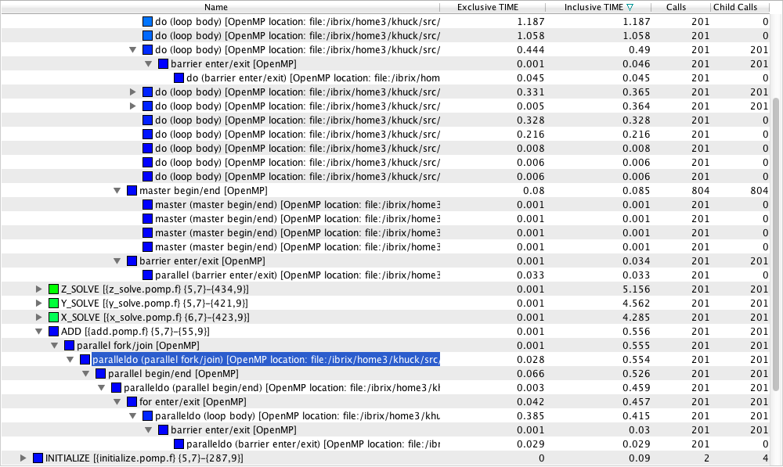
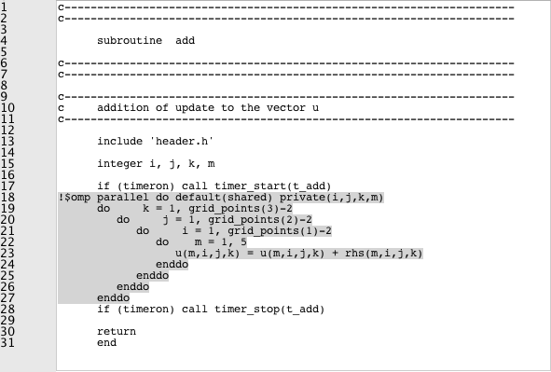
Profile Example NPB3.2 BT.B (32)
Notes:
OPARI requires (and adds) explicit barrier at end of loop

Slide 9
OpenMP Runtime API / Collector API
Proposed callback interface for tool support in OpenMP runtimes
Itzkowitz et al., 2007 (2006?) – Sun / Oracle
1 API function for tools to make requests (registration, query state)
  int __omp_collector_api(void *message);
Callback interface to tools from runtime
  22 events (profiling/tracing), 11 states (sampling)
Pros
  Instrumentation not required
  Event, sampling support
  Partial view of runtime internals (implicit barriers, locks)
  No more library blind spots
Cons
  Not widely implemented
  No static executable support (requires dlsym(); call)
  No explicit support for locks, stack frame locations, blame shifting
  No support for source context (integer “region id”)
Runtimes: Open64, OpenUH*
*with task extensions presented @IWOMP2013
Notes:
This paper has been adopted by the OpenMP Architecture Review Board as an official ARB White Paper. But was not adopted as part of the 3.0 standard. It certainly is not widely adopted.

Slide 10
ORA Events & States
Fork/Join
Begin/End Idle
Begin/End Implicit Barrier
Begin/End Explicit Barrier
Begin/End Lock wait
Begin/End Critical wait
Begin/End Ordered wait
Begin/End Master
Begin/End Single
Begin/End Ordered
Begin/End Atomic Wait
Overhead
Working
Implicit Barrier
Explicit Barrier
Idle
Serial
Reduction
Lock Wait
Critical Wait
Ordered Wait
Atomic Wait

Slide 11
OpenUH new Task Events
Begin/End Create Task Immediate/Delayed
Begin/End Schedule Task
Begin/End Suspend Task
Begin/End Steal Task
Fetched Task
Begin Execute Task
Begin/End Finish Task

Slide 12
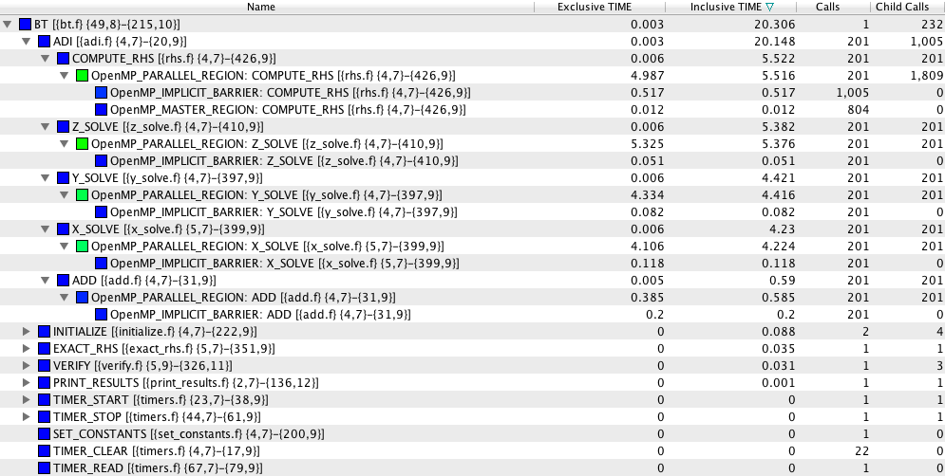
Profile Example NPB3.2 BT.B (32)

Slide 13
GOMP ORA Support
GOMP Implementation of OpenMP Collector API (ORA)
GOMP_* library functions wrapped dynamically, statically
Pros
  Same as Collector API
  Dynamic, static executable support (static requires relinking)
Cons
  Only available for GNU
  No introspection of GOMP internals
  Only partial support for implicit barriers
  GNU runtime is functional, widely available, but not optimal
  No explicit support for blame shifting, source context
Runtimes: GNU

Slide 14
Profile Example NPB3.2 FT.B (32)
Flat profile from uninstrumented binary, but getting events from runtime callbacks and samples from profiling tool
Notes:
Classic example of pointer chasing

Slide 15
OMPT: OpenMP Tools Interface
Proposal to add callback API to OpenMP runtimes
Pros:
  No instrumentation required
  Event, sampling support
  Dynamic, static executable support
  Internals knowledge, surgical measurement, always on
  Blame-shifting, debugger support
Cons
  Still in development
  Not an accepted standard (yet)
Available: IBM (limited/experimental on BGQ), GNU (prototyped by Rice), Intel (in development), OpenUH (planned)

Slide 16
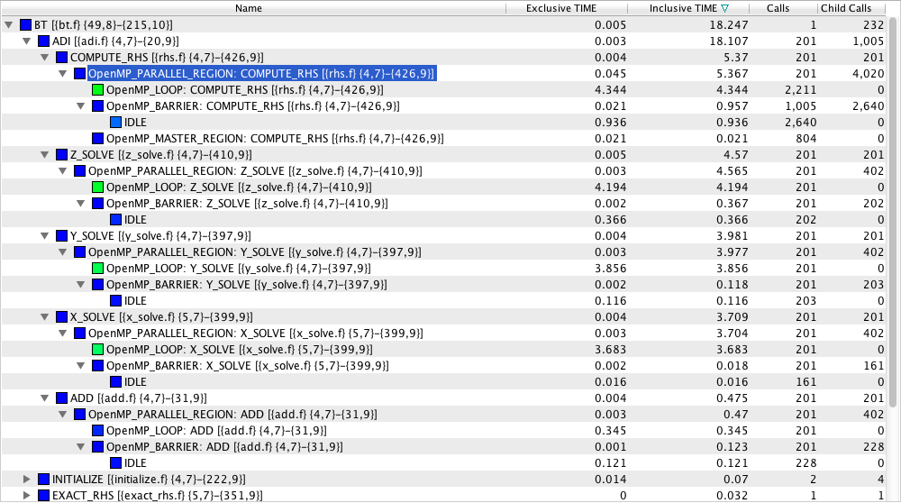
Profile Example: NPB 3.2 BP (32)

Slide 17
Event/State Coverage
Feature | OPARI | ORA | OpenUH-ORA | GOMP-ORA | OMPT
Parallel Region | Enter/exit, begin/end | ✔ | ✔ | ✔ | ✔
Thread create/exit | Pthread | ✖ | ✖ | ✔ | ✔
Work Sharing | Enter/exit, begin/end | ✔ | ✔ | ✔ | ✔
Atomics | Enter/exit | Wait State | Wait State | Waiting State | ✔
Barriers | Explicit only | ✔ | ✔ | Explicit, Some Implicit | ✔
Critical | Enter/exit, begin/end | Wait State | Wait State | Waiting State | ✔
Master | Begin/end | ✔ | ✔ | ✔ | ✔
Ordered | Enter/exit, begin/end | ✔, Wait | ✔, Wait State | ✔, Wait State | ✔
Sections | Enter/exit, begin/end | ✖ | ✖ | ✖ | ✔
Single | Begin/end | ✔ | ✔ | ✔ | ✔
Locks | Lock wrapper | Wait State | Wait State | Waiting State | ✔
Task Creation | Begin/end | ✔ | ✔ | ✔ | ✔
Task Schedule | ✖ | ✖ | ✔ | n/a | ✔
Task Wait | Begin/end | ✔ | ✔ | ✔ | ✔
Task Execution | Begin/end | ✔ | ✔ | ✔ | ✔
Task Completion | ✖ | ✖ | ✔ | ✖ | ✔
Task Yield | ✖ | ✖ | ✔ | n/a | ✔
Notes:
Need to get details on OMPT specification, implementations

Slide 18
Benchmark Experiments
Compilers: GNU 4.8.0, OpenUH 3.0.26, Intel 13.1.2, with –O3 or -Ofast
System: 1 “fatnode” on ACISS@UO, with four Intel X7560 2.27GHz 8-core CPUs and 384GB of memory (32 total cores)
Benchmarks: NAS Parallel Benchmarks 3.2.1, SPEC 2012, BOTS 1.1.2 (tied tasks only)
All experiments executed with 32 threads to stress maximal concurrency
All other settings left at default*
All benchmarks minimally instrumented, or executed with tau_exec

Slide 19
Overhead comparisons – NPB 3.2.1
High overhead for POMP (LU, LU-HP)?
  Many parallel region instances require many calls to the POMP API (at least 8 per)
High overhead for ORA, OMPT (LU-HP)?
  Many parallel region instances require many calls to the ORA callback function (at least 2,4 per)

Slide 20
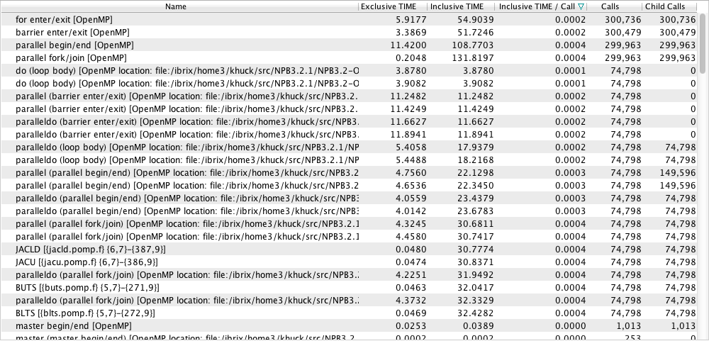
OPARI Additional Events
c
c
c
~34,239,023 timer invocations!

Slide 21
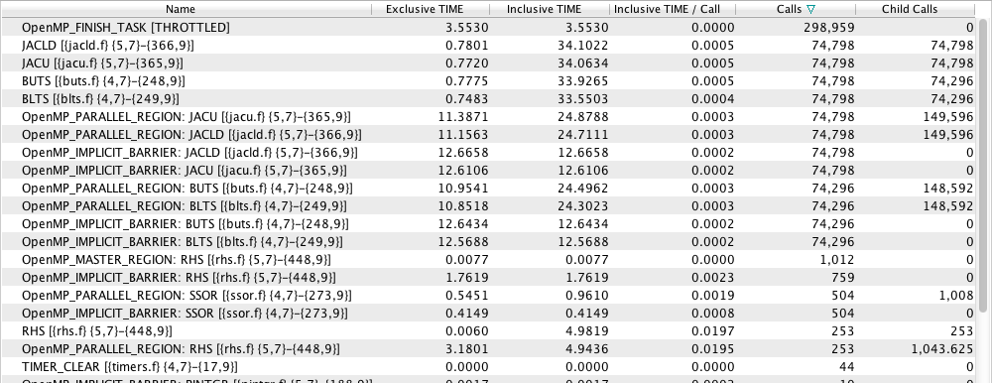
Collector API Extra Events
c
c
Obvious takeaway: unless needed,
Events will add overhead for
lightweight loops
~3,456,152 extra timers!

Slide 22
Overhead comparisons – BOTS 1.1.2
GNU horrible baseline performance
  Spawning, waiting for small granularity tasks with taskwait
  Lock contention in the task scheduler
OpenUH measurement overhead (floorplan)
Intel measurement overhead (floorplan, nqueens, uts)
  Millions of short-lived, lightweight tasks that take longer to measure than to execute
  Sampling gives similar measurement results, without overhead

Slide 23
GCC BOTS Floorplan Profile (samples)
Vast majority of time spent in locks, waits and spins
2 OpenMP states – creating tasks and waiting at a taskwait

Slide 24
GNU Task Scheduler modifications
4.8.2 implementation uses double-linked lists and locks for task queue and child dependencies
Re-implemented with lock-free circular queue and smart pointers (for memory management)
4.9 implementation will be worse – 2 more queues added for task groups, task dependencies
Current implementation needs debugging, hardening, then will be submitted to GNU maintainers

Slide 25
Overhead comparisons – SPEC 2012
GNU horrible performance (360.ibdc)
  TAU ORA profile shows vast majority of time in the GOMP scheduler (overhead state)
  Pragma specifies “runtime” scheduler
  Default scheduler for GOMP: “dynamic, 1”
  After setting to OMP_SCHEDULER to “static”, times reduced to 39.25, 43.08 and 42.25 seconds

Slide 26
SPEC 2012 360.ilbdc ORA profile
Not really WORKING: this time should be
measured as OVERHEAD. This is a limitation
of the wrapper approach

Slide 27
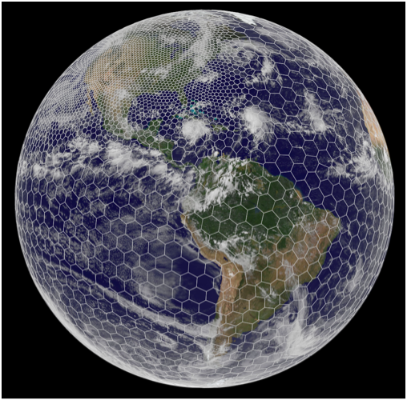
Application Example: MPAS-Ocean
MPAS-Ocean (SciDAC-3 MULTISCALE) has scaling limits using MPI only
Currently adding OpenMP pragmas to efficiently increase concurrency
TAU (SciDAC-3 SUPER) was used to evaluate MPI+OpenMP approach, suggest improvements
Tests performed by Doug Jacobsen (LANL), Kevin Huck and Sameer Shende (U. Oregon)
Linked with TAU, no instrumentation (no OPARI)
Observations, optimizations found:
  MPI block decomposition + OpenMP element decomposition reduces total instructions in computational regions (~10% faster) when compared to MPI block decomposition alone
  Weighted block decomposition using vertical elements (depth) balances work across processes (~5% faster)
  Guided schedule balances work across threads (~6% faster)
  Overlapping communication and computation will reduce synchronization delays when exchanging halo regions (not yet implemented)
Evaluation of OpenMP implementation is ongoing
http://mpas-dev.github.io

Slide 28
MPAS-Ocean Scaling Behavior
Executed on Hopper @ NERSC, a Cray XE6 with 2 twelve-core AMD ‘MagnyCours’ 2.1-GHz processors per node
Intel 13 compilers with prototype OMPT support

Slide 29
OpenMP Scaling Details

Slide 30



Summary
Several OpenMP options to choose from
  OPARI is the most portable alternative
Obviously, best implementation support comes from within the runtime
OMPT is a promising opportunity for OpenMP runtime tool support
Still need to be careful about processing too many lightweight events (especially tasks) – even with OMPT
Acknowledgements: The research was supported by grants from the National Science Foundation and the US Department of Energy

