Slide 1
SUPER: Institute for Sustained Performance, Energy, and Resilience
Lenny Oliker
Lawrence Berkeley National Laboratory
Bob Lucas
University of Southern California
Sept. 23, 2011
Support for this work was provided through the Scientific Discovery through Advanced Computing (SciDAC) program funded by the U.S. Department of Energy, Office of Science, Advanced Scientific Computing Research

Slide 2
SUPER Organization Change
Director
Lenny Oliker
Deputy
Jeff Hollingsworth
Auto-Tuning
Mary Hall
Energy Efficiency
Laura Carrington
Resilience
Bronis de Supinski
SAP Engagement
Patrick Worley
Tool Integration
Allen Malony
Optimization
Paul Hovland
Will focus talk on:
engagement highlights (including MPAS collaboration),
thrust area contributions, inter-institute progress

Slide 3

Participation in 12 SciDAC-3 Application Partnerships
13 active SAP collaborations
BER Applying Computationally Efficient Schemes for BioGeochemical Cycles (ORNL)
BER MultiScale Methods for Accurate, Efficient, and Scale-Aware Models of the Earth Sys. (LBNL)
BER Predicting Ice Sheet and Climate Evolution at Extreme Scales (LBNL & ORNL)
BES Developing Advanced Methods for Excited State Chemistry in the NWChem S/W Suite (LBNL)
BES Optimizing Superconductor Transport Properties through Large-scale Simulation (ANL)
BES Simulating the Generation, Evolution and Fate of Electronic Excitations in Molecular and Nanoscale Materials with First Principles Methods (LBNL)
FES Advanced Tokamak Modeling (ORNL)
FES Partnership for Edge Plasma Simulation (ORNL)
FES Plasma Surface Interactions (ORNL)
HEP Community Petascale Project for Accelerator Science and Simulation (ANL & UOregon)
NP A MultiScale Approach to Nuclear Structure and Reactions (LBNL)
NP Computing Properties of Hadrons, Nuclei and Nuclear Matter from QCD (UNC)
NP Nuclear Computational Low Energy Initiative (ANL)
SUPER
Notes:
Changes:
New AToM project (FES, Ed D’Azevedo is a funded member of the project and is the liaison from SUPER)
ComPASS was renewed (? Need to verify details with Stefan and Boyana as to the details and correct language to use here). Added UOregon since Boyana moved there
If the question comes up, ACES4BGC has ended, but this was not until March, 2015, so was still active much of this past year.
GEANT4 and ParaDIS do not appear on this slide, though ParaDIS could if we wanted to, and should if we are not talking about it elsewhere.

Slide 4
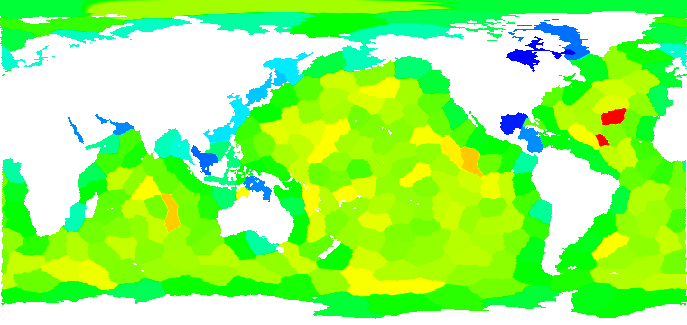
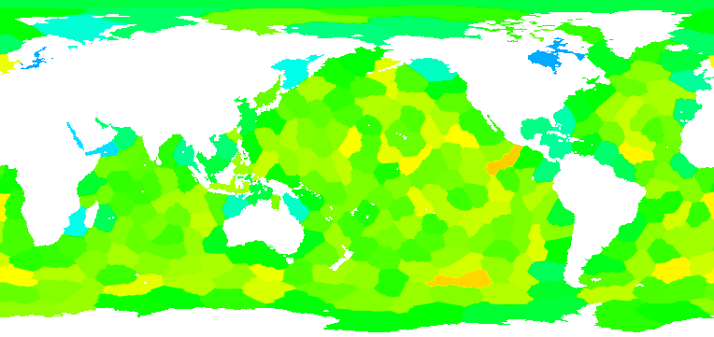
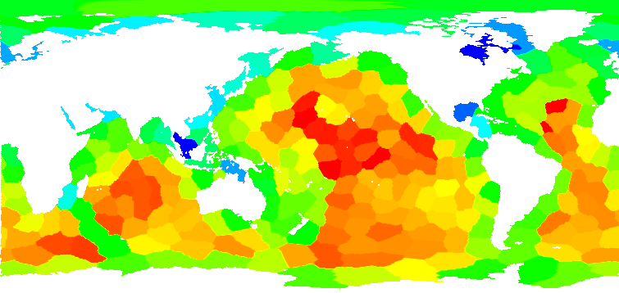
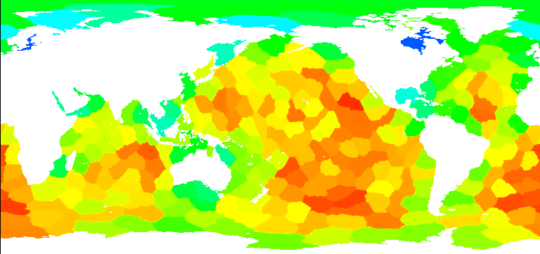
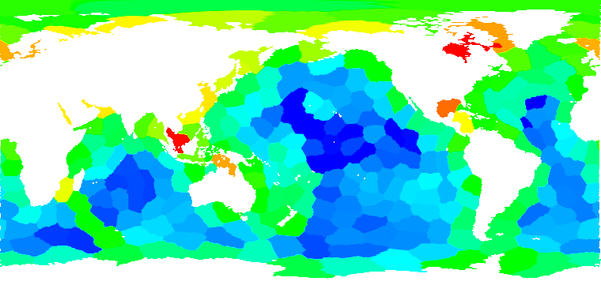
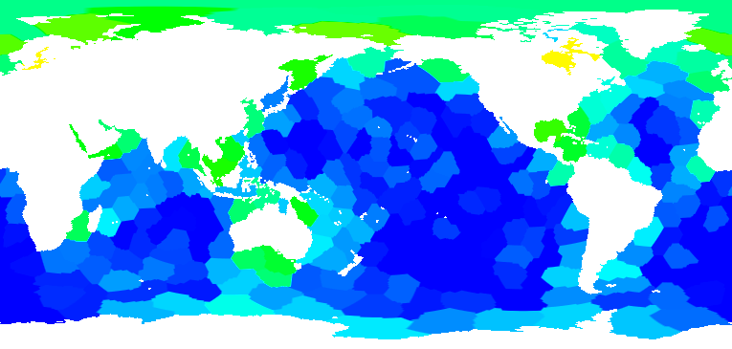
Linking Performance MPAS-O Data into Scientific Visualization Tools
SDAV/SUPER Collaboration (BER/ASCR Multiscale PI: Bill Collins)
Objectives
Impact
Map TAU performance measurements to the
MPAS-Ocean spatial domain to assist in
optimization of partition strategies
Integrated TAU performance measurement data with application scientific data in VisIt
Reduced execution time up to 15% for 60km model on 256 processes
Original Partitions Refined Partitions
Progress & Accomplishments
  Demonstrated that the load imbalance problem is correlated with variability among partition block size due to relatively large halo regions
  Visualizations also show that vertical depth, coastlines and number of neighbors likely affect computation, communication times
  Hindsight partition refinement using block+halo weights reduced mean MPI_Wait times by 40%, and overall execution time up to 15%
  Workshop publication: Huck et al., “Linking Performance Data into Scientific Visualization Tools”, Visual Performance Analytics at SC’14
min: 473, max: 846 Total Cells per Block min: 535, max: 771
min: 83s, max: 250s Computation Time min: 98s, max: 240s
min: 27s, max: 190s MPI_Wait Time min: 9s, max: 150s
Results collected on Edison@NERSC using 60km data and 240 processes
Notes:
MPAS-Ocean: “Model for Prediction Across Scales” project from NCAR & LANL (COSIM). In MPAS, the ocean (or atmospheric) data is discretized into unstructured Voronoi meshes, formally Spherical Centriodal Voronoi Tesselations (SCVTs).
The mesh cells are partitioned by GPMETIS into blocks. The blocks are very well balanced with respect to the number of cells per block. However, TAU performance measurement demonstrated that the computational load is not well balanced across blocks.
Correlating the performance data with application metadata collected by TAU, we were able to determine that the imbalance was correlated with not the number of cells per block, but the total number of cells needed to compute a block – which includes 3 layers of halo cells from neighboring blocks. Blocks with relatively few neighbors (coastal cells) have relatively fewer cells to compute, and terminate early on each iteration, leading to long MPI_Wait times.
The “Hindsight” partition refinement method modifies the static partitioning by assigning weights to each cell in the block, where the weight is defined as the total amount of work in the block, including halo cells. The mesh is then repartitioned, with the goal of reducing max total amount of work assigned any block.
The TAU performance measurements and Metadata are post-processed, and combined with the application NetCDF data. That data is parsed and visualized in VisIt. 3D and 2D projections are possible, but the 2D projection looks best for slides/publications. 3D is best for interactive exploration in VisIt.
4

Slide 5
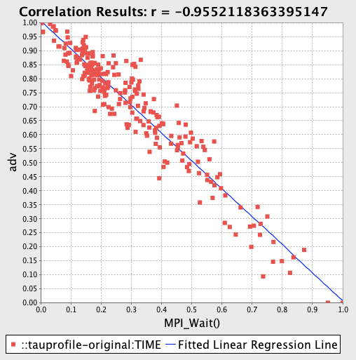
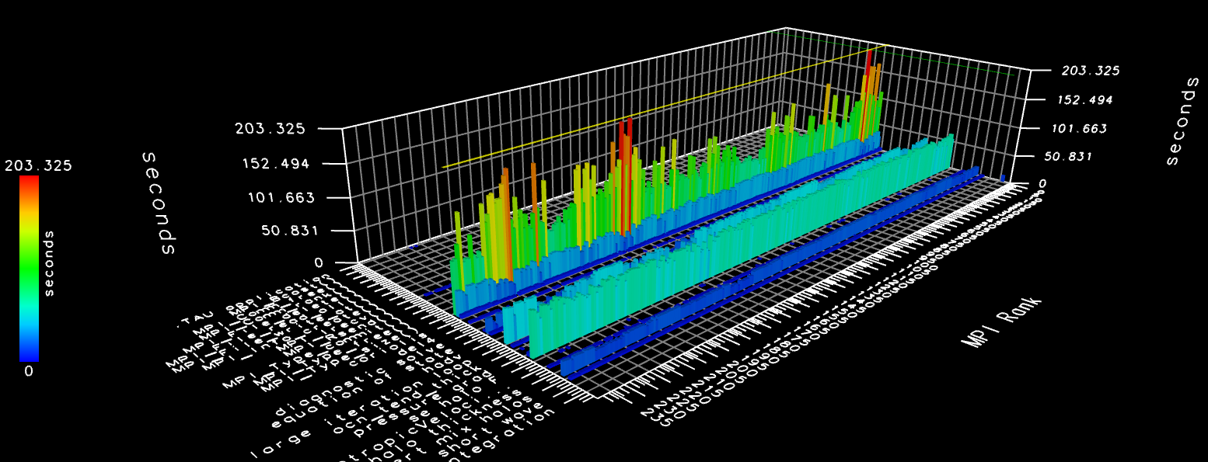
TAU Measurement of
MPAS Load Imbalance
Unusual stencil problem: 3 layers of halo/ghost cells lead to imbalance
Performance measurement in isolation is not enough
  Need to combine:
  Performance measurements
  Application metadata
  Correlations between measurements and metadata
  Visualization of performance data in application domain
TAU Measurement / Analysis Approach:
MPAS application instrumentation modified to use TAU_start/stop, link with TAU library
Use applicable MPI wrappers, OpenMP introspection and PAPI support
Data properties instrumented / captured as TAU metadata at runtime
Results archived in TAUdb database
PerfExplorer script to analyze and extract data from TAU profiles
ParaProf, PerfExplorer, VisIt visualizations

Slide 6
Performance Optimizations for MPAS-Ocean
Objectives:
Impact:
Accelerate MPAS-Ocean code performance on state-of-the-art supercomputers
Prepare MPAS-Ocean for transition to next generation highly parallel architectures
Work collaboratively with SUPER Institute to leverage performance optimization tools and expertise
Demonstrated that space-filling curve based ordering essential for intra-node communication reduction
Developed partitioning optimization approaches broadly applicable to numerous of unstructured-mesh based computations
Allow higher Simulated-Years-Per-Day throughput for ocean modeling simulations with MPAS-Ocean.
(Left) Low concurrency speedup via mesh reordering on Edison
(Right) High concurrency speedup via hypergraph partitioning
Progress and Accomplishments:
SFC-based mesh data reordering: average 1.25x performance gain
New halo-aware hypergraph partitioning algorithm improves scalability at high concurrency by over 2x.
Combined with SUPER optimizations, including pointer reduction at 12K cores: 3-4x MPAS overall speedup
A. Sarje et al. MSESM/ICCS 2015
nominated best paper
Notes:
6

Slide 7
PMaC’s Green Queue: Customized Application-aware Fine-grained Power Adjustments for Better Energy Efficiency
PMaC’s Green Queue Framework
Consists of static and runtime application analysis tools to quantify characteristics of application phases that directly affect component level power draw
Uses application characteristics to model the impact of changes in hardware power states on performance and component-level power draw
Recent additions include a module that enacts application-aware customized power-capping strategies to optimally allocate power to CPU, DRAM and uncore domains. Objectives include:
  Maximizing performance within given power bound
  Selecting the best performing code-variant from among a set of alternatives that performs the best given power bounds
Deployed and evaluated at scale
Notes:
The Green Queue is a framework that automates the process of selecting and setting customized fine-grained power adjustments throughout the execution of a large scale HPC applications.
The framework analyzes the computational characteristics of computational phases within large-scale HPC applications via PMaC’s static and dynamic analysis tools. These computational characteristics are used to model the impact of changes in hardware power states on performance and component-level power draw (estimated using Intel’s RAPL framework). The model is then used to inform the optimal hardware power states for different phases in applications, which are enacted at runtime.
The power adjustments were originally in the form of DVFS (Dynamic Voltage and Frequency Scaling); recent additions to the framework have enabled Green Queue to exploit power capping, which is available in current generation Intel Xeons (SandyBridge, IvyBridge and Haswell). The power capping can be enacted for CPU, DRAM and uncore (available only on Haswell) domains. This addition has enabled investigations into –
maximizing performance within given power bound
Determining the best code-variant or algorithm for a given power budget.
We applied the Green Queue framework on the MPAS application as part of a SUPER multi-thrust investigation.

Slide 8
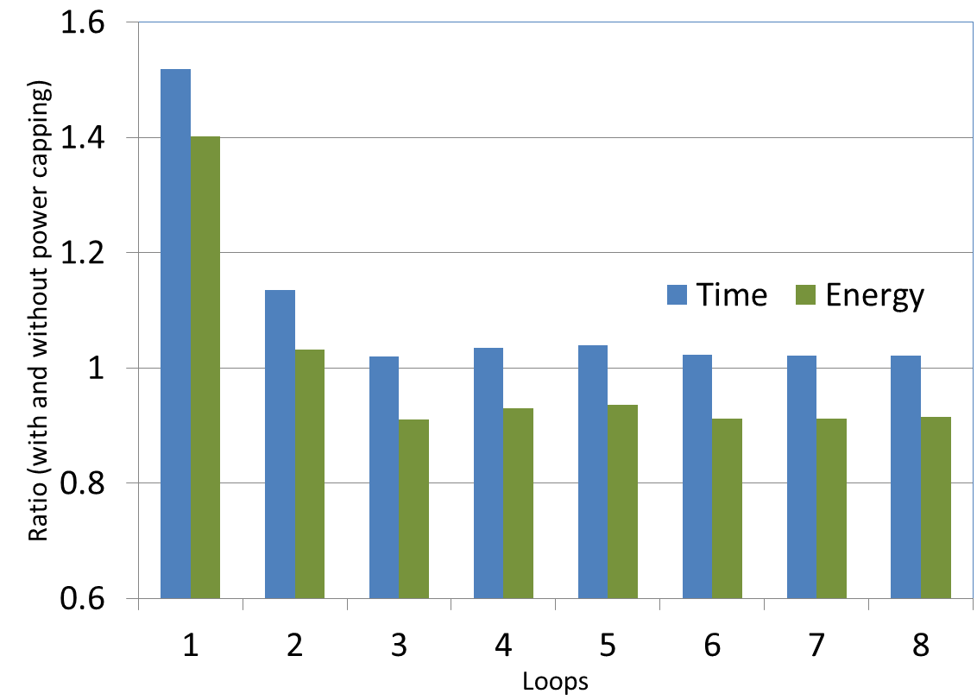
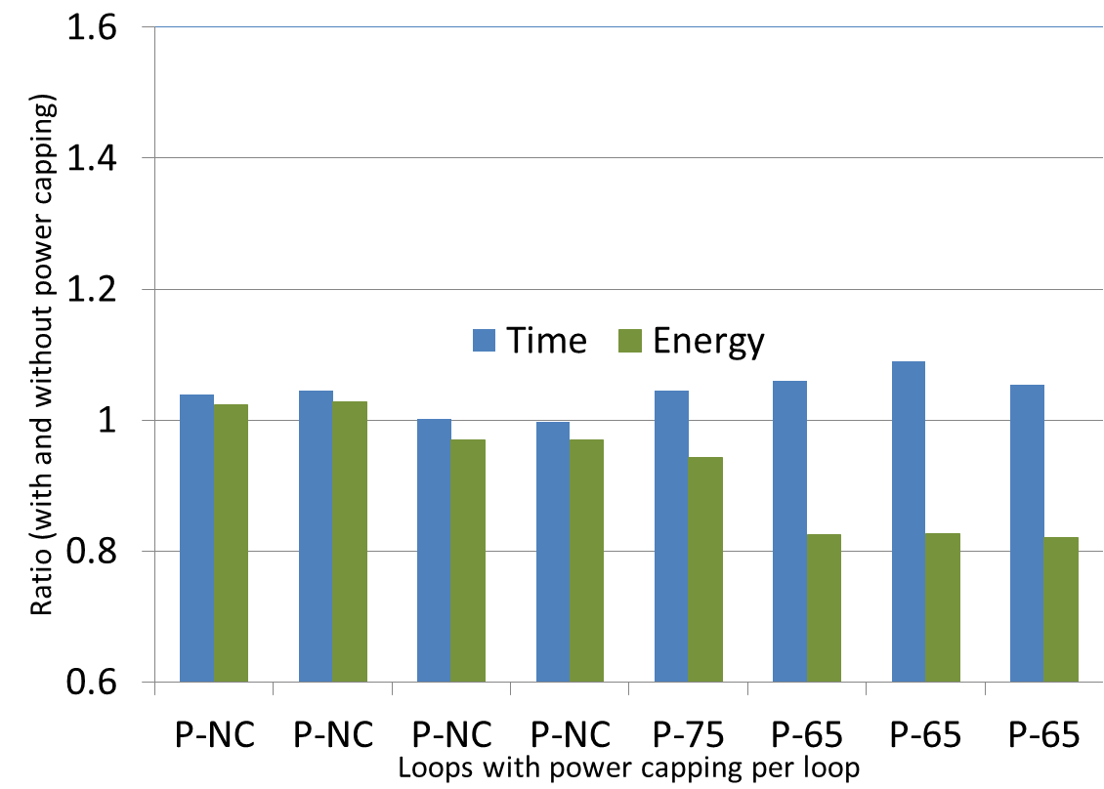
Customize Loop-level Power Capping in Large-scale Applications for
Power Provisioning/Energy Efficiency
Tools and models to automate customized loop-level power capping for better energy efficiency.
Automated identification of hotspot loops in large-scale application
Identify energy-optimal power capping level
Automate power-capping per loop/function throughout large-scale application
Power capping at 75W
(no overhead of capping)
Custom power capping
(includes overhead of capping)
Performance Penalty
Energy savings
Customization avoids penalty
Customization leads to larger energy savings
Large performance & energy penalty
Customize loop-level power capping for MPAS
MPAS: Ocean modeling application 20-day simulation on 512 cores
Customized loop-level power capping avoids performance penalties while reducing power & energy costs.
Notes:
In this study, we applied the Green Queue framework to the MPAS ocean modeling application; empirical results demonstrate how the framework can handle large-scale applications running at scale.
The tools automate the process of sweeping through the application and identifying all the candidate hot-spots that qualify for power-capping. The framework selects optimal power caps (based on energy efficiency) for each of the selected phases and inserts hooks in the production binary (via binary instrumentation) to automate the setting of power bound during runtime.
We took 8 computation phases within MPAS; these phases account for 90% of total execution time. A phase consists mostly of a series of loops or functions.
We ran a 20-day simulation on 512 cores of a SandyBridge system.
The results of the study are shown here in the two graphs, where y-axis is the ratio of runtime or energy in the power capped run to the base case (i.e., without power capping). So for the blue bars anything above 1 means the power capped execution ran slower than the base, ideally you would want those bars to remain as close to one as possible. For the green bars or energy any bar less than one means that the power capped execution run saved energy, thus reducing operational costs. The x-axis represents the candidate loops in the MPAS application.
The first graph shows the results of a run where all loops were set to the same capping level (i.e., no customization at per-loop granularity was done). Illustrating that without customization the execution can have severe performance and even energy penalties. The second graph shows performance and energy characterizations for MPAS phases when Green Queue selects and enacts (at runtime) different power caps for different phases. Note that customization avoids large performance penalties and has larger energy savings.
We see that 6 phases (out of 8) are amenable to power capping optimizations; these 6 phases account for more than 50% of the total execution time.
The plots are preliminary and hence encouraging because we could potentially have better results by introducing additional optimizations within Green Queue – e.g., minimizing the overhead of instrumentation, merging phases that have similar power caps, etc.

Slide 9
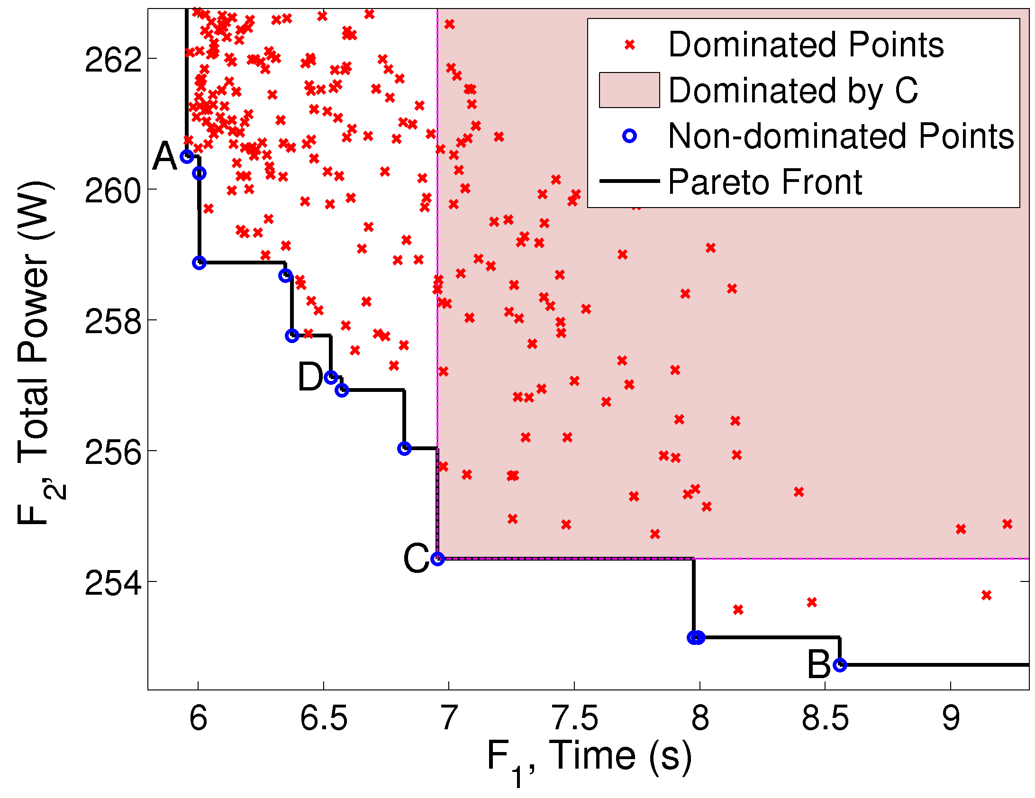
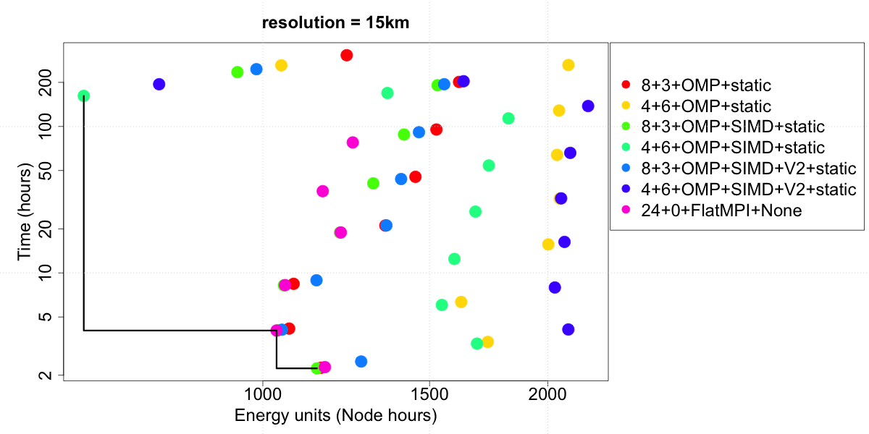
Multiobjective optimization for MPAS
Multiple objectives: execution time, energy consumption, resilience to errors, power demands, and memory footprint, etc.
Multiobjective optimization problem with relative weights/constraints are not known at search time
Pareto optimality: non dominating points ABCD (left fig.)
MPAS - Node hours as a proxy for energy (and utilization) on Edison
For 15km, Pareto points from 3 different configurations, due to of better-than-ideal scaling
Notes:
- Traditional performance engineering has focused on the single metric of run time
- In SUPER, we are also looking at metrics and constraints that take into account power/energy and correctness/accuracy
- When the objectives are conflicting (as with power and time), such "multi-objective optimization" is more computationally challenging than is single objective optimization
- Figure on left: each point is a variant of a kernel (DGEM, I think); the "Pareto-optimal" points are those for which no other variant has both lower lower consumption and less run time.
Figure on right (may not be needed if you favor sparse slides) just says that these objectives don't always conflict, as is the case in race-to-idle situations where minimizing time is equivalent to minimizing energy
****
- Bottom figure shows that there are only some # of nodes that make sense from a perspective of minimizing both time-to-solution and the nodehours consumed.
- (Aside: The reason is because of better-than-ideal scaling)
- Each color represents a different allocation of MPI ranks and threads per rank, showing that certain (low) node counts are uninteresting in all cases.
Someone would use this offline analysis to allocate both ranks & threads, and determine how many nodes to run on (based on online information about a time deadline and/or remaining nodehour allocation).
For the higher (15km) resolution, there does exist cases were flat MPI alone is not always optimal

Slide 10
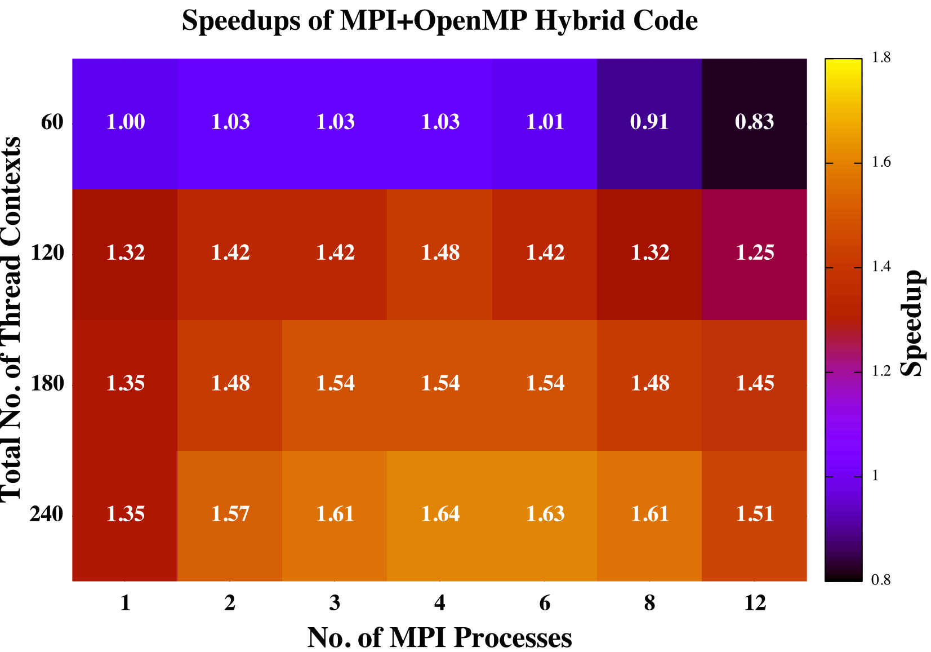
65x and 1.6x Speedup for CCSD and Fock matrix for NWChem
PI: Chris Cramer BES/ASCR Collaboration
Objectives
Impact
Accelerate NWChem performance by implementing
thread-level parallelism on the Intel Phi many-core
architecture.
Faster time-to-solution enabling larger and more accurate excited-state simulations with NWChem.
Progress & Accomplishments
  SUPER Institute collaboration implemented OpenMP parallelism for two NWChem modules
  Native mode optimization to prepare for next-generation NERSC8 Cori
  Threading is essential to exploit full capability of MIC architecture
  Performance of triples part of CCSD(T) improved 65x over original flat MPI implementation
  Flat MPI constrained to single process because of memory limitation
  Performance of Fock matrix construction improved 1.64x over original flat MPI
  Flat MPI constrained to 60 MPI processes
Performance improvement of hybrid MPI+OpenMP over flat MPI code for Fock matrix construction on Intel MIC architecture. The hybrid code exploits all 240 hardware thread contexts on card
Notes:
10

Slide 11
Up to 40% Performance Improvement from New Load Balancing Scheme
PI: C.S. Chang, Fusion SciDAC Center for Edge Physics Simulation (EPSi)
ASCR−FES SciDAC Highlight: Two-way collaboration among EPSi and SUPER
Objectives
Impact
Address performance degradation due to load imbalance in nonlinear collision calculation for XGC1 on DOE Leadership Computing Systems.
Low overhead automatic adjustment of parallel decomposition improves computational performance robustly and with minimal user input.
Accomplishment highlight
Challenge
  Existing particle load balancing algorithm does not also balance distribution of collision cost in parallel decomposition.
  Both particle count and collision cost per grid cell distributions evolve with the simulation.
Solution
  Two level optimization strategy: (a) balance collision cost subject to constraint on particle load imbalance, (b) optimize XGC1 performance by varying constraint periodically, converging to the optimum if distributions are static and adapting to the changing distributions otherwise.
Result
  10%-40% improvement for production runs.
Example load imbalance in collision operator cost, comparing load balancing only particle distribution with also load balancing collision cost. Cost is summed over rows of virtual 2D processor grid. Full model performance improvement is 30% for this example.
Notes:
11

Slide 12
LibTensor / CTF
Electronic Excitations in Molecular and Nanoscale Materials BES (PI: Martin Head-Gordon)
Originally restricted to running on large SMPs with spinning disks (bad match DOE HPC)
Optimized version leverages Cyclops Tensor Framework (CTF) developed at UCB
    Cyclic distribution of tensor via MPI All-to-All (stresses network) & SUMMA (Bcast & BLAS)
    GPU-acceleration reduced DGEMM to 3% of the run time.
    Mira had slowest DGEMM, but fastest Broadcast & Reshuffle: best runtime & scalability
    New version: 2K Mira nodes is 150x faster vs original large-scale SMP
LibTensor/CTF Strong Scaling
compute nodes
compute nodes
compute nodes
Edison (Xeon)
Mira (BGQ)
Titan (w/GPUs)

Slide 13
BIGSTICK
CalLat NP SciDAC Partnership (PI: Wick Haxton)
Configuration-interaction (CI) popular technique for solving quantum many-body systems
    BIGSTICK: scalable, memory-efficient CI code, large eigenpair problem via iterative methods
Applied both intra- and inter-node optimizations
(1) Empirical load balance for OpBundles nonzeros (2) Tuning MPI+OpenMP for each system
(3) Fusing collectives (4) empirically-tuned reduced concurrency for reorthogonalization
  Overall, improved scalability and performance by 1.3x – 8x (Accepted SC15)
    ¹³²Xe using a ¹⁰⁰Sn frozen core with 4 valence protons and 8 valence neutrons

Slide 14
SUPER Tool Integration
ROSE
compiler infrastructure
LLNL
PBOUND
performance modeling from code
ANL
performance models,
initial roofline support
TAU
tuning and analysis system
Oregon
ORIO
empirical tuning system
ANL/Oregon
CHiLL
transformation and code generation
UTAH/USC
PAPI
performance API
UTK
Active Harmony
online and offline autotuning
UMD
optimized control flow,
sparse matrices,
threading (CUDA & OMP),
expanded Fortran support
Edges/arrows show SUPER tools that have been integrated.

Slide 15
Auto-Tuning Results
Great results go here

Slide 16
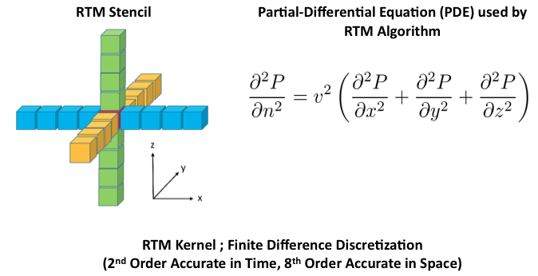
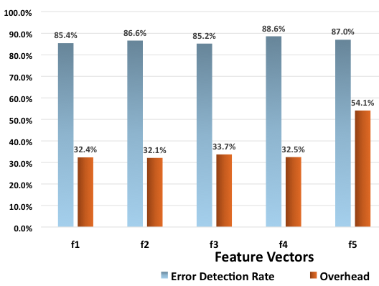
Resilience Thrust
Error Detector Synthesis (Utah; joint work with Greg Bronevetsky)
  We develop Customized Solutions for Error Detection in Stencil Computations
  Example: Given a 25-point RTM Stencil Function (used in Geo-Science Applications)
    Synthesize approximations of this function using fewer spatial / temporal points
    Synthesis accomplished through Linear Regression (Machine Learning)
    Method is general for PDE Stencil Codes
  Learned Functions Serve as Error Detectors (outlier)
    Release of SORREL : Platform for Machine-Learning based Error Detector Synthesis
    Insight into Feature Selection and Overhead
  Error Detectors Customizable for Overhead / Detection Ratio
    Can Achieve 88% error detection for 32% overhead
    Future Work : Better methods for overhead reduction and amortization

Slide 17
Modeling mixed resilient solutions (C/R + ABFT) (UTK)
An iterative application using a resilient library
Protect the application with traditional
checkpoint/restart
Protect the library with new techniques (ABFT)
≠ Exascale machine
Memory per component remains constant
Problem size increases (O(√n): matrix based)
μ (MTBF) at n=10⁵ 1 day is O(1/n)
C (=R) at n=10⁵ is 1m, 80% in library (α)
C (=R) is in O(n)
C (=R) independent of n (O(1))

Slide 18
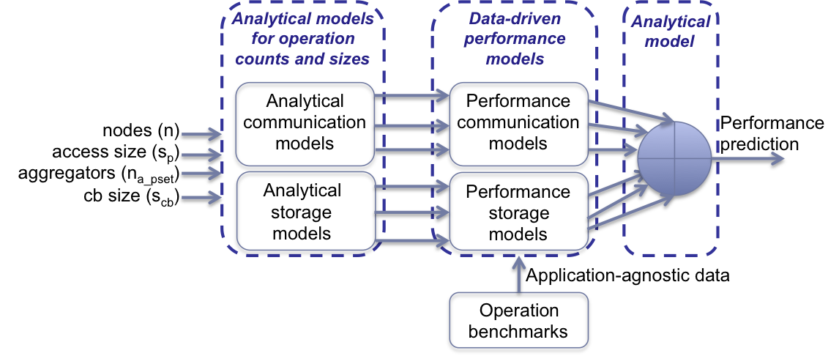
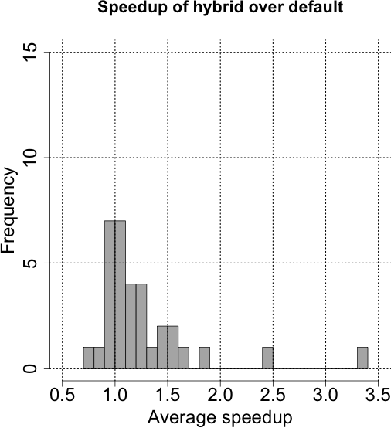
SUPER/SDAV Collaboration: Improving Computational Science Throughput via Model-Based I/O Optimization (Lead: Ross, SDAV; Wild and Balaprakash SUPER, ANL)
Leverage SUPER multiobjective optimization capabilities with SDAV I/O expertise and models
Model subsystems for performance, power, energy via hybrid approach: analytical and machine learning
Design model-based optimization approaches and evaluate with exemplar SciDAC workloads
Quadratic models effective at predicting parallel I/O write times in the absence of noise
Analytical models for communication + Empirical model for storage
On IOR benchmark, model-based optimization obtains speedup from 1.5x to 2.5x over default [Cluster 2015a, Cluster 2015b]
Notes:
Our goal in SDAV/SUPER supplement project is to leverage the complementary capabilities in SDAV and SUPER to address the
problems of more rapidly developing accurate I/O models and using these models to optimize
critical components of the leadership-class computing storage software stack, leading to better and
more predictable I/O performance models for SciDAC applications.
A high level overview of the approach is shown in the left figure.
Two broad types of models will be built: analytical models and surrogate models. Analytical
models will be mostly based on domain knowledge. When analytical models fall short in predicting the
performance in an I/O subsystem, surrogate modeling can be used as an effective tool for approximating
the errors made by the analytical models.
As a case study of the effectiveness of
model-based autotuning in the context of ROMIO collective
I/O implementation. We compare a black-box approach and
a hybrid approach leveraging analytical modeling and machine
learning. In the hybrid approach analytical models are
used for deriving the count and sizes of communication and
storage operations. The results on the right graph show
that the hybrid outperforms the currently adopted default values;
The obtained speedups are from 1.5x to 2.5x over default.
Collective I/O Tuning Using Analytical and Machine Learning Models. F. Isaila, P. Balaprakash, S. Wild, R. Latham, D. Kimpe, R. Ross and P. Hovland. Cluster 2015a.
Dynamic Model-driven Parallel I/O Performance Tuning B. Behzad, S. Byna, S. Wild, Prabhat and M. Snir. Cluster 2015b.

Slide 19
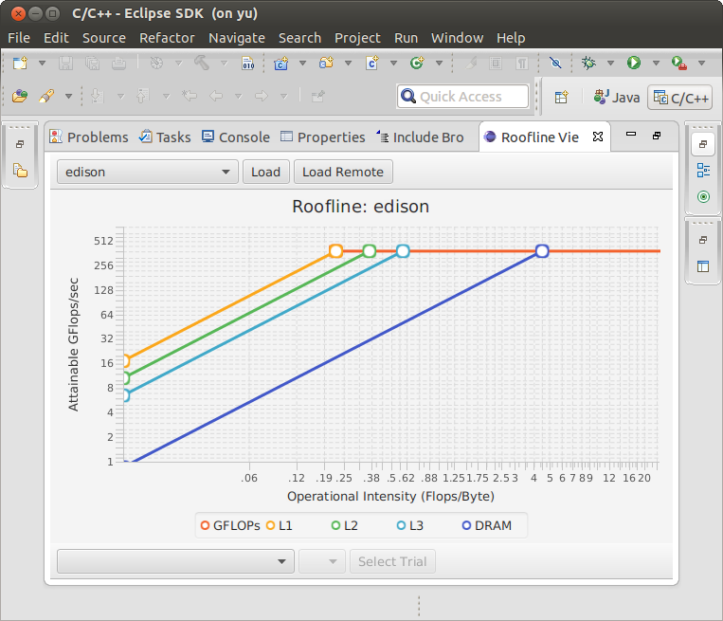
The Roofline Toolkit
SUPER/FASTMath Collaboration
Objectives:
Impact:
Performance modeling is critical for identifying and ameliorating bottlenecks on emerging HPC systems
Roofline performance model is a highly recognized approach for quantifying system and program behavior, but requires expert knowledge
Goal: produce set of software tools allowing non-experts to automatically leverage Roofline modeling capabilities
Automated roofline code could be used to diagnose performance problems for DOE & SciDAC codes
The community can focus on addressing appropriate performance impediments via optimization, algorithm design, or hardware selection
Parameterized roofline models can be used to predict behavior of future systems, to help drive forward-looking algorithms and architectures
(Left) Automated Roofline Visualizer using ERT Edison data.
(Right) Mira Roofline bounds relative to MiniDFT compact app highlighting performance potential.
Progress and Accomplishments:
Detailed roofline analysis of 4 leading HPCs: Edison, Mira, Babbage, and Titan
Quantified benefits of emerging GPU software managed cache technologies
Y. Lo et al. PMBS2014
Insights resulted in 03/2015 public release V1.0: Empirical Roofline Tool (LBNL) & Roofline Visualizer (U Oregon)
Roofline Toolkit is a community tool for automatic hardware introspection & analysis
Notes:
19

Slide 20
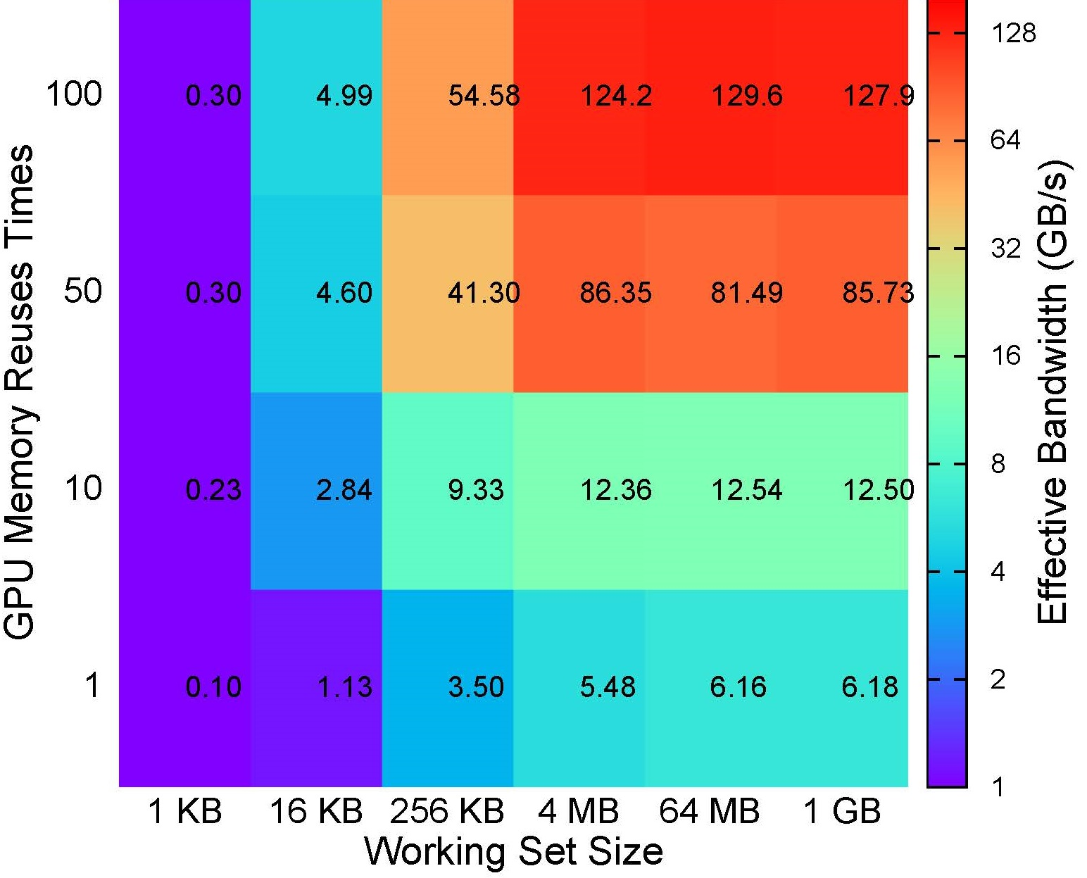
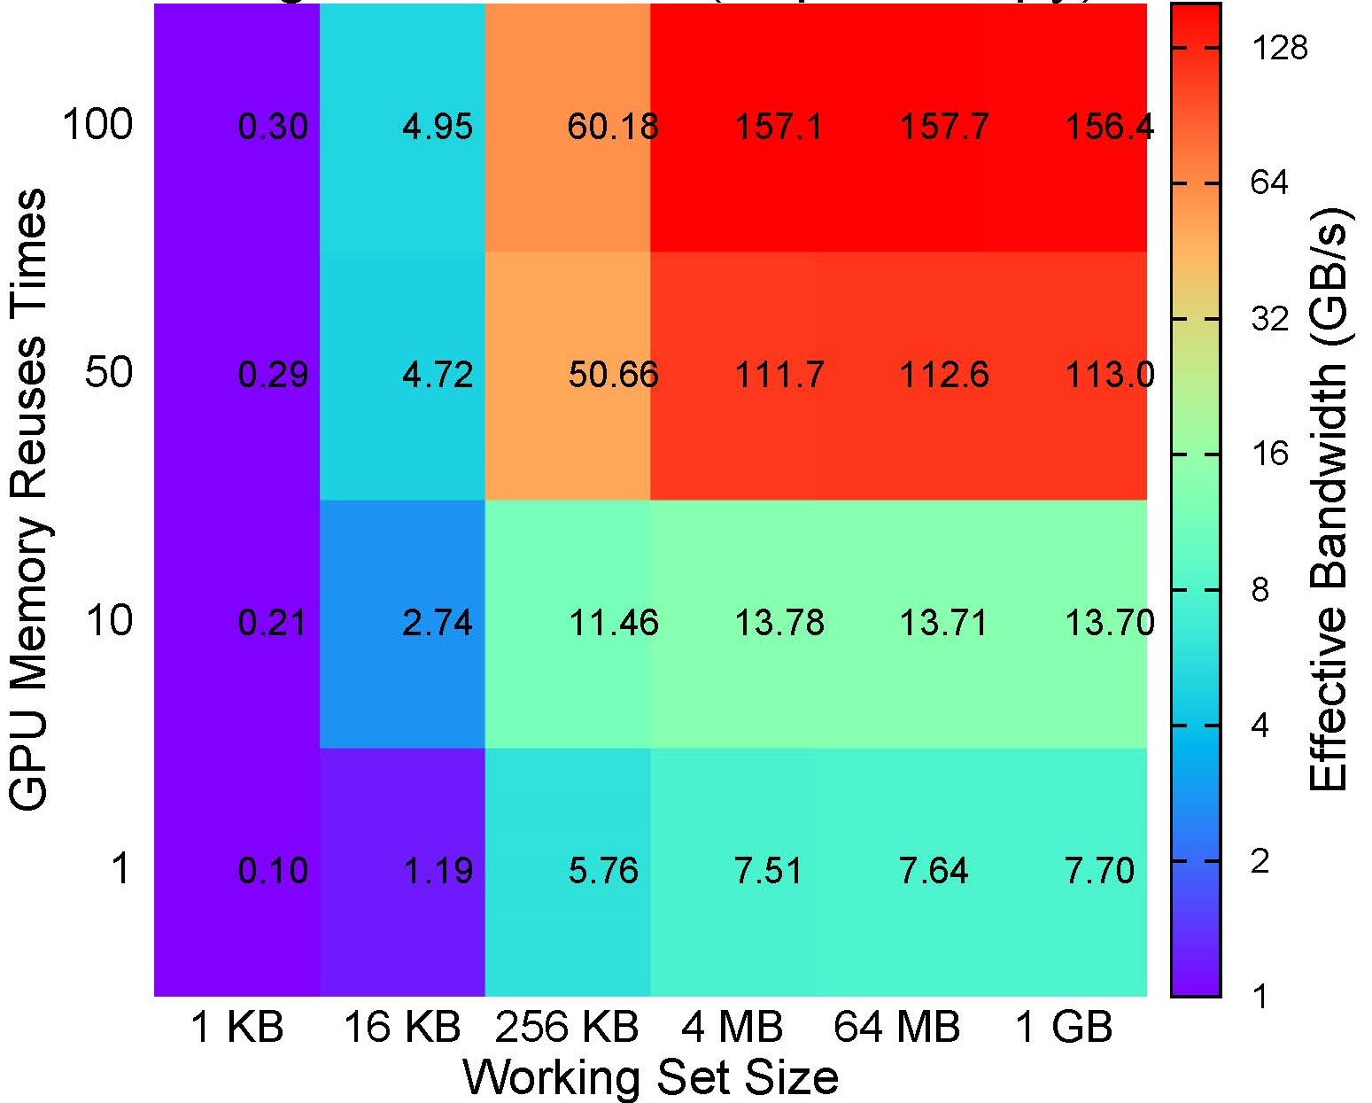
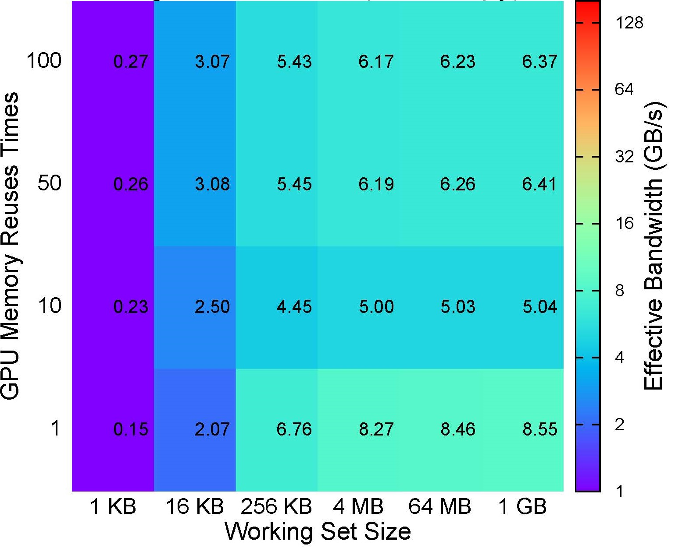
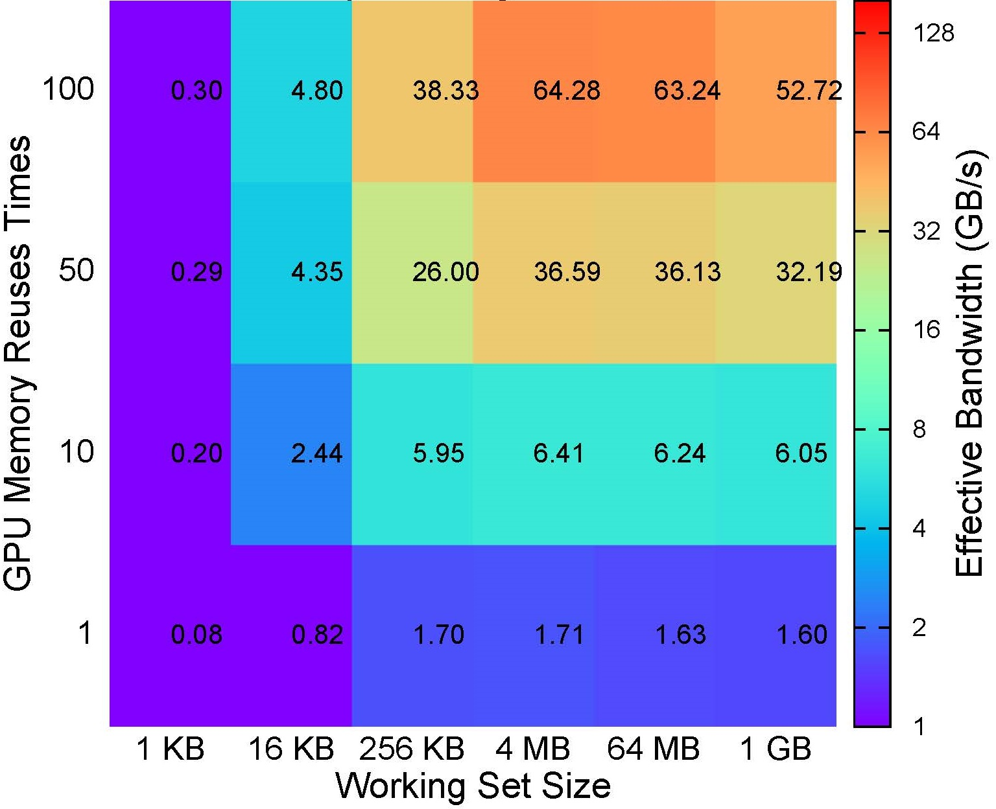
Roofline for GPU Memory Performance
1
Pageable host w/ explicit copy
2
Page-locked host w/ explicit copy
Bandwidth dramatically impacted by working set, reuse and memory access scheme.
Empirical study completed, GPU functionality expected in new Roofline release fall 2015.
3
Page-locked host w/ zero copy
4
Unified Memory
Notes:
CUDA 6.5 now supports Unified Memory (treat device memory as OS-controlled page cache on CPU memory)
GPU Programmers must choose whether to…
use Unified memory and let the OS control everything
micromanage data allocation/movement/locality themselves
use zero copy memory and keep everything on the host.
How does performance vary on Kepler GPUs (e.g. ORNL’s Titan and NERSC’s Dirac)?
zero copy memory performs very poorly (PCIe bandwidth on every access) and has no benefit from temporal locality
Page locked with explicit management works well for large working sets (>4MB) with high temporal locality (reuse 50x)
Unified memory behaves like explicit management getting a benefit from temporal locality, but is 3x slower.
It seems explicit management of data movement and locality is still required on Titan.

Slide 21
Summary
  Performance Engineering of Scientific Software
    Active participation in SciDAC-3 application partnerships
    Significant optimization progress for numerous SciDAC applications
  Tool integration
    Significant progress in measurement/performance/optimization tool integration
    Co-design of tools and application optimization to maximize impact
  Energy minimization
    Fine grained power capping for energy savings while maintaining performance
  Optimization
    Coarse grained auto-tuning of energy and performance tradeoffs
  Automatic performance tuning
    TBD
  Resilient computing
    TBD
  Inter-institute collaboration
    Performance visualization, model-based I/O optimization, Empirical Roofline Toolkit

Slide 22
EXTRA SLIDES

Slide 23
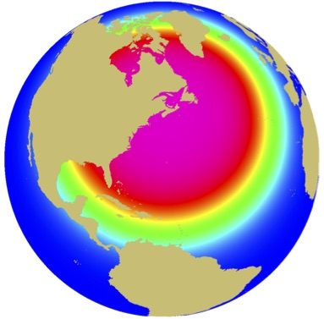
MPAS-Ocean Overview
Multiscale for Accurate, Efficient, Scale-Aware Models of the Earth System (PI: Bill Collins)
MPAS = Model for Prediction Across Scales [LosAlamos]
A multiscale method, with Voronoi tessellation-based variable resolution mesh (SCVT).
Notes:
SCVT Cells and computed quantities.
Major advantages of such unstructured mesh:
Offers variable resolutions. User defined density functions.
Focus on area of interest with high resolution. Avoid unnecessary high-resolution computations in unwanted areas.

