Slide 1




MONA: Performance Understanding and Analysis for Exascale Data Management
Karsten Schwan (PI)
Greg Eisenhauer, Matthew Wolf
Georgia Institute of Technology
Allen D. Malony, Kevin Huck
University of Oregon
Hasan Abbasi
Oak Ridge National Lab
Stephan Ethier
Princeton Plasma Physics Lab
February 18, 2016

Slide 2
Overview
Seeks new methods for performance monitoring and analytics (monalytics) of data management actions for exascale simulations
Gain a deeper understanding of where and when
performance bottlenecks occur
  Scientific workflows involve parallel components
  Properties of scientific workflows (flow)

Slide 3
Conceptual Model for Exascale Execution
Codes
GTS
GTC-P
LAMMPS
NAMD
PIConGPU
Pixie3D
S3D
Einstein Toolkit
…

Slide 4
Science applications are changing
Due to I/O bottlenecks, codes are being forced to come up with new data management and execution models
  Code Coupling
    DNS to LES model coupling in Combustion
    Comparative Analytics models for ITER
  In situ/in transit processing
    Physics-driven compression
    Diagnostic histogram output
Existing tools focus on single applications/executions
New tools must focus on the entire workflow, including interactions between different stages.
  Must address both the logical and physical performance issues.
Notes:
As scalability is increasing there are new challenges.

Slide 5
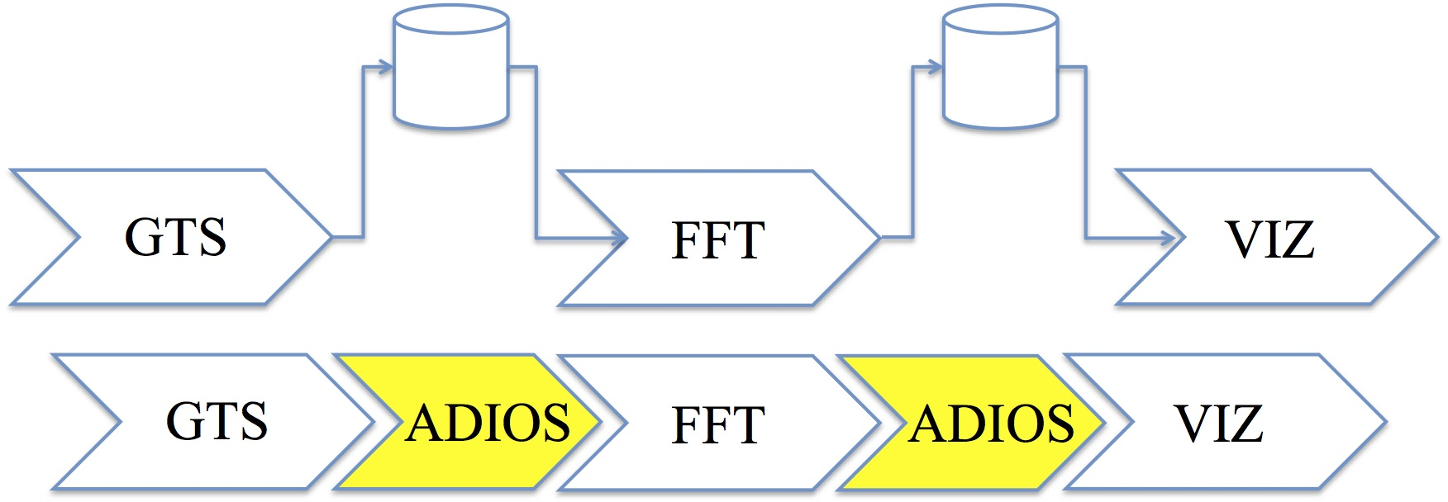
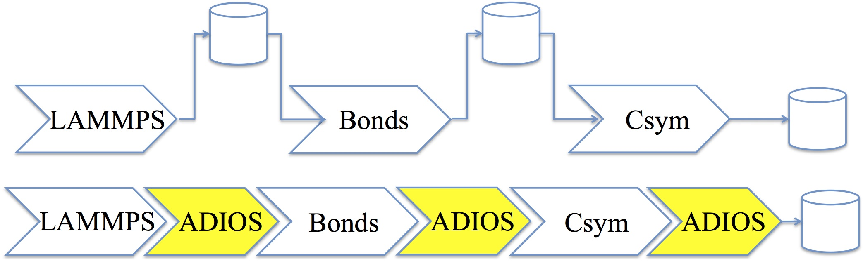
Science Engagement Motivation
GTS and LAMMPS are developed w/file-based workflows control
ADIOS has been used to replace the file I/O with a memory-based workflow management scheme
  Manages data movement in memory or between nodes
  Supports parallel communication
ADIOS buffers can have parameters set/optimized at run-time
GTS Workflow
Gyrokinetic Tokamak Simulation
http://theorycodes.pppl.wikispaces.net/GTS
LAMMPS Workflow
Large-Scale Atomic/Molecular Massively Parallel Simulator
http://lammps.sandia.gov

Slide 6
Goals
Evaluate, analyze and understand performance of online data management workflows
  Explore metrics, such as energy saved, in online vs. offline data processing to aid understanding of tradeoffs
  Evaluate and understand co-scheduling of analysis and visualization tasks with simulations to improve utility of online data management workflows
MONA aims to provide workflow orchestration systems with end to end feedback on performance metrics
  MONA’s models will provide the framework for smarter resource utilization for data management workflows
  MONA will optimize end to end metrics such as energy consumption and total time to insight for complex exascale workflows
MONA will provide a framework for users to easily create proxy workflows that can be used within the co-design pipeline

Slide 7
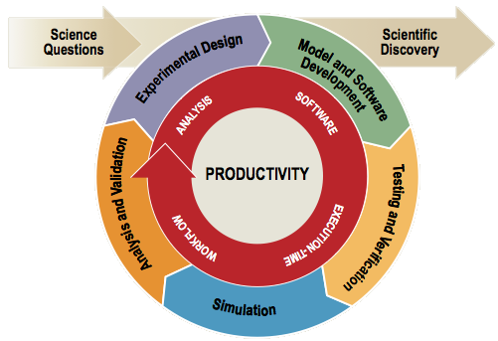
Scientific Productivity at a Glance
Scientific productivity is a quality
measure of the process of
achieving science results,
incorporating:
  Software productivity
  Execution-time productivity
  Workflow & analysis productivity
  End-to-end productivity
Productivity costs
  Human resources for development and
  re-engineering
  Machine and energy resources during runtime
  Utility and correctness of computational results
Notes:
To understand our approach, you first have to understand how we view scientific progress.

Slide 8
Exascale Computing Productivity
Exascale computing productivity is the effective, efficient use of all exascale resources (power, hardware, application software, runtime, people) in the production of new scientific insights
GOAL:
  Productivity awareness embedded in all exascale lifecycle activities, from R&D through deployment to operation and production of scientific insights
  Increase efficiency of overall exascale ecosystem during research and development by identifying, removing, and ameliorating productivity and performance bottlenecks
What will be required to meet these goals:
  ON-LINE / REAL-TIME Operating Model
  IN SITU Analysis and Responsiveness

Slide 9
A glimpse ahead: MONA so far
Created a first prototype workflow monitoring (WOWMON) infrastructure to capture and analyze information about scientific workflow behavior and performance
Developed a simple interface for users to instrument codes
  Workflow component performance (TAU)
  Workflow component metrics and events (WOWMON API)
Developed a workflow manager to aggregate and analyze performance data from workflow components
  Designed with runtime workflow control in mind
  Initial prototype
Developed a lightweight and flexible networking layer (using EVPath) for communication of performance data with workflow manager
Tested WOWMON on realistic scientific workflows
Demonstrated WOWMON with respect to evaluation of end- to-end latency in scientific workflow
Notes:
Reorganize under 3 points: Understanding, End-to-End, and Proxies

Slide 10
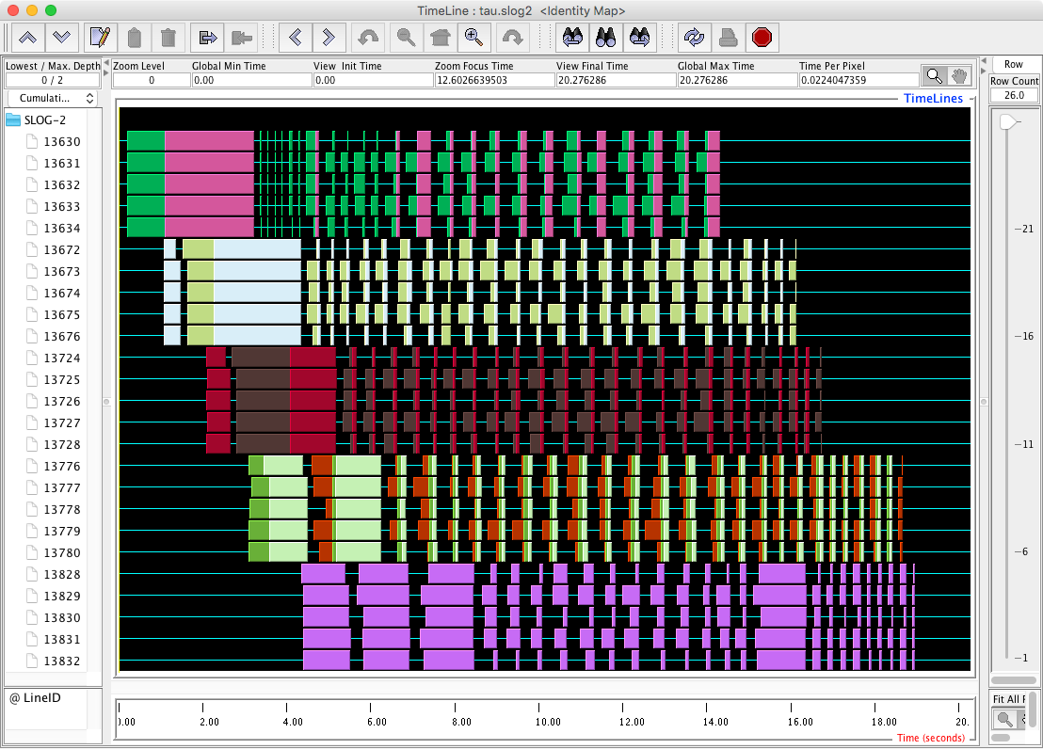
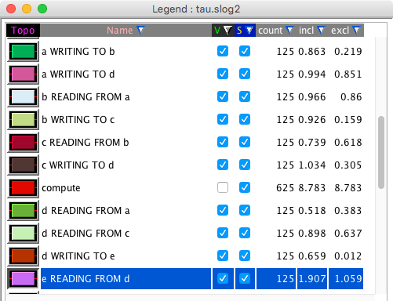
MONA: Synthetic Workflow Generation
Construction of arbitrary workflow structures from JSON configuration file
MPI “applications” in the workflow connected with ADIOS over Flexpath
Provides framework for developing, testing MONA infrastructure in different scenarios
Currently supports TAU, ADIOS metrics collected over SOSflow
Future work: enable dynamic behavior
  Computation ratios
  Which ranks/communicators participate
  Volume, frequency of data
Future: integrate Monalytics
A
B
C
D
E
B
A
C
D
E
Notes:
For the MONA project, the University of Oregon team has constructed a synthetic workflow framework to generate arbitrary workflow structures using a simple, reconfigurable MPI application (written in C) driven by a JSON configuration file. Using this framework, we can develop and test the MONA infrastructure, including the SOS_flow data collection, the back-end Monalytics, as well as any re-configuration of application behavior at runtime. Each iteration, the generated synthetic workflow applications read from input applications (using ADIOS over Flexpath), does a configurable amount of actual computation (iterative Mandelbrot), then write to the next application in the workflow graph (again, using ADIOS over Flexpath). Static workflows and data sizes are currently supported, we hope to add dynamic behavior in the near future. In the example, there are 5 applications in the workflow, each executing with 5 MPI ranks. These applications are named A,B,C,D,E. They execute for 25 iterations. The primary application (after executing the 25 iterations) signals the other applications (over ADIOS) when it is time to exit. The visualization is from a merged TAU trace of all applications in the workflow. The only events visualized are those around ADIOS transfer code regions. All MPI ranks participate in each ADIOS transfer.

Slide 11
Building towards Exascale: technical components
TAU
  Established monitoring infrastructure
EVPath
  Highly efficient middleware event transport and processing
ADIOS
  Widely used I/O middleware with code coupling capabilities

Slide 12
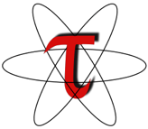
TAU Performance System®
Performance problem solving framework for HPC
  Integrated, scalable, flexible, portable
  Target all parallel programming paradigms
Integrated performance toolkit (open source)
  Multi-level performance instrumentation
    Source, compiler, library, binary
  Flexible and configurable performance measurement
    Shared-memory multithreading
    Distributed memory message passing
    Heterogeneous: accelerators (GPUs), coprocessors (Xeon Phi)
    I/O frameworks and runtime systems
  Widely-ported performance profiling / tracing system
    Measurement system integration with Score-P
  Performance data management and data mining
  Incorporates several other technologies in its implementation
TAU is available on all DOE HPC systems
TAU is being incorporated in several DOE exascale projects: Mona, Argo, XPRESS, Vancouver
http://tau.uoregon.edu
Notes:
TAU is intended to target a general parallel systems architecture.
The TAU "framework" tries to capture design principles
* events associated with: threads, processes, messages, ...
* metrics: time, counts, ...
* measurements to be made: profiles, traces, ...
TAU is also an open source implementation consisting of:
* instrumentation layer
- we have robust instrumentation capabilities
- TAU's Program Database Toolkit (PDT) is very powerful for source instrumentation
- TAU uses Dyninst, MAQAO, and PEBIL for binary instrumentation
- robust library wrapping allows us to instrument any library from headers
- access compiler instrumentation support
* measurement layer
- TAU has probe-based and sample-based measurement support
- TAU interfaces with PAPI for hardware counters
- TAU can get power through Intel's RAPL and other interfaces
- profiling and tracing is provided
- UO worked with Research Centre Juelish to build a core measurement infrastructure
+ supported by DOE PRIMA project
+ this became Score-P
- TAU provides heterogeneous measurement
+ will give an integrated performance profile:
threads, ranks, communication, accelerators, ...
- TAU works with the OpenMP OMPT profiling interface
- TAU works with the MPI MPI-T interface
- TAU works with the CUDA 4 CUPTI interface
- TAU's library wrapping technology allows I/O libraries to be instrumented and measured
* analysis layer
- TAU offers parallel profile analysis (ParaProf)
- TAU uses Vampir or Jumpshot for trace displays and analysis
* database and data mining
- TAU Performance System provides a parallel profile database (TAUdb)
* holds parallel profile data from multiple experiments
- TAU offers performance data mining (PerfExplorer)
TAU is completely open source
It will run practically anywhere
TAU is being incorporated in DOE projects:
* MONA: monitoring and analytics for scientific workflow performance
* ARGO: runtime observation, in situ introspection and analysis, feedback
* XPRESS: integration with HPX software stack, building APEX for policy-based adaptation
* Vancouver: heterogeneous parallel system performance measurement and analysis

Slide 13
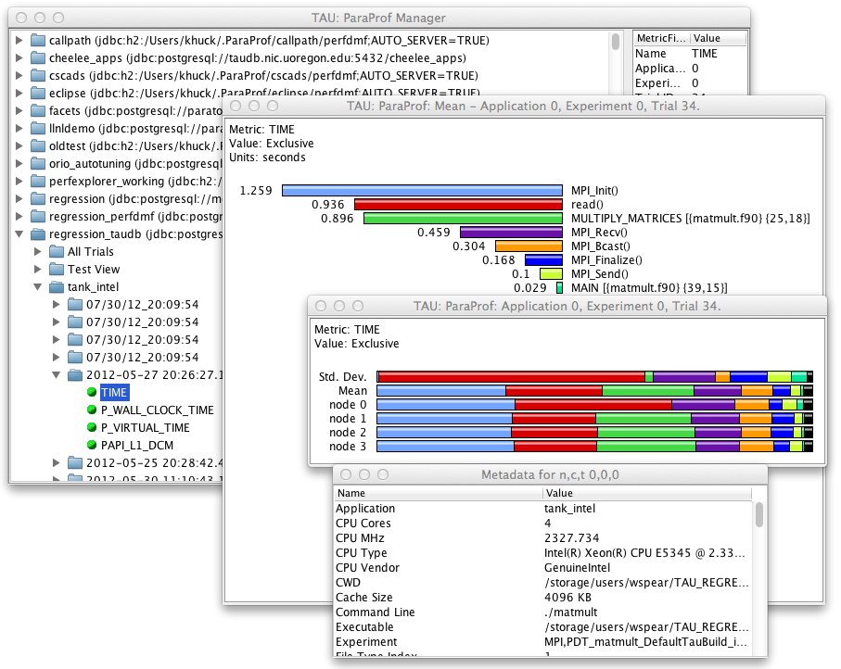
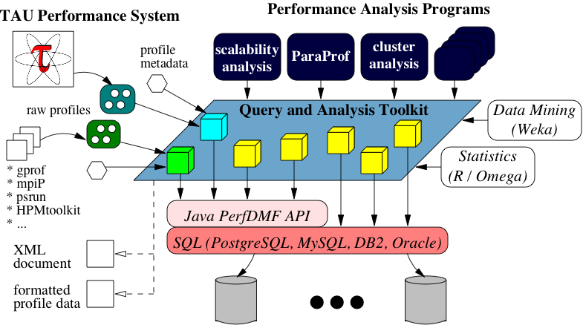
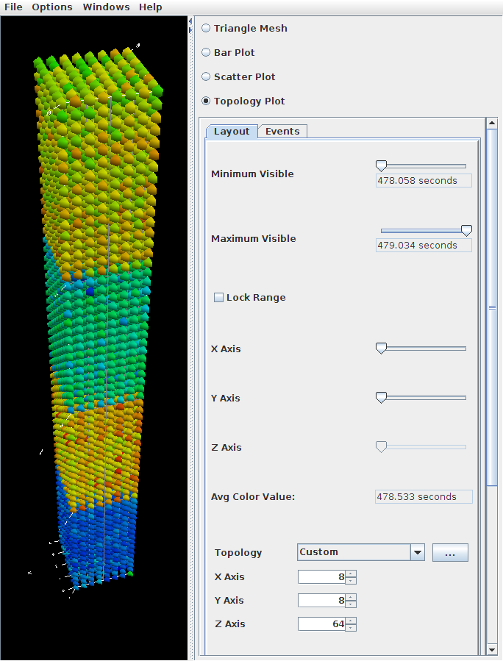
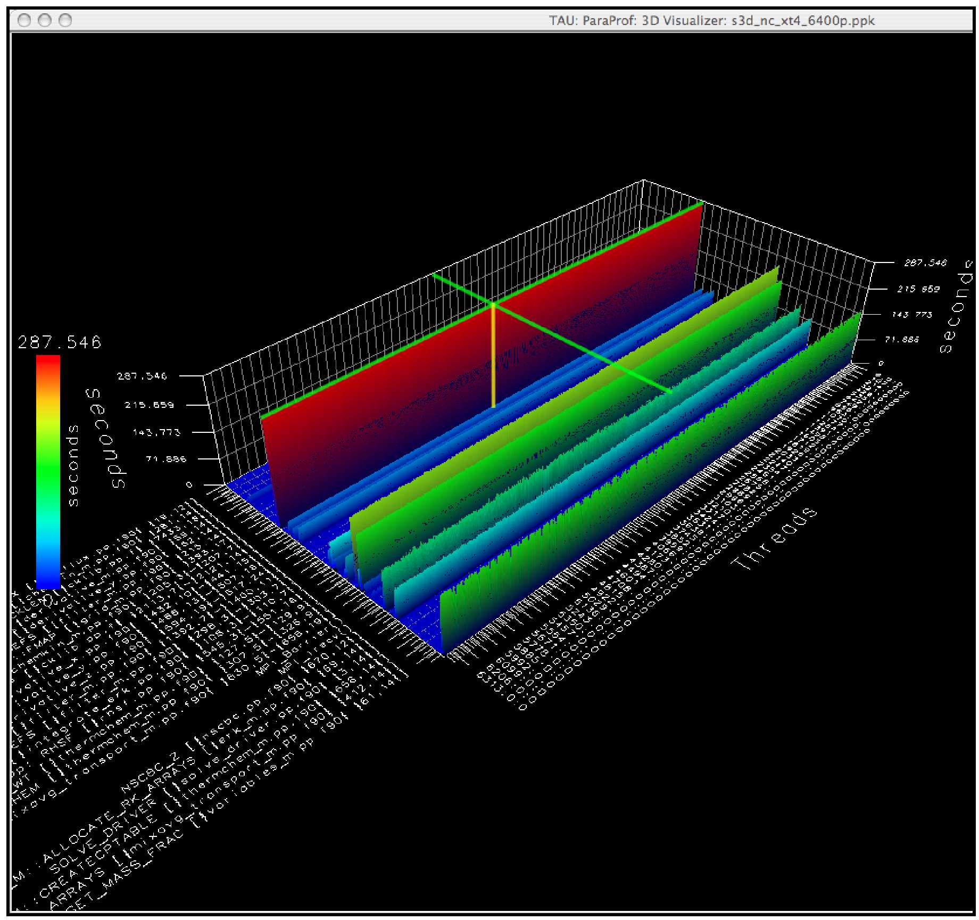

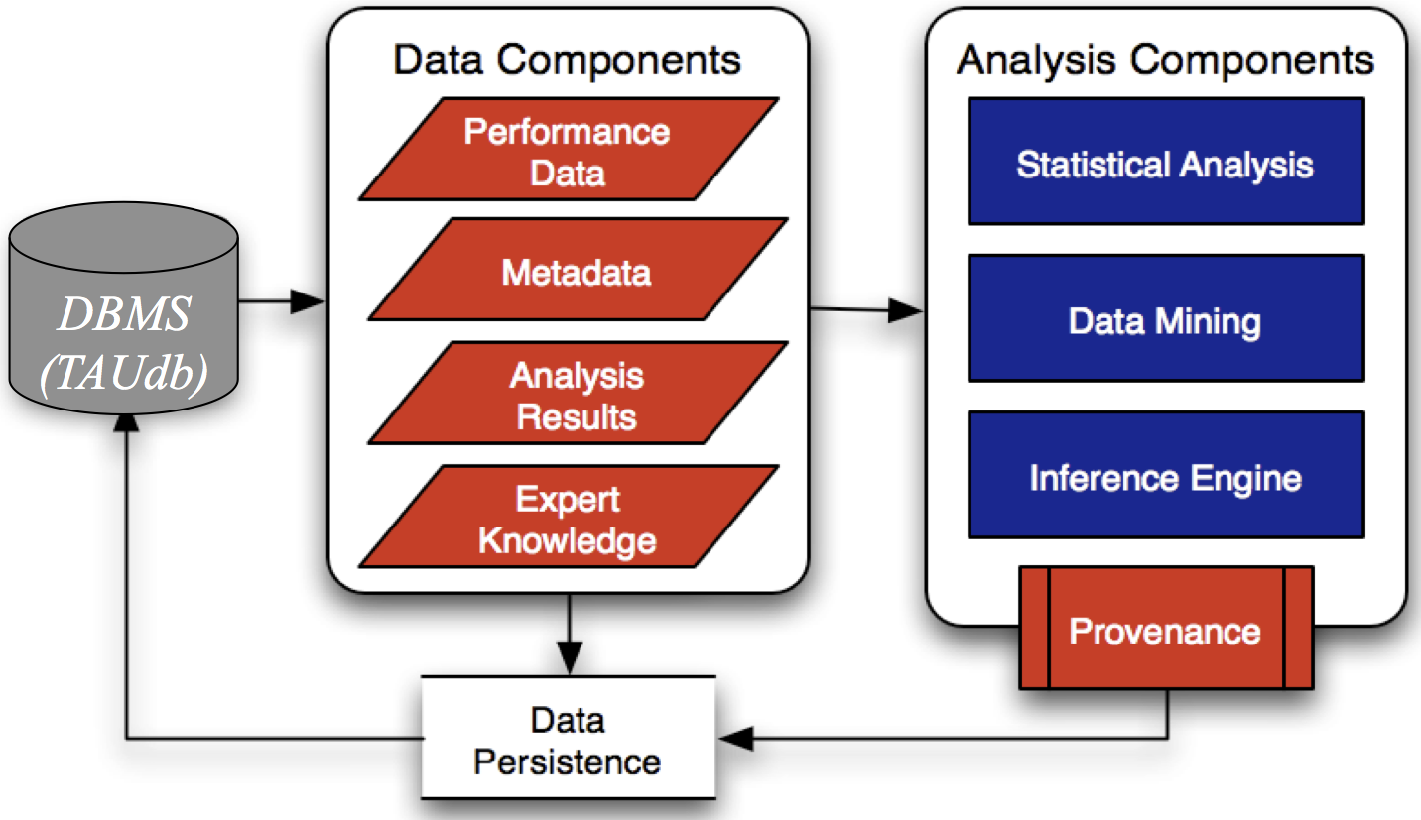
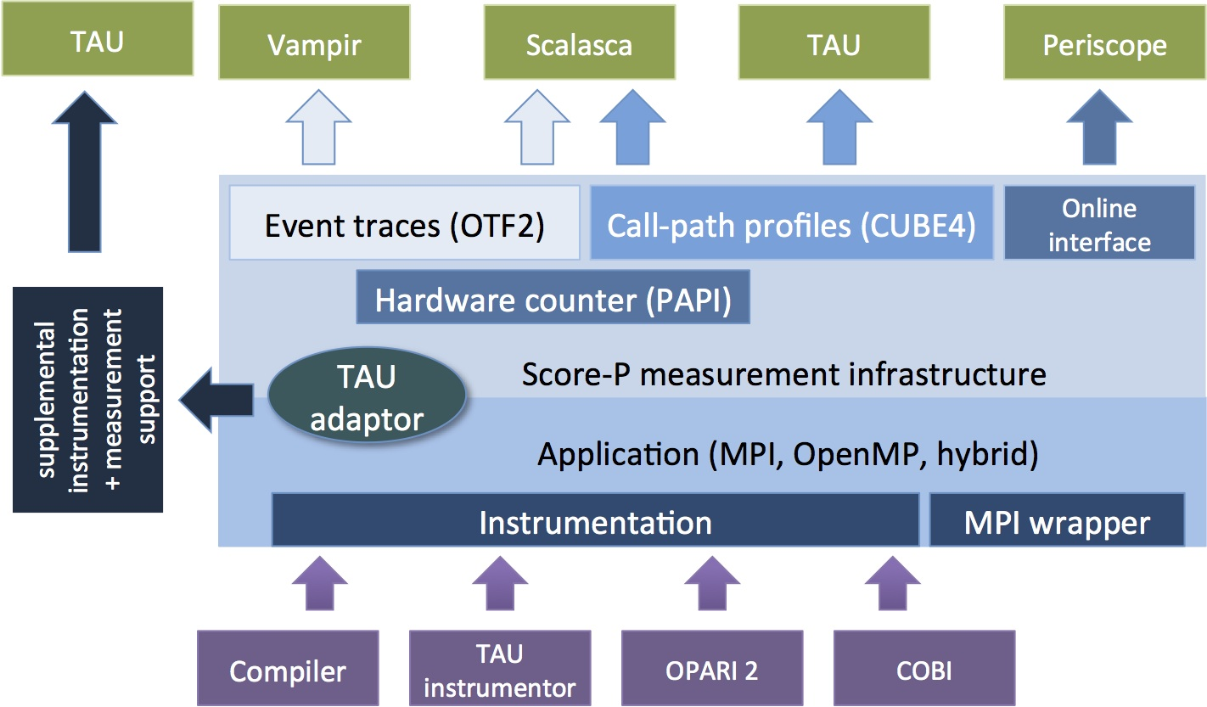
Advances in TAU Technologies
TAUdb
ParaProf
TAU + Scalasca Score-P
PerfExplorer
Notes:
Pictures of 4 cores TAU components
TAU + Scalasca -> Score-P
* emphasizes our joint work with Research Centre Juelich
* delivered a core measurement system infrastructure
* jointly produced Score-P and continue as a major contributor
* TAU measurement system is fully compatible with Score-P
* TAU provides additional capabilities not yet included in Score-P
ParaProf
* parallel profile analyzer and visualizer
* support interactive bargraph, histogram, and 3D views
TAUdb
* robust parallel profile database
* support importing of many parallel profile data formats from other tools
* used by TAU ParaProf and PerfExplorer
* implemented by different backend database engines
PerfExplorer
* performance data mining system
* scriptable analysis
* rule-based
* automatic generation of multi-experiment performance reports

Slide 14
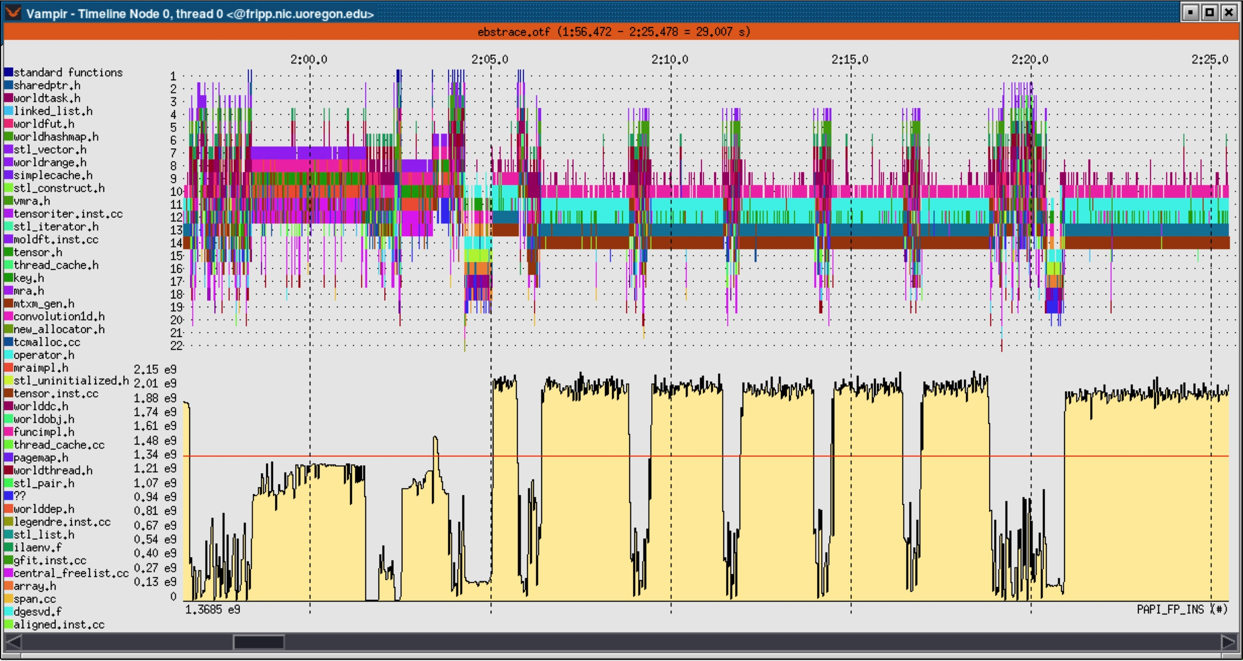
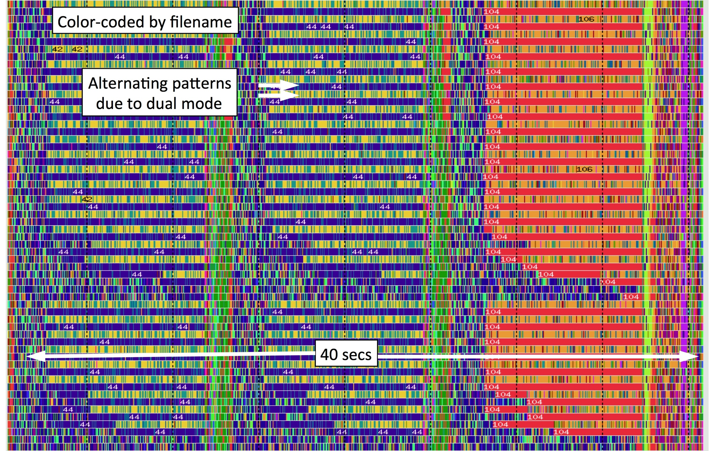
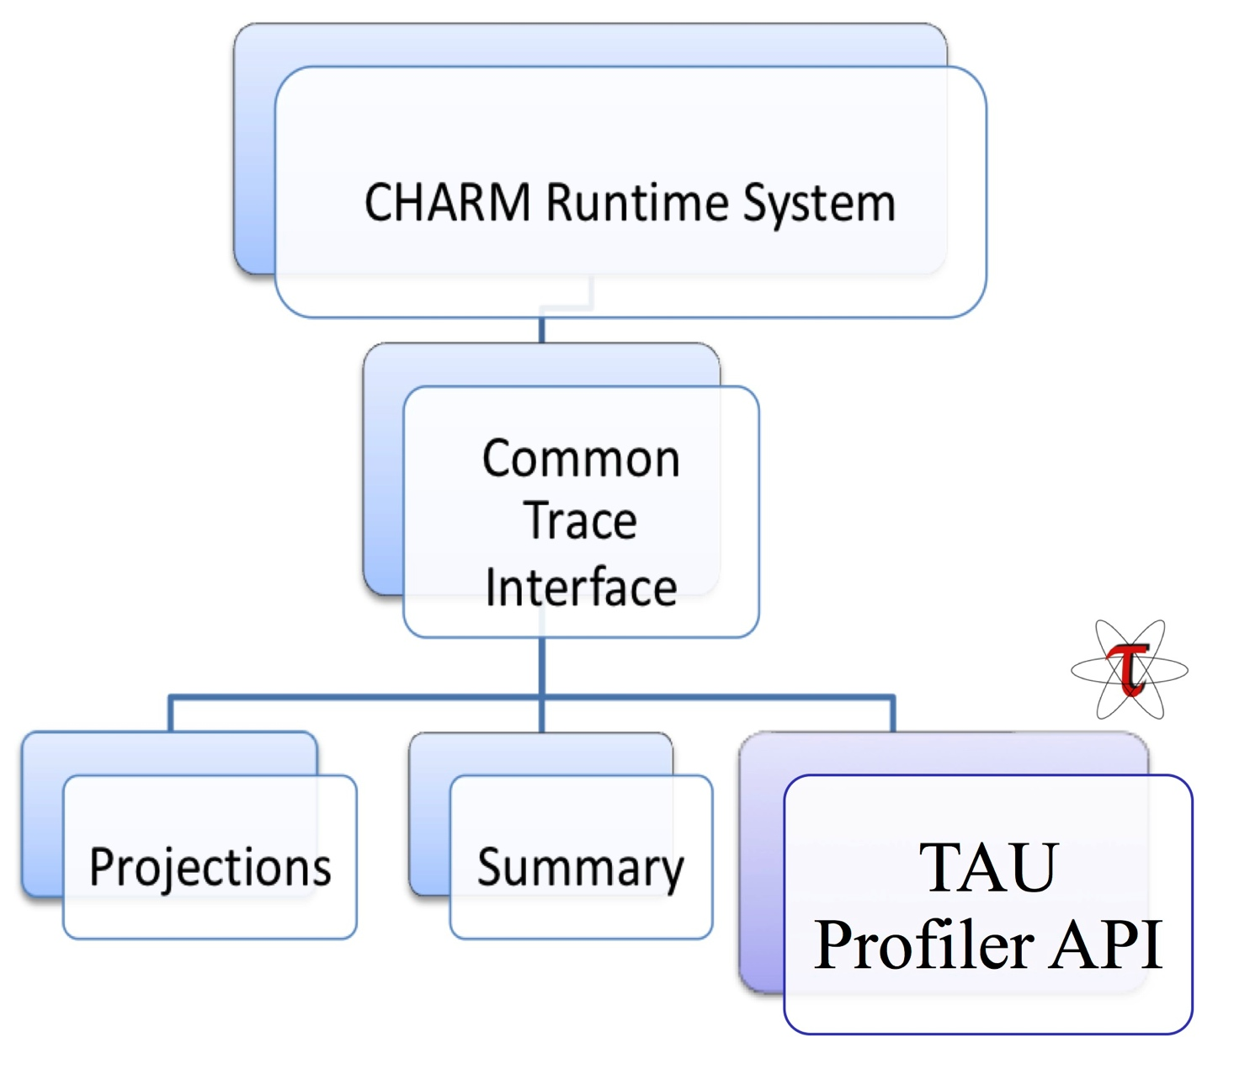
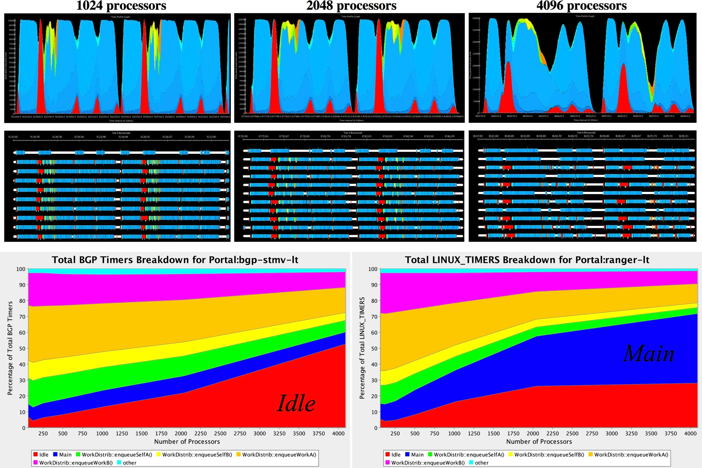
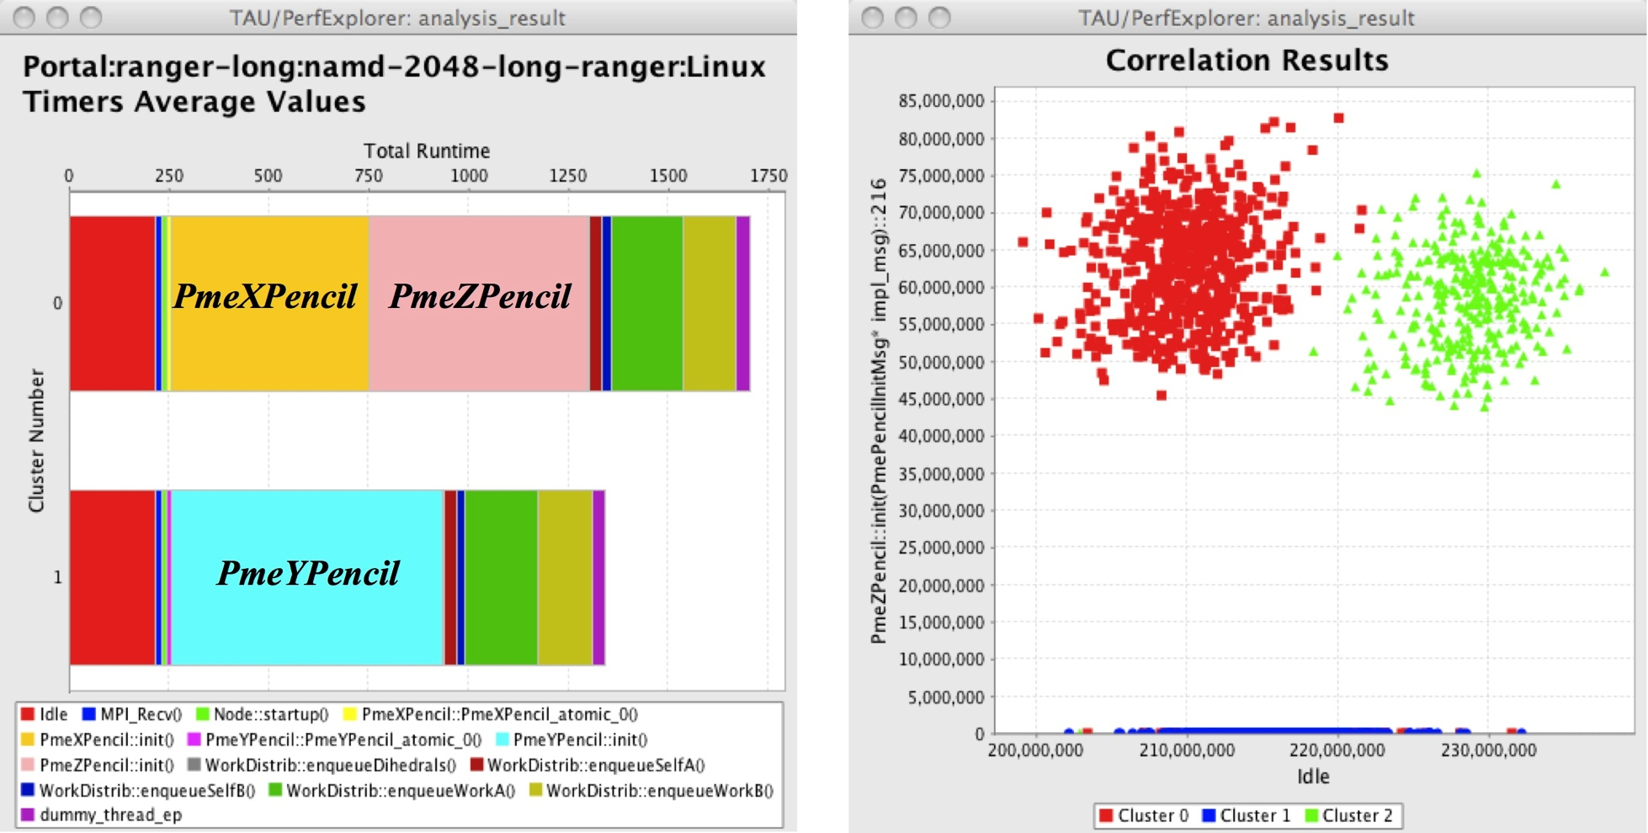
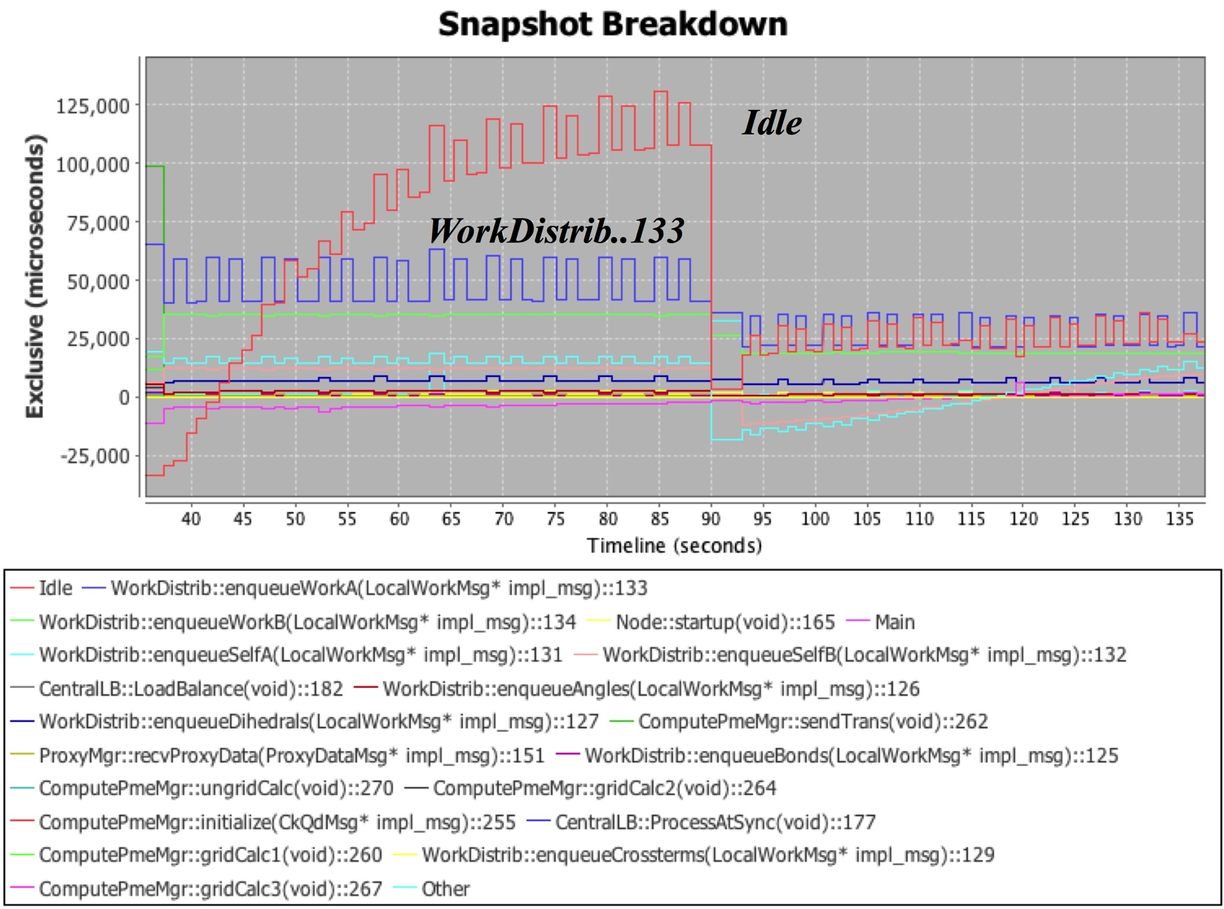
Integrated Profiling
Madness
FLASH
Phase-based profiling
Integrated hybrid profiling
  Merge sampling-based and
  probe-based measurement
  Unified context
Charm++ integration
  Projections (tracing)
  TAU (profiling)
Intrepid
Ranger
NAMD
Notes:
Shows the richness of TAU parallel profiling
Shows both ParaProf and PerfExplorer views
TAU profiling measurements provides:
* flat profiling
* callpath profiling
* phase profiling
* context-based
* probe-based measurement and sample-based measurement
* hybrid profiling: integrated probe-based and sample-based
Applications are just to show variety of use cases
Charm++ profiling integration of their Projections tool and TAU

Slide 15
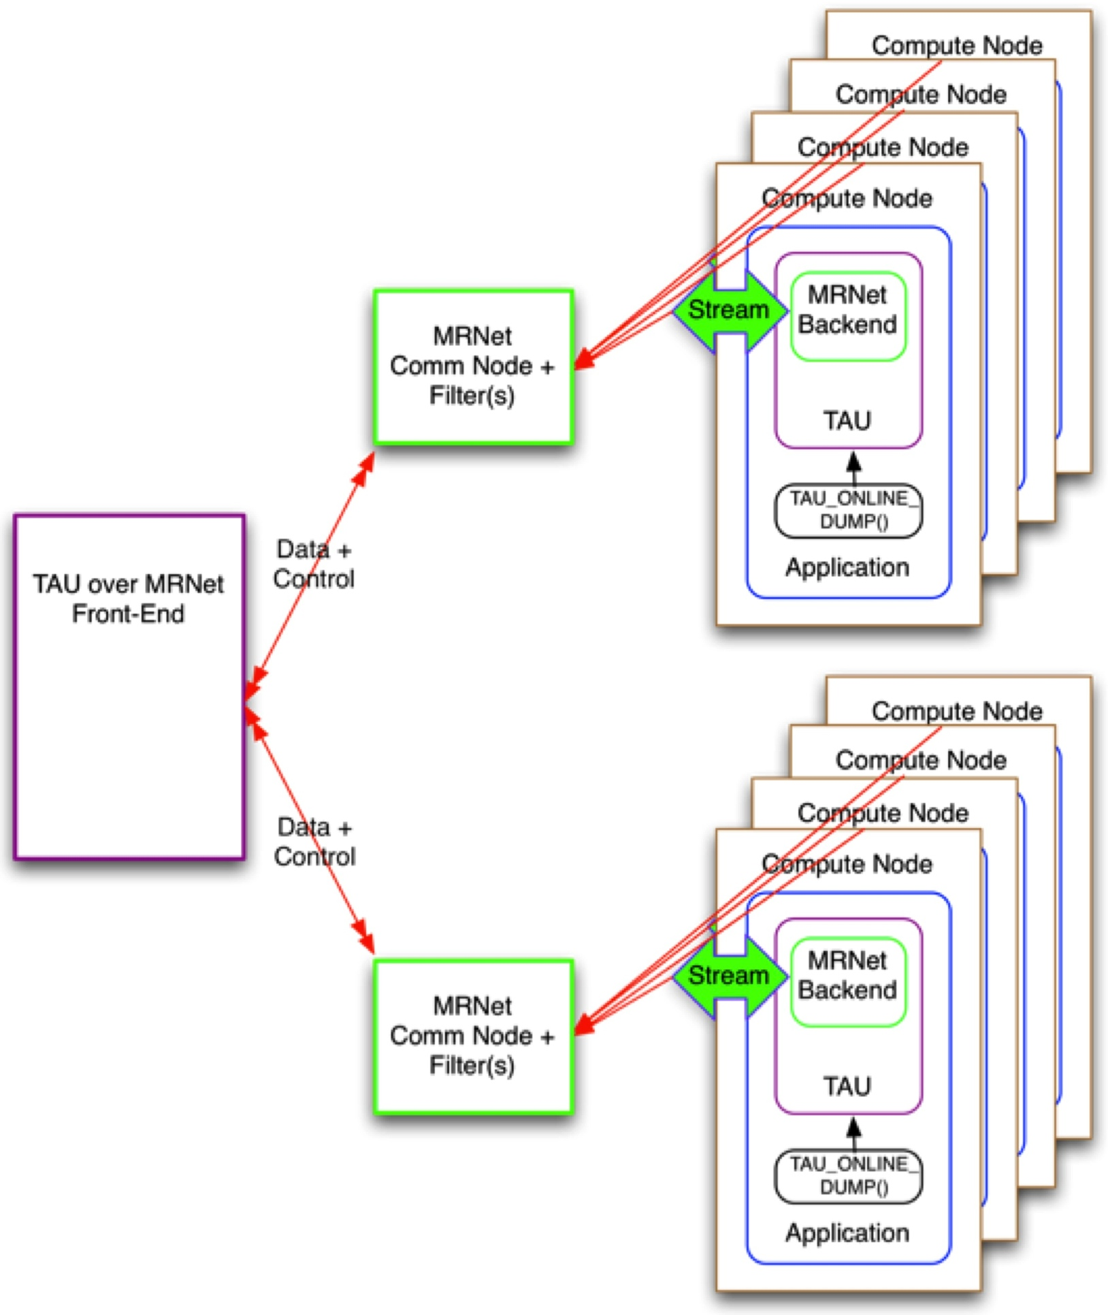
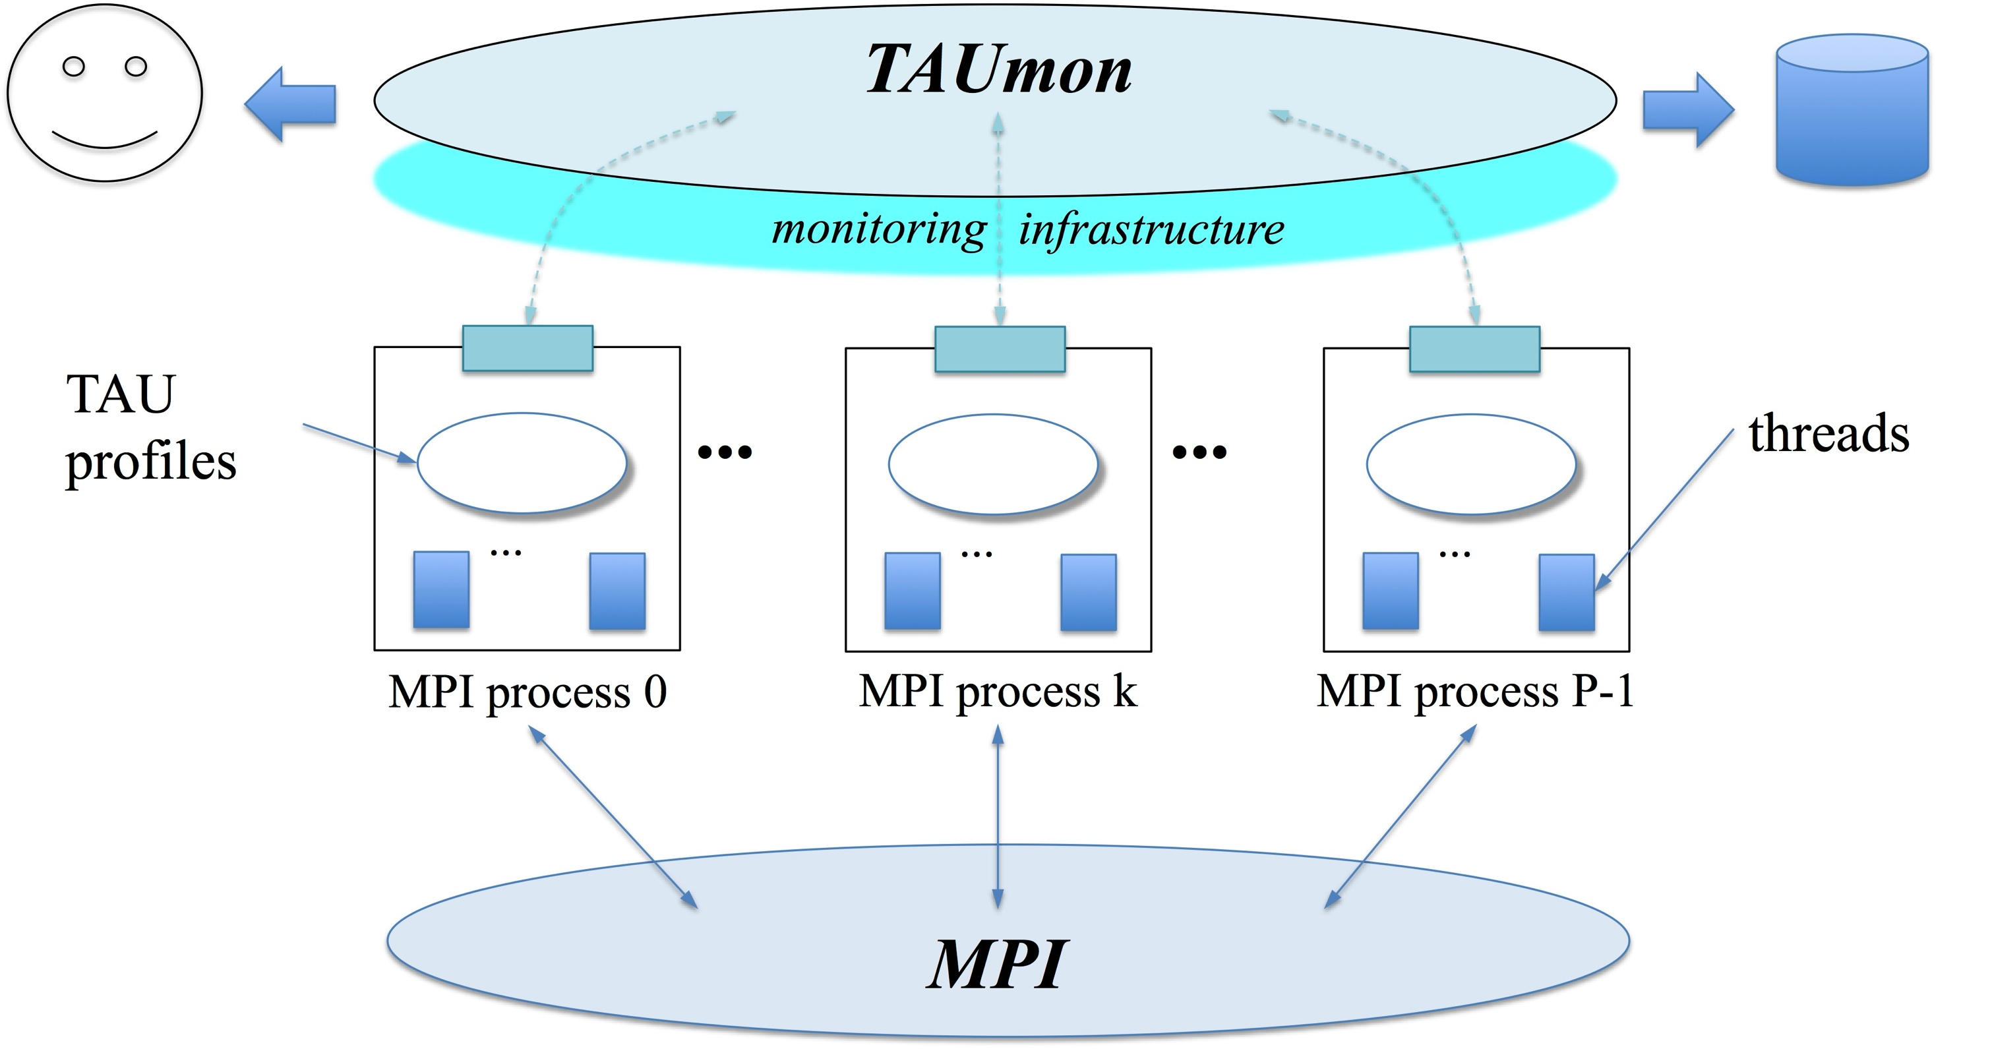
Parallel Performance Monitoring
Parallel performance state is globally distributed
  Logically part of application’s global data space
  Offline: outputs data at execution end for post-mortem analysis
  Online: access to performance state for analysis
Definition: Monitoring
  Online access to parallel performance (data) state
  May or may not involve runtime analysis
Couple with monitoring infrastructures
TAUoverSupermon
  Supermon monitor from
  Los Alamos National Laboratory
TAUoverMRNET
  Multicast Reduction Network (MRNet)
  infrastructure from Wisconsin
TAUg
  MPI-based infrastructure to provide
  global view of TAU profile data
TAUmon
  Transport-neutral (SuperMon, MRNet, MPI)
Develop online analysis methods
  Aggregation, statistics, …
Notes:
Shows a history of our attempts to develop TAU monitoring support
Objective is primarily to allow system-wide access to TAU performance data
SOS and WOWMON can be seen as an extension to this monitoring trajectory

Slide 16
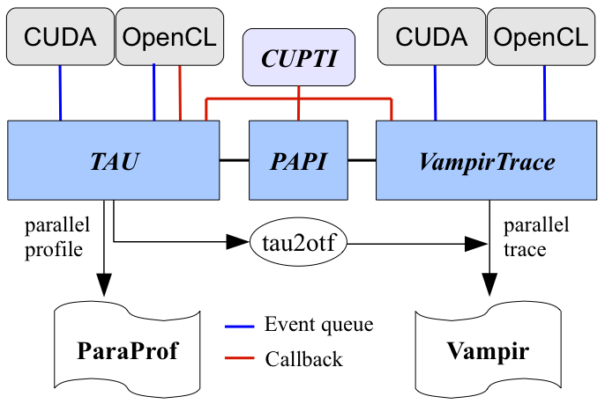
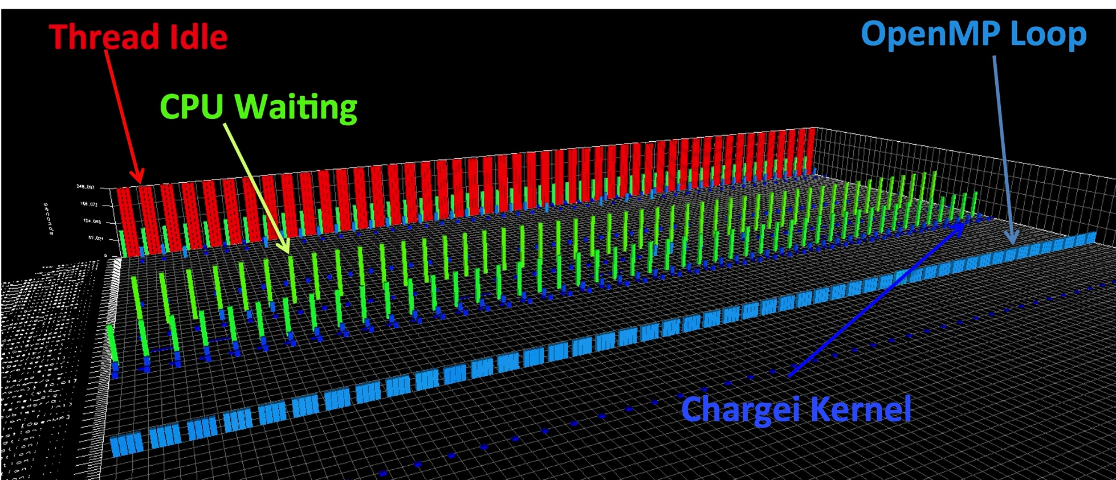
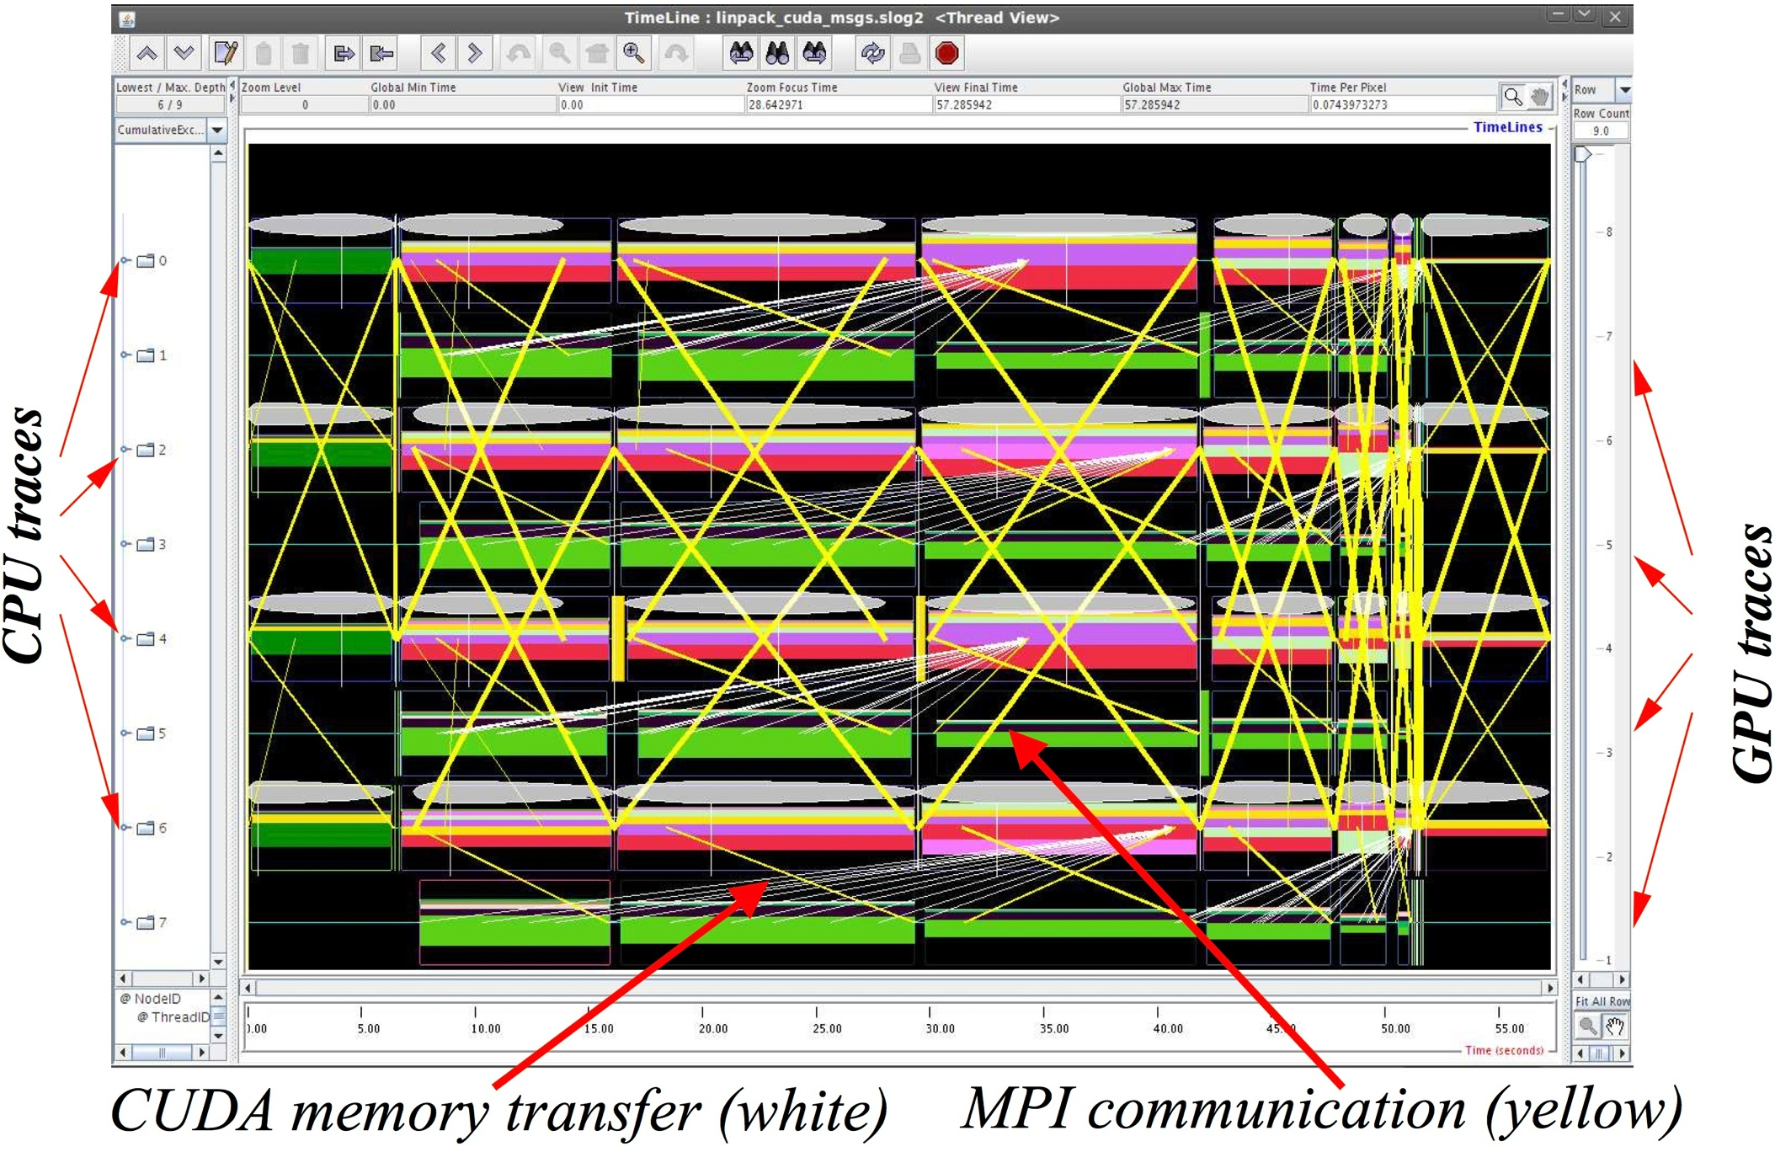
Integrated Heterogeneous Support in TAU
Integrated GPU support
  Enable host-GPU measurement
    CUDA, OpenCL, OpenACC
    accelerator compiler integration
    utilize PAPI CUDA and CUPTI
  Provide both heterogeneous profiling and tracing support
    contextualization of asynchronous kernel invocation
  Static analysis of GPU kernel
  GPU kernel sampling
Full support for Intel Xeon Phi
GTC
Notes:
Deeper-dive on what we have done with GPUs
Slide is a couple of years old
TAU continue to stay at the leading-edge of support for GPUs
* use NVIDIA CUPTI
This work is being supported by the DOE Vancouver project
GTC is also one of highlight slides

Slide 17
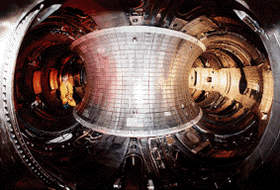
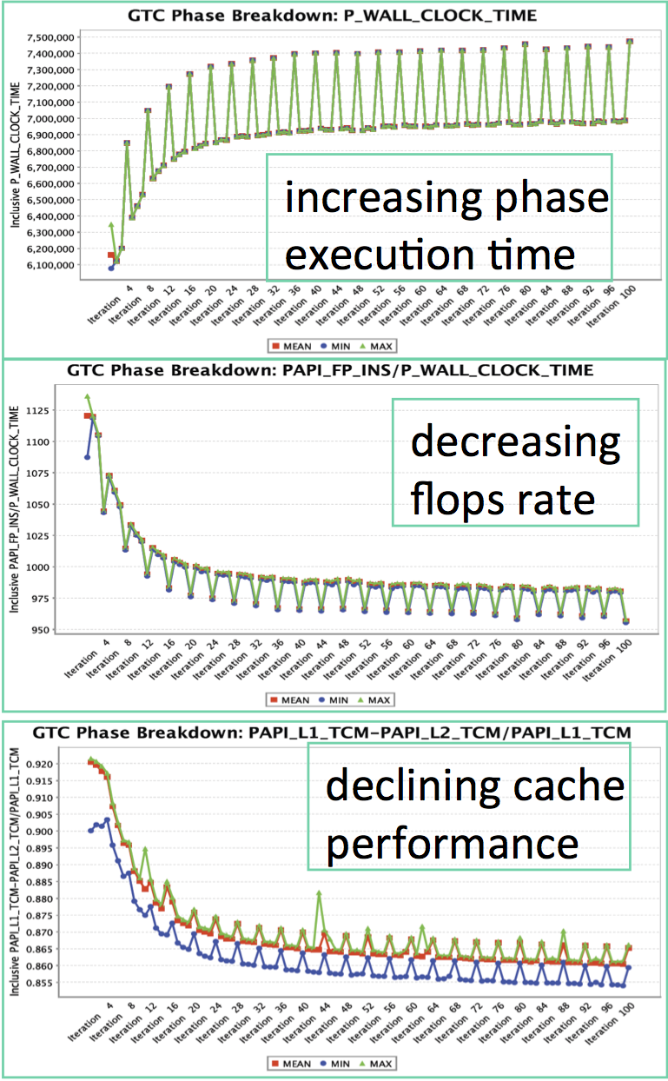
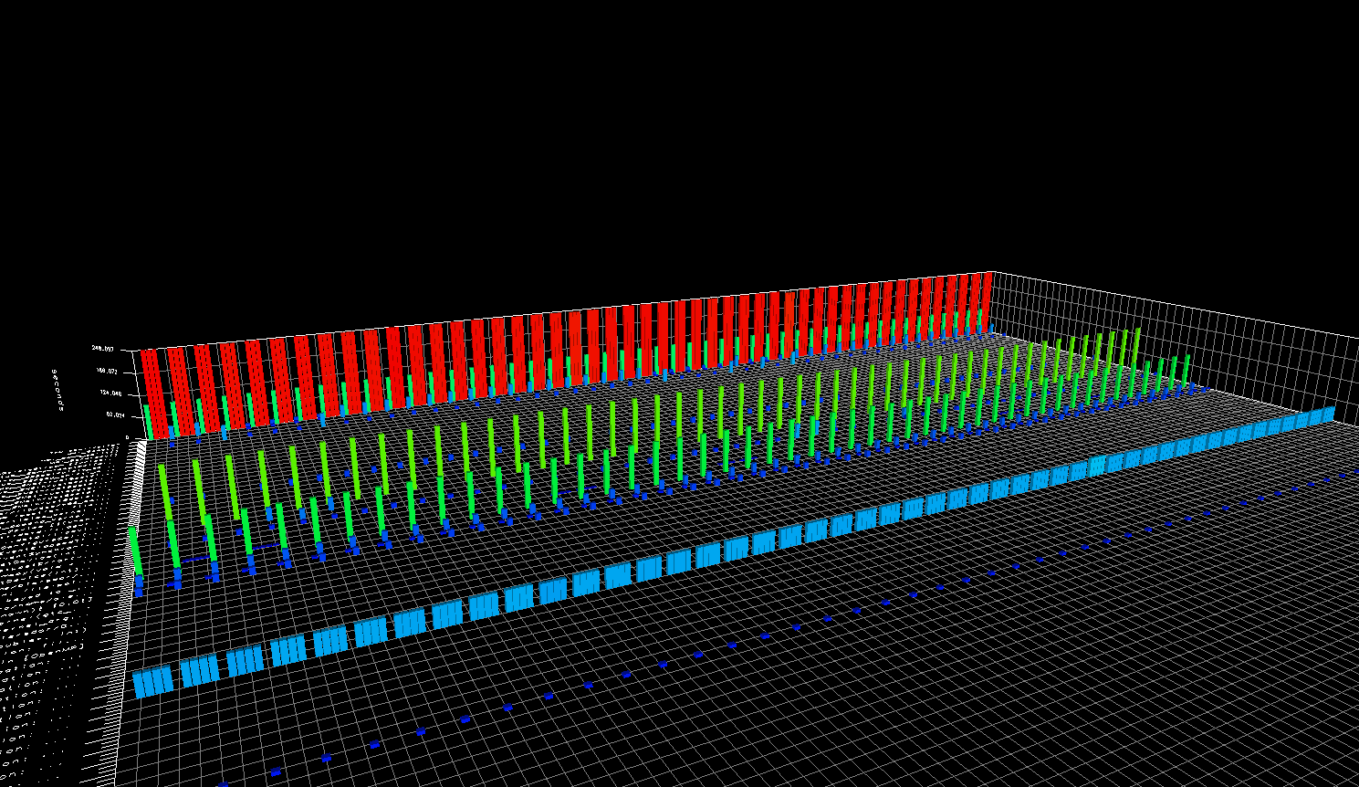
TAU Application Highlights – GTC
Gyrokinetic Toroidal Code (GTC)
  3D PIC code to study microturbulence in
  magnetically confined fusion plasmas
GTC is highly-parallelizable, but different
factors can affect its performance
  TAU was used for scaling studies on Jaguar/Titan
PIC codes can be affected by imbalances arising
during execution because of particle movement
  TAU to capture performance metrics with respect
  to application iterations
  Identified reason for declining performance
  was due to cache problems
GTC implementation on GPUs
  TAU provides integrated support for
  measurement, analysis, and visualization
  of heterogeneous performance
  MPI + OpenMP + CUDA
GTC, 240 threads profiled
CPU Waiting
Thread Idle
Chargei Kernel
OpenMP Loop

Slide 18

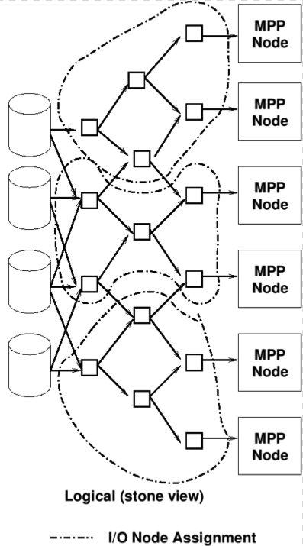
EVPath – Event Transport Middleware
http://evpath.net & http://korvo.gatech.edu/software
Open Source event processing infrastructure designed for HPC environments
Allows the construction of application-level overlay networks with embedded computation
Fully-typed data flows along the path
Very low overhead self-describing binary data
Dynamic code generation for on-the-fly processing
Flexible network infrastructure allows run-time selection and parameterization of network transport

Slide 19
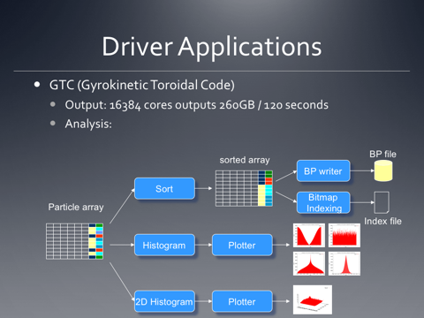
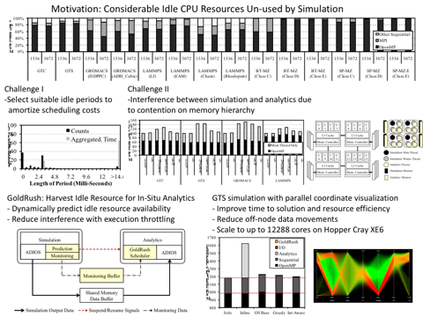
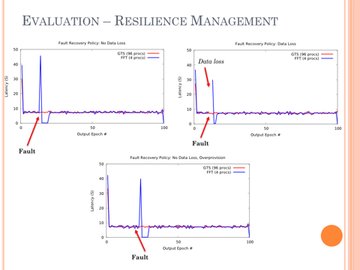
Success story
Addressing issues from Fusion and Materials science:
Predata
  Initial demonstration of MPMD Staging capability
Goldrush
  Advanced Runtime support for in situ/Staging solutions
Flexpath
  Pub/sub deployment into ADIOS w/management & resilience
ARGO/Hobbes:
  Prototype implementation of Beacon, the pub/sub framework uses EVPath.
  2 of 3 reference use cases built on our science workflows

Slide 20
EVPath key components
FFS
Fast Flexible Serialization
Direct-from-memory zero-copy marshaling
Fully transparent handling of heterogeneity
    Byte size, order, pointer size, etc.
XML-like handling of unknown /divergent data
Also used to represent state for relocatable in situ/in transit functions
  extraction, reinstantiation
EVdfg
(end-to-end DFG creation and management)
EVPath
EVpath
Event transport / data reduction / processing
Connection Manager
Point-to-point messaging
FFS
Marshalling& State mgmt
CoD
Dynamic code generation
Dynamically Loaded Network Transports
Sockets
RDMA
(IB, NNTI, UGNI)
Reliable UDP
SharedMemory

Slide 21
EVPath key components
CoD
“C-on-Demand” is a domain-specific language for event data manipulation
Dynamic code generation
  Subroutine-based compilation
  Insert native opcodes directly into memory for execution
  Supports x86, x86_64, ARM, POWER, and legacy architectures
Allows for mobile computation at the speed of compiled code
Used to move computation to data
  In situ
  In transit
  General opportunistic relocation of processing
EVdfg
(end-to-end DFG creation and management)
EVPath
EVpath
Event transport / data reduction / processing
Connection Manager
Point-to-point messaging
FFS
Marshalling& State mgmt
CoD
Dynamic code generation
Dynamically Loaded Network Transports
Sockets
RDMA
(IB, NNTI, UGNI)
Reliable UDP
SharedMemory

Slide 22
EVPath key components
Network Transports
Transparently pluggable network-level data transport
Configurable on application start, or message-by-message through event attributes
Flexible buffer management
New transports added easily
  Service oriented architecture aids software sustainability
  Libfabric
  UCX
EVdfg
(end-to-end DFG creation and management)
EVPath
EVpath
Event transport / data reduction / processing
Connection Manager
Point-to-point messaging
FFS
Marshaling& State mgmt
CoD
Dynamic code generation
Dynamically Loaded Network Transports
Sockets
RDMA
(IB, NNTI, UGNI)
Reliable UDP
SharedMemory

Slide 23
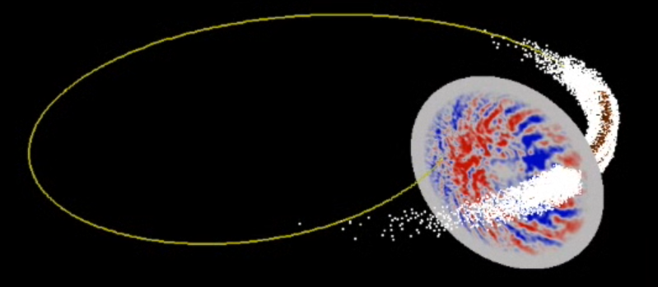
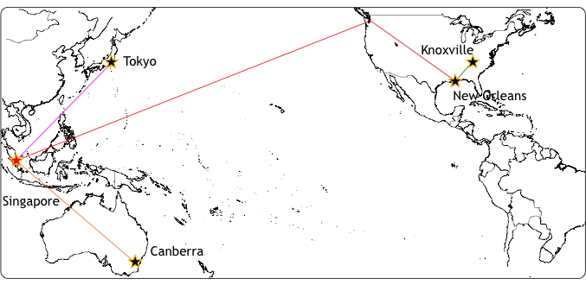
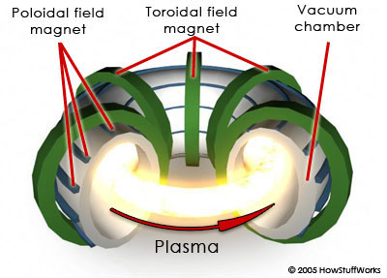
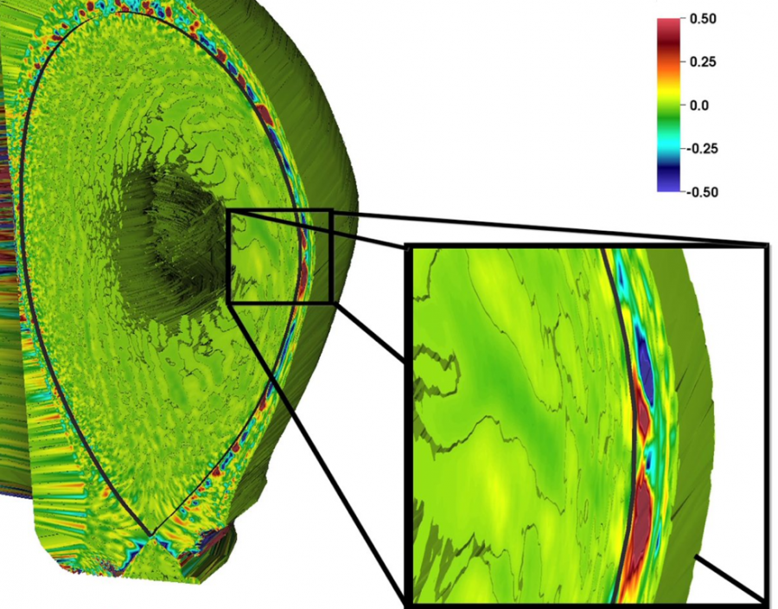
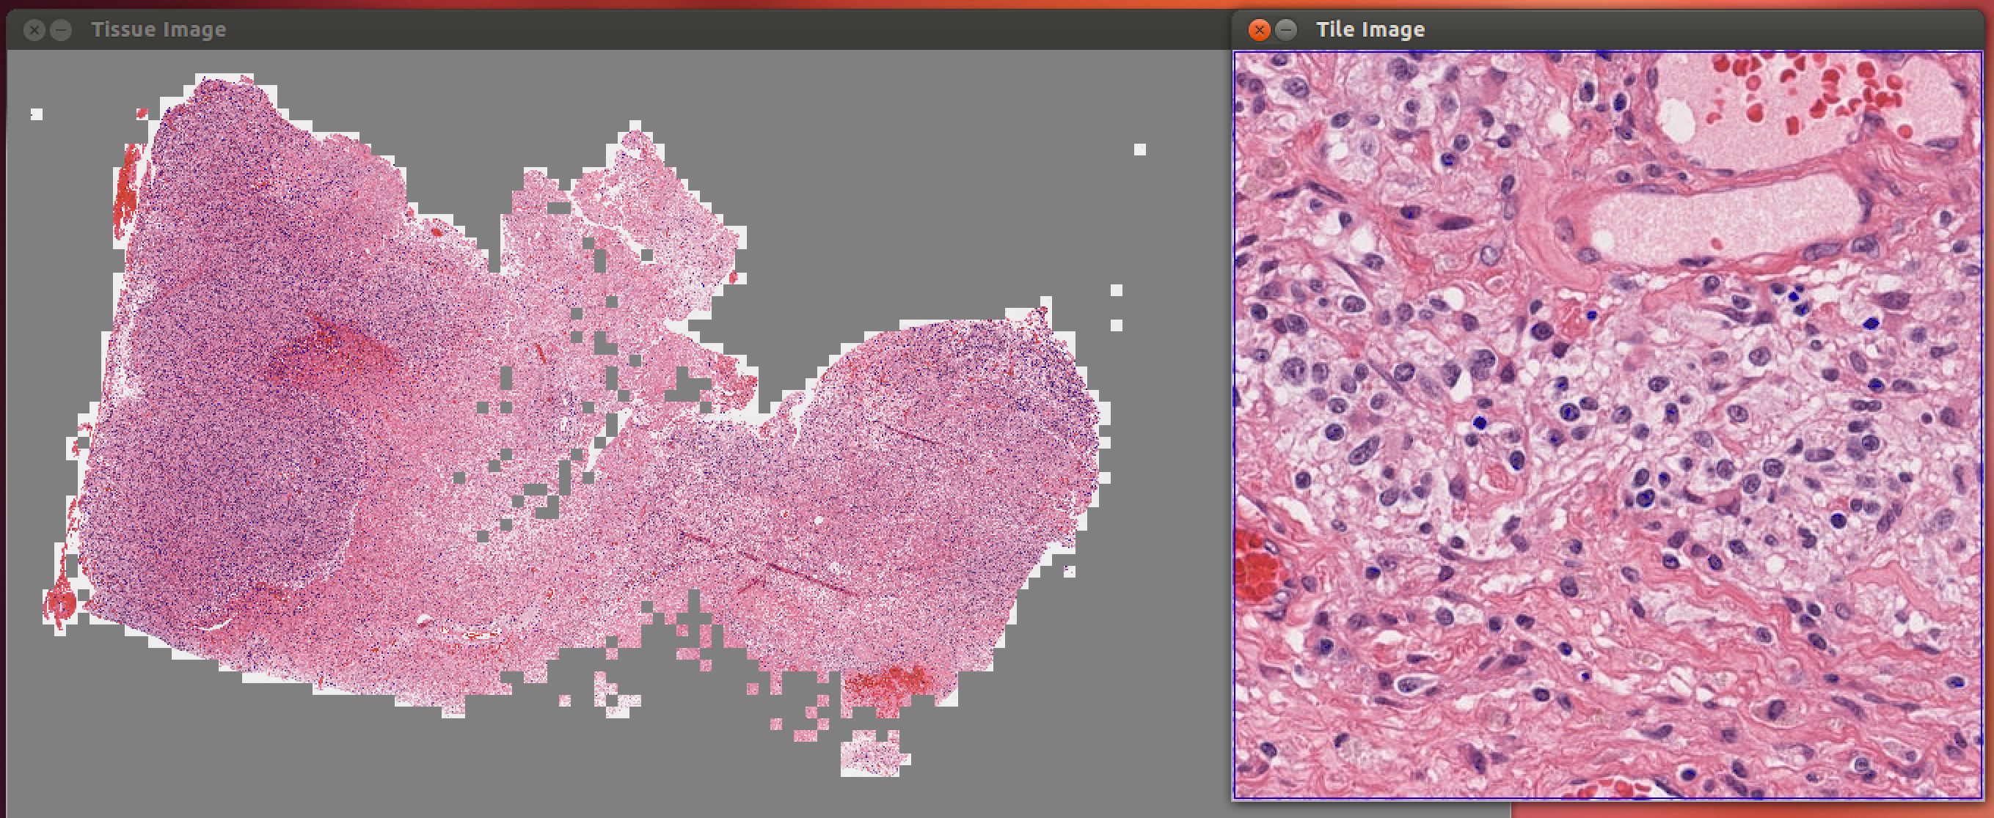
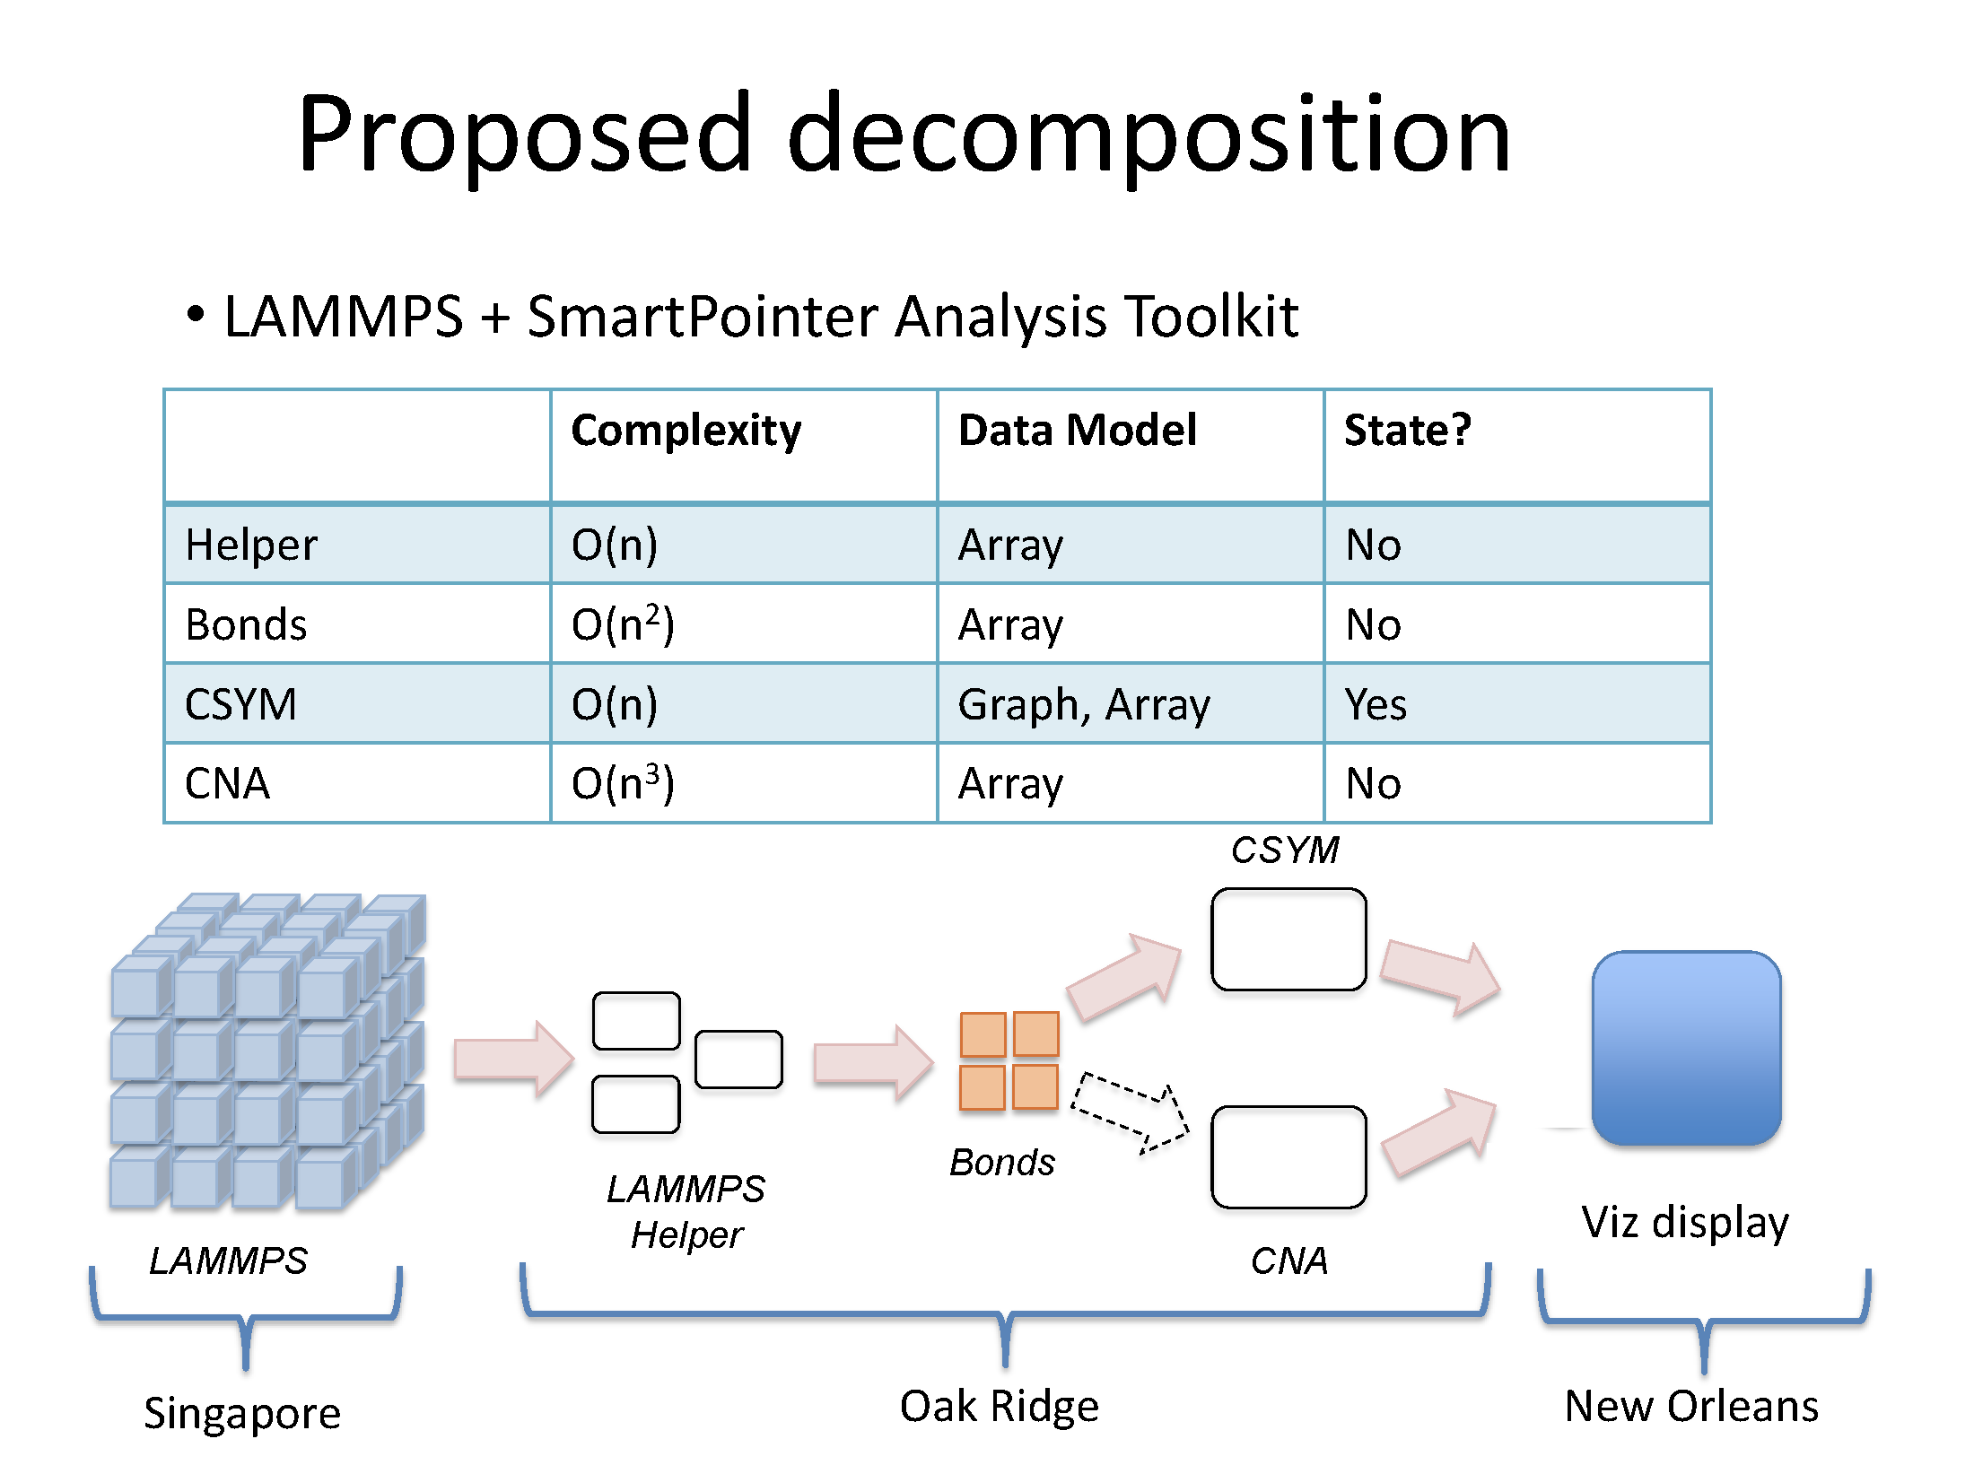
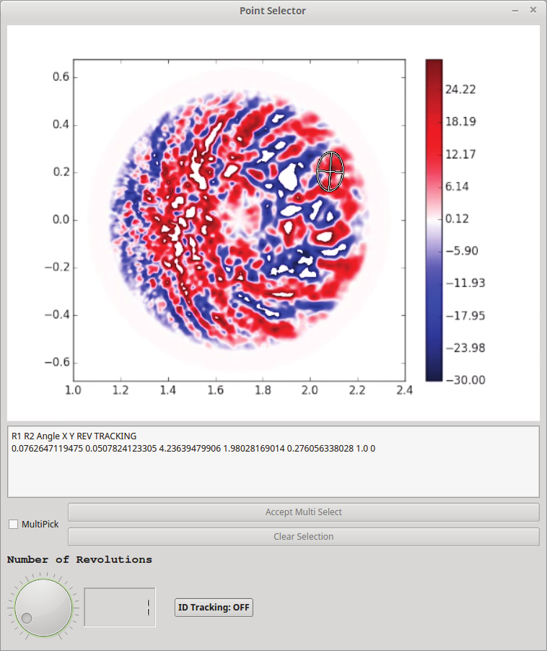
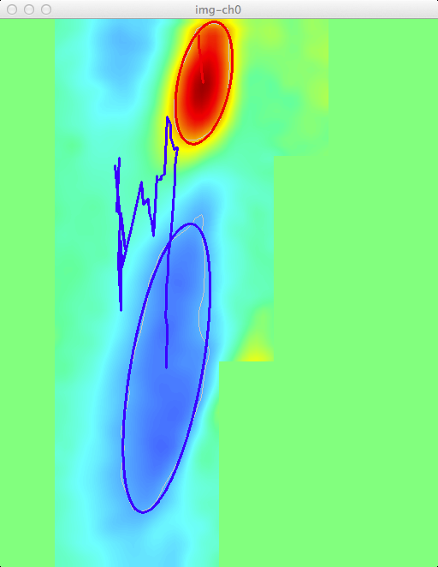
SC2014/15 Demos using EVPath
Concurrent Supercomputing using Trans-continental InfiniBand
Molecular Dyamics - Design of Materials
Near Real Time Detection of Fusion Blobs
KSTAR ECEI Sample Workflow
Microscopy Image Analysis
Visualization and Analysis for Near-Real-Time Decision Making in Distributed Workflows
Notes:
Run through these quickly, EVPath has been quite successful on it’s own

Slide 24
ADIOS in MONA
Adaptable I/O System middleware for data transfer in online and offline workflows
Multiple I/O methods for to-disk and to-memory output
Streaming format support with ADIOS-BP and FFS
Inline compression/decompression to manage data volumes
Integrated with a large number of leadership applications
Self describing data formats
Application semantic information added to data stream
Additional ADIOS information presented in ADIOS/RSVP talk by Scott Klasky

Slide 25
Instrumenting ADIOS
Instrumentation hooks to track data movement in workflows
  Adds knowledge about how much data movement is caused by which variables
Use semantic information to track key variables
  Application input parameters stored alongside performance data
Tracking internal memory used for buffering
  Size and memory residency timing information
Track real time frequency of data outputs
  Provides insight into how long asynchronous operations can take
Track read access patterns and frequencies
  Patterns used to optimize data organization for workflow
Inline transformation support
  Will be augmented with greater support for COD

Slide 26
Embedding Performance Data
Runtime extensible format
  Attributes added to describe performance data associated with each timestep
  Attributes are exposed to entire workflow for online analytics
  Attributes are stored with dataset for offline analytics
  Data and performance metadata is linked for more relevant analysis
ADIOS characteristics
  Statistics for variables stored as metadata for querying
  Results of online analytics stored as characteristics to allow querying
  Aggregate and transmit characteristics through the workflow

Slide 27
Enabling Performance Analytics
Ties to new metrics
Cannot take all monitoring data
  Need to have reduction/information extraction
The in situ and code coupling components have very dynamic performance profiles
  Initial results indicate there likely isn’t a single good metric.
  Need support for dynamic decisions

Slide 28
Long-term Engagement with Science – Codes/Scientists
Fusion:
  XGC1 (CS Chang),
  GTS (S. Ethier),
  GTC-P (B. Wang)
  Pixie3D (L. Chacon)
Materials
  Warp, LAMMPS (several)
  Ab Initio Methods (several)
Atmospheric Modeling
Combustion
  S3D (J. Chen)
  AVF-Leslie3D (S. Menon)
Each Collaboration has focused on bridging beyond capabilities of traditional monolithic MPI codes
In-line application and system monitoring, steering, performance understanding, non-SPMD executions
Led to tools like ADIOS (I/O), TAU (performance understanding), FlexPath (in situ/in transit support for ADIOS)
Notes:
The MONA team is not starting from scratch. We have long term engagements with scientists

Slide 29
Building on past investments
1998 – “Program Steering: From Interactive Programs to Distributed Laboratories'', NSF New Technologies Program.
2002 – “NetReact Services: Middleware Technologies to Enable Real-time Collaboration Across the Internet'', National Science Foundation.
2005 – “Service Paths - Optimizing end-to-end Behaviors in Distributed Service Architectures’’, NSF.
2006 - "Collaborative Research: Peta-scale Storage for High End Computing", NSF HECURA Program.
2009 – “Research Foundations for Exascale Computing Systems'', Oak Ridge National Laboratories, Computing Science and Systems (CSSD).
2011 – “Data Staging on Future Platforms: Systems Management for High End Machines'', Sandia Labs.
2012 – “A Glass Box Approach to Enabling Open Deep Interactions in the HPC Toolchain’, NSF SI2-SSI.
2012 – “Scalable Data Management, Analysis, and Visualization (SDAV)'', DOE SciDAC Institute, ASCR.
2012 – “Combustion CoDesign Center'', Department of Energy, ASCR.
2013 – “Hobbes: OS and Runtime Support for Application Composition'', DOE, ASCR.
2013 – “RSVP: Runtime System for I/O Staging in support of Voluminous in-situ Processing of extreme scale data'', DOE, ASCR.
Notes:
The Georgia Tech team has been working in this space for many, many years.

Slide 30
TAU History
1992-1995: DARPA pC++ (Gannon, Malony, Mohr). TAU (Tools Are Us) is born.
[parallel profiling, tracing, performance extrapolation]
1995-1998: Shende Ph.D. (performance mapping, instrumentation). TAU v1.0.
[multiple languages, source analysis, automatic instrumentation]
1998-2001: Significant effort in Fortran analysis and instrumentation, work with
Mohr on OpenMP, Kojak tracing integration, focus on automated performance
analysis. [performance diagnosis, source analysis, instrumentation]
2002-2005: Focus on profiling analysis, measurement scalability, and perturbation
compensation. [analysis, scalability, perturbation analysis, applications]
2005-2007: More emphasis on tool integration, usability, and data presentation. TAU
v2.0 released. [performance visualization, binary instrumentation, integration,
performance diagnosis and modeling]
2008-2011: Add performance database support, data mining, and rule-based analysis.
Develop measurement/analysis for heterogeneous systems. Core measurement
infrastructure integration (Score-P). [database, data mining, expert system,
heterogeneous measurement, infrastructure integration]
2012-present: Focus on exascale systems. Improve scalability, heterogeneous
support, runtime system integration, dynamic adaptation. Apply to petascale /
exascale applications. [scale, autotuning, user-level]
Observability
Diagnosis
Complexity
Exascale
Notes:
Long history of TAU evolution and innovation
Much of this history has been driven by DOE mission
Worked with many DOE projects along the way
Just use to give folks a feeling of long-term, dedicated research and development

Slide 31
Putting it together: SOSflow Prototype 2.0
❑ HPC platform service
  ❍ Single instance, system wide
  ❍ Serves applications, RTS, OS
  ❍ Shares metrics and analysis
  ❍ Framework-like interaction
  ❍ (Possible) dedicated resources
❑ SOS monitors coordinate node to analysis cloud interactions
  ❍ Any process on node can expose data via SOS
❑ SOS cloud self organizes to efficiently process data
❑ Control can go directly to interested processes
❑ Develop SOS MPMD MPI prototype
  ❍ Running on BG/Q, Cray, and Linux platforms
  ❍ Use for testing and experimentation

Slide 32
SOSflow – next steps
Tighter integration with TAU
Native EVPath event transmission for analysis
Provide API wrapper for additional languages (Python) to integration events and metadata from non-compiled script sources
Develop and validate a set of synthetic benchmark workflows for use in future workflow management system designs
Deep-semantic instrumentation of common workflow components:
  MPI
  ADIOS
  Swift/T (et al.)
  Visit + VTK and VTK-m

Slide 33
Expected Outcomes of MONA
Tools and techniques for Efficient Workflow Performance Characterization
Performance Proxies for Data Management Workflows, and
A Deep Understanding for Workflow Behavior and the Effects of Workflow Control, on- and across-nodes, for the Exascale Regime.

Slide 34
Beyond MONA: success at Exascale
It will be important for Exascale to provide performance awareness at all levels of the hardware and software so that performance issues can be identified and resolved at runtime
We propose to contribute to ECP by:
  Building advanced performance tools for heterogeneous exascale architectures, technologies, and ultimately ECP-specified platforms
  Developing scalable performance introspection and in situ performance analytics that can provide whole systems observation
  Creating online, dynamic performance tuning, adaptation, and control
  Integrating performance techniques and tools in exascale program development environments, autotuning systems, and runtime systems

Slide 35
Exascale Research Challenges
  ECP systems are anticipated to be heterogeneous, combining high-performance manycore processors with accelerator devices, hierarchical memory, networking, and I/O infrastructure
  It will be important for exascale to provide performance and power usage awareness at all levels of the hardware and software so that performance and energy issues can be identified and resolved at runtime
  Increased performance complexity in hardware and software requiring more support for automated performance
  Higher degree of system variability and execution dynamics requiring more dynamic runtime observation and adaptation
  Multi-objective multi-stage workflow optimization requiring greater runtime and system awareness

Slide 36
MONA roadmap to Exascale
2017
Create environment for complex testing
Clean code for maintainability: strong layering, data abstractions, and modular runtime
Instrumentation for memory hierarchies
2018
Support for hybrid staging
Adaptive instrumentation and analysis
Support for new programming models
Advanced Analytics models
2019
Validate workflows with models
Resilience
Support automated workflow management
Beyond 2019
Smarter data reduction models and methods
Instrumentation for evolving architectures
Provenance management
Learning for predictive resource management
Container Support
Data Lifecycle
Workflow Support

Slide 37
(start of 15 slide ECP response)
Exascale
What research do you need to get to exascale (one or two slides)
Deep memory
Highly heterogeneous
Thick/thin node swing lanes.
Stay abreast of communication technologies changing performance hot points as technology evolves.

Slide 38
Milestones (3 slides)

Slide 39
Connections
ADIOS
Sensei
Sirius?
Decaf

Slide 40
Timelines

Slide 41
Post-MONA Roadmap to Exascale
Core Challenges:
Workflow, provenance, resilience, hardware tuning/adaptation,
Maintenance and facility support
Monalytics for dynamic understanding
  Do machine learning methods make sense for exascale? Is a model-based approach better for near-time decision making? If so, what models or approaches?
What goes here? Stuff from Al's ECP response? Research...
Software development + hardening + maintenance
(Scott's note on 10% dev, 90% maintenance ? )

Slide 42
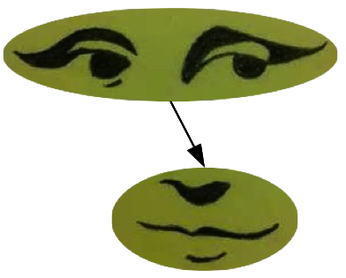
Questions?

Slide 43
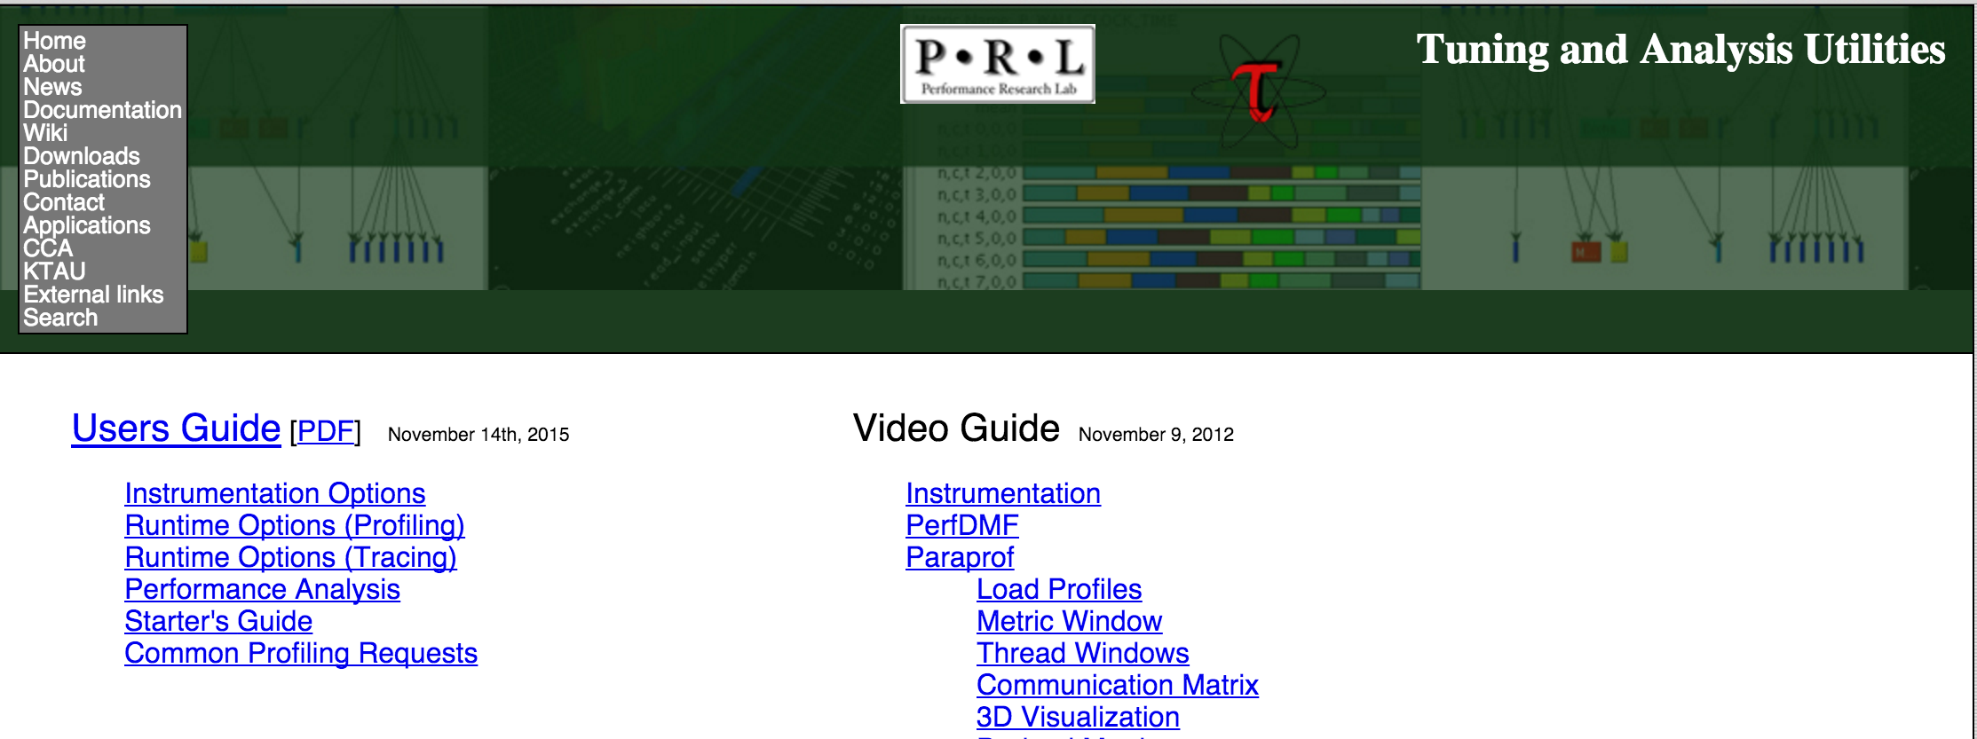
TAU software sustainability
Professional support and training is available through ParaTools, Inc.
Documentation and video guides available
Ready installed on most DOE HPC resources

Slide 44
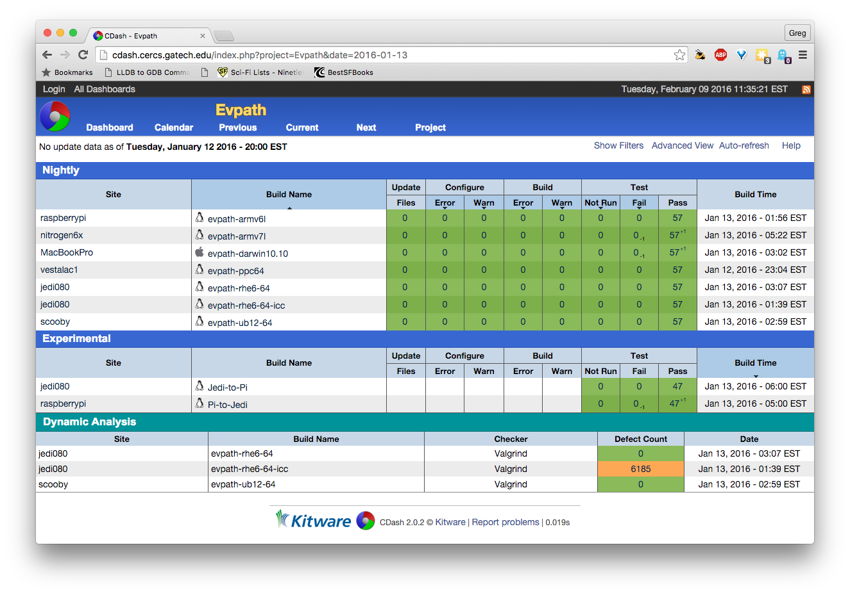
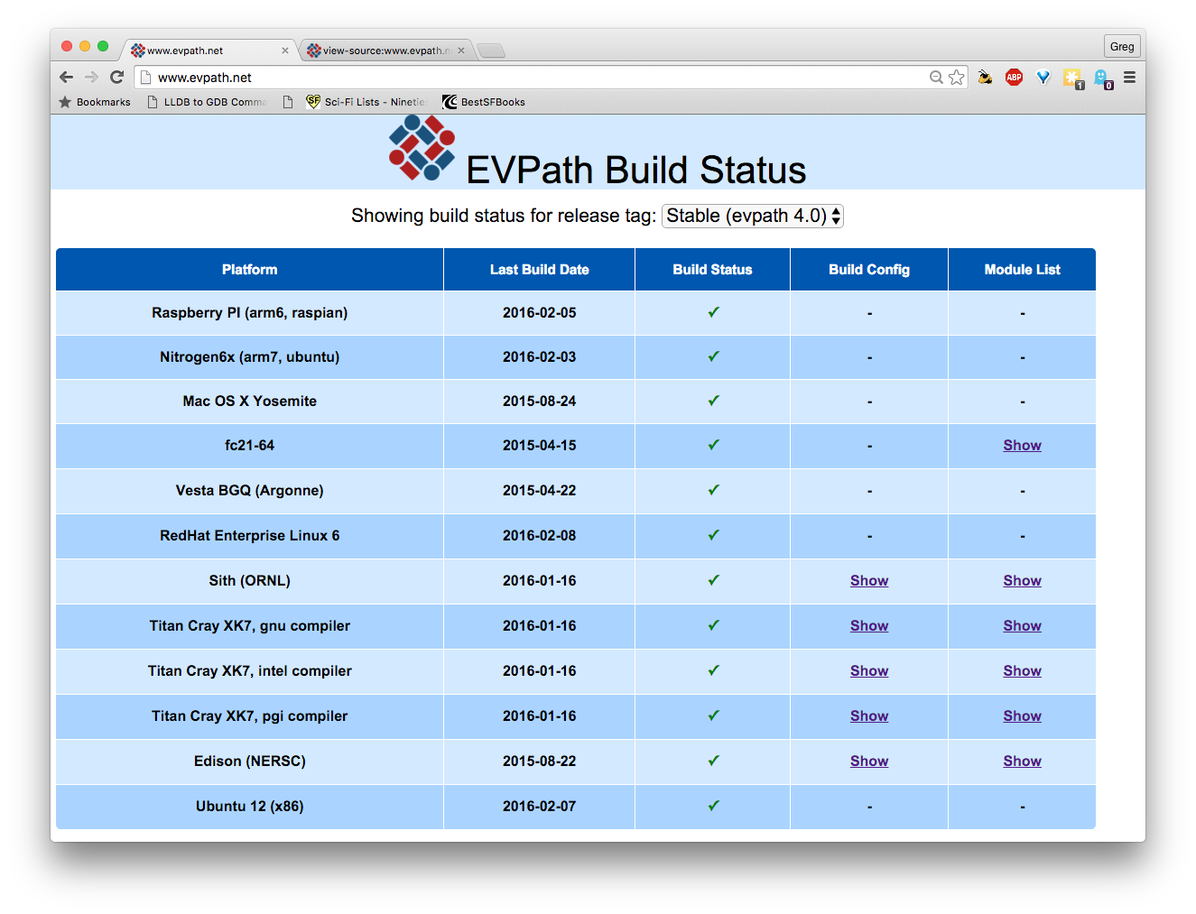
EVPath software sustainability
Currently only ad hoc support through GaTech
Nightly testing on a variety of architectures- Cdash
Build parameters, environment and status captured on Evpath.net
Training sessions
Already built on many DOE machines

Slide 45
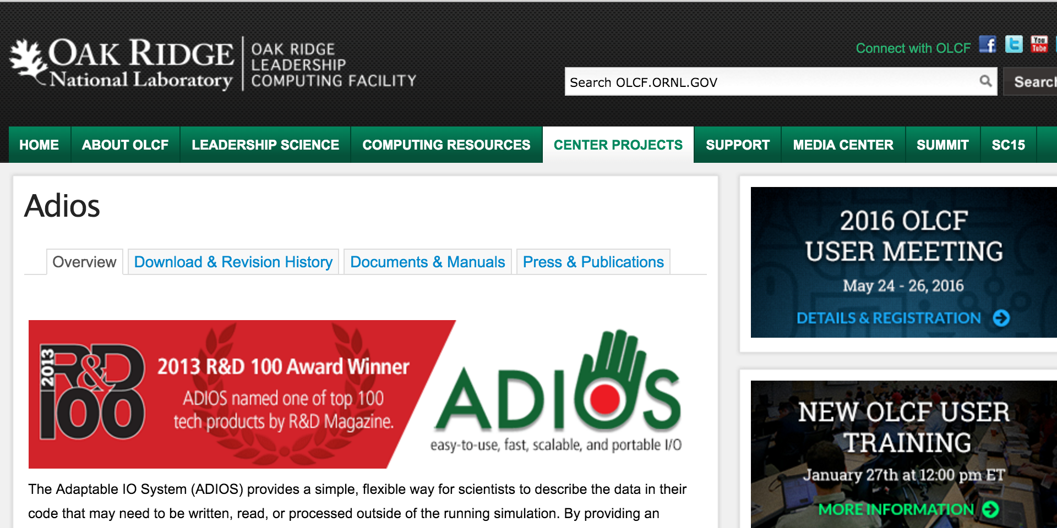
ADIOS software sustainability
Discussed by S. Klasky previously
Close cooperation with ADIOS team
  MONA integration maintained in future releases

Slide 46
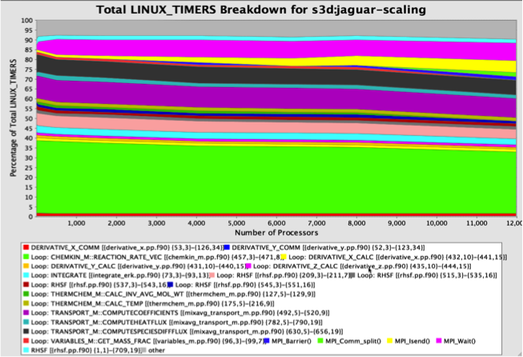
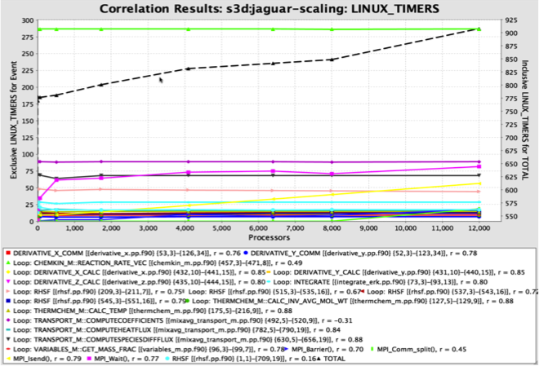
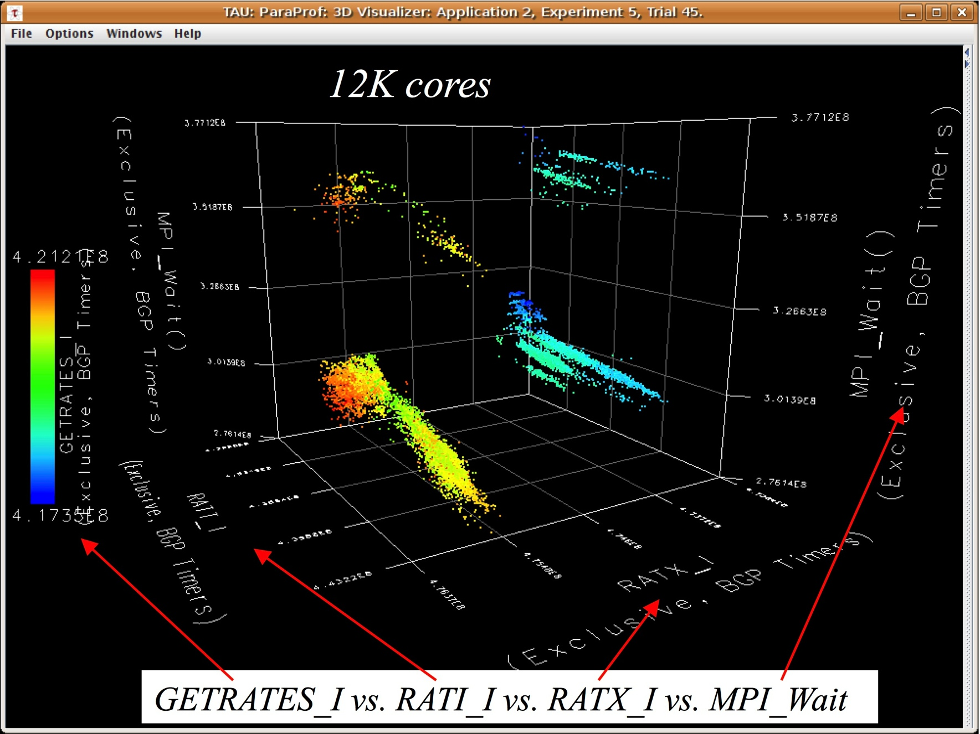
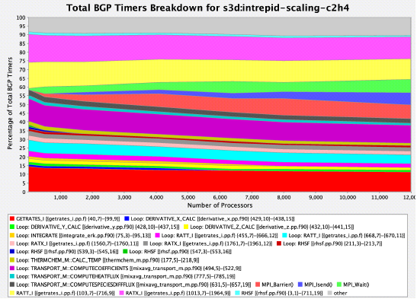
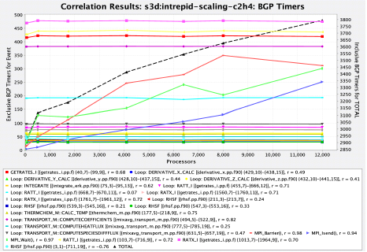
Automation and Knowledge Engineering
PerfExplorer
  Multi-experiment data mining
  Programmable, extensible framework
  to support workflow automation
  Rule-based inferences for expert system analysis
S3D scalability analysis (Jaguar, Intrepid, 12K cores)
r = 1 implies
direct correlation
Notes:
Just a deeper dive on the PerfExplorer capabilities
S3D scalability analysis example shows:
* automated multi-experiment analysis
* automated plot generation
* integration with ParaProf's 3D display to show top-correlated events

Slide 47
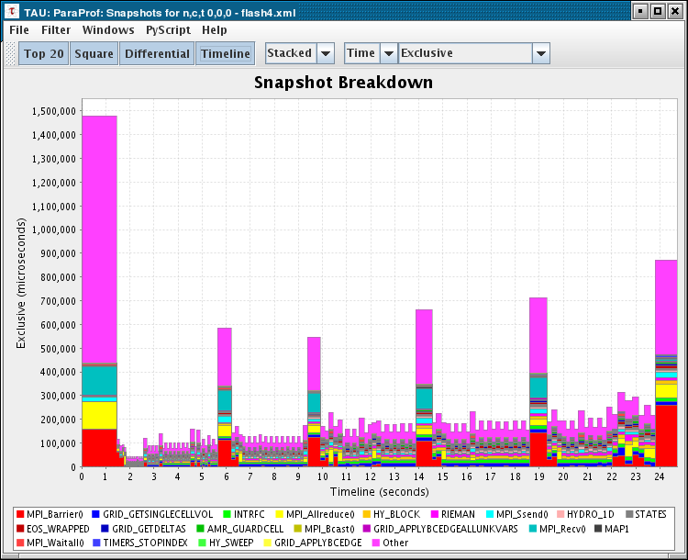
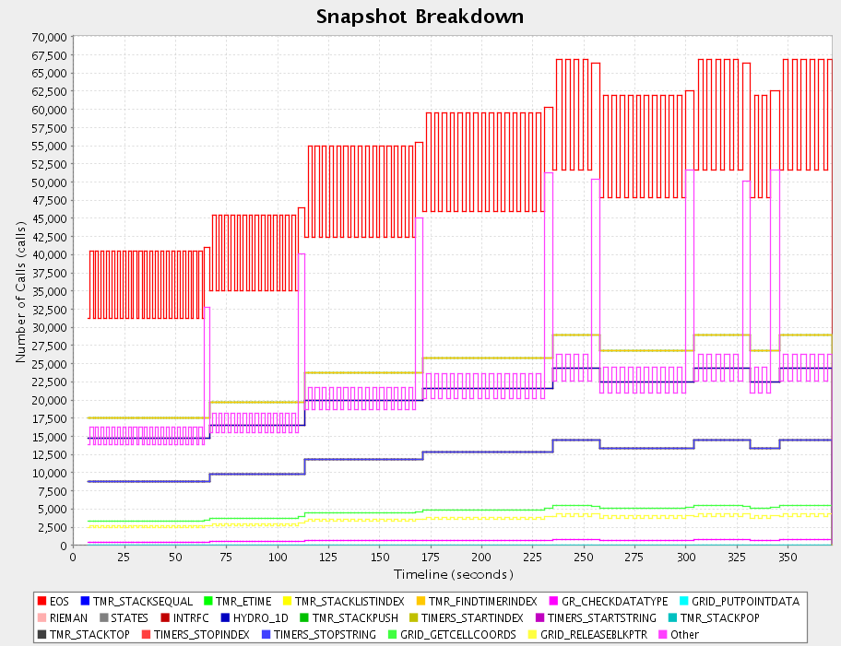
Observing Performance Dynamics
Parallel profiling is lightweight, but lacks temporal measurement
Tracing can generate large trace files
Capture performance dynamics with profile snapshots
Traces
Overhead
Profile Snapshots
Profiles
Flash 3.0
Information
Initialization
Finalization
INTRFC
Checkpointing
Notes:
Demonstrates TAU's support for capture profile dynamics
TAU implements this with:
* profile snapshots
* can also use phase profiling
Was used in FLASH to see performance changes over time

Slide 48

Cross-Platform OpenMP Performance Analysis
How do you support a common performance analysis methodology for OpenMP across systems and compilers?
Evaluate four methods for OpenMP measurement:
  POMP
  ORA w/OpenUH
  ORA w/GOMP
  OMPT w/Intel
  … all integrated into TAU
Compare performance
visibility, semantic context,
measurement overhead, and integration in analysis
ORA: OpenMP Runtime API
GOMP: GCC OpenMP implementation
OMPT: OpenMP Tools interface
Notes:
TAU supports OpenMP performance measurement and analysis
TAU implements this support for multiple runtime environments
Working closely with the OMPT tools interface
TAU is also working with the OpenUH compiler

Slide 49








TAU and Autotuning in SUPER
CHiLL
+ AH
ROSE
OpenCL
CUDA
Orio
TAUdb
Geant4
MPAS-O
CESM
XGC1
PerfExplorer
Notes:
TAU is integrated in autotuning frameworks:
* Orio
* CHill + Active Harmony
TAU is used for performance measurements, database, and analysis
TAU works with ROSE to automatically study parameter-based performance of code variants
TAUdb is shown as a central component for application engagement

Slide 50



TAU Application Highlights – IRMHD
INCITE Implicit Radiative and Magneto
Hydro Dynamical Solver (IRMD)
  Understand solar winds and coronal heating
  Argonne: T. Williams
  University of New Hampshire: J. Perez, B. Chandran
  University of Oregon: S. Shende
TAU performance optimizations
  Eliminated MPI overheads
  Improved communication overlap
  Reduced barriers and load imbalance
  Used more efficient libraries
  Over-subscribed nodes
  528.18 core hours to 70.85 core hours!
“Groundbreaking Astrophysics
Accelerated,” HPC Source, pp. 9-12, February 2013.
Mira topology
visualization of
MPI performance
Mira load
imbalance on
32K MPI ranks

Slide 51



TAU Application Highlights – OpenMC
OpenMP Monte Carlo particle transport
  Argonne: Andrew Siegel
  University of Oregon: D. Ozog, A. Malony
Compare event-based and history-based
algorithms for exploiting SIMD simulations
  Port OpenMC code to Xeon Phi cluster
TAU performance analysis informed
optimizations to OpenMC to achieve the
highest known single-node calculation rate
on a standard benchmark
  17,000 particles/second
  Done by load balancing between
  CPU + Xeon Phi processors
Achieved 95% distributed efficiency when
using 512 concurrent Xeon Phi devices
D. Ozog, A. Malony, A. Siegel,
“Full-Core PWR Transport Simulations on Xeon Phi Clusters,” Joint International Conference on Mathematics and Computation (M&C), Supercomputing in Nuclear Applications (SNA) and the Monte Carlo (MC) Method (ANS MC 2015), April 19–23, 2015.
CPU vs. Xeon
Phi performance
Strong scaling
for 10M particles

