Slide 1

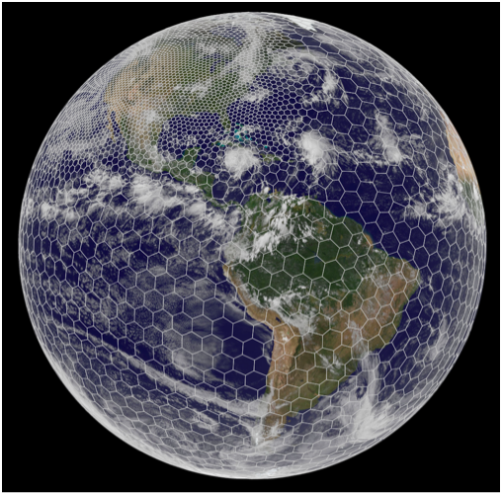
Case Study : MPAS-Ocean
  http://mpas-dev.github.io
Use multiscale methods for accurate, efficient, and scale-aware models of the earth system
MPAS-O uses a variable resolution unstructured mesh of (mostly) hexagonal grid cells
Cells assigned to MPI processes, grouped as “blocks”
  Each cell has 1-40 vertical layers, depending on ocean depth
Our focus: partitioning

Slide 2
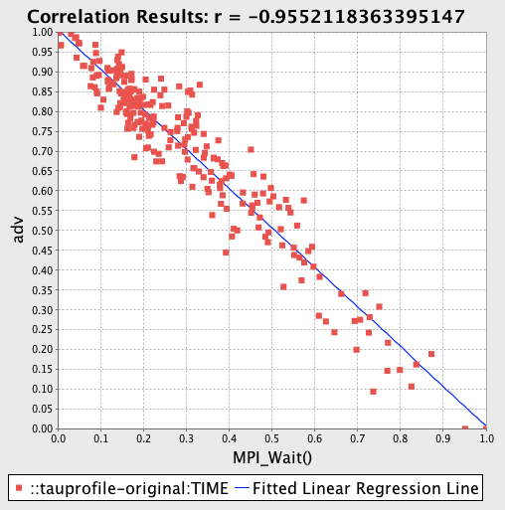
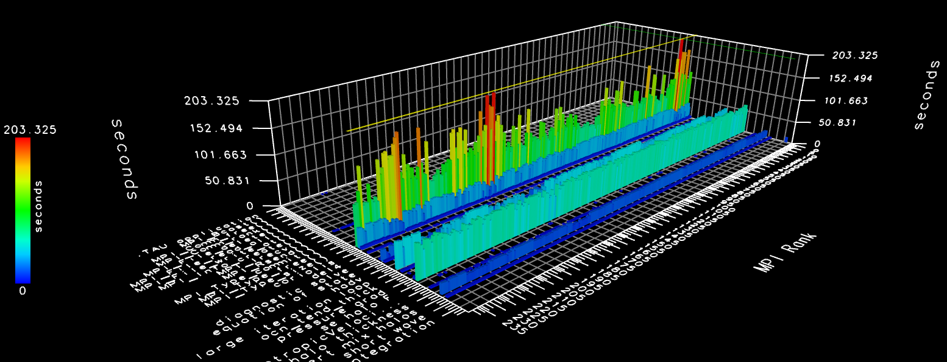
MPAS-Ocean: Load Imbalance
Load imbalance across processes
  Unusual stencil problem: halo/ghost cells lead to imbalance (3 layers)
Performance measurement in isolation is not enough
Need to combine:
  Performance measurements
  Application metadata
  Correlations between measurements and metadata
  Visualization of performance data in application domain

Slide 3
Metadata Correlation – Stencil Properties
Added TAU_METADATA calls to capture properties for all partitions, including:
  nCellSolve: cells in partition
  nCell: nCellSolve + nCellsHalo (3 layers)
Correlate computation time with metadata fields
Original partitioning based on nCellsSolve only
Conclusions:
nCells - Min(51): 893 Max(111): 1416 Avg: 1282.83
Want to balance on nCell, but unknown before partitioning
  nCell = nCellSolve + nHaloCell
nCell imbalance is driving overall performance
Suggestion from Karen Devine (Sandia NL): post-process the partitions

Slide 4
Approach: Hindsight Partitioner
Optimizing Heuristic:
  Partition with Metis
  Compute properties of partitions (i.e. #cells in partition + #cells in halo) to use as cell weights
  Assign weights to cells and update graph
  Iterate until balance can’t be improved
Analysis suggests 2-12% reduction in execution time, depending on quality of initial partition (based on size of largest partition)
TAU profile measurement shows 12-15% reduction in execution time
  ~45% reduction in mean MPI_Wait() times

Slide 5
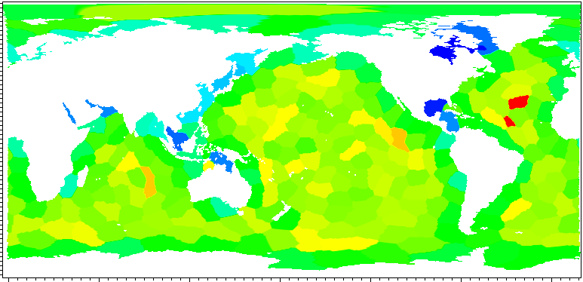
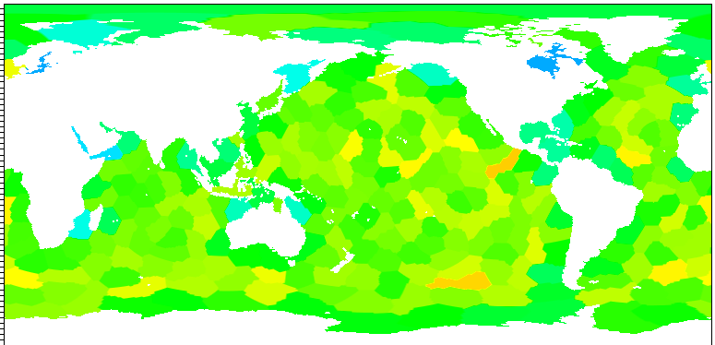
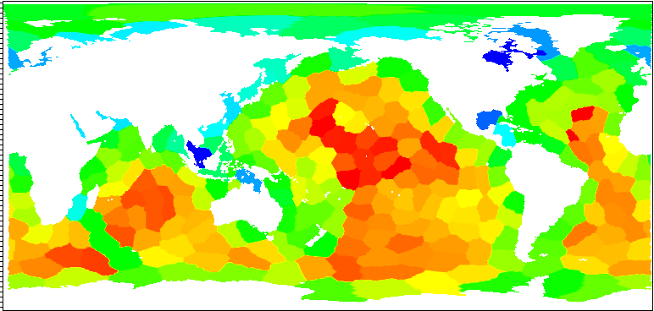
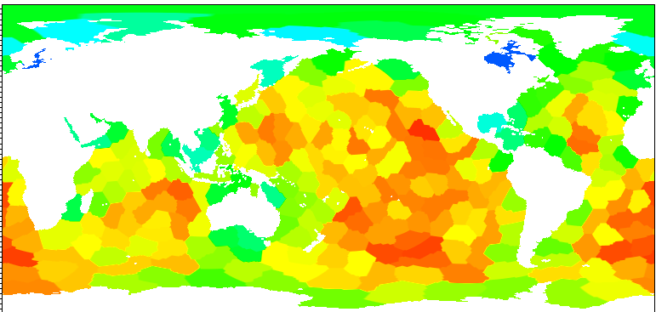
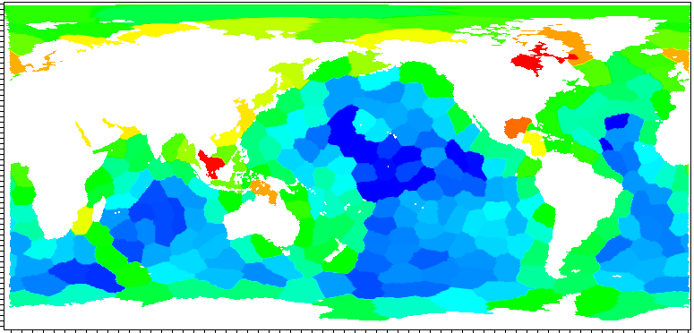
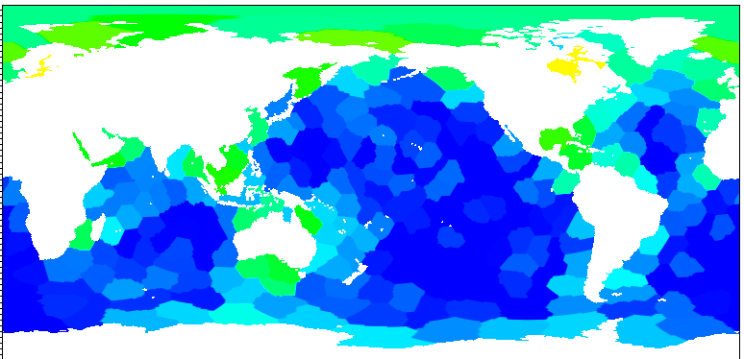
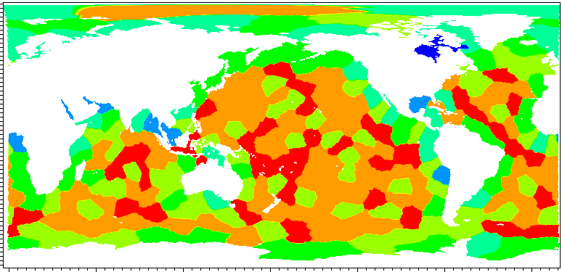
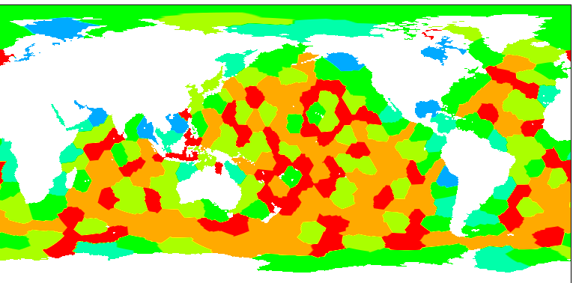
Hindsight Results: 256 processes
min:
473  535
max:
846  771
Total cells (explicit +
halo) per block
min:
8.3e7  9.8e7
max:
2.5e8  2.4e8
Time spent
computing
Time spent in
MPI_Wait
min:
2.7e7  9.0e6
max:
1.9e8  1.5e8
Number of neighbors
per block
min:
1  2
max:
7  9

Slide 6
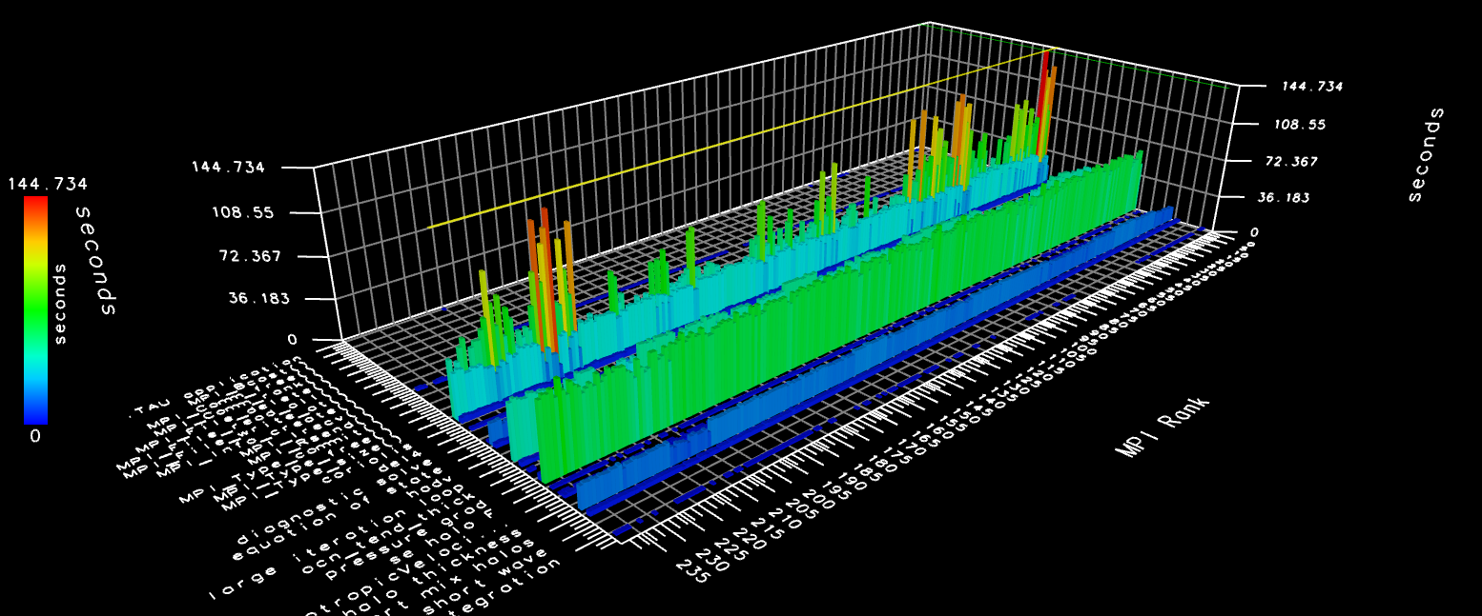
Hindsight Results: 240 processes on NERSC Edison
Original
Refined
Reduction in communication routines due to better balance

