Slide 1
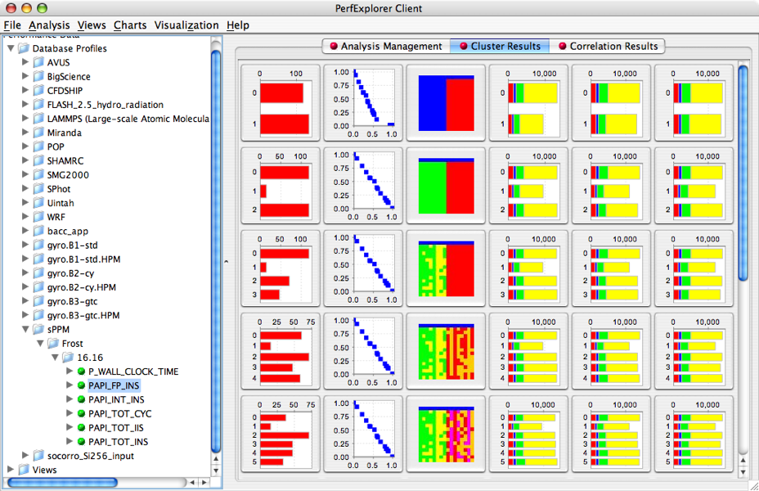
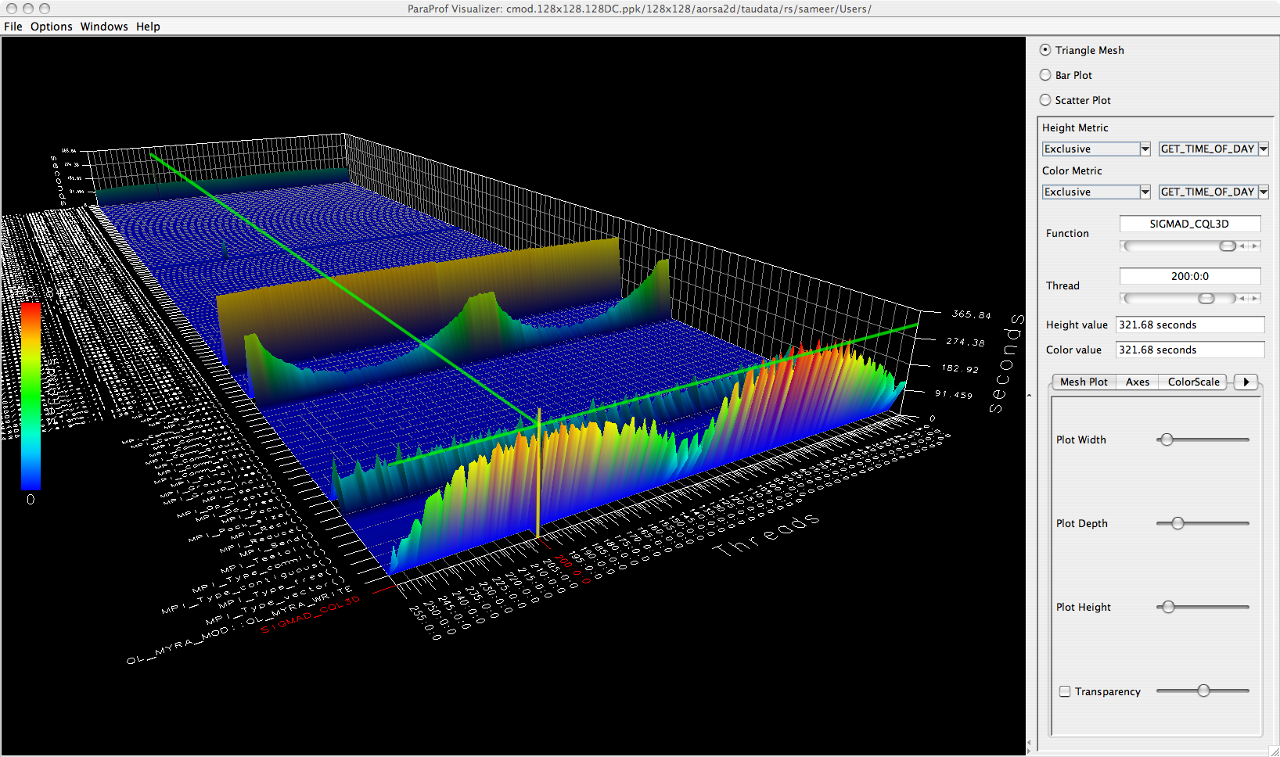
TAU: Tuning and Analysis Utilities
  Application measurement system for a broad array of parallel programming models, languages, and platforms. Source and binary instrumentation automation, library wrapper support, and sampling. Visual and automated analysis tools, with file conversion support to other profile and trace visualization and analysis tools.
  Measurement and analysis support for numerous models, platforms and languages such as MPI, OpenMP, SHMEM, Posix Threads, CUDA, C/C++, Fortran, Python, Spark, Java, UPC, Cray, IBM BG/*
Released TAU v2.27.2, updated HPCLinux (hpclinux.org)
  New multi-level sampling resolution support (line, function, file)
Adding support for ARM LLVM compilers (armclang, armclang++, armflang) and associated MPI wrappers
Evaluated AMD ROCm infrastructure and tested native events from PAPI with TAU on a Polaris (RX 480) AMD GPU
Integrated TAU with LANL's Kitsune LLVM plugin for function call instrumentation using instrumentation at the LLVM IR level

Slide 2
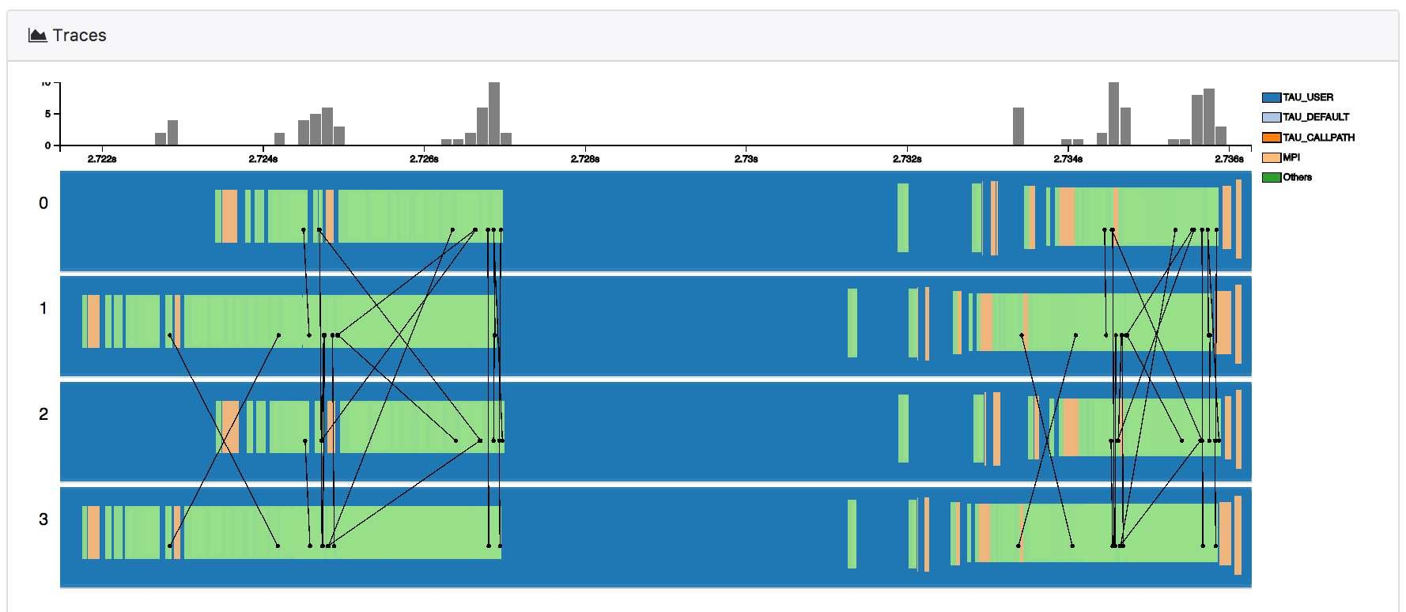
Engagement: CODAR, ADIOS Interaction Update
  Workflow performance data aggregation utilities for CODAR
    Combine performance profiles/traces from multiple parallel applications into one data source for analysis
  TAU, SOS (Scalable Observation System) used in CODAR runtime anomaly detection and for trace performance visualization, testing with NWChemEx
  TAU, SOS integrated into Cheetah/Savanna parametric study infrastructure for multi-component applications
Figure shows TAU trace data from NWChem visualized in a trace viewer designed to read traces from multiple applications in a workflow. Recent updates aggregate TAU data over SOS, export it to ADIOS, which is then read by both the trace visualization and runtime anomaly detection. Figure source: Xie, Xu, Ha, Huck, Shende, Van Dam, Dam, Mueller. (2018). Performance Visualization for TAU Instrumented Scientific Workflows. 333-340. 10.5220/0006646803330340.

