Slide 1




Oct 2018 ECP ST Project Review
2.3.2.09 STTO12-PROTEAS: Programming Toolchain for Emerging Architectures and Systems
PI: Jeffrey S. Vetter (ORNL)
Co-PIs:
Allen D. Malony and Sameer Shende, U. Oregon
Kei Davis, Los Alamos National Laboratory
Hal Finkel, Argonne National Laboratory
3 Oct 2018

Slide 2
Project Overview
Team Members and Affiliations
Administrative
Oak Ridge National Laboratory
  Jeffrey S Vetter (PI), Joel Denny, Jungwon Kim, and Seyong Lee
University of Oregon
  Allen Malony (Co-PI), Sameer Shende, and Kevin Huck
Los Alamos National Laboratory
  Kei Davis (Co-PI), David Ringo
Argonne National Laboratory
  Hal Finkel (Co-PI), Johannes Doerfert
Multi-dimensional project
Projects nearly fully staffed
Three years at ~$1.2M/yr
Directed to ‘own’ OpenACC programming model for ECP
  PCR increment to enable this work

Slide 3
Architectural specialization and integration will create very complex, heterogeneous systems
Not to mention Frontier, Crossroads, El Capitan, NERSC9
System attributes | NERSC Now | OLCF Now | ALCF Now | NERSC Upgrade | OLCF Upgrade | ALCF Upgrades
Planned Installation | Edison | TITAN | MIRA | Cori 2016 | Summit 2017-2018 | Theta 2016 | Aurora 2018-2019
System peak (PF) | 2.6 | 27 | 10 | > 30 | 150 | >8.5 | 180
Peak Power (MW) | 2 | 9 | 4.8 | < 3.7 | 10 | 1.7 | 13
Total system memory | 357 TB | 710TB | 768TB | ~1 PB DDR4 + High Bandwidth Memory (HBM)+1.5PB persistent memory | > 1.74 PB DDR4 + HBM + 2.8 3.7 ~7 PB persistent memory | >480 TB DDR4 + High Bandwidth Memory (HBM) | > 7 PB High Bandwidth On-Package Memory Local Memory and Persistent Memory
Node performance (TF) | 0.460 | 1.452 | 0.204 | > 3 | > 40 | > 3 | > 17 times Mira
Node processors | Intel Ivy Bridge | AMD Opteron Nvidia Kepler | 64-bit PowerPC A2 | Intel Knights Landing many core CPUs Intel Haswell CPU in data partition | Multiple IBM Power9 CPUs & multiple Nvidia Voltas GPUS | Intel Knights Landing Xeon Phi many core CPUs | Knights Hill Xeon Phi many core CPUs
System size (nodes) | 5,600 nodes | 18,688 nodes | 49,152 | 9,300 nodes 1,900 nodes in data partition | ~3,500 nodes | >2,500 nodes | >50,000 nodes
System Interconnect | Aries | Gemini | 5D Torus | Aries | Dual Rail EDR-IB | Aries | 2nd Generation Intel Omni-Path Architecture
File System | 7.6 PB 168 GB/s, Lustre® | 32 PB 1 TB/s, Lustre® | 26 PB 300 GB/s GPFS™ | 28 PB 744 GB/s Lustre® | 120 PB 1 TB/s GPFS™ | 10PB, 210 GB/s Lustre initial | 150 PB 1 TB/s Lustre®
Architectural specialization and integration will create very complex platforms
  Heterogeneous computing
  Deep memory hierarchies incl NVM
  Plateauing I/O forces app redesign
Implications
  DOE and companies will need to understand design tradeoffs
  Programming systems will need to be portable
  Performance portability will be a stretch goal
Complexity α T
Notes:
SciDAC, ECP, ASCR, etc
Climate, Materials, Chemistry, HEP
No easy solutions…

Slide 4
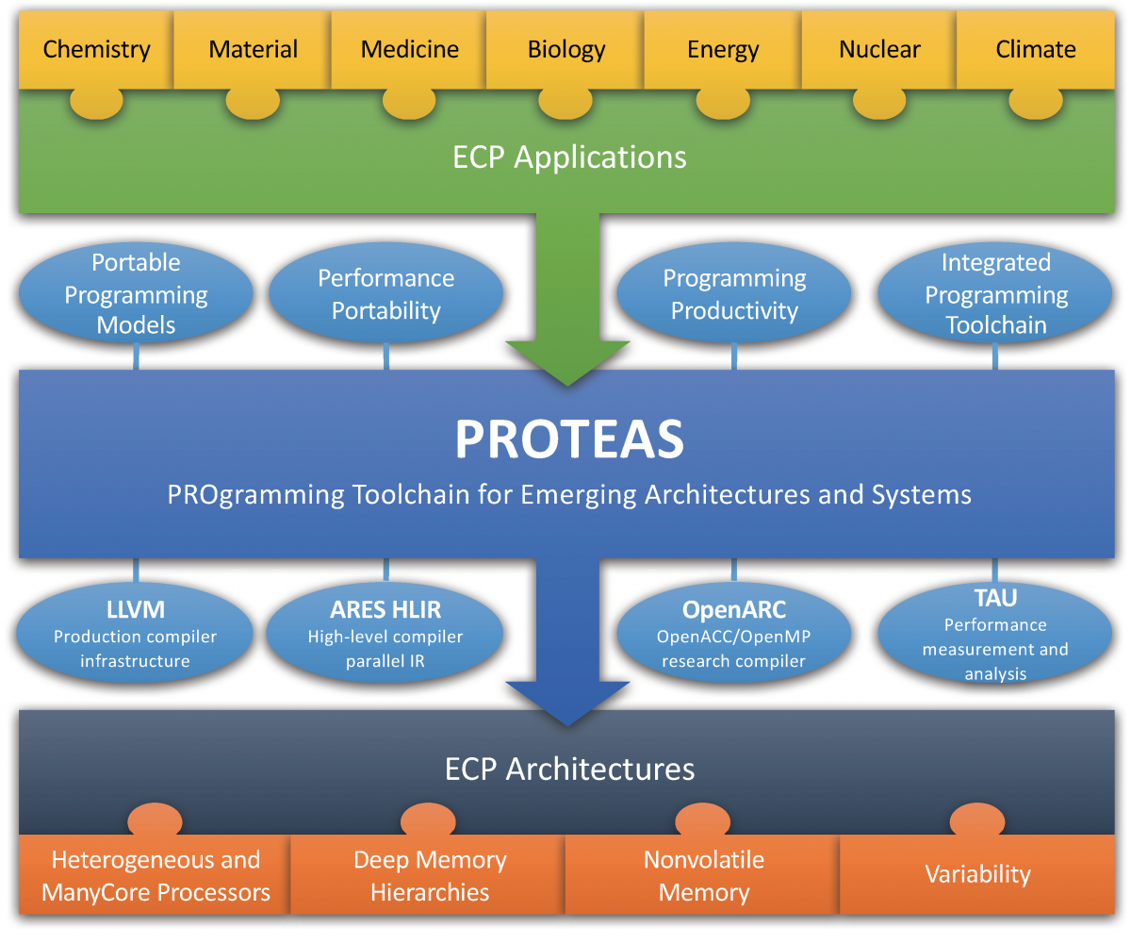
Project Overview and Capabilities
PROTEAS is not a monolithic project; it has multiple technical thrusts.
Programming expertise and software for emerging architectures
  Heterogeneous and manycore processors (GPUs, FPGAs, Manycore),
  Deep memory hierarchies incl nonvolatile memory systems (NVM);
  Focusing primarily on directive-based solutions
Integrated toolchain that is powerful enough to prototype solutions for emerging architectures
Integrated performance assessment solutions for these programming systems that will enable
  automatic performance analysis
  performance-driven optimization;
Engage with ECP applications and software teams
Champion our successful solutions in ECP, community standards, and open-source software stacks
Programming models
  OpenACC, CUDA, OpenCL, OpenMP
  Optimization techniques and algorithms
  Approaches to using NVM, such as embedded KV stores (papyrus)
LLVM Compiler
  OpenACC support, parallel IR, etc.
Portable, scalable performance analysis with TAU
Integration and interoperability across programming models
  OpenACC and OpenMP, MPI and OpenACC
Performance portability metrics, tools, and strategies
Notes:
Review the goal(s) of the project: team, funding level, impact goals and metrics, etc.

Slide 5
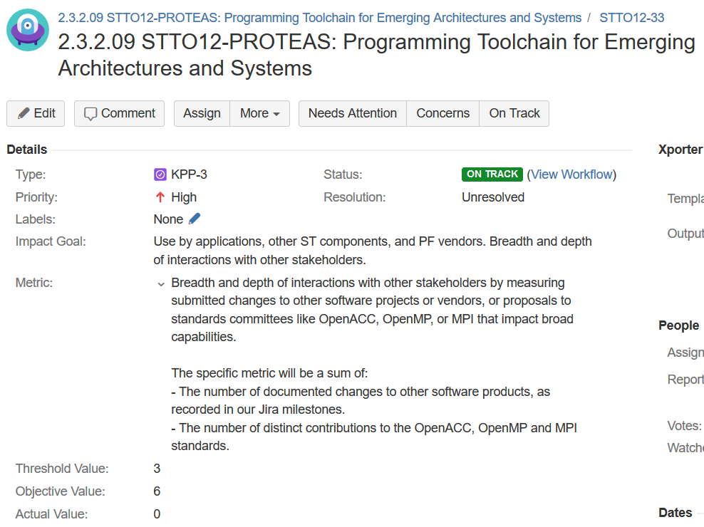
Project Impact Goals and Metrics
Impact on applications
  Engagement
  Delivered software
  Performance improvement
Impact on community
  Open specifications
    Number of changes
  Open source software
    Number of commits
Compilers and tools have indirect metrics that can be devilish to measure
  Compilers and performance tools do not ship with the application but can have great impact.

Slide 6
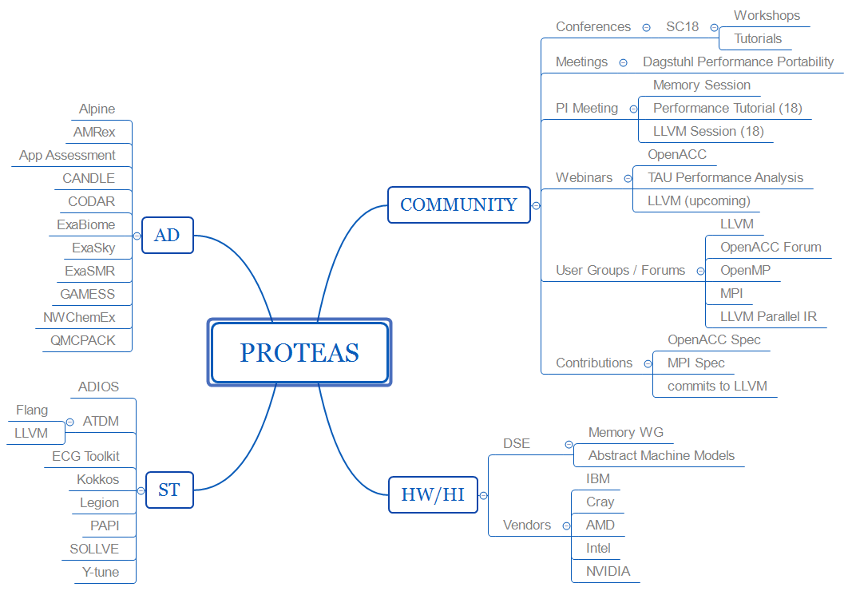
Relationships

Slide 7
Technical Thrusts

Slide 8
Programming Support for Heterogeneous and ManyCore Architectures

Slide 9
ECP ST Projects Developing LLVM-Based Technology
SOLLVE: OpenMP (WBS 2.3.1.13)
Y-Tune: Autotuning (WBS 2.3.2.07)
  Enhancing the implementation of OpenMP in LLVM:
    Developing support for unified memory (e.g., from NVIDIA), kernel decomposition and pipelining, automated use of local memory, and other enhancements for accelerators.
    Developing optimizations of OpenMP constructs to reduce overheads (e.g., from thread startup and barriers).
      Building on LLVM parallel-IR work in collaboration with Intel.
  Using LLVM, Clang, and Flang to prototype new OpenMP features for standardization.
  Developing an OpenMP test suite, and as a result, testing and improving the quality of OpenMP in LLVM, Clang, and Flang.
  Enhancing LLVM to better interface with autotuning tools.
  Enhancing LLVM's polyhedral loop optimizations and the ability to drive them using autotuning.
  Using Clang, and potentially Flang, for parsing and semantic analysis.
LANL ATDM Development Tools (WBS 2.3.2.02)
  Using parallel IR to replace template expansion in FleCSI, Kokkos, RAJA, etc.
  Enhanced parallel-IR optimizations and targeting of various runtimes/architectures.
  Flang evaluation, testing, and Legion integration, plus other programming-model enhancements.
  ByFl: Instrumentation-based performance counters using LLVM.
PROTEAS: Parallel IR & More (WBS 2.3.2.09)
  Developing extensions to LLVM's intermediate representation (IR) to represent parallelism.
    Strong collaboration with Intel and several academic groups.
    Parallel IR can target OpenMP's runtime library among others.
    Parallel IR can be targeted by OpenMP, OpenACC, and other programming models in Clang, Flang, and other frontends.
    Building optimizations on parallel IR to reduce overheads (e.g., merging parallel regions and removing redundant barriers).
  Developing support for OpenACC in Clang, prototyping non-volatile memory features, and integration with Tau performance tools.
Flang: LLVM Fortran Frontend (WBS 2.3.5.06)
  Working with NVIDIA (PGI), ARM, and others to develop an open-source, production-quality LLVM Fortran frontend.
    Can target parallel IR to support OpenMP (including OpenMP offloading) and OpenACC.
Note: The proxy-apps project (WBS 2.2.6.01) is also enhancing LLVM's test suite.
Notes:
Note to authors: Delete all italicized text before adding your contributions.
9

Slide 10
Clacc: OpenACC Support for Clang/LLVM
OpenACC source
Goals
  Contribute production-quality OpenACC support to Clang/LLVM
  Enable OpenACC tool R&D in the Clang/LLVM ecosystem
Design
  Extend Clang to translate OpenACC to OpenMP
  Build on Clang’s existing OpenMP compiler/runtime support
Deployment and Outreach
  Contributing improvements to Clang/LLVM infrastructure
  Contributing to OpenACC spec.
  Hosted OpenACC Forum this summer
Benefits
  OpenACC support in a popular open-source compiler infrastructure
  Ability to construct new source-level OpenACC tools using Clang’s extensible ecosystem: pretty printers, analyzers, lint-like tools, debugger extensions, editor extensions, etc.
  Automated translation from OpenACC source to OpenMP source
  Ability to build optimizations on future LLVM IR parallel extensions
Clang parser
OpenACC AST
AST transformer
OpenMP AST
codegen
LLVM IR
LLVM
executable
OpenMP runtime
Joel E. Denny, Seyong Lee, and Jeffrey S. Vetter. "Clacc: Translating OpenACC to OpenMP in Clang." In LLVM-HPC2018: The Fifth Workshop on the LLVM Compiler Infrastructure in HPC, November 2018.

Slide 11
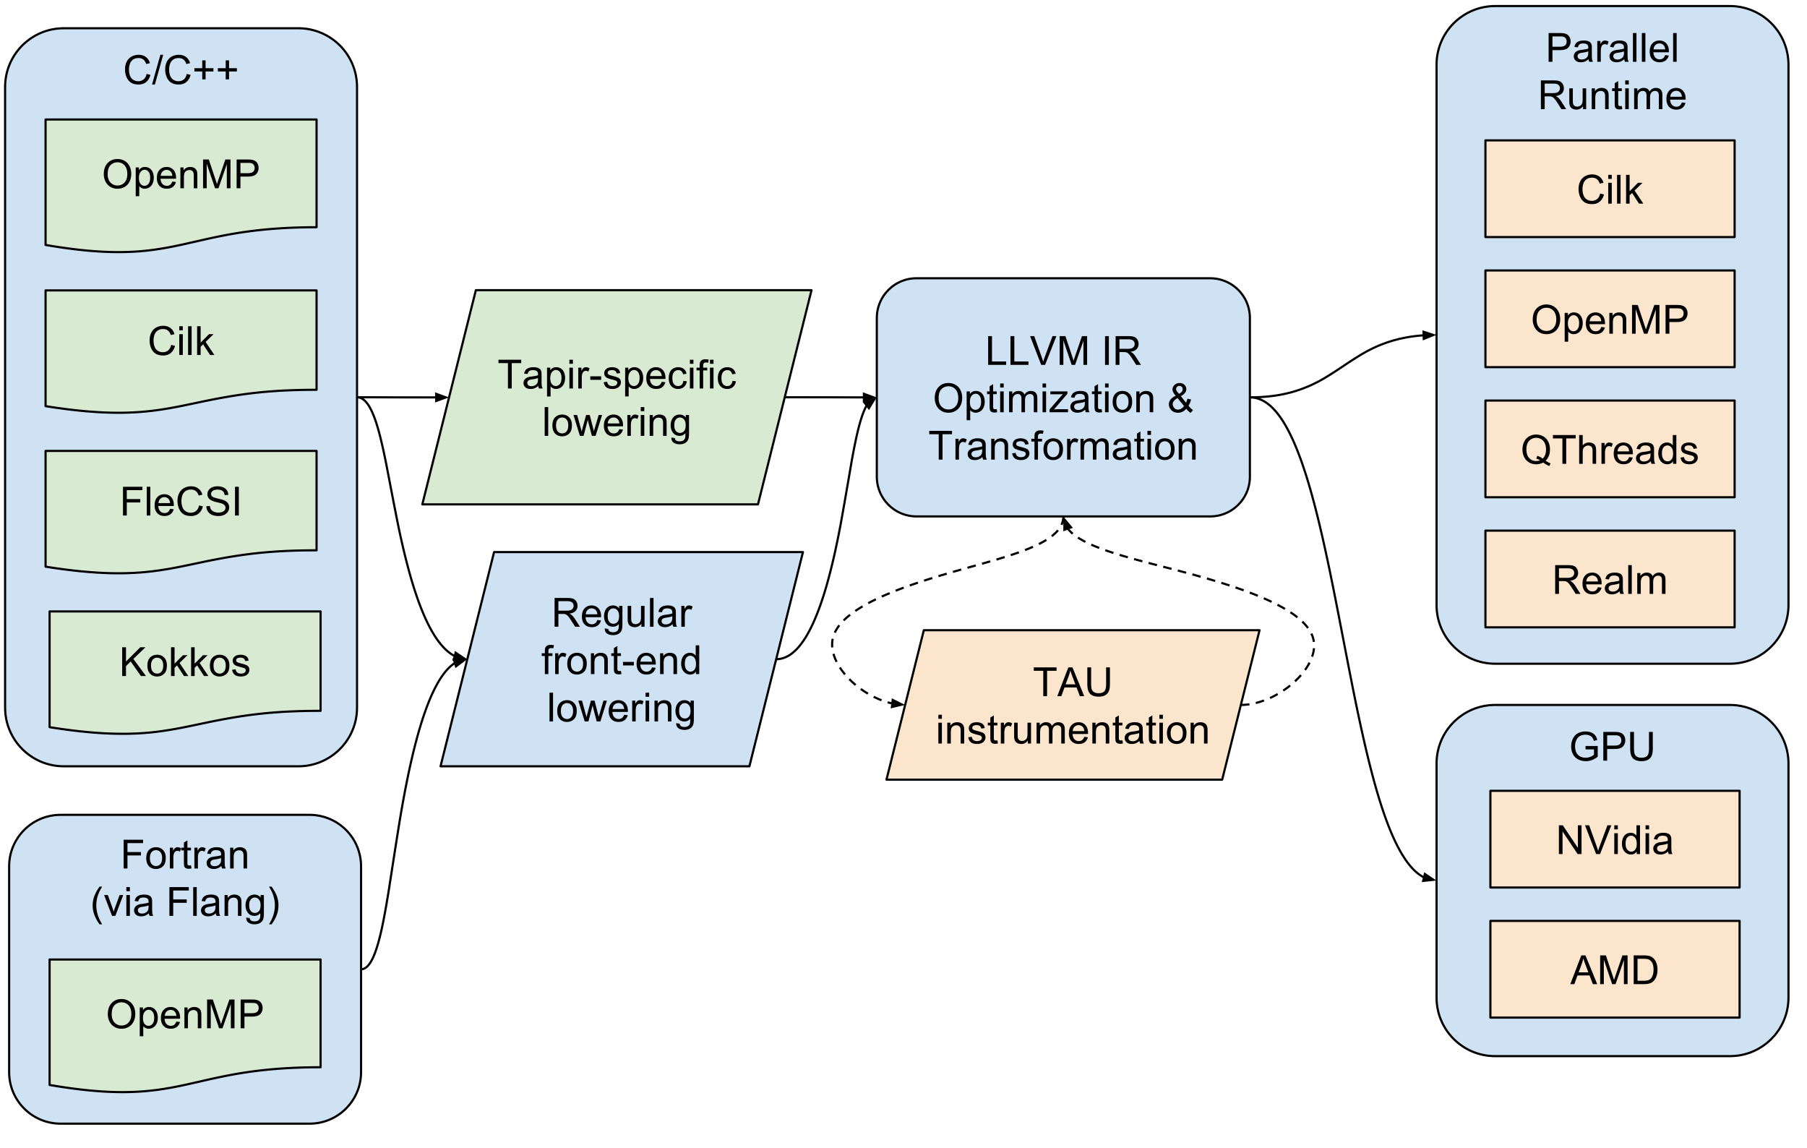
Tapir for Parallelism at the IR level
Tapir (LLVM IR extension from at MIT) is the basis of the Proteas High Level IR for Exascale (PHIRE)
Permits otherwise absent optimization of parallel source constructs
Collaboration with Intel, MIT, UIUC
Shared codebase with ECP Kitsune project
Currently
  Fixing Clang OpenMP tests broken by Tapir
  Extending support to OpenMP clauses

Slide 12
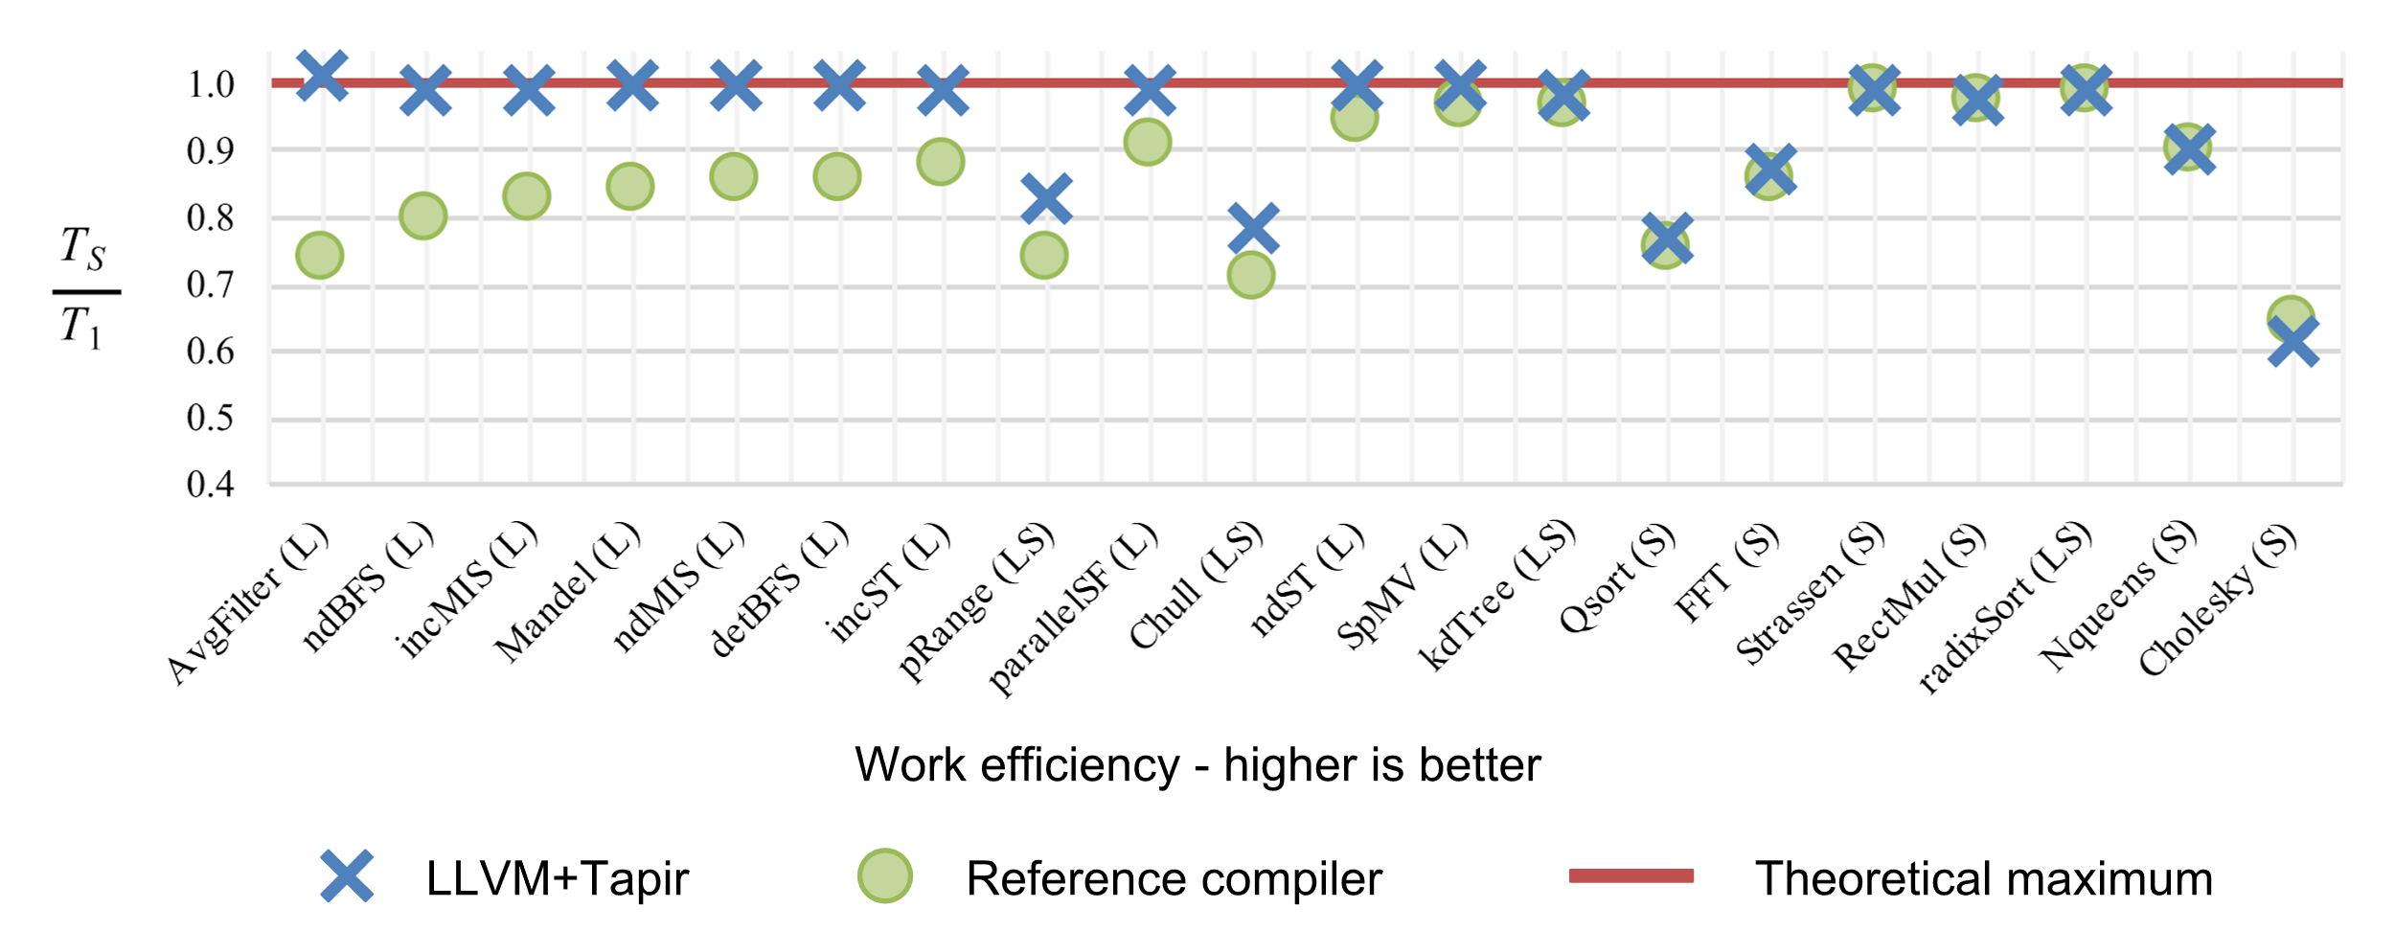
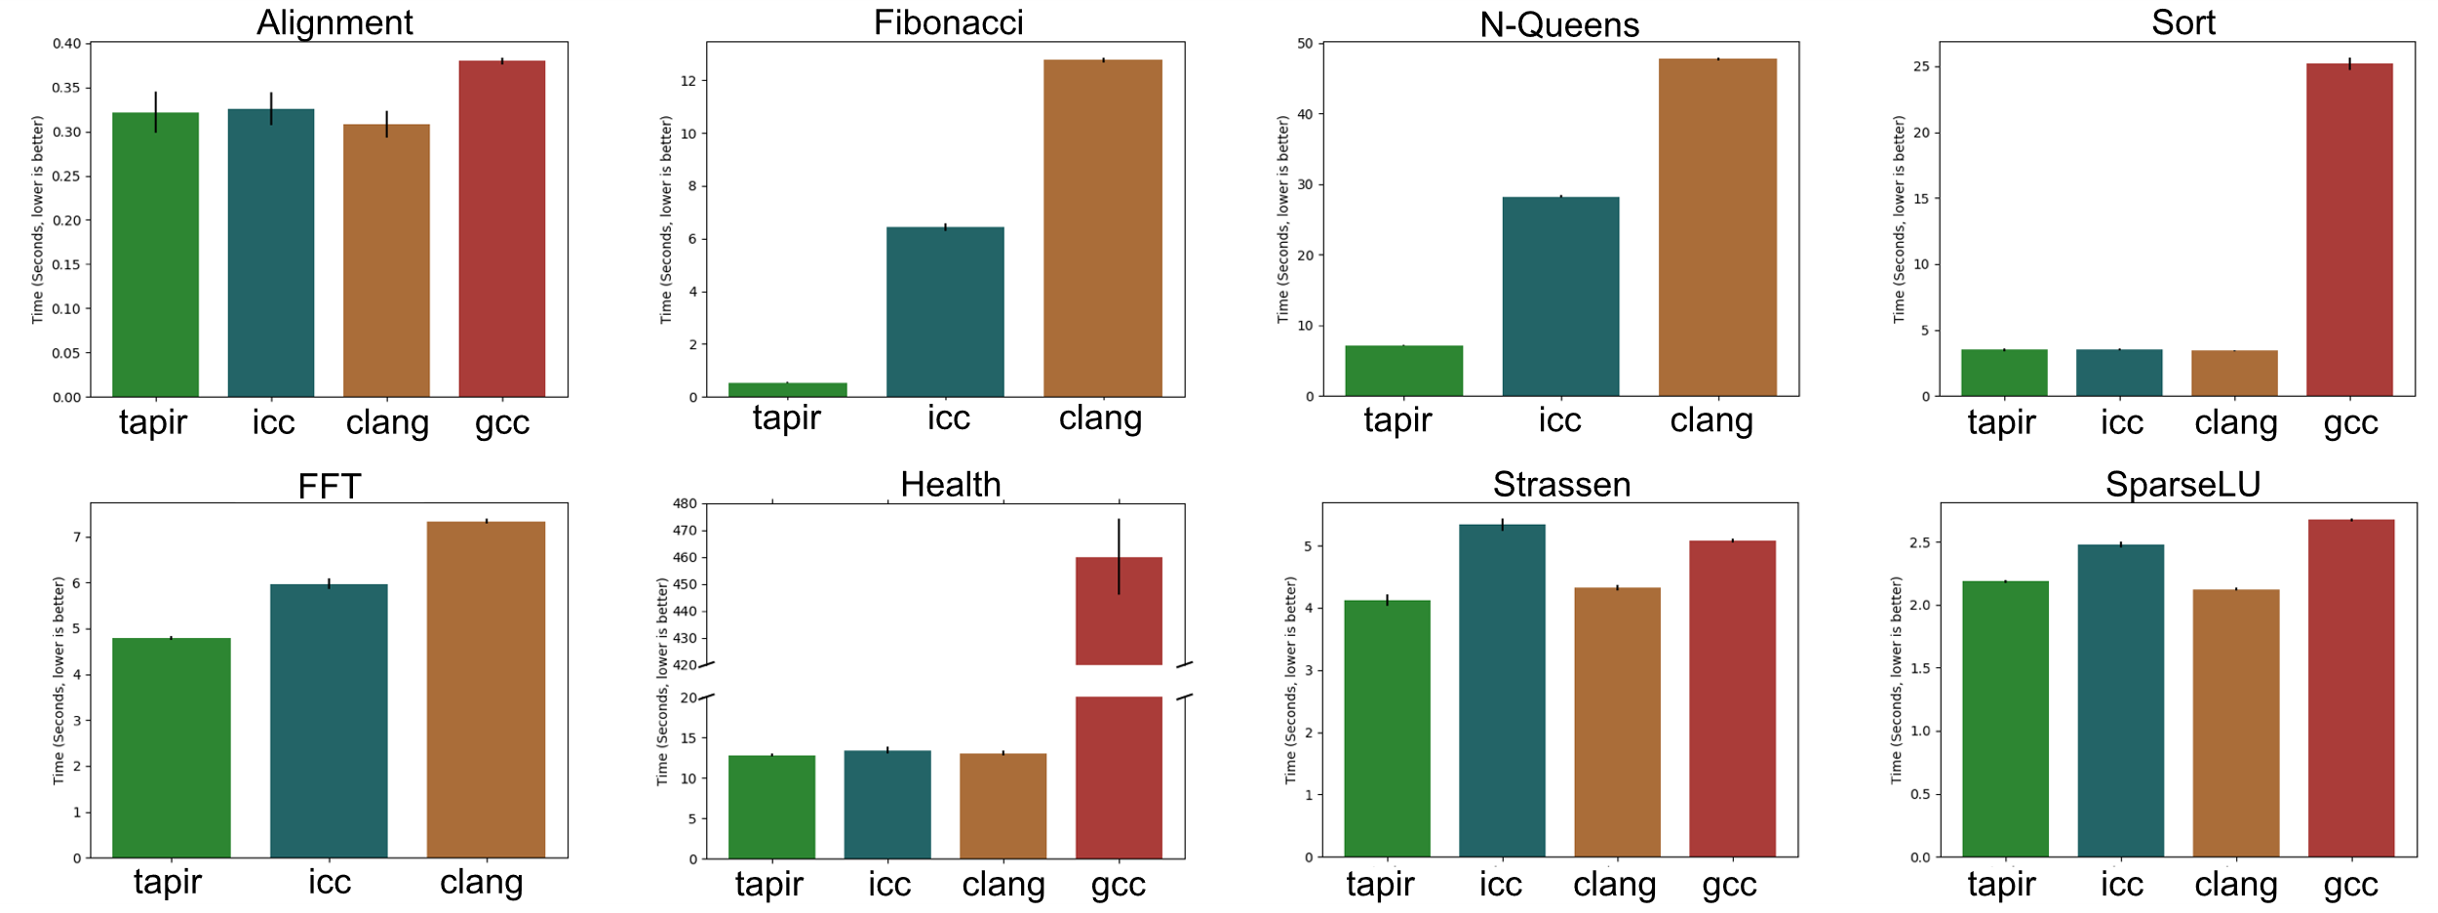
PHIRE Performance
Tapir brings demonstrated improvement over opaque runtime calls
Tapir: Embedding Fork-Join Parallelism into LLVM's Intermediate Representation
by Tao B. Schardl, William S. Moses, and Charles E. Leiserson
Symposium on Principles and Practice of Parallel Programming,
Pages: 249–265, February, 2017
New contributions enable gains in established parallel benchmarks
OpenMPIR: Implementing OpenMP Tasks with Tapir
by George Stelle, William S. Moses, Stephen L. Olivier, Patrick McCormick,
LLVM-HPC'17 Proceedings of the Fourth Workshop on the LLVM Compiler Infrastructure in HPC, Denver, CO, USA — November 12 - 17, 2017,

Slide 13
TAU Instrumentation via LLVM Plugin
LLVM architecture permits dynamically loaded plugins to analyze and transform IR
Collaboration with UO
This enables compiler-level instrumentation with TAU for any language with an LLVM backend¹
Prototype plugin instruments C/C++ functions by name
  Works with LLVM+Tapir and vanilla LLVM
  Tested on Kokkos MiniFE² proxy application
  Can (FY19?) be extended to recognize PHIRE constructs
[1]: https://llvm.org/Users.html
[2]: https://github.com/Mantevo/miniFE

Slide 14
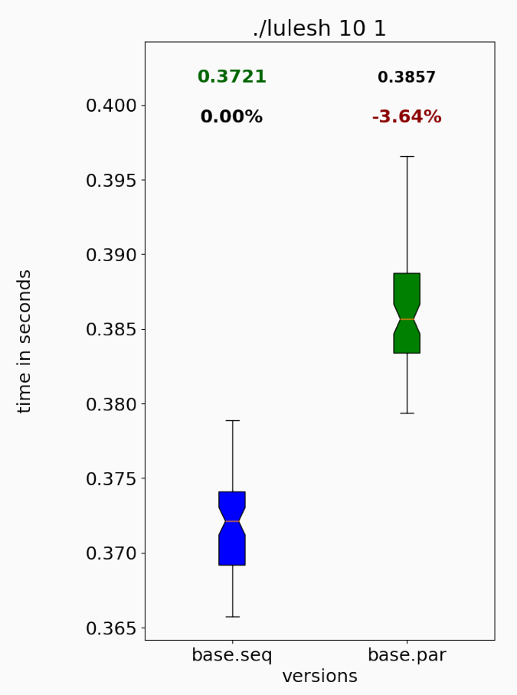
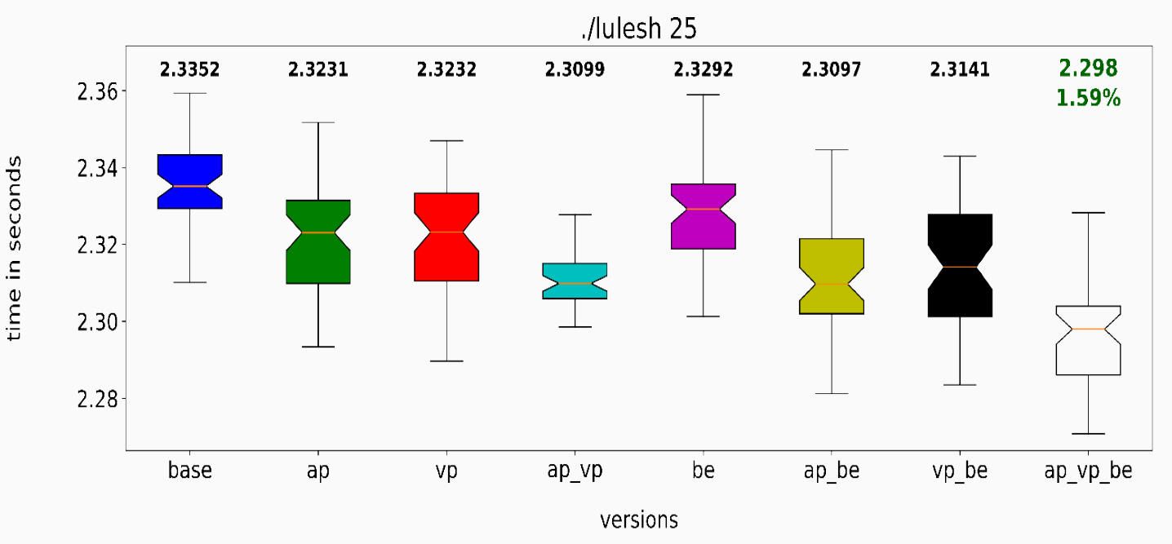
Parallelism Optimizations: Infrastructure and Enhancements
Abstracts over different parallel-IR varieties (e.g., Tapir, Intel's PIR, and raw runtime calls).
Adds explicit optimization of parallel constructs (e.g., fusion of parallel regions, removal of redundant barriers, minimization of captured state).
Adds improved inter-procedural optimizations; Aids optimization with runtime calls (applies to parallel programming models as well as other indirect calls through libraries).
Adds improved optimizer support, in many areas, to support these optimizations in the presence of C++ libraries such as Kokkos.
Parallel lulesh version (1 thread) vs. serial version: parallel version is slower...
With parallelism optimizations, parallel code can be better optimized (increased performance using one thread and many threads)
Doerfert, Johannes, and Hal Finkel. "Compiler Optimizations for OpenMP." In International Workshop on OpenMP (IWOMP'18), pp. 113-127. Springer, 2018. https://doi.org/10.1007/978-3-319-98521-3_8
Doerfert, Johannes, and Hal Finkel. "Compiler Optimizations for Parallel Programs." In International Workshop on Languages and Compilers for Parallel Computing (LCPC'18), Springer, 2018. To be published.

Slide 15

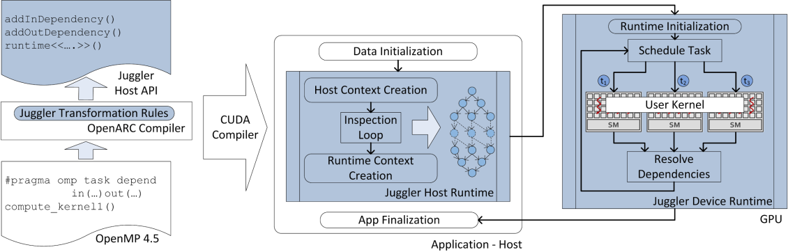
Juggler: A Dependency-Aware Task-Based Execution Framework for GPUs
Overview
  Develop Juggler, a task-based execution framework for GPU workloads with data dependencies.
Activities
  Partially implemented the compiler that inserts code to generate task graph with dependencies at runtime.
  Implemented the in-device runtime that assigns these tasks to workers (i.e., SMs) and ensures that dependencies are satisfied.
Next Steps
  Continue to develop the compiler and runtime passes to support fine-grained task parallelism in an OpenMP target region.
Mehmet E. Belviranli, Seyong Lee, Jeffrey S. Vetter, and Laxmi N. Bhuyan. Juggler: A Dependency-Aware Task Based Execution Framework for GPUs, Proceedings of ACM SIGPLAN Symposium on Principles and Practice of Parallel Programming (PPoPP), Vösendorf/Wien, Austria, 2018.

Slide 16
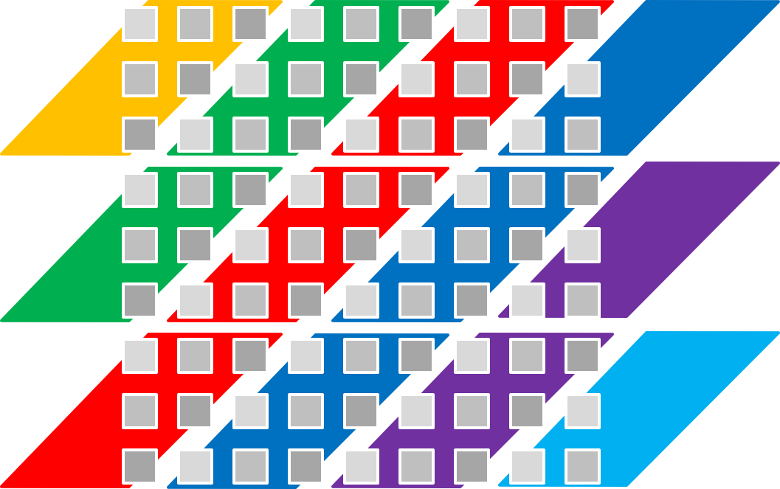
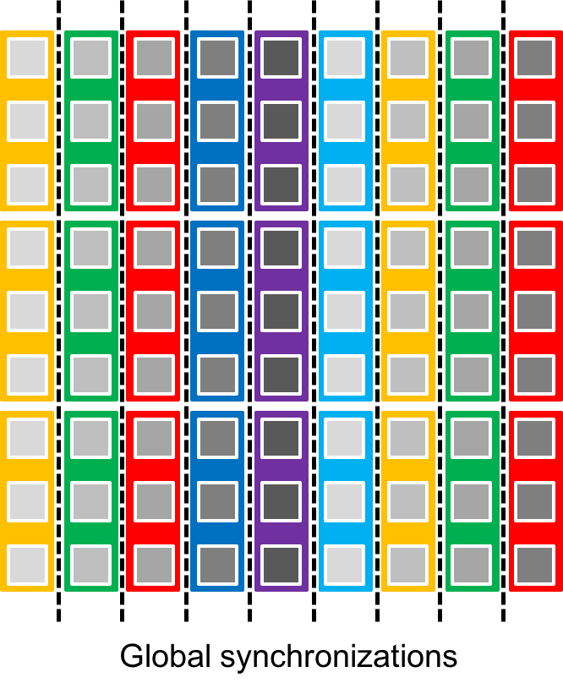
Parallelizing Wavefront Loops on Modern Vector Hardware
Hybrid method to parallelize wavefront loops
Overview
  Many DOE (or related) applications based on PDE solvers have wavefront loops (loops with loop-carried dependencies).
  We propose new hybrid and general methods to efficiently parallelize the wavefront loops on different heterogeneous architectures.
Activities
  Developed a highly efficient, compensation-based parallelization technique (scan method) for wavefront loops on GPUs, which performs better than the existing state-of-the-art hyper-diagonal method under certain circumstances.
  Preliminary results will be published in the upcoming IPDPS18 conference (32nd IEEE International Parallel and Distributed Processing Symposium).
Next Steps
  Develop a compiler framework that applies loop transformation techniques to automatically transform the wavefront loops for better utilization of different vector architectures in different accelerators.
(a) Hyper-diagonal method
(b) Scan method

Slide 17
Highly Efficient Compensation-based Parallelism for Wavefront Loops on GPUs
Overview
  Many DOE applications based on PDE solvers have wavefront loops (loops with loop-carried dependencies).
  We propose a compensation-based, hybrid method to efficiently parallelize wavefront loops on heterogeneous architectures.
Activities
  Design and implement a highly efficient compensation-based parallelism on GPUs.
  Prove under which circumstances that the proposed compensation-based method does not affect the correctness of results.
Next Steps
  Develop a compiler framework to automatically transform the wavefront loops for better utilization of different vector architectures in different accelerators.
Proposed hybrid method to adapt different wavefront problems
Kaixi Hou, Hao Wang, Wu-chun Feng, Jeffrey S. Vetter, and Seyong Lee. Highly Efficient Compensation-based Parallelism for Wavefront Loops on GPUs. 32th IEEE International Parallel & Distributed Processing Symposium (IPDPS), Vancouver, Canada, 2018.

Slide 18
Performance Analysis

Slide 19
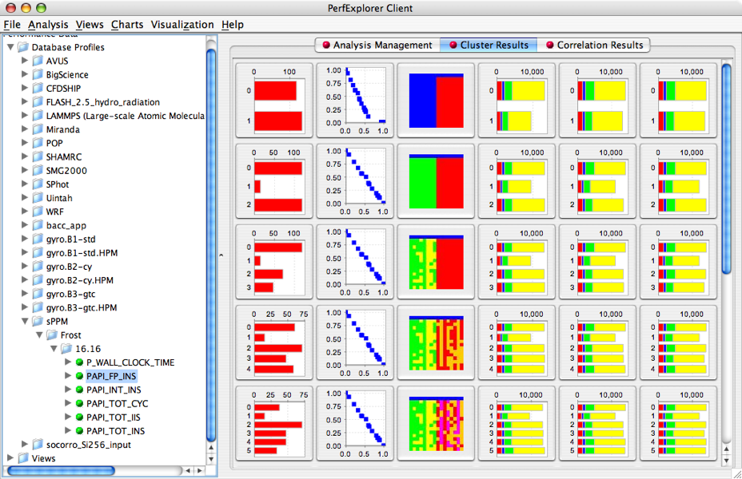
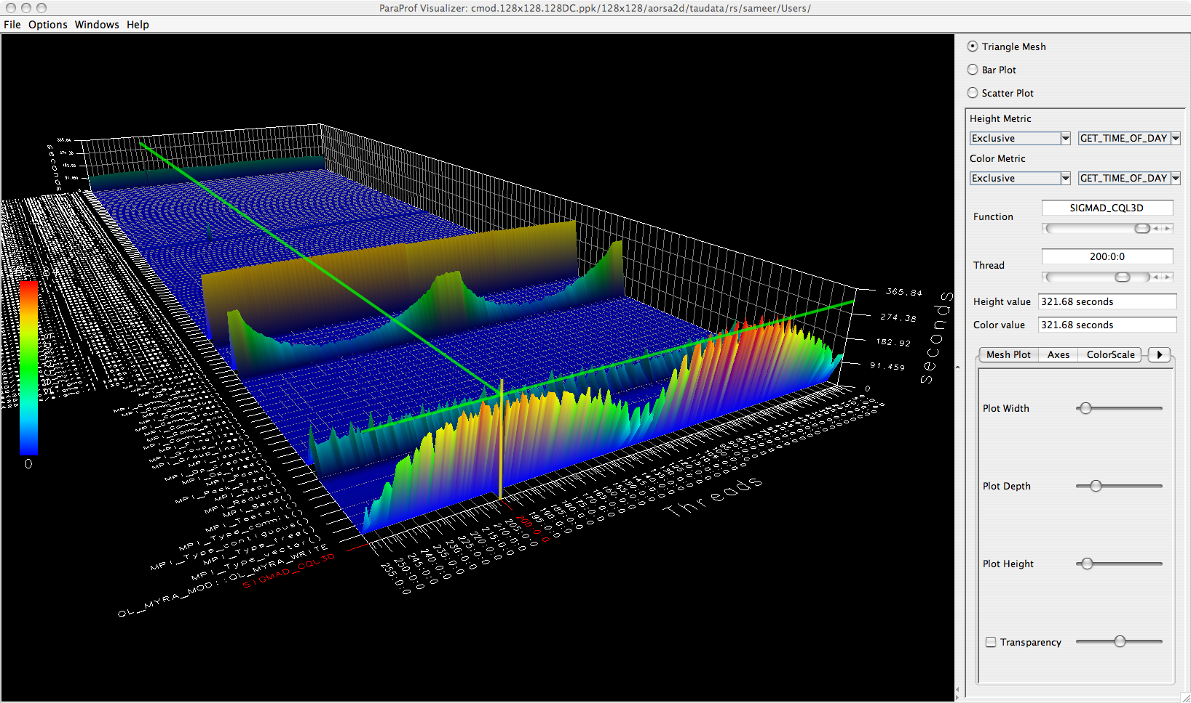
TAU: Tuning and Analysis Utilities
  Application measurement system for a broad array of parallel programming models, languages, and platforms. Source and binary instrumentation automation, library wrapper support, and sampling. Visual and automated analysis tools, with file conversion support to other profile and trace visualization and analysis tools.
  Measurement and analysis support for numerous models, platforms and languages such as MPI, OpenMP, SHMEM, Posix Threads, CUDA, C/C++, Fortran, Python, Spark, Java, UPC, Cray, IBM BG/*
Released TAU v2.27.2, updated HPCLinux (hpclinux.org)
  New multi-level sampling resolution support (line, function, file)
Adding support for ARM LLVM compilers (armclang, armclang++, armflang) and associated MPI wrappers
Evaluated AMD ROCm infrastructure and tested native events from PAPI with TAU on a Polaris (RX 480) AMD GPU
Integrated TAU with LANL's Kitsune LLVM plugin for function call instrumentation using instrumentation at the LLVM IR level

Slide 20
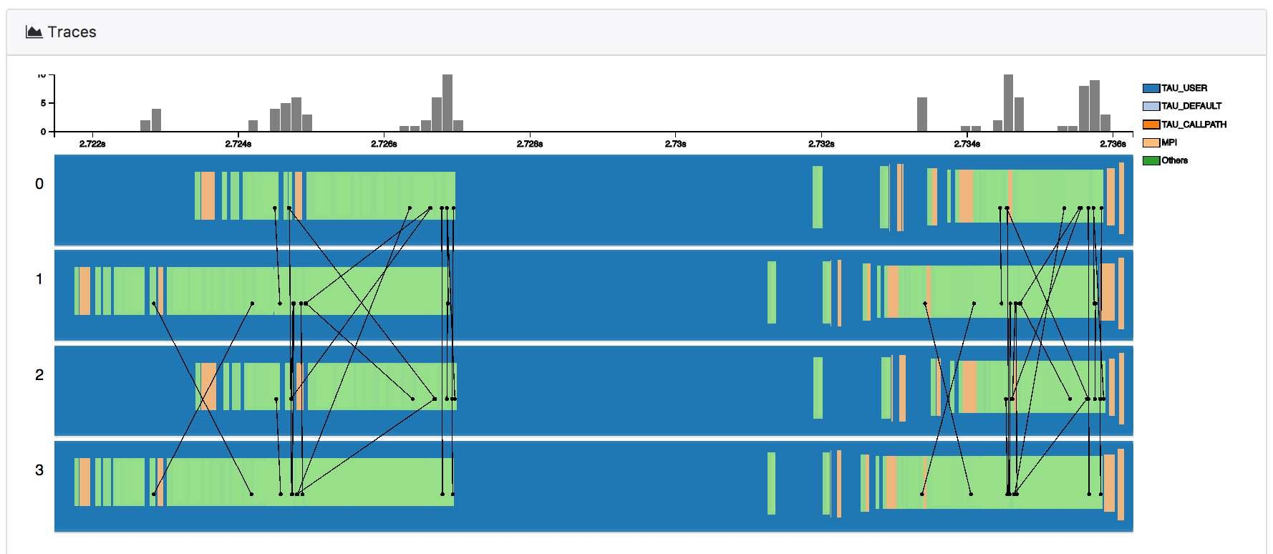
Engagement: CODAR, ADIOS Interaction Update
  Workflow performance data aggregation utilities for CODAR
    Combine performance profiles/traces from multiple parallel applications into one data source for analysis
  TAU, SOS (Scalable Observation System) used in CODAR runtime anomaly detection and for trace performance visualization, testing with NWChemEx
  TAU, SOS integrated into Cheetah/Savanna parametric study infrastructure for multi-component applications
Figure shows TAU trace data from NWChem visualized in a trace viewer designed to read traces from multiple applications in a workflow. Recent updates aggregate TAU data over SOS, export it to ADIOS, which is then read by both the trace visualization and runtime anomaly detection. Figure source: Xie, Xu, Ha, Huck, Shende, Van Dam, Dam, Mueller. (2018). Performance Visualization for TAU Instrumented Scientific Workflows. 333-340. 10.5220/0006646803330340.

Slide 21
Deep Memory Hierarchies
Nonvolatile Memory

Slide 22
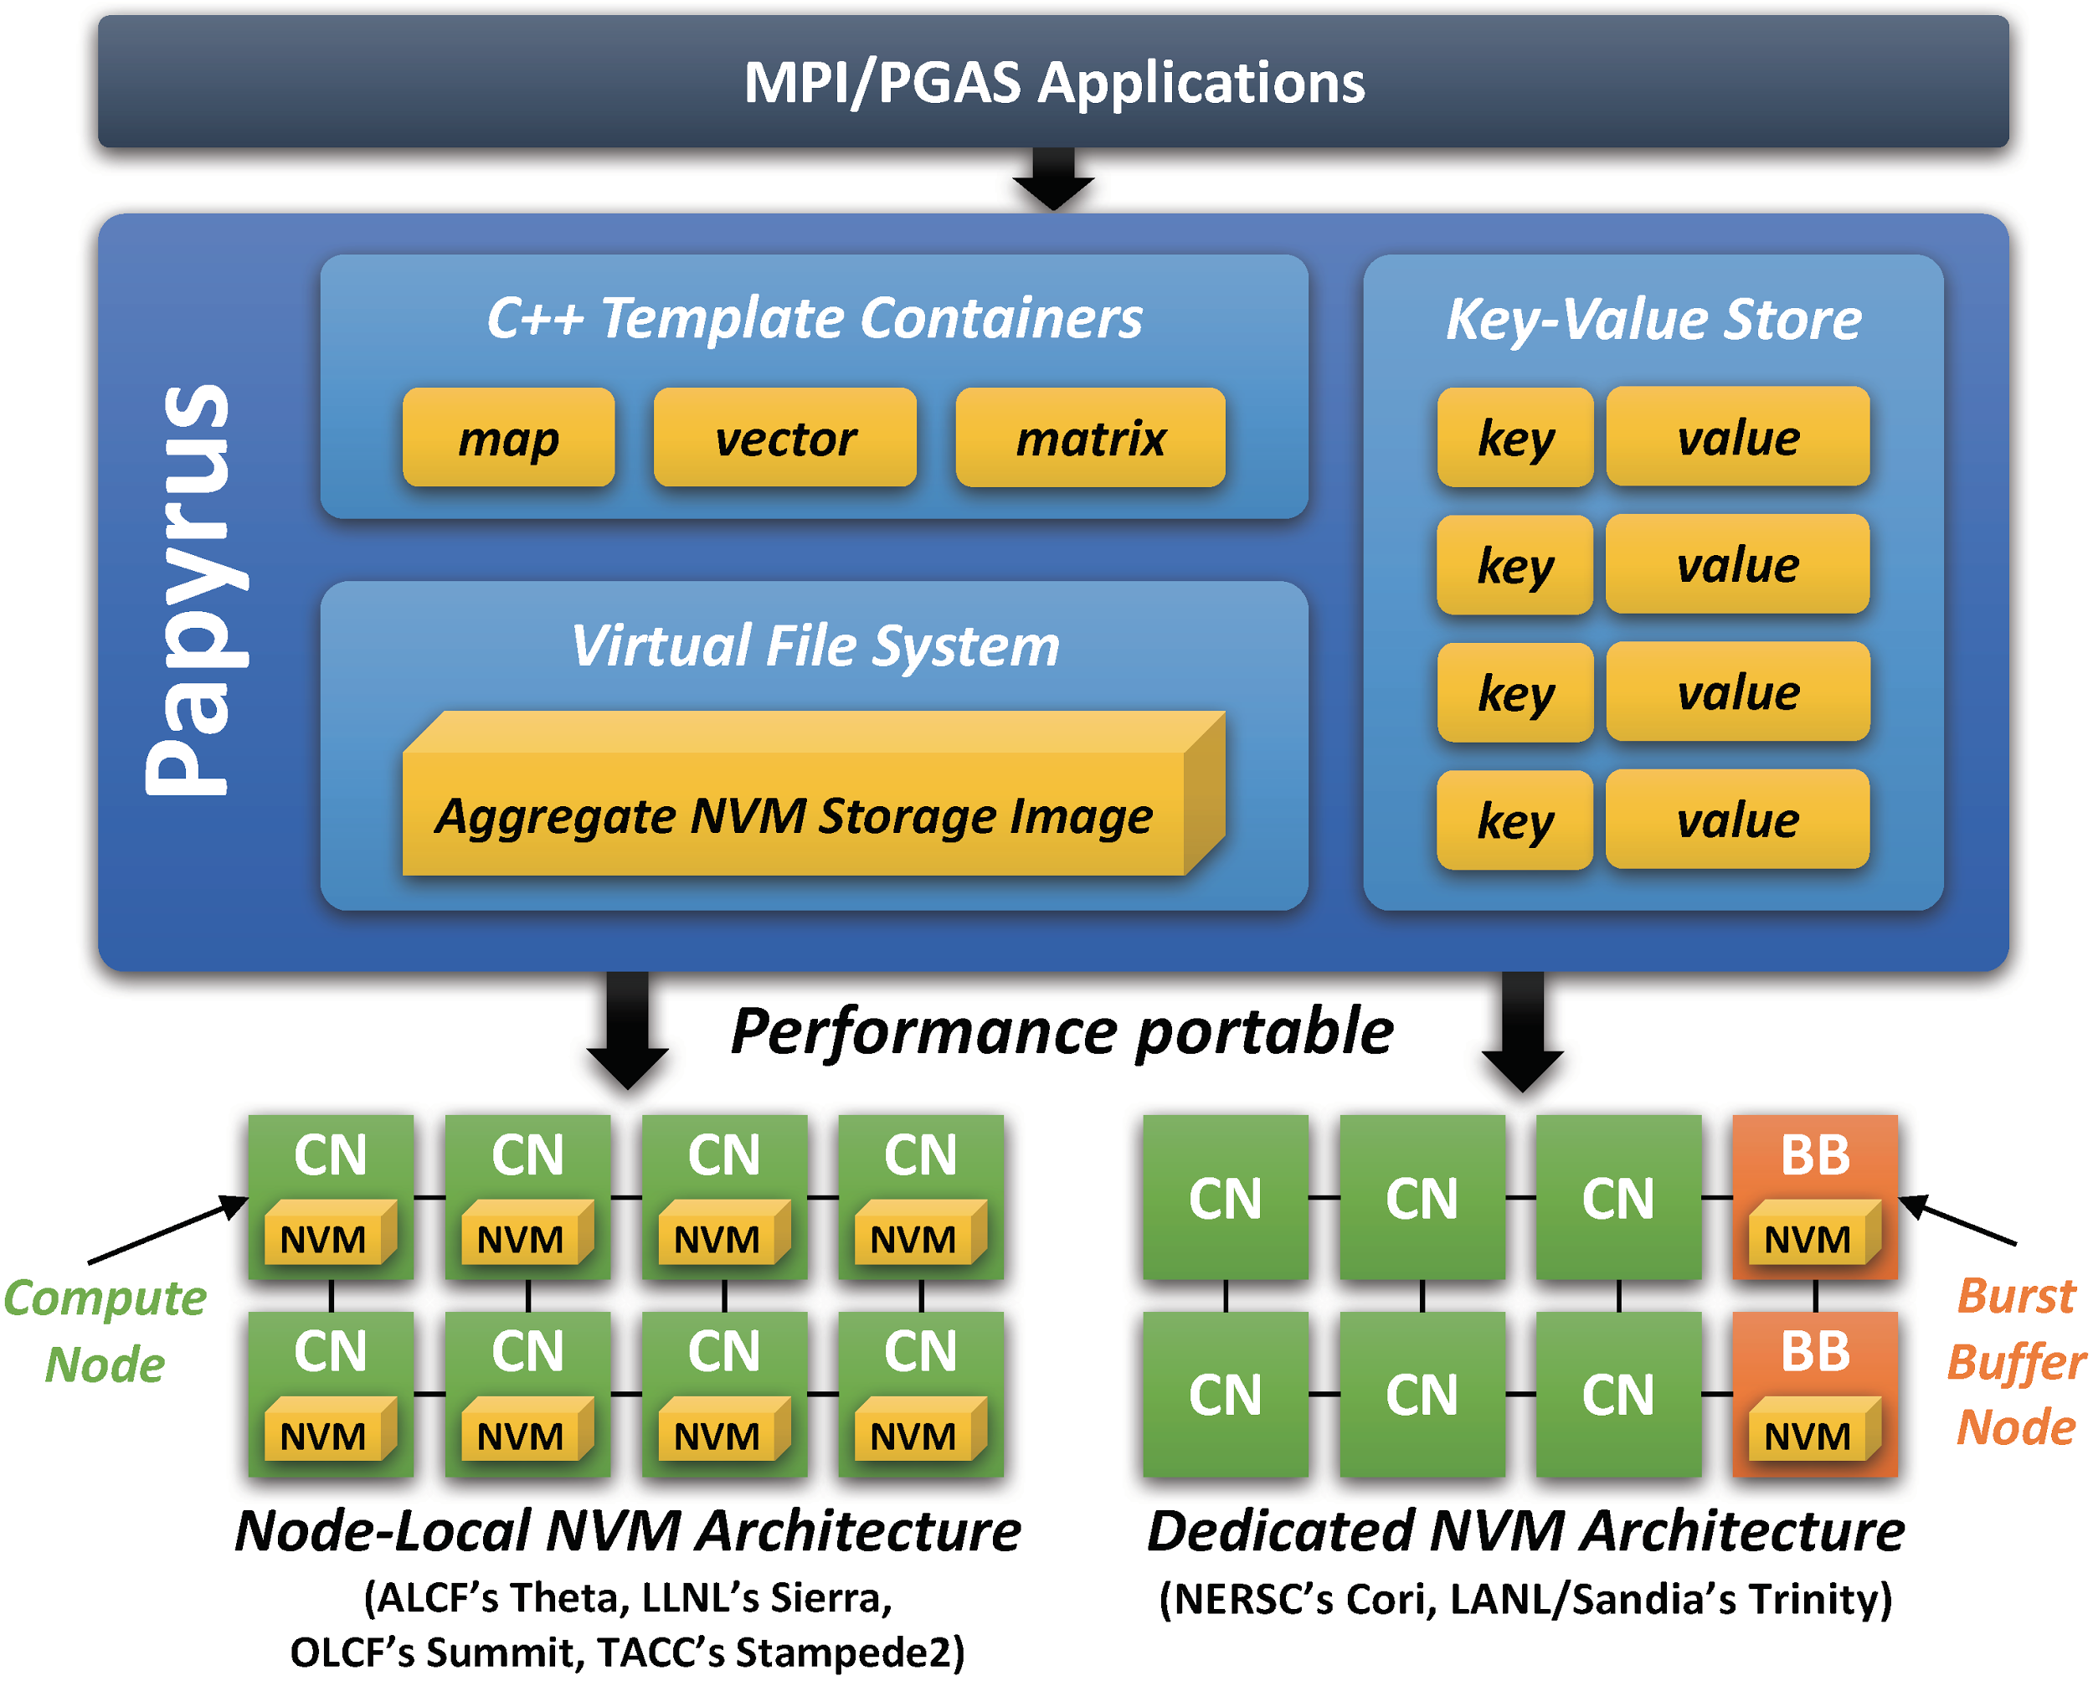
Papyrus: Parallel Aggregate Persistent Storage
Overview
  A performance-portable programming system for aggregating distributed NVM in the next-generation DOE systems
Activities
  Designed and implemented the virtual file system, C++ template containers, and key-value store
  Published technical papers in IPDPS’17 and SC’17
  Released the source code as open source software (https://code.ornl.gov/eck/papyrus)
Next Steps
  Port ECP applications using Papyrus and evaluate the performance on the DOE systems

Slide 23
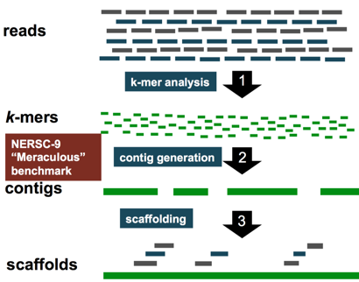
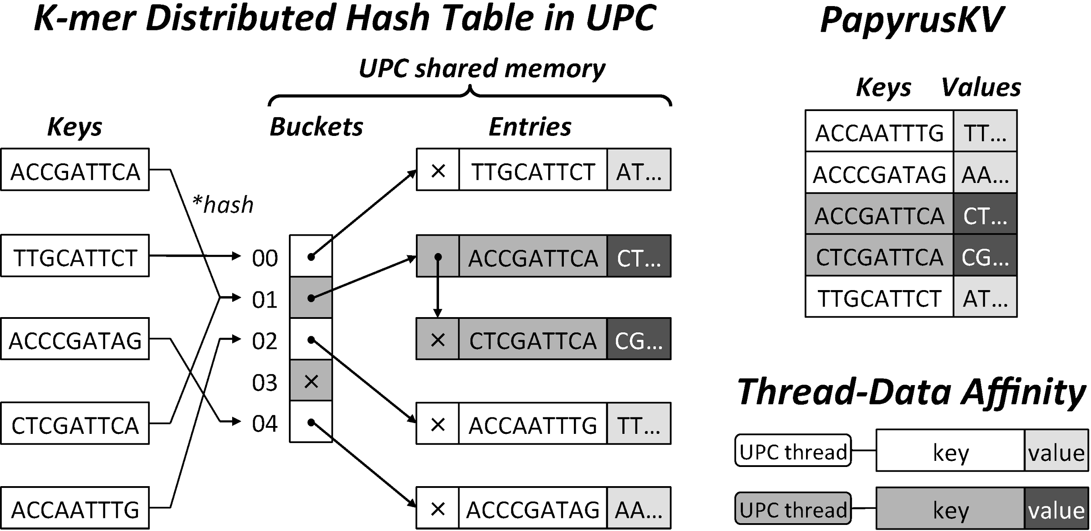
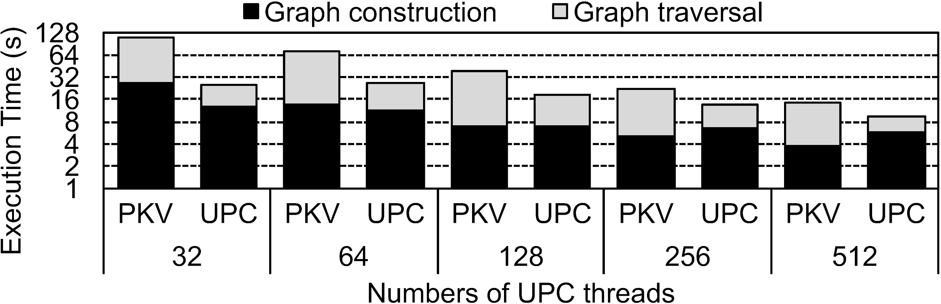
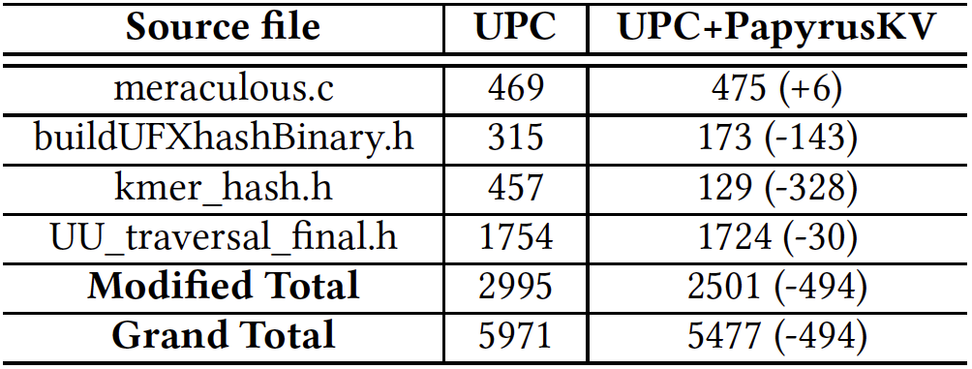
PapyrusKV: A High-Performance Parallel Key-Value Store for Distributed NVM Architectures
Embedded distributed key-value store
Advanced features for HPC
  Dynamic consistency configuration (sequential and relaxed), data protection attributes, zero-copy workflow, asynchronous checkpoint/restart
Meraculous
  ExaBiome: Exascale Solutions for Microbiome Analysis
on NERSC’s Cori
*Graphic from ExaBiome: Exascale Solutions to Microbiome Analysis (LBNL, LANL, JGI), 2017

Slide 24
Application Engagement: AMRex

Slide 25
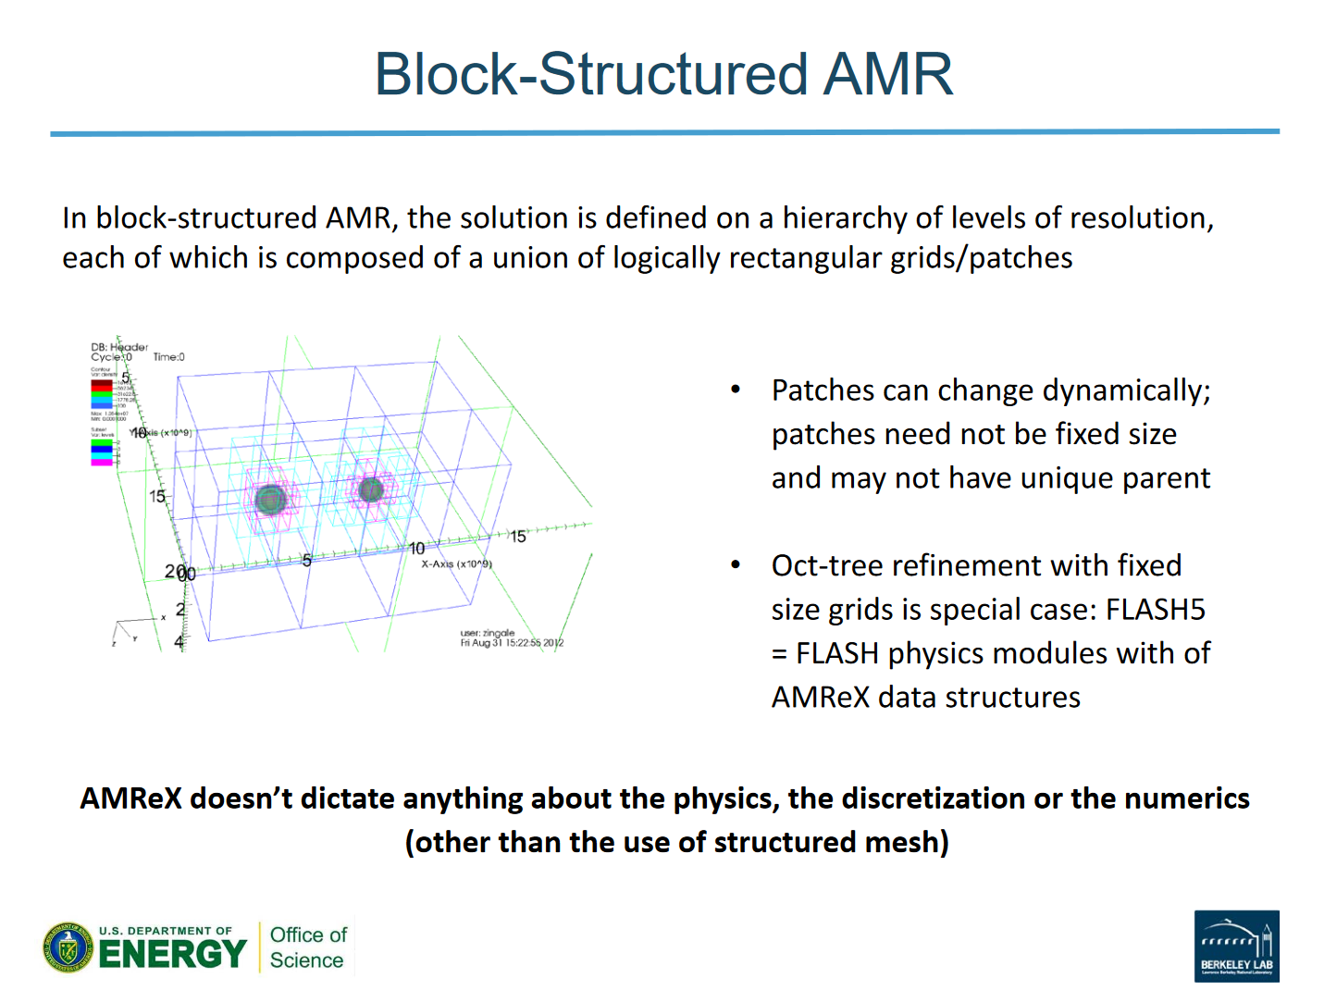
AMRex: codesign center for block structured AMR
Currently used by five ECP applications teams
Goal: move to heterogeneous architectures using a portable programming model
PROTEAS
  Initial triage of AMRex
  Analysis of initial GPU kernels
  Developed initial recommendations
  Testing recommendations now
  Work-in-progress

Slide 26
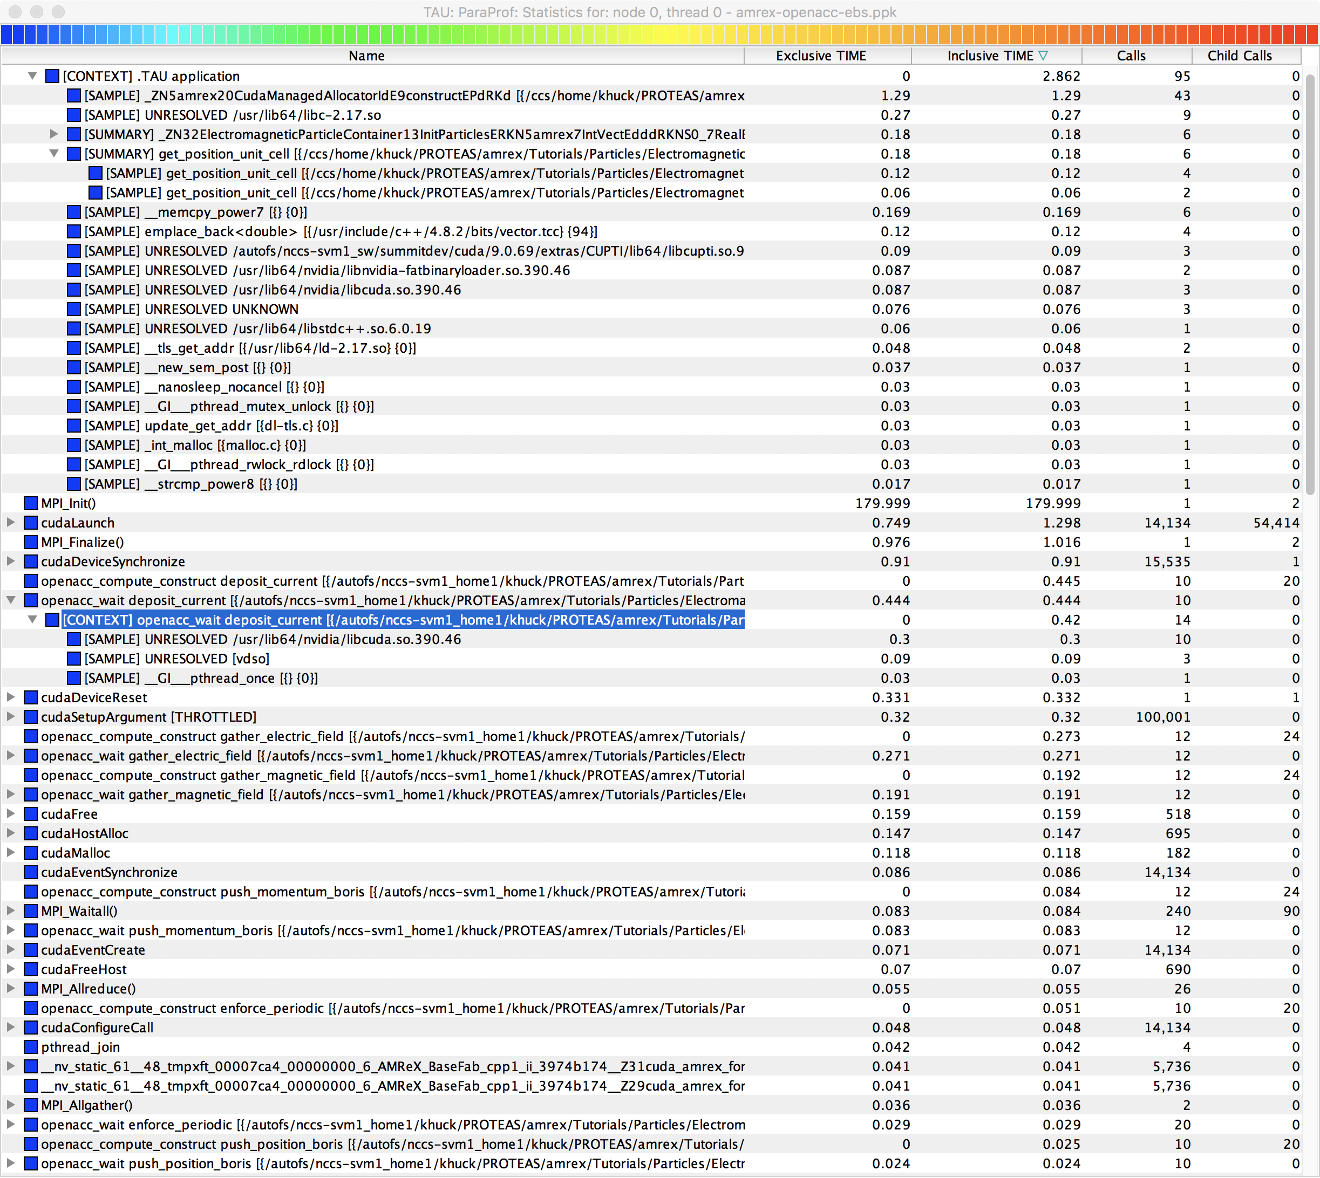
AMRex performance analysis with Tau
TAU shows application performance data using event-based sampling as well as CUDA, MPI, pthread, and OpenACC execution times on Summit-dev
This is a profile from rank 0 thread 0.

Slide 27
AMRex: optimization work in progress
1) Manually optimize memory transfers between the host and the device by using OpenACC data constructs instead of using CUDA Unified Memory.
2) Minimize memory transfers between the host and the device by porting the whole compute regions; the current implementation executes some data manipulation functions on the host, but we can port those functions to the device and update the host at the end of the main compute regions.
3) Update atomic update overheads either 1) by changing them to array reduction patterns (array reduction is experimentally supported by OpenARC, but array reduction support will be included in the next OpenACC standard release.) or 2) by changing iteration-to-thread mapping to avoid memory conflicts across different thread blocks when mapped to GPUs.
4) For nested parallel loops, we can apply OpenACC tiling directives to better exploit device local memory.

Slide 28
Assessment

Slide 29
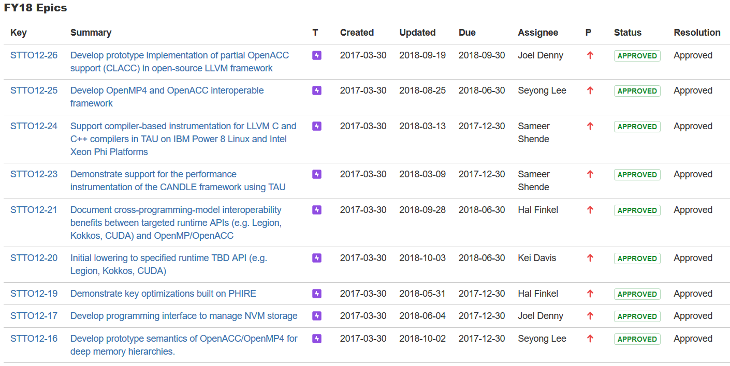
Milestones

Slide 30
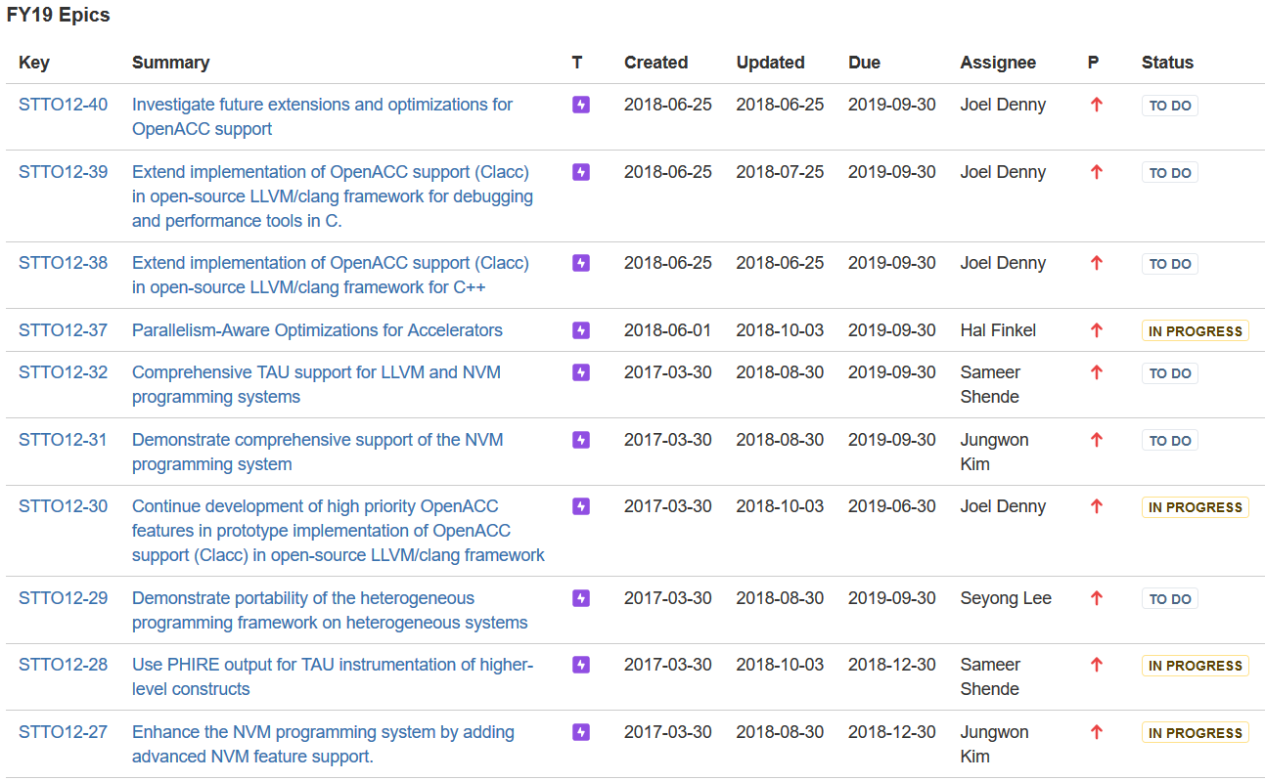

Slide 31
Delivering capabilities to stakeholders
Engagements and deployment
  Demonstrate and deploy support for the performance instrumentation of the CANDLE framework using TAU
  Demonstrate and deploy open-source OpenACC option on LLVM
  Demonstrate support for Kokkos using TAU to access high-level kernel information
  Demonstrate enhanced performance portability through the OpenMP4 and OpenACC interoperable framework and the integrated, hybrid MPI+OpenMP/OpenACC programming system.
  Deploy distributed NVM programming system (papyrus) for upcoming architectures
  Demonstrate compiler/runtime techniques to better exploit complex memory hierarchies.
History of open-source software delivery
  LLVM
  TAU
  Recent efforts: OpenACC on LLVM, Papyrus (released just last month)
  Some tools already available in OpenHPC (e.g., TAU, mpiP)
Sustainability
  Open source software
  Impact on standards, industry software, and de facto APIs
  Deployment strategies already in place for several packages
Notes:
How the project will deliver its capabilities to users.
Discuss any project history of production software delivery.
Describe planned delivery paths, in particular: open source repositories with production source installation capabilities, third parties (vendors, OpenHPC), direct to facilities.
Describe means of documentation, testing, user support, licensing, etc.

Slide 32
Software
TAU Performance System v2.27.2.p1, http://tau.uoregon.edu/downloads.php
OpenARC: Open Accelerator Research Compiler, http://ft.ornl.gov/research/openarc
Papyrus: Parallel Aggregate Persistent Storage, http://ft.ornl.gov/research/papyrus
Kitsune - LLVM + Tapir https://github.com/lanl/kitsune
Clacc: OpenACC Support for Clang and LLVM, https://ft.ornl.gov/research/clacc
LLVM: http://llvm.org/

Slide 33
Recent Publications
Joel E. Denny, Seyong Lee, and Jeffrey S. Vetter. "Clacc: Translating OpenACC to OpenMP in Clang." In LLVM-HPC2018: The Fifth Workshop on the LLVM Compiler Infrastructure in HPC, November 2018.
Doerfert, Johannes, and Hal Finkel. "Compiler Optimizations for OpenMP." In International Workshop on OpenMP (IWOMP'18), pp. 113-127. Springer, 2018. https://doi.org/10.1007/978-3-319-98521-3_8
Doerfert, Johannes, and Hal Finkel. "Compiler Optimizations for Parallel Programs." In International Workshop on Languages and Compilers for Parallel Computing (LCPC'18), Springer, 2018. To be published.
B. Nguyen, H. Tan, K. Davis and X. Zhang, "Persistent Octrees for Parallel Mesh Refinement Through Non-Volatile Byte-Addressable Memory," in IEEE Transactions on Parallel & Distributed Systems.
doi:10.1109/TPDS.2018.2867867
Michael Wolfe, Seyong Lee, Jungwon Kim, Xiaonan Tian, Rengan Xu, Barbara Chapman, Sunita Chandrasekaran, "The OpenACC data model: Preliminary study on its major challenges and implementations", Parallel Computing: systems & applications Volume 78, Pages 15-27, October 2018
https://doi.org/10.1016/j.parco.2018.07.003
Jungwon Kim, and Jeffrey S. Vetter. "Implementing Efficient Data Compression and Encryption in a Persistent Key-Value Store for HPC". In Proceedings of the International Conference for High Performance Computing, Networking, Storage and Analysis, Dallas, Texas, USA, November 2018.
Samuel K. Gutierrez, Kei Davis, Dorian Arnold, Randal S. Baker, Robert W. Robey, Patrick McCormick, Daniel Holladay, Jon A. Dahl, Joe Zerr, Florian Weik, Christoph Junghans. Accommodating Thread-Level Heterogeneity in Coupled Parallel Applications. In Proceedings of the IEEE International Parallel and Distributed Processing Symposium, 2017. DOI: 10.1109/IPDPS.2017.13
Sam Gutierrez, Dorian Arnold, Kei Davis, Patrick McCormick. On the Memory Attribution Problem: A Solution and Case Study Using MPI. In Proceedings of the Workshop on Exascale MPI, Supercomputing, 2017.
Mehmet E. Belviranli, Seyong Lee, Jeffrey S. Vetter, and Laxmi N. Bhuyan. Juggler: A Dependency-Aware Task Based Execution Framework for GPUs, Proceedings of ACM SIGPLAN Symposium on Principles and Practice of Parallel Programming (PPoPP), Vösendorf/Wien, Austria, 2018.

Slide 34
Project Costs from ECP Oct Report for FY17
ORNL 78.1%
UO 95%
ANL 17.8%
LANL 40.4%
ECP delay in getting funding to UO had a delay but was able to accelerate work.
ANL
  Difficulty hiring; new postdoc started in Feb
LANL
  Staffing change in personnel; now fully staffed.
Notes:
What are your project costs so far (total and by institution expressed as a percent of an annual allocation)? How do they compare to your spend plan? If different than the plan, why? What is your remaining carryover from FY17 (in $ and as a percentage of FY17 funding)?

Slide 35
Project risks and issues
Unknown ECP architectures (critical at this software level)
  Access to information and testbed
  Software integration and testing environment
  Architecture silos
    LLVM extensions for selective instrumentation appearing in Intel compilers
Application adoption
  Experiences from GPUs and Manycore
  Not enough support for deployment and training
Notes:
Project risks and issues (1-2)
Discuss technical, programmatic, or personnel risks and issues and how you plan to address and manage them.
What can ECP (in particular ST) do better or differently to help you succeed?

Slide 36
Bonus Material

Slide 37
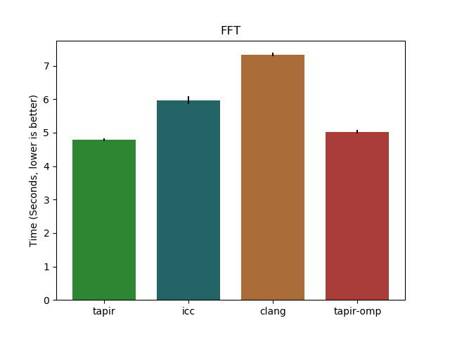
OpenMP Tapir Front-end
Parallel optimizations of OpenMP using LLVM + Tapir (a parallel IR extension from MIT)
Outperforms state of the art
Path towards full optimizing OpenMP compiler
Collaborating with Intel, MIT, UIUC, and others on further LLVM extensions for parallel-programming models
Graph shows performance on dual socket haswell of Barcelona OpenMP Task Suite’s fast fourier transform (FFT) benchmark. ‘tapir’ is a cilk backend, while ‘tapir-omp’ is an OpenMP backend for Tapir. Shows that tapir enables targeting multiple backends with the same code, while providing better performance than the current state of the art. Experiments on LLVM proj OMP backends.
Notes:
Graph shows performance on Barcelona OpenMP Task Suite’s fast fourier transform (FFT) benchmark. ‘tapir’ is a cilk backend, while ‘tapir-omp’ is an OpenMP backend for Tapir. Shows that tapir enables targeting multiple backends with the same code, while providing better performance than the current state of the art. Experiments on LLVM proj OMP backends.

Slide 38
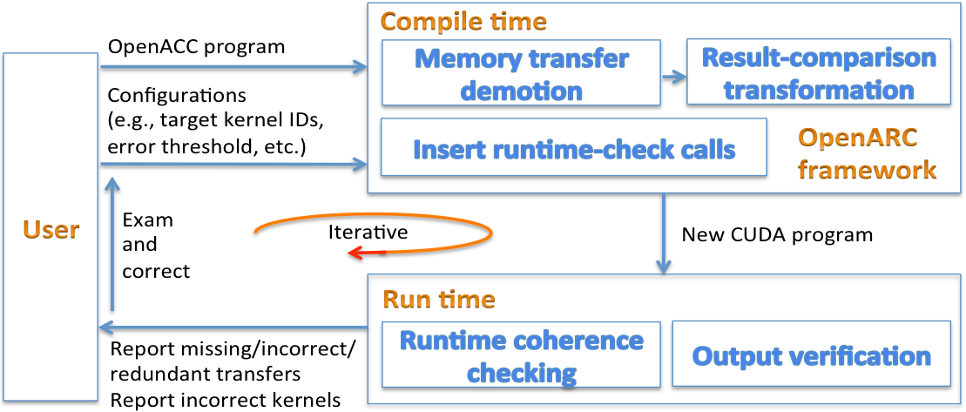
Directive-Based, Interactive Debugging and Optimization
Overview
  Enhance and deploy a directive-based, interactive program debugging and optimization system, which enables intuitive and synergistic integration among users, compilers, and runtimes for productive and efficient accelerator computing.
Activities
  Debugged and optimized the base framework.
  Released the initial version as a part of the OpenARC repository (http://ft.ornl.gov/research/openarc).
Next Steps
  Apply the framework to debug and optimize ECP applications while porting to OpenACC.

Slide 39
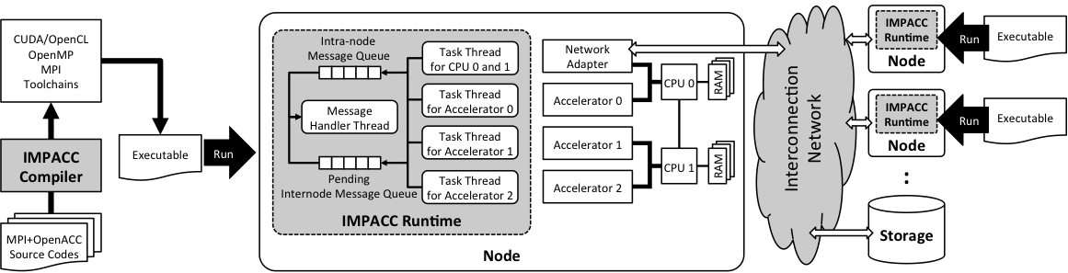
IMPACC: A Framework for Adaptive Integration of MPI and OpenACC
Overview
  Enhance and deploy IMPACC, a framework that tightly integrates both MPI and OpenACC programming models to reduce redundant data movement and excessive synchronization.
Activities
  Debugged and optimized the base framework.
  Released the initial version as a part of the OpenARC repository (http://ft.ornl.gov/research/openarc).
Next Steps
  Port ECP applications using IMPACC and evaluate the performance.

Slide 40
Porting a Transport Algorithm in the Shift MC Solver to Heterogeneous Architectures using OpenACC
Overview
  Develop an OpenACC version of an MC transport algorithm in the Shift MC Solver, which is portable across diverse heterogeneous architectures, such as NVIDIA/AMD GPUs, Intel Xeon Phis, Altera FPGAs, etc.
    Use the existing CUDA version of Profugus, a min-app of the Shift MC Solver, as a base version.
    Use directive extensions and interactive debugging/optimization tools of OpenARC from ECP-PROTEAS for efficient porting.
Activities
  Partially ported the CUDA codes into the OpenACC version.
Next Steps
  Continue to port the CUDA version into a standard OpenACC version.
  Enhance the OpenACC version using extended OpenACC features (OpenACC-e) to minimize the performance gap between the high-level OpenACC and the low-level CUDA.
  Evaluate the performance portability of the OpenACC version on heterogeneous architectures (e.g., NVIDIA/AMD GPUs to Intel Xeon Phi and FPGAs).

Slide 41
Guidance: 30 minute presentation + 10 min questions
Topics to cover (with suggested slide count)
Project Overview (1-2)
  Review the goal(s) of the project: team, funding level, impact goals and metrics, etc.
Project Plan (1-2)
  Describe your plan and roadmap: Focus on FY18 but also provide some details on FY19.
Self-assess your project in 5 categories (<15) Describe:
  How the project is important or essential to achieving sustainable, production-level computing capabilities for ECP.
    Focus on the new capabilities that ECP is funding, not the general capabilities represented your project.
    Address what ECP would lack if your project could not deliver.
    Discuss the project’s clients and users, and the importance of your efforts to helping them achieve ECP goals.
  Project deliverables for 2019 and (assuming continuous funding) deliverables in the ECP timeframe (2021 - 2023).
  How the project will deliver its capabilities to users.
    Discuss any project history of production software delivery.
    Describe planned delivery paths, in particular: open source repositories with production source installation capabilities, third parties (vendors, OpenHPC), direct to facilities.
    Describe means of documentation, testing, user support, licensing, etc.
  Progress toward the project's milestones.
    List project impact goals and impact metrics.
    Review and highlight completed milestones.
    Discuss progress toward integration with applications, other ST projects, vendors, and facilities and platform readiness.
    Discuss progress on software performance, scalability, and portability.
  Relationships with other software (from any source) and other ECP efforts.
    List project dependencies (you depend on others and others depend on you) that are not ECP apps.
    Discuss projects with similar capabilities, and distinguishing features you want to highlight.
    Discuss collaborating projects and any relationships with ECP HI (co-design, PathForward, DSE) efforts.
Project costs (1)
  What are your project costs so far (total and by institution expressed as a percent of an annual allocation)? How do they compare to your spend plan? If different than the plan, why? What is your remaining carryover from FY17 (in $ and as a percentage of FY17 funding)?
Next steps: focus on FY18 plans and milestones (1-2)
Project risks and issues (1-2)
  Discuss technical, programmatic, or personnel risks and issues and how you plan to address and manage them.
  What can ECP (in particular ST) do better or differently to help you succeed?

Slide 42
TAU: Tuning and Analysis Utilities
  Application measurement system for a broad array of parallel programming models, languages, and platforms. Source and binary instrumentation automation, library wrapper support, and sampling. Visual and automated analysis tools, with file conversion support to other profile and trace visualization and analysis tools.
  Measurement and analysis support for numerous models, platforms and languages such as MPI, OpenMP, SHMEM, Posix Threads, CUDA, C/C++, Fortran, Python, Spark, Java, UPC, Cray, IBM BG/*
Released TAU v2.26.2 and v2.27, PDT v3.25, updated HPCLinux (hpclinux.org)
Added compiler-based instrumentation for Clang C/C++ compilers on Cray XC and IBM Power Linux
Added, improved Kokkos integrated profiling interface
Updates for CUPTI/CUDA 9.0 and OpenACC
Presented ECP webinar, ALCF developer webinar, SC17 tutorial
Python + CUDA support updated to support CANDLE project

Slide 43
Engagement: TAU’s support for Kokkos Profiling Interface
TAU defines Kokkos profiling API routines.
TAU preloads a DSO and registers callback routines.
Generates profiles and/or OTF2 native traces for Vampir.
No need to modify the application! It works with Trilinos/Kokkos.
High level kernel names visible in profiles and traces.
Supports all of TAU’s measurements - callsite profiling, traces, etc.
Updated API now available in TAU v2.27 (November 2017).

Slide 44
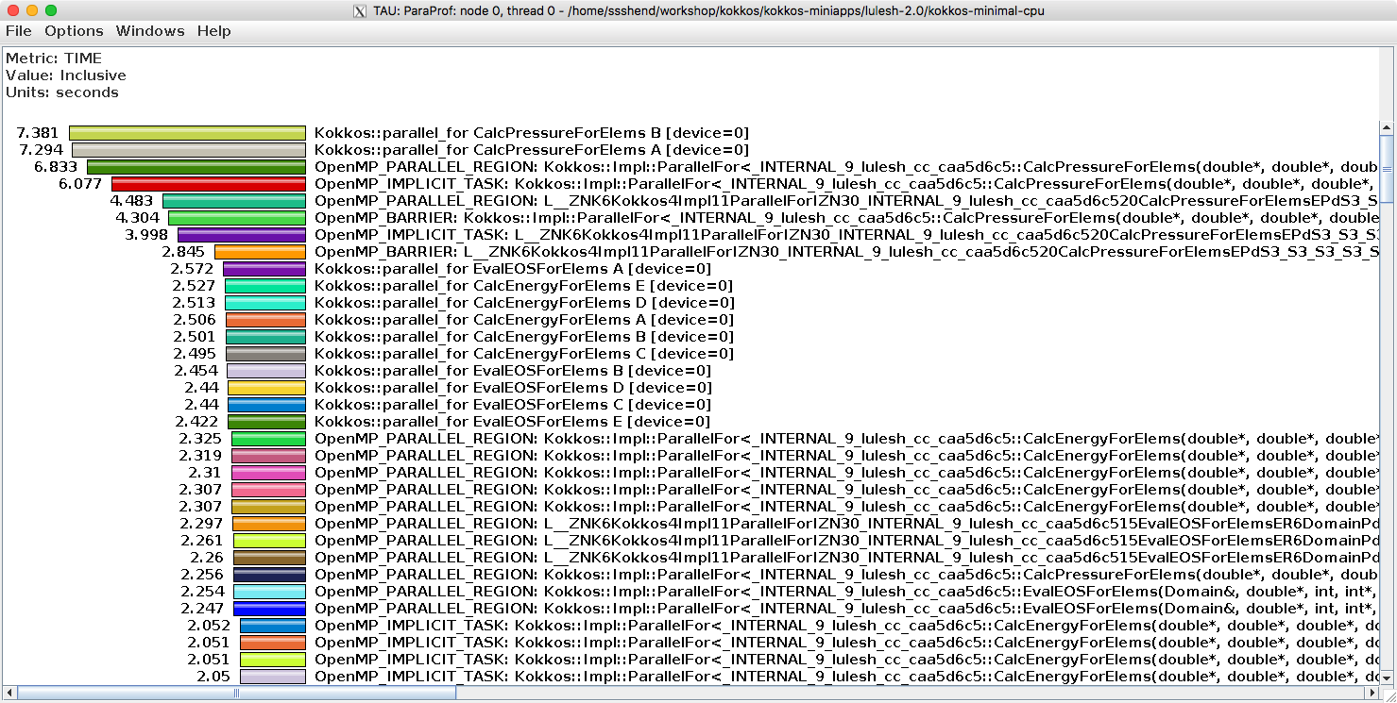
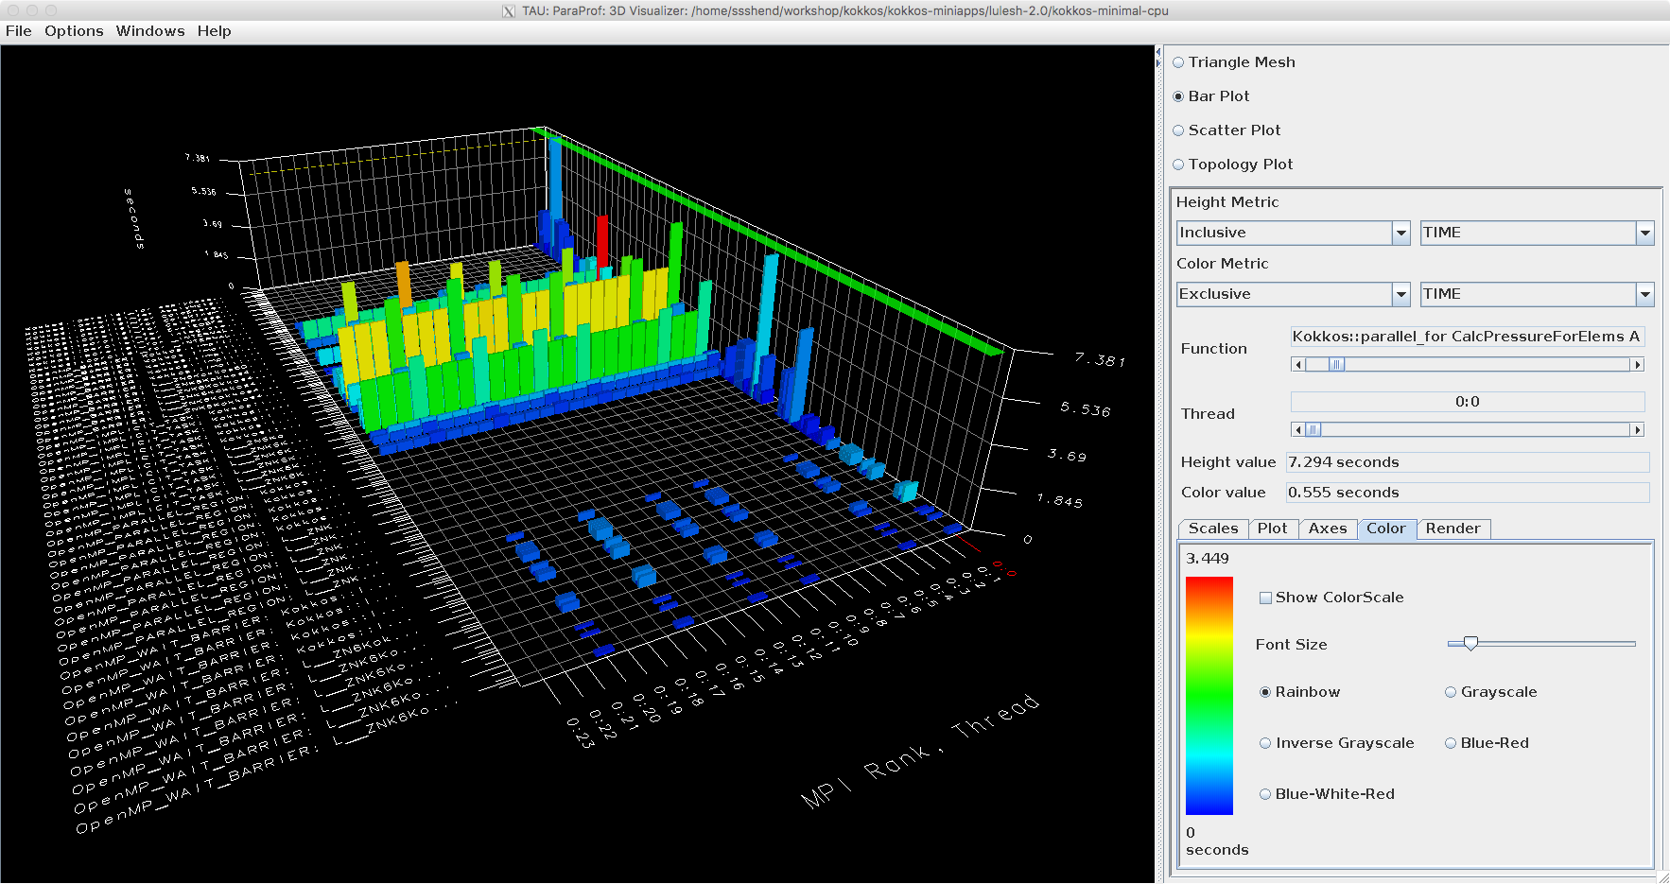
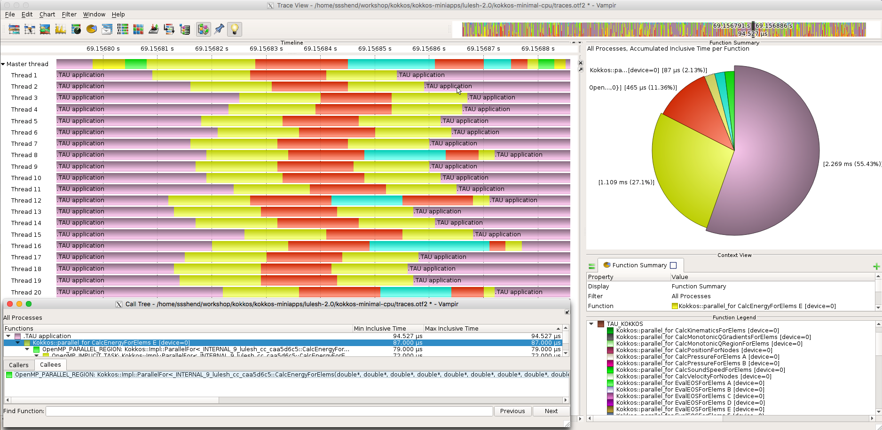
TAU’s support for Kokkos in ParaProf and Vampir [TUD]

Slide 45
Engagement: TAU’s support for CANDLE ECP Application
TAU extended to support Python with CUDA (for Titan) and Python with OpenMP replacement library for OMPT (for Theta).
TAU instruments CANDLE P3B1 benchmark on Titan and Theta.
No modifications are needed to CANDLE.
Tau_python script launches CANDLE.
TAU preloads Python instrumentation library and OMPT/CUDA.
Compare performance of CANDLE code with different Python packages.

Slide 46
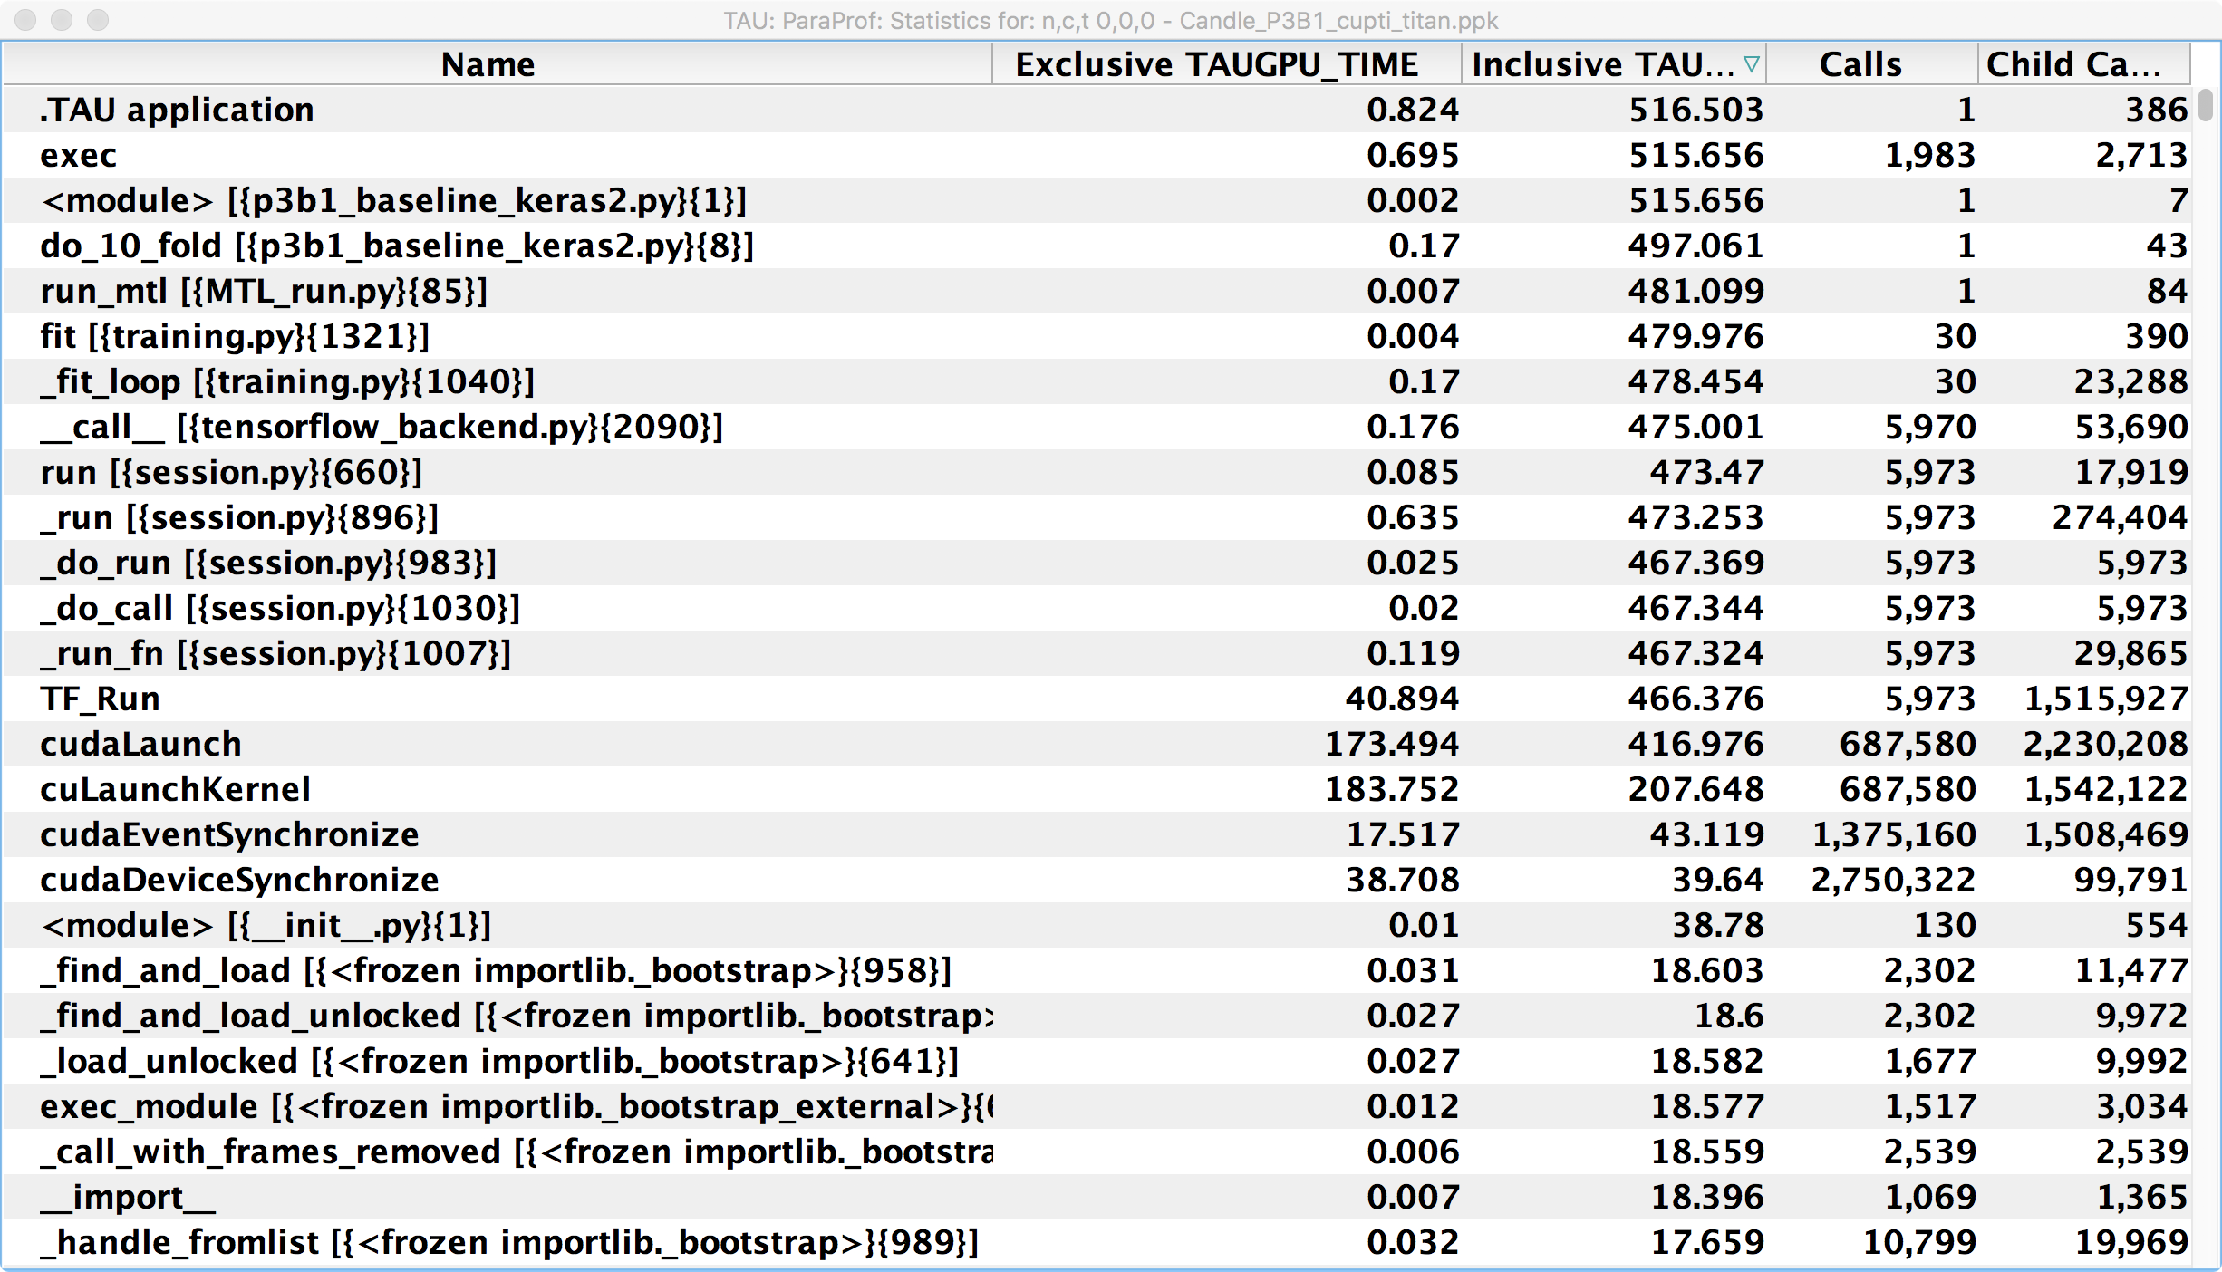
TAU with CANDLE
Pilot 3
Benchmark 1

Slide 47
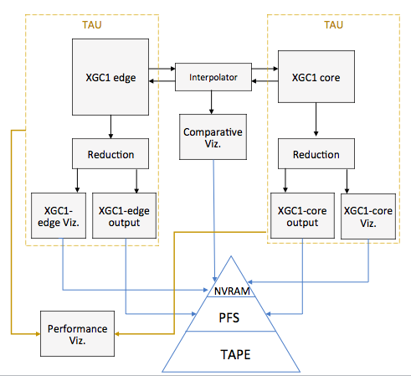
Engagement: CODAR, ADIOS Interaction
  Workflow performance data aggregation utilities for CODAR
    Combine performance profiles/traces from multiple parallel applications into one data source for analysis
  Callback API added to ADIOS 1.12, updated in 1.13 for generic tool integration, TAU support added in v2.27 release
  TAU, SOS (Scalable Observation System) used in CODAR XGC code-coupling integration demo at SC17 for runtime performance visualization

Slide 48
Capabilities for ECP
Not surprisingly, ECP applications would lose options and time in these topics if PROTEAS could not deliver: LLVM enhancements, OpenACC, NVM software, scalable performance analysis, etc.
Notes:
How the project is important or essential to achieving sustainable, production-level computing capabilities for ECP.
Focus on the new capabilities that ECP is funding, not the general capabilities represented your project.
Address what ECP would lack if your project could not deliver.
Discuss the project’s clients and users, and the importance of your efforts to helping them achieve ECP goals.

