Slide 1
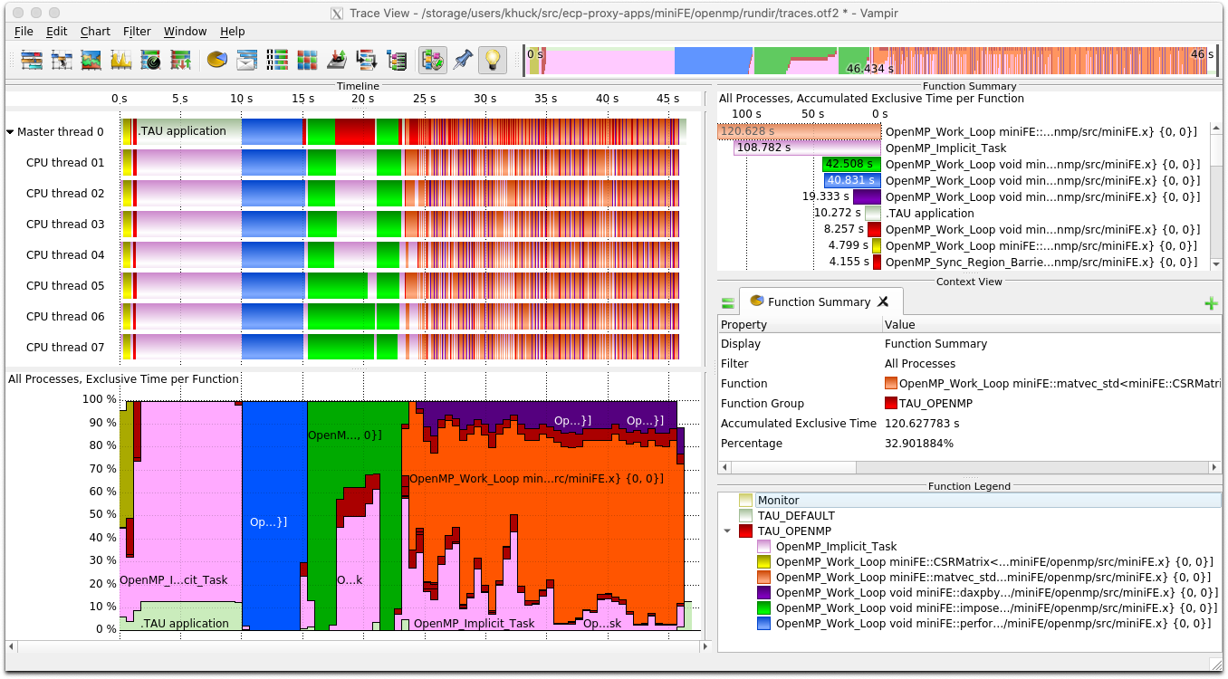
PROTEAS-TUNE Milestone STDT10-21:
Updated support for OMPT interface for measurement of OpenMP applications
ECP WBS | PROTEAS-TUNE STDT10-21.
PI | Jeffrey Vetter, ORNL
Members | U. Oregon, ANL, LANL, LBL, ORNL, U. Utah
Scope and objectives
Support in TAU for OMPT measurement
  OpenMP 5.0 specification includes requirements for OpenMP Tools (OMPT) support for both compiler/runtime and tool developers.
  TAU support was updated to the official OpenMP 5.0 specification
  Tested with compilers/runtimes that support OMPT, including Intel 19+, LLVM 8+ and GCC 7+
  Available in TAU release v2.29.1
  Evaluated with ECP Proxy applications that use OpenMP, such as miniFE and miniQMC.
TAU was used to collect profiles and traces of ECP proxy applications like miniFE (shown), observing OpenMP parallel regions, loops and synchronization without application instrumentation
Impact
  Enables measurement of internal OpenMP behavior without instrumentation
Deliverables | See milestone report for STDT 10-21. Updated support in the most recent TAU release available at http://tau.uoregon.edu and http://github.com/UO-OACISS/tau2

