Slide 1
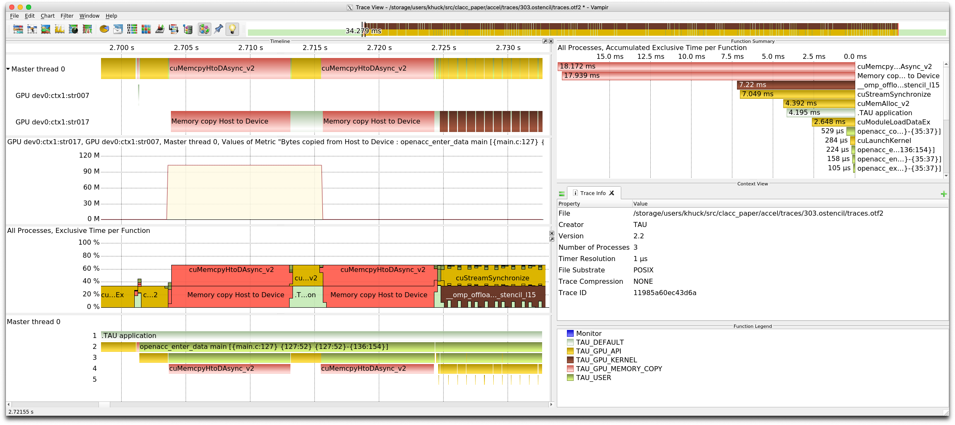
PROTEAS-TUNE Milestone STDT10-23:
TAU support for Clacc OpenACC runtime
ECP WBS | PROTEAS-TUNE STDT10-23.
PI | Jeffrey Vetter, ORNL
Members | U. Oregon, ANL, LANL, LBL, ORNL, U. Utah
Scope and objectives
Support in TAU for OpenACC measurement
  Clacc OpenACC implementation uses the LLVM OpenMP runtime, but did not provide the OpenACC profiling callbacks.
  Clacc implementation was updated to provide an OpenMP OMPT event handler to provide corresponding OpenACC profiling event support
  TAU OpenACC support was updated to work with the provided profiling event interface
  Tested with OpenACC benchmarks and current Clacc
  Available in next TAU release
TAU was used to collect profiles and traces of OpenACC benchmarks (303.stencil shown), observing OpenACC regions and device offload events without application instrumentation
Impact
  Enables measurement of internal OpenACC behavior without instrumentation
Deliverables | See milestone report for STDT 10-23. Updated support in the most recent TAU master branch available at http://github.com/UO-OACISS/tau2

