Slide 1
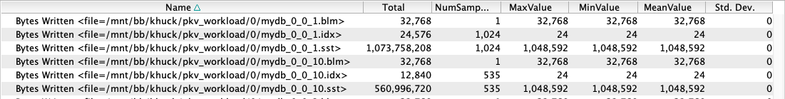
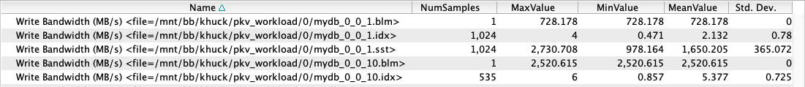
PROTEAS Milestone STTO12-32: Comprehensive TAU support for LLVM and NVM programming systems
ECP WBS | PROTEAS STTO12-32.
PI | Jeffrey Vetter, ORNL
Members | U. Oregon, LANL, ANL, ORNL
Scope and objectives
Support in TAU for Flang profiling and I/O measurement
  Objectives:
  Add support for LLVM FLANG, C and C++ compilers
  Add support for NVM measurement with TAU
  Scope: Demonstrate TAU profiling with new support
  Motivation: TAU previously lacked support for Flang compiler-based instrumentation or PDT-based instrumentation. Improve our ability to measure I/O performance for all filesystems, including NVM.
Tracking bytes written to Summit burst buffers and computing bandwidth rates on a per-file basis.
Impact and accomplishments
  Release provides LLVM Flang support in TAU.
  Instrumentation of PapyrusKV library and measurement of filesystem I/O performance helps understand NVM latency times and bandwidth rates.
Instrumentation of PapyrusKV library provides insight into asynchronous threaded library details when benchmarking 16 MPI ranks, 10k iterations with 16B keys, 1MB values on Summit using local NVM burst buffers.
Deliverables | TAU with support for Flang and operating system I/O measurement: http://tau.uoregon.edu/tau2.tgz

