Slide 1


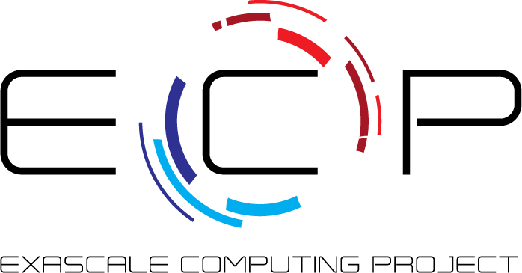


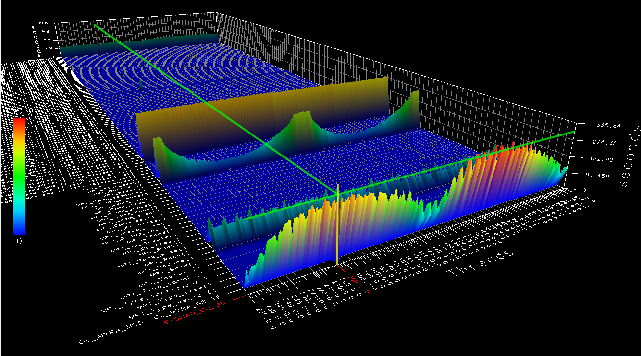
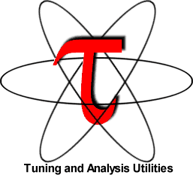
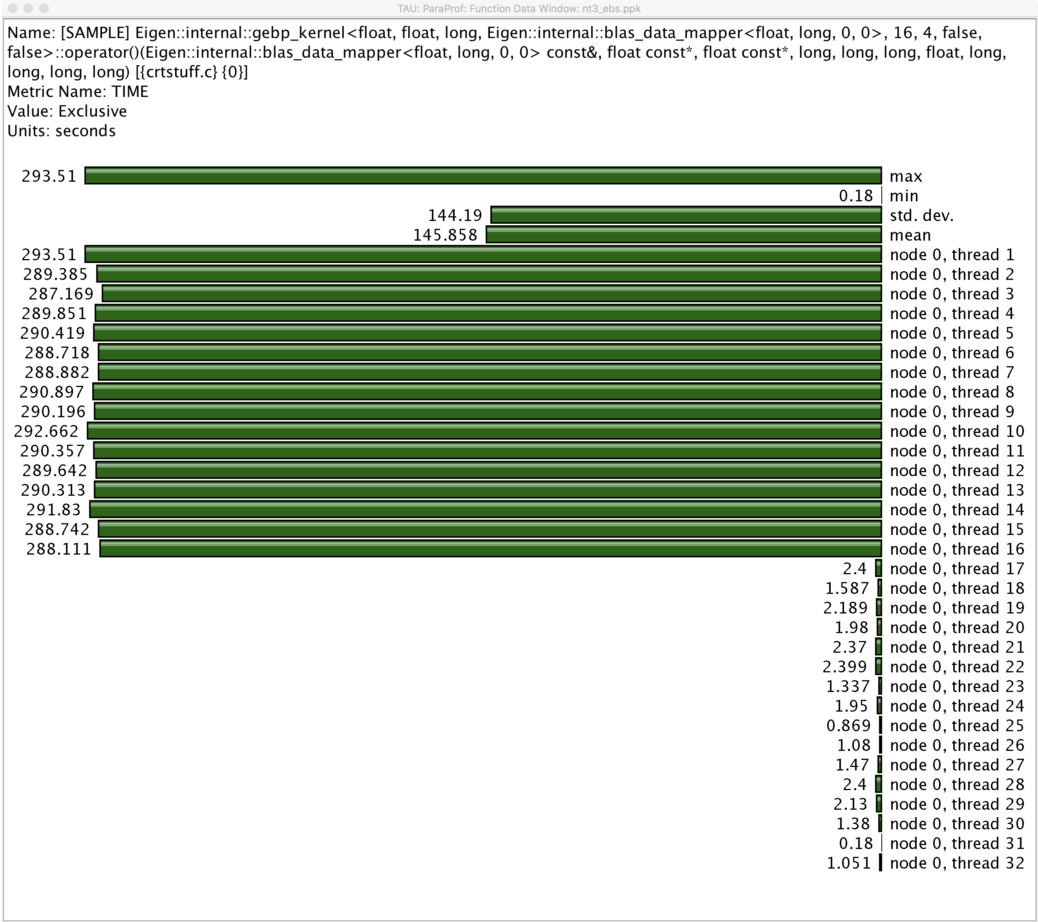
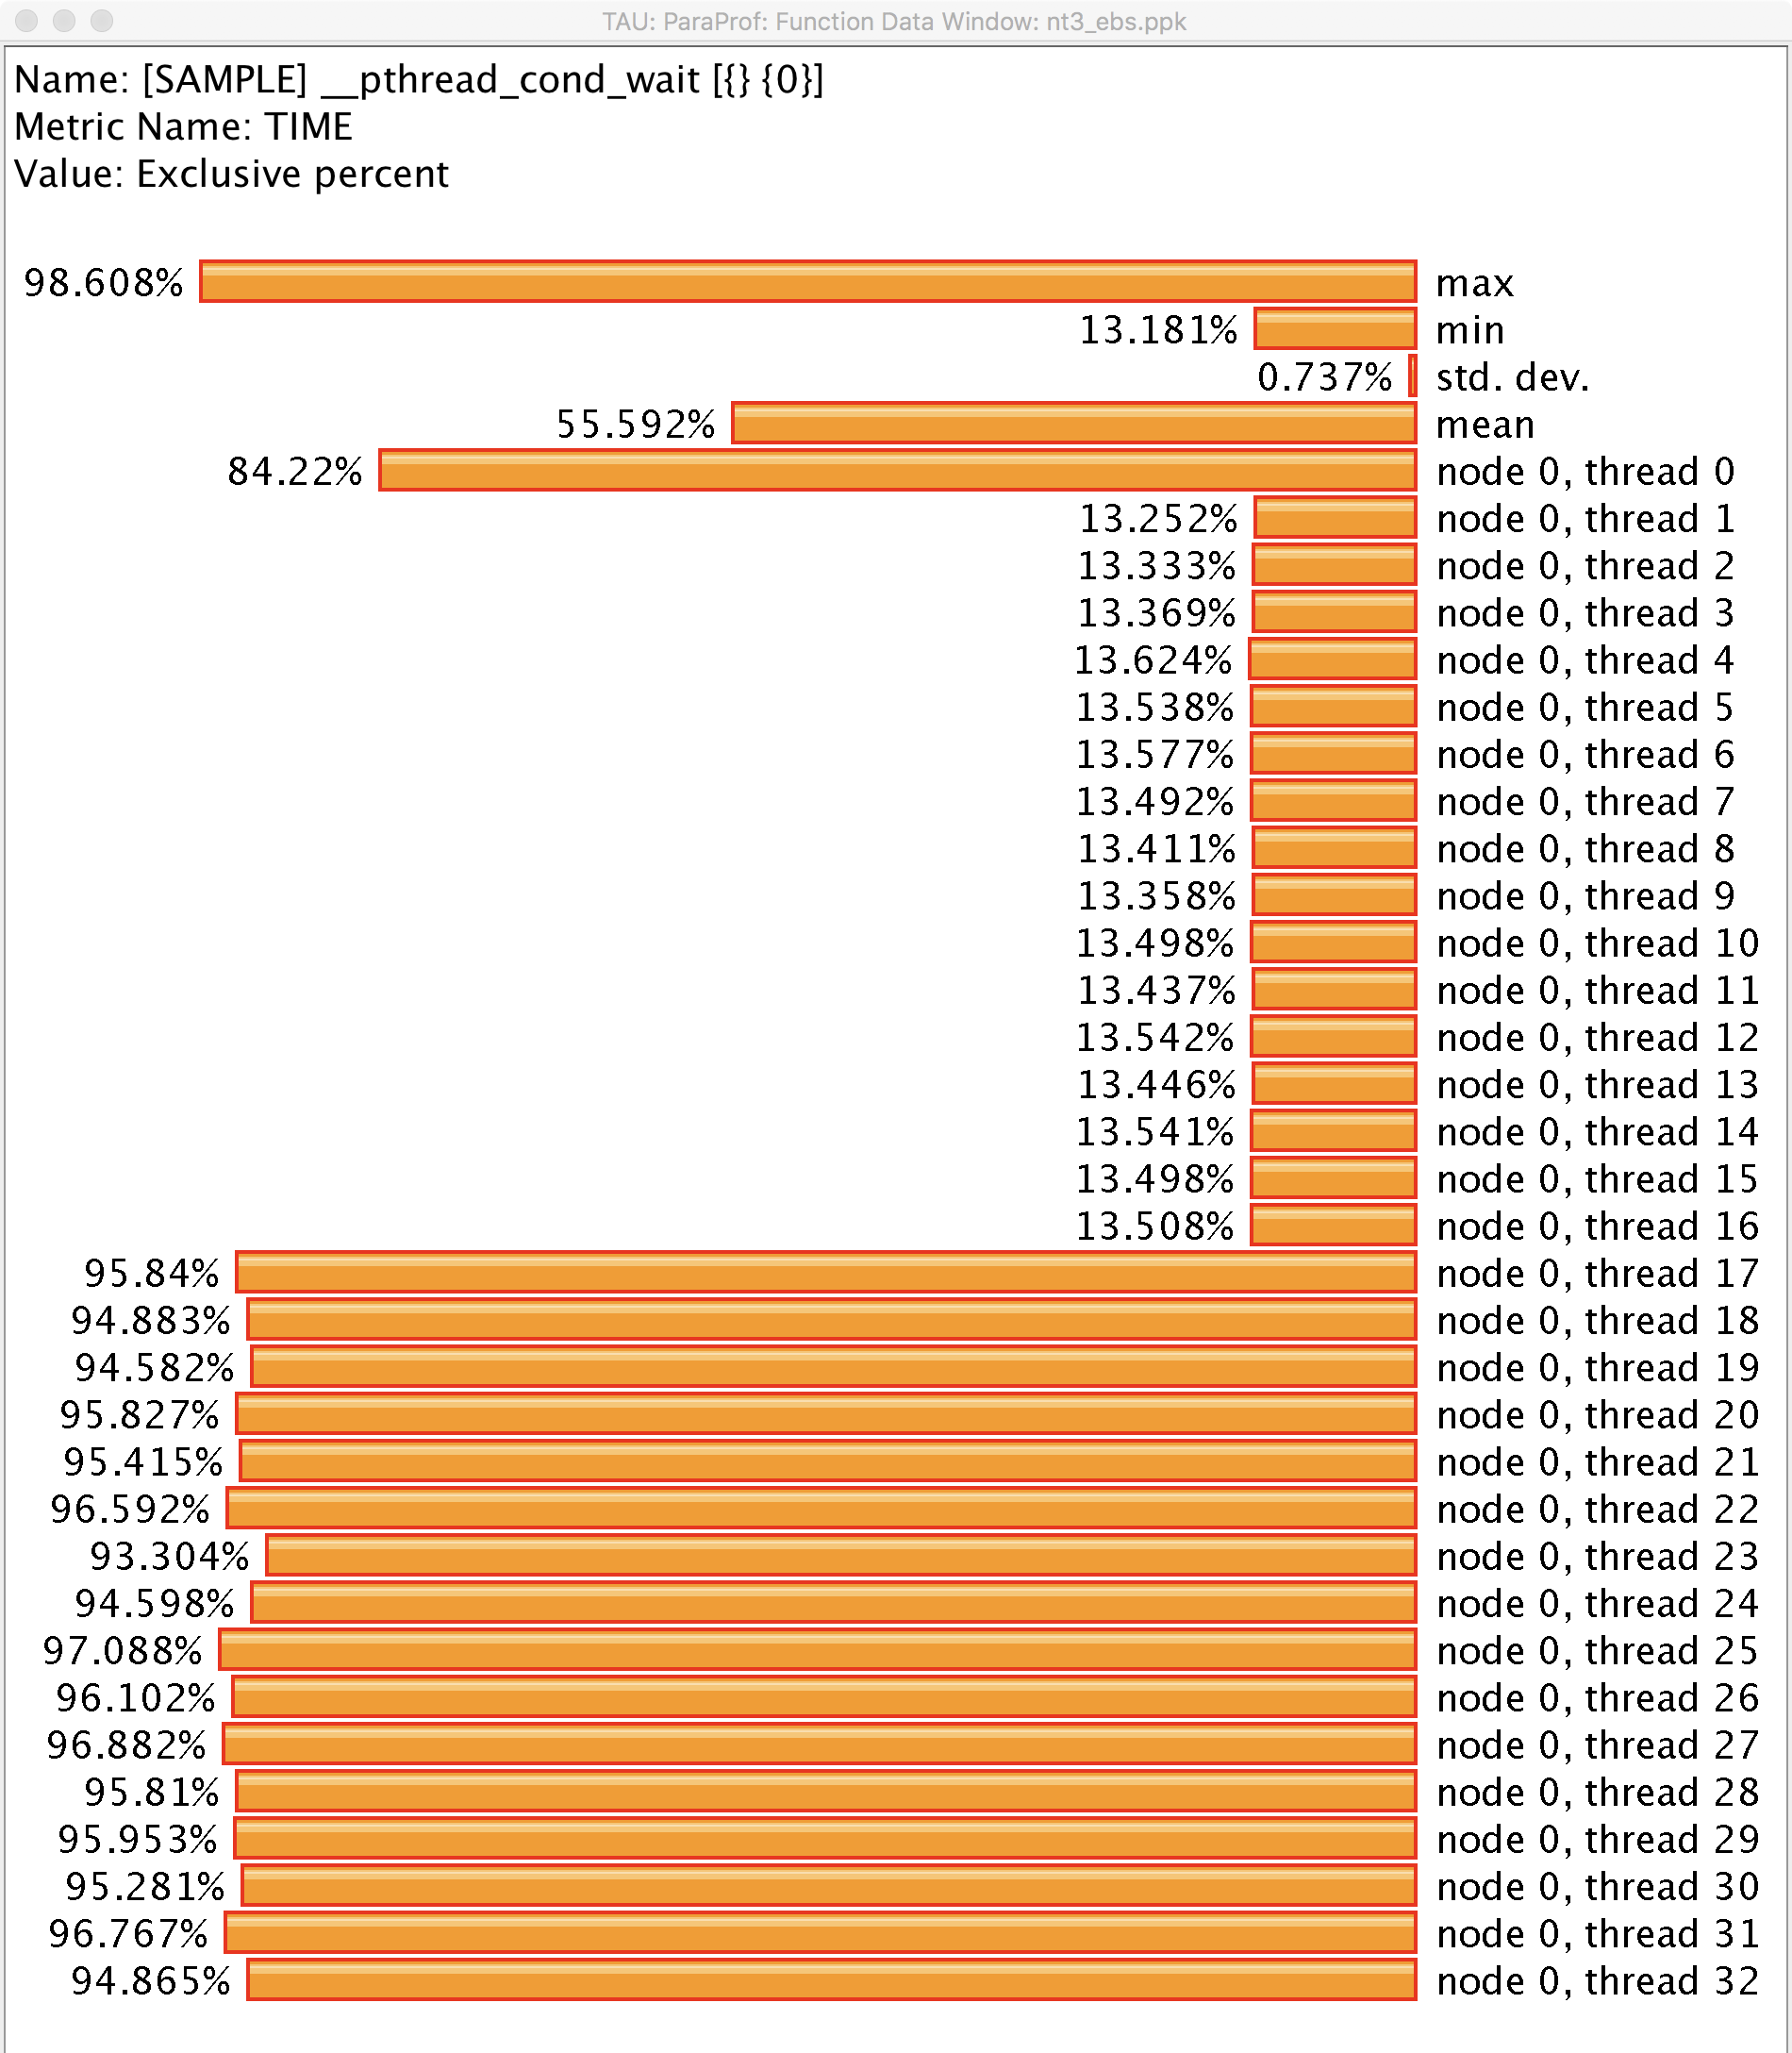
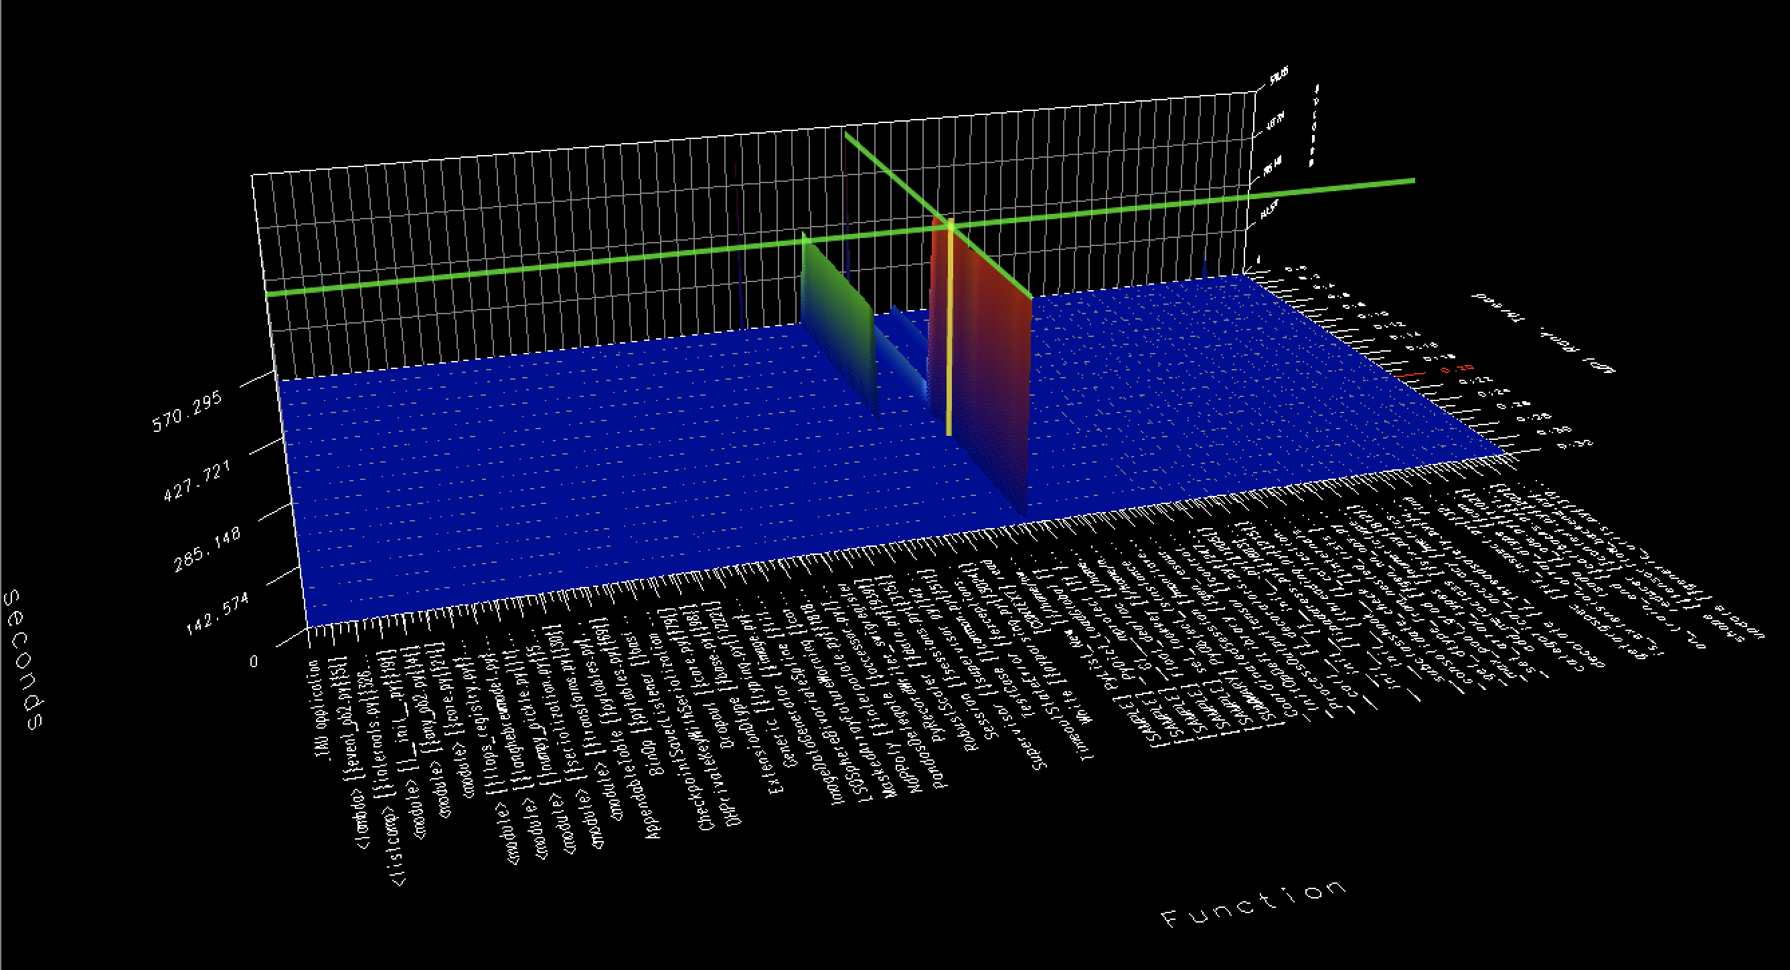
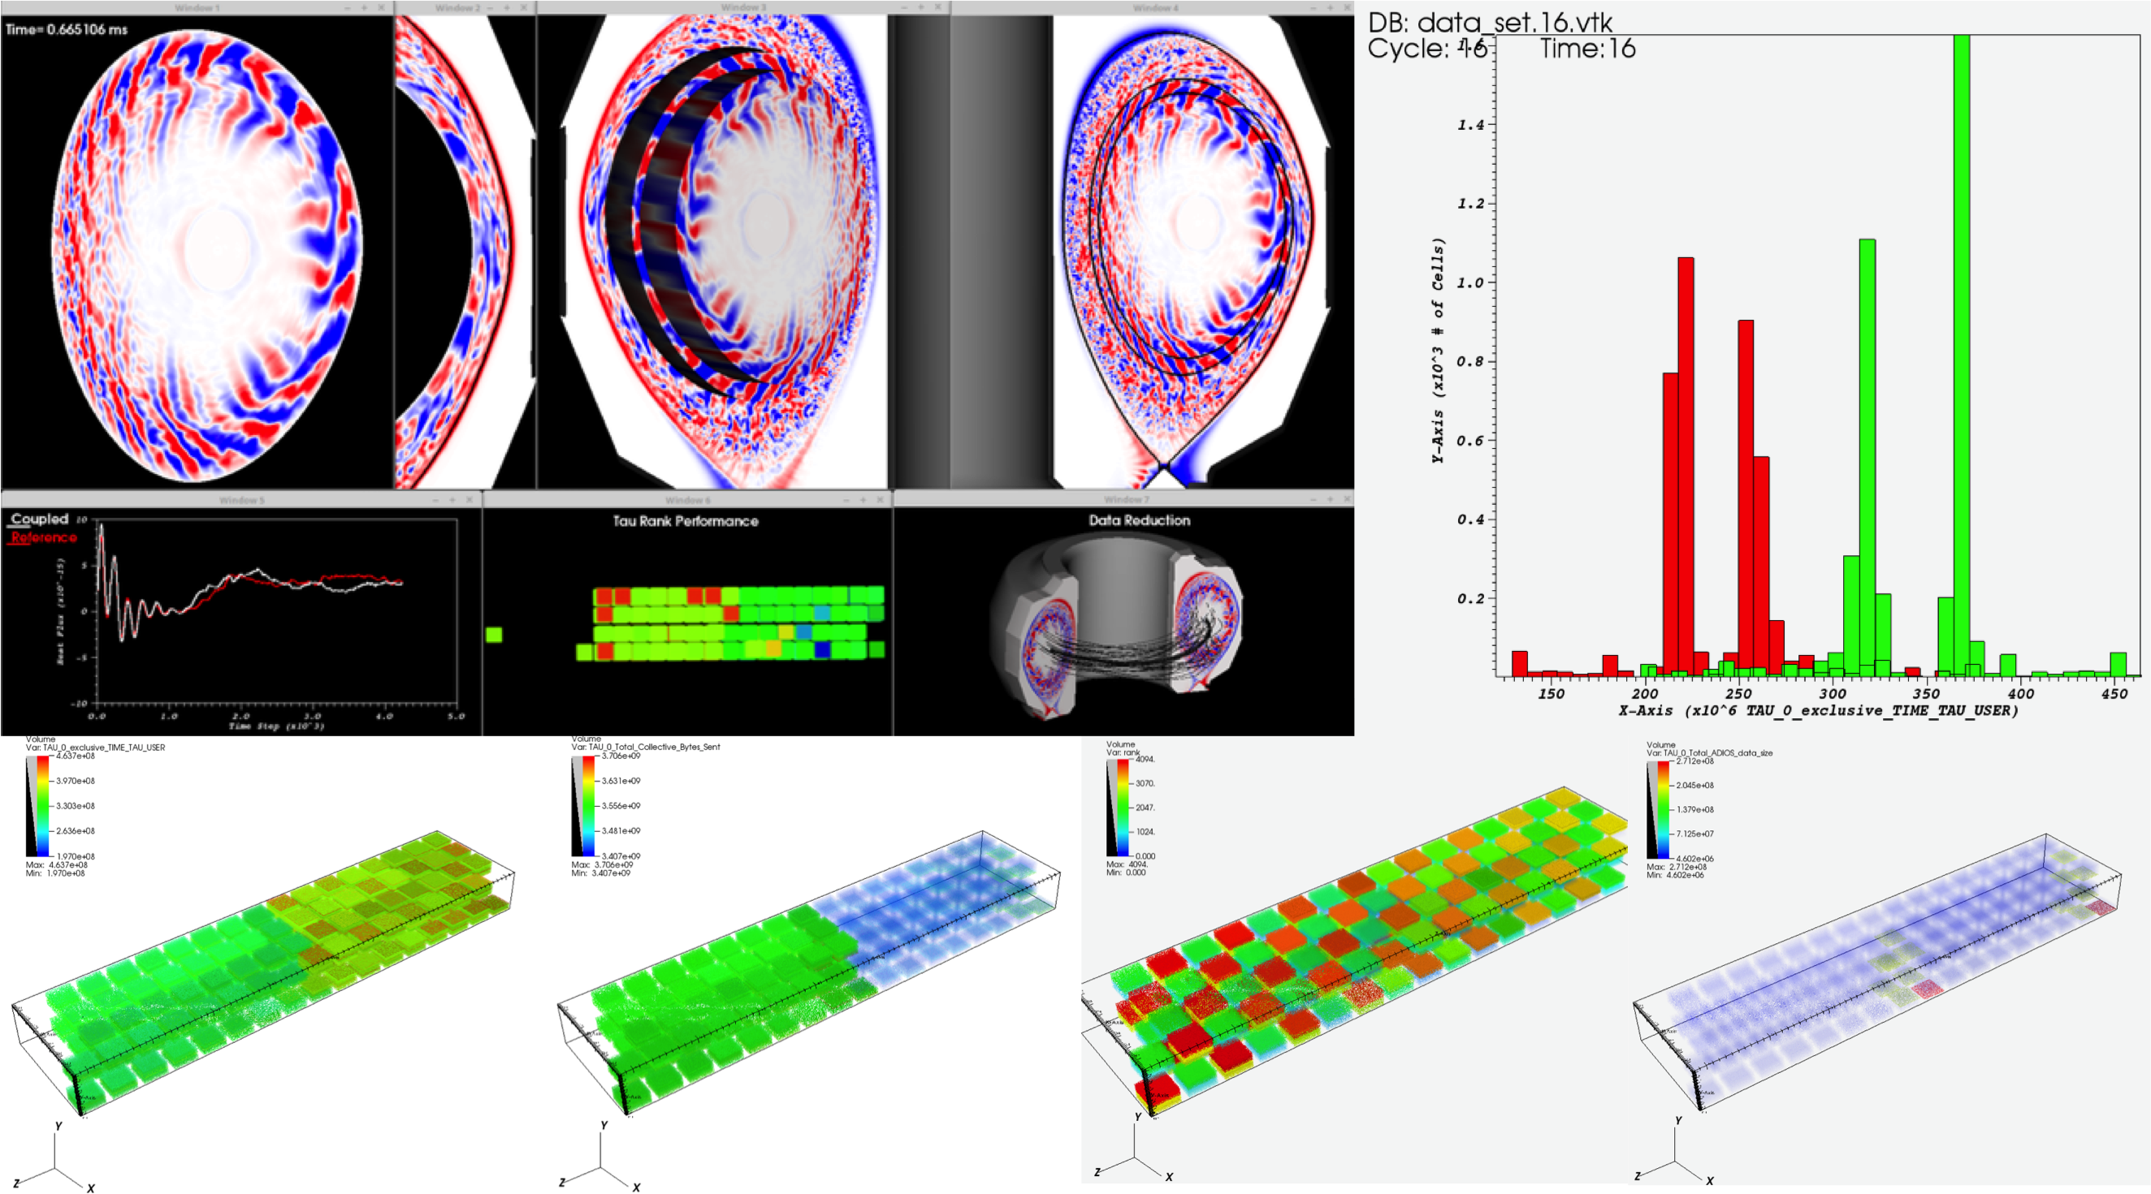
Performance Measurement and Analysis using the TAU Performance System
Allen D. Malony, Sameer Shende, Kevin Huck, Camille Coti, Jeffrey S. Vetter, Mary Hall, Kei Davis, Hal Finkel,
Ian Foster, Scott Klasky, Kerstin Kleese van Dam, Todd Munson
Funded through ECP 2.3.2.10 (PROTEAS-TUNE) and ECP 2.2.6.08 (CODAR)
What is TAU?
Tuning and Analysis Utilities (25+ year project)
http://tau.uoregon.edu
Comprehensive performance profiling and tracing
  Scalable, flexible, portable
  Targets all parallel programming/execution paradigms
Integrated performance toolkit
  Instrumentation, measurement, analysis, visualization
  Timers, samples, counters, integrated tool callback support, hardware counter support
  Widely-ported performance profiling and tracing system
  Performance data management and data mining
  Open source (BSD-style license)
PROTEAS-TUNE Project Goals
(PROgramming Toolchain for Emerging Architectures and Systems)
Programmer productivity and performance portability are two of the most important challenges facing applications targeting future exascale computing platforms. The PROTEAS-TUNE project is a strategic response to the continuous changes in architectures and hardware (e.g., heterogeneous computing, deep memory hierarchies, nonvolatile memory) that are defining the landscape for emerging ECP systems. PROTEAS-TUNE is a flexible programming framework and integrated toolchain that will provide ECP applications the opportunity to work with programming abstractions and to evaluate solutions that address the exascale programming challenges they face.
Key Capabilities: LLVM; OpenACC, CUDA, OpenCL; Performance tools with TAU; Expertise and software systems for heterogeneous computing (GPUs, FPGAs, Manycore) and deep memory hierarchies including nonvolatile memory; Performance portability metrics, tools, and strategies.
New Capabilities in TAU from PROTEAS-TUNE
Python3+CUDA : Extended TAU to enhance performance evaluation of multi-threaded Python3 and CUDA and applied it to evaluate the performance of the CANDLE ECP Benchmarks.
CUDA/OpenCL : Updated support for CUDA and OpenCL measurement, organizing data around streams and command queues for robust multithreaded and HW counter support.
OpenMP : Updated the OpenMP Tools Interface support in TAU, to support the current 5.0 standard.
F18/Flang Instrumentation : TAU support for the Flang Fortran compiler was added. PDT- and Compiler-based instrumentation support for Flang was implemented and tested on x86_64 Linux platforms.
OpenACC : TAU OpenACC measurement was demonstrated on the AMReX library.
Performance Monitoring : TAU plugin for streaming profile and trace output to ADIOS2 for realtime application monitoring. Integrated with Chimbuko framework for runtime trace analysis, demonstrated with NWChem on Summit using 2000+ MPI ranks.
NVM Measurement : Instrumented the PapyrusKV library and benchmarked performance of the library while using NVM resources on Summit.
Figures: CANDLE application measurement, showing bimodal performance distribution
ECP Collaborators
Co-Design Center for Online Data Analysis and Reduction at the Exascale (CODAR)
ADIOS Framework for Scientific Data on Exascale Systems (ADIOS)
Exascale Deep Learning and Simulation Enabled Precision Medicine for Cancer (CANDLE) – see figures
Tackling Chemical, Materials and Biomolecular Challenges in the Exascale Era (NWChemEx)
Block-Structured AMR Co-Design Center (AMReX)
ECP Applications Effective use of Kokkos to Achieve Performance Portability (Kokkos)
Others...
Figure (below): Instrumentation of PapyrusKV library provides insight into asynchronous threaded library details when benchmarking 16 MPI ranks, 10k iterations with 16B keys, 1MB values on Summit using local NVM burst buffers.
TAU Tutorial: Tuesday, February 4
10:30 AM - 12:00 PM
TAU / PROTEAS-TUNE: Next Steps
CUDA 10.2 : Implement new Profiling and Perfworks APIs for CUDA/CUPTI 10+ to replace deprecated CUPTI support.
OpenMP / OpenACC : Explore and implement prototype measurement for OpenMP and OpenACC regions executed on target devices.
NVM : Design and implement support for supporting deep memory hierarchies in TAU for supporting MCDRAM based systems and NVM architectures
PHIRE : Improved LLVM IR-based instrumentation using PHIRE.
Related Project: Scalable Observation System
Runtime data aggregation for monitoring and control
SOS
Figures: Coupled fusion application measured by TAU and monitored by SOS with VTK visualization data
Analysis
Clients
Applications,
ADIOS, MPI,
TAU, Caliper, RAJA, etc.
Steering
Logic
Output
Summaries,
Visualizations,
Dashboards, Configuration Files, Logs, etc.
This research was supported by the Exascale Computing Project (17-SC-20-SC), a collaborative effort of two U.S. Department of Energy organizations (Office of Science and the National Nuclear Security Administration) responsible for the planning and preparation of a capable exascale ecosystem, including software, applications, hardware, advanced system engineering, and early testbed platforms, in support of the nation’s exascale computing imperative.

