Slide 1


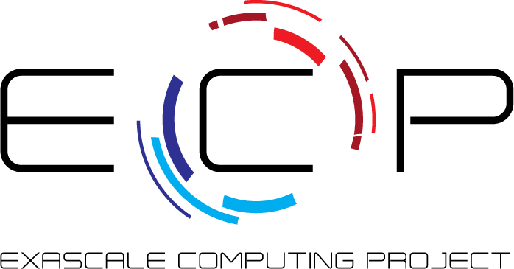


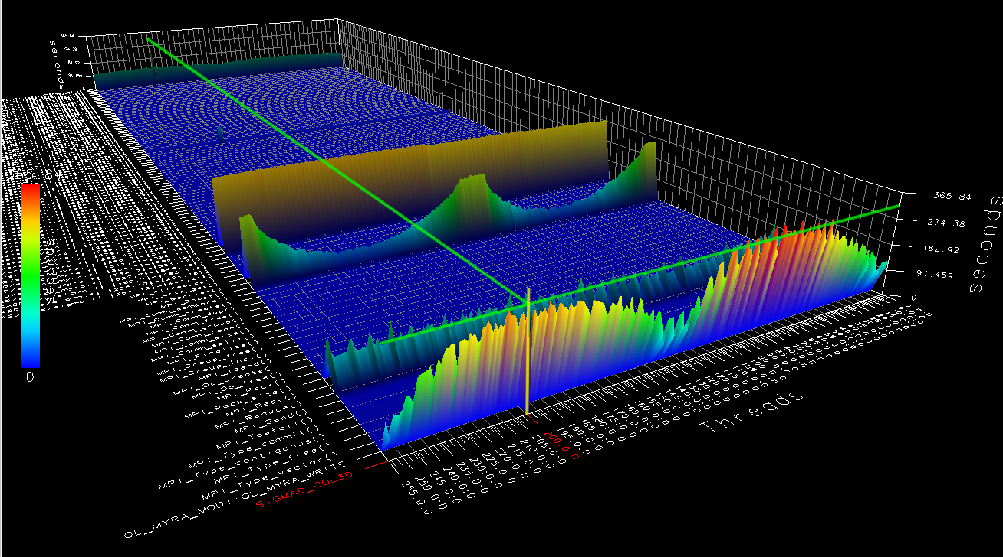
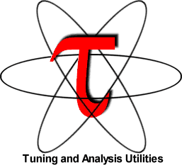
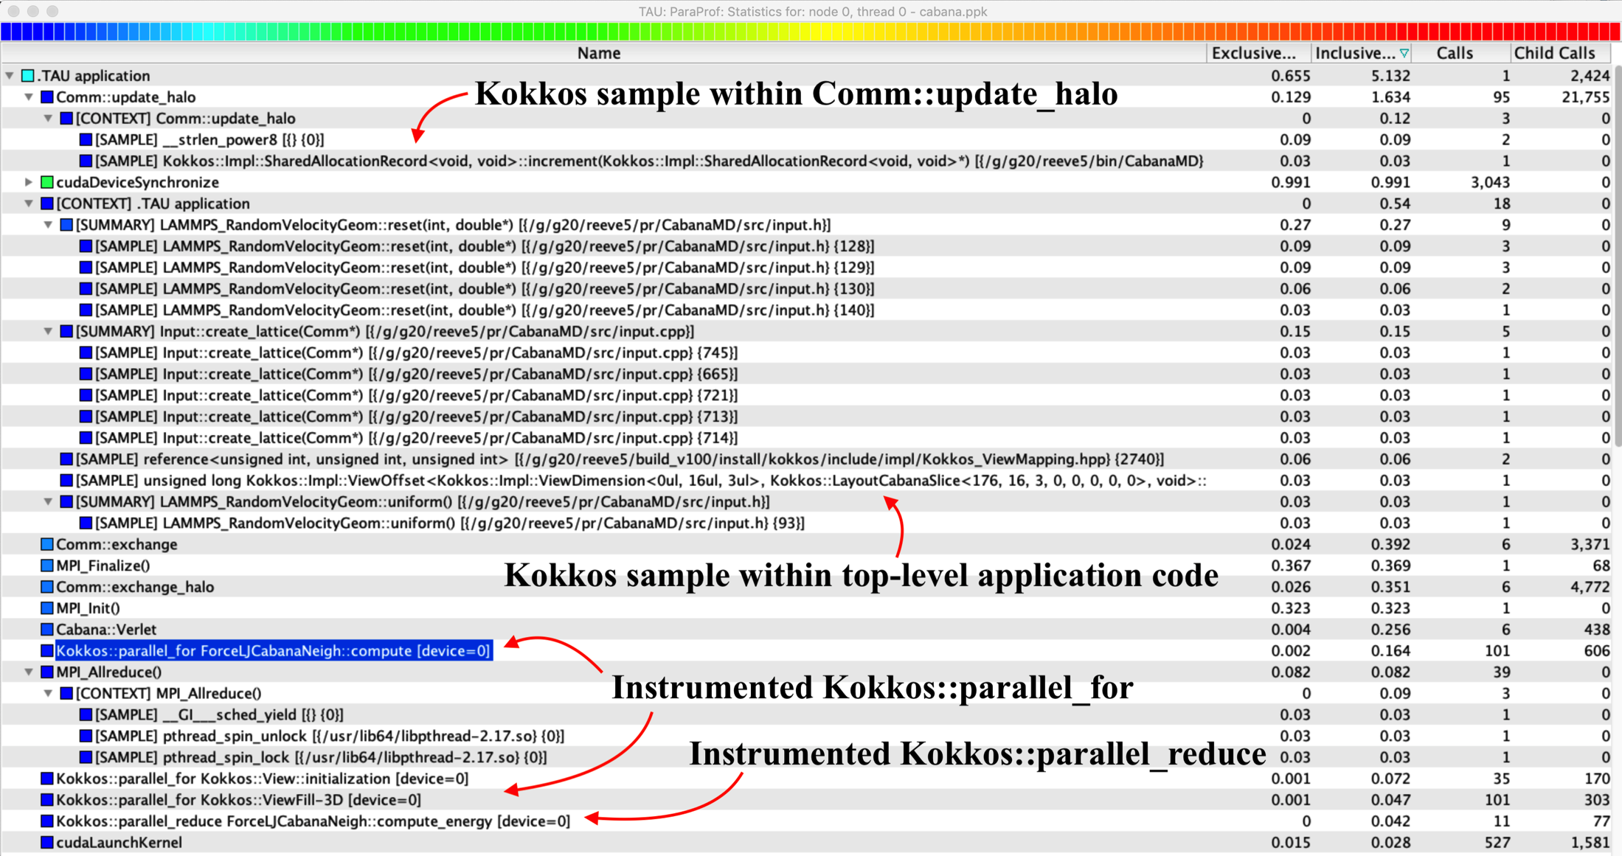
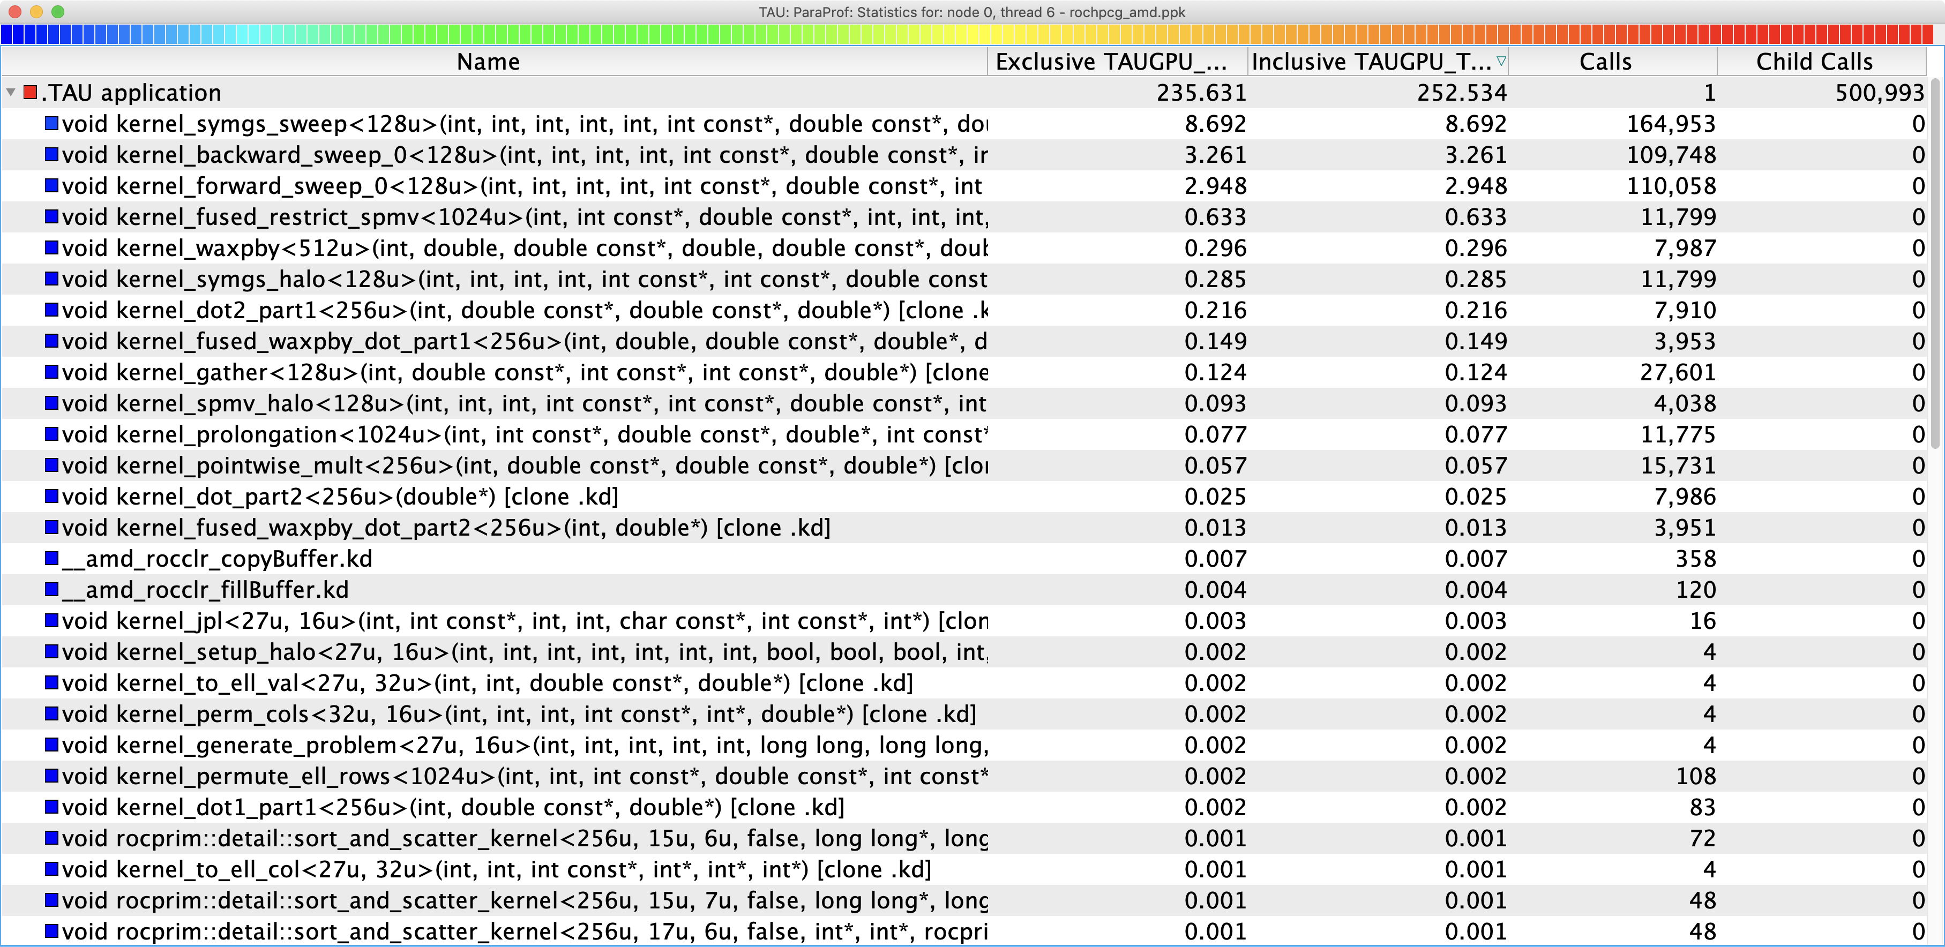
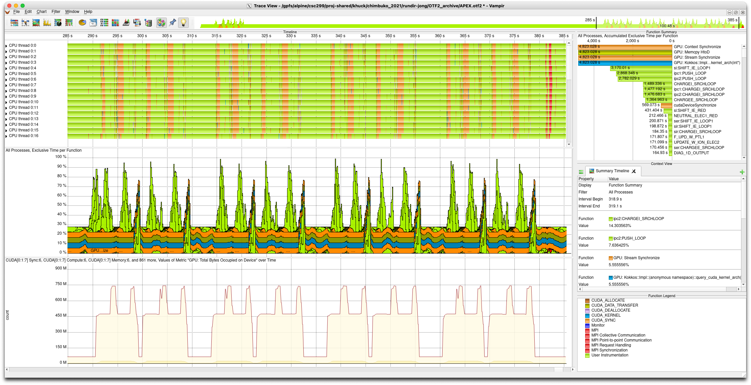
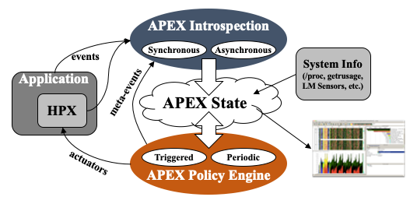
Performance Measurement and Analysis using the TAU Performance System
Allen D. Malony, Sameer Shende, Kevin Huck, Camille Coti, Wyatt Spear, Jeffrey S. Vetter, Mary Hall, Kei Davis,
Ian Foster, Scott Klasky, Kerstin Kleese van Dam, Todd Munson
Funded through ECP 2.3.2.10 (PROTEAS-TUNE) and ECP 2.2.6.08 (CODAR)
What is TAU?
Tuning and Analysis Utilities (25+ year project)
http://tau.uoregon.edu
Comprehensive performance profiling and tracing
  Scalable, flexible, portable
  Targets all parallel programming/execution paradigms
Integrated performance toolkit
  Instrumentation, measurement, analysis, visualization
  Timers, samples, counters, integrated tool callback support, hardware counter support
  Widely-ported performance profiling and tracing system
  Performance data management and data mining
  Open source (BSD-style license)
PROTEAS-TUNE Project Goals
(PROgramming Toolchain for Emerging Architectures and Systems)
Programmer productivity and performance portability are two of the most important challenges facing applications targeting future exascale computing platforms. The PROTEAS-TUNE project is a strategic response to the continuous changes in architectures and hardware (e.g., heterogeneous computing, deep memory hierarchies, nonvolatile memory) that are defining the landscape for emerging ECP systems. PROTEAS-TUNE is a flexible programming framework and integrated toolchain that will provide ECP applications the opportunity to work with programming abstractions and to evaluate solutions that address the exascale programming challenges they face.
Key Capabilities: LLVM; OpenACC, CUDA, HIP, OpenCL, OneAPI; Performance tools with TAU; Expertise and software systems for heterogeneous computing (GPUs, FPGAs, Manycore) and deep memory hierarchies including nonvolatile memory; Performance portability metrics, tools, and strategies.
New Capabilities in TAU from PROTEAS-TUNE
Updated support for latest CUDA, AMD GPUs and software
clang/clang++ TAU plugin : Selective instrumentation of C and C++ code, choice of functions to instrument based on name and / or source file – now with support for hipcc.
Monitoring support : updated monitoring plugin provides support for capturing hardware and OS state, NVIDIA Monitoring Library (NVML) support, and broad PAPI counter support (capture all available metrics globally, in one run, using multiplexing).
Python3+CUDA : Enhanced dynamic measurement support for complex deep/machine learning platforms such as TensorFlow and PyTorch.
Intel OneAPI : Implemented support for Intel oneAPI, including Level Zero, time spent in kernels. on GPU and time spent in OneAPI calls.
OpenMP : Updating OMPT offload event support provided by AMD 5.1.0 clang / hipcc compilers.
F18/Flang Instrumentation : TAU support for the Flang Fortran compiler was added. PDT- and Compiler-based instrumentation support for Flang was implemented and tested on x86_64 Linux platforms.
OpenACC : Updated profiling support for Clacc, developing OpenACC support for f18 Fortran.
ECP 2021 Sessions with TAU:
Tutorial – E4S for ECP ST and AD teams : Monday, May 2, 10:00-11:30 AM EST
Tutorial – TAU Performance System : Monday, May 2, 12:00-1:30 PM EST
Tutorial – AMD Software Tools for Exascale Computing : Monday, May 2, 2:30-6:00 PM EST
Breakout – Performance Tools for Emerging Exascale Platforms: Status and Challenges : Thursday, May 5, 1:00-3:00 PM EST
Tutorial – Using Containers to Accelerate HPC : Friday, May 6, 2:30-4:00 PM EST
ECP Collaborators
Co-Design Center for Online Data Analysis and Reduction at the Exascale (CODAR)
ADIOS Framework for Scientific Data on Exascale Systems (ADIOS)
The Whole Device Model Application (WDMApp)
Exascale Deep Learning and Simulation Enabled Precision Medicine for Cancer (CANDLE)
Tackling Chemical, Materials and Biomolecular Challenges in the Exascale Era (NWChemEx)
Block-Structured AMR Co-Design Center (AMReX)
ECP Applications Effective use of Kokkos to Achieve Performance Portability (Kokkos)
Others...
Event-based Sampling (EBS):
CabanaMD on an IBM AC922 with NVIDIA V100 GPUs
AMD HIP: Kernel execution on GPUs: rochpcg
Event-based sampling (EBS) with Kokkos API
TAU / PROTEAS-TUNE: Next Steps
CUDA 11 : Finish new Perfworks APIs for CUDA/CUPTI 10+ to replace deprecated CUPTI metric support.
OpenMP / OpenACC : Continue to explore and implement prototype measurement for OpenMP and OpenACC regions executed on target devices.
ROCm/HIP : Continued support for AMD GPUs
oneAPI : Continue to update and develop support for Intel GPUs
TAU compiler wrappers : new instrumentation support based on libclang and libtooling libraries from LLVM
Related Project: APEX
Autonomic Performance Environment for Exascale
https://github.com/UO-OACISS/apex
Master timeline
Summary timeline of utilization
Memory occupied on GPU
Figure: XGC executed on Summit, measured with APEX, visualized in Vampir, including CUDA and Kokkos activity. APEX supports several asynchronous threading and tasking programming models, including C++ std::async, HPX, OpenMP, OpenACC, Kokkos, Raja, CUDA, HIP. Monitoring support similar to the TAU plugin, providing utilization statistics for the filesystem, network, devices, CPU, GPU, and memory.
This research was supported by the Exascale Computing Project (17-SC-20-SC), a collaborative effort of two U.S. Department of Energy organizations (Office of Science and the National Nuclear Security Administration) responsible for the planning and preparation of a capable exascale ecosystem, including software, applications, hardware, advanced system engineering, and early testbed platforms, in support of the nation’s exascale computing imperative.
Notes:
The TAU Performance System is an integrated performance toolkit including scalable performance profiling and tracing library and analysis tools for HPC. The 2022 ECP poster will provide updated information on support for the latest AMD, NVIDIA and Intel hardware, the latest support for programming models like Kokkos, OpenMP, and SYCL, as well as integrated compiler support for instrumentation through a Clang/Clang++ plugin.
Allen Malony (UO) malony@cs.uoregon.edu
Sameer Shende (UO) sameer@cs.uoregon.edu
Camille Coti (UO) coti@cs.uoregon.edu
Wyatt Spear (UO) wspear@cs.uoregon.edu
Jeffrey Vetter (ORNL) vetter@ornl.gov
Mary Hall (UU) mhall@cs.utah.edu
Kei Davis (LANL) kei@lanl.gov

