Slide 1


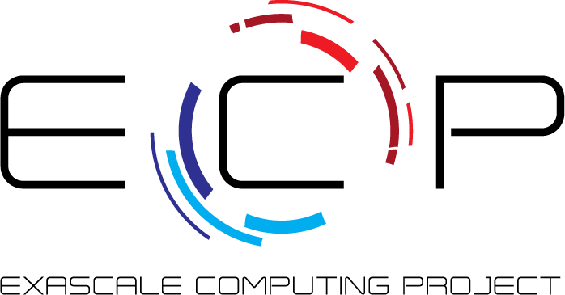


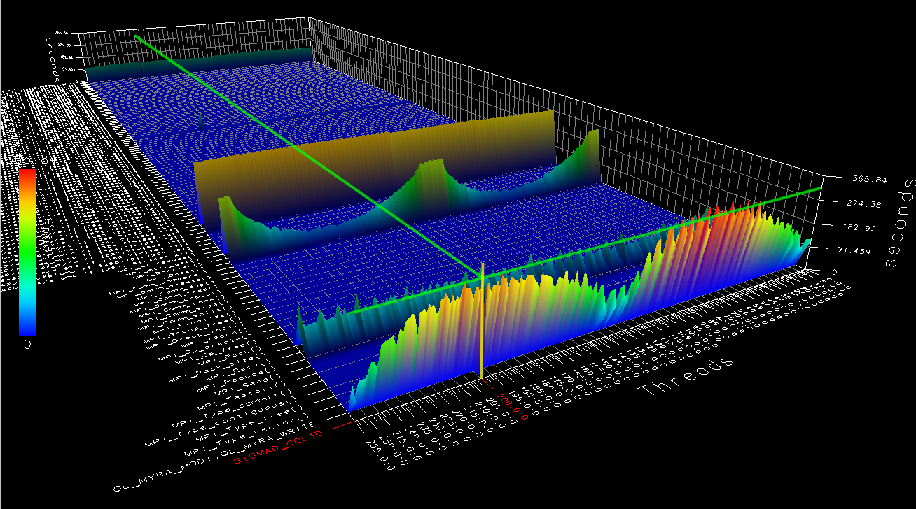
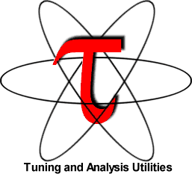
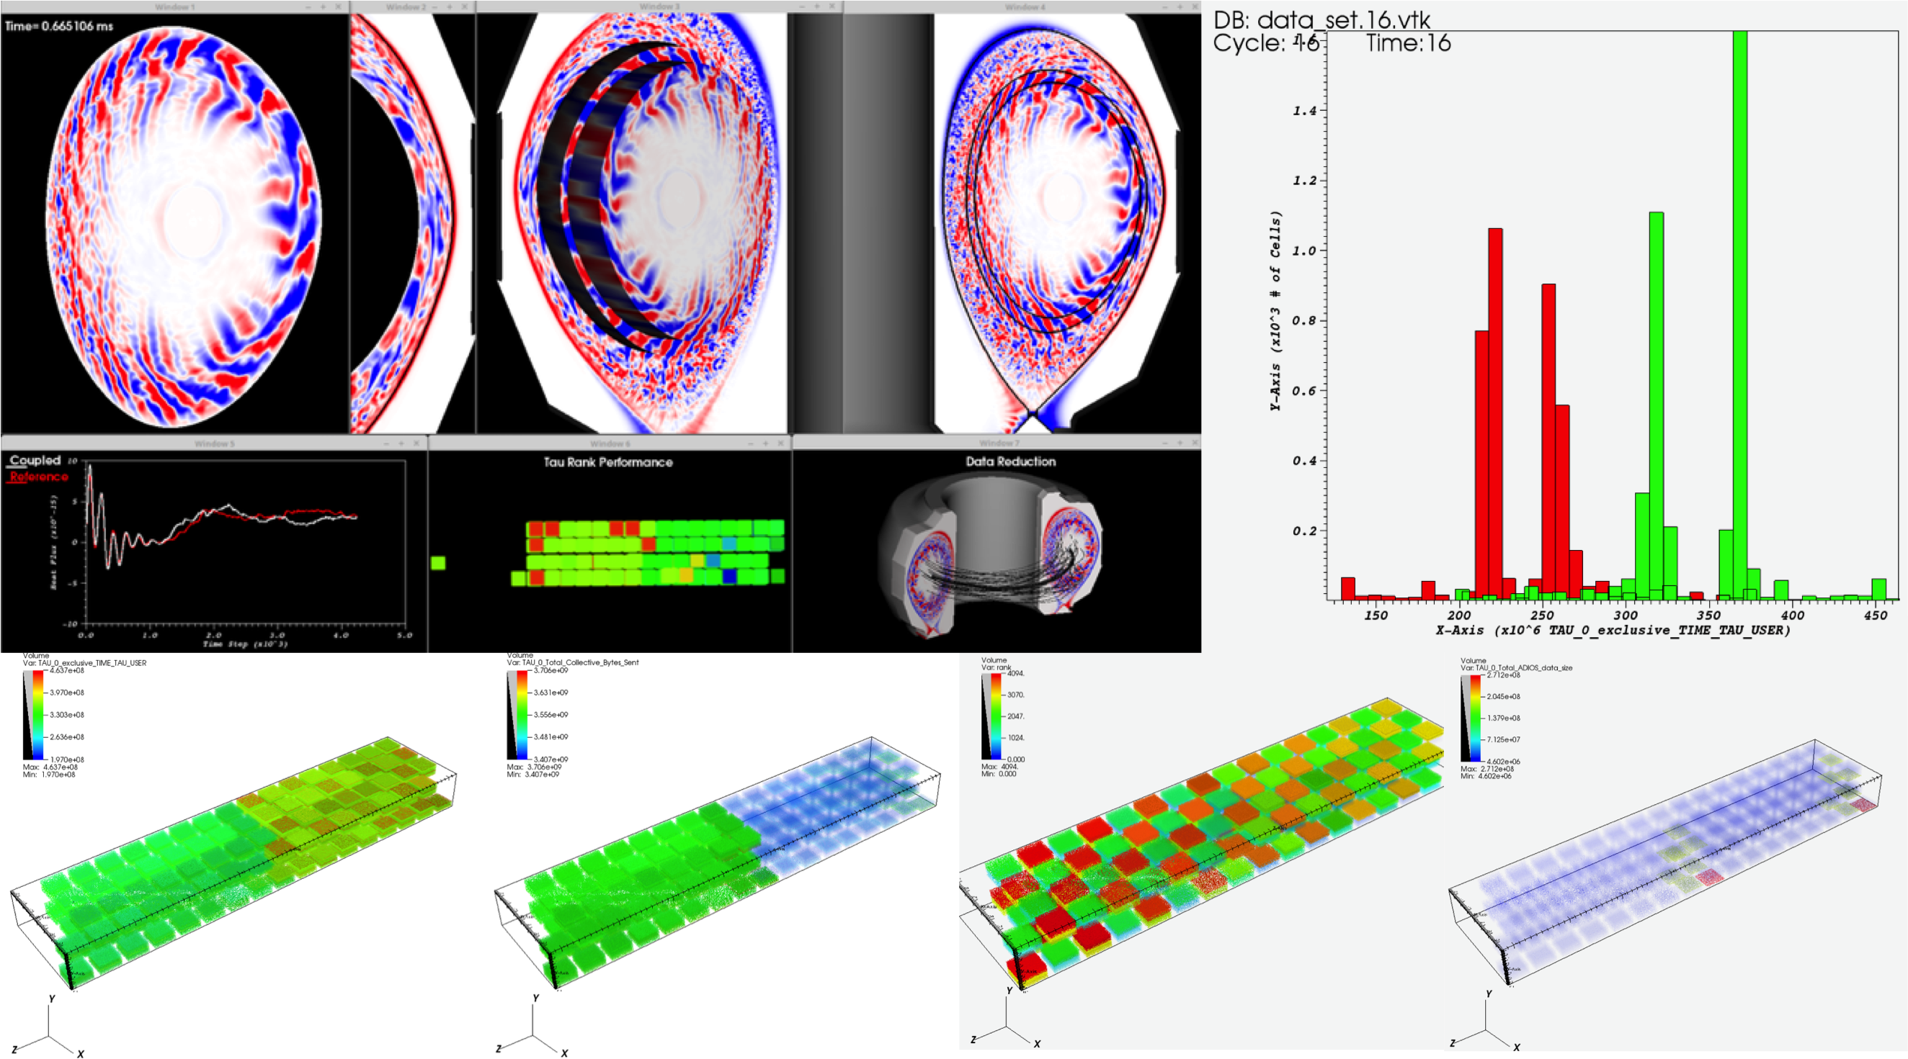
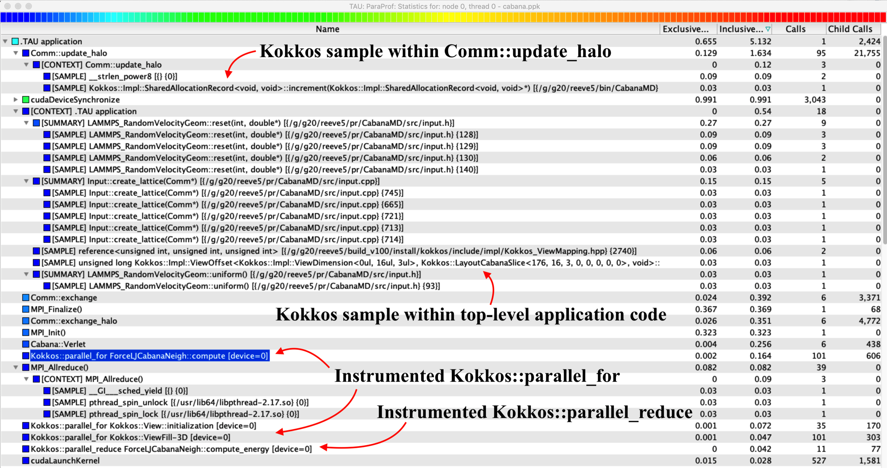
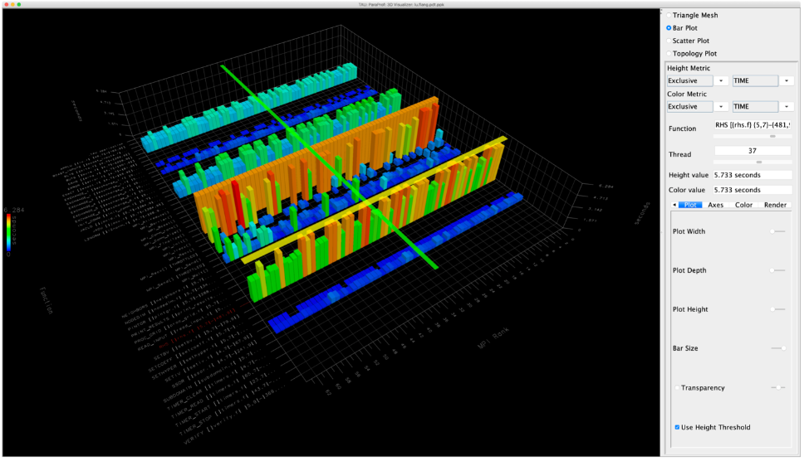
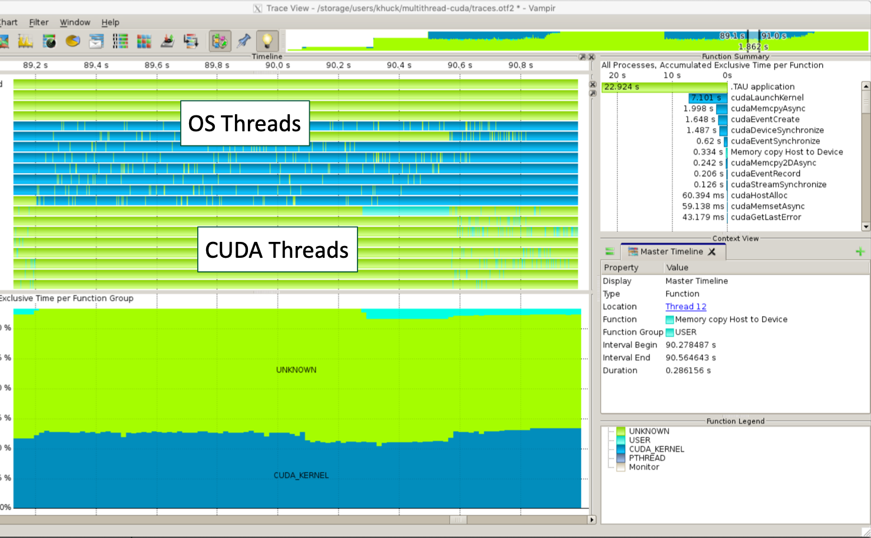
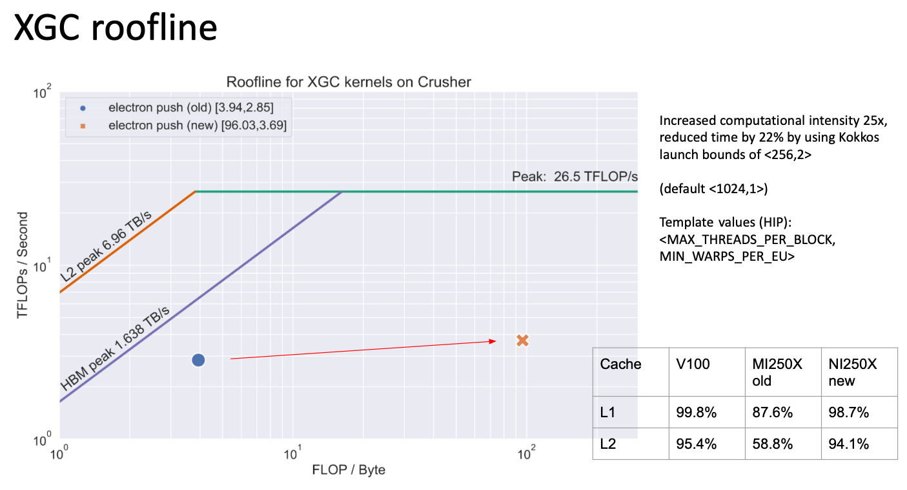
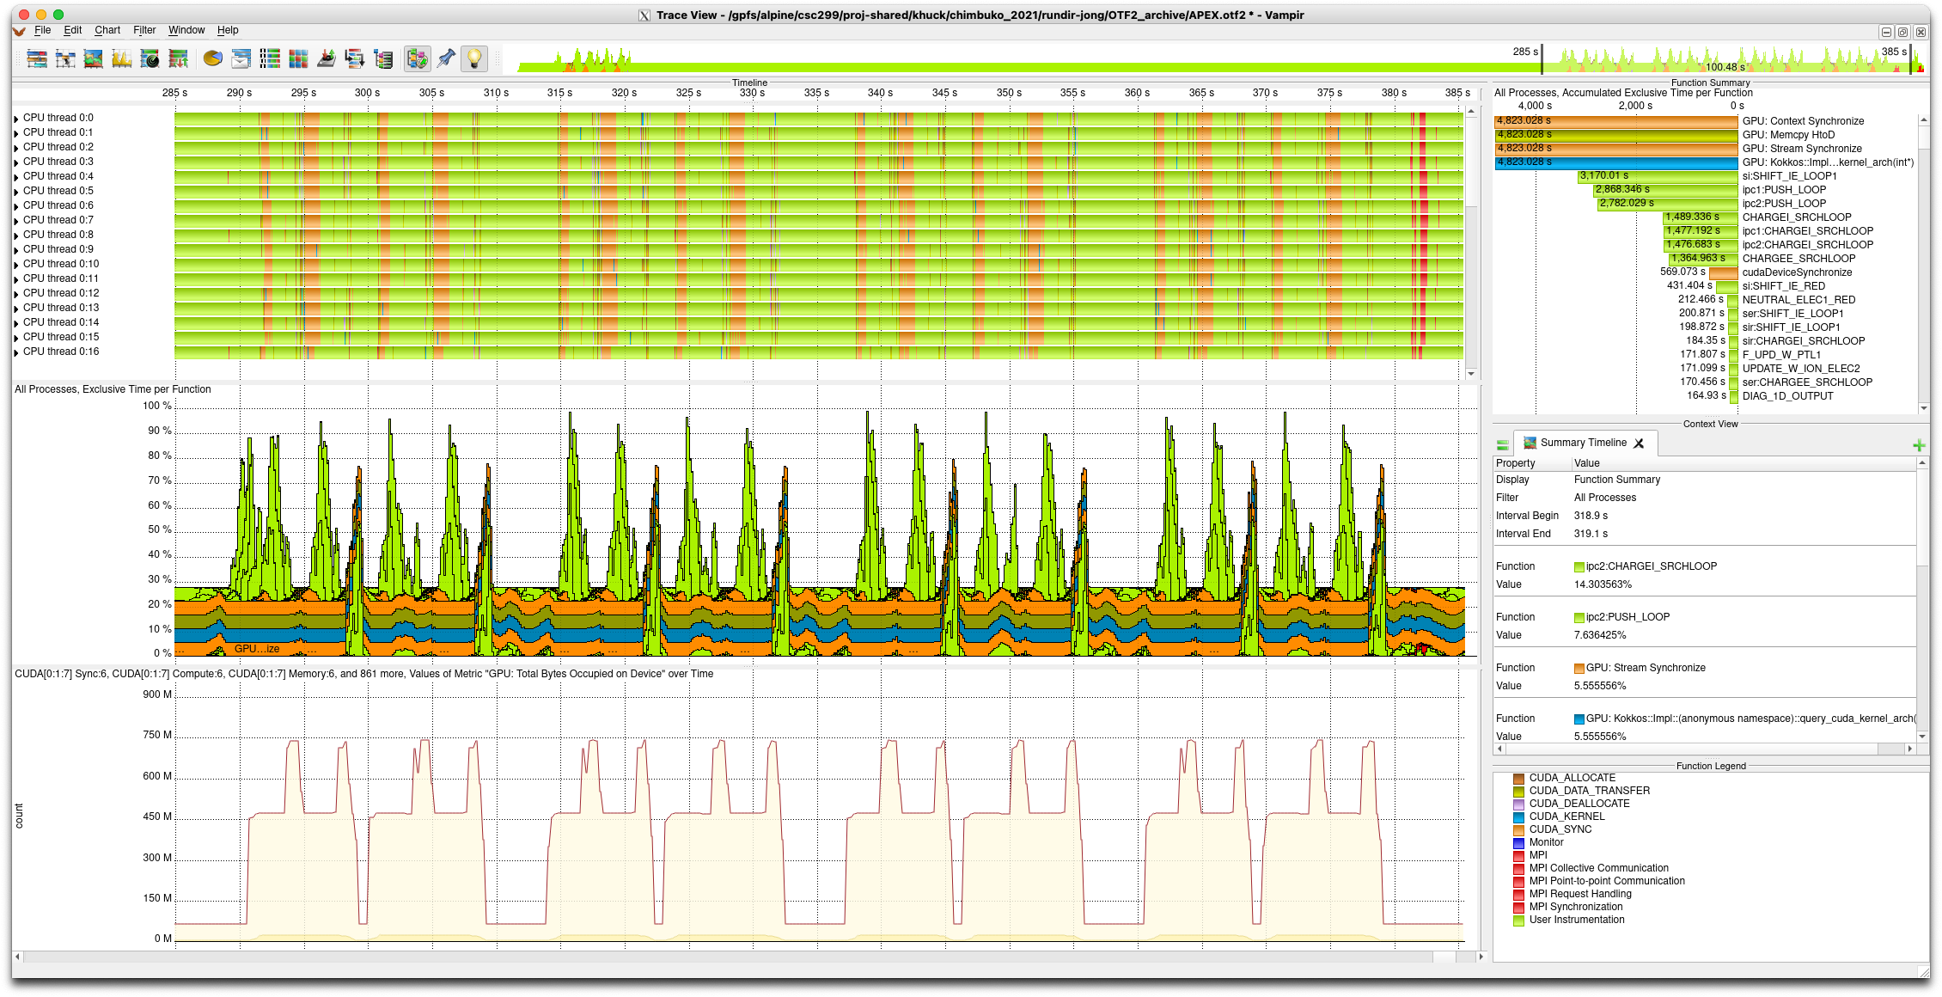
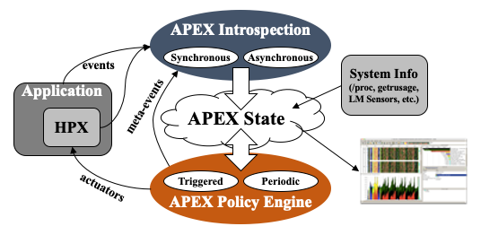
Performance Measurement and Analysis using the TAU Performance System
Allen D. Malony, Sameer Shende, Kevin Huck, Camille Coti, Wyatt Spear, Jeffrey S. Vetter, Mary Hall, Kei Davis,
Ian Foster, Scott Klasky, Kerstin Kleese van Dam, Todd Munson
Funded through ECP 2.3.2.10 (PROTEAS-TUNE) and ECP 2.2.6.08 (CODAR)
What is TAU?
Tuning and Analysis Utilities (25+ year project)
http://tau.uoregon.edu
Comprehensive performance profiling and tracing
  Scalable, flexible, portable
  Targets all parallel programming/execution paradigms
Integrated performance toolkit
  Instrumentation, measurement, analysis, visualization
  Timers, samples, counters, integrated tool callback support, hardware counter support
  Widely-ported performance profiling and tracing system
  Performance data management and data mining
  Open source (BSD-style license)
PROTEAS-TUNE Project Goals
(PROgramming Toolchain for Emerging Architectures and Systems)
Programmer productivity and performance portability are two of the most important challenges facing applications targeting future exascale computing platforms. The PROTEAS-TUNE project is a strategic response to the continuous changes in architectures and hardware (e.g., heterogeneous computing, deep memory hierarchies, nonvolatile memory) that are defining the landscape for emerging ECP systems. PROTEAS-TUNE is a flexible programming framework and integrated toolchain that will provide ECP applications the opportunity to work with programming abstractions and to evaluate solutions that address the exascale programming challenges they face.
Key Capabilities: LLVM; OpenACC, CUDA, HIP, OpenCL, OneAPI; Performance tools with TAU; Expertise and software systems for heterogeneous computing (GPUs, FPGAs, Manycore) and deep memory hierarchies including nonvolatile memory; Performance portability metrics, tools, and strategies.
MPI_T added
Kokkos support
Native OTF2 tracing
System monitoring
ADIOS measurement
SOS integration
InteL PIN support
Plugin system added
  Tuning plugins
  Selective measurement
POSIX I/O metadata capture
OMPT TR4 prototypes
LIKWID support
Caliper integration
V2.27 released
ECP Collaborators : CODAR, ADIOS, WDMApp, CANDLE, NWChemEx, AMReX, Kokkos, others…
GPU support updates
Clang/Clang++ selective instrumentation with plugin
ARM64FX/AARCH64 support
CLACC/OpenACC updates
Prototyped new C++ source instrumentation
NVHPC compiler support
AMDClang compiler support
V2.31 released
Python3 + CUDA support
CUDA/OpenCL enhancements
OMPT 5.0 update
F18/Flang instrumentation
OpenACC updates
ADIOS2 monitoring output
Chimbuko integration w/ADIOS2
V2.29 released
2017
2018
2019
2020
2021
2022
2023
New, updated plugins, callbacks
OMPT TR6 extensions
Additional system monitoring
MPI_T PVAR tuning
LIKWID updates
CUDA 9, 10 updates
ARM Compiler support
PerfStubs prototyped
ROCm support prototyped
CLACC integration
Refactored Kokkos support
Sampling refinements
V2.28 released
CUDA, ROCm support updates
Clang/Clang++ instrumentation plugin
Enhanced system monitoring
  NVML
  PAPI
  HW/OS state
Enhanced TensorFlow/PyTorch support
Intel OneAPI support (Level Zero)
OMPT 5.1 updates
CLACC/OpenACC updates
V2.30 released
Eliminated pthread limits
GPU support updates
Roofline model for AMD MI250X
Updated OneAPI support
OMPT 5.2 target offload, test with Intel, AMD, NVHPC compilers
NVTX support added
Optimized instrumentation plugin
Refactored preload support
StarPU integration
V2.32 released
TAU / PROTEAS-TUNE: Final Steps
CUDA 11 : Continued updates and testing with A100 architectures and newer
OpenMP / OpenACC : Maintain and update target offload measurement for OpenMP and OpenACC regions executed on target devices.
ROCm/HIP : Continued support for AMD GPUs, HW counters
oneAPI : Update and develop support for latest Pontevecchio GPU
TAU compiler wrappers : enhanced LLVM plugin, source-to-source capabilities
Related Project: APEX
Autonomic Performance Environment for Exascale
https://github.com/UO-OACISS/apex
Master timeline
Summary timeline of utilization
Memory occupied on GPU
Figure: XGC executed on Summit, measured with APEX, visualized in Vampir, including CUDA and Kokkos activity. APEX supports several asynchronous threading and tasking programming models, including C++ std::async, HPX, OpenMP, OpenACC, Kokkos, Raja, CUDA, HIP. Monitoring support similar to the TAU plugin, providing utilization statistics for the filesystem, network, devices, CPU, GPU, and memory.
This research was supported by the Exascale Computing Project (17-SC-20-SC), a collaborative effort of two U.S. Department of Energy organizations (Office of Science and the National Nuclear Security Administration) responsible for the planning and preparation of a capable exascale ecosystem, including software, applications, hardware, advanced system engineering, and early testbed platforms, in support of the nation’s exascale computing imperative.
Notes:
The TAU Performance System is an integrated performance toolkit including scalable performance profiling and tracing library and analysis tools for HPC. The 2022 ECP poster will provide updated information on support for the latest AMD, NVIDIA and Intel hardware, the latest support for programming models like Kokkos, OpenMP, and SYCL, as well as integrated compiler support for instrumentation through a Clang/Clang++ plugin.
Allen Malony (UO) malony@cs.uoregon.edu
Sameer Shende (UO) sameer@cs.uoregon.edu
Camille Coti (UO) coti@cs.uoregon.edu
Wyatt Spear (UO) wspear@cs.uoregon.edu
Jeffrey Vetter (ORNL) vetter@ornl.gov
Mary Hall (UU) mhall@cs.utah.edu
Kei Davis (LANL) kei@lanl.gov

