Slide 1

APEX: HPX/Phylanx Y2 Plans
(Autonomic Performance Environment for eXascale)
Kevin Huck, Mohammad Alaul Haque Monil,
Allen Malony
khuck@cs.uoregon.edu
http://github.com/khuck/xpress-apex

Slide 2
What is APEX?
Performance measurement library for distributed, asynchronous tasking models/runtimes
  i.e. HPX, but there are others
  Lightweight measurement (tasks <1ms)
  High concurrency (both OS threads and tasks in flight)
  Distinction between OS and runtime (HPX) thread context
  Lack of a traditional call stack
    Task dependency chain instead
  Runtime controlled task switching
Infrastructure for dynamic feedback and control of both the runtime and the application
Notes:
Point of this slide: introduce the motivation for the APEX project. Why was it first funded under the XPRESS project?
APEX was originally designed as a performance measurement library for distributed Asynchronous Tasking Runtimes - specifically HPX. Some of the challenges include:
Lightweight measurement (tasks <1ms) – all libraries want low overhead, but HPX tasks are “ideally” in the ~10ms size, but can be much smaller
Thread safety – all libraries require thread safety, but high concurrency demands no shared data between measurement threads
Distinction between OS threads and HPX threads – sampling techniques rely on the OS thread context. (i.e. callstack). But tasks yield, migrate, resume – OS context is meaningless.
Lack of a meaningful callstack – with the exception of “direct actions”, HPX tasks create other tasks, everything is queued and scheduled to run when possible. The task dependency chain is much more meaningful in HPX.
Runtime controlled task switching – when task dependencies aren’t met, the task yields and resumes when they are met – usually on another CPU core/OS thread, possibly another node (locality) in the allocation.
Dynamic runtime control – key requirement – the measurement system is in service of runtime feedback and control.

Slide 3
APEX Measurement
Top down (application) and bottom up (OS/HW) performance mapping / feedback
  Make node-wide resource utilization data and analysis, energy consumption, and health information available in real time
  Associate performance state with policies for feedback control
APEX introspection
  OS: track system resources, utilization, job contention, overhead
  Runtime (HPX): track threads, queues, concurrency, remote operations, parcels, memory management
  Application timer / counter observation
Post-mortem performance analysis
Integrated with HPX performance counters

Slide 4
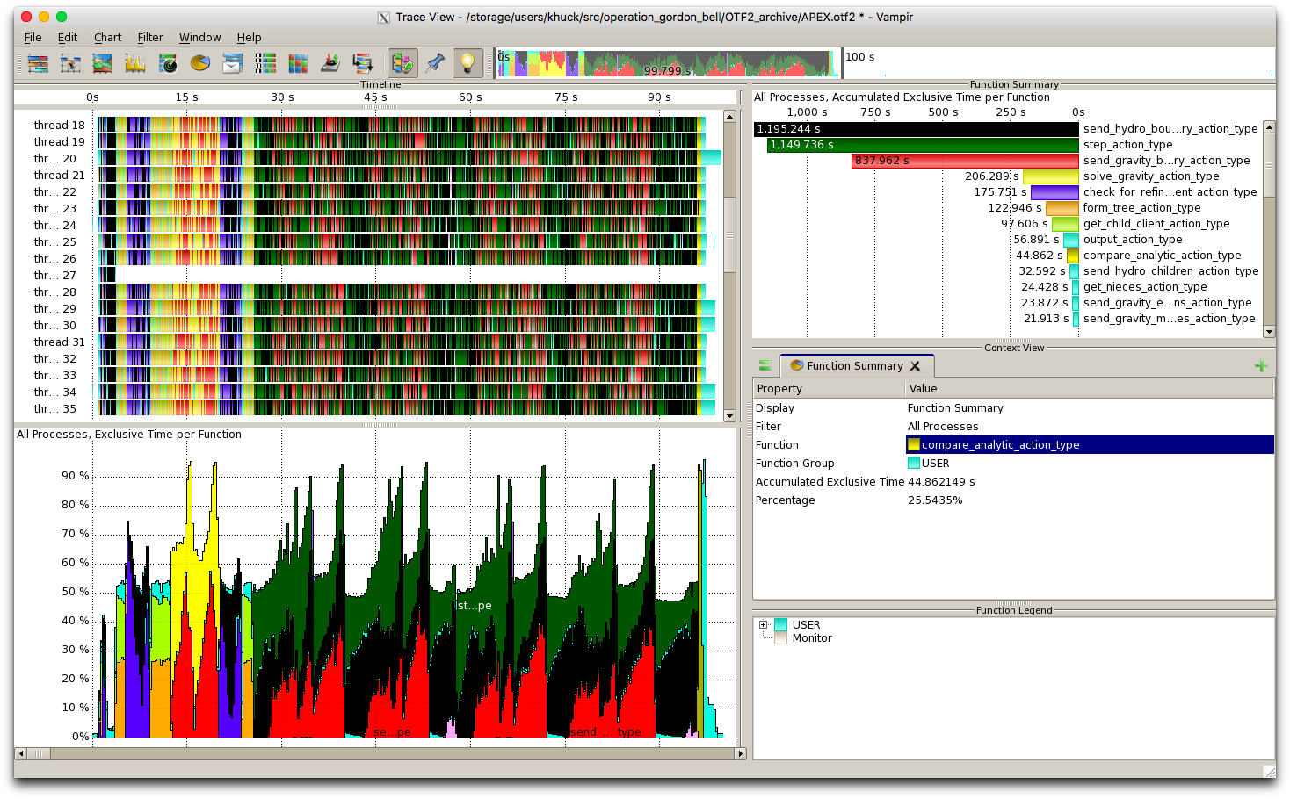
APEX Architecture
APEX Introspection
Synchronous
Asynchronous
events
System Info
(/proc, getrusage, LM Sensors, etc.)
Application
meta-events
APEX State
HPX
APEX Policy Engine
Triggered
Periodic
actuators
Notes:
This is a graphical representation of the APEX architecture.
The application and HPX are sending synchronous events through the APEX API to the synchronous Introspection layer.
In addition, APEX is asynchronously measuring the OS, hardware, etc. to monitor node “health”.
The APEX performance state is asynchronously updated by processing the performance measurements.
The policy engine monitors the performance state, and executes policies that potentially modify runtime and/or application behavior.
The APEX state is optionally written to disk for post-mortem analysis, either as TAU profiles, OTF2 traces, CSV, or other forms of output.

Slide 5
APEX Introspection
APEX collects data through “inspectors”
  Synchronous uses an event API and event “listeners”
    Initialize, terminate, new thread – added to HPX runtime
    Timer start, stop, yield*, resume* – integrated into HPX task scheduler
    Custom events (meta-events)
  Asynchronous do not rely on events, but occur periodically
    Sampled values (counters from HPX)
APEX exploits access to performance data from lower stack components
  “Health” data through other interfaces (/proc/stat, /proc/cpuinfo, /proc/meminfo, /proc/net/dev, /proc/self/status, lm_sensors, power*, PAPI hardware counters, etc.)

Slide 6
APEX Event Listeners
Profiling listener
  New task event: capture parent task relationship
  Start event: input name/address, get timestamp, return profiler handle
  Stop event: get timestamp, put profiler object in a queue for back-end processing, return
  Sample event: put the name & value in the queue
  Asynchronous consumer thread: process profiler objects and samples to build statistical profile (in HPX, processed/scheduled as a thread/task)
TAU Listener (postmortem analysis)
  Synchronously passes all measurement events to TAU to build an offline profile/trace
OTF2 Listener (postmortem analysis)
  Synchronously passes all measurement events to libotf2 for trace analysis
Concurrency listener (postmortem analysis)
  Start event: push timer ID on stack
  Stop event: pop timer ID off stack
  Asynchronous consumer thread: periodically log current timer for each thread, output report at termination

Slide 7
APEX Policy Listener
Policies are rules that decide on outcomes based on observed state
  Triggered policies are invoked by introspection API events
  Periodic policies are run periodically on asynchronous thread
Polices are registered with the Policy Engine
  Applications, runtimes, and/or OS register callback functions
Callback functions define the policy rules
  “If x < y then…” – any arbitrary logic
Enables runtime adaptation using introspection data
  Feedback and control mechanism
  Engages actuators across stack layers
  Could also be used to involve online auto-tuning/online-search support
    Active Harmony http://www.dyninst.org/harmony
    Hill climbing, etc.
    Control theory (e.g. concurrency)

Slide 8
Building HPX with APEX
$ cmake <usual HPX settings>…
  -DHPX_WITH_APEX=TRUE \
  -DAPEX_WITH_ACTIVEHARMONY=ON/OFF \
  -DAPEX_WITH_PAPI=ON/OFF \
  -DAPEX_WITH_MSR=ON/OFF \
  -DAPEX_WITH_OTF2=ON/OFF \
  ..
$ make (as usual) i.e. “make –j 8 core examples tests”

Slide 9
APEX environment variables
APEX_DISABLE : 0
APEX_SUSPEND : 0
APEX_PAPI_SUSPEND : 0
APEX_PROCESS_ASYNC_STATE : 1
APEX_TAU : 0
APEX_POLICY : 1
APEX_MEASURE_CONCURRENCY : 0
APEX_MEASURE_CONCURRENCY_PERIOD : 1000000
APEX_SCREEN_OUTPUT : 1
APEX_PROFILE_OUTPUT : 0
APEX_CSV_OUTPUT : 0
APEX_TASKGRAPH_OUTPUT : 0
APEX_PROC_CPUINFO : 0
APEX_PROC_MEMINFO : 0
APEX_PROC_NET_DEV : 0
APEX_PROC_SELF_STATUS : 0
APEX_PROC_SELF_IO : 0
APEX_PROC_STAT : 1
APEX_PROC_PERIOD : 1000000
APEX_THROTTLE_CONCURRENCY : 0
APEX_THROTTLING_MAX_THREADS : 4
APEX_THROTTLING_MIN_THREADS : 1
APEX_THROTTLE_ENERGY : 0
APEX_THROTTLE_ENERGY_PERIOD : 1000000
APEX_THROTTLING_MAX_WATTS : 300
APEX_THROTTLING_MIN_WATTS : 150
APEX_PTHREAD_WRAPPER_STACK_SIZE : 0
APEX_OMPT_REQUIRED_EVENTS_ONLY : 0
APEX_OMPT_HIGH_OVERHEAD_EVENTS : 0
APEX_PIN_APEX_THREADS : 1
APEX_TASK_SCATTERPLOT : 1
APEX_POLICY_DRAIN_TIMEOUT : 1000
APEX_PAPI_METRICS :
APEX_PLUGINS :
APEX_PLUGINS_PATH : ./
APEX_OTF2 : 0
APEX_OTF2_ARCHIVE_PATH : OTF2_archive
APEX_OTF2_ARCHIVE_NAME : APEX
Notes:
Opportunity to integrate with HPX command line?

Slide 10
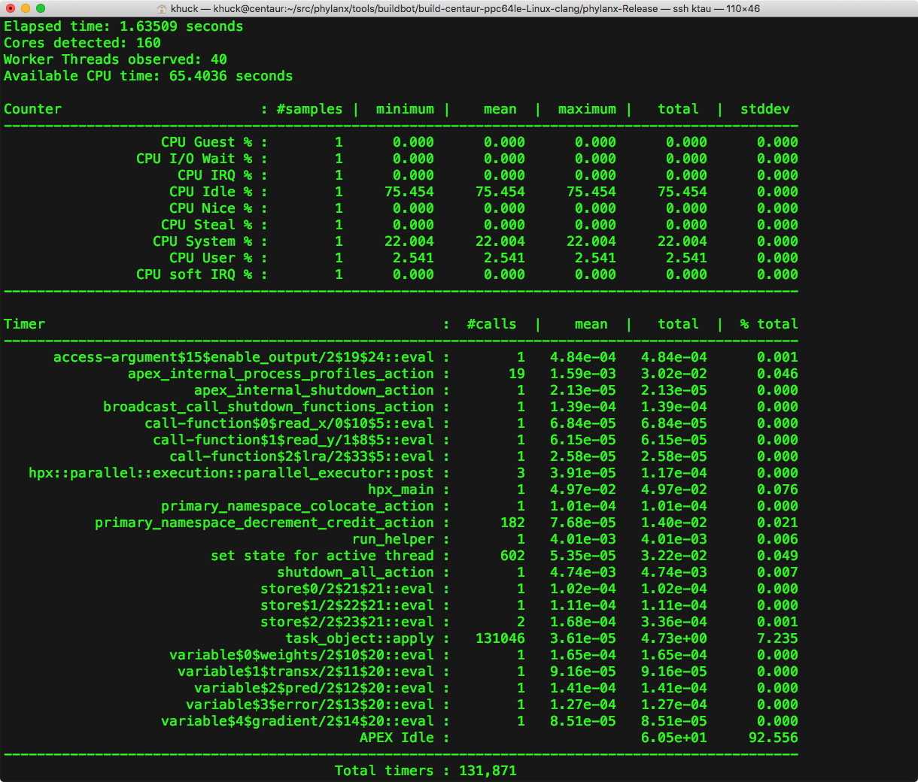
Screen Output
APEX, HPX counters
APEX timers

Slide 11
Concurrency View

Slide 12
Concurrency View

Slide 13
OTF2 View in Vampir

Slide 14
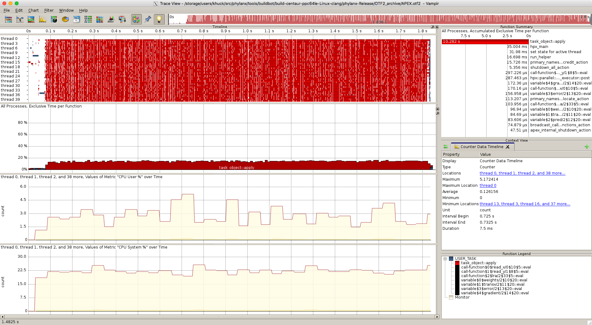
OTF2 View in Vampir - Phylanx

Slide 15
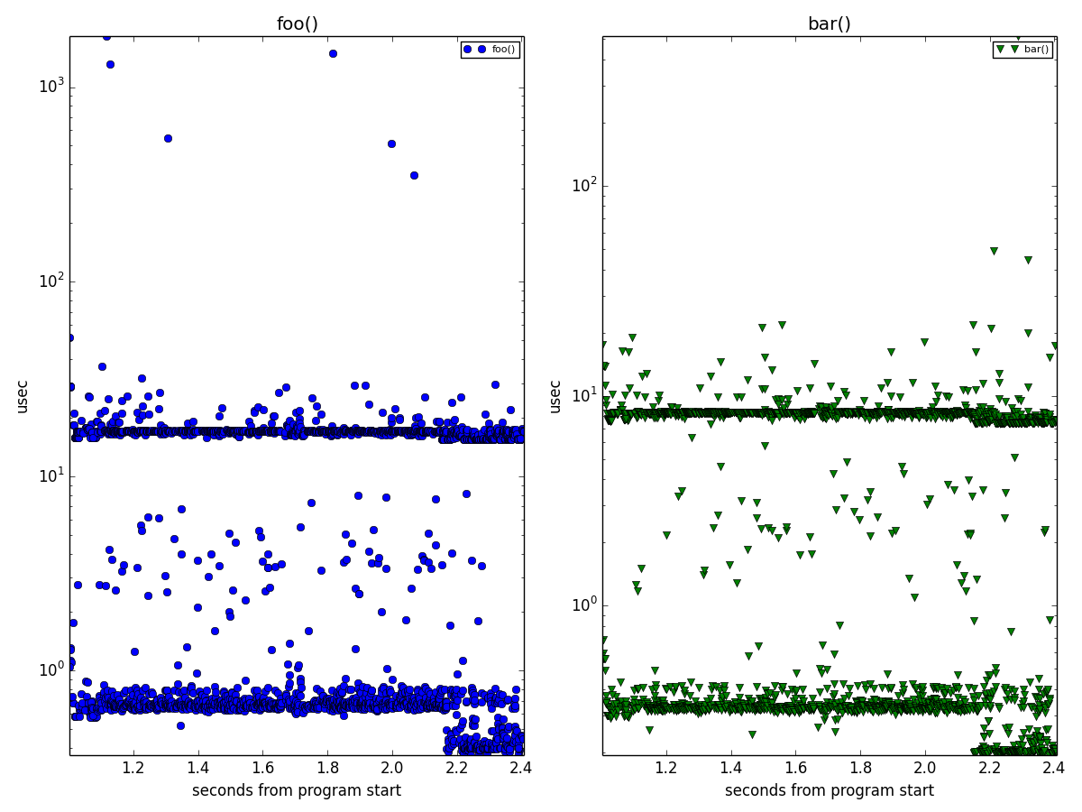
Task Scatterplot Analysis

Slide 16
Taskgraph View

Slide 17
Next Steps
Phylanx Policies
  Direct actions vs. scheduled tasks
  Algorithmic parameter optimization
HPX Policies
  Parcel coalescing
  Auto-chunking / Parallel Algorithms
  Global performance view
Phylanx counter integration
  Add as APEX counters
  AST tree measurements
Task dependency analysis
  APEX taskgraph combined with Phylanx AST graph
  OTF2 task dependency analysis
  HPX “states”
Updated documentation
  Quickstart
  Howto
  FAQ
  User/Reference guides
    http://khuck.github.io/xpress-apex/
Notes:
GUIDs
Y2:

Slide 18
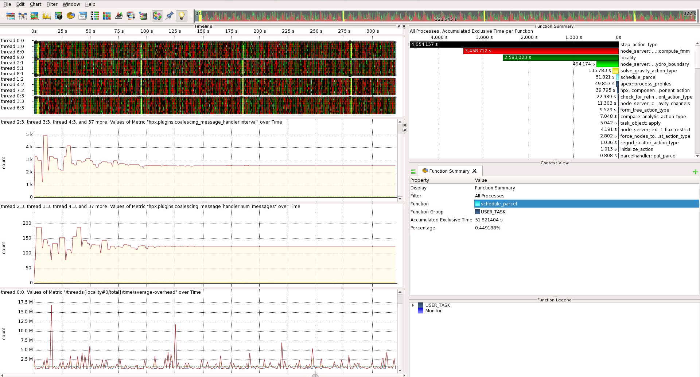
Policy Example: Parcel Coalescing

Slide 19
Task Graph Example : lra_csv

Slide 20
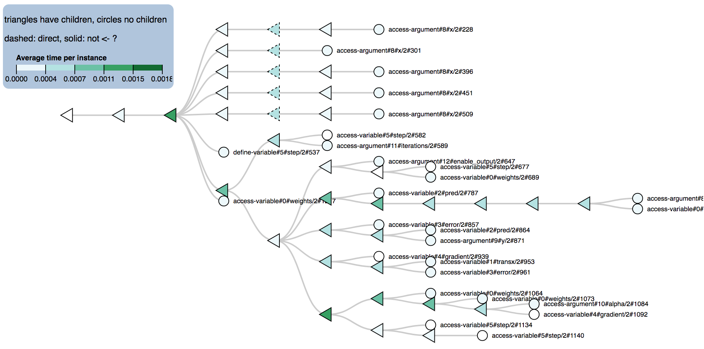
Phylanx AST (old data/graph)

Slide 21
Task dependency analysis
Previous work (see following slides) performed by extending OTF2 and building custom analysis and viewer
Current OTF2 modifications: adding task GUID and parent GUID attributes to timer events captures dependencies
Options:
  Update existing viewer to work with conventional OTF2 with attributes
  Add analysis algorithm to “viewer 2.0” (née Ravel)

Slide 22
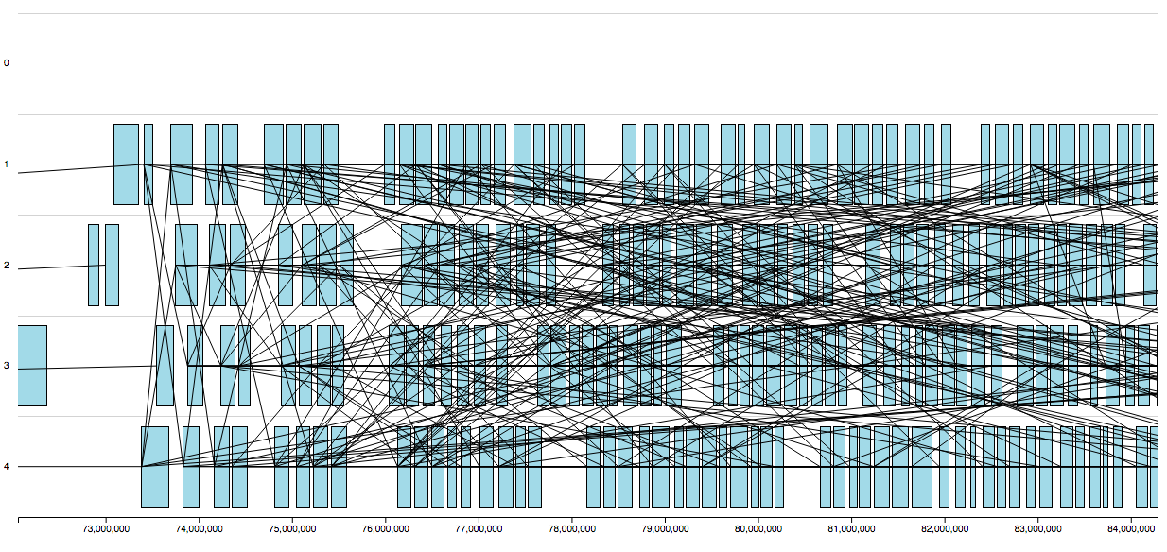
Task dependency in new viewer
Notes:
Fibonacci computation from HPX, using 4 threads. Currently a rats’ nest.

Slide 23
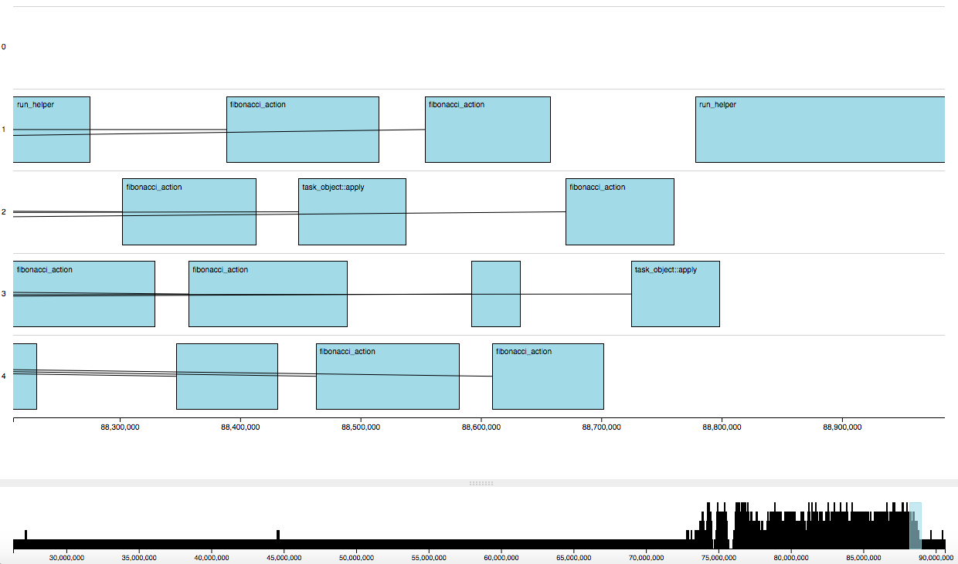
Zoom to end of computation
Notes:
End of the Fibonacci computation.

Slide 24
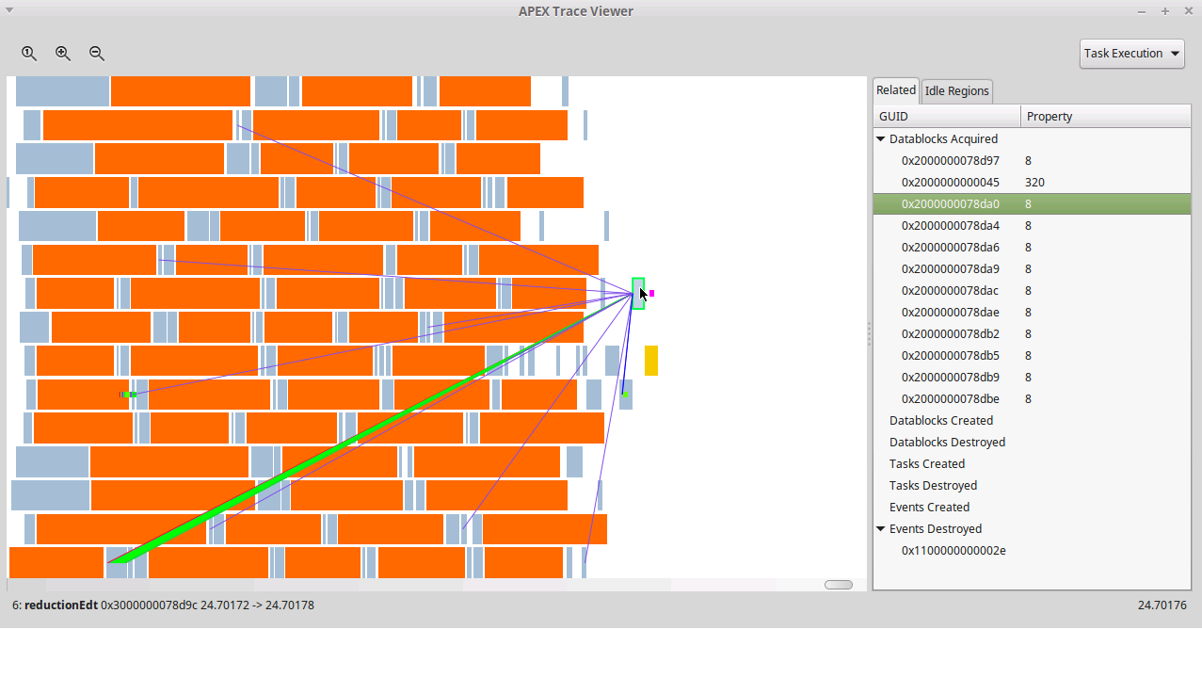
HPCG application from “another runtime”
Notes:
Do demo here

Slide 25
Automated Performance Diagnosis
Idle workers
  Can we automatically identify why workers are idle?
HPCG iteration boundaries
  Center of reduction represents natural bottleneck
  Reduction cannot complete until the final task of the iteration is complete
  Next iteration cannot begin until reduction completes
Generic diagnosis module
  Find idle regions
  Identify the bottleneck task (region-breaking task)
  Follow dependencies back from effect to cause (task to blame)

Slide 26
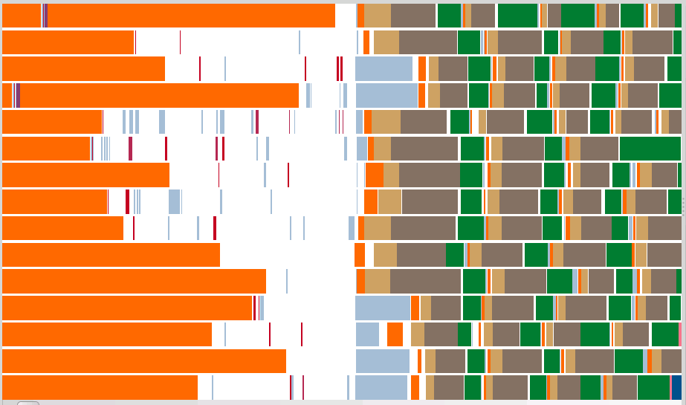
Idle region of interest
Threads of execution
Time

Slide 28
Decreasing Running + Eligible
0 Eligible
Return to Full Occupancy
Notes:
Important to point out that we currently don’t know when an HPX thread/ task is “eligible”. Can we add that?

Slide 29
Idle Region

Slide 30
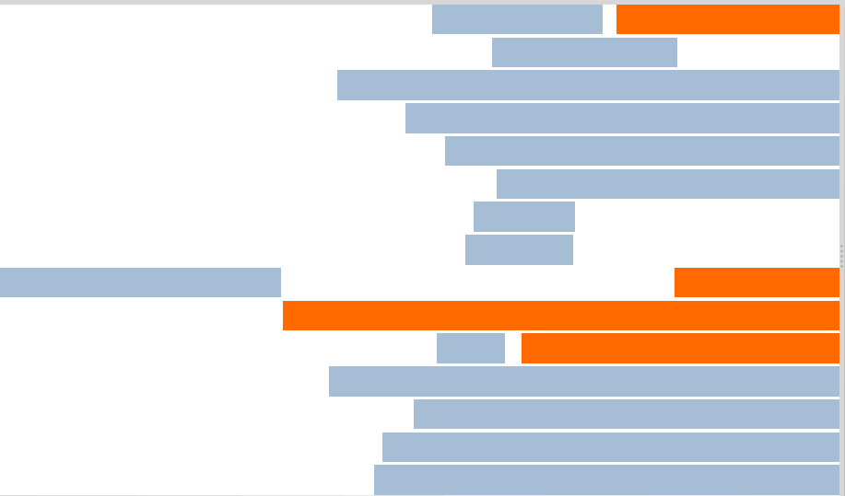
Earliest task after idle region such that multiple tasks are eligible during its execution
Breaking Task

Slide 31
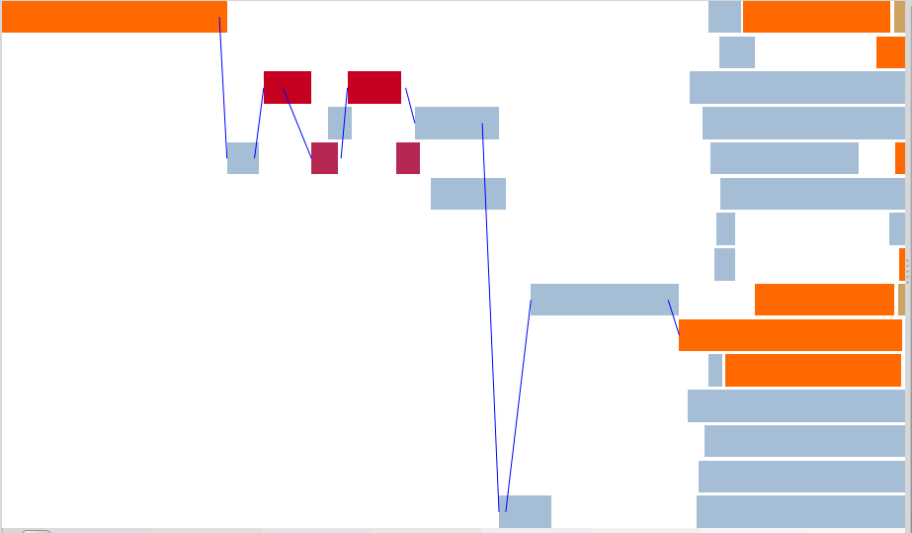
Follow dependencies back, for each task taking the last-satisfied dependency, back to a task which began execution before the idle region

Slide 32
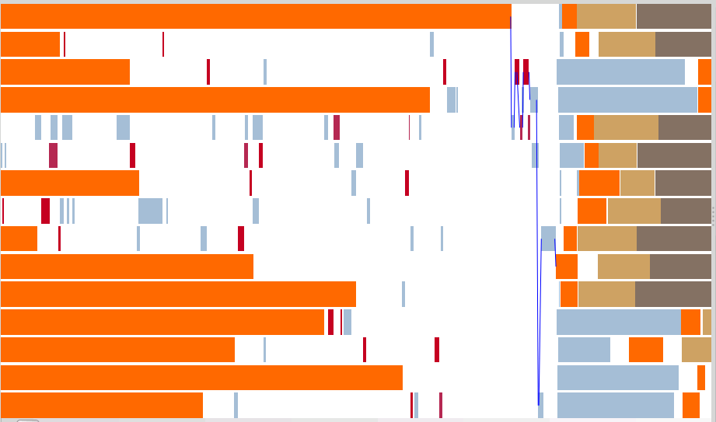
Task to Blame
If the final satisfaction taking place during the task to blame had occurred earlier, the idle region could have been shorter.

Slide 33
“Eligible” to run (scheduled)
Add events to HPX scheduler to identify thread states
  Created ✅
  Waiting on dependency
  Scheduled / ready-to-run
  Executing ✅
  Completed ✅

Slide 34
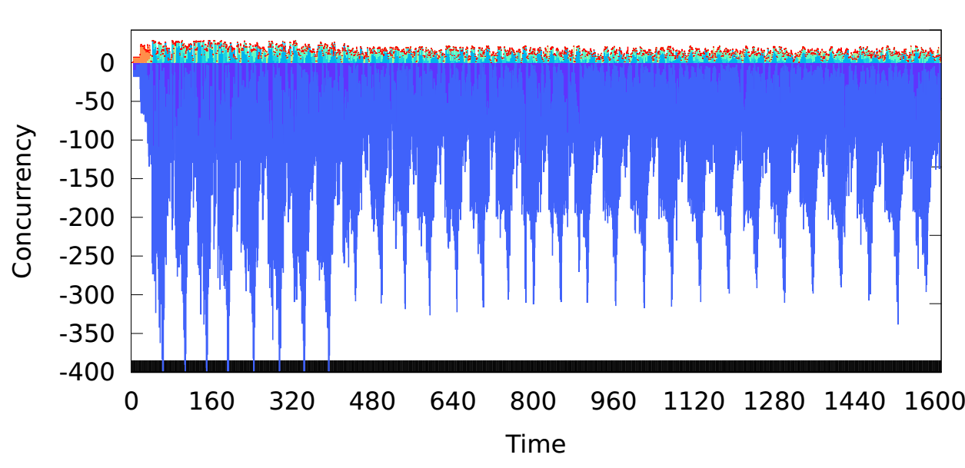
APEX concurrency view (modified)
Running
Eligible
Created but ineligible
(unsatisfied depen-dencies)
Notes:
Extended with Created/Eligible

Slide 35

Region of interest
Idle Workers
No Eligible Tasks
Full Occupancy
Eligible Tasks

