Slide 1

Performance Analysis of HPX in Jupyter Notebooks using APEX
Kevin Huck
khuck@cs.uoregon.edu
http://github.com/khuck/xpress-apex
Download slides from: http://tau.uoregon.edu/APEX.pdf

Slide 2
Outline
Introduction to APEX – Autonomic Performance Environment for eXascale
Building HPX with APEX
Program Examples in Jupyter Notebook
Postmortem analysis of HPX applications
  Gnuplot/Python visualizations of APEX data
  OTF2 output to Vampir
  Profile output to TAU

Slide 3
APEX Runtime Adaptation : Motivation
Controlling concurrency
  Energy efficiency
  Performance
Parametric variability
  Granularity for this machine / dataset?
Load Balancing
  When to perform AGAS migration?
Parallel Algorithms (for_each…)
  Separate what from how
Address the “SLOW(ER)” performance model
Post-mortem performance analysis
  “secondary” goal, but has been useful

Slide 4
Introduction to APEX
Performance awareness and performance adaptation
Top down and bottom up performance mapping / feedback
  Make node-wide resource utilization data and analysis, energy consumption, and health information available in real time
  Associate performance state with policy for feedback control
APEX introspection
  OS: track system resources, utilization, job contention, overhead
  Runtime (HPX): track threads, queues, concurrency, remote operations, parcels, memory management
  Application timer / counter observation

Slide 5
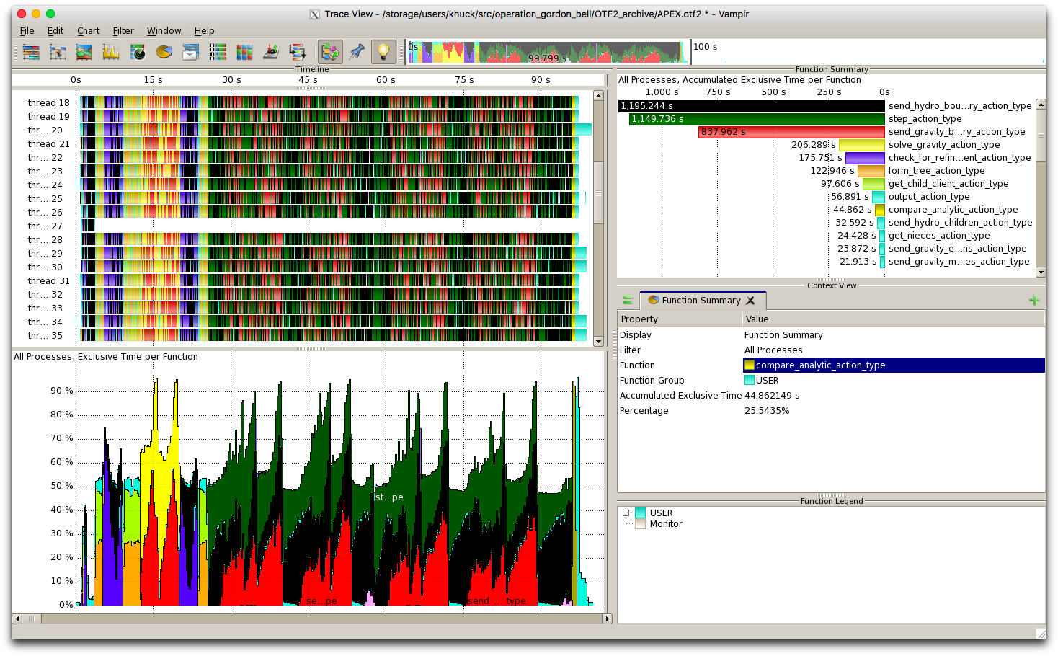
APEX architecture
APEX Introspection
Synchronous
Asynchronous
events
System Info
(/proc, getrusage, LM Sensors, etc.)
Application
meta-events
APEX State
HPX
APEX Policy Engine
Triggered
Periodic
actuators

Slide 6
APEX Introspection
APEX collects data through “inspectors”
  Synchronous uses an event API and event “listeners”
    Initialize, terminate, new thread – added to HPX runtime
    Timer start, stop, yield*, resume* - added to HPX task scheduler
    Sampled value (counters from HPX-5, HPX-3)
    Custom events (meta-events)
  Asynchonous do not rely on events, but occur periodically
APEX exploits access to performance data from lower stack components
  Reading from the RCR blackboard (i.e., power, energy)
  “Health” data through other interfaces (/proc/stat, cpuinfo, meminfo, net/dev, self/status, lm_sensors, power*, etc.)

Slide 7
APEX Event Listeners
Profiling listener
  Start event: input name/address, get timestamp, return profiler handle
  Stop event: get timestamp, put profiler object in a queue for back-end processing, return
  Sample event: put the name & value in the queue
  Asynchronous consumer thread: process profiler objects and samples to build statistical profile (in HPX-3, processed/scheduled as a thread/task)
  Optional: screen/CSV output, build task scatterplot, build taskgraph, etc.
TAU Listener (postmortem analysis)
  Synchronously passes all measurement events to TAU to build an offline profile
OTF2 Listener (postmortem analysis)
  Synchronously passes all measurement events to libotf2 for trace analysis
Concurrency listener (postmortem analysis)
  Start event: push timer ID on stack
  Stop event: pop timer ID off stack
  Asynchronous consumer thread: periodically log current timer for each thread, output report at termination

Slide 8
APEX Policy Listener
Policies are rules that decide on outcomes based on observed state
  Triggered policies are invoked by introspection API events
  Periodic policies are run periodically on asynchronous thread
Polices are registered with the Policy Engine
  Applications, runtimes, and/or OS register callback functions
Callback functions define the policy rules
  “If x < y then…”
Enables runtime adaptation using introspection data
  Feedback and control mechanism
  Engages actuators across stack layers
  Could also be used to involve online auto-tuning support*
    Active Harmony http://www.dyninst.org/harmony

Slide 9
Building HPX with APEX
$ cmake <usual HPX settings>…
  -DHPX_WITH_APEX=TRUE \
  -DAPEX_WITH_ACTIVEHARMONY=TRUE/FALSE \
  -DAPEX_WITH_PAPI=TRUE/FALSE \
  -DAPEX_WITH_MSR=TRUE/FALSE \
  -DAPEX_WITH_OTF2=TRUE/FALSE \
  …
$ make (as usual) i.e. “make –j 8 core examples tests”

Slide 10
APEX environment variables
APEX_DISABLE : 0
APEX_SUSPEND : 0
APEX_PAPI_SUSPEND : 0
APEX_PROCESS_ASYNC_STATE : 1
APEX_TAU : 0
APEX_POLICY : 1
APEX_MEASURE_CONCURRENCY : 0
APEX_MEASURE_CONCURRENCY_PERIOD : 1000000
APEX_SCREEN_OUTPUT : 1
APEX_PROFILE_OUTPUT : 0
APEX_CSV_OUTPUT : 0
APEX_TASKGRAPH_OUTPUT : 0
APEX_PROC_CPUINFO : 0
APEX_PROC_MEMINFO : 0
APEX_PROC_NET_DEV : 0
APEX_PROC_SELF_STATUS : 0
APEX_PROC_SELF_IO : 0
APEX_PROC_STAT : 1
APEX_PROC_PERIOD : 1000000
APEX_THROTTLE_CONCURRENCY : 0
APEX_THROTTLING_MAX_THREADS : 4
APEX_THROTTLING_MIN_THREADS : 1
APEX_THROTTLE_ENERGY : 0
APEX_THROTTLE_ENERGY_PERIOD : 1000000
APEX_THROTTLING_MAX_WATTS : 300
APEX_THROTTLING_MIN_WATTS : 150
APEX_PTHREAD_WRAPPER_STACK_SIZE : 0
APEX_OMPT_REQUIRED_EVENTS_ONLY : 0
APEX_OMPT_HIGH_OVERHEAD_EVENTS : 0
APEX_PIN_APEX_THREADS : 1
APEX_TASK_SCATTERPLOT : 1
APEX_POLICY_DRAIN_TIMEOUT : 1000
APEX_PAPI_METRICS :
APEX_PLUGINS :
APEX_PLUGINS_PATH : ./
APEX_OTF2 : 0
APEX_OTF2_ARCHIVE_PATH : OTF2_archive
APEX_OTF2_ARCHIVE_NAME : APEX
Notes:
Opportunity to integrate with HPX command line?

Slide 11
Note about environment variables…
Some batch submission systems do not pass environment variables to the application without considerable effort
APEX will read environment variables from $PWD/apex.conf file
All variables also have API calls for getting/setting

Slide 12
Screen Output
Elapsed time: 2.40514 seconds
Cores detected: 4
Worker Threads observed: 5
Available CPU time: 9.62057 seconds
Timer : #calls | mean | total | % total
------------------------------------------------------------------------------------------------
someThread(void*) : 2 1.39e+00 2.79e+00 28.965
foo(int) : 131072 2.00e-05 2.63e+00 27.306
bar(int, apex::profiler**, void**) : 131072 9.69e-06 1.27e+00 13.198
someUntimedThread(void*) : 2 1.12e+00 2.24e+00 23.271
main : 1 1.40e+00 1.40e+00 14.548
APEX MAIN : 1 2.41e+00 2.41e+00 100.000
------------------------------------------------------------------------------------------------
Total timers : 262,150

Slide 13
Concurrency View (before fix)

Slide 14
Concurrency View (after fix)

Slide 15
OTF2 View in Vampir

Slide 16
Profile View in TAU ParaProf

Slide 17
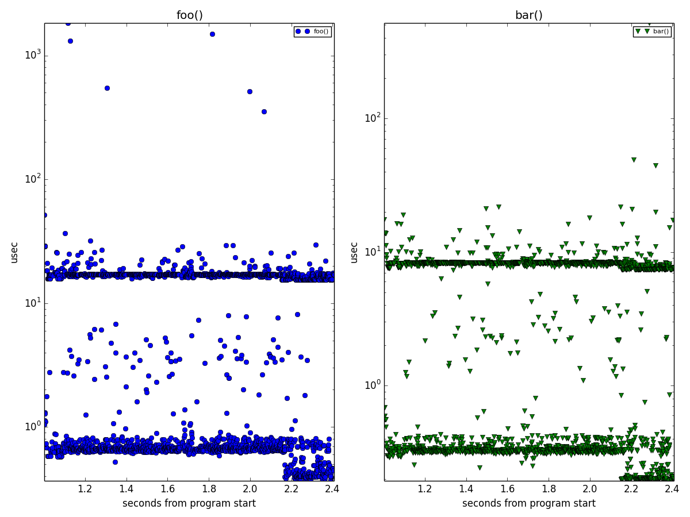
Task Scatterplot Analysis (prototype)

Slide 18
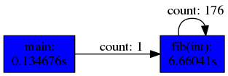
Taskgraph View (prototype)

Slide 19
Example : HPX+APEX
Heat diffusion
1D stencil code
  Data array
  partitioned into
  chunks
1 node with
no hyperthreading
Performance increases to a point with increasing worker threads, then decreases
Notes:
UPDATE THIS FOR EDISON/BEACON

Slide 20
Concurrency & Performance
Region of
maximum
performance
correlates with
thread queue
length runtime
performance counter
  Represents # tasks currently waiting to execute
Could do introspection on this to control concurrency throttling policy (see next example)
Runtime
Thread queue length
Notes:
UPDATE THIS FOR EDISON/BEACON

Slide 21
1d_stencil_4 Baseline
48 worker threads (with hyperthreading, on Edison)
Actual concurrency much lower
  Implementation is memory bound
Large variation in concurrency over time
  Tasks waiting on prior tasks to complete
100,000,000 elements, 1000 partitions
138 secs
Where
calculation
takes place
Event-generated
metrics
Notes:
hpx::lcos::local::dataflow is the action that actually carries out the calculation

Slide 22
1d_stencil w/optimal # of Threads
12 worker threads on Edison
Greater proportion of threads kept busy
  Less interference between active threads and threads waiting for memory
Much faster
  61 sec. vs 138 sec.
100,000,000 elements, 1000 partitions
61 secs

Slide 23
1d_stencil Adaptation with APEX
Initially 32 worker threads
ActiveHarmony searches for minimal thread queue length
Quickly converges on 20

Slide 24
Adapting Block Size
Is 1000 partitions of 100000 cells the best partitioning?
Parametric studies say “no”.
Can we modify the example to repartition as necessary to find better performance?

Slide 25
1d_stencil: adapting block size
Notes:
Also have experimental results using ActiveHarmony to adapt concurrency & granularity

Slide 26



Support Acknowledgements
Support for this work was provided through Scientific Discovery through Advanced Computing (SciDAC) program funded by U.S. Department of Energy, Office of Science, Advanced Scientific Computing Research (and Basic Energy Sciences/Biological and Environmental Research/High Energy Physics/Fusion Energy Sciences/Nuclear Physics) under award numbers DE-SC0008638, DE-SC0008704, DE- FG02-11ER26050 and DE-SC0006925.
This research used resources of the National Energy Research Scientific Computing Center, a DOE Office of Science User Facility supported by the Office of Science of the U.S. Department of Energy under Contract No. DE-AC02-05CH11231.
This material is (will be?) based upon work supported by the National Science Foundation Graduate Research Fellowship under Grant No. 1737803.
The authors acknowledge that the Talapas HPC cluster and the High Performance Computing Research Core Facility at The University of Oregon have contributed to the research results reported within this paper.

