Slide 1
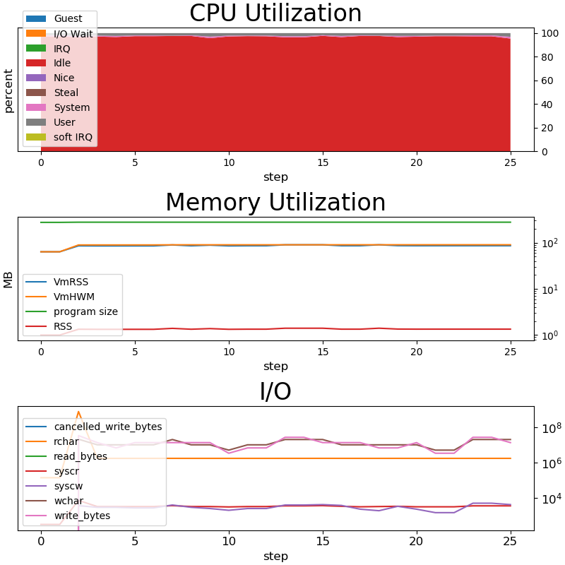

TAU Performance System - Data Management Interactions
Updated TAU support to save profiles as ADIOS2
  Now supports both asynchronous (periodic) output and synchronous output on “dump” events
Runtime performance monitoring
  TAU plugin for monitoring /proc, power, GPU/CPU/Memory utilization
  Allows for user-space HW/OS monitoring per-process/-node in a dashboard
PerfStubs library for instrumentation support (C/C++/Fortran) without a build dependency
  http://github.com/khuck/perfstubs (moving to UO-OACISS)
  Tested with: Apline/Ascent, PETSc, PapyrusKV, ADIOS2 example programs
  Targets: CAMTIMERS, ADIOS2
  Presented at ProTools workshop, SC19
SENSEI measurement
  Data volume/rates, memory footprint, observed time for in-situ analysis (in progress)
Notes:
Working on a newer figure with a relevant example

