Slide 1
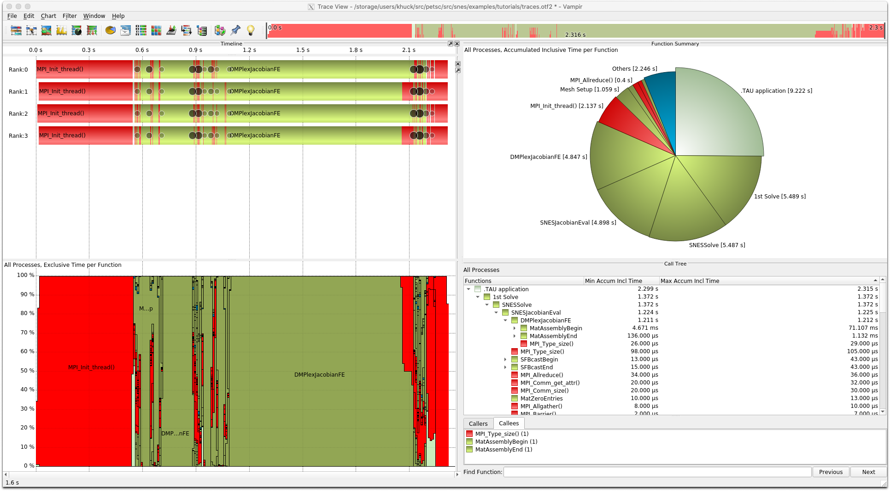
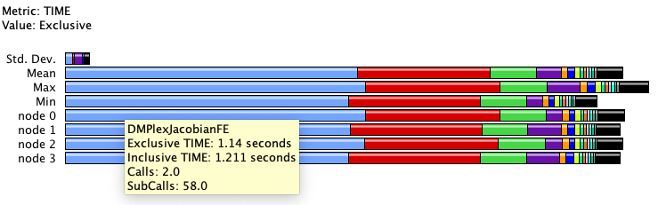


FastMath Collaboration: Exposing PETSc Profiling to External Tools
PETSc has an internal profiling API
  Enabled with “-log_view” argument
  Outputs text summary
  Also has an event trace API
Added PerfStubs calls to PETSc
  Enables tool plugin interface with no new build depdency
Enable tool at runtime to activate
  “tau_exec ./ex56 ...” to preload TAU
Tools now see all PETSc internals
  No additional instrumentation needed
Vampir Trace view of PETSc stages and events
TAU ParaProf profile view of PETSc stages and events
Work performed by K. Huck (UO)
in collaboration with R. T. Mills (ANL)
Notes:
This could be implemented with Score-P, as well. Similar technique is used with ADIOS2.

