Slide 1
PR: Analysis, Modeling, Autotuning (B. Norris and students)
Reproducible measurement and analysis workflows
  Collect data with a variety of tools (vendor and open-source)
  Create Pandas data analysis workflows that can be applied repeatedly
Hybrid static/empirical model generation
  Used binary analysis to create parameterized performance models at the CFG level
  Initially developed with ROSE, migrated to LLVM
  Long-term goal: use in autotuning, enable prediction on hypothetical architectures
Autotuning
  Autotuned empirical rooflines for specific instruction mixes (to produce a tighter upper bound)

Slide 2
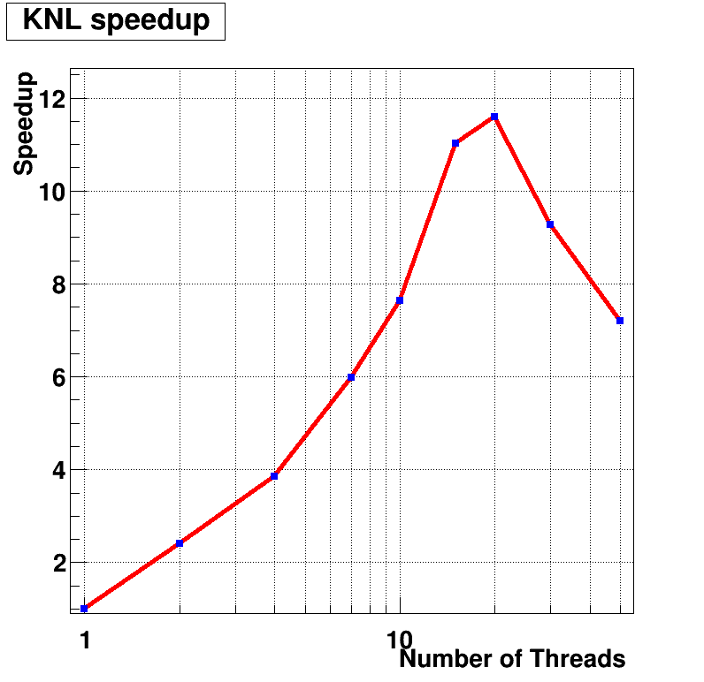
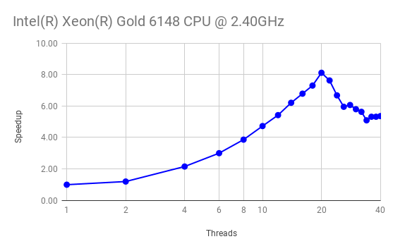
Reproducible Performance Analysis Workflows
    (Motivated and evaluated by the SciDAC-4 HEP Event Reconstruction with Cutting Edge Computing Architectures and NUCLEI projects)
PR goal:
  Provide a data analytics platform for creating and reusing performance analysis workflows
Recent achievements:
Prototype analysis workflows based on data gathered with different tools (TAU, Intel Vtune, etc.) and Python Pandas
  Analysis and optimization of CMS tracking prototype on Skylake and KNL(@NERSC Cori), improvement so far ~8%
  Hit finding: Achieved speedups of 2.7x from explicit vectorization and of >10x from shared-memory parallelization
Scaling of mem. miss rates w.r.t number of threads
Breakdown of CPU stalls for specific functions/loops:
Execution speedup on KNL of hit finding code as a function of the number of threads.
Execution speedup on Skylake of hit finding code
as a function of the number of threads.

Slide 3
TAU Performance System - Updates
GPU
  Cuda 9+ with NVLink support
  Fixing support for concurrent kernels launched from threads > 1
  TAU integration with AMD ROCm platform
OpenMP
  Finishing up OMPT TR7 / OpenMP 5.0 support
  Integrated measurement for OpenMP regions, target directives, GPU measurements
  Lower overhead than original OMPT TR4 support from 2 years ago
Other Updates
  Support for IBM XL compilers with MVAPICH2 under IBM Power Linux Power 9 + GPU platform
  LIKWID hardware counter support

Slide 4
TAU Performance System - Data Management Interactions
Added TAU support to save profiles as ADIOS2
  Profiles only (no trace data)
  End of execution only (no periodic/timestep output support yet)
Working on Darshan integration
  Both libraries wrap MPI_Init() and MPI_Finalize(), MPI I/O routines
SOS Updates
  In memory database support
  No-database support (local cache for streaming support)
Working on “always on” support, without having TAU be a build dependency
  Integrate with application timers and/or timer libraries (e.g. CAMTIMERS) to use TAU if LD_PRELOAD’ed into the environment - otherwise ignore
  Integration opportunities: CAMTIMERS, ADIOS2, Xolotl, Caliper, others

Slide 5
Application Engagement: TEAMS / FLASH
Nightly Performance Regression Testing
  Check out current master, configure, build, run
  Store performance data in TAUdb database (Postgres)
  Run automated PerfExplorer scripts to generate charts
  Scaling behavior, top 5 event breakdown
http://www.nic.uoregon.edu/~khuck/regression/flash/
Notes:
Towards Exascale Astrophysics of Mergers and SuperNova project, collaboration between Anshu Dubey and Kevin Huck. The goal of the engagement is to set up nightly performance regression testing for key algorithms. The prototype test case is the Sedov explosion problem. From the FLASH documentation: “The Sedov explosion problem (Sedov 1959) is another purely hydrodynamical test in which we check the code's ability to deal with strong shocks and non-planar symmetry.” The latest code from github.com is downloaded, configured and built and then executed under different processor counts.

