Slide 1
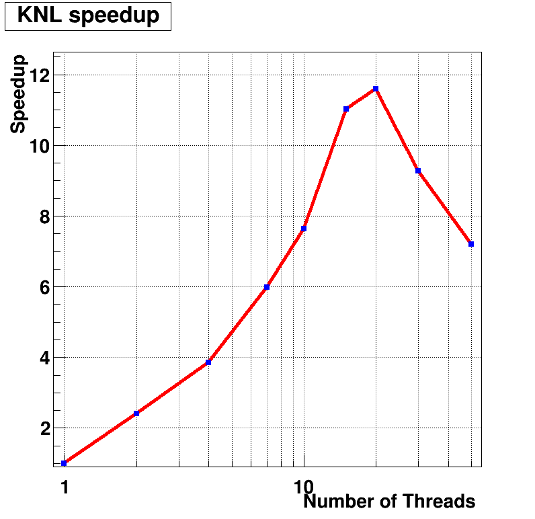
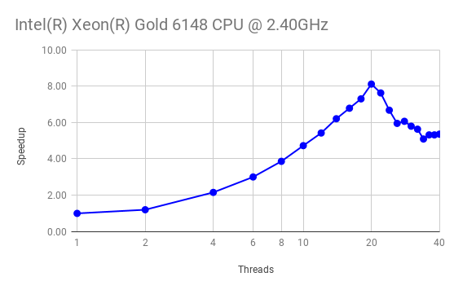
Reproducible Performance Analysis Workflows - HEP NUCLEI
    (Motivated and evaluated by the SciDAC-4 HEP Event Reconstruction with Cutting Edge Computing Architectures and NUCLEI projects)
PR goal:
  Provide a data analytics platform for creating and reusing performance analysis workflows
Recent achievements:
Prototype analysis workflows based on data gathered with different tools (TAU, Intel Vtune, etc.) and Python Pandas
  Analysis and optimization of CMS tracking prototype on Skylake and KNL(@NERSC Cori), improvement so far ~8%
  Hit finding: Achieved speedups of 2.7x from explicit vectorization and of >10x from shared-memory parallelization
Scaling of mem. miss rates w.r.t number of threads
Breakdown of CPU stalls for specific functions/loops:
Execution speedup on KNL of hit finding code as a function of the number of threads.
Execution speedup on Skylake of hit finding code
as a function of the number of threads.
Notes:
Pilot project, funded for 3 years.
Goal: accelerate HEP event reconstruction exploiting highly parallel computing architectures. Focus on two areas: CMS Tracking and LArTPC Reconstruction
Institutions and people:
Fermilab: G. Cerati (PI), M. Wang (staff), A. Hall (postdoc), S. Berkman (postdoc); expertise in HEP reconstruction
University of Oregon: B. Norris (PI), B. Gravelle (grad. student);
expertise in analysis and optimization for HPC
Milestones achieved:
CMS tracking: 1. Benchmark physics performance and work on improvements;
2. Profile computing performance and work on solutions
LArTPC Reconstruction: 1. Port ideas and tools from CMS tracking work; 2. Produce standalone implementation of algorithm for feasibility study; 3. Perform tests of parallel execution of feasibility study algorithm.
Coordinating activities:
Partnership with RAPIDS Institute, in particular for advanced profiling tools

Slide 2
Application Engagement: TEAMS (FLASH)
Nightly Performance Regression Testing
  Check out current master, configure, build, run
  Store performance data in TAUdb database (Postgres)
  Run automated PerfExplorer scripts to generate charts
  Scaling behavior, top 5 event breakdown
http://www.nic.uoregon.edu/~khuck/regression/flash/
Notes:
Towards Exascale Astrophysics of Mergers and SuperNova project, collaboration between Anshu Dubey and Kevin Huck. The goal of the engagement is to set up nightly performance regression testing for key algorithms. The prototype test case is the Sedov explosion problem. From the FLASH documentation: “The Sedov explosion problem (Sedov 1959) is another purely hydrodynamical test in which we check the code's ability to deal with strong shocks and non-planar symmetry.” The latest code from github.com is downloaded, configured and built and then executed under different processor counts.

