Slide 1
PR: Analysis, Modeling, Autotuning (B. Norris and students)
Reproducible measurement and analysis workflows
  Collect data with a variety of tools (vendor and open-source)
  Create Pandas data analysis workflows that can be applied repeatedly
Hybrid static/empirical model generation
  Used binary analysis to create parameterized performance models at the CFG level
  Initially developed with ROSE, migrated to LLVM
  Long-term goal: use in autotuning, enable prediction on hypothetical architectures
Autotuning
  Autotuned empirical rooflines for specific instruction mixes (to produce a tighter upper bound)

Slide 2
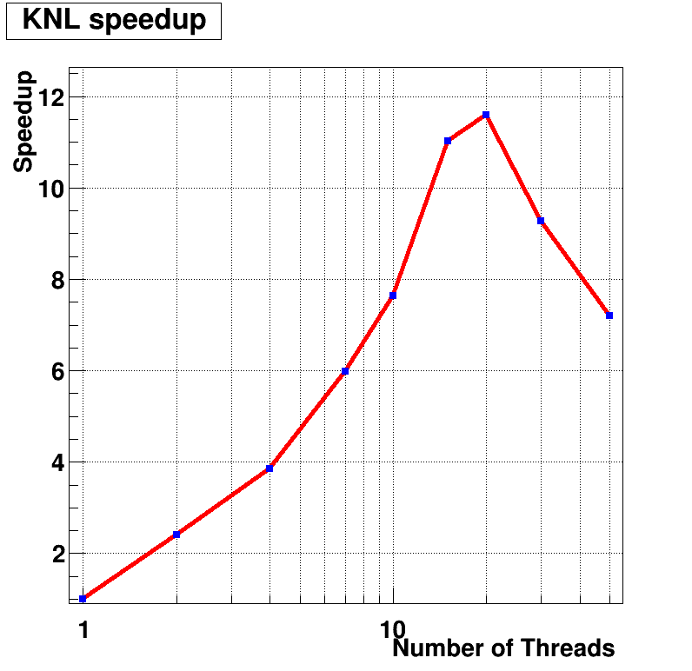
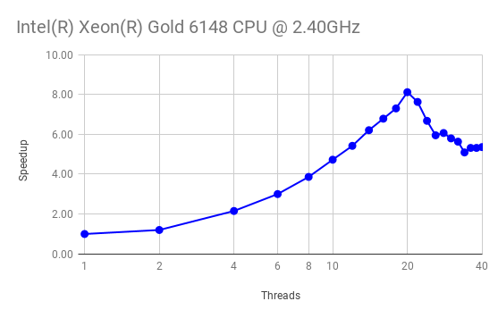
Reproducible Performance Analysis Workflows
    (Motivated and evaluated by the SciDAC-4 HEP Event Reconstruction with Cutting Edge Computing Architectures and NUCLEI projects)
PR goal:
  Provide a data analytics platform for creating and reusing performance analysis workflows
Recent achievements:
Prototype analysis workflows based on data gathered with different tools (TAU, Intel Vtune, etc.) and Python Pandas
  Analysis and optimization of CMS tracking prototype on Skylake and KNL(@NERSC Cori), improvement so far ~8%
  Hit finding: Achieved speedups of 2.7x from explicit vectorization and of >10x from shared-memory parallelization
Scaling of mem. miss rates w.r.t number of threads
Breakdown of CPU stalls for specific functions/loops:
Execution speedup on KNL of hit finding code as a function of the number of threads.
Execution speedup on Skylake of hit finding code
as a function of the number of threads.
Notes:
Pilot project, funded for 3 years.
Goal: accelerate HEP event reconstruction exploiting highly parallel computing architectures. Focus on two areas: CMS Tracking and LArTPC Reconstruction
Institutions and people:
Fermilab: G. Cerati (PI), M. Wang (staff), A. Hall (postdoc), S. Berkman (postdoc); expertise in HEP reconstruction
University of Oregon: B. Norris (PI), B. Gravelle (grad. student);
expertise in analysis and optimization for HPC
Milestones achieved:
CMS tracking: 1. Benchmark physics performance and work on improvements;
2. Profile computing performance and work on solutions
LArTPC Reconstruction: 1. Port ideas and tools from CMS tracking work; 2. Produce standalone implementation of algorithm for feasibility study; 3. Perform tests of parallel execution of feasibility study algorithm.
Coordinating activities:
Partnership with RAPIDS Institute, in particular for advanced profiling tools

Slide 3
TAU Performance System - Updates
GPU
  Cuda 9+ with NVLink support
  Fixing support for concurrent kernels launched from threads > 1
  TAU integration with AMD ROCm platform
OpenMP
  Finishing up OMPT TR7 / OpenMP 5.0 support
  Integrated measurement for OpenMP regions, target directives, GPU measurements
  Lower overhead than original OMPT TR4 support from 2 years ago
Other Updates
  Support for IBM XL compilers with MVAPICH2 under IBM Power Linux Power 9 + GPU platform
  LIKWID hardware counter support

