Slide 1



Performance Measurement and Analysis using the TAU Performance System®
Kevin Huck khuck@cs.uoregon.edu
Allen D. Malony, Sameer Shende, Wyatt Spear, Robert Lim,
Chad Wood, Jacob Lambert, Srinivasan Ramesh,
Mohammad Alaul Haque Monil, Alister Johnson
http://tau.uoregon.edu tau-bugs@cs.uoregon.edu

Slide 2
TAU Performance System®
Tuning and Analysis Utilities (20+ year project)
Comprehensive performance profiling and tracing
  Integrated, scalable, flexible, portable
  Targets all parallel programming/execution paradigms
Integrated performance toolkit
  Instrumentation, measurement, analysis, visualization
  Widely-ported performance profiling / tracing system
  Performance data management and data mining
  Open source (BSD-style license)

Slide 3
Understanding Application Performance using TAU
How much time is spent in each application routine and outer loops? Within loops, what is the contribution of each statement?
How many instructions are executed in these code regions?
Floating point, Level 1 and 2 data cache misses, hits, branches taken?
What is the memory usage of the code? When and where is memory allocated/de-allocated? Are there any memory leaks?
What are the I/O characteristics of the code? What is the peak read and write bandwidth of individual calls, total volume?
What is the contribution of each phase of the program? What is the time wasted/spent waiting for collectives, and I/O operations in Initialization, Computation, I/O phases?
How does the application scale? What is the efficiency, runtime breakdown of performance across different core counts?
Notes:
What are the types of performance analysis questions that a framework like TAU can help with?

Slide 4
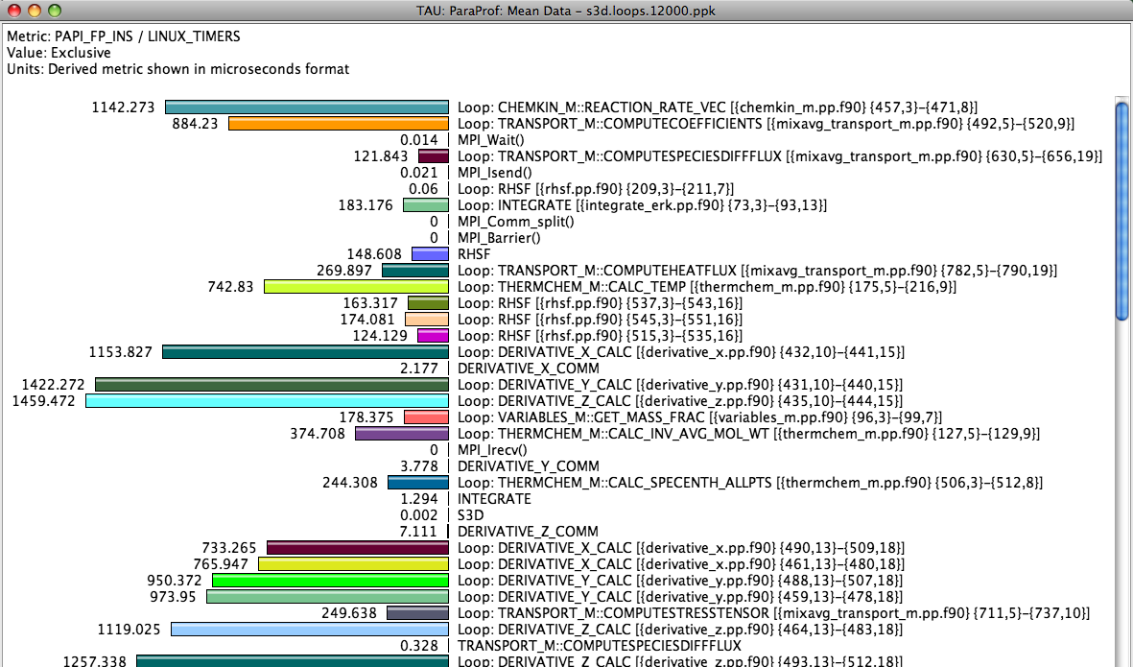
Identifying Potential Bottlenecks
low mflops in
loops?
Notes:
For example, here is a profile showing the floating point operations per microsecond. The events are sorted in order of exclusive time - the functions / loops at the top of the window take the most time. In this case, we see two loops that have very low FLOPs/us rates. They would be good targets for optimization.

Slide 5
What does TAU support?
C/C++
CUDA
UPC
GPI
Python
Fortran
OpenACC
MPI
Java
pthreads
Intel MIC
OpenMP
GCC
Intel
PGI
Cray
Sun
LLVM
HPX
MPC
Windows
AIX
OS X
Linux
Insert yours
here
Power 8
NVIDIA
BlueGene
Fujitsu
ARM64
Notes:
Not listed: SHMEM, OpenCL, ROCm, etc.

Slide 6
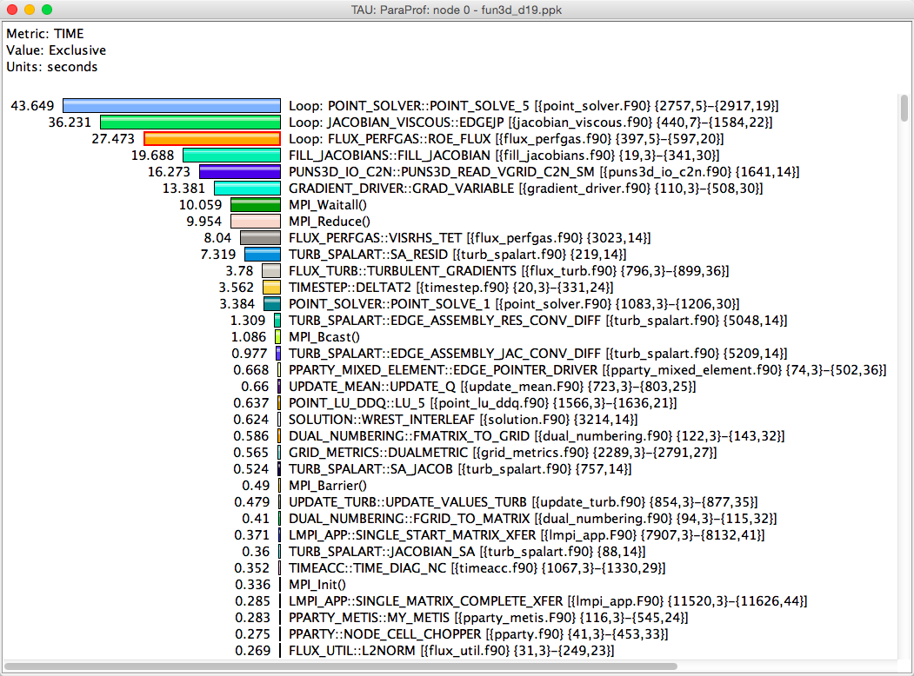
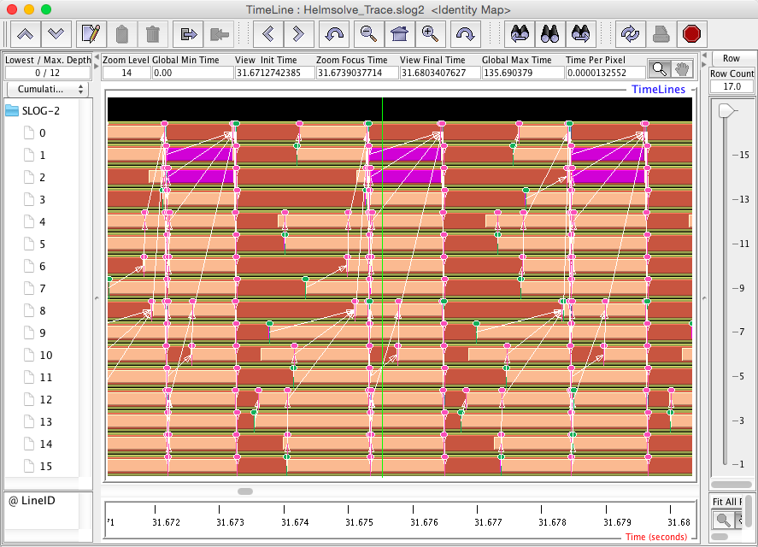
Profiling and Tracing
Profiling
Tracing
Profiling shows you how much (total) time was spent in each routine
Tracing shows you when the events take place on a timeline
Profiling and tracing
  Profiling shows you how much (total) time was spent in each routine
  Tracing shows you when the events take place on a timeline

Slide 7
Inclusive vs. Exclusive Measurements
Performance with respect to code regions
Exclusive measurements for region only
Inclusive measurements includes child regions
int foo()
{
int a;
a =a + 1;
bar();
a =a + 1;
return a;
}
inclusive
duration
exclusive
duration

Slide 8
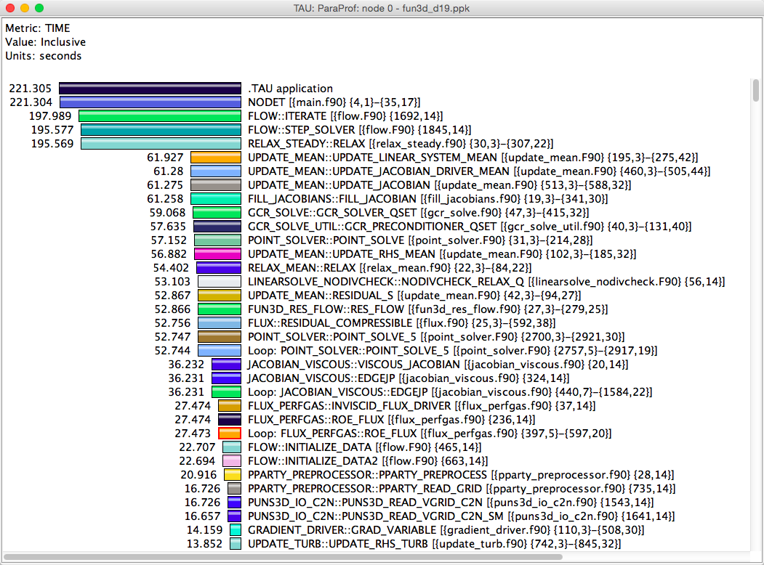
Inclusive vs. Exclusive Measurements
Inclusive time
Exclusive time

Slide 9
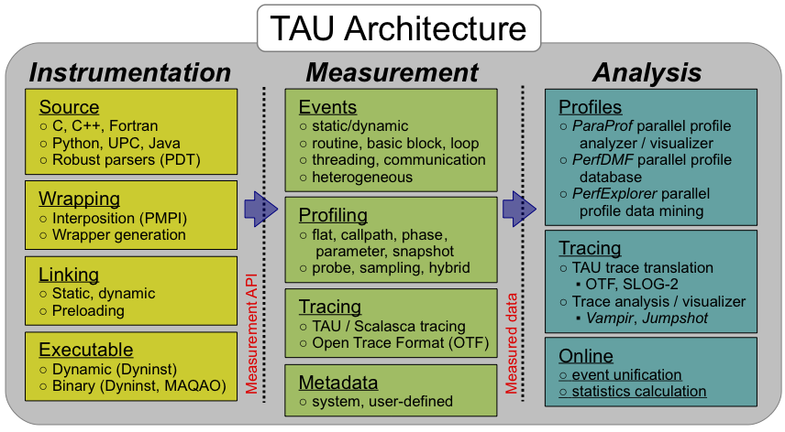
TAU Architecture and Workflow
Notes:
Missing from this figure: sampling, PAPI/LIKWID, power,

Slide 10
TAU Architecture and Workflow
Instrumentation: Add probes to perform measurements
  Source code instrumentation using pre-processors and compiler scripts
  Wrapping external libraries (I/O, MPI, Memory, CUDA, OpenCL, pthread)
  Runtime library callbacks (ADIOS, OpenMP, Kokkos, Python)
  Rewriting the binary executable
Measurement: Profiling or tracing using various metrics
  Direct instrumentation (Interval events measure exclusive or inclusive duration)
  Periodic sampling (measures statement level contribution)
  Throttling and runtime control of low-level events that execute frequently
  Per-thread storage of performance data
  Interface with external packages (e.g. PAPI hw performance counter library)
Analysis: Visualization of profiles and traces
  3D visualization of profile data in paraprof or perfexplorer tools
  Trace conversion & display in external visualizers (Vampir, Jumpshot, ParaVer)

Slide 11
Automatic Instrumentation with TAU
Add TAU bin directory to your path
Set TAU_MAKEFILE environment variable
  Choose configuration from /path/to/tau/arch/lib/Makefile.tau-*
Replace compilers with TAU compiler wrappers
  tau_cc.sh, tau_cxx.sh, tau_f90.sh
Set TAU_OPTIONS environment variable (optional)
  Instrumentation type, selective instrumentation, linker options, etc.
Build as usual

Slide 12
TAU Execution Command (tau_exec)
Uninstrumented execution
% mpirun -np 256 ./a.out
Track GPU operations
% mpirun –np 256 tau_exec –cupti ./a.out
% mpirun –np 256 tau_exec –cupti -um ./a.out (for Unified Memory)
% mpirun –np 256 tau_exec –opencl ./a.out
% mpirun –np 256 tau_exec –openacc ./a.out
Track MPI performance
% mpirun -np 256 tau_exec ./a.out
Track OpenMP, I/O, and MPI performance (MPI enabled by default)
% mpirun -np 256 tau_exec –ompt -io ./a.out
Track memory operations
% export TAU_TRACK_MEMORY_LEAKS=1
% mpirun –np 256 tau_exec –memory_debug ./a.out (bounds check)
Use event based sampling (compile with –g)
% mpirun –np 256 tau_exec –ebs ./a.out
Also –ebs_source=<PAPI_COUNTER> -ebs_period=<overflow_count>
Notes:
Many types of measurement (sampling, MPI, CUDA, OpenMP, OpenACC, etc) don’t require instrumentation, and can be measured by preloading measurement libraries. The tau_exec wrapper preloads the libraries, sets environment variables, and then launches the application. Only works with dynamically linked executables.

Slide 13
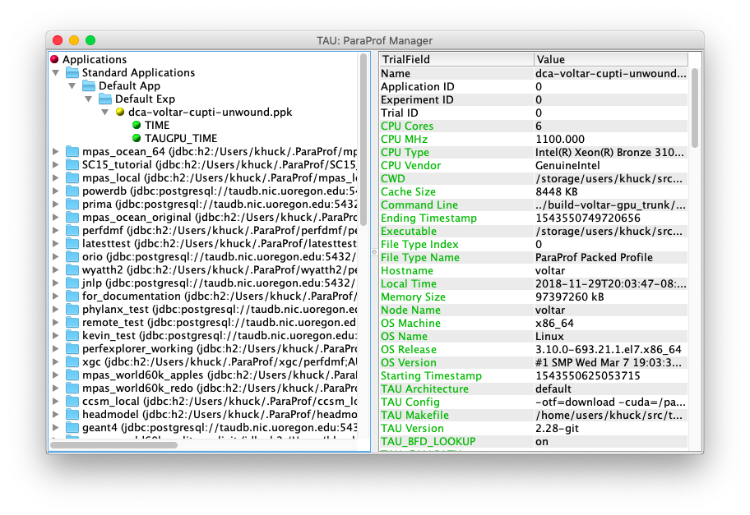
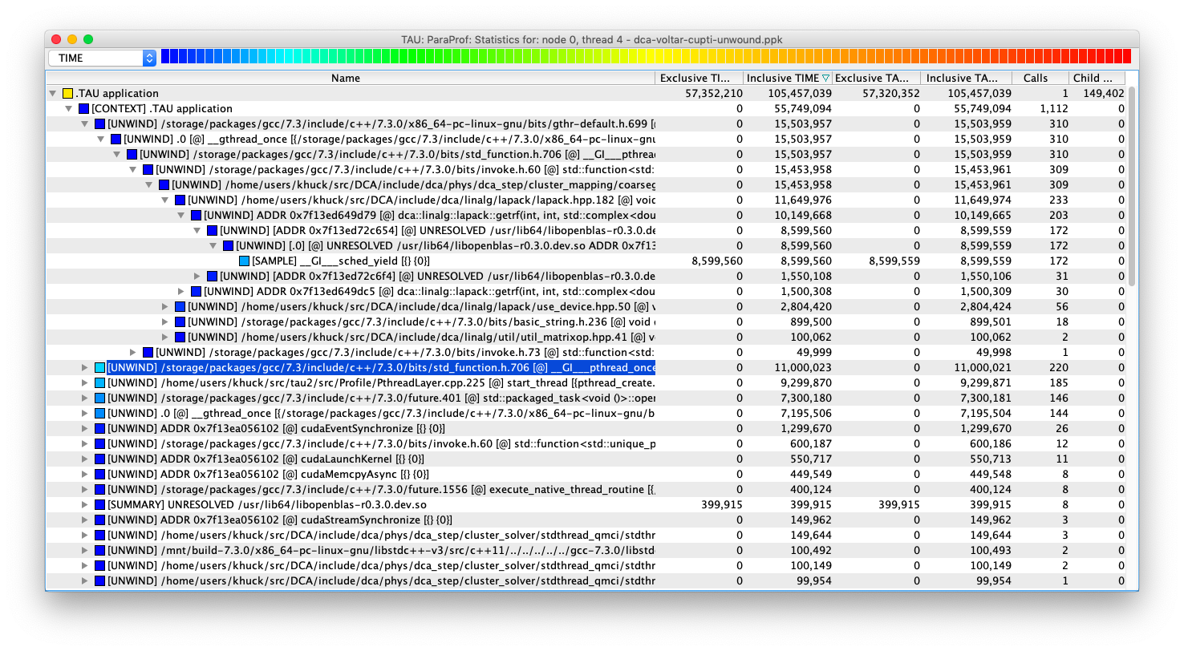
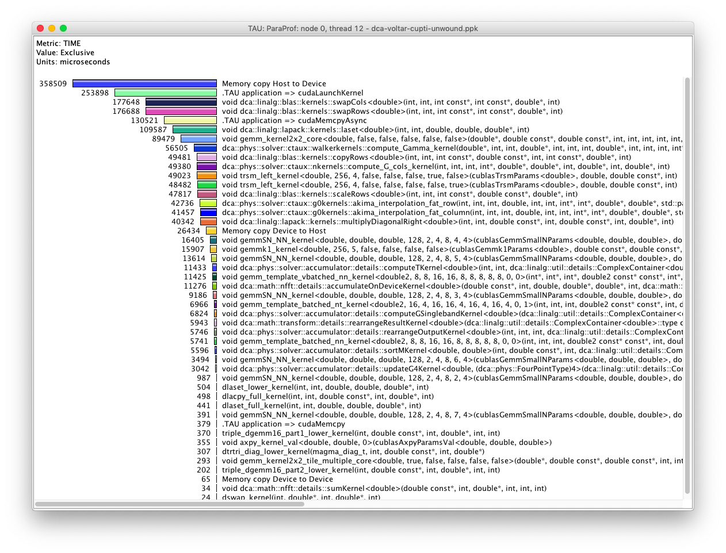
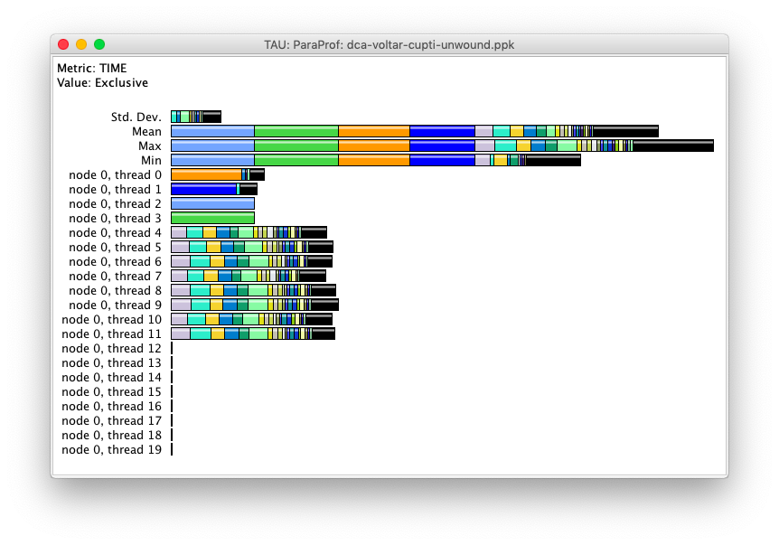
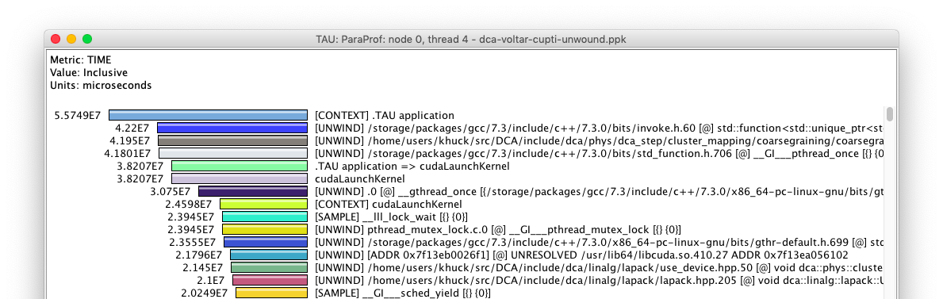
ParaProf Profile Browser
Main window
Statistic Table
Per-thread view
CUDA Thread
GPU Thread
Notes:
This is a C++ application with multiple threads and CUDA. All data collected together.

Slide 14
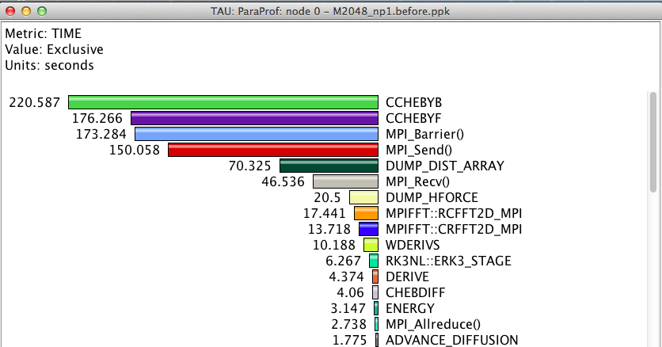
Routine Level Profile
How much time is spent in each application routine?

Slide 15
Callpath measurement in TAU
Periodic sampling interrupts with optional callstack unwinding

Slide 16
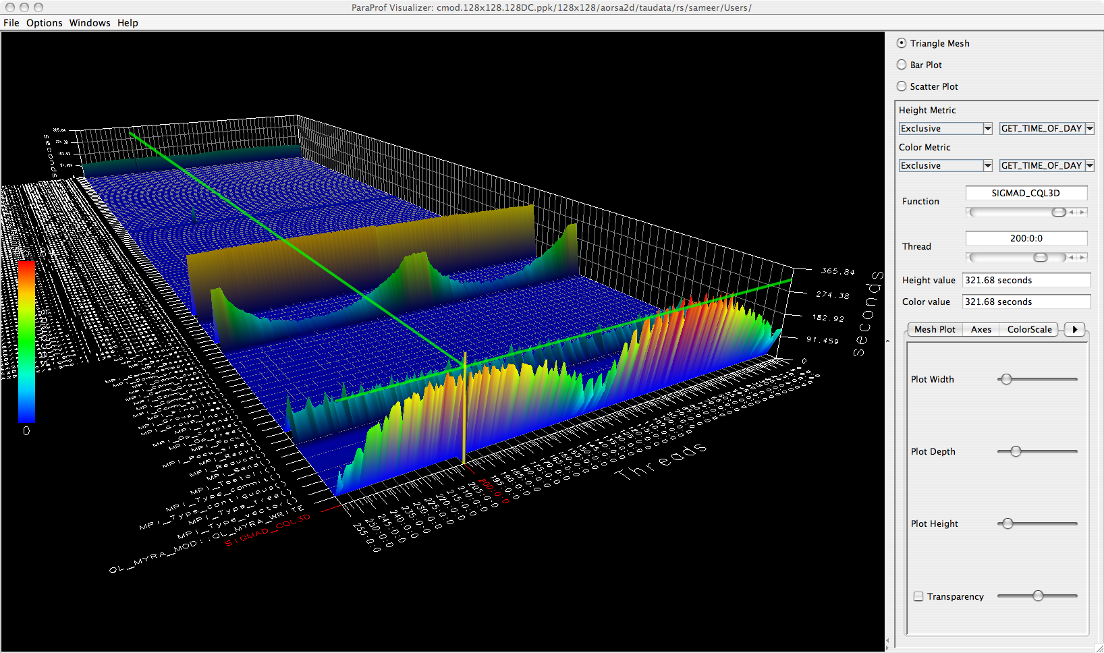
ParaProf 3D Profile Browser
Height, color shows performance distribution across all timers, all threads of execution

Slide 17
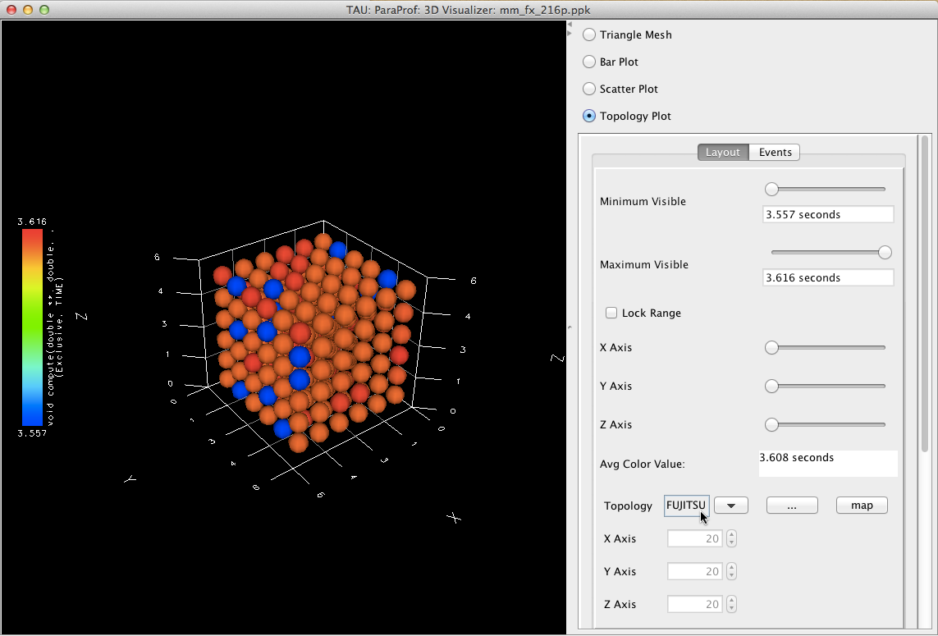
ParaProf Topology Display
Can map performance data to logical or physical topologies using metadata attributes

Slide 18
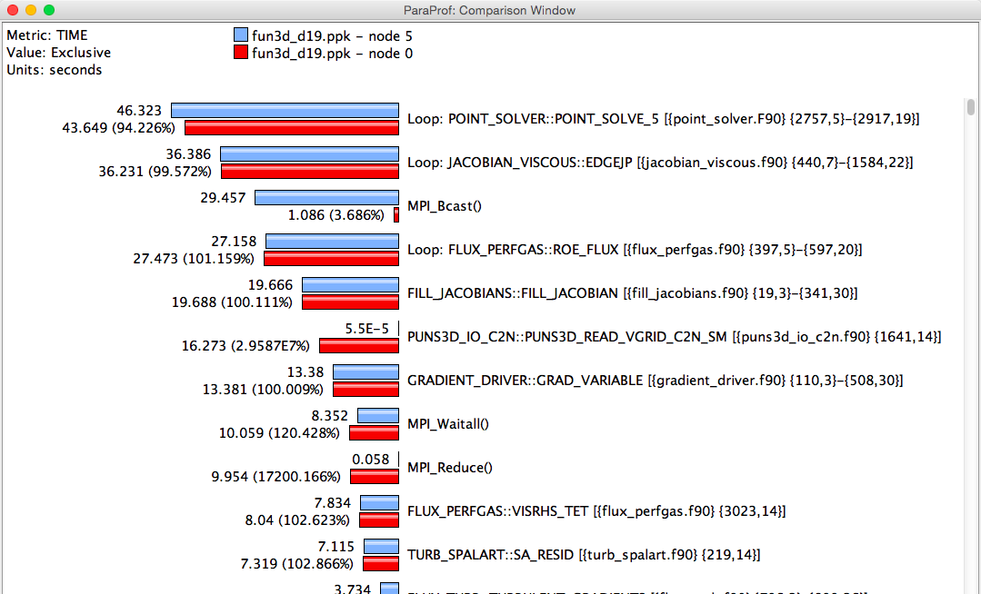
ParaProf Comparison Window
Compare threads/processes from the same execution, or from different executions
Comparing Rank 0 with 5 : Right click on “node 5” -> Add node to comparison window

Slide 19
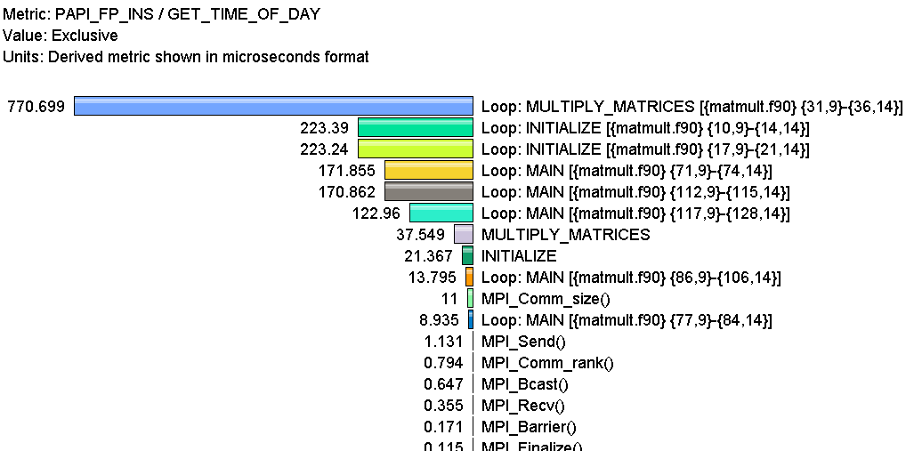
Derived hardware counter metrics in TAU
Goal: What is the execution rate of my loops in MFLOPS?
Flat profile with PAPI_FP_INS and time with loop instrumentation:
Derived metric interface to compute FLOPS, cache hit ratios, IPC, etc.

Slide 20
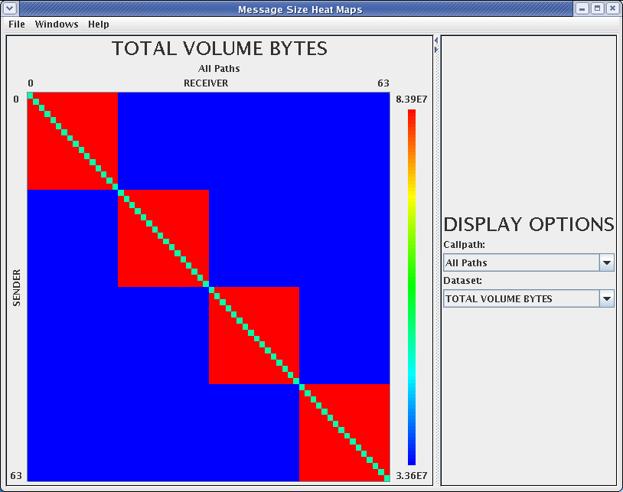
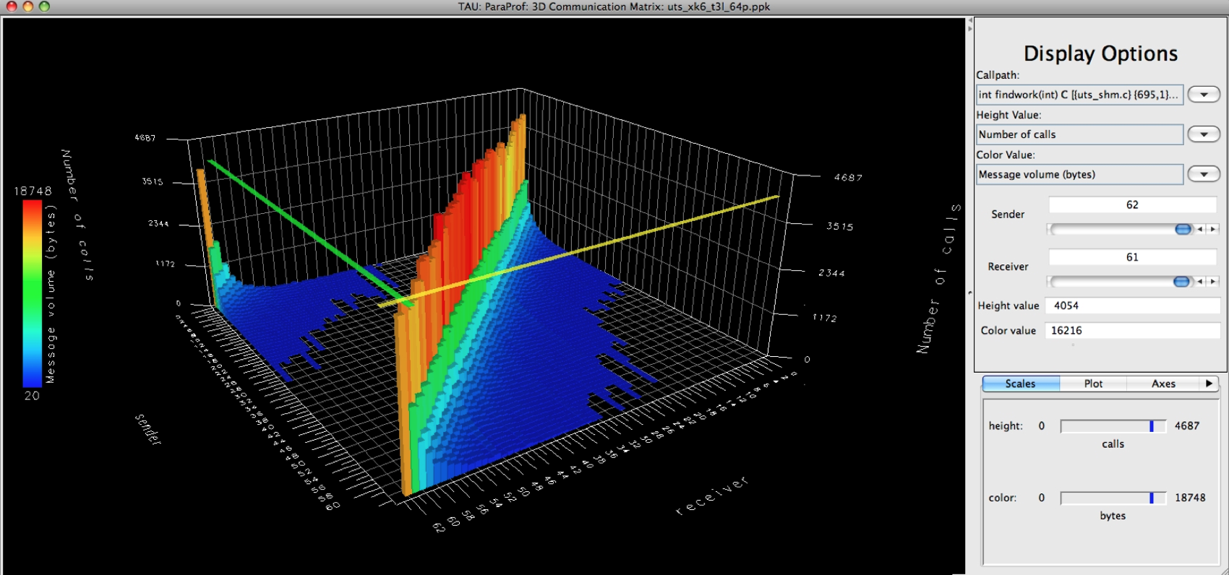
Communication Matrix
2D and 3D visualization of P2P communication patterns
Goal: What is the volume of inter-process communication? Along which calling path?

Slide 21
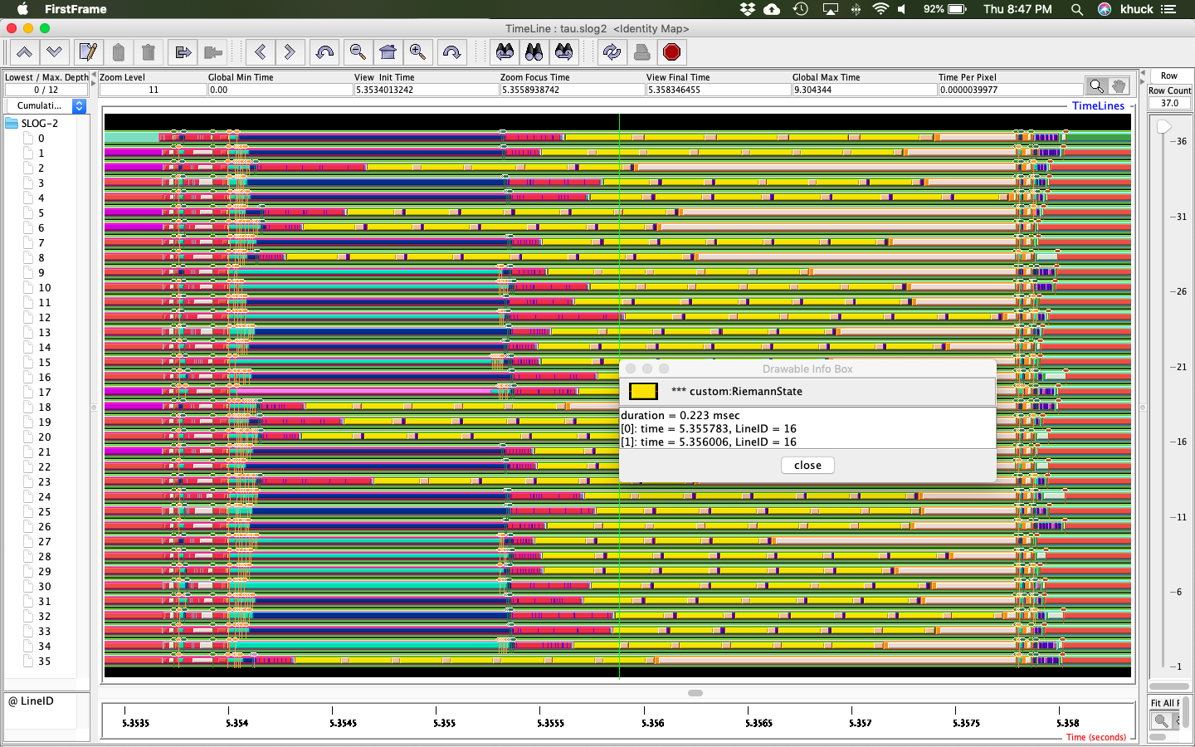
Jumpshot Trace Visualizer
Free trace timeline viewer (comes with TAU)

Slide 22
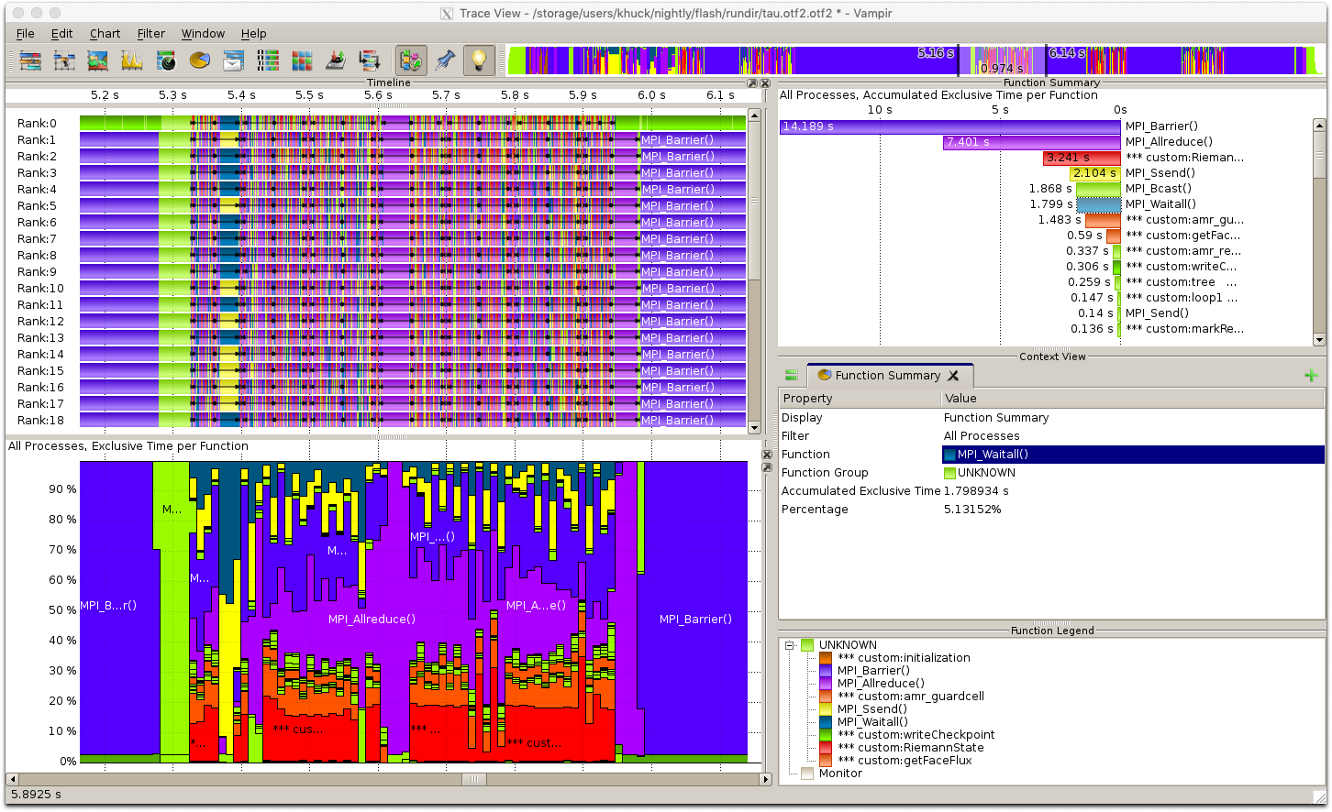
Vampir Trace Visualizer
Commercial trace viewer (installed at many HPC centers)

Slide 23
Where to go from here?
Two more sections of examples in this overview:
  Parallel model / language support
    MPI, OpenMP, OpenACC, CUDA, Python, Kokkos
  I/O library support
    POSIX, MPI I/O, HDF5, ADIOS
We can jump to whatever is most relevant/interesting...

Slide 24
Parallel Model Support in TAU
Measurement Support:
Instrumentation
  Source
  Binary
Interposition libraries
Wrappers
Callbacks
Sampling
Profiling
Tracing
Model/Hardware Support:
MPI
OpenMP
OpenACC
CUDA
Python
Kokkos
PAPI
http://tau.uoregon.edu/tau.tgz
Notes:
TAU supports OTF2 native output now - but I am not demonstrating it today. PAPI support has been around for years, and TAU provides several ways to measure power/energy depending on HW support.

Slide 25
MPI Support
Interposition library support (adding -pthread recommended)
  $ ./configure -mpi -pthread ...
Replaces MPI API weak symbols with instrumented versions
  MPI_Send(...) { return PMPI_Send(...); } is the default implementation
Linker based instrumentation (static executables)
  tau_cc.sh -o foo *.o libstuff.a
Runtime preloading (dynamic executables)
  tau_exec -T mpi,pthread ./my_program

Slide 26
MPI dynamic executable example
Example code from https://www.hpc.ntnu.no/display/hpc/Writing+to+MPI+Files
# configure TAU with MPI support
$ ./configure -iowrapper -bfd=download -mpi -pthread
# compile TAU
$ make -j install
# build and run the example (new example)
$ cd examples/mpi_io
$ mpicc -DDEBUG -g -O3 -o mpiio mpiio.c
$ mpirun -np 4 tau_exec -T mpi,pthread ./mpiio ...

Slide 27
Profile Views
Rank 0, thread 0:
All ranks and threads:

Slide 28
MPI and POSIX?
Just add -io to the tau_exec options
Can also add -ebs for sampling support
MPI+POSIX+sampling
MPI+POSIX
Notes:
For callpath profiling, add TAU_CALLPATH=1 and TAU_CALLPATH_DEPTH=100 (or equivalent) to your environment

Slide 29
Counters, too...
Aggregates
(broken
down by
filename):
With calling
context:

Slide 30
OpenMP Support Update
Built-in support
  $ ./configure -bfd=download -openmp -ompt=download-tr6 ...
Compiles in support for latest OpenMP Tools interface
TR6 Support will eventually be default (“-ompt=download”)
Currently supports Intel, LLVM, GNU, will soon support IBM, PGI
Linker-based instrumentation (static executables)
  $ tau_cc.sh -o foo *.o libstuff.a
Runtime preloading (dynamic executables)
  $ tau_exec -T openmp,ompt -ompt ./my_program
PDT+Opari support still available for instrumented measurement
$ ./configure -openmp -opari
Notes:
TAU will download, configure, compile and use the LLVM OpenMP runtime that has baked-in support for Intel, LLVM and GCC OpenMP APIs.

Slide 31
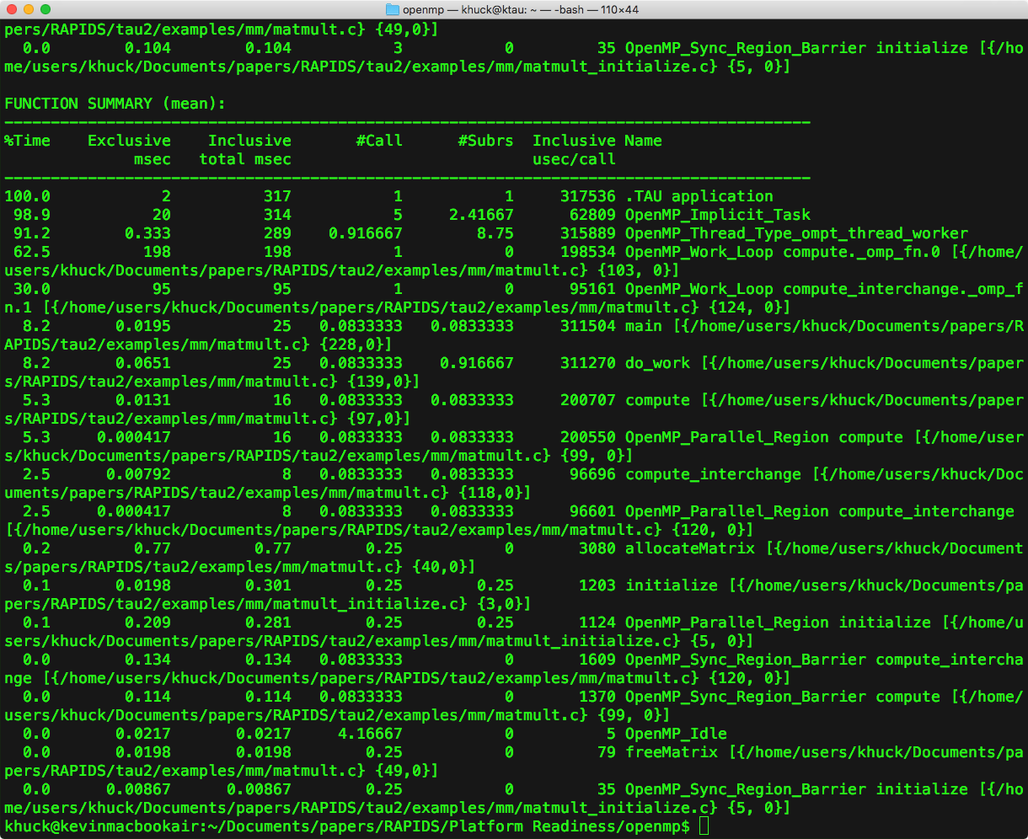
Profile Views
pprof output:
All threads profile:
Thread 0 callpath:
Notes:
Found bug in address resolution for callpaths... But the flat profile is resolved correctly.
Updated support has environment variables to control overhead - how many OpenMP event callbacks are supported, how much “context” to capture per call.

Slide 32
OpenACC Support
Built-in support
  $ ./configure -cc=pgcc -c++=pg++ -fortran=pgi ...
Runtime preloading (dynamic executables)
  tau_exec -T pgi -openacc ./my_program
$ cd examples/openacc
$ make
$ tau_exec -T pgi -openacc ./jacobi

Slide 33
OpenACC Profile Data
Flat Profile:
Callpath Profile:
Notes:
Note - the source code attribution seems to be off in this example. Not sure if that’s a PGI problem or TAU problem, I’ll check with Sameer.

Slide 34
CUDA Support
Built-in support
  $ ./configure -cuda=/path/to/cuda ...
Runtime preloading (dynamic executables)
  $ tau_exec -T cupti -cupti ./my_program
Environment variables to control TAU measurement:
  TAU_TRACK_CUDA_CDP tracks dynamic parallelism (kernels calling kernels)
  TAU_TRACK_UNIFIED_MEMORY enables unified memory metrics if the GPU supports it (most Maxwells and beyond)
  TAU_TRACK_CUDA_INSTRUCTIONS,
  TAU_TRACK_CUDA_SASS related to source line instrumentation metrics

Slide 35
CUDA Profile Data
Host, device(s) profile:
Host counters:
Host timers:
Device counters:
Device timers:

Slide 36
Python Support
Built-in support
  $ ./configure -python ...
Runtime preloading (dynamic executables)
  tau_python ./my_program.py

Slide 37
Python Profile Data
Callpath Profile:
TensorFlow from virtual
environment, Horovod
over OpenMPI
Flat Profile:

Slide 38
Kokkos Support
Built-in support
  $ ./configure ...
Runtime preloading (dynamic executables)
  tau_exec -T serial,openmp,ompt,tr6,cupti -ompt ./my_program.py
Cupti, OMPT are optional, but give more insight

Slide 39
Kokkos + OpenMP Profile Data
Flat Profile, thread 0:
Callpath Profile, thread 0:
Notes:
Found bug in address resolution for callpaths... But the flat profile is resolved correctly.

Slide 40
I/O Library Support in TAU
Measurement Support:
Instrumentation
  Source
  Binary
Interposition libraries
Wrappers
Callbacks
Sampling
Library Support:
POSIX
MPI I/O
HDF5
ADIOS
http://tau.uoregon.edu/tau.tgz

Slide 41
POSIX measurement
Built-in support
  $ ./configure -iowrapper
Wraps API calls related to files and sockets
Linker based instrumentation (static executables)
  -Wl,-wrap,fopen -Wl,-wrap,fclose ... -lTauPosixWrap
  Wrapper library implements __wrap_fopen, calls __real_fopen
Runtime preloading (dynamic executables)
  LD_PRELOAD=libTauPosixWrap.so (or use tau_exec -io)
  Wrapper library defines fopen(), loads real fopen using dlsym()
“Characterizing I/O Performance Using the TAU Performance System”, Shende et al., PARCO, 2011

Slide 42
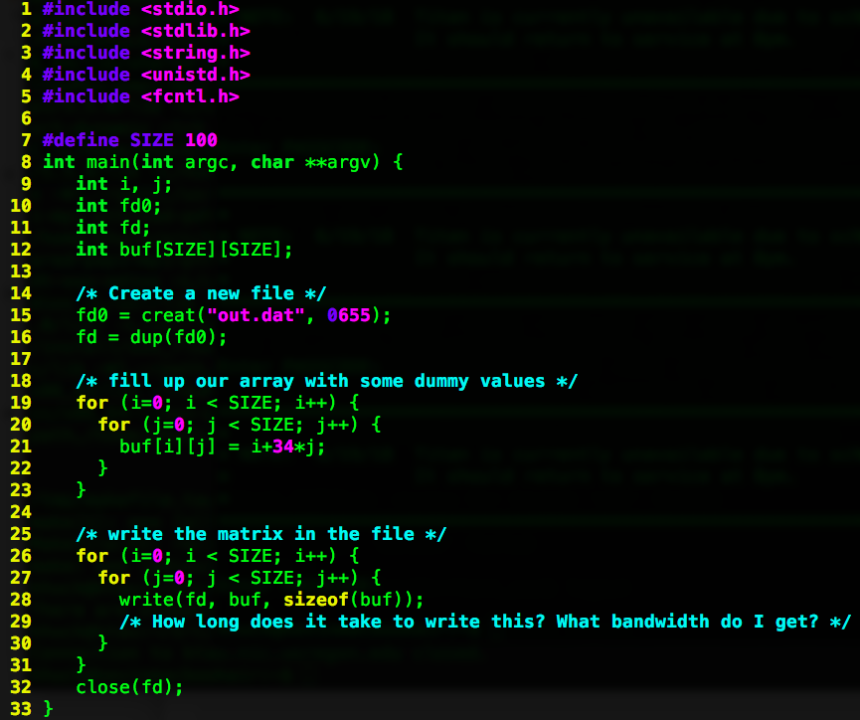
POSIX static executable example
# configure TAU with POSIX IO wrapper support
$ ./configure -iowrapper -bfd=download -unwind=download
# compile TAU
$ make -j install
# add TAU to the path
$ PATH=$PATH:`pwd`/x86_64/bin
# build and run the example
$ cd examples/iowrappers/posixio
$ make
$ ./foo
# view a profile summary
$ pprof
# profile visualizer
$ paraprof

Slide 43
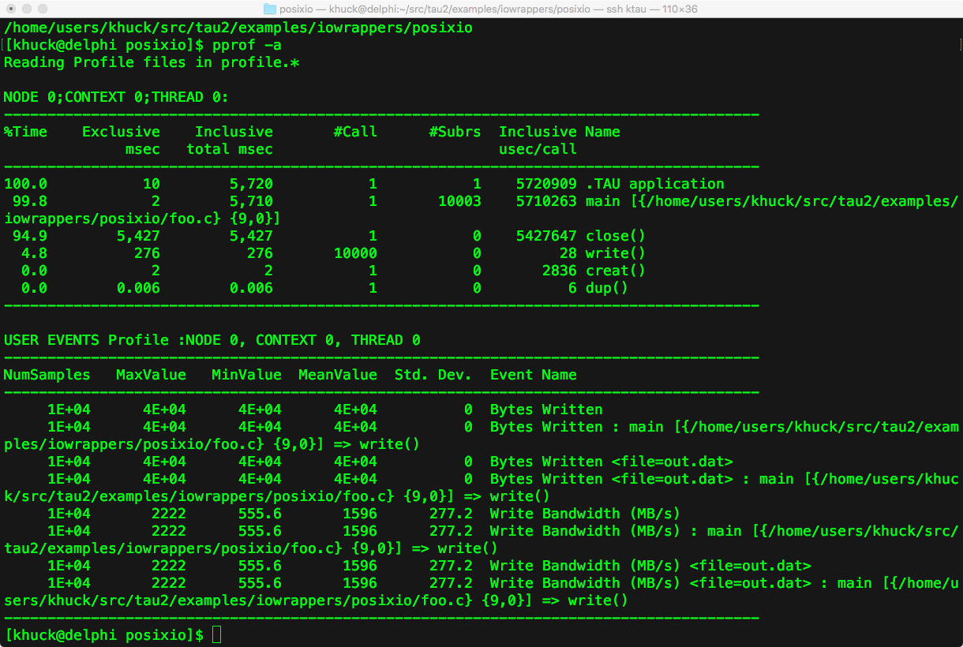
Profile Views (pprof, paraprof)
Text output from pprof:
Callpath view in paraprof:
(run with TAU_CALLPATH=1,
TAU_CALLPATH_DEPTH=3 or greater)
Flat profile in paraprof:

Slide 44
POSIX dynamic executable example
# configure TAU with POSIX IO wrapper support
$ ./configure -iowrapper -bfd=download -unwind=download
# compile TAU
$ make -j install
# build and run the example
$ cd examples/iowrappers/posixio
$ gcc foo.c -o foo
$ tau_exec -T serial -io -ebs ./foo
# view a profile summary
$ pprof -a

Slide 45
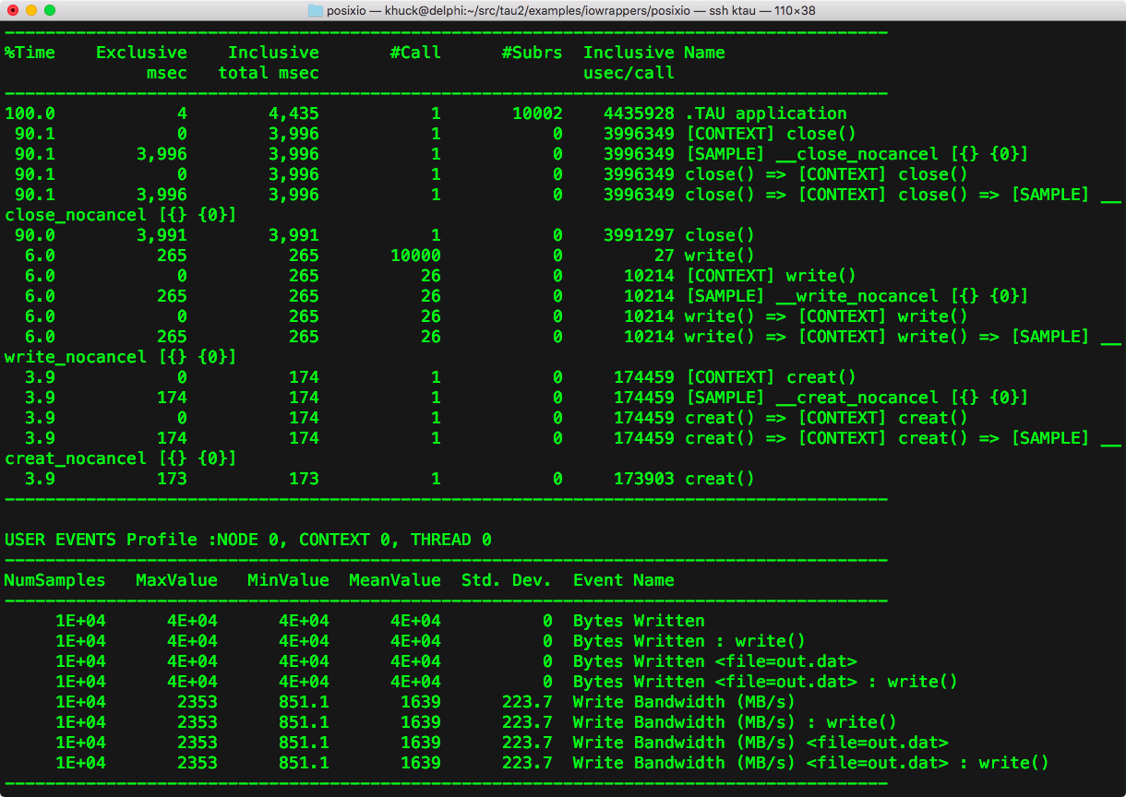
Profile Views (pprof, paraprof)
Rank 0, thread 0:
Text output from pprof:
Callpath view:

Slide 46
POSIX counters and metadata, too
Broken down by filename
...and by calling context
Metadata for file

Slide 47
MPI I/O Support
Built-in support (adding -pthread recommended)
  $ ./configure -mpi -pthread
Replaces MPI API weak symbols with instrumented versions
  MPI_Send(...) { return PMPI_Send(...); } is the default implementation
Linker based instrumentation (static executables)
  tau_cc.sh -o foo *.o libstuff.a
Runtime preloading (dynamic executables)
  tau_exec -T mpi,pthread ./my_program

Slide 48
MPI dynamic executable example
Example code from https://www.hpc.ntnu.no/display/hpc/Writing+to+MPI+Files
# configure TAU with MPI support
$ ./configure -iowrapper -bfd=download -unwind=download -mpi -pthread
# compile TAU
$ make -j install
# build and run the example (new example)
$ cd examples/mpi_io
$ mpicc -DDEBUG -g -O3 -o mpiio mpiio.c
$ mpirun -np 4 tau_exec -T mpi,pthread ./mpiio -f foo -l 10

Slide 49
Profile Views
Rank 0, thread 0:
All ranks and threads:

Slide 50
MPI and POSIX?
Just add -io to the tau_exec options
Can also add -ebs for sampling support
MPI+POSIX+sampling
MPI+POSIX

Slide 51
Counters, too...
Aggregates
(broken
down by
filename):
With calling
context:

Slide 52
HDF5 support
Not built-in, but TAU includes an example using the tau_gen_wrapper utility
Uses PDT (http://tau.uoregon.edu/pdt.tgz) to parse a library header, and provides a wrapper library similar to what is available for the POSIX library wrapper
Linker based instrumentation (static executables)
  i.e. tau_cc.sh -o foo *.o -tau_options='-optTauWrapFile=headers/hdf5_wrapper/link_options.tau -optTrackIO' libotherstuff.a
Runtime preloading (dynamic executables)
  i.e. tau_exec -T mpi,pthread -loadlib=./libhdf5_wrap.so ./my_program

Slide 53
HDF5 tau_gen_wrap example
# configure TAU with PDT support
$ ./configure -iowrapper -bfd=download -unwind=download -mpi -pthread -pdt=/path/to/pdt
# compile TAU
$ make -j install
# build and run the wrapper
$ cd examples/iowrappers/hdf5_wrap
$ mkdir headers ; cd headers ; ln -s /path/to/hdf5/include/* .
$ tau_gen_wrapper hdf5.h /path/to/hdf5/lib/libhdf5.a -f ../select.tau ; cd ..
# build and run the example
$ tau_cc.sh -tau_options='-optTauWrapFile=headers/hdf5_wrapper/link_options.tau -optTrackIO ' -c hyperslab_by_row.c -I/path/to/hdf5/include
$ tau_cc.sh -tau_options='-optTauWrapFile=headers/hdf5_wrapper/link_options.tau -optTrackIO ' -o hyperslab_by_row hyperslab_by_row.o -L/path/to/hdf5/lib -lhdf5_hl -lhdf5 -lz -lsz -ldl -lm -Wl,-rpath,/path/to/hdf5/lib
$ mpirun -np 4 ./hyperslab_by_row

Slide 54
Profile Views
Rank 0, thread 0:
All ranks and threads:

Slide 55
HDF5 tau_wrap example
Can use a similar process to generate a libhdf5_wrap.so wrapper that can be preloaded with tau_exec:
$ tau_gen_wrapper -r ...
$ tau_exec -T mpi,pthread -io –loadlib=./libhdf5_wrap.so ./hyperslab_by_row

Slide 56
ADIOS support
Built-in, uses callback API provided by ADIOS 1.13
Using the callback API, measurement tools can register with ADIOS during initialization, and be notified when ADIOS events happen (even asynchronous ones)
  Tool implements adiost_tool() function that returns a pointer to an initialization function to register for event notification
ADIOS is (by default) built as static library on many systems, so only way to register tools is by adding linker options before the ADIOS libraries
Dynamic linking is easier on other systems, of course (can just use tau_exec)

Slide 57
ADIOS example
# configure TAU with PDT support
$ ./configure -iowrapper -bfd=download -unwind=download -mpi -pthread -pdt=/path/to/pdt -adios=/path/to/adios
# compile TAU
$ make -j install
# build and run the example
$ cd src/Example-Heat_Transfer
# modify Makefile to compile with tau_f90.sh instead of mpif90:
# FC=tau_f90.sh -optTauSelectFile=select.tau –optShared
$ make
$ mpirun -np 4 ./heat_transfer_adios

Slide 58
Profile Views
Rank 0, thread 0:
ADIOS events
All ranks and threads:

Slide 59
Profile Views, cont.
Callgraph:
Counters:

Slide 60
Reader Profile, Counters
Rank 0, thread 0 (only ADIOS events):
Counters:

