Slide 1
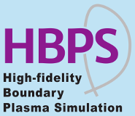
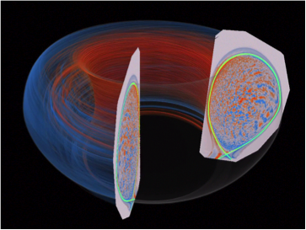

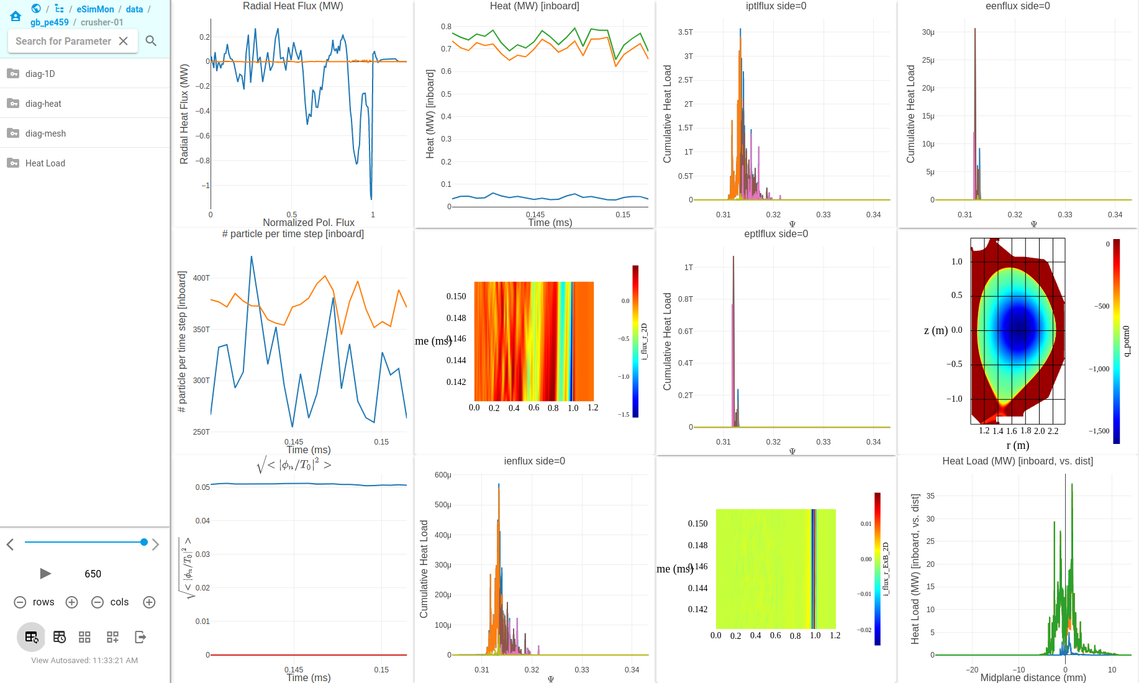
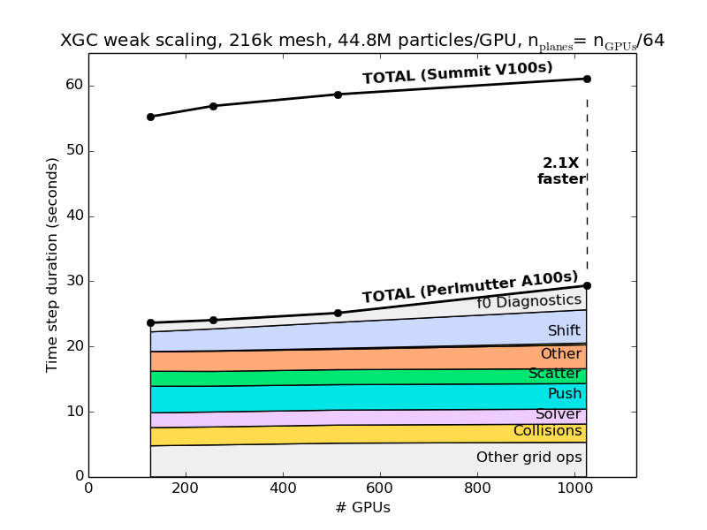
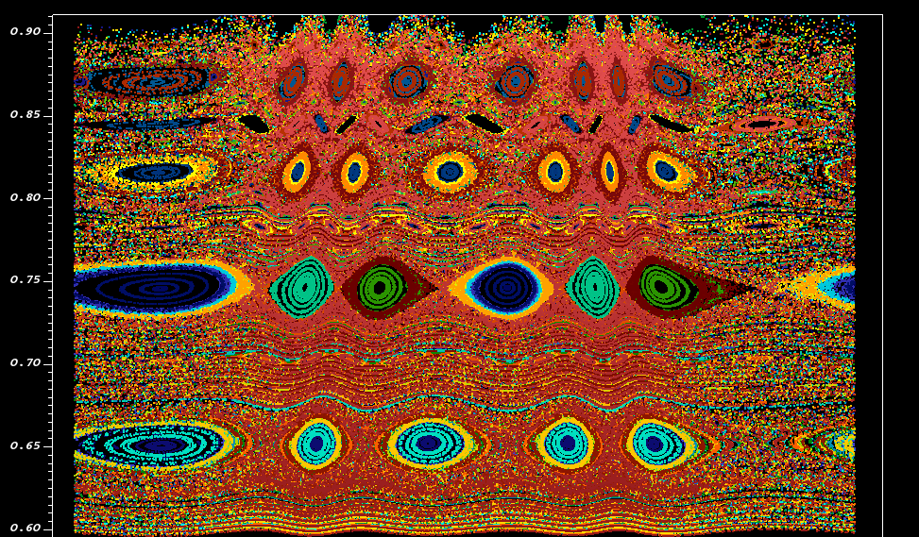

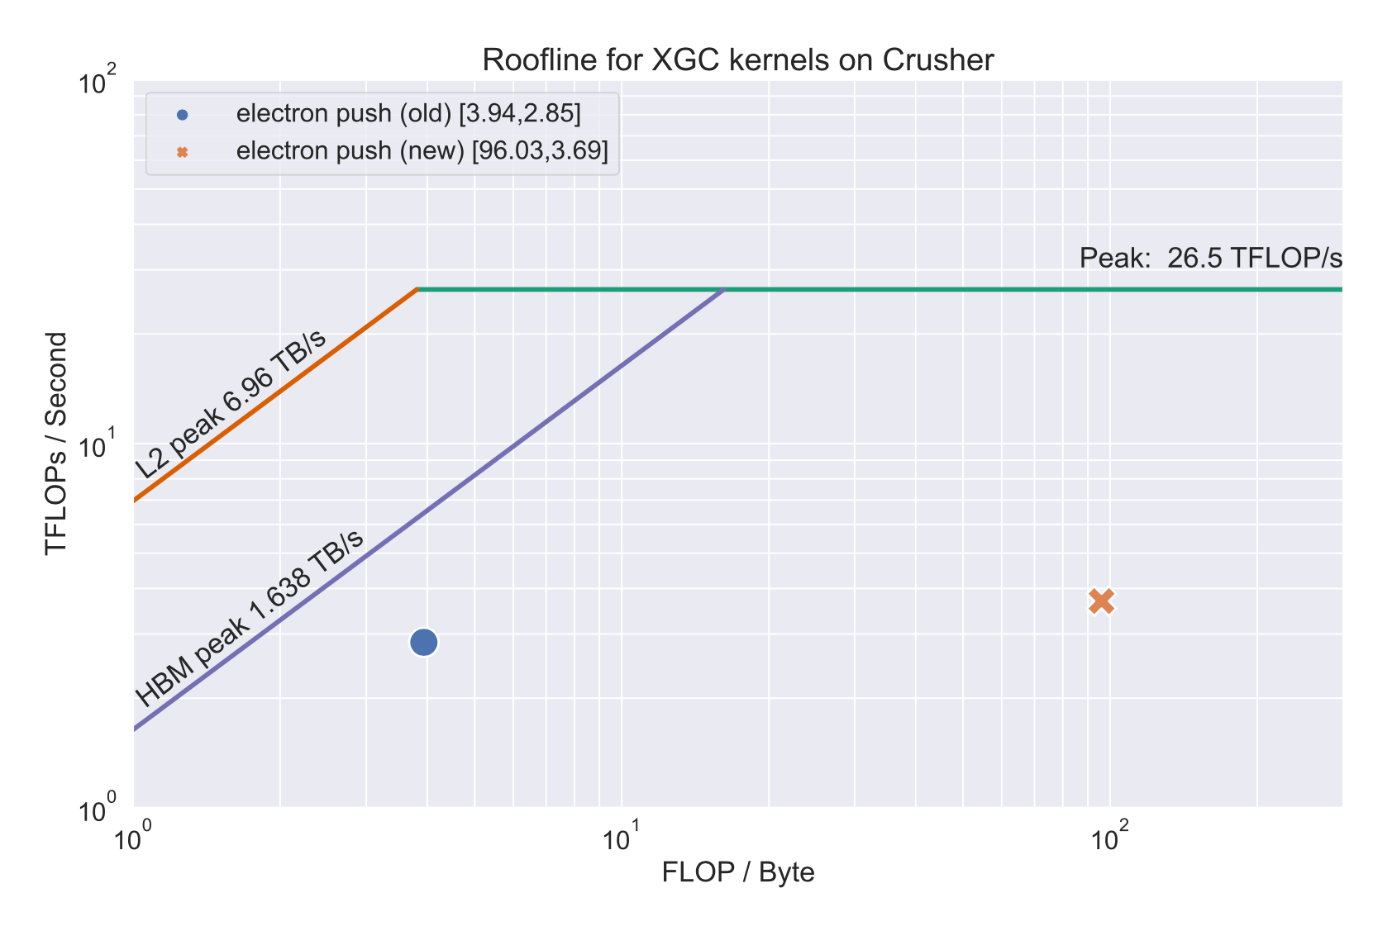
Monitoring, Porting, and Optimizing the
Global Gyrokinetic Particle-in-cell Code XGC
Kevin Huck, Aaron Scheinberg, David Pugmire, Norbert Podhorszki. Scott Klasky
RAPIDS2 has maintained an ongoing collaboration and partnership with the SciDAC-4 Partnership Center for High Fidelity Boundary Plasma Simulation (HBPS). The HBPS goal is to develop advanced simulation software, utilizing extreme parallelism and based upon a first-principles kinetic approach, to address the challenges associated with understanding the edge region of magnetically confined plasmas. This work is relevant to existing magnetic fusion experiments and essential for next-generation burning plasma experiments such as ITER. The success of ITER is critically dependent upon sustained high confinement (H-mode) operation, which requires an edge pedestal of sufficient height for good core plasma confinement without producing deleterious large-scale, edge-localized instabilities. The plasma edge presents a set of multi-physics, multi-scale problems involving a separatrix and complex 3D magnetic geometry. Perhaps the greatest computational challenge is the lack of scale separation – temporal scales for drift waves, Alfvén waves, and ELM dynamics, for example, have strong overlap. Similar overlap occurs in the spatial scales for the ion poloidal gyro-radius, drift wave, and plasma pedestal width. Microturbulence and large-scale neoclassical dynamics self-organize together nonlinearly. The traditional approach of separating fusion problems into weakly interacting spatial or temporal domains clearly breaks down in the edge. A full kinetic model (total-f non-perturbative model) must be applied to understand and predict the edge physics including non-equilibrium thermodynamic issues arising from the magnetic topology (e.g., the open field lines producing a spatially sensitive velocity hole), plasma wall interactions, neutral and atomic physics. (source: https://epsi.pppl.gov/about-epsi)
This figure shows an electrostatic potential perturbation from a petascale simulation of full-function gyrokinetic ion temperature gradient turbulence in realistic global DIII-D geometry. The magnetic separatrix surface is highlighted in the edge region. (source: https://epsi.pppl.gov)
End-to-end simulation monitoring workflow
We have developed an end-to-end workflow to monitor simulation results at runtime. This workflow enables scientists to collaboratively track results produced by high performance simulations in order to ensure successful runs. In collaboration with the HBPS SciDAC partnership, we have demonstrated this workflow for the XGC simulation modeling edge plasma physics.
Significance and Impact
The high performance simulation workflows involve lengthy (non-interactive) runs on supercomputers followed by data movement and post-processing. The workflow that we developed empowers the science teams to produce visual output from the simulation at runtime and present them in an accessible way to a group of experts. This enables the correction of issues early in the simulation cycle, significantly increasing productivity.
Technical Approach
The workflow begins with an in situ analysis engine, EFFIS, to analyze and visualize results as they are produced.
The data extracts generated are then captured via ADIOS by an interactive dashboard, eSimmon, that can be accessed over the Web.
The workflow enables the use of various VTK-m and ParaView for data extraction and interactive visualization over the Web.
Figure, above: The eSimmon dashboard showing data extracts generated by EFFIS during an XGC simulation.
Figure, left: Scaling performance and timer breakdown of the XGC simulation on Perlmutter (NERSC) relative to Summit (OLCF), using the same number of GPUs (roughly 2.1x faster). Because electromagnetic simulations are a science priority going forward, the electron push kernel is less time dominant since it is sub-cycled fewer times. Scaling performance on Polaris (ALCF) is similar to Perlmutter. Credit: A. Scheinberg, Jubilee Development
Porting and tuning HBPS applications with TAU and APEX
TAU and APEX’s scalable performance & visualization tools from The University of Oregon OACISS Institute help High-Fidelity Boundary Plasma Simulation (HBPS) scientists achieve performance portability on the latest generation of DOE leadership-class systems.
Figure, above: A Poincaré plot showing the cross section of many particle traces that iterate several times around a fusion reactor. These plots are generated in situ using VTK-m and displayed by the eSimmon dashboard.
Significance and Impact
TAU’s performance measurement and analysis is helping XGC and GENE developers design new algorithms and parallelization strategies to fully utilize GPUs on Perlmutter and Polaris as well as on Frontier and Aurora development machines. TAU and APEX are also helping the HBPS team to improve OpenMP performance on CPUs. Improved computational efficiency and reduced memory usage allow for explorations of larger fusion energy problems with fewer compute nodes.
Figure, left: Increased computational intensity 25x, reduced time by 22% by using Kokkos launch bounds of <256,2> (default <1024,1>)
Template values (HIP): <MAX_THREADS_PER_BLOCK, MIN_WARPS_PER_EU>
Technical Approach
Measured, analyzed and tuned XGC computational kernels for AMD GPUs as well as NVIDIA GPUs using TAU and APEX.
Helped tune XGC OpenMP regions to replace atomic operations with faster reductions.
APEX is enabling portable comparisons of the GENE simulation to fully utilize new systems utilizing NVIDIA, AMD, or Intel GPUs.
Cache | V100 | MI250X old | MI250X new
L1 | 99.8% | 87.6% | 98.7%
L2 | 95.4% | 58.8% | 94.1%

