Slide 1
Performance Debugging and Tuning of Flash-X with Data Analysis Tools
Kevin Huck*, Xingfu Wu†, Anshu Dubey†, Antigoni Georgiadou‡, J. Austin Harris‡, Tom Klostermann†, Matthew Trappett*, Klaus Weide†
0000-0001-7064-8417
Email: khuck@cs.uoregon.edu
* University of Oregon, †Argonne National Laboratory, ‡Oak Ridge National Laboratory

Slide 2




Performance Debugging and Tuning of Flash-X with Data Analysis Tools
Kevin Huck *, Xingfu Wu†, Anshu Dubey†, Antigoni Georgiadou‡, J. Austin Harris‡, Tom Klostermann†, Matthew Trappett*, Klaus Weide†
khuck@cs.uoregon.edu
University of Oregon, †Argonne National Laboratory, ‡Oak Ridge National Laboratory

Slide 3
Executive Summary
While evaluating new partitioning library in Flash-X…
Removing “not needed” communication code led to a slowdown in computation
We developed a set of Jupyterlab Python scripts that utilize Pandas and Plotly to automate the generation of distribution and correlation visualizations for better understanding of performance behavior
In this process, we discovered and removed/mitigated two additional performance limiting bottlenecks for performance tuning

Slide 4
Introduction
Multiphysics simulations and HPC platforms have many degrees of freedom leading to high complexity
Optimization search space is huge, compilers make conservative assumptions (do no harm)
Modifying code by hand – even changes as simple as removing a function call – can have negative unintended (and unexpected) performance consequences
Pulling on the loose thread can be a rabbit hole…and/or lead to other insights (apologies for mixed metaphors)

Slide 5

Flash-X Anomaly
Flash-X: newer descendant of FLASH – a multiphysics, multicomponent code
Fortran implementation
Base discretization in Flash-X is Eulerian, with 3 flavors of management for the discretized mesh
  Uniform
  Two different AMR methods, Paramesh and (now) AMReX
Integration of AMReX revealed vestigial/superfluous communication routine from Paramesh implementation
Removing them reduced communication cost, but increased (unrelated?) computation cost by more than 20% in some cases
https://flash-x.org

Slide 6
Sod Shock Tube, Weak Scaling Setup
Perfect weak scaling scenario – extend the domain perpendicular to the discontinuity
Notes:
All experiments are conducted for this study using the Sod shock tube problem. It is a purely hydrodynamics application, where the domain is initialized with a discontinuity in density and pressure. In the configurations we used, the location of discontinuity is always a plane oriented perpendicular to one of the Cartesian coordinate directions. One half of the domain is at higher pressure and density than the other half, with a sharp drop in pressure at the interface. When the evolution begins, the discontinuity gives rise to a shock wave that travels perpendicular to the plane of discontinuity. The Sod problem is perfect for devising a weak scaling study for AMR because replicating the domain along an axis parallel to the plane of discontinuity as shown in Figure increases the amount of work proportional to the replication factor.

Slide 7
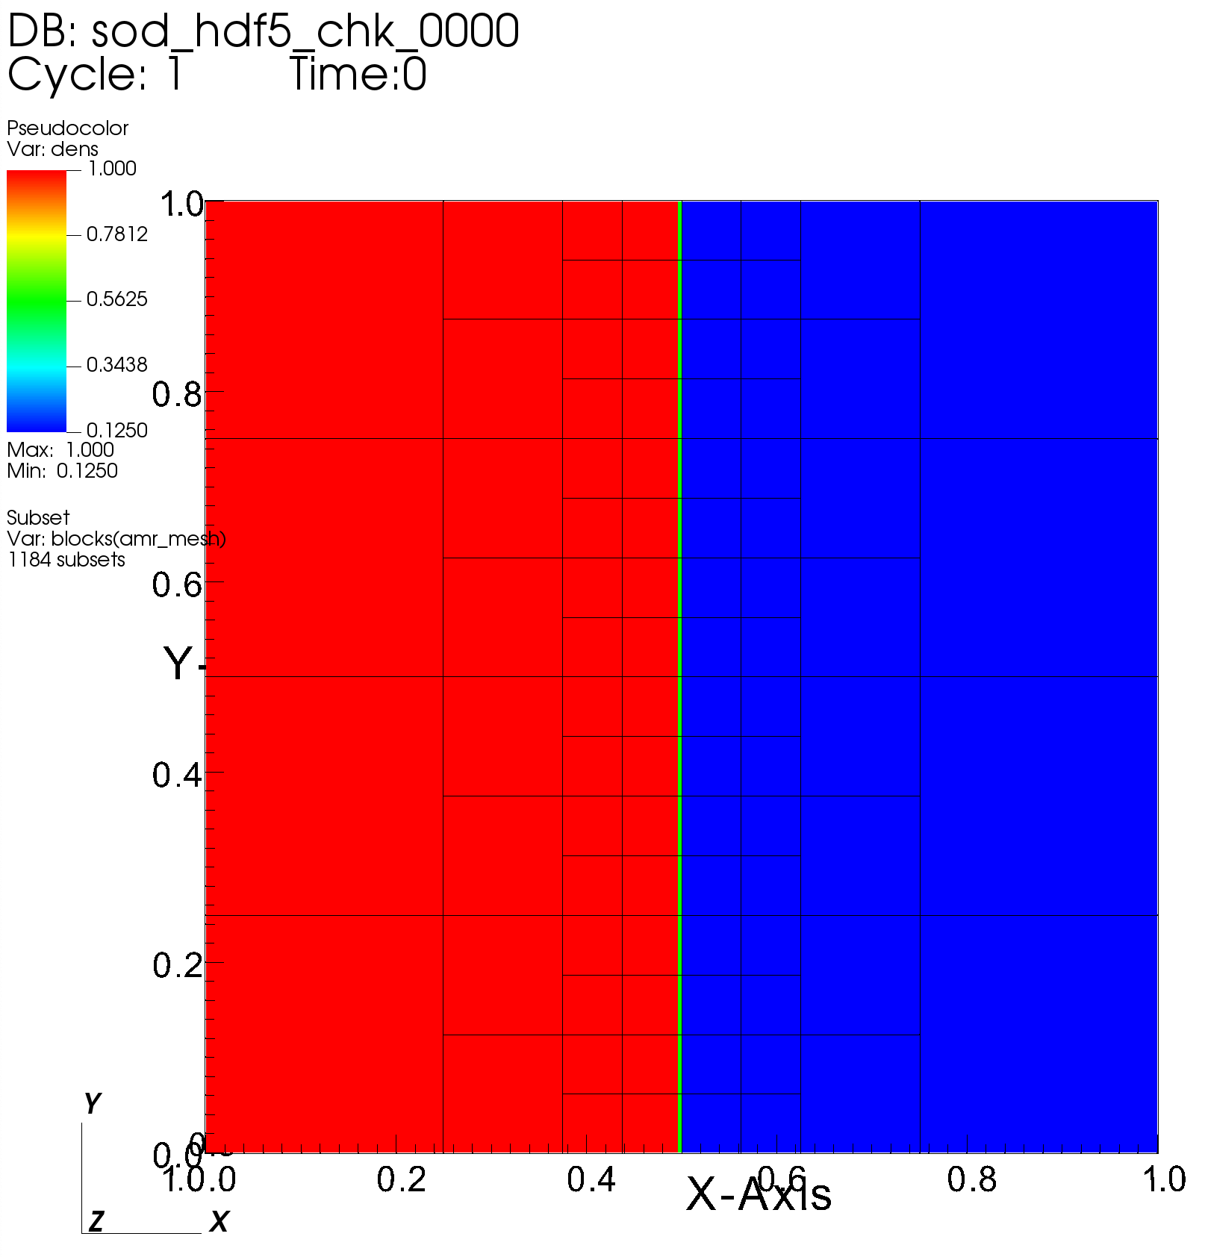
Flash-X AMR Partitioning Overview
Paramesh is only AMR support in FLASH, Flash-X added new support for AMReX
All blocks are identical in #cells along each dimension, and all blocks are organized in an octree. (AMReX allows for irregular cells, but not needed in this case)
Parallelism provided by MPI, load balancing provided by Morton ordering
Original task: integrate, evaluate AMReX in Flash-X and compare with Paramesh (work is still ongoing)
Figure: A 2D slice of the initial 3D mesh for the Sod shock tube problem. Each of the outlined squares represents a block of 16³ computational cells.
Notes:
Load distribution uses Morton space filling curve where each block is assigned a weighting factor and a Morton number. Blocks are sorted and divided between MPI ranks based on their Morton numbers. The information about nearest neighbors and their refinement level for each local block is maintained in each MPI rank. Paramesh owns and manipulates the state data in a set of data structures that support cell-centered, face-centered and edge-centered discretizations.

Slide 8
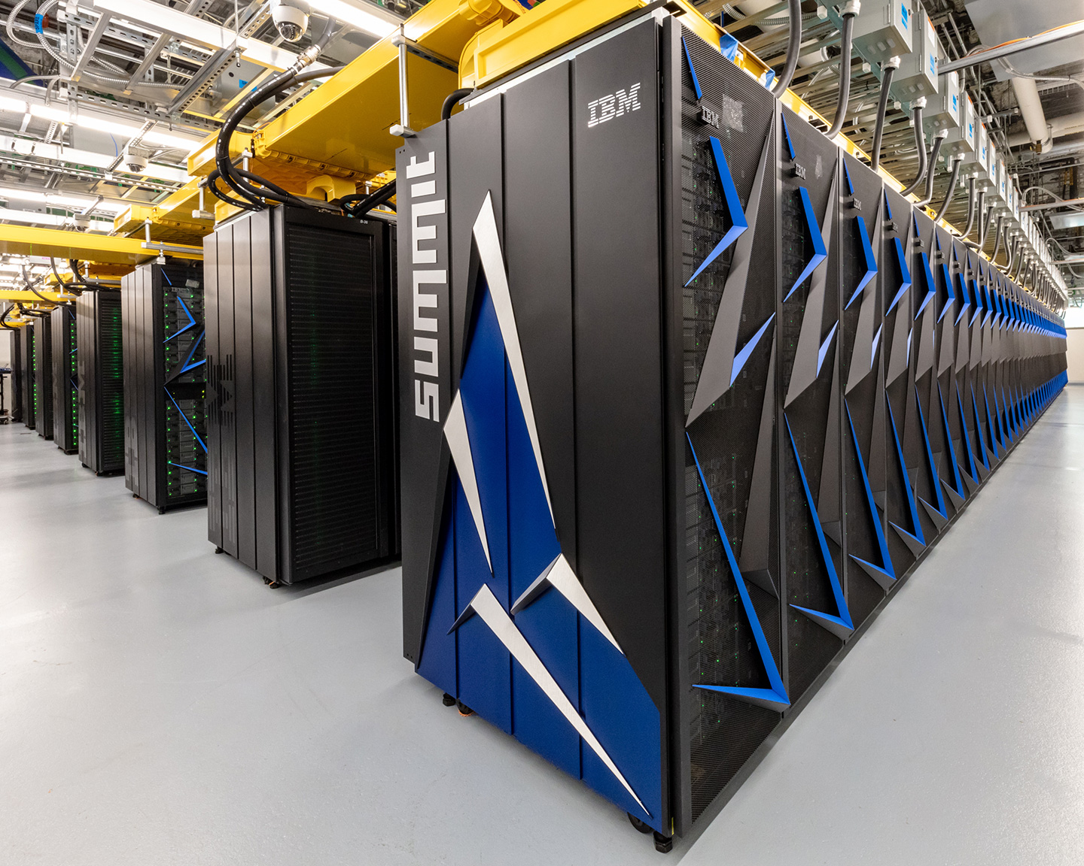

Systems Evaluated
Summit: IBM® POWER9™️ at ORNL, 200 PFLOP/s
  4,608 IBM POWER System AC922 nodes
  Two IBM POWER9 processors, 42 total compute cores and six NVIDIA Volta V100 accelerators, 512 GB of DDR4 per node
Theta: Cray® XC40 at ANL, 12 PFLOP/s
  4,392 Cray XC40 nodes
  One Intel Phi Knights Landing (KNL) 7230 with 64 compute cores, shared L2 cache of 32 MB (1 MB L2 cache shared by two cores), 16 GB of high-bandwidth in-package memory, 192 GB of DDR4 RAM per node
  Cache mode used for all experiments
Figure: https://www.olcf.ornl.gov/olcf-resources/
Figure: https://www.alcf.anl.gov/alcf-resources/theta
Notes:
Theta provides two memory modes: cache and flat. Based on our experiments, we find that using cache mode outperforms using flat mode for Flash-X. In this paper, we conduct all experiments using cache mode on Theta.

Slide 9
Performance Anomaly
Paramesh grid routine: mpi_amr_boundary_block_info
  Collects some information about the faces of blocks that coincide with the boundary of the simulation domain, and makes this global information available as a heap-allocated array on each rank
  Called once each time that the AMR grid has changed
  Allowed specialized handling of boundary conditions…but -
  Result never used (not used in current version of code)
To reduce global communication overhead and improve performance, it was removed
Performance got worse…?

Slide 10
mpi_amr_boundary_block_info
Allocates scratch space that is some multiple of the number of local blocks that have any of their neighboring blocks on the boundary
Collective operations to share this information globally
In total, six scratch arrays are allocated, some of which persist through the evolution step
In brief: relevant portions of the routine are
  Allocations
  Global collective operations
  Memory is freed
These allocations are sized by the number of blocks, therefore can have odd sizes – each rank can be different size

Slide 11
Result From Removing Call
Performance anomaly first discovered on Theta
Time spent in communication routines decreased as expected, but…
Overall evolution time (total simulation time) increased non-trivially, in some instances by as much as 20% or more
The degradation in performance was observed in the routine that computes Riemann states. This is a completely local routine, essentially an expensive stencil calculation, that has nothing whatsoever to do with communication
Behavior was reproducible not only on the same number of MPI ranks and therefore the same problem, but also across the entire weak scaling study
On Summit the effect is more subtle, but exists
Behavior not due to variability inherent in the platforms or because of workload differences at different times

Slide 12

Debugging Approach – TAU
TAU Performance System – University of Oregon
Tuning and Analysis Utilities (28+ year project)
Integrated performance toolkit:
  Multi-level performance instrumentation
  Highly configurable
  Widely ported performance profiling / tracing system
  Portable (java, python) visualization / exploration / analysis tools
Supports all major HPC programming models
  MPI/SHMEM, OpenMP/ACC, CUDA, HIP, OneAPI, Kokkos...
Flash-X already integrated with TAU, so logical choice

Slide 13
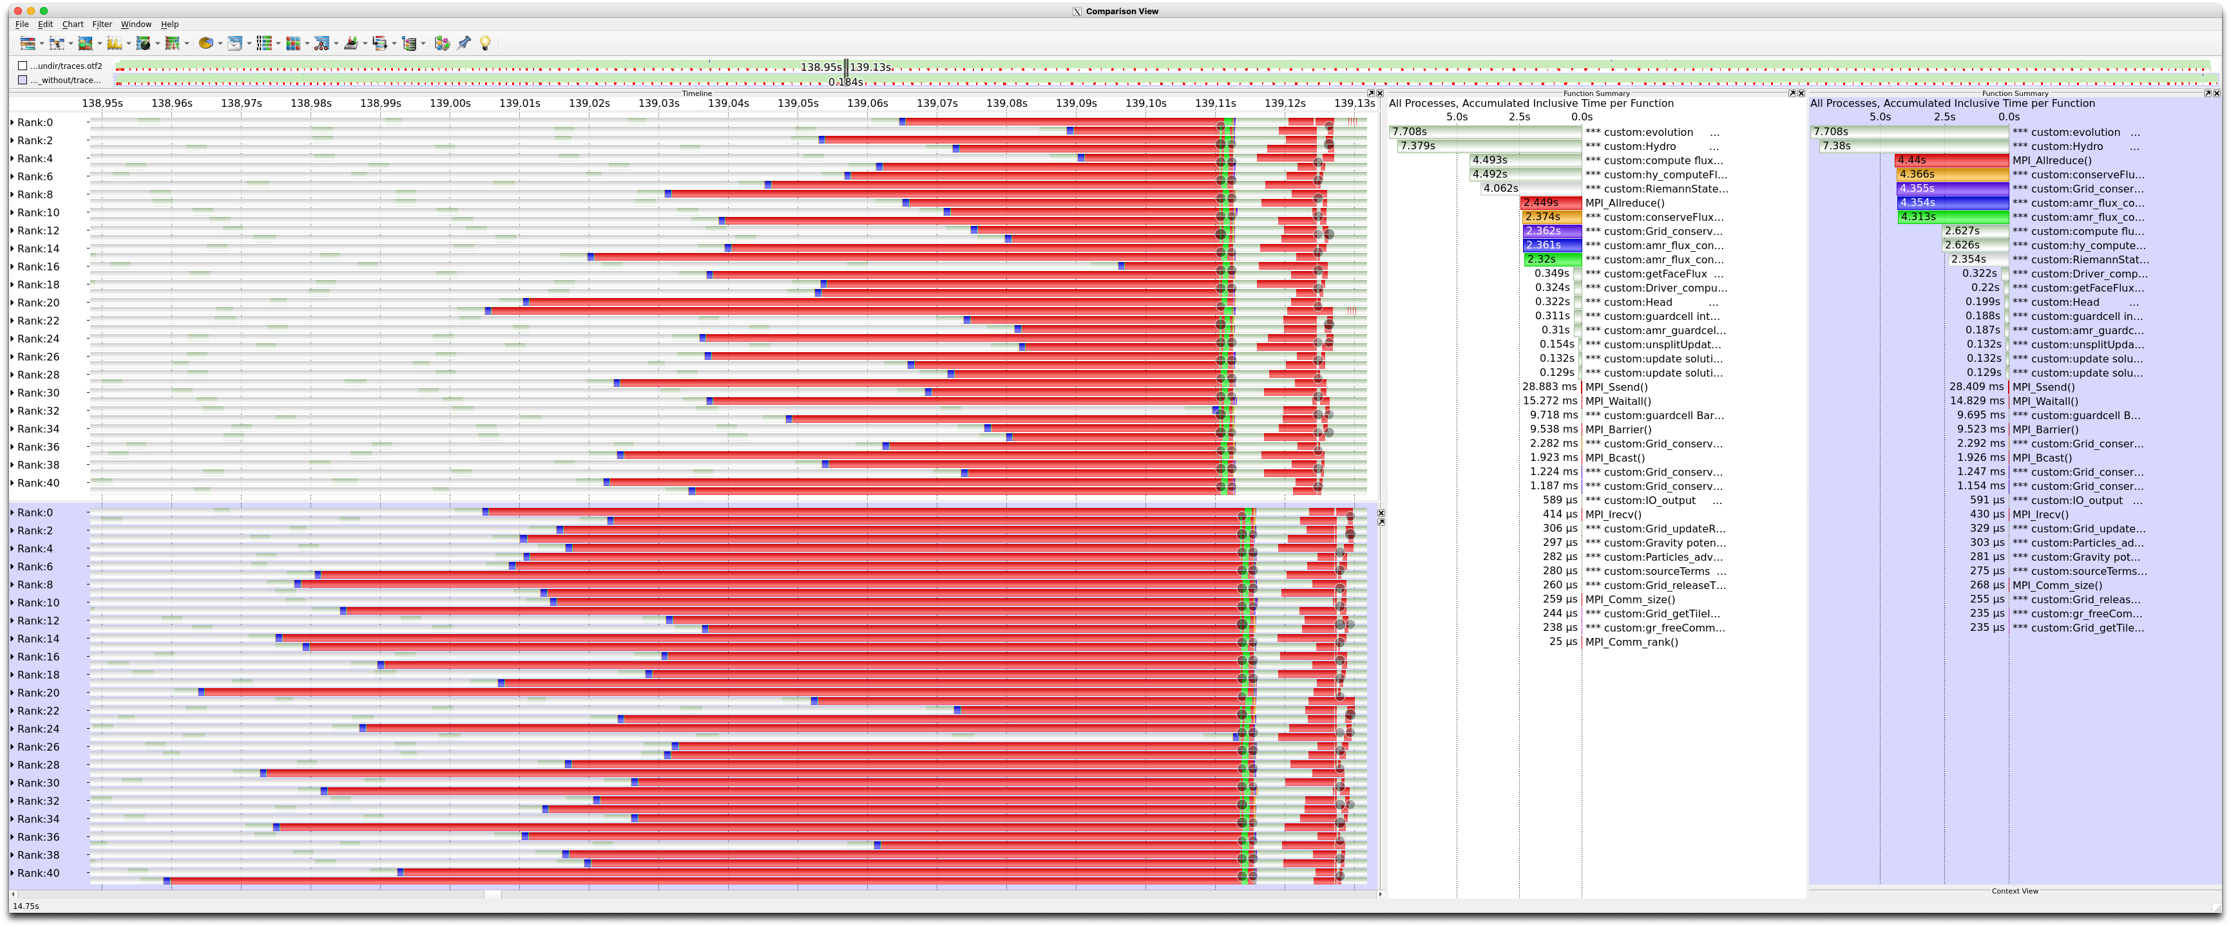
Trace comparison – TAU data in Vampir
Early
Late
Late
Early
Trace comparison between orig (above timeline, left profile) and nocall (bottom timeline, right profile) Flash-X on Summit, visualized in Vampir. The red regions represent time spent in MPI_Allreduce.
Notes:
First step: collect profiles/traces to compare datasets. Above, trace comparison of original code and modified code. MPI_Allreduce time has increased significantly after Riemann step. Imbalance?

Slide 14
Needed: Analysis Tools
Need to quickly and easily visualize the distributions, correlations of timers/metrics in the performance data
Vampir, ParaProf, PerfExplorer all have limitations (license limit, capability, scale/age respectively) for runs with 2688+ processes
Python provides nice set of tools to prototype with
  Pandas
  Plotly
  JupyterLab
TAU has a Python data parser that loads the data into DataFrames
See https://github.com/Flash-X/SC-22-artifacts for notebooks used in this study

Slide 15
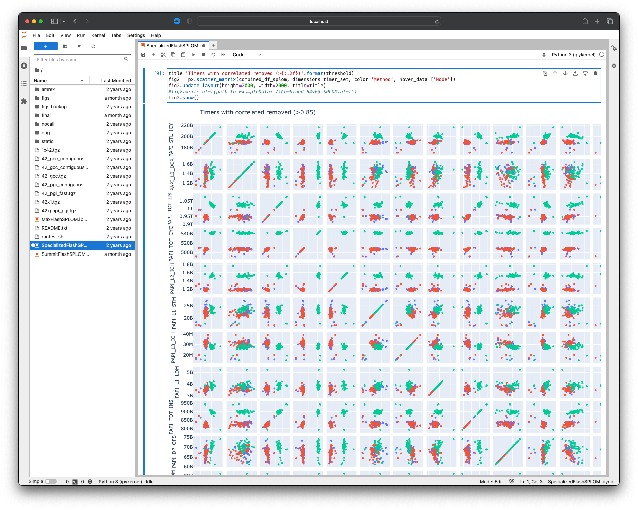
Step 1: Which counters?
Collected several PAPI counters from multiple runs
Which counter(s) are correlated with time (and/or each other)?
PAPI_L1_DCM, PAPI_RES_STL*
Also collected PAPI_TOT_INS
*Only available on Theta
Notes:
Essentially we are looking for actual smoking guns and/or proxy counters to help lead us to the problem

Slide 16
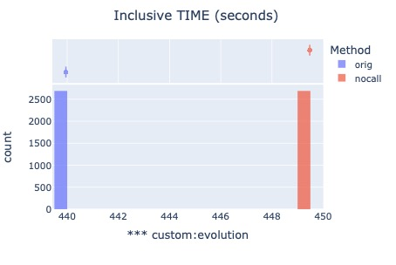
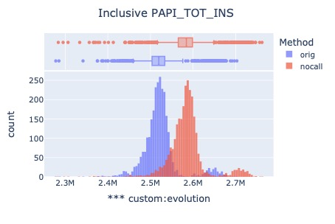
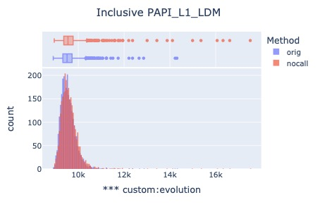
Evolution – High Level Timer
Summit run with 2688 MPI ranks shown. Almost no variability in evolution suggests that MPI collective synchronization is aligning all ranks – we need a lower level timer to tease apart MPI and actual computation. There’s also an increase in total instructions – what caused that?

Slide 17
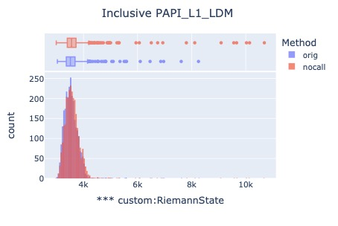
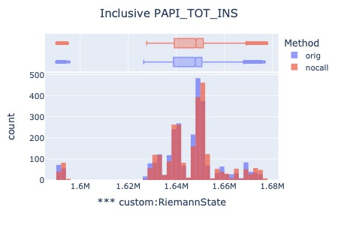
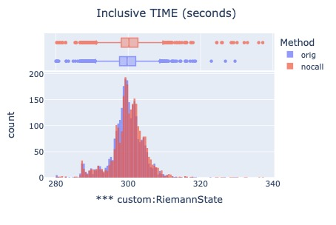
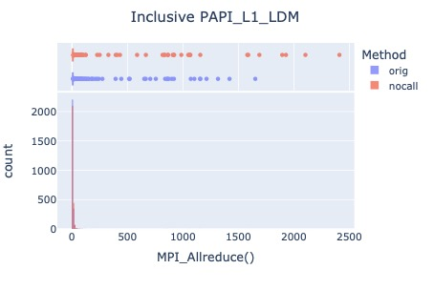
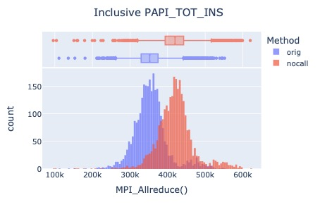
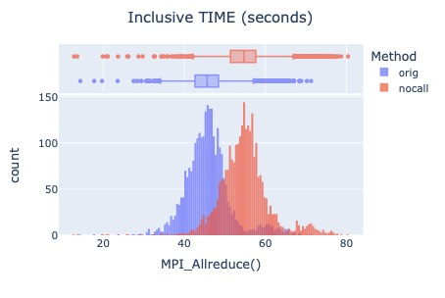
Breaking Down Evolution
MPI busy waiting at synchronization is cause of increased instructions

Slide 18
Correlation With MPI_Allreduce

Slide 19
Adding Sampling to Dig Deeper
Original
No call
Notes:
The results to this point led us to conclude that this particular scenario is taxing the memory subsystem, regardless of architecture. It is possible that a large number of synchronous processes per node (one per core), executing in lockstep, making frequent allocation requests at the same time would burden the OS kernel somewhat, regardless of architecture. It is also possible that the L1 cache misses are a misleading symptom, but are correlated with the true contention and are a helpful proxy. In general, we suspect that there are so many frequent, small allocation/deallocations happening that Flash- X is taxing the system allocator.

Slide 20
Performance Conclusions
High contention for memory subsystem from concurrent processes
Main computation is aggressively using ALLOCATABLE array variables and ALLOCATE/DEALLOCATE operations
Manual analysis determined that array variables in the Riemann computation don’t change over time – consistent size per process
Replace them with arrays that are allocated once and reused/saved (configuration named ”static”)

Slide 21
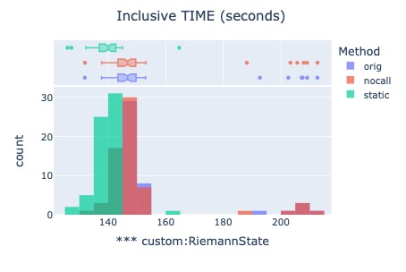
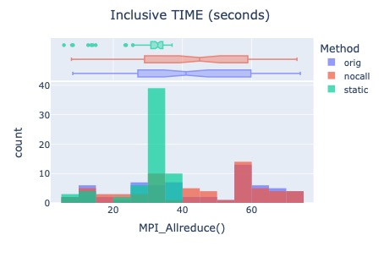
Single Node Performance on Theta
Notes:
Switching to Theta data sets for more available counters.

Slide 22
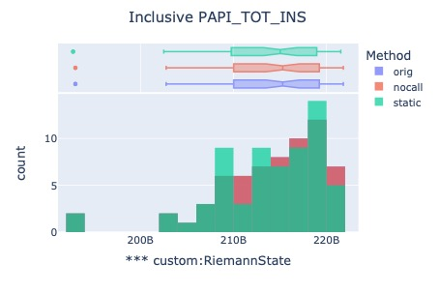
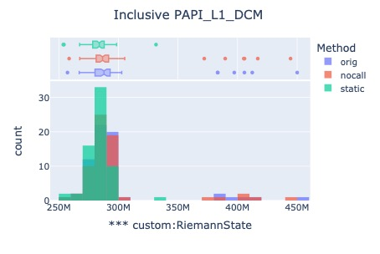
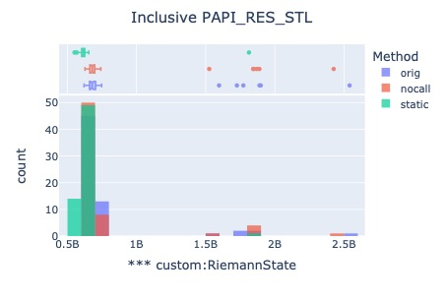
Reduction in L1_DCM, Resource Stalls

Slide 23
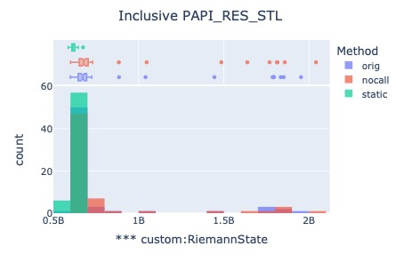
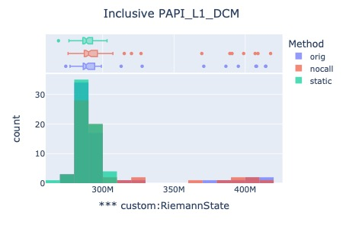
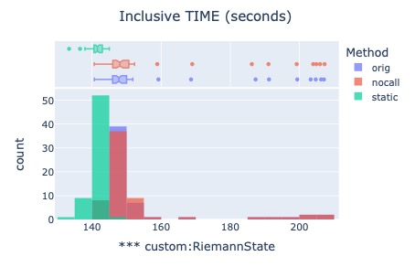
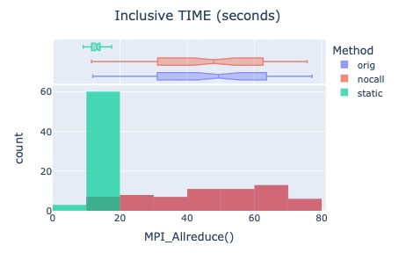
Reserving a Core for the OS
Determined that lowest rank process on each node is this outlier!
ALCF has instructions on reserving a core for the OS (specialization)
😎
Change from 64 ranks per node to 63 ranks per node, reserving one core for OS

Slide 24








Final Results: Theta
10% faster than baseline with one less core
20% less
time in max
10% more
time on average…
75% less
time in max
67% less
time on average…
Overall faster with less contention, and a more balanced load

Slide 25
Related Work
Many ad-hoc Python solutions to similar data analysis problems
PerfExplorer – uses Octave/R, Weka but not performant (Java), not as flexible
Hatchet – GraphFrame data model – same analysis in this paper could be done with Hatchet data
Load balance analysis not new in HPC, but Python, Plotly, JupyterLab introduces ease, flexibility, extensibility

Slide 26
Conclusions, Future Work
Removing communication code led to a slowdown in computation
We developed a set of Jupyterlab Python scripts that utilize Pandas and Plotly to automate the generation of distribution and correlation visualizations for better understanding of performance behavior
In this process, we discovered and removed or mitigated two additional performance limiting bottlenecks for performance tuning
Still working on AMReX optimizations to help it benefit from regular mesh in Flash-X

Slide 27
Relevant Links
Flash-X Project Website: https://flash-x.org
Flash-X source code: https://github.com/Flash-X/Flash-X
TAU Website: https://tau.uoregon.edu
TAU GitHub mirror: https://github.com/UO-OACISS/tau2
Presented Scripts and Results: https://github.com/Flash-X/SC-22-artifacts

Slide 28



Acknowledgements
The submitted manuscript has been created by UChicago Argonne, LLC, Operator of Argonne National Laboratory (“Argonne”). Argonne, a U.S. Department of Energy Office of Science laboratory, is operated under Contract No. DE-AC02-06CH11357. The U.S. Government retains for itself, and others acting on its behalf, a paid-up nonexclusive, irrevocable worldwide license in said article to reproduce, prepare derivative works, distribute copies to the public, and perform publicly and display publicly, by or on behalf of the Government. The Department of Energy will provide public access to these results of federally sponsored research in accordance with the DOE Public Access Plan. http://energy.gov/downloads/doe-public-access-plan.
Parts of this research was supported by the Exascale Computing Project (17-SC-20-SC), a joint project of the U.S. Department of Energy’s Office of Science and National Nuclear Security Administration, responsible for delivering a capable exascale ecosystem, including software, applications, and hardware technology, to support the nation’s exascale computing imperative.
This research used resources of the Oak Ridge Leadership Computing Facility at the Oak Ridge National Laboratory, which is supported by the Office of Science of the U.S. Department of Energy under Contract No. DE-AC05-00OR22725.

