Slide 1





An Autonomic Performance Environment for Exascale
Kevin A. Huck¹, Allan Porterfield², Nick Chaimov¹, Hartmut Kaiser³, Allen D. Malony¹, Thomas Sterling⁴
¹University of Oregon, Eugene, Oregon, USA
²RENCI, Chapel Hill, North Carolina, USA
³Louisiana State University, Baton Rouge, Louisiana, USA
⁴University of Indiana, Bloomington, Indiana, USA

Slide 2
Motivation
Challenges of performance growth and power will cause exascale systems to depart from conventional MPP designs
  Greater core counts and hardware thread concurrency
  Heterogeneous hardware and deeper memory hierarchy
  Hardware-assisted global addressing space support
  Power limits and reliability concerns built in
Emerging exascale programming models emphasize message-driven computation and finer-grained parallelism semantics
  More asynchronous and lower-level thread management
  More exposure of concurrency through task-level parallelism
  Global address space models versus conventional message passing
  Heterogeneity in parallel execution and locality optimization
Greater performance variability will be a consequence
  Questions traditional iterative performance optimization
  Requires integration of introspection, in situ analysis, feedback

Slide 3
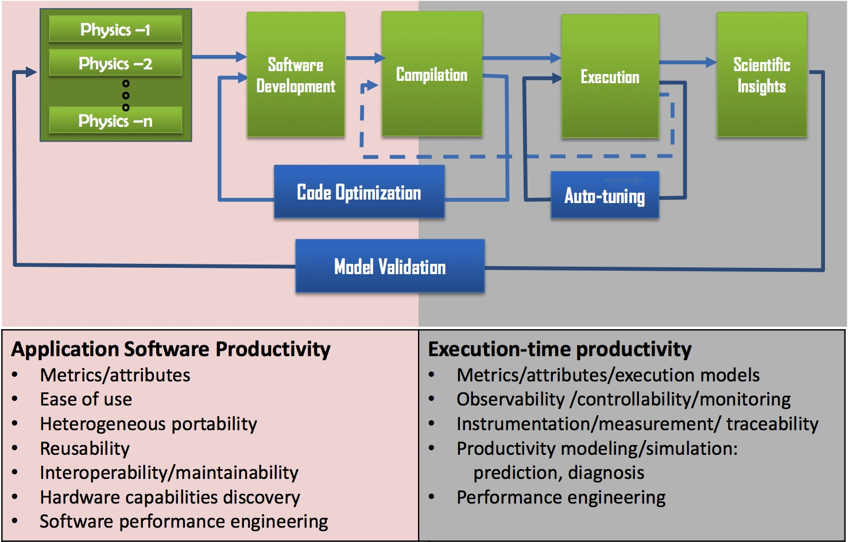
Exascale End-to-End Productivity
Application Software Productivity
Execution-time Productivity
Dynamic performance adaptation
Courtesy of Thomas Ndousse-Fetter, DOE

Slide 4
Performance Technology Implications
Performance technology has evolved to serve the dominant architectures and programming models
  Observability era (1991 – 1998)
    instrumentation, measurement, analysis
  Diagnosis era (1998 – 2007)
    identifying performance inefficiencies
  Complexity era (2008 – 2012)
    scale, memory hierarchy, network, multicore, GPU
20+ years of stable parallel execution models
  “1st person” application focus
  Productivity somewhat decoupled from performance
    not directly necessary to know application semantics

Slide 5
Uniformity Assumptions for Exascale
Exascale design directions raise issues of uniformity
  Components and behaviors are not the same or regular
  Heterogeneous compute engines behave differently
  Fine-grained power management affects homogeneity
  Process technology results in non-uniform execution behavior
  Fault resilience introduces inhomogeneity
Bulk synchronous model is increasingly impractical
  Current focus is on removing sources of performance variation (jitter) will be increasingly impractical
  Huge costs in power/complexity/performance to extend the life of a purely bulk synchronous model
Embrace performance heterogeneity
  Assume asynchronous execution model as the norm

Slide 6
Exascale Era and Performance Productivity
Productivity and performance are more intimately coupled in exascale environments
  Applications must be mapped to new exascale systems
  Post-mortem performance analysis is inadequate due to lack of repeatability between runs
  High concurrency and dynamic operation introduces execution-time variation (performance and power)
New rules for “exascale era” performance productivity
  “1st person” + “3rd person” performance introspection
  Introspection across exascale software stack (RTS mainly)
  In situ analysis is the norm
  Dynamic feedback and adaptation (policy-driven)
  Integration in exascale productivity environment

Slide 7





XPRESS
DOE X-Stack project to develop the OpenX software stack, implementing the ParalleX execution model
  Sandia National Laboratories (R. Brightwell)
  Indiana University (T. Sterling, A. Lumsdane)
  Lawrence Berkeley National Laboratory (A. Koniges)
  Louisiana State University (H. Kaiser)
  Oak Ridge National Laboratory (C. Baker)
  University of Houston (B. Chapman)
  University of North Carolina (A. Porterfield, R. Fowler)
  University of Oregon (A. Malony, K. Huck, S. Shende)
http://xstack.sandia.gov/xpress/

Slide 8
ParalleX, HPX, and OpenX
ParalleX is an experimental execution model
  Theoretical foundation of task-based parallelism
  Run in the context of distributed computing context
  Supports integration of the entire system stack
HPX is the runtime system that implements ParalleX
  Exposes an uniform, standards-oriented API
  Enables to write fully asynchronous code using hundreds of millions of threads
  Provides unified syntax and semantics for local and remote operations
  HPX-3 (LSU, C++ language/Boost)
  HPX-5 (IU, C language)
XPRESS will develop OpenX exascale software stack based on ParalleX

Slide 9
HPX
Governing principles (components)
  Active global address space (AGAS) instead of PGAS
    Enables seamless distributed load balancing and adaptive data placement and locality control
  Message-driven via Parcels instead of message passing
    Enables transparent latency hiding and event driven computation
    Parcels are a form of active messages
  Lightweight control objects (LCO) instead of global barriers
    Reduces global contention and improves parallel efficiency
    Synchronization semantics
  Moving work to data instead of moving data to work
    Basis for asynchronous parallelism and dataflow style computation
  Fine-grained parallelism of lightweight Threads (vs. CSP)
    Improves system and resource utilization

Slide 10
HPX-3 Architecture
Notes:
Parcels & parcel transport layer, PX-threads and management, Local Control Objects (LCO), Active Global Address Space (AGAS)
Important to note that HPX already has performance counters, we want to tie into them.

Slide 11
Dynamic Execution Strategy

Slide 12
OpenX Stack
Integrated Exascale software stack for ParalleX
“APEX”
Autonomic
Performance
Environment
for Exascale

Slide 13
APEX and Autonomics
Performance awareness and performance adaptation
Top down and bottom up performance mapping / feedback
  Make node-wide resource utilization data and analysis, energy consumption, and health information available in real time
  Associate performance state with policy for feedback control
APEX introspection
  OS (LXK) tracks system resource assignment, utilization, job contention, overhead
  Runtime (HPX) tracks threads, queues, concurrency, remote operations, parcels, memory management
  ParalleX, DSLs and legacy codes allow language-level performance semantics to be measured
Notes:
Performance is no longer constrained primarily by the throughput of individual cores or the behavior of the code executing in a single pipeline.

Slide 14
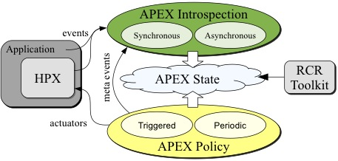
APEX Design
Notes:
Allen – can you get a higher resolution or vector version of this figure? We do have a meta-event in use: the “reset” event. It is used when we make an adaptive change in processing, and want to reset one or more counters/timers.

Slide 15
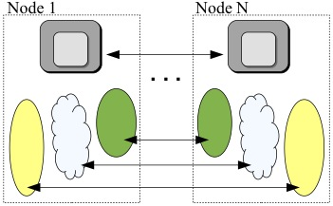
APEX Global Design
Leverage HPX to provide global introspection, state, and policies

Slide 16
APEX Introspection
APEX collects data through “inspectors”
  Synchronous uses an event API and event “listeners”
    Initialize, terminate, new thread
    Timer start, stop
    Sampled value
    Custom events (meta-events)
  Asynchonous do not rely on events
APEX exploits access to performance data from lower stack components
  Reading from the RCR blackboard (i.e., power, energy)
  “Health” data through other interfaces (e.g., /proc/stat)
Notes:
The APEX introspection is provided through the APEX API. Applications, libraries, and runtimes can pass events and data to APEX through the API. Important to point out that the synchronous processing of timer and counter data is done as minimally as possible – control returns to the application without excessive processing
The most important API events are listed. Introspection is also provided through RCR and through reading of available system data.

Slide 17
RCR: Resource Centric Reflection
Performance introspection across layers to enable dynamic, adaptive operation and decision control
Extends previous work on building decision support instrumentation (RCRToolkit) for introspective adaptive scheduling
Daemon monitors shared, non-core resources
Real-time analysis, raw/processed data published to shared memory region, clients subscribe
APEX policy components will evaluate

Slide 18
APEX Event Listeners
Profiling listener
  Start event: take timestamp, return profiler handle
  Stop event: take timestamp, put profiler object in a queue for back-end processing, return
  Sample event: put the sample in the queue
  Consumer thread: process profiler objects and samples to build statistical profile
Concurrency listener
  Start event: push timer ID on stack
  Stop event: pop timer ID off stack
  Consumer thread: periodically log current timer for each thread, output report at termination

Slide 19
APEX Policy
Policies are rules that decide on outcomes based on introspected state
  Triggered policies are invoked by “triggers” from introspection
  Periodic policies are run periodically
Policy engine allows polices to be registered
  Applications, runtimes, and/or OS register callback functions
  Executed on triggers or periodically
Callback functions => policy rules
  “If x < y then…”
Enables runtime adaptation using introspection data
  Engages actuators at across stack layers
  Could also be used to involve online auto-tuning support

Slide 20
APEX Global View
All APEX introspection is collected locally
  However, it is not limited to a single-node view
Global view of introspection data and interactions
  Take advantage of the distributed runtime support
    HPX3, HPX5, MPI, …
API interface provided for additional back-end implementations
  action_apex_get_value() – each node gets data to be reduced, optional RDMA put (push model)
  action_apex_reduce() – optional RDMA get (pull model), node data is aggregated at root node, optional broadcast back out
Can also extend global view to policies
Notes:
The 1-sided communication can be done either by the non-root nodes (using a “put”) or by the root node (using N-1 “get” calls)

Slide 21
APEX Examples
HPX-3 1-D stencil code
HPX-5 Single-source-shortest-path benchmark
HPX-5 LULESH kernel
HPX-3 miniGhost kernel
All experiments conducted on Edison
  Cray XC30 @ NERSC.gov
  5576 nodes with two 12-core Intel "Ivy Bridge" processors at 2.4 GHz
  48 threads per node (24 physical cores w/hyperthreading)
  Cray Aries interconnect with Dragonfly topology with 23.7 TB/s global bandwidth

Slide 22
Concurrency Throttling for Performance
Heat diffusion
1D stencil code
  Data array
  partitioned into
  chunks
HPX-3 application
executed on 1 node
No hyperthreading
Performance increases to a point with increasing worker threads, then decreases.

Slide 23
Concurrency Throttling for Performance
Region of
maximum
performance
correlates with
thread queue
length runtime
performance counter
  Represents # tasks currently waiting to execute
Could do introspection on this to control concurrency throttling policy
Runtime
Thread queue length

Slide 24
1d_stencil Baseline
100,000,000 elements, 1000 partitions
48 worker threads (with hyperthreading)
Actual concurrency much lower
  Many worker threads are spinning waiting for work to become available
Large variation in concurrency over time
  Tasks waiting on prior tasks to complete
138 seconds
Notes:
hpx::lcos::local::dataflow is the action that actually carries out the calculation

Slide 25
1d_stencil Optimal # of Threads
100,000,000 elements, 1000 partitions
12 worker threads
Greater proportion of threads assigned work
  Less interference between active threads and threads waiting for work
  Edison has 24 physical cores; idle hardware threads >24 are hyperthreads which may interfere with active threads
Much faster
  61 sec. vs 138 sec.
61 seconds
Notes:
hpx::lcos::local::dataflow is the action that actually carries out the calculation

Slide 26
1d_stencil Optimized with APEX
100,000,000 elements, 1000 partitions
Initially 48 worker threads
Discrete hill climbing search to minimize average number of pending tasks
Converges on 13 (vs. optimal of 12)
Nearly as fast as optimal
  64 sec. vs. 61 sec.
64 seconds
Notes:
hpx::lcos::local::dataflow is the action that actually carries out the calculation

Slide 27
HPX-5 Throughput Optimization
Single source, shortest path graph search benchmark (SSSP)
  Graph500.org benchmark kernel - http://www.graph500.org
Large graph loaded, a point is selected at random and the shortest path between it and all other points is found
  Random4-n.10 dataset, runs for 60 sec. of timed searches
Metric of interest: throughput, not time to completion
10 nodes, 24 threads per node (no hyperthreading)
HPX5 implementation: graph is distributed across nodes
APEX Policy rule:
  # calls to _handle_queue_action() used as “throughput” metric
  Adjust thread concurrency to maximize throughput
  Use Active Harmony for optimization search
    Parallel Rank Order search strategy
Notes:
NB: The Random4-n.10 dataset is on the small end, but larger problems (11,12) show similar performance throttling results. For the 12 on 16 nodes, the speedup is ~2.1X.

Slide 28
SSSP Baseline
1962 searches
performed in
60 seconds
Notes:
Baseline run, shows that all 240 threads are busy… power consumption is not bad – about 240 W per node.

Slide 29
SSSP with Policy Engine Support
6929 searches
Performed
In 60 seconds
Notes:
Optimized run - shows that only 61 (6 threads on 9 nodes, 7 threads on one node) threads are busy… power consumption is much less – about 150 W per node. Most importantly – the number of searches done in the 60 seconds is much higher.

Slide 30
SSSP with Policy Engine Support
6929 searches
Performed
In 60 seconds
Notes:
Throughput == total calls to “handle_queue_action”. This view shows the metric what the policy uses to optimize the number of active threads. The queue contains vertices to explore (Traversed Eges Per Second -> TEPS)

Slide 31
SSSP Performance Explanation
Less threads = less contention for task yield locks (network)
Tasks yield when waiting on network (code is network bound)
TEPS: Traversed Edges Per Second
Metric | Baseline | Optimized | Difference
Searches Done | 1962 | 6929 | 353.16%
Cycles | 6.91756E+12 | 2.81473E+12 | 40.69%
Instructions | 3.17485E+12 | 2.01608E+12 | 63.50%
L2 Cache Misses | 7986640437 | 8570692088 | 107.31%
IPC | 0.458955 | 0.716263 | 156.06%
INS/L2TCM | 397.52 | 235.23 | 59.17%
min_TEPS | 7.23E+04 | 9.47E+04 | 130.87%
median TEPS | 1.36E+05 | 4.95E+05 | 365.01%
max_TEPS | 2.51E+05 | 7.63E+05 | 303.36%
Notes:
TEPS = “Traversed Edges Per Second”. More is better. IMPORTANT TO NOTE: problem is not with HPX, but the nature of the problem. Because the graph is distributed, the threads contend while waiting on remote actions.

Slide 32
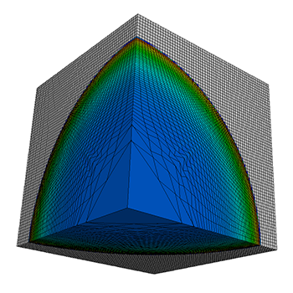
HPX-5 Throttling for Power
Livermore Unstructured Lagrangian Explicit Shock
Hydrodynamics (LULESH)
Proxy application in DOE co-design efforts for exascale
CPU bounded in most implementations
Develop an APEX policy for power
  Threads are idled in HPX to keep node under power cap
  Use hysteresis of last 3 observations
  If Power < low cap increase thread cap
  If Power > high cap decrease thread cap
HPX thread scheduler modified to idle/activate threads per cap
Test example:
  343 domains, nx = 48, 100 iterations
  16 nodes of Edison, Cray XC30
  Baseline vs. Throttled (200W per node high power cap)
LULESH image, source: Hydrodynamics Challenge Problem, Lawrence Livermore National Laboratory. Technical Report, LLNL-TR-490254
Notes:
LULESH is a proxy application from LLNL to model and study hydrodynamics, the motion of materials relative to each other when subject to forces.
The LULESH implementation was done by the researchers at IU.
We modified the thread scheduler algorithm to check the thread cap on every iteration of the main worker loop. If a thread is not holding any resources and the number of active workers is greater than the current thread cap, the thread goes into an idle state until signaled to resume work. If the number of active workers is less than the cap, an active worker signals an idle thread to resume working. The policy rule sets the thread cap according to the latest power observations. A quiescent node of Edison draws ~40W. Fully loaded, it draws ~300W.

Slide 33
LULESH baseline
No power cap
No thread cap
768 threads
Avg. 247 Watts/node
~360 kiloJoules total
~91 seconds total
~74 seconds HPX tasks
Notes:
The tasking time in the application takes ~74 seconds, when the aprun launch and HPX startup time is included, the total runtime is ~91 seconds. The read line shows the maximum concurrency, 768 threads (no cap used).The black line shows the cumulative power draw across all 16 nodes – it maxes out around 4500 W, about 281 W per node. The average power draw per node was around 247 W. The total energy usage was measured as 360 kiloJoules. The stacked bars show which tasks were executing when APEX sampled them with a 1Hz period (1 sample per second).

Slide 34
LULESH Throttled by Power Cap
200W power cap
768 threads
throttled to 220
Avg. 186 Watts/node
~280 kiloJoules total
~94 seconds total
~77 seconds HPX tasks
Notes:
This is the same measurement, with throttling enabled. The key difference: the total energy draw was only 280 kiloJoules, 22% less. The runtime only increased by ~3 seconds! The red line shows the thread cap as it is modified by the policy. The black line shows the reflected reduction in Power draw, with some localized fluctuations. The average power draw for this run was 186 W. This execution used less than 1/3 the number of threads, but only took 3 seconds longer. The next slide explains why…

Slide 35
LULESH Performance Explanation
768 vs. 220 threads (after throttling)
360 kJ vs. 280 kJ total energy consumed (~22% decrease!)
75.24 vs. 77.96 seconds in HPX (~3.6% increase)
Big reduction in yielded action stalls (in thread scheduler) – less contention for network access
Hypothesis: LULESH implementation is network bound because spatial locality of subdomains is not maintained
Metric | Baseline | Throttled | % Difference
Cycles | 1.11341E+13 | 3.88187E+12 | 34.865%
Instructions | 7.33378E+12 | 5.37177E+12 | 73.247%
L2 Cache Misses | 8422448397 | 3894908172 | 46.244%
IPC | 0.658677 | 1.38381 | 210.089%
INS/L2CM | 870.742 | 1379.18 | 158.391%
Notes:
One big difference is that the throttled version of the code does not “yield” near as much as the original (I don’t have a good measurement of that yet). But a sampled profile showed much less time spent in yielding activity – when a worker thread surrenders its task to be executed by another worker. IMPORTANT TO NOTE: problem is not with HPX, but with the LULESH implementation. Hypothesis: the subdomains are not assigned to nodes to exploit spatial locality. We will experiment to improve spatial locality with subdomains.

Slide 36
HPX-3 Throttling for Power
MiniGhost
  Mantevo finite different miniapp
  Implements a
  difference stencil across homogenous 3D domain
  Ported to HPX-3 from OpenMP+MPI
  HPX-3 has better performance than OpenMP version
Diminishing returns with added cores per node
  Can throttle for energy without substantial performance impact

Slide 37
MiniGhost baseline
92 seconds
total runtime
Notes:
If allowed to use 48 cores (all the logical cores on a node) not all cores are actually utilized (by worker threads at least; there are additional helper threads in the HPX3 runtime not shown on the chart and not affected by throttling).
(All actions in the code are getting represented as continutation::async because the functions are function objects from boost::bind and we can’t tell the name of the original function at present)

Slide 38
MiniGhost throttled
103 seconds
total runtime
200 Watt power cap
12% slower, 33% less power
Notes:
IPC: 0.605227 (unthrottled)
IPC: 0.751752 (throttled)

Slide 39
Conclusion
Exascale brings fundamentally new challenges to performance and to productivity
Embrace performance heterogeneity
Integrate performance introspection, in situ analysis, and adaptation in exascale system stack
XPRESS project developed prototype of APEX in HPX-3 and HPX-5 for use in OpenX
Demonstrate APEX operation in examples
APEX framework generally applicable to other X-stack runtime efforts

Slide 40
Future Work
Conduct more robust experiments and at larger scales on different platforms
More/better policy (optimization) rules
  Runtime and operating system
  Application and device-specific
Multi-objective optimization
Integration of online auto-tuning framework
API refinements for general purpose usage
Optimize other runtimes?
Notes:
Even though APEX is for exascale research, it could have usage opportunities with today’s technology

Slide 41


Acknowledgements
Support for this work was provided through Scientific Discovery through Advanced Computing (SciDAC) program funded by U.S. Department of Energy, Office of Science, Advanced Scientific Computing Research (and Basic Energy Sciences/Biological and Environmental Research/High Energy Physics/Fusion Energy Sciences/Nuclear Physics) under award numbers DE-SC0008638, DE-SC0008704, DE- FG02-11ER26050 and DE-SC0006925.
Sandia National Laboratories is a multi-program laboratory managed and operated by Sandia Corporation, a wholly owned subsidiary of Lockheed Martin Corporation, for the U.S. DOE’s National Nuclear Security Administration under contract DE- AC04-94AL85000.
This research used resources of the National Energy Research Scientific Computing Center, a DOE Office of Science User Facility supported by the Office of Science of the U.S. Department of Energy under Contract No. DE-AC02-05CH11231.

