Slide 1
Tools, Integration,
Measurement & Modeling Update
Allen Malony, Sameer Shende, Boyana Norris, Shirley Moore, Jeff Hollingsworth, Kevin Huck, Nick Chaimov, Robert Lim, Xiaoguang Dai, Wyatt Spear, Josefina Lenis

Slide 2
TAU Port to ARM64 Linux
Instrumentation
  PDT parsers (C, C++, F90) ported
  MPI, OpenMP, pthread libraries ported
  TAU’s compiler-based instrumentation
  Wrapper generator ported
Measurement
  Sampling support
  Binutils ported (libunwind not available)
  PAPI not available yet

Slide 3
TAU Port to Power 8 Linux
Instrumentation
  PDT parsers (C, C++, F90) being ported
  MPI, OpenMP, pthread libraries ported
  TAU’s compiler-based instrumentation
  Wrapper generator ported
  CUDA 7.x support is stable
Measurement
  Sampling support
  Binutils ported, libunwind also available
  OMPT port underway

Slide 4
TAU Interface for Tracking Energy
PAPI
  RAPL access directly
    Needs root privileges, setcap, msr read access
  PERF interface to RAPL
    Needs paranoid file to contain -1 (root)
    No special privileges for binaries
Cray PM Counters Interface
  Available on Cray XC40
    No special privileges for users
    TAU reads data from files
    export TAU_TRACK_POWER=1

Slide 5
Tool Integration
DyninstAPI v9.0.3
  TAU supports DyninstAPI 7.x, 8.x, and 9.x
  New TAU release depends on BOOST and Dwarf when used with DyninstAPI
  Used with tau_exec for instrumenting binaries and preloading MPI wrapper interposition libraries
  Supports rewriting binaries

Slide 6
Program Database Toolkit
Static Analysis Framework for instrumentation of source code, used by TAU and Score-P
New Parsers for C, C++, and Fortran are being integrated
Gfortran 4.8.5 and ROSE, EDG 4.10.1 parsers being tested
TAU v2.25 and PDT v3.21 scheduled for release at SC’15

Slide 7
New PDT Parsers
New PDT C/C++ parser
  Based on EDG 4.10.1.
  Adds new support for C++11 and C++14 features.
  More compatible with GNU extensions.
  Ability to parse code using new versions of the Boost headers not supported by the previous EDG and ROSE-based parsers.
  CUDA parsing support
    Can instrument host functions defined in a .cu file.
  Should substantially expand the range of codes for which TAU can do source-level instrumentation.
    Many Boost-using codes previously were limited to compiler-level instrumentation or sampling.

Slide 8
OMPT updates
OMPT proposal presented to OpenMP language committee at last F2F (Aachen)
  Several reasonable concerns raised by compiler vendors
OpenMP 3.0 features done
Outstanding 4.0 issues:
  Tracking task dependencies
  Target directives
TAU support:
  Transitioning from Intel modified runtime to “LLVM/Clang” runtime
  Support for GCC 4.9+ (GOMP_parallel)
  https://github.com/OpenMPToolsInterface/LLVM-openmp
  https://github.com/OpenMPToolsInterface/ompt-test-suite
Notes:
Concerns raised at face 2 face meeting:
People were asking why this should be in the standard itself and we need to make this clear, although I think we have very good arguments for it
There was concern about the overhead and people wanted more information on where things happen on the critical path (even without tools attached)
There were also questions about the impact of OMPD on the actual runtime and the relationship between OMPT and OMPD.
The suggestion of a standard and a debug runtime was met with large hesitation – looking at overheads should therefore not only be limited to the mandatory parts. People would like to implement what they can in the production runtime

Slide 9
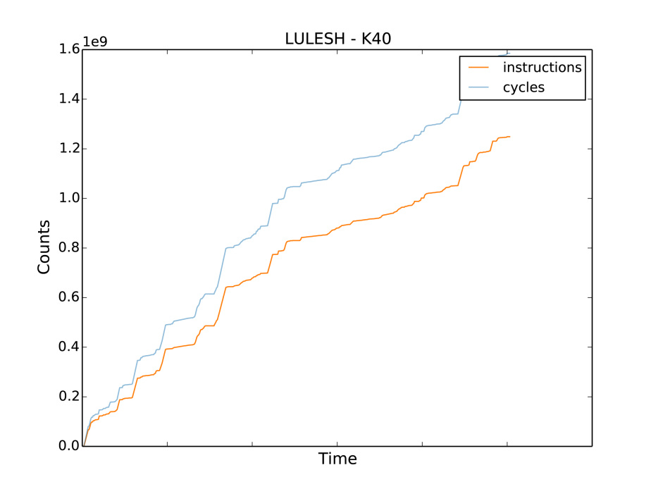
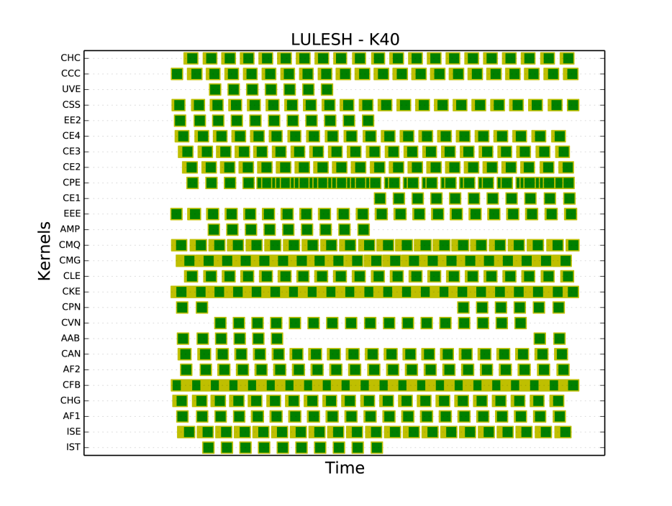
Problem with Current GPU Profiling
Hard to correlate where performance spikes are attributed to in source code
Event queue method: event injected at beginning and at end of execution (no idea what happens in between)

Slide 10
TAU CUPTI Updates (1)
Integrating PC Sampling in TAU
Mapping PC samples to disassembled instructions
Calculating metrics intensity at kernel level
  FLOPS, Memory, Control intensity
Understanding kernel behavior in real time, identifying where to spend tuning efforts
  See paper: Identifying Optimization Opportunities within Kernel Execution in GPU Codes (HeteroPar 2015)

Slide 11
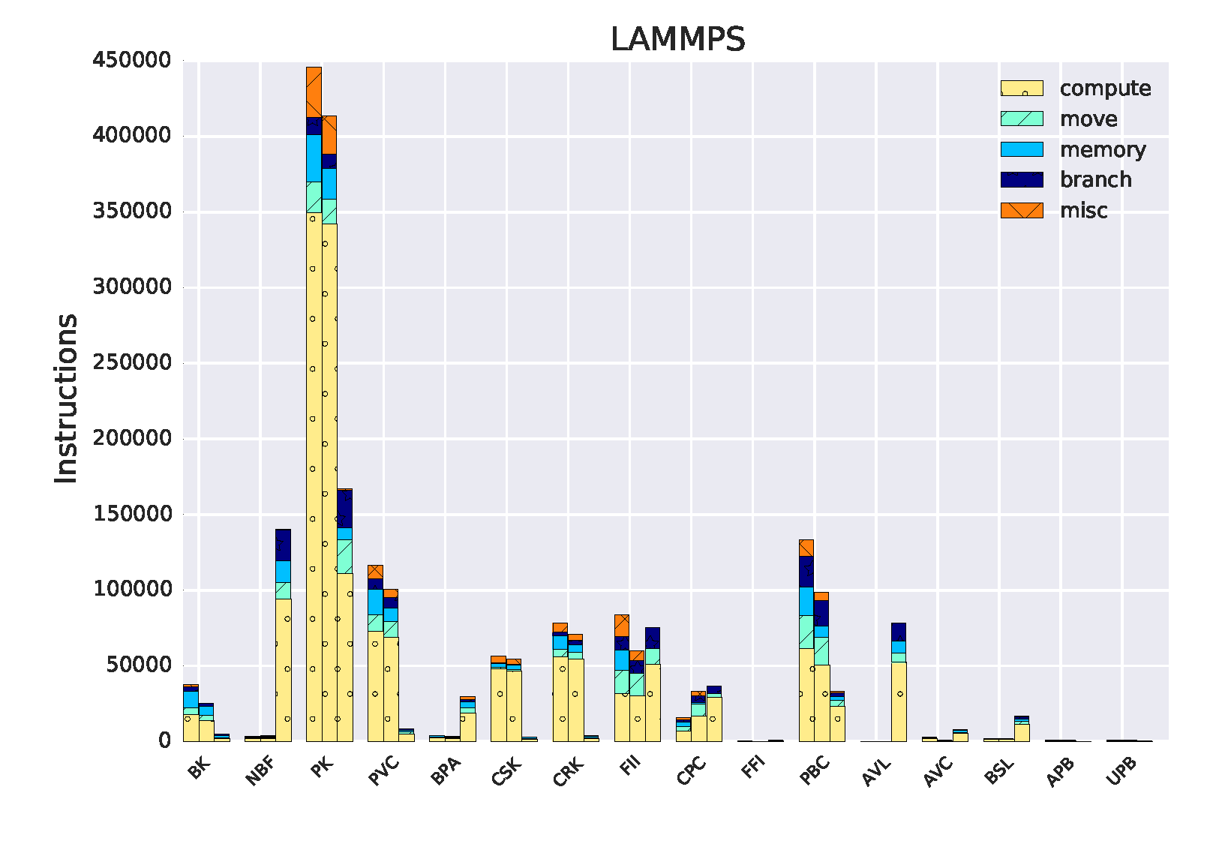
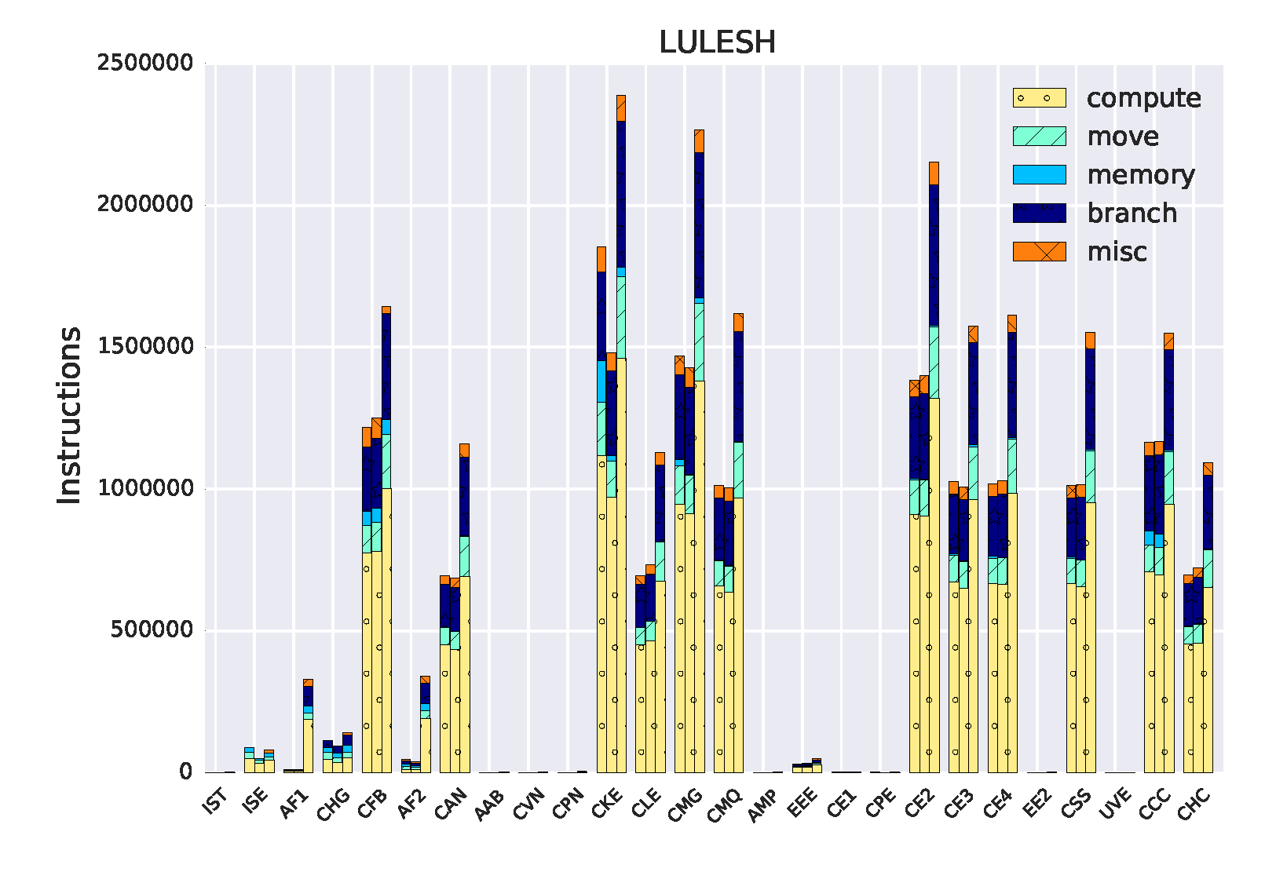
Kernel Characterization for LAMMPS and LULESH Applications
LAMMPS
LULESH
Three GPUs: M2090 (Fermi), K80 (Tesla), M6000 (Maxwell)
LAMMPS: PK kernel shows more computational operations
LULESH: CKE, CMG, CE2 shows more compute-intensive, as well as branches and moves

Slide 12
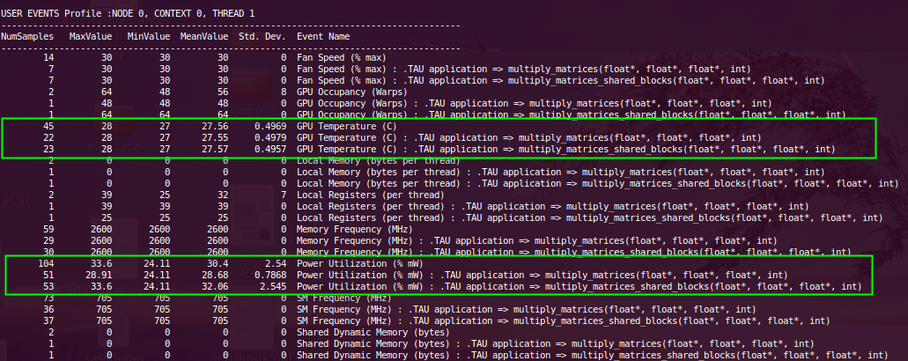
TAU CUPTI Updates (2)
Providing environment measurements in ParaProf
  Fan Speed, GPU Temperature, Memory Frequency, Power Utilization, SM Frequency

Slide 13
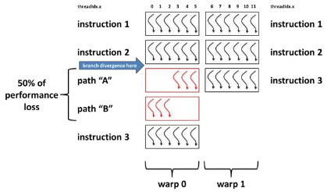
Divergent Branch Problem
GPU architectures specialize in executing SIMD in lock step
  Mask threads that do not satisfy branch conditions
Lanes allow branching threads to execute and non-branching threads to wait and eventually synchronize
Leads to performance drawbacks

Slide 14
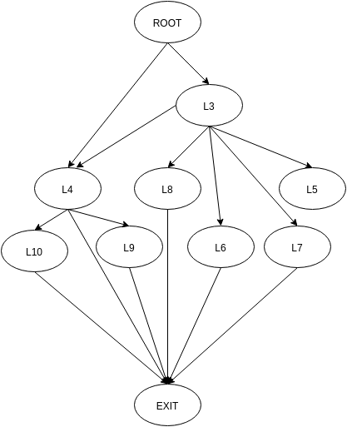
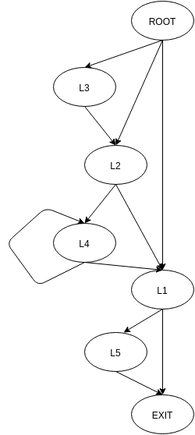
Control Flow Graphs for Various
Rodinia Kernel Functions
Gaussian
Streamcluster
Calculating execution frequencies in control flow graphs provide an understanding of the program structure
Deriving trip counts can determine how an application of input size N will perform without having to compile or run the application

Slide 15
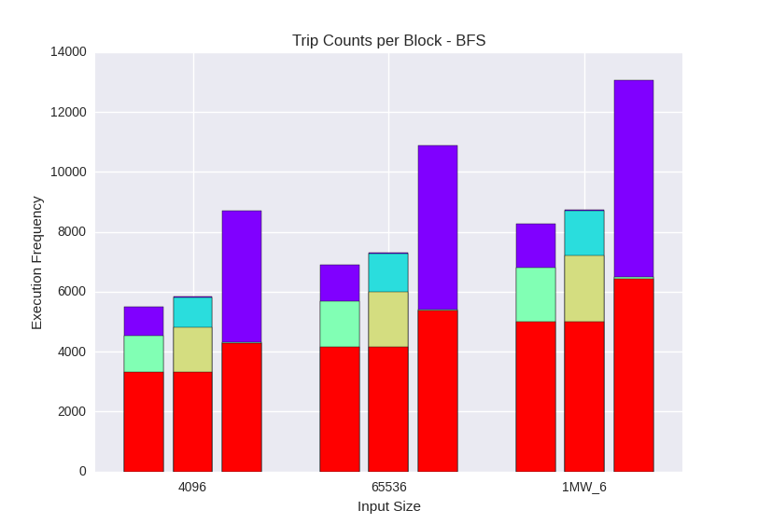
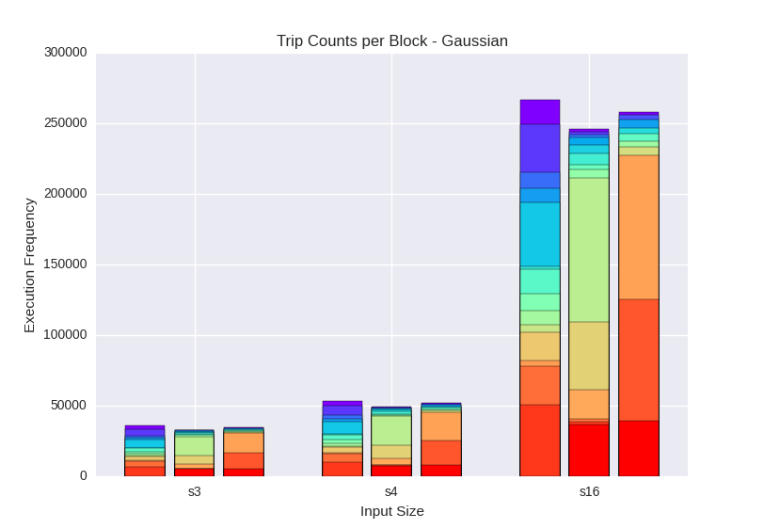
Basic Block Trip Counts
Breadth First Search
Gaussian
Three GPUs: M2090 (Fermi), K80 (Tesla), M6000 (Maxwell)
Each stacked bar represents a basic code block region
Each GPU creates its own version of a control flow graph
Higher trip counts seen for Maxwell in BFS, and Fermi in Gaussian

Slide 16
Ongoing work
Autotuned three kernel computations using Orio on three GPU architectures, constructed control flow graphs and collected execution frequencies
Predict performance parameters for certain types of input (e.g. given input size m, what thread or block size would lead to optimal performance?)

Slide 17
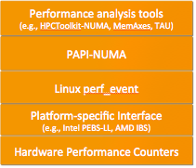
PAPI-NUMA: Experimental Extension to PAPI for NUMA Profiling
Modern architectures have complex shared cache and memory hierarchies.
Sub-optimal data/thread placement resulting in non-local data accesses can seriously degrade performance.
Proposed software stack →
PAPI-NUMA routines
  PAPI_sample_init(): sets up perf_event_attr structure and calls perf_event_open
  PAPI_sample_start(): enables sampling
  PAPI_sample_stop(): disables sampling
Reference: Ivonne Lopez, Shirley Moore, and Vince Weaver. A Protoytpe Sampling
Interface for PAPI, XSEDE15, St. Louis, July 2015.
Notes:
The “NUMA ceiling” can prevent applications from reaching the memory bandwidth roofline. The PAPI-NUMA extension is intended to help application developers find and fix NUMA bottlenecks so that their applications map more efficiently onto the cache and memory system. The experimental PAPI-NUMA implementation is layered over the low-level Linux perf_event hardware counter sampling interface and currently works only on Intel systems with PEBS-LL (Precise Event Based Sampling with Load Latency). We are working on extending it to AMD systems with Instruction Based Sampling (IBS). We are also working on a higher level tool interface that handles more of the low-level details of configuring the sampling and parsing the sample buffer.

Slide 18
Proposed Tool Interface
int PAPI_sample_numa(
int EventSet;
int Event; /* Preset such as PAPI_LD_LAT */
int sample_period, /* Sample every N events */
int threshold, /* latency threshold for latency events */
PAPI_callback func,
sample_record buf[NUM_CPUS];
int fds); /* file descriptor for each logical CPU */
Thread-specific NUMA profiling
Would be included in each sample record: processID, threadID, instruction address, data operand address , source of data – i.e., cache level or DRAM , instruction latency in cycles, TLB hit or miss and level, thread NUMA region, data NUMA region.
User callback function would be invoked when user buffer is almost full.
Notes:
Sample loads or stores.
Sampling can be used together with counting mode.
Need buffer to be fairly large for low overhead.

Slide 19
TAU + PAPI-NUMA
Current support option – derived metric
  TIME
  PAPI_NATIVE_OFFCORE_RESPONSE_0:REMOTE_DRAM
  PAPI_NATIVE_perf::PERF_COUNT_HW_CACHE_NODE:ACCESS
Still need to add support for multidimensional samples from thin PAPI perf_event layer
  PERF_SAMPLE_IP (64-bit address)
  PERF_SAMPLE_TID (32-bit pid, 32-bit tid)
  PERF_SAMPLE_WEIGHT (cycles)
  PERF_SAMPLE_DATA_SRC (address)
  Everything else encoded as 64-bit value (load/store, hit/miss/prefetch, level, snoop mode, TLB hit/miss & level)
AMD support likely, as well
Targeting MemAxes for visualization
General solution with CUDA samples?

Slide 20
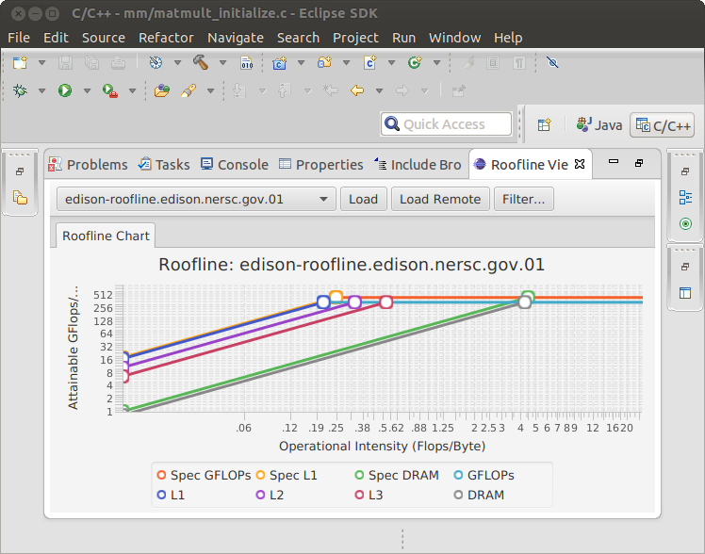
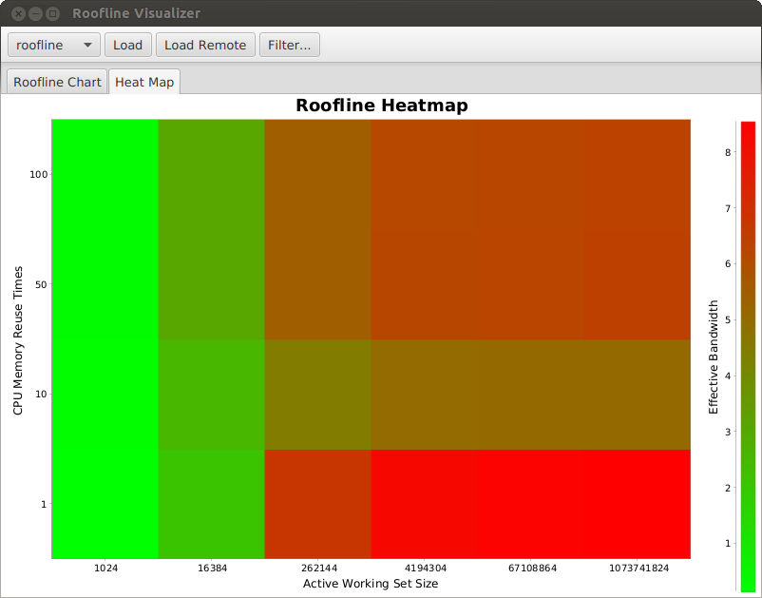
Roofline Visualization
Available as Eclipse component or standalone Java application
Load local JSON files generated by ERT or access public Roofline data repository
JavaFX chart implementation
Filter rooflines by metadata filelds
Heat map visualization
In development:
  Overlay multiple rooflines
  Display applicatoin performance data in roofline chart

Slide 21
Autoperf
Simple tool for performance experiments and associated analysis
Adds a layer of abstraction over existing performance tools
Automates tedious and error-prone tasks
  Selecting performance counters (minimize # of experiments required)
  Setting up the environment for each tool, managing batch jobs
  Generating selective profiling configuration based on sampling results
  Configuring access to databases, uploading data
  Reusable and extensible analyses that are easy to understand; comparisons across multiple code versions

Slide 22
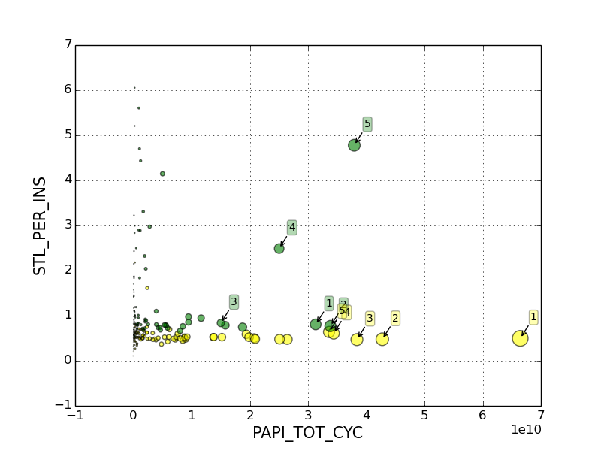
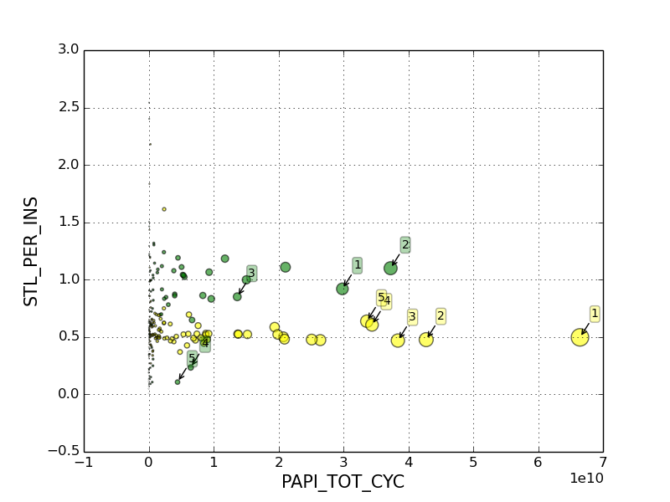
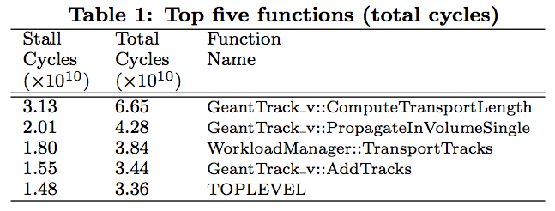
Geant4 Example: Effect of optimizations
Stalls per instruction vs total cycles—O2 unexpectedly increases stalls per instruction in two of the functions
-O2
-O3
Notes:
What is the difference between yellow and green?

