Slide 1
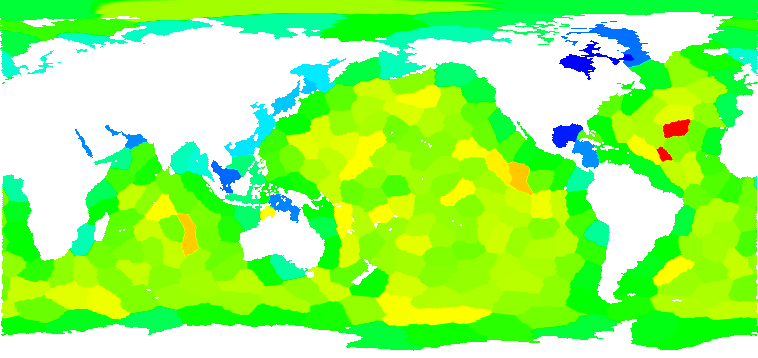
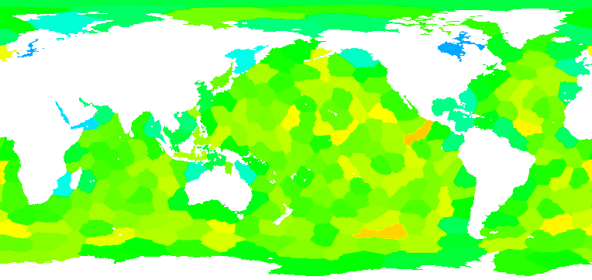
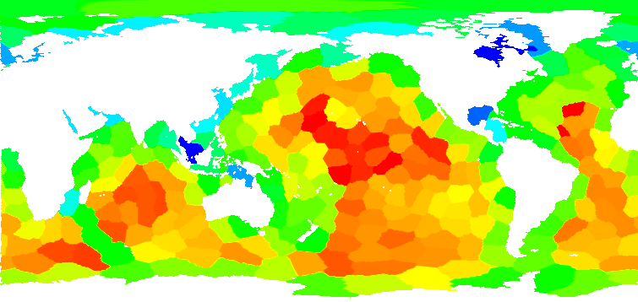
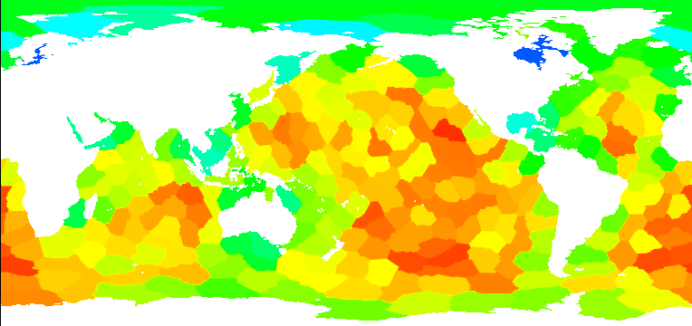
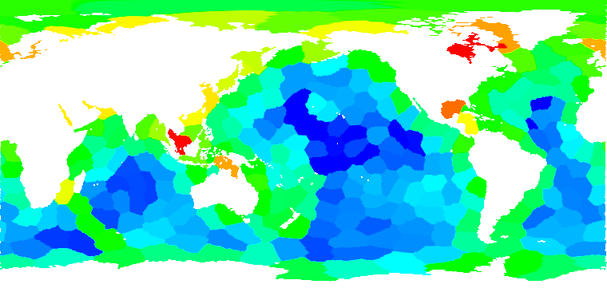
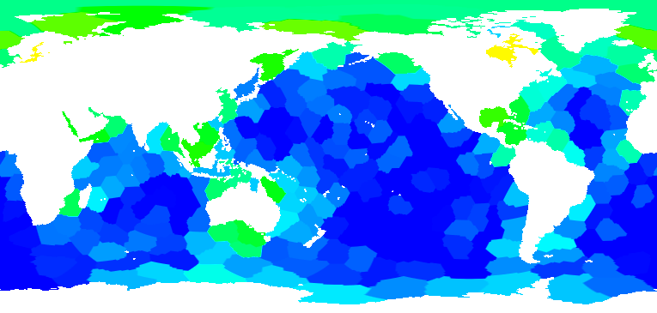
Linking Performance Data into Scientific Visualization Tools
Kevin A. Huck (SUPER), Hank Childs (SDAV), Allen D. Malony (SUPER)
Objectives
Impact
Map TAU performance measurements to the MPAS-Ocean spatial domain to assist in optimization of partition strategies
Integrated TAU performance measurement data with application scientific data in VisIt
Reduced execution time up to 15% for 60km model on 256 processes
Original Partitions Refined Partitions
Progress & Accomplishments
  Demonstrated that the load imbalance problem is correlated with variability among partition block size due to relatively large halo regions
  Visualizations also show that vertical depth, coastlines and number of neighbors likely affect computation, communication times
  Hindsight partition refinement using block+halo weights reduced mean MPI_Wait times by 40%, and overall execution time up to 15%
  Workshop publication: Huck et al., “Linking Performance Data into Scientific Visualization Tools”, Visual Performance Analytics at SC’14
min: 473, max: 846 Total Cells per Block min: 535, max: 771
min: 83s, max: 250s Computation Time min: 98s, max: 240s
min: 27s, max: 190s MPI_Wait Time min: 9s, max: 150s
Results collected on Edison@NERSC using 60km data and 240 processes
Notes:
MPAS-Ocean: “Model for Prediction Across Scales” project from NCAR & LANL (COSIM). In MPAS, the ocean (or atmospheric) data is discretized into unstructured Voronoi meshes, formally Spherical Centriodal Voronoi Tesselations (SCVTs).
The mesh cells are partitioned by GPMETIS into blocks. The blocks are very well balanced with respect to the number of cells per block. However, TAU performance measurement demonstrated that the computational load is not well balanced across blocks.
Correlating the performance data with application metadata collected by TAU, we were able to determine that the imbalance was correlated with not the number of cells per block, but the total number of cells needed to compute a block – which includes 3 layers of halo cells from neighboring blocks. Blocks with relatively few neighbors (coastal cells) have relatively fewer cells to compute, and terminate early on each iteration, leading to long MPI_Wait times.
The “Hindsight” partition refinement method modifies the static partitioning by assigning weights to each cell in the block, where the weight is defined as the total amount of work in the block, including halo cells. The mesh is then repartitioned, with the goal of reducing max total amount of work assigned any block.
The TAU performance measurements and Metadata are post-processed, and combined with the application NetCDF data. That data is parsed and visualized in VisIt. 3D and 2D projections are possible, but the 2D projection looks best for slides/publications. 3D is best for interactive exploration in VisIt.
1

