Slide 1

SUPER update: MPAS Load Imbalance Study (ongoing)
Kevin Huck

Slide 2
Disclaimer
These slides are from the last week or so of work
I reserve the right to be completely wrong about my conclusions ☺
Hopefully(?) there is a known solution

Slide 3
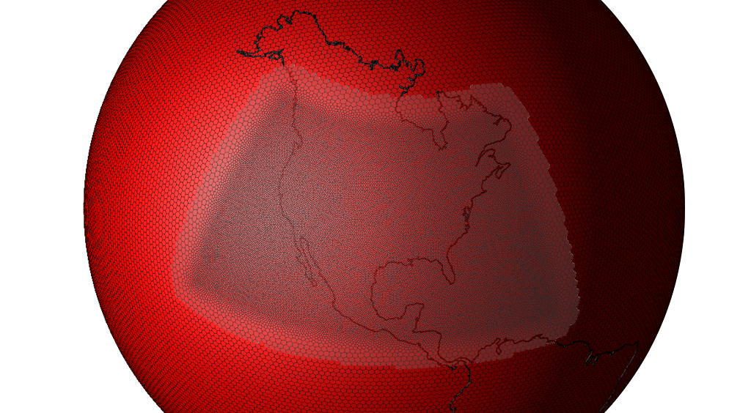
Overview of MPAS partitioning
Source: Ringler, T.D., An Ocean Dynamical Core with Local Mesh Refinement, NCAR CCSM Ocean Modeling Working Group, Boulder, Colorado, December 10, 2009. LA-UR 09-05207.

Slide 4
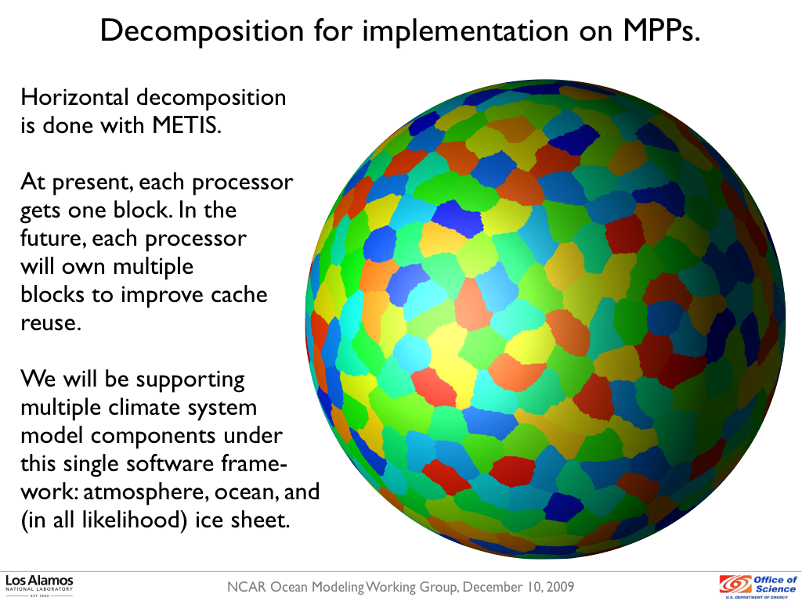
Overview of MPAS partitioning
Source: Ringler, T.D., An Ocean Dynamical Core with Local Mesh Refinement, NCAR CCSM Ocean Modeling Working Group, Boulder, Colorado, December 10, 2009. LA-UR 09-05207.

Slide 5
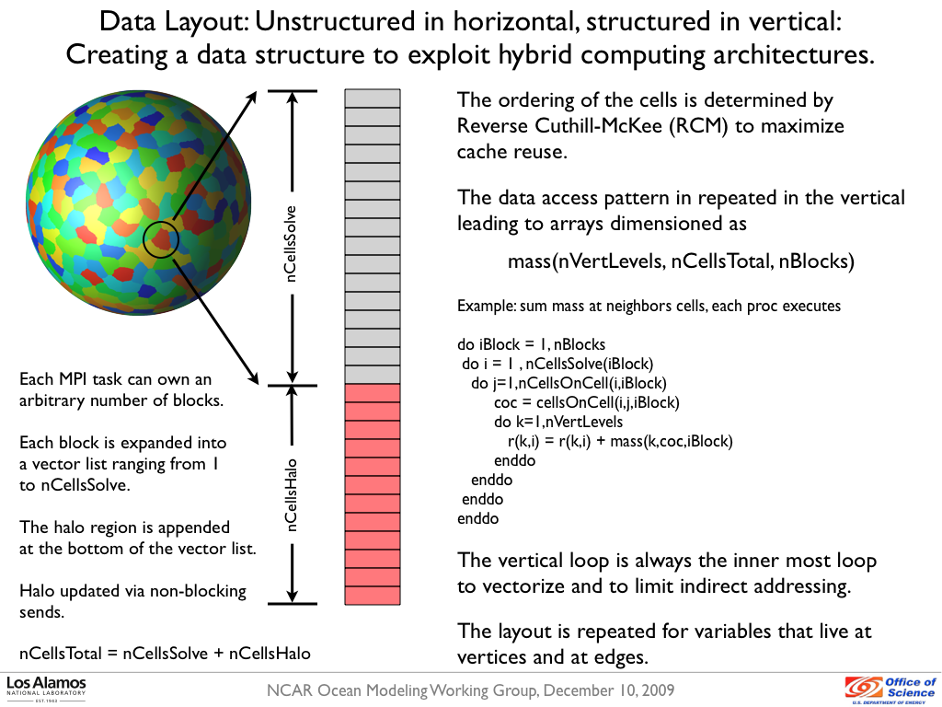
Overview of MPAS partitioning
Source: Ringler, T.D., An Ocean Dynamical Core with Local Mesh Refinement, NCAR CCSM Ocean Modeling Working Group, Boulder, Colorado, December 10, 2009. LA-UR 09-05207.

Slide 6
Approach
Add TAU_METADATA calls to capture nCellSolve, nCell, nEdge, maxLevelCell, topLevelEdge for all partitions
  nCellSolve: cells in partition
  nCell: nCellSolve + nCellsHalo (3 layers)
  nEdge: edges on all cells in nCell
  totalLevelCells: sum depth of each cell in nCell
  tauTotalLevelEdgeTop: min(level) of each edge in nEdge
Correlate computation balance with metadtata fields

Slide 7
Per-process correlation, world 60km with 120 processes on Edison
Se timestep, se_btr_vel, equation_of_state: all similar behavior
Cells - Min(51): 893 Max(111): 1416 Avg: 1282.83
Edges - Min(51): 2517 Max(111): 4248 Avg: 3791.86
Levels - Min(51): 5035 Max(111): 8496 Avg: 7584.38

Slide 8
Per-process correlation, world 60km with 120 processes on Edison
As expected, inverse of computational correlations

Slide 9
METIS partitioning problem
nCellSolve is not correlated with “work”.
METIS partitioning on nCellSolve (currently)
Idea: give cells weight… but which weight?
  Cell depth?
  Cell degree?
Both resulted in similar execution times to no weight
totalLevelEdgeTop?

Slide 10
totalLevelEdgeTop partitioning results – no improvement?
No longer correlated, but outliers are skewing result
Can’t we balance on nEdge/nCell?

Slide 11
The Real Problem
Want to balance on nCell, but unknown before partitioning
  nCell = nCellSolve + nHaloCell
  nEdge ~= nCell * 6
Suggestion from Karen Devine (FastMath/SNL): post-process the partitions
Attempting to do that, not clear that it is beneficial (yet)

Slide 12
The Postprocessing Problem
  Moving a cell from one partition to another has a cascade affect on halo regions
  Removing a cell from the partition can potentially increase the number of halo cells for the partition
  Adding a cell to another partition can significantly increase the halo cells in the other partition
As partitions become elongated, halo cells increase, total work in the system increases
  “not good”

Slide 13
Conclusion
Need original partitioning that understands halo region requirement
  METIS does not.
Or, need smarter post-processing algorithm
METIS + totalLevelEdgeTop weights might be solution, if outliers can be avoided
Other suggestions?

