Slide 1


Measurement of I/O with TAU
Kevin Huck, Allen Malony, Sameer Shende, Aurele Maheo, Wyatt Spear, Robert Lim, Chad Wood, Jacob Lambert, Srinivasan Ramesh, Mohammad Alaul Haque Monil
khuck@cs.uoregon.edu
http://tau.uoregon.edu

Slide 2
I/O Library Support in TAU
Measurement Support:
Instrumentation
  Source
  Binary
Interposition libraries
Wrappers
Callbacks
Sampling
Library Support:
POSIX
MPI I/O
HDF5
ADIOS
http://tau.uoregon.edu/tau.tgz

Slide 3
POSIX measurement
Built-in support
  $ ./configure -iowrapper
Wraps API calls related to files and sockets
Linker based instrumentation (static executables)
  -Wl,-wrap,fopen -Wl,-wrap,fclose ... -lTauPosixWrap
  Wrapper library implements __wrap_fopen, calls __real_fopen
Runtime preloading (dynamic executables)
  LD_PRELOAD=libTauPosixWrap.so (or use tau_exec -io)
  Wrapper library defines fopen(), loads real fopen using dlsym()
“Characterizing I/O Performance Using the TAU Performance System”, Shende et al., PARCO, 2011

Slide 4
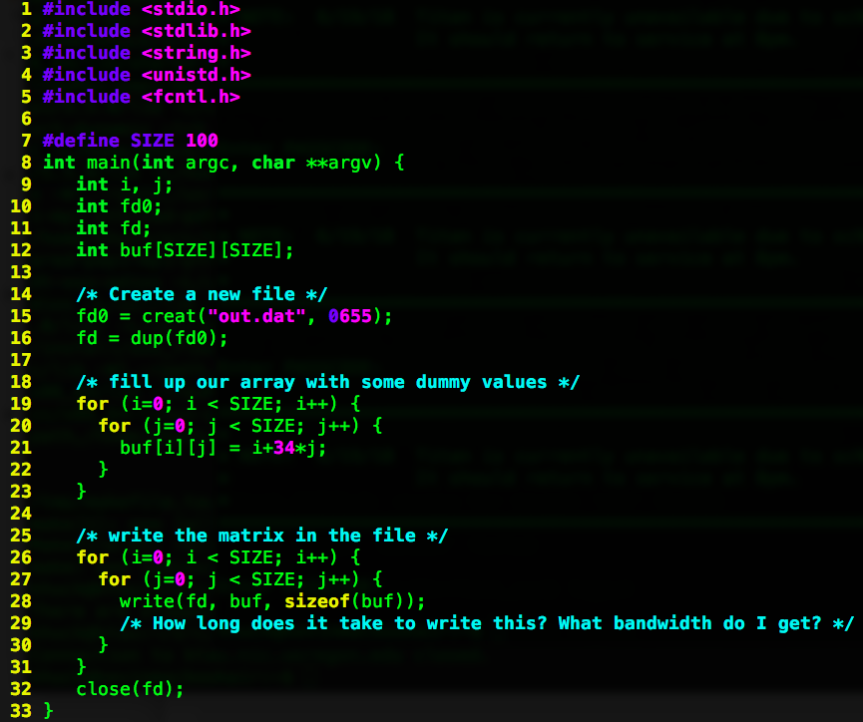
POSIX static executable example
# configure TAU with POSIX IO wrapper support
$ ./configure -iowrapper -bfd=download -unwind=download
# compile TAU
$ make -j install
# add TAU to the path
$ PATH=$PATH:`pwd`/x86_64/bin
# build and run the example
$ cd examples/iowrappers/posixio
$ make
$ ./foo
# view a profile summary
$ pprof
# profile visualizer
$ paraprof

Slide 5
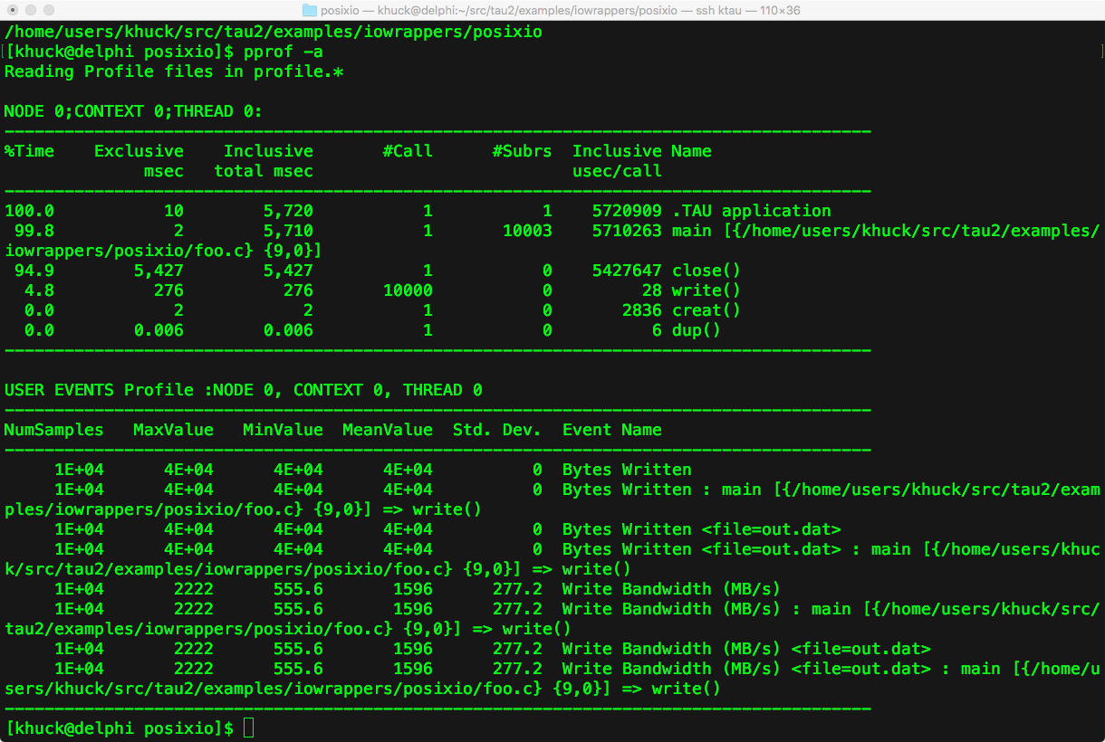
Profile Views (pprof, paraprof)
Text output from pprof:
Callpath view in paraprof:
(run with TAU_CALLPATH=1,
TAU_CALLPATH_DEPTH=3 or greater)
Flat profile in paraprof:

Slide 6
POSIX dynamic executable example
# configure TAU with POSIX IO wrapper support
$ ./configure -iowrapper -bfd=download -unwind=download
# compile TAU
$ make -j install
# build and run the example
$ cd examples/iowrappers/posixio
$ gcc foo.c -o foo
$ tau_exec -T serial -io -ebs ./foo
# view a profile summary
$ pprof -a

Slide 7
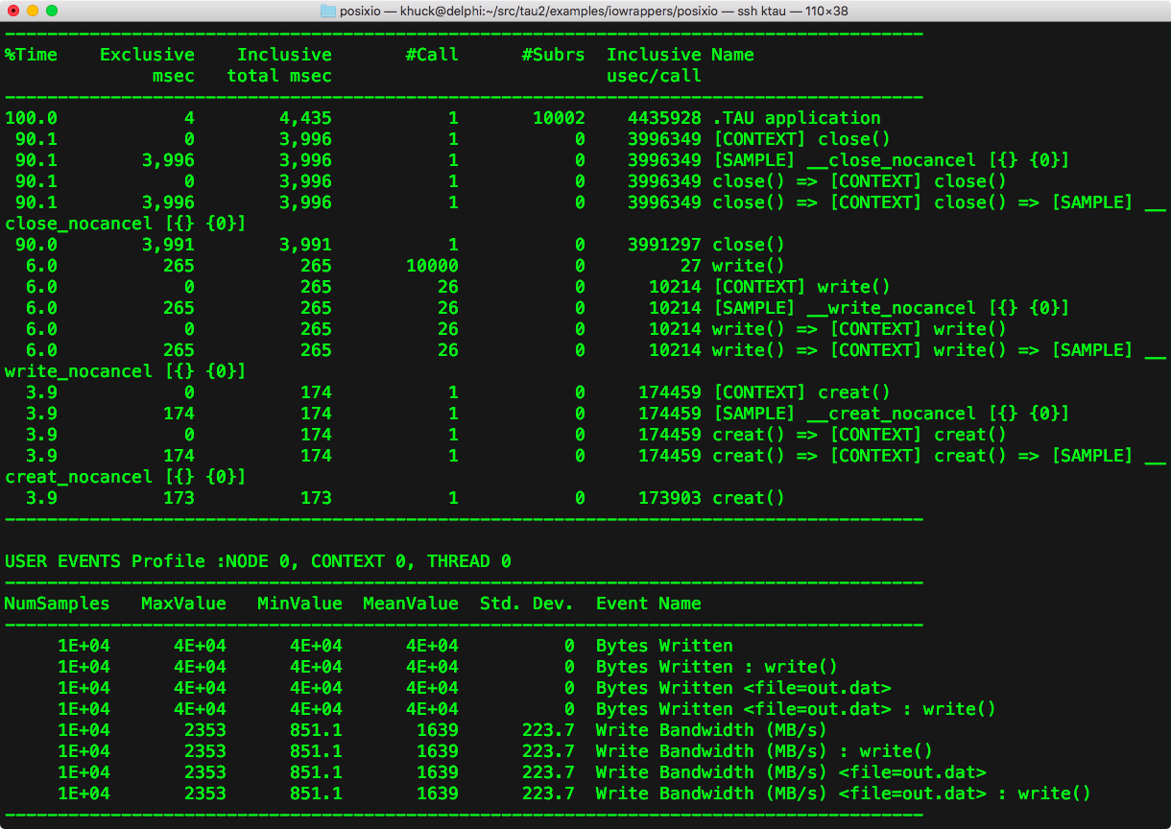
Profile Views (pprof, paraprof)
Rank 0, thread 0:
Text output from pprof:
Callpath view:

Slide 8
POSIX counters and metadata, too
Broken down by filename
...and by calling context
Metadata for file

Slide 9
MPI I/O Support
Built-in support (adding -pthread recommended)
  $ ./configure -mpi -pthread
Replaces MPI API weak symbols with instrumented versions
  MPI_Send(...) { return PMPI_Send(...); } is the default implementation
Linker based instrumentation (static executables)
  tau_cc.sh -o foo *.o libstuff.a
Runtime preloading (dynamic executables)
  tau_exec -T mpi,pthread ./my_program

Slide 10
MPI dynamic executable example
Example code from https://www.hpc.ntnu.no/display/hpc/Writing+to+MPI+Files
# configure TAU with MPI support
$ ./configure -iowrapper -bfd=download -unwind=download -mpi -pthread
# compile TAU
$ make -j install
# build and run the example (new example)
$ cd examples/mpi_io
$ mpicc -DDEBUG -g -O3 -o mpiio mpiio.c
$ mpirun -np 4 tau_exec -T mpi,pthread ./mpiio -f foo -l 10

Slide 11
Profile Views
Rank 0, thread 0:
All ranks and threads:

Slide 12
MPI and POSIX?
Just add -io to the tau_exec options
Can also add -ebs for sampling support
MPI+POSIX+sampling
MPI+POSIX

Slide 13
Counters, too...
Aggregates
(broken
down by
filename):
With calling
context:

Slide 14
HDF5 support
Not built-in, but TAU includes an example using the tau_gen_wrapper utility
Uses PDT (http://tau.uoregon.edu/pdt.tgz) to parse a library header, and provides a wrapper library similar to what is available for the POSIX library wrapper
Linker based instrumentation (static executables)
  i.e. tau_cc.sh -o foo *.o -tau_options='-optTauWrapFile=headers/hdf5_wrapper/link_options.tau -optTrackIO' libotherstuff.a
Runtime preloading (dynamic executables)
  i.e. tau_exec -T mpi,pthread -loadlib=./libhdf5_wrap.so ./my_program

Slide 15
HDF5 tau_gen_wrap example
# configure TAU with PDT support
$ ./configure -iowrapper -bfd=download -unwind=download -mpi -pthread -pdt=/path/to/pdt
# compile TAU
$ make -j install
# build and run the wrapper
$ cd examples/iowrappers/hdf5_wrap
$ mkdir headers ; cd headers ; ln -s /path/to/hdf5/include/* .
$ tau_gen_wrapper hdf5.h /path/to/hdf5/lib/libhdf5.a -f ../select.tau ; cd ..
# build and run the example
$ tau_cc.sh -tau_options='-optTauWrapFile=headers/hdf5_wrapper/link_options.tau -optTrackIO ' -c hyperslab_by_row.c -I/path/to/hdf5/include
$ tau_cc.sh -tau_options='-optTauWrapFile=headers/hdf5_wrapper/link_options.tau -optTrackIO ' -o hyperslab_by_row hyperslab_by_row.o -L/path/to/hdf5/lib -lhdf5_hl -lhdf5 -lz -lsz -ldl -lm -Wl,-rpath,/path/to/hdf5/lib
$ mpirun -np 4 ./hyperslab_by_row

Slide 16
Profile Views
Rank 0, thread 0:
All ranks and threads:

Slide 17
HDF5 tau_wrap example
Can use a similar process to generate a libhdf5_wrap.so wrapper that can be preloaded with tau_exec:
$ tau_gen_wrapper -r ...
$ tau_exec -T mpi,pthread -io –loadlib=./libhdf5_wrap.so ./hyperslab_by_row

Slide 18
ADIOS support
Built-in, uses callback API provided by ADIOS 1.13
Using the callback API, measurement tools can register with ADIOS during initialization, and be notified when ADIOS events happen (even asynchronous ones)
  Tool implements adiost_tool() function that returns a pointer to an initialization function to register for event notification
ADIOS is (by default) built as static library on many systems, so only way to register tools is by adding linker options before the ADIOS libraries
Dynamic linking is easier on other systems, of course (can just use tau_exec)

Slide 19
ADIOS example
# configure TAU with PDT support
$ ./configure -iowrapper -bfd=download -unwind=download -mpi -pthread -pdt=/path/to/pdt -adios=/path/to/adios
# compile TAU
$ make -j install
# build and run the example
$ cd src/Example-Heat_Transfer
# modify Makefile to compile with tau_f90.sh instead of mpif90:
# FC=tau_f90.sh -optTauSelectFile=select.tau –optShared
$ make
$ mpirun -np 4 ./heat_transfer_adios

Slide 20
Profile Views
Rank 0, thread 0:
ADIOS events
All ranks and threads:

Slide 21
Profile Views, cont.
Callgraph:
Counters:

Slide 22
Reader Profile, Counters
Rank 0, thread 0 (only ADIOS events):
Counters:

Slide 23
RAPIDS Data Management plans
More ADIOS integration
  Save TAU data as ADIOS format (and/or with science data)
  Update to ADIOS 2 support (and other improvements)
NetCDF support
  Wrapper library like HDF5?
Co-location with Darshan
  Currently have to unload darshan module before using TAU
  Could benefit from shared measurement
  MPIT solution?
Usability improvements (library wrapper)

