Slide 1


Platform Readiness - TAU
Kevin Huck, Allen Malony, Sameer Shende, Aurele Maheo, Wyatt Spear, Robert Lim, Chad Wood, Jacob Lambert, Srinivasan Ramesh, Mohammad Alaul Haque Monil
khuck@cs.uoregon.edu
http://tau.uoregon.edu
Notes:
Mini tutorial / overview of support for different programming models/architectures. Some boggy details in the beginning, don’t loose heart/interest...
Caveat: examples put together over last day or so using development code - I found some bugs.

Slide 2
Data Management Update:
See http://www.nic.uoregon.edu/~khuck/TAU-IO-overview.pptx for presentation given to RAPIDS Data Management group, “Measurement of I/O with TAU”
  Overview of TAU support for:
    POSIX
    MPI-IO
    HDF5
    ADIOS

Slide 3
I/O Library Support in TAU
Measurement Support:
Instrumentation
  Source
  Binary
Interposition libraries
Wrappers
Callbacks
Sampling
Profiling
Tracing
Model/Hardware Support:
MPI
OpenMP
OpenACC
CUDA
Python
PAPI
http://tau.uoregon.edu/tau.tgz
Notes:
TAU supports OTF2 native output now - but I am not demonstrating it today. PAPI support has been around for years, and TAU provides several ways to measure power/energy depending on HW support.

Slide 4
Many Measurement Choices
Source Instrumentation
  Source (PDT based)
  Source (Compiler based)
  C/C++, Fortran
Binary Instrumentation
  DynInst
  PEBIL
  PIN
  MAQAO
Runtime Measurement
  Interposition libraries
    i.e. MPI
  Callbacks
    i.e. OMPT
  APIs
    i.e. Python
  Sampling
  Compiler support
    i.e. OpenACC, CUDA/CUPTI
Notes:
The star of the show and the theme of the talk is tau_exec and tau_python - wrapper scripts to LD_PRELOAD TAU and other libraries to provide runtime introspection.

Slide 5
Basic TAU configuration (x86_64, gcc)
$ wget http://tau.uoregon.edu/tau.tgz # or tau2.tgz
$ tar -xvzf tau.tgz
$ cd tau-2.27.1 # soon will be 2.27.2
$ ./configure -bfd=download -iowrapper ...
$ make install
$ PATH=`pwd`/x86_64/bin:$PATH
Spack package (very?) soon...
$ spack install tau@pgi+ompt+cuda+...

Slide 6
Platform Support Examples
Titan, PGI compilers:
  $ ./configure -cc=pgcc -c++=pg++ -fortran=pgi -arch=craycnl ...
Cori, GNU compilers (either KNL or Haswell environment):
  $ ./configure -cc=gcc -c++=g++ -fortran=gnu -arch=craycnl ...
Theta, Intel compilers:
  $ ./configure -cc=icc -c++=icpc -fortran=intel -arch=craycnl ...
Summitdev, PGI compilers:
  $ ./configure -cc=pgcc -c++=pg++ -fortran=pgi -arch=ibm64linux ...
Notes:
TAU can usually figure out the underlying compiler from the Cray wrappers, but when in doubt, specify them.
TAU is installed as a module on all these systems. But in case you need up-to-date release of TAU or missing configuration/feature...

Slide 7
MPI Support
Interposition library support (adding -pthread recommended)
  $ ./configure -mpi -pthread ...
Replaces MPI API weak symbols with instrumented versions
  MPI_Send(...) { return PMPI_Send(...); } is the default implementation
Linker based instrumentation (static executables)
  tau_cc.sh -o foo *.o libstuff.a
Runtime preloading (dynamic executables)
  tau_exec -T mpi,pthread ./my_program

Slide 8
MPI dynamic executable example
Example code from https://www.hpc.ntnu.no/display/hpc/Writing+to+MPI+Files
# configure TAU with MPI support
$ ./configure -iowrapper -bfd=download -mpi -pthread
# compile TAU
$ make -j install
# build and run the example (new example)
$ cd examples/mpi_io
$ mpicc -DDEBUG -g -O3 -o mpiio mpiio.c
$ mpirun -np 4 tau_exec -T mpi,pthread ./mpiio ...

Slide 9
Profile Views
Rank 0, thread 0:
All ranks and threads:

Slide 10
MPI and POSIX?
Just add -io to the tau_exec options
Can also add -ebs for sampling support
MPI+POSIX+sampling
MPI+POSIX
Notes:
For callpath profiling, add TAU_CALLPATH=1 and TAU_CALLPATH_DEPTH=100 (or equivalent) to your environment

Slide 11
Counters, too...
Aggregates
(broken
down by
filename):
With calling
context:

Slide 12
OpenMP Support Update
Built-in support
  $ ./configure -bfd=download -openmp -ompt=download-tr6 ...
Compiles in support for latest OpenMP Tools interface
TR6 Support will eventually be default (“-ompt=download”)
Currently supports Intel, LLVM, GNU, will soon support IBM, PGI
Linker-based instrumentation (static executables)
  $ tau_cc.sh -o foo *.o libstuff.a
Runtime preloading (dynamic executables)
  $ tau_exec -T openmp,ompt -ompt ./my_program
PDT+Opari support still available for instrumented measurement
$ ./configure -openmp -opari
Notes:
TAU will download, configure, compile and use the LLVM OpenMP runtime that has baked-in support for Intel, LLVM and GCC OpenMP APIs.

Slide 13
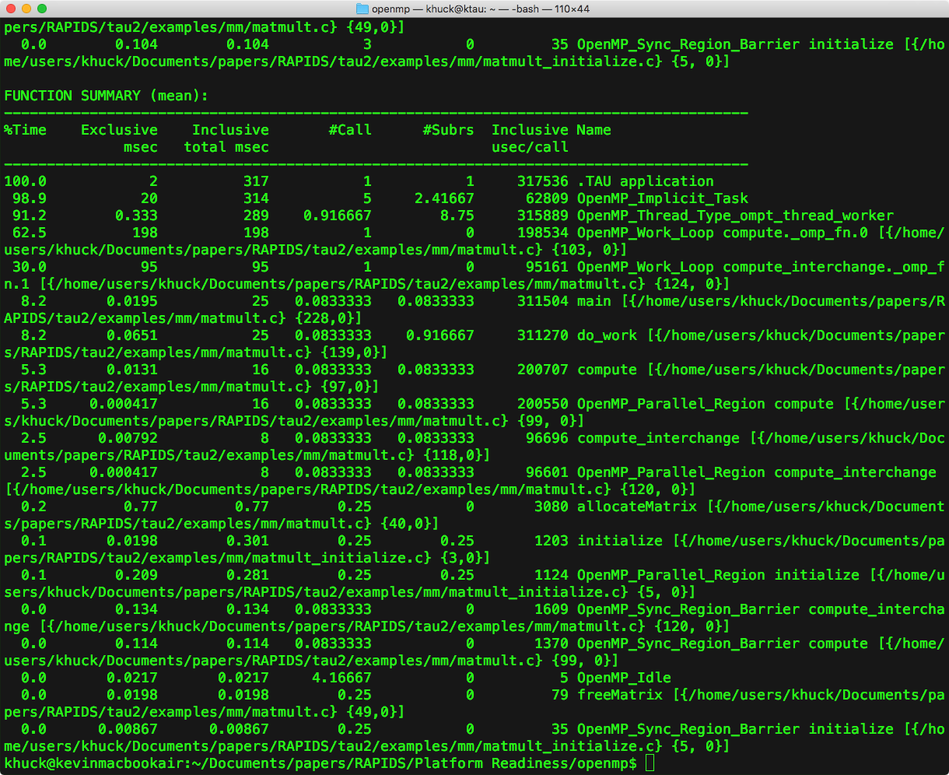
Profile Views
pprof output:
All threads profile:
Thread 0 callpath:
Notes:
Found bug in address resolution for callpaths... But the flat profile is resolved correctly.
Updated support has environment variables to control overhead - how many OpenMP event callbacks are supported, how much “context” to capture per call.

Slide 14
OpenACC Support
Built-in support
  $ ./configure -cc=pgcc -c++=pg++ -fortran=pgi ...
Runtime preloading (dynamic executables)
  tau_exec -T pgi -openacc ./my_program
$ cd examples/openacc
$ make
$ tau_exec -T pgi -openacc ./jacobi

Slide 15
OpenACC Profile Data
Flat Profile:
Callpath Profile:
Notes:
Note - the source code attribution seems to be off in this example. Not sure if that’s a PGI problem or TAU problem, I’ll check with Sameer.

Slide 16
CUDA Support
Built-in support
  $ ./configure -cuda=/path/to/cuda ...
Runtime preloading (dynamic executables)
  $ tau_exec -T cupti -cupti ./my_program
Environment variables to control TAU measurement:
  TAU_TRACK_CUDA_CDP tracks dynamic parallelism (kernels calling kernels)
  TAU_TRACK_UNIFIED_MEMORY enables unified memory metrics if the GPU supports it (most Maxwells and beyond)
  TAU_TRACK_CUDA_INSTRUCTIONS,
  TAU_TRACK_CUDA_SASS related to source line instrumentation metrics

Slide 17
CUDA Profile Data
Host, device(s) profile:
Host counters:
Host timers:
Device counters:
Device timers:

Slide 18
Python Support
Built-in support
  $ ./configure -python ...
Runtime preloading (dynamic executables)
  tau_python ./my_program.py

Slide 19
Python Profile Data
Callpath Profile:
TensorFlow from virtual
environment, Horovod
over OpenMPI
Flat Profile:

Slide 20
Kokkos Support
Built-in support
  $ ./configure ...
Runtime preloading (dynamic executables)
  tau_exec -T serial,openmp,ompt,tr6,cupti -ompt ./my_program.py
Cupti, OMPT are optional, but give more insight

Slide 21
Kokkos + OpenMP Profile Data
Flat Profile, thread 0:
Callpath Profile, thread 0:
Notes:
Found bug in address resolution for callpaths... But the flat profile is resolved correctly.

Slide 22
RAPIDS Platform Readiness plans
More OMPT updates
  Fix bugs, finish TR6 updates, support case where installed runtime already supports OMPT interface (IBM, PGI, others)
  Device offload support - CUPTI integration
Continue to update CUDA support
  Integrate with OpenACC measurement?
Usability improvements
  Spack package
Visualization / Analysis Tool updates
  ADIOS output from TAU for ParaView, VisIt exploration

