Slide 1
TAU: Performance Measurement Technology
Performance Research Lab
University of Oregon
Allen Malony, Sameer Shende, Kevin Huck
{malony, sameer, khuck} @cs.uoregon.edu

Slide 2
TAU Performance System®
Tuning and Analysis Utilities (18+ year project)
Comprehensive performance profiling and tracing
  Integrated, scalable, flexible, portable
  Targets all parallel programming/execution paradigms
  Integrated performance toolkit
Instrumentation, measurement, analysis, visualization
  Widely-ported performance profiling / tracing system
  Performance data management and data mining
  Open source (BSD-style license)
Easy to integrate in application frameworks
http://tau.uoregon.edu

Slide 3
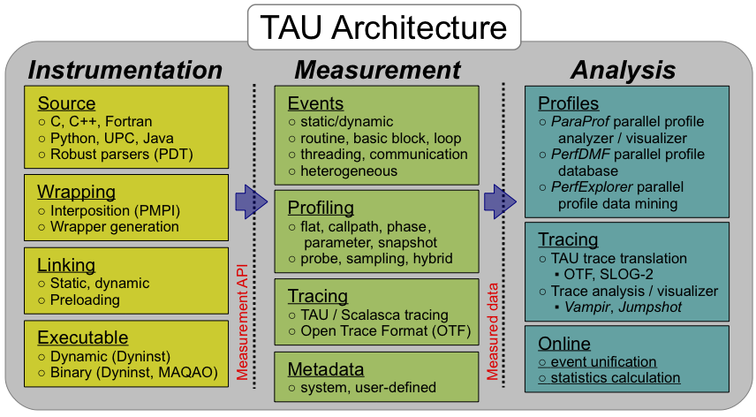
TAU Performance System®
Parallel performance framework and toolkit
  Goal: to support all HPC platforms, compilers, and runtime systems
  Provides portable instrumentation, measurement, analysis

Slide 4
How does TAU work?
Instrumentation: Adds probes to perform measurements
  Source code instrumentation using pre-processors and compiler scripts
  Wrapping external libraries (I/O, MPI, Memory, CUDA, OpenCL, pthread)
  Rewriting the binary executable
Measurement: Profiling or Tracing using wallclock time or hardware counters
  Direct instrumentation (Interval events measure exclusive or inclusive duration)
  Indirect instrumentation (Sampling measures statement level contribution)

Slide 5
How does TAU work, cont.
  Throttling and runtime control of low-level events that execute frequently
  Per-thread storage of performance data
  Interface with external packages (e.g. PAPI performance counter library)
Analysis: Visualization of profiles and traces
  2D, 3D visualization of profile data in paraprof, perfexplorer tools
  Trace conversion & display in external visualizers (Vampir, Jumpshot, ParaVer)

Slide 6
Using TAU: A brief Introduction to instrumentation
TAU supports several measurement and thread options
  Each measurement configuration of TAU corresponds to a unique stub makefile and library that is generated when you configure it
To instrument source code automatically using PDT
  $ export TAU_MAKEFILE=/home/sshende/apps/tau/x86_64/lib/Makefile.tau-icpc-mpi-pdt
  $ export PATH=/home/sshende/apps/tau/x86_64/bin:$PATH
Use tau_f90.sh, tau_cxx.sh, tau_upc.sh, or tau_cc.sh:
  $ mpif90 foo.f90 …changes to… $ tau_f90.sh foo.f90
Set variables, execute and analyze performance data:
  $ pprof or paraprof

Slide 7
Using TAU: A brief introduction to tau_exec
TAU can collect data without instrumentation
Instead of Makefile.tau-… , use tau_exec –T
  mpirun –np 4 tau_exec –T icpc,pdt,mpi ./a.out
  tau_exec –T icpc,papi,openmp ./a.out
  tau_exec –T icpc,openmp –ebs ./a.out
  tau_exec –T icpc,pthread –memory_debug ./a.out
  tau_exec –T icpc,mpi,openmp –io ./a.out
  tau_exec –T icpc,openmp –loadlib=<lib> ./a.out
  …
-T tags are used in other TAU tools:
  tau_run, tau_rewrite, tau_exec, tau_gen_wrapper

Slide 8
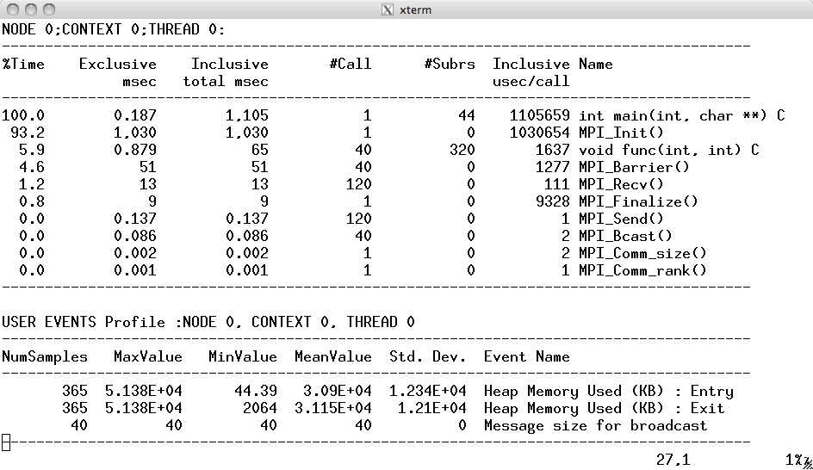
Interval and Atomic Events in TAU
Interval events
e.g., routines
(start/stop) show
duration
Atomic events
(triggered with
value) show
extent of variation
(min/max/mean)
% export TAU_CALLPATH_DEPTH=0
% export TAU_TRACK_HEAP=1

Slide 9
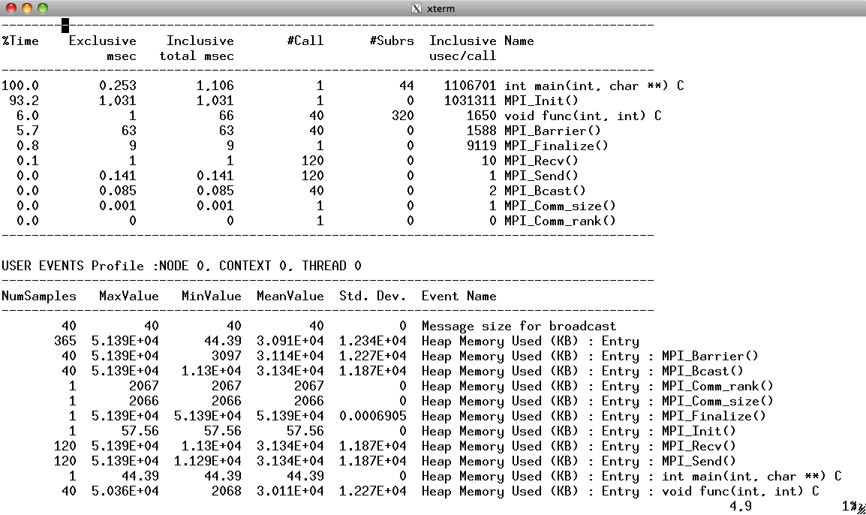
Atomic Events, Context Events
Atomic events
Context events
=atomic event
+ executing
context
% export TAU_CALLPATH_DEPTH=1
% export TAU_TRACK_HEAP=1
Controls depth of executing
context shown in profiles

Slide 10
Instrumentation Options in TAU
Source Code Instrumentation
  Manual instrumentation
  Automatic instrumentation using pre-processor based on static analysis of source code (PDT), creating an instrumented copy
  Compiler generates instrumented object code
Library Level Instrumentation
  Wrapper libraries for standard MPI libraries using PMPI interface
  Wrapping external libraries where source is not available
Runtime pre-loading and interception of library calls
Binary Code instrumentation
  Rewrite the binary, runtime instrumentation
Virtual Machine, Interpreter, OS level instrumentation

Slide 11
Source Instrumentation Using PDT
TAU source
analyzer
Application
source
Parsed
program
Instrumented
copy of source
tau_instrumentor
Instrumentation
specification file

Slide 12
TAU Instrumentor for generic instrumentation
“Improving the flexibility of the TAU instrumentor”
Markus Geimer, JSC
Cooperative effort during summer of 2008
Make TAU instrumentor generic

Slide 13
“file” construct

Slide 14
“entry” construct

Slide 15
“exit” construct

Slide 16
“init” construct

Slide 17
“decl” construct

Slide 18
Code Substitutions

Slide 19
Putting it all together: an example

Slide 20
TAU Instrumentor Example, cont.

Slide 21
Example output

Slide 22
Three Techniques for Wrapping External Libraries
Pre-processor based substitution by re-defining a call
  Tool defined header file with same name <unistd.h> takes precedence
  Header redefines a routine as a different routine using macros
  Substitution: read() substituted by preprocessor as tau_read() at callsite
Preloading a library at runtime
  Library preloaded (LD_PRELOAD env var in Linux) in the address space of executing application intercepts calls from a given library
  Tool’s wrapper library defines read(), gets address of global read() symbol (dlsym), internally calls timing calls around call to global read
Linker based substitution
  Wrapper library defines __wrap_read which calls __real_read and linker is passed -Wl,-wrap,read to substitute all references to read from application’s object code with the __wrap_read defined by the tool

Slide 23
Issues: Preprocessor based substitution
Pre-processor based substitution by re-defining a call
  Compiler replaces read() with tau_read() in the body of the source code
Advantages:
  Simple to instrument
  Preprocessor based replacement
  A header file redefines the calls
  No special linker or runtime flags required
Disadvantages
  Only works for C & C++ for replacing calls in the body of the code.
  Incomplete instrumentation: fails to capture calls in uninstrumented libraries (e.g., libhdf5.a)

Slide 24
Issues: Linker based substitution
Linker based substitution
  Wrapper library defines __wrap_read which calls __real_read and linker is passed -Wl,-wrap, read
Advantages
  Tool can intercept all references to a given call
  Works with static as well as dynamic executables
  No need to recompile the application source code, just re-link the application objects and libraries with the tool wrapper library
Disadvantages
  Wrapping an entire library can lengthen the linker command line with multiple –Wl,-wrap,<func> arguments. It is better to store these arguments in a file and pass the file to the linker
  Approach does not work with un-instrumented binaries

Slide 25
Preloading a wrapper library at runtime
Tool defines read(), gets address of global read() symbol (dlsym), internally calls timing calls around call to global read
tau_exec tool uses this mechanism to intercept library calls
Advantages
  No need to re-compile or re-link the application source code
  Drop-in replacement library implemented using LD_PRELOAD environment variable under Linux, Cray CNL, IBM BG/P CNK, Solaris…
Disadvantages
  Only works with dynamic executables. Default compilation mode under Cray XE6 and IBM BG/P is to use static executables
  Not all operating systems support preloading of dynamic shared objects (DSOs)

Slide 26
tau_gen_wrapper
Automates creation of wrapper libraries using TAU
Input:
  header file (foo.h), library to be wrapped (/path/to/libfoo.a)
  technique for wrapping
    Preprocessor based redefinition (-d)
    Runtime preloading (-r)
    Linker based substitution (-w: default)
  Optional selective instrumentation file (-f select)
    Exclude list of routines, or
    Include list of routines
Output:
  wrapper library, optional link_options.tau file (-w), pass –optTauWrapFile=<file> in TAU_OPTIONS environment variable

Slide 27
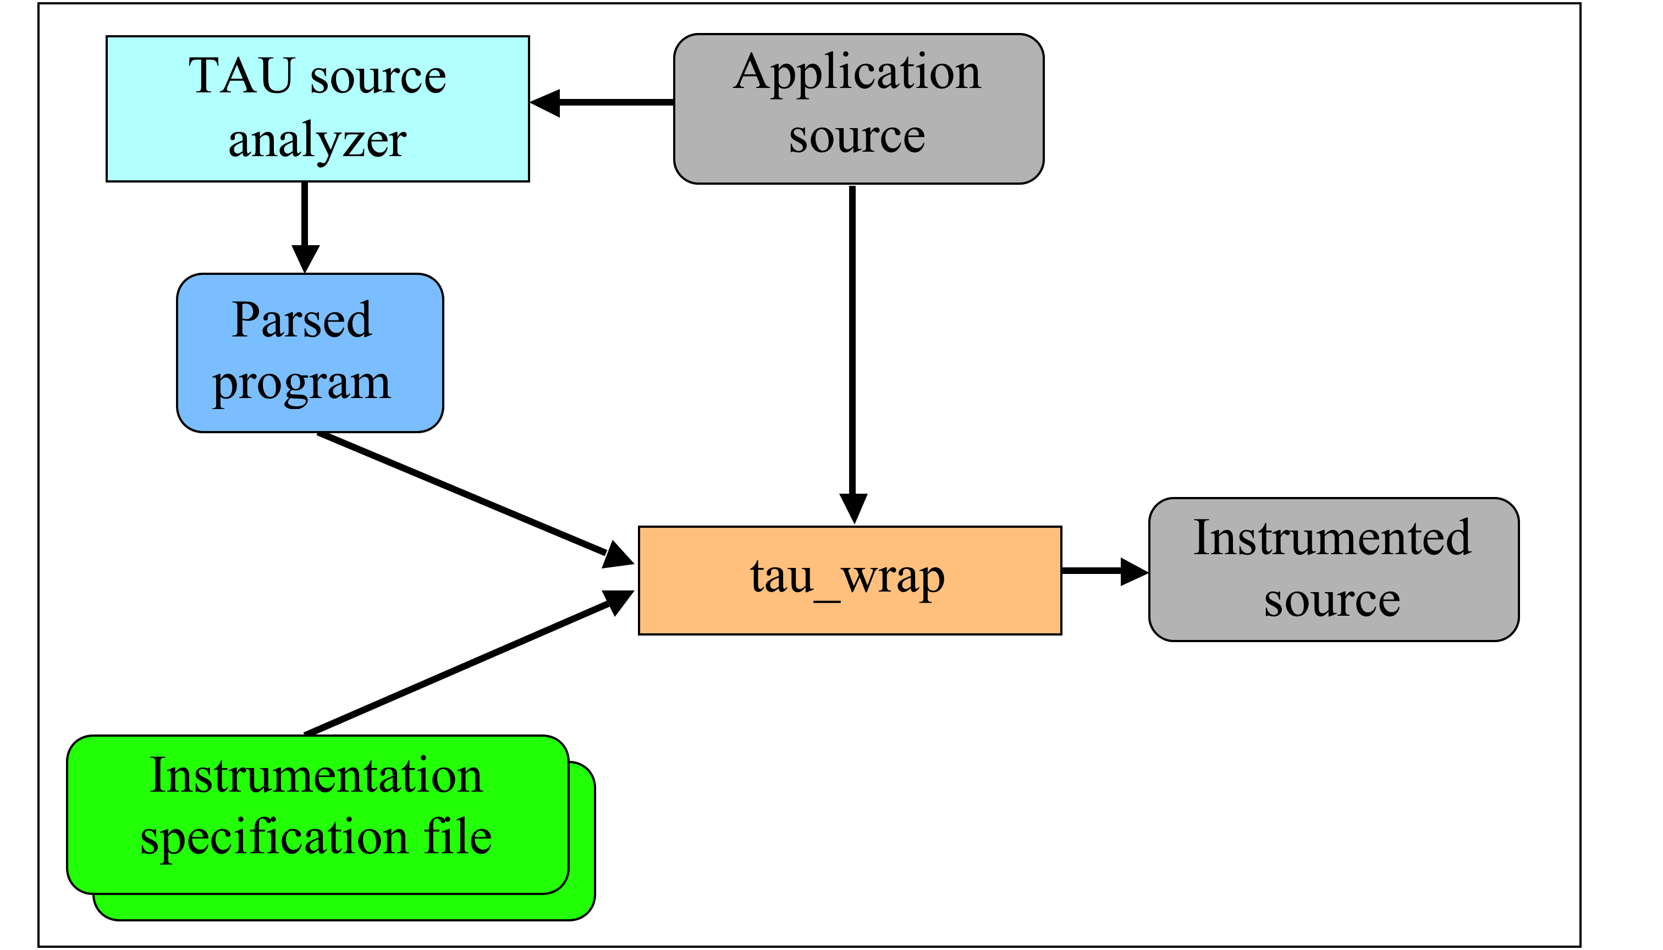
tau_wrap

Slide 28
HDF5 Library Wrapping
[sameer@zorak]$ tau_gen_wrapper hdf5.h /usr/lib/libhdf5.a -f select.tau
Usage : tau_gen_wrapper <header> <library> [-r|-d|-w (default)] [-g groupname] [-i headerfile] [-c|-c++|-fortran] [-f <instr_spec_file> ]
instruments using runtime preloading (-r), or -Wl,-wrap linker (-w), redirection of header file to redefine the wrapped routine (-d)
instrumentation specification file (select.tau)
group (hdf5)
tau_exec loads libhdf5_wrap.so shared library using –loadlib=<libwrap_pkg.so>
creates the wrapper/ directory
NODE 0;CONTEXT 0;THREAD 0:
---------------------------------------------------------------------------------------
%Time Exclusive Inclusive #Call #Subrs Inclusive Name
msec total msec usec/call
---------------------------------------------------------------------------------------
100.0 0.057 1 1 13 1236 .TAU Application
70.8 0.875 0.875 1 0 875 hid_t H5Fcreate()
9.7 0.12 0.12 1 0 120 herr_t H5Fclose()
6.0 0.074 0.074 1 0 74 hid_t H5Dcreate()
3.1 0.038 0.038 1 0 38 herr_t H5Dwrite()
2.6 0.032 0.032 1 0 32 herr_t H5Dclose()
2.1 0.026 0.026 1 0 26 herr_t H5check_version()

Slide 29
TAU Binary Instrumentation
DynInst, MACAO, Pebil (in progress)
Support for both static and dynamic executables
Specify the list of routines to instrument/exclude from instrumentation
Specify the TAU measurement library to be injected Simplify the usage of TAU:
  To instrument:
    $ tau_run –T [tags] a.out –o a.inst
  To perform measurements, execute the application:
    $ mpiexec./a.inst
  To analyze the data
    $ paraprof

Slide 30
TAU Sampling
Periodic sampling support
Libunwind, StackWalkerAPI support
Variable sampling frequency
SIGPROF / ITIMER_PROF for multithreaded signaling
PAPI counter overflow timer support

Slide 31
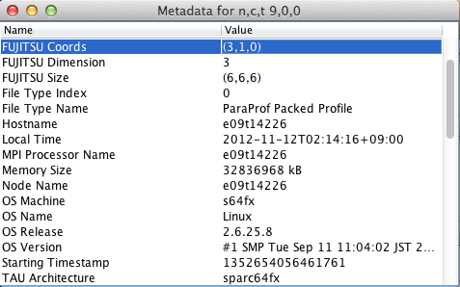
TAU Metadata Collection
Automatically collected from /proc/cpuinfo, /proc/meminfo, BGP, BGQ personality information, Cray Topology information
Context-sensitive
Structured

Slide 32
GPU: Method Support and Implementation
Synchronous method
  Place instrumentation appropriately around GPU calls (kernel launch, library routine, …)
  Wrap (synchronous) library with performance tool
Event queue method
  Utilize CUDA and OpenCL event support
  Again, need instrumentation to create and insert events in the streams with kernel launch and process events
  Can be implemented with driver library wrapping
Callback method
  Utilize language-level callback support in OpenCL
  Utilize NVIDIA CUDA Performance Tool Interface (CUPTI)
  Need to appropriately register callbacks

Slide 33
Profiling GPGPU Executions
GPGPU compilers (e.g., CAPS hmpp and PGI) can now automatically generate GPGPU code using manual annotation of loop-level constructs and routines (hmpp)
The loops (and routines for HMPP) are transferred automatically to the GPGPU
TAU intercepts the runtime library routines and examines the arguments
Shows events as seen from the host
Profiles and traces GPGPU execution

Slide 34
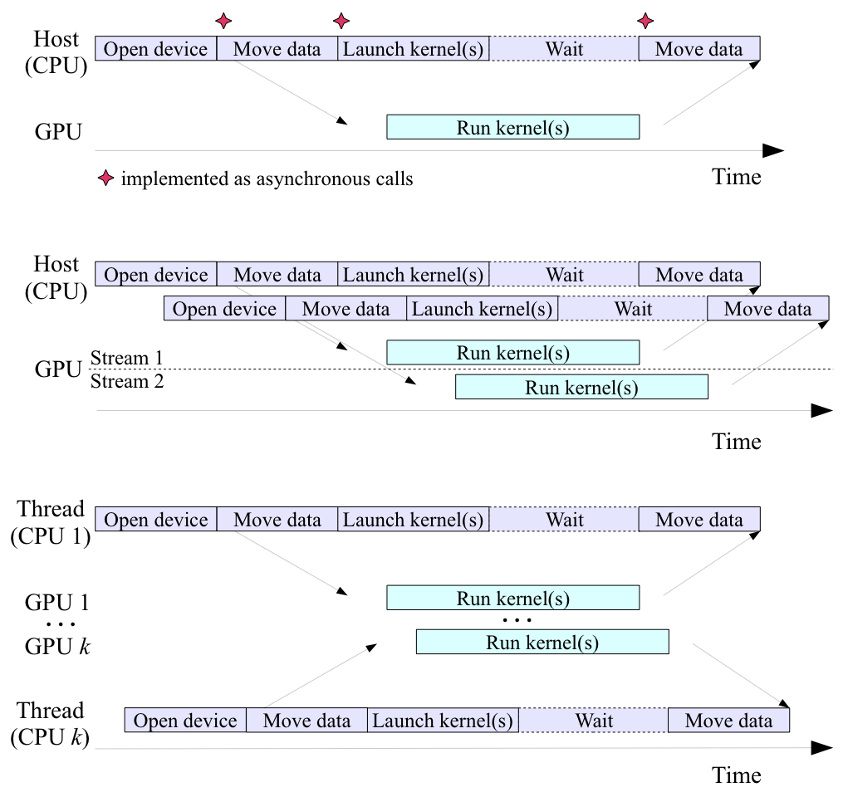
Host (CPU) - GPU Scenarios
Single GPU
Multi-stream
Multi-CPU,
Multi-GPU

Slide 35
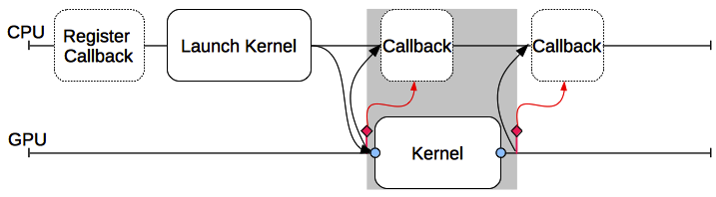
Host-GPU Measurement – Callback Method
GPU driver libraries provide callbacks for certain routines and captures measurements
Measurement tool registers the callbacks and processes performance data
Application code is not modified

Slide 36
NVIDIA CUPTI
NVIDIA has developed CUPTI to enable the creation of profiling and tracing tools
Callback API
  Interject tool code at the entry and exist to each CUDA runtime and driver API call
Counter API
  Query, configure, start, stop, and read the counters on CUDA-enabled devices
CUPTI is delivered as a dynamic library
CUPTI is released with CUDA 4.0+

Slide 37
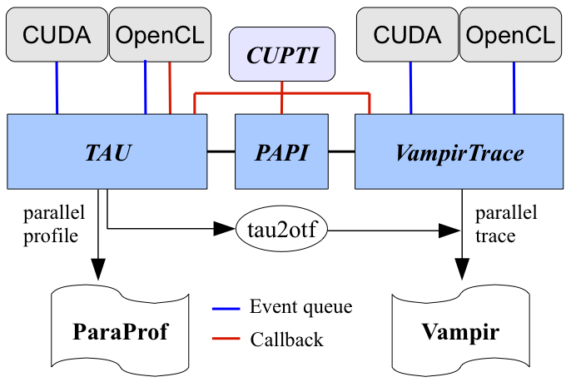
GPU Performance Tool Interoperability

Slide 38
Profiling PGI Accelerator Primatives
PGI compiler allows users to annotate source code to identify loops that should be accelerated
When a program is compiled with TAU, its measurement library intercepts the PGI runtime library layer to measure time spent in the runtime library routines and data transfers
TAU also captures the arguments:
  array data dimensions and sizes, strides, upload and download times, variable names, source file names, row and column information, and routines

Slide 39
TAU Profile, Trace Analysis
Profiles:
  ParaProf
  PerfExplorer
  CUBE
Traces:
  Vampir (OTF, VTF)
  Jumpshot (SLOG2)
  Paraver (PRV)
  Expert
  ProfileGen
  Vampir Server

Slide 40
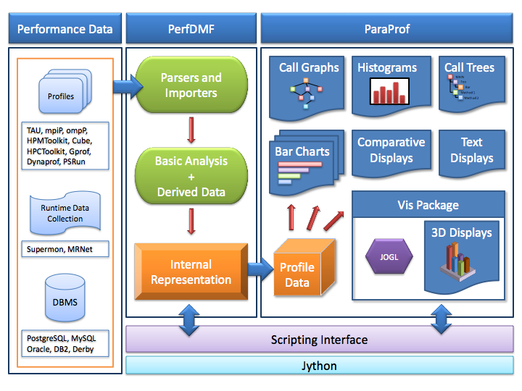
ParaProf Profile Analysis & Visualization

Slide 41
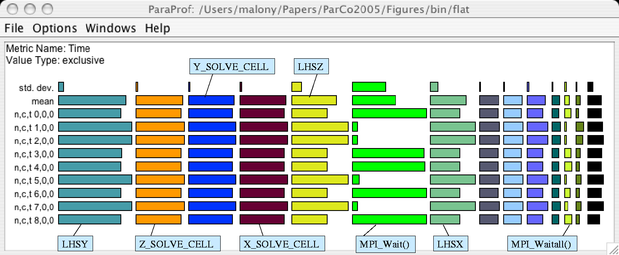
ParaProf : NAS BT MPI Flat Profile
Application routine names
reflect phase semantics
How is MPI_Wait()
distributed relative to
solver direction?

Slide 42
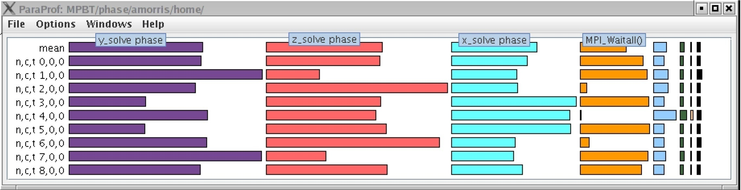
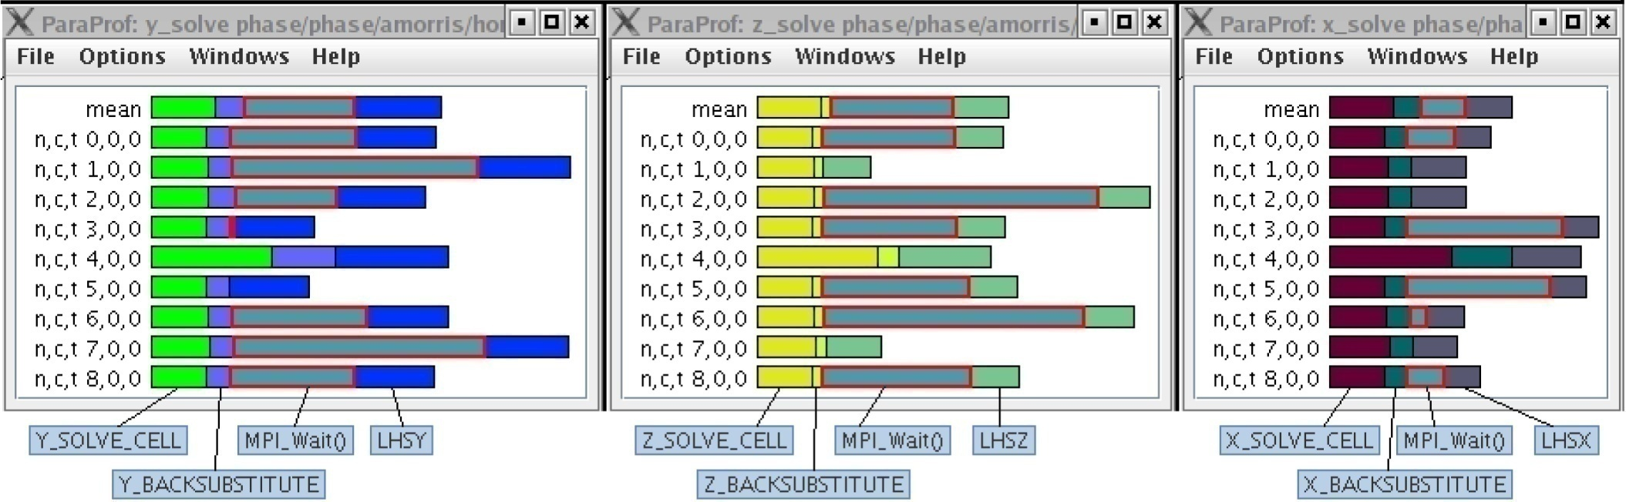
ParaProf: NAS BT MPI Phase Profile
Main phase shows nested phases and immediate events

Slide 43
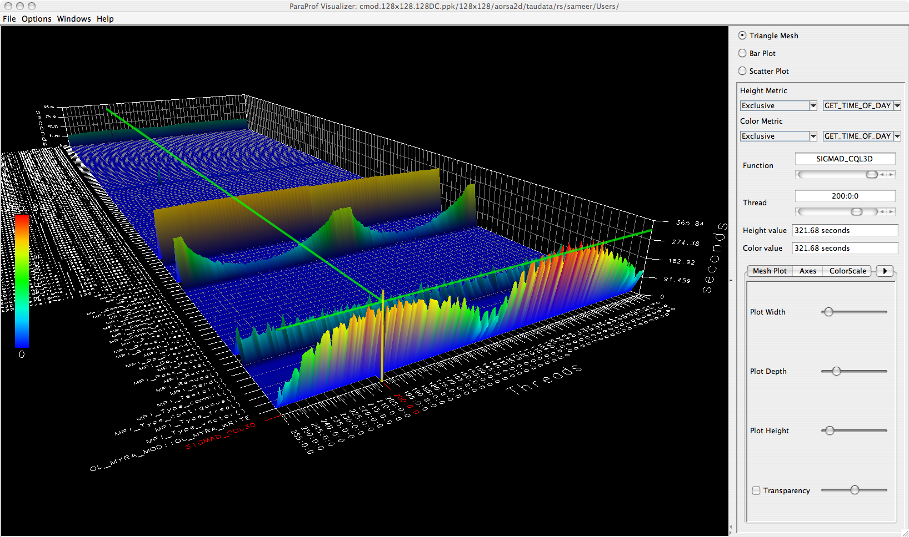
ParaProf: 3D Display

Slide 44
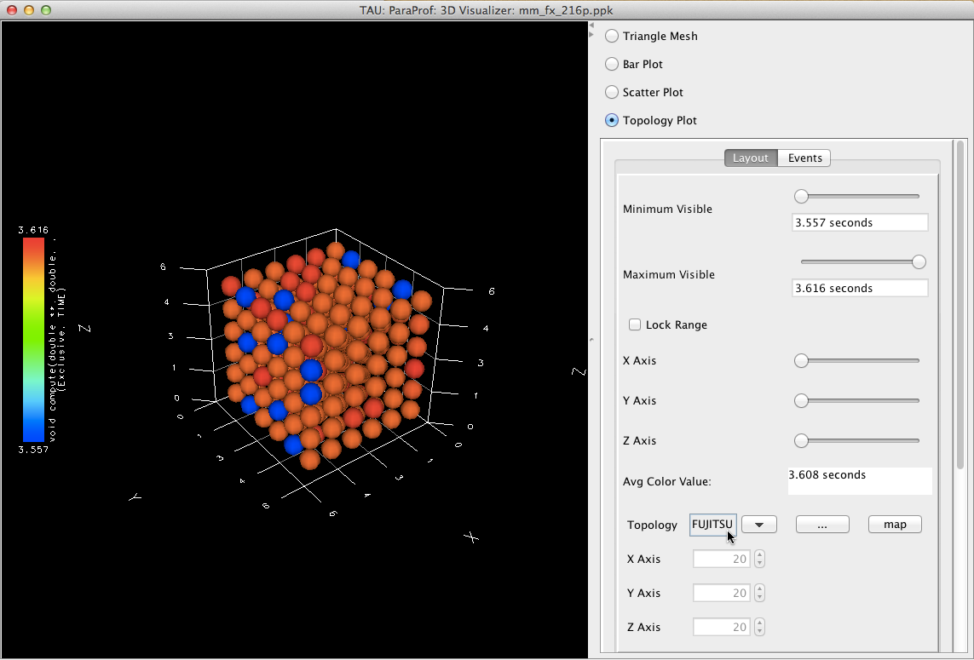
ParaProf: 3D Topolology

Slide 45
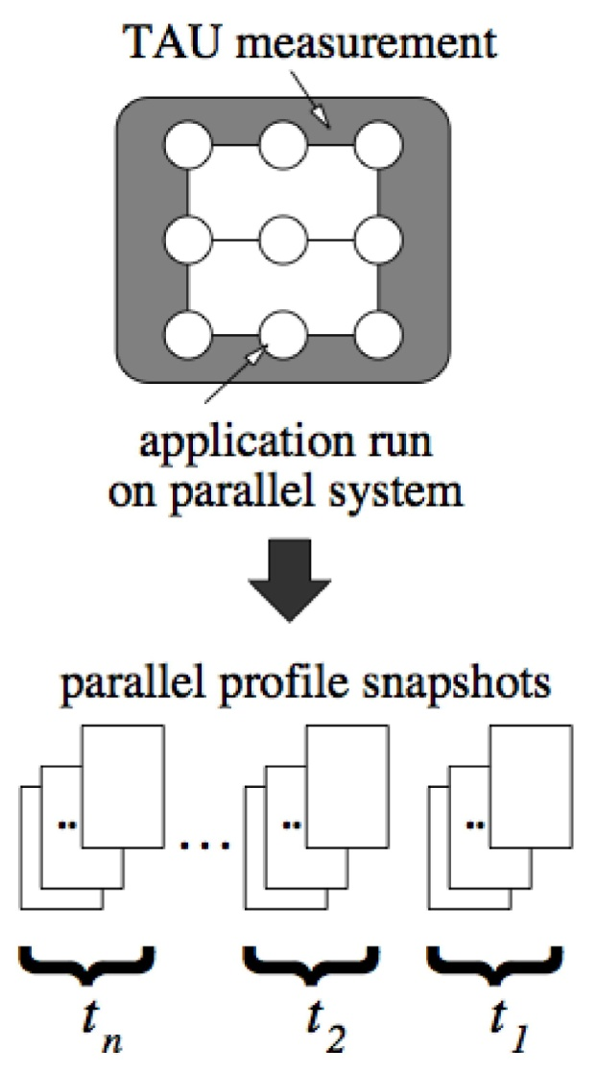
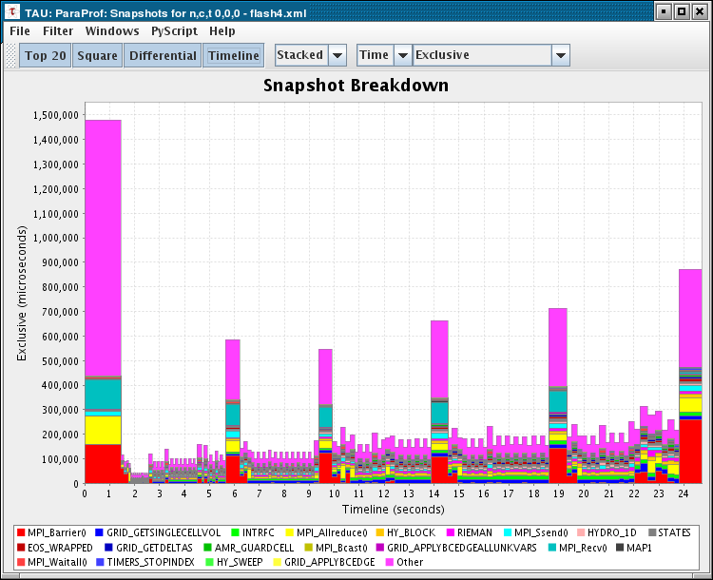
ParaProf: Snapshot profiles
Profile snapshots are parallel profiles recorded at runtime
Shows performance profile dynamics (all types allowed)
Initialization
Finalization
Checkpointing
45

Slide 46
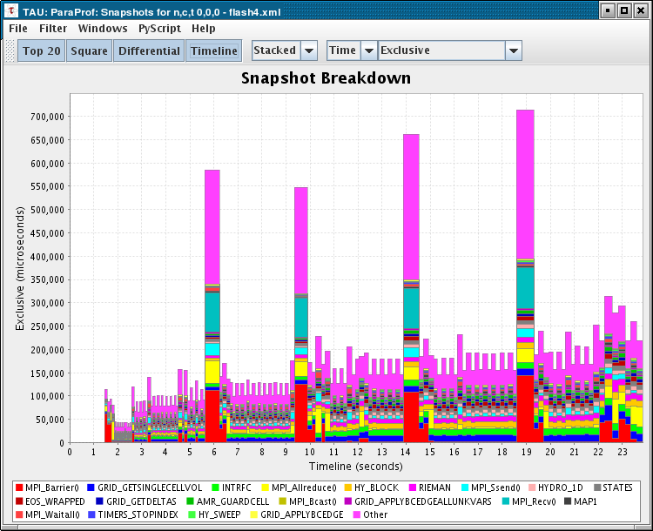
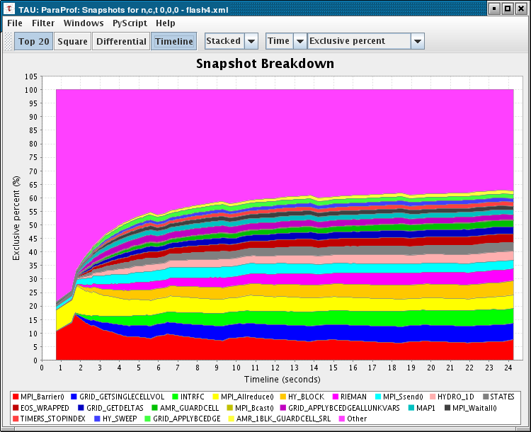
ParaProf: Profile Snapshot Views
Percentage breakdown
Only show main loop

Slide 47
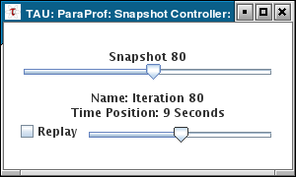
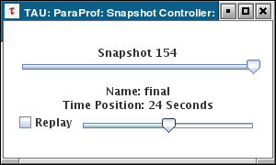
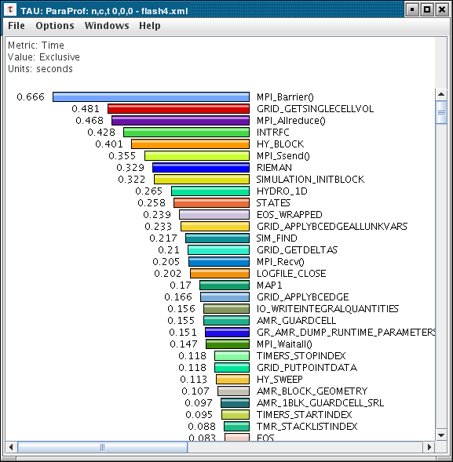
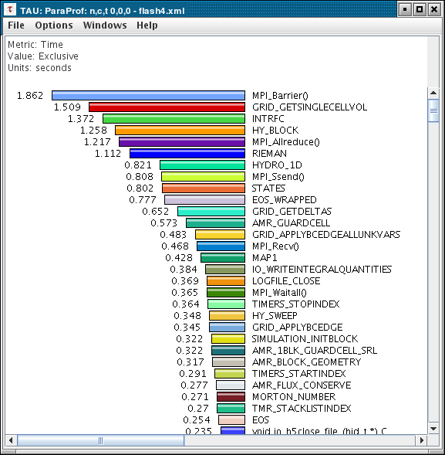
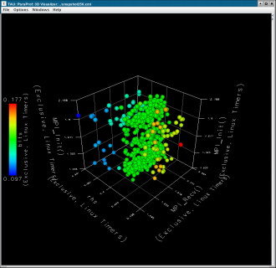
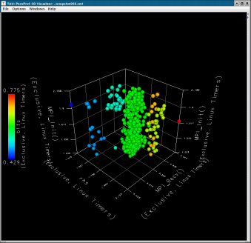
ParaProf: Snapshot Replay
All windows dynamically update
47

Slide 48
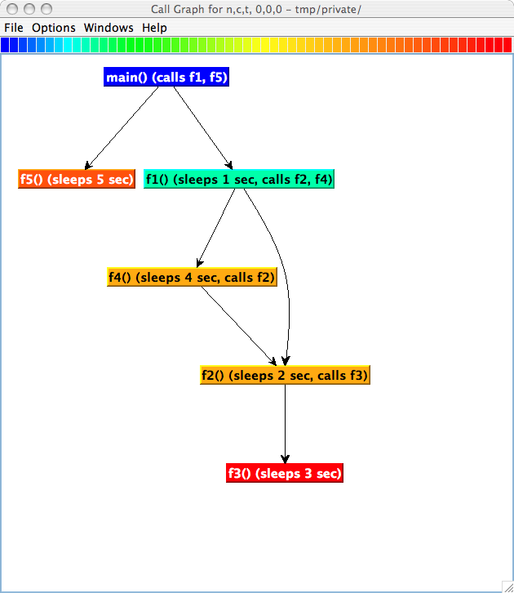
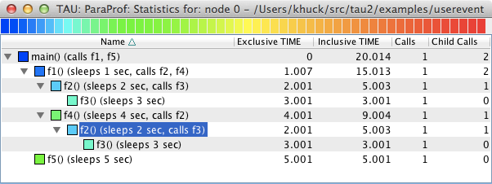
ParaProf: Callgraph Visualizations

Slide 49
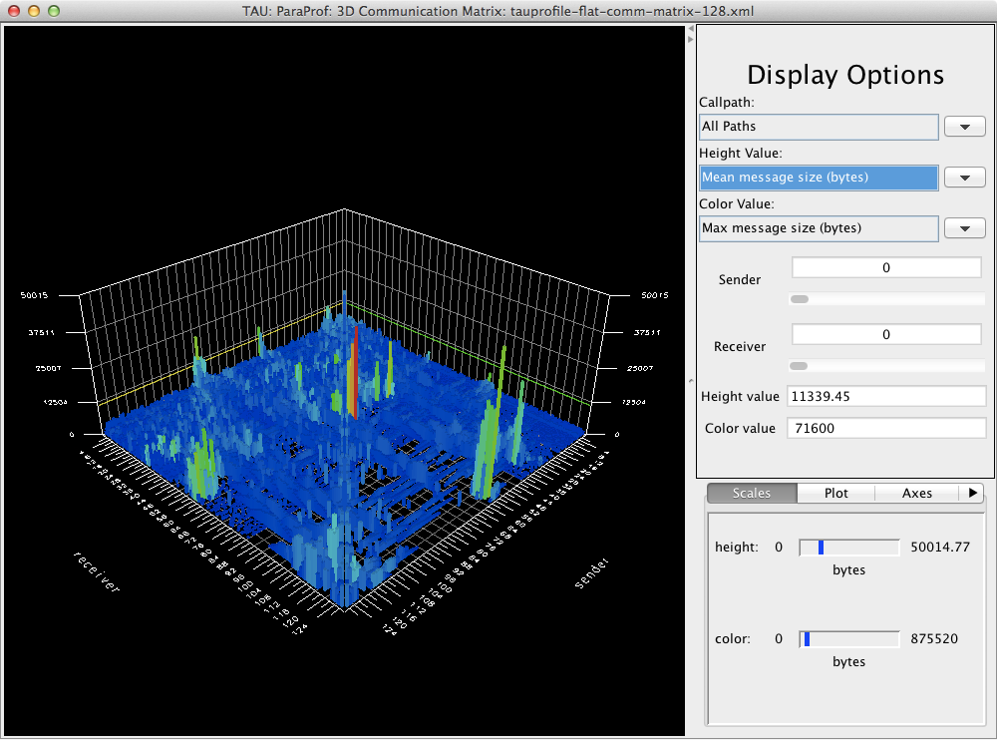
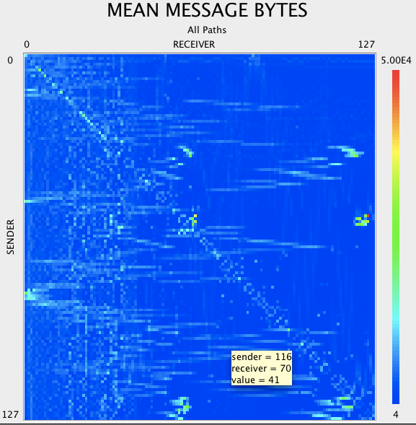
ParaProf: Communication Matrix – 2D, 3D

Slide 50
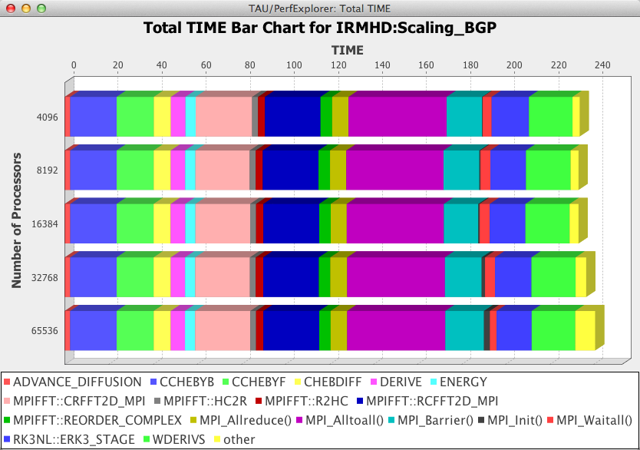
PerfExplorer: Parametric Study Support

Slide 51
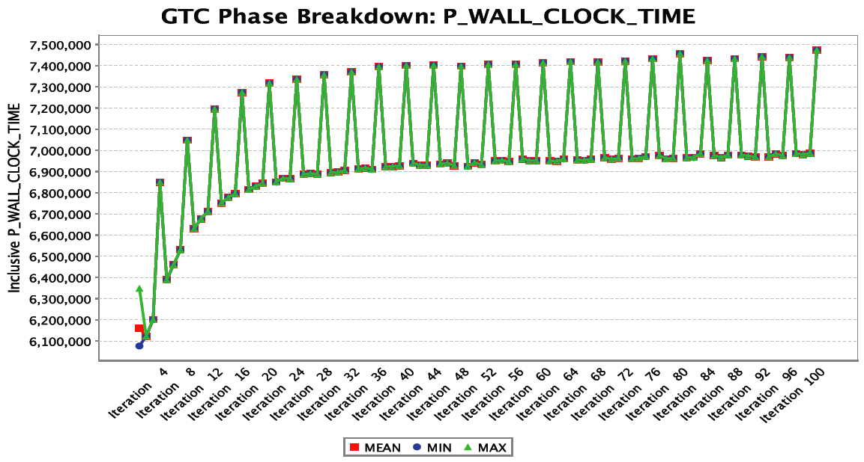
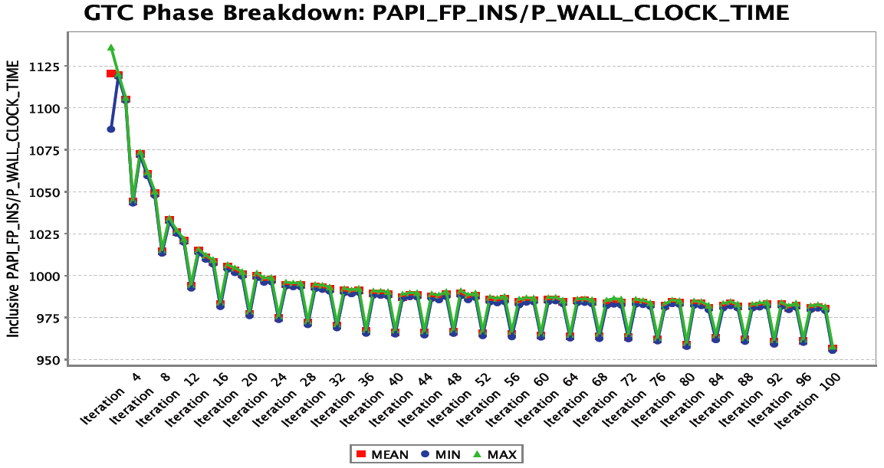
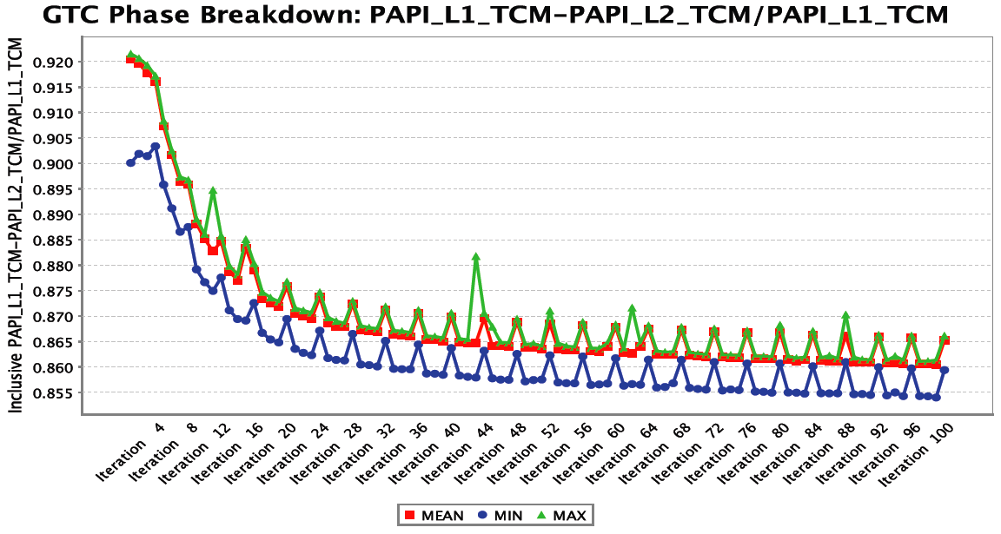
PerfExplorer: Phase Profiling of HW Counters
GTC particle-in-cell simulation of fusion turbulence
Phases assigned to
iterations
Poor temporal locality for
one important data
Automatically generated
by PE2 python script
increasing phase
execution time
decreasing
flops rate
declining cache
performance
51

Slide 52
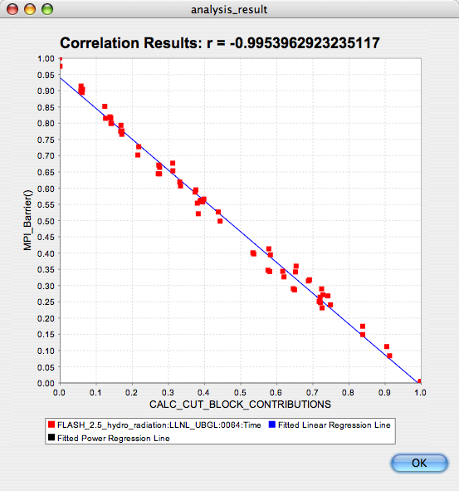
PerfExplorer: Correlation Analysis
-0.995 indicates strong, negative relationship. As
CALC_CUT_BLOCK_CONTRIBUTIONS() increases in execution time, MPI_Barrier() decreases

Slide 53
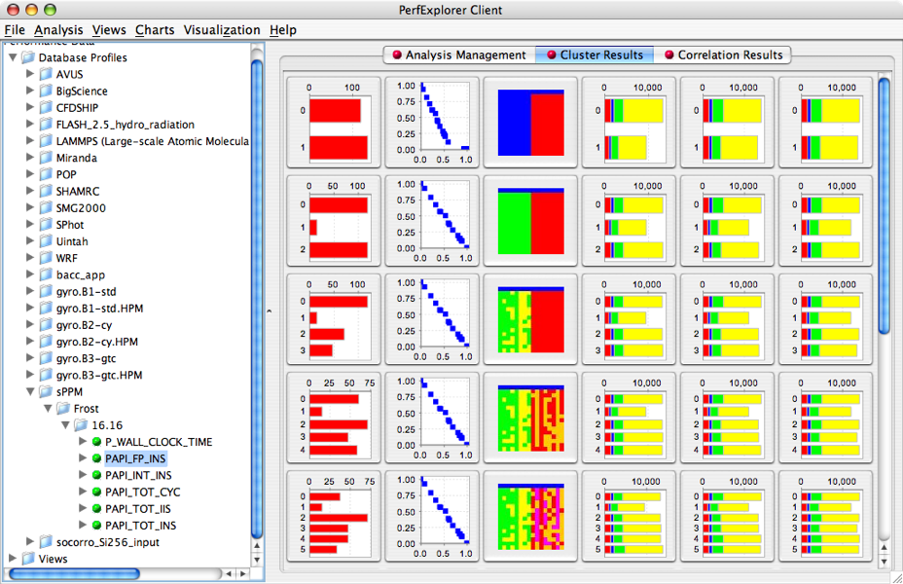
PerfExplorer Cluster Analysis

Slide 54
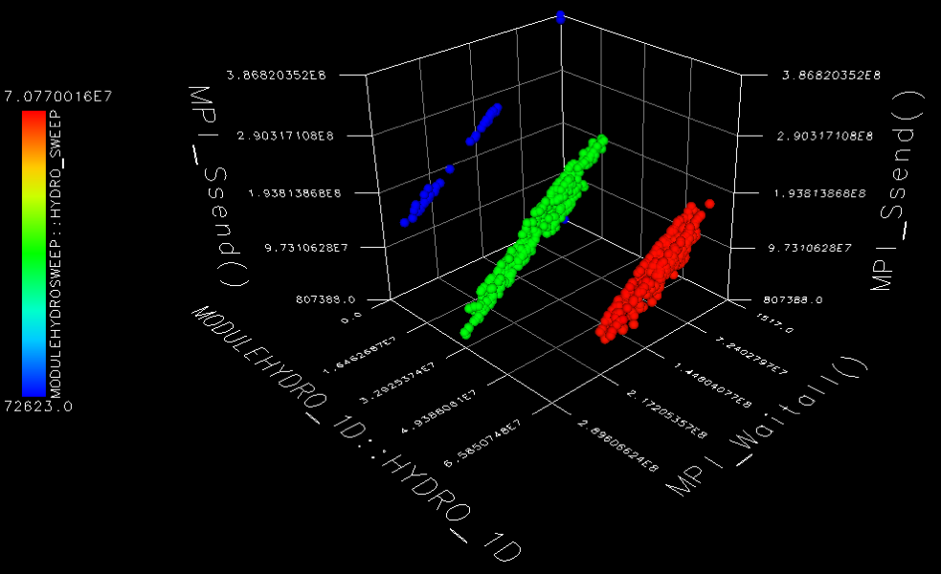
PerfExplorer Cluster Analysis
Four significant events automatically selected
Clusters and correlations are visible

Slide 55
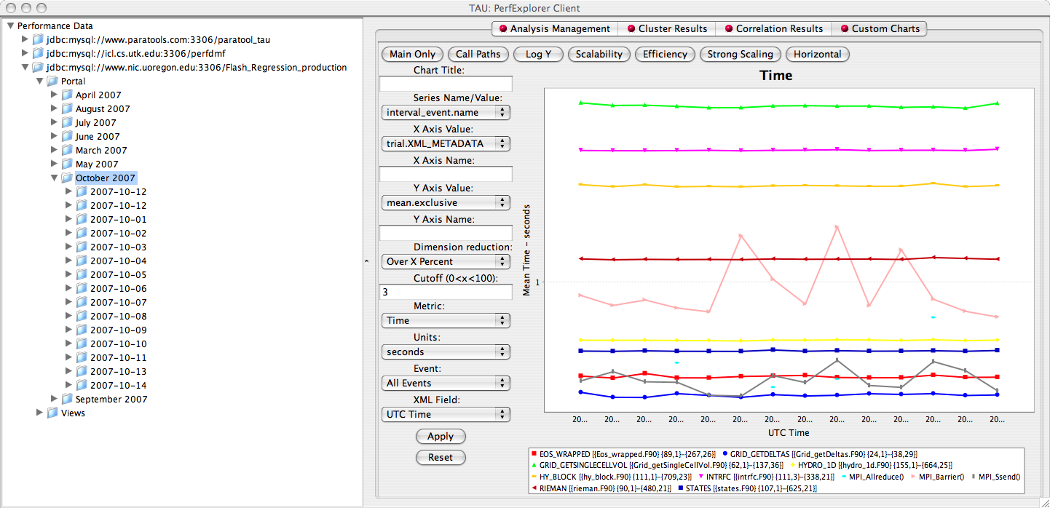
PerfExplorer: Regression Visualization

Slide 56
Final Items of Note
KTAU
  Instrumentation of Linux kernel space
    System calls, exceptions, interrupts, scheduling, signals
  Kernel-wide, process-specific perspectives
  /proc/ktau filesystem for interaction between kernel space and user space
  User space measurements given kernel space context
OpenMP
  Collector API support (OpenUH)
  GOMP Wrapper

Slide 57















Support Acknowledgements
US Department of Energy (DOE)
  Office of Science contracts
  SciDAC, LBL contracts
  LLNL-LANL-SNL ASC/NNSA contract
  Battelle, PNNL contract
  ANL, ORNL contract
Department of Defense (DoD)
  PETTT, HPCMP
National Science Foundation (NSF)
  Glassbox, SI-2
Partners:
University of Oregon
ParaTools, Inc.
University of Tennessee, Knoxville
T.U. Dresden, GWT
Juelich Supercomputing Center

