Slide 1


University of Oregon
SUPER Update
Allen Malony, Sameer Shende, Kevin Huck, Nick Chaimov, Wyatt Spear

Slide 2

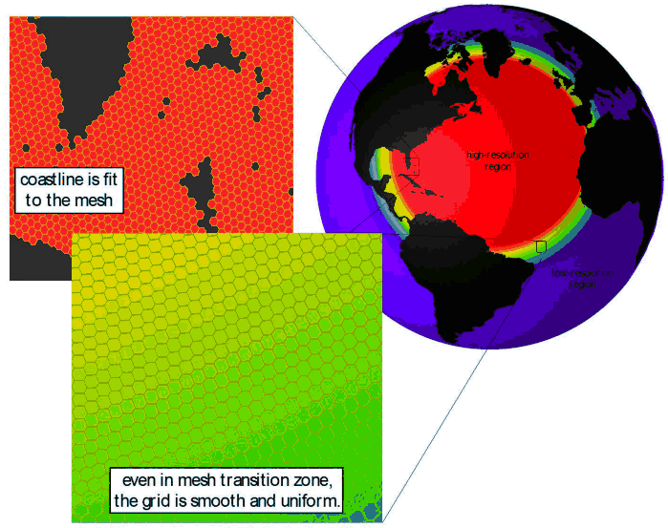
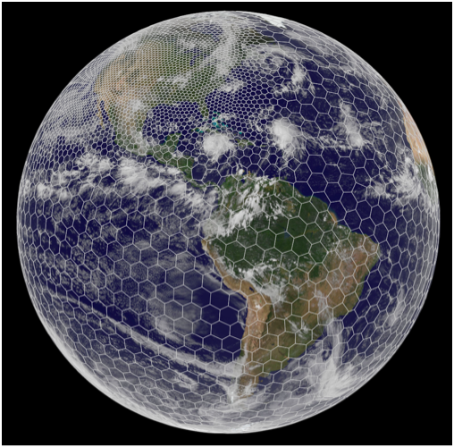
SUPER: MPAS-Ocean Engagement
Use multiscale methods for accurate, efficient, and scale-aware models of the earth system
MPAS-O uses a variable resolution irregular mesh of hexagonal grid cells
Cells assigned to MPI processes, grouped as “blocks”
  Each cell has 1-40 vertical layers, depending on ocean depth
MPAS-O has demonstrated scaling limits when using MPI alone
Look at increasing concurrency
Developers added OpenMP
  Both split explicit and RK4 solvers
Our focus: partitioning, folding
  http://mpas-dev.github.io

Slide 3
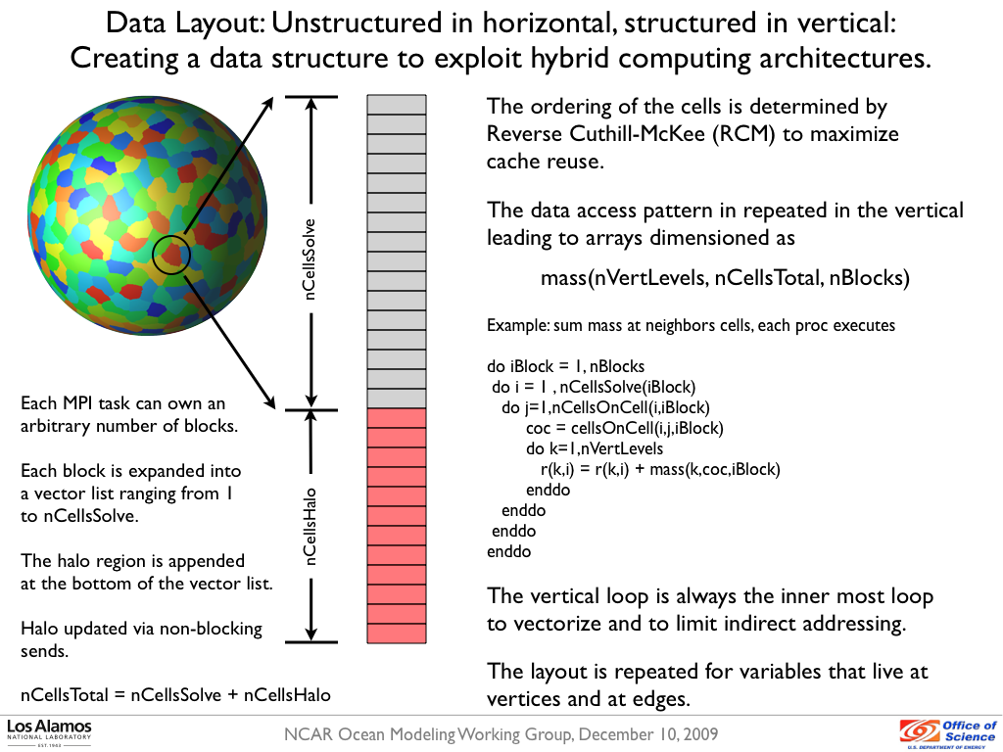
Overview of MPAS partitioning
Source: Ringler, T.D., An Ocean Dynamical Core with Local Mesh Refinement, NCAR CCSM Ocean Modeling Working Group, Boulder, Colorado, December 10, 2009. LA-UR 09-05207.

Slide 4
Approach
Add TAU_METADATA calls to capture nCellSolve, nCell, nEdge, maxLevelCell, topLevelEdge for all partitions
  nCellSolve: cells in partition
  nCell: nCellSolve + nCellsHalo (3 layers)
  nEdge: edges on all cells in nCell
  totalLevelCells: sum depth of each cell in nCell
  tauTotalLevelEdgeTop: min(level) of each edge in nEdge
Correlate computation balance with metadtata fields

Slide 5
Per-process correlation, world 60km with 120 processes on Edison
Se timestep, se_btr_vel, equation_of_state: all similar behavior
Cells - Min(51): 893 Max(111): 1416 Avg: 1282.83
Edges - Min(51): 2517 Max(111): 4248 Avg: 3791.86
Levels - Min(51): 5035 Max(111): 8496 Avg: 7584.38

Slide 6
MPAS Partitioning & Load balance
Want to balance on nCell, but unknown before partitioning
  nCell = nCellSolve + nHaloCell
  nEdge ~= nCell * 6
Suggestion from Karen Devine (FastMath/SNL): post-process the partitions
Attempting to do that, not clear that it is beneficial or possible (yet)
Similar results confirmed by Jeff Hollingsworth and Sukhyun Song in autotuning study using gpmetis seed parameter (presented earlier this month on autotuning call)
End-to-end telecon slides with more in-depth discussion: http://www.nic.uoregon.edu/~khuck/SUPER_update.pptx

Slide 7
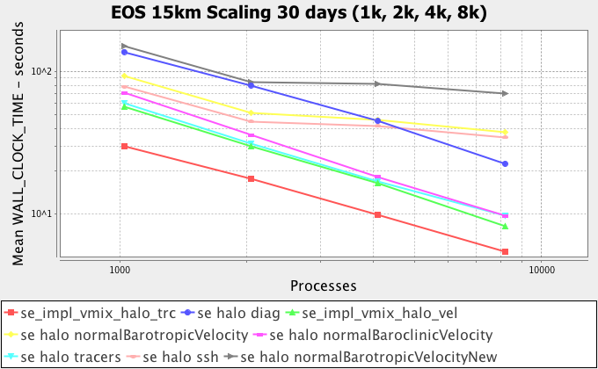
Scaling data on EOS

Slide 8
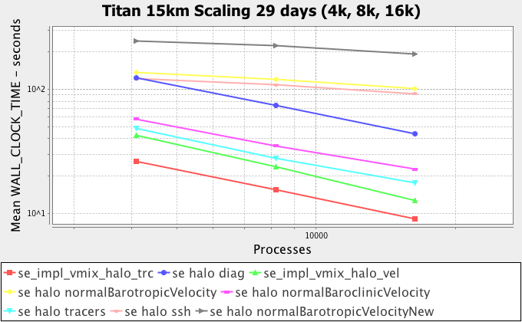
Titan scaling data

Slide 9
Folded Samples (experimental)
Harald Servat (BSC) developed a technique for high-resolution sampling with fewer interruptions [1,2]
  At iteration start: save time and PAPI counters
  At sample: save deltas from start
  At iteration end: normalize time deltas and save counters
  Post-processing: normalize and fold iterations into 1 synthetic iteration
[1] H. Servat, G. Llort, J. Giménez, J. Labarta. “Detailed Performance Analysis Using Coarse Grain Sampling”, Euro-Par 2009
[2] H. Servat, G. Llort, K. Huck, J. Giménez, J. Labarta. “Framework for a productive performance optimization”, Parallel Computing, 2014

Slide 10
Folding & Optimization
Cumulative aggregation of instructions completed correlated with source code locations (samples)
Example uses CPI stack from IBM Power stall counters
Reduction in stalls leads to shorter iteration and higher MIPS

Slide 11
TAU prototype implementation
Folding during profile collection (in-situ)
No CPI stack model available for Intel Xeon
Just collect raw counters, use gnuplot for graphing
Future work – integrate Harald’s post-processing steps (smoothing, interpolation, etc)
Evaluated with MPAS-Ocean on Edison with worldOcean 60km model, 120 processes

Slide 12
Folding MPAS iterations (one node)
!
!
Spike in Branch Mispredictions
Spike in cache misses
Stage 3: Tracer, density, pressure,
vertical velocity prediction
Stage 2: Barotropic velocity (2D) prediction, explicitly subcycled

Slide 13
MPAS Timers
large iteration loop, equation of state,
se implicit vert mix, eos rich
se btr vel, halo transfers (MPI)
se btr vel, halo exchanges (MPI)
Large iteration loop, equation of state, coriolis, del4, forcings, se bcl vel
se prep, coriolis, forcings, ocn_fuperp
ocn_tend_tracer, adv
ocn_tend_tracer, adv

Slide 14
The data suggests:
IPC (~1.62) sounds good, but most of the time IPC is high is during busy-wait polling during MPI_Wait – and the CPU slows down
Need larger granularity (and fewer) halo exchanges?
  Correlates with Abhinav’s findings
Restructuring of data should have significant effect from reduction in L2, L3 cache misses, in particular “se implicit vert mix”

Slide 15

SUPER: Autotuning
Source code annotations allow Orio to generate a set of low-level performance optimizations, after each optimization (or transformation) is applied the kernel is run and the set of optimizations is searched for the best transformations to be applied for a given kernel.
We have integrated Orio with TAU to collect performance data about each experiment that Orio runs.
Performance data collected by TAU are stored in TAUdb and are fed back to Orio, allowing Orio to tune based on any metric TAU can collect.

Slide 16
Multi-Target Autotuning for Accelerators
Our System: OrCL
OpenCL Code Generation with Annotations
Large Parameter Space – OpenCL parameters
Autotuning Experiments using Orio
  BLAS kernels
  Compared to ViennaCL library implementations
  Radiation transport code

Slide 19
Comparison to ViennaCL*
*C++ linear algebra library for accelerator devices using OpenCL.

Slide 20
Class Aggregation
Rather than break down time in a profile by function, also break down by class, method
PerfExplorer script for TAU, gprof profiles of C++ applications to aggregate by class
Next step – identify lightweight member methods as targets for elimination
  Called “many” times, small inclusive per call
Early results with Geant4 code seem promising (Boyana knows more details)
How to deal with measurement perturbation?
Class 'CLHEP::MTwistEngine' : total = 1.12e+11, % application = 3.67%
Method 'flat' : total = 1.12e+11, calls = 1.38e+08, percall = 806.97, %class = 100.00%
Class 'CLHEP::HepRandom' : total = 1.06e+11, % application = 3.47%
Method 'getTheEngine' : total = 1.06e+11, calls = 1.38e+08, percall = 762.92, %class = 100.00%

Slide 21
OpenMP Measurement
POMP/OPARI (source instrumentation)
Runtime Tool Callback/Query Support:
  Collector API (ORA) support (OpenUH/64)
  GOMP Wrapper (i.e. GNU, uses ORA)
OMPT Update:
  OpenMP language committee vote on April 1
  Intel: http://intel-openmp-rtl.googlecode.com/
  TAU, HPCToolkit, BSC/Extrae, Scalasca tool implementations in development
  GNU 4.8.2 implementation started: https://code.google.com/p/ompt-libgomp/

Slide 22
TAU: Additional Enhancements
CUDA 6.0 (developer pre-release) support
Maturing Intel Phi support
  OMPT configure option: -ompt=download
More robust sampling/hybrid profile support
TAU release v2.23.2 imminent (in final testing)

