Slide 1



Linking Performance Data into Scientific Visualization Tools
Kevin A. Huck, Kristin Potter, Doug W. Jacobsen, Hank Childs, Allen D. Malony
Workshop on Visual Performance Analysis
@ SC’14 New Orleans, Louisiana USA
November 21, 2014

Slide 2
Motivation
Evaluate the performance properties of different decomposition strategies for scientific simulation, in the physical domain
Performance data is only analyzed, visualized with respect to node/process rank/id
Currently, we can correlate physical properties with performance measurements, but we want to visualize those performance correlations
Use case: load imbalance in ocean simulation
Notes:
Previous work – mapping science domain (topology) to the performance visualization tools (CUBE viewer of sea ice data, using custom topology)

Slide 3
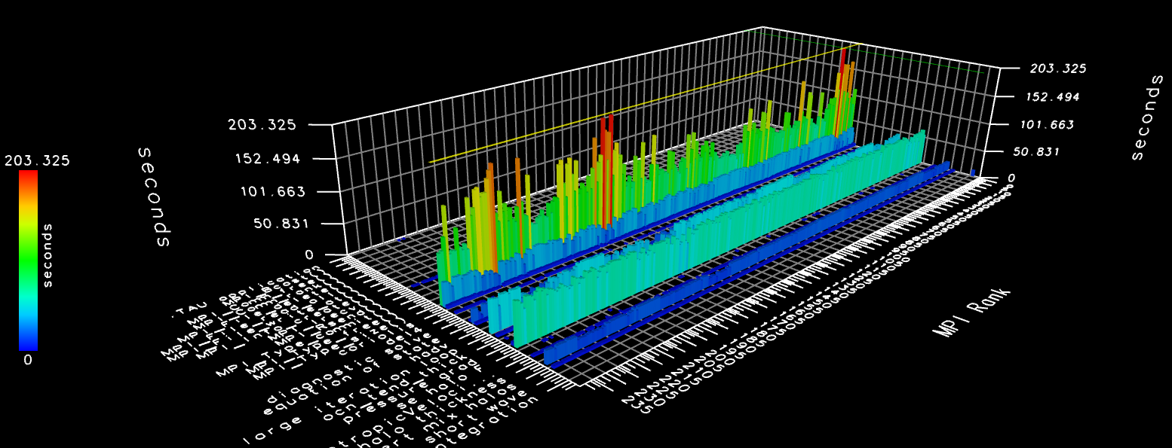
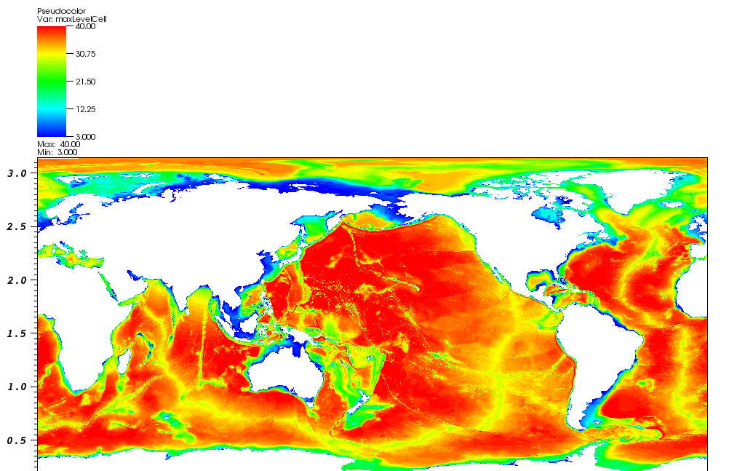
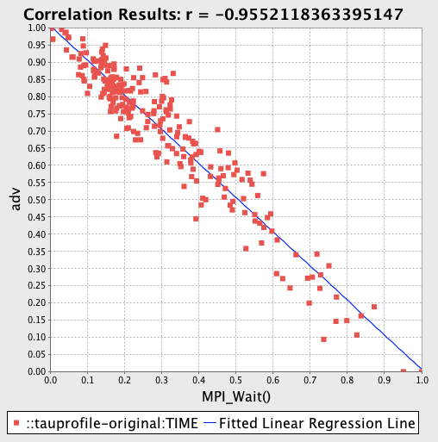
Visualization Perspectives
Two separate(?) worlds
Notes:
Previous work – mapping science domain (topology) to the performance visualization tools (CUBE viewer of sea ice data, using custom topology)

Slide 4
Background : VisIt
Open-source visualization, animation, and analysis toolkit
Interactive user interface
Support for over 120 different scientific data formats
The customizable plugin design allows for user-developed modifications to accommodate a large variety of scientific visualization data sets and display methods
Many traditional visualization techniques supported
  2D data (pseudo-color, scatterplots, etc)
  3D data (volume rendering, isocontours, etc)
  vector data (stream- lines, glyphs, etc)
Runs on a variety of platforms
Can be configured to post-process in parallel
Scales from desktop machines to large-scale HPC
http://visit.llnl.gov

Slide 5
These examples (and more) available at:
https://wci.llnl.gov/simulation/computer-codes/visit/gallery
Notes:
Science visualization

Slide 6

Background : TAU
Tuning and Analysis Utilities (20+ year project)
Performance problem solving framework for HPC
  Integrated, scalable, flexible, portable
  Target all parallel programming / execution paradigms
Integrated performance toolkit
  Multi-level performance instrumentation
  Timers, counters, sampling, binary rewriting…
  Flexible and configurable performance measurement
  Widely-ported performance profiling / tracing system
  Device support (CUDA, OpenCL, OpenACC, Intel Phi…)
  Performance data management and data mining
  Open source (BSD-style license)
Broad use in complex software, systems, applications
http://tau.uoregon.edu

Slide 7
Notes:
Information visualization

Slide 8
Background : MPAS-Ocean
The Model for Prediction Across Scales (NCAR, LANL)
Framework for rapid prototyping of single-component climate system models
TAU was used to evaluate MPI approach, suggest improvements
Linked with TAU, existing manual instrumentation mapped to TAU API
http://mpas-dev.github.io
Data domain organized as unstructured meshes, typically Spherical Centroidal Voronoi Tesselations (SCVTs).
Mesh cells are arbitrary polygons, usually hexagons, decomposing the data in 2 dimensions.

Slide 9
Background : Load Imbalance
Domain decomposition across MPI ranks: cells are organized into blocks, with (typically) three layers of halo cells from neighboring blocks.
Blocks are partitioned only with respect to nCellsSolve (cells in block)
TAU timers were integrated into MPAS using application timers and CAMTIMERS (CESM), and application metadata is also collected
TAU PerfExplorer correlation analysis showed high correlation of computational imbalance and MPI synchronization with nCells (cells in block + halo cells) - each process has to solve for its explicitly assigned cells and its halo cells
SCVT structure,
cell/mesh neighborhood
nCells - Min(51): 893 Max(111): 1416 Avg: 1282.83
Notes:
Two algorithms for the solver – RK4 and split_explicit.

Slide 10
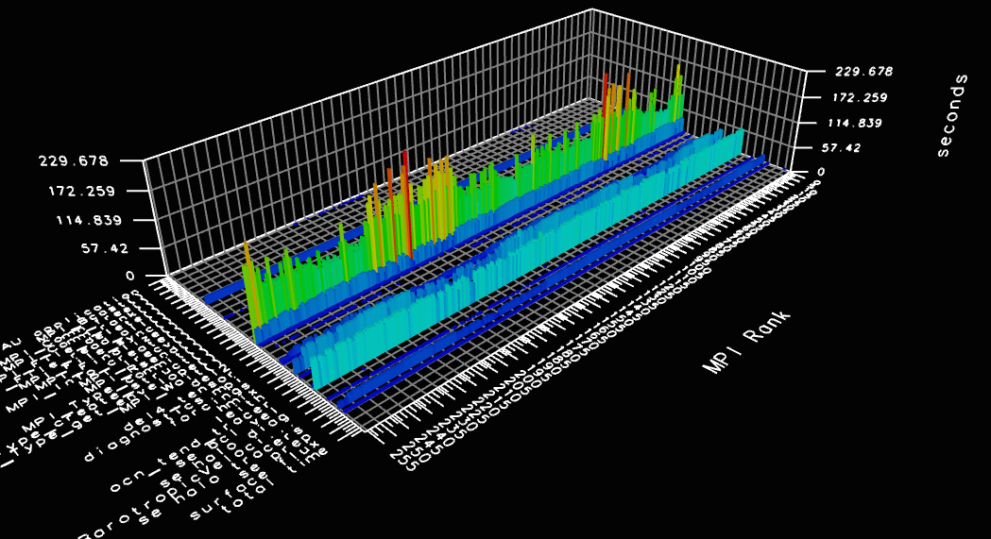
Load Imbalance: TAU Visualizations
nCells - Min(51): 893 Max(111): 1416 Avg: 1282.83

Slide 11
Approach
New parser for VisIt: *.mpas index (meta) files
  NetCDF input/output data file
    n cell definitions, with simulation properties
  Gpmetis partition file
    n rows, one for each cell
    Block ID for each cell in NetCDF data
    Assume 1 block per process
  Performance data summaries
    p values, assume 1 value per process, to be matched up with each block
PerfExplorer script to extract data from TAU profiles

Slide 12
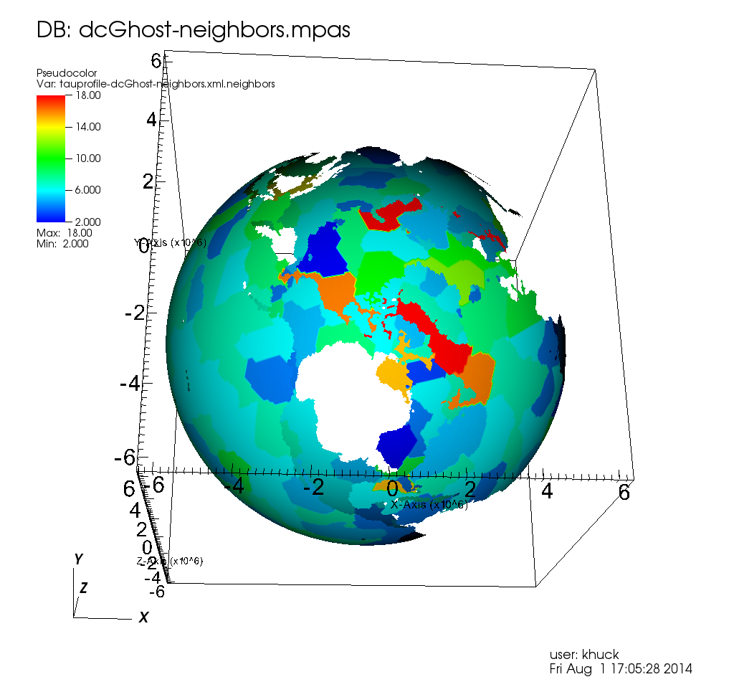
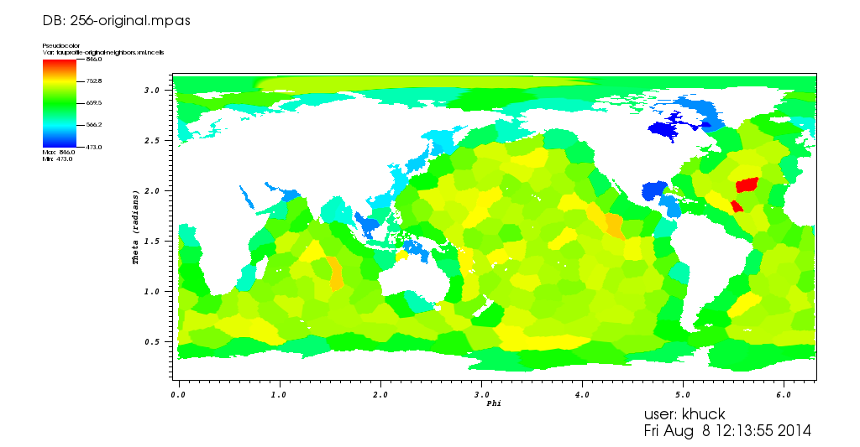
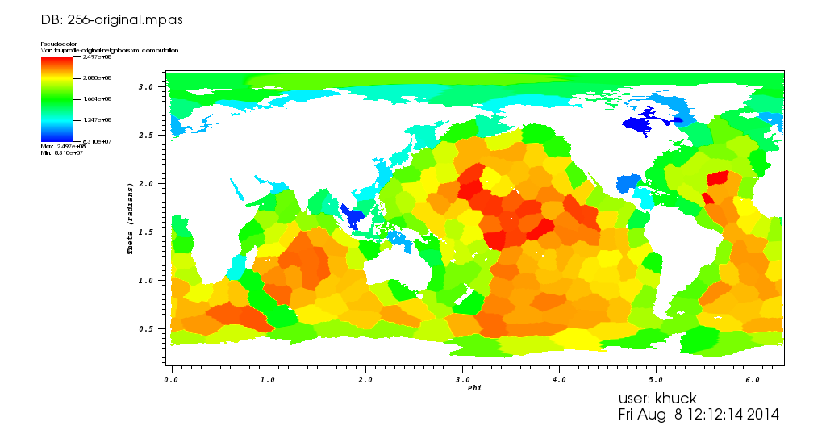
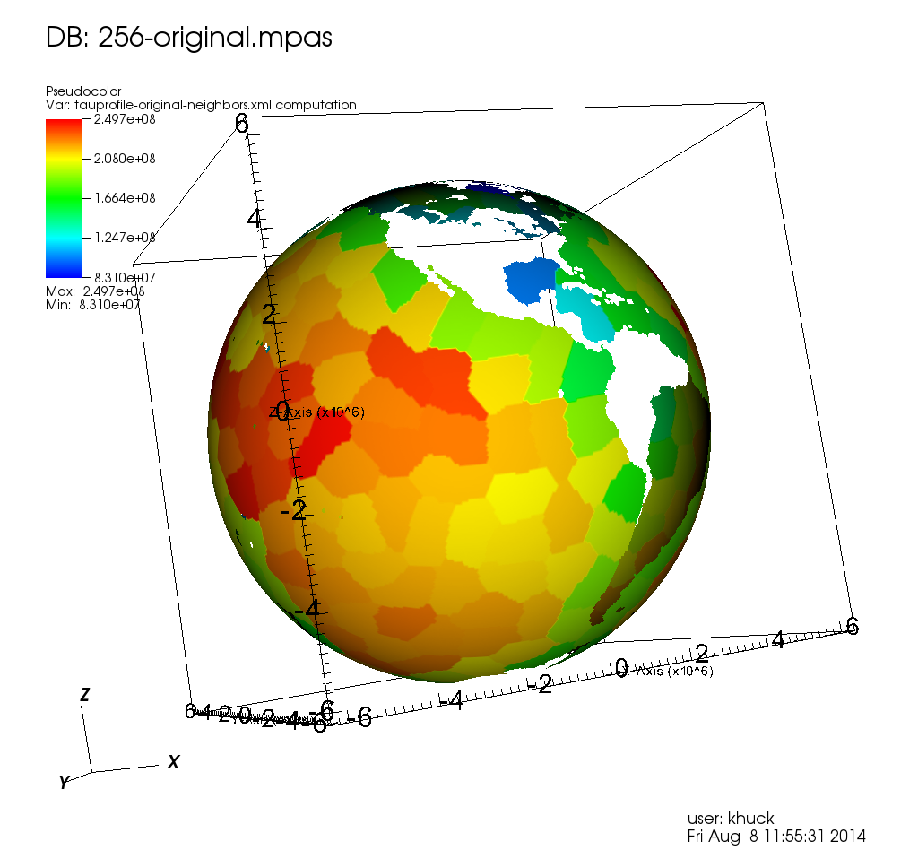
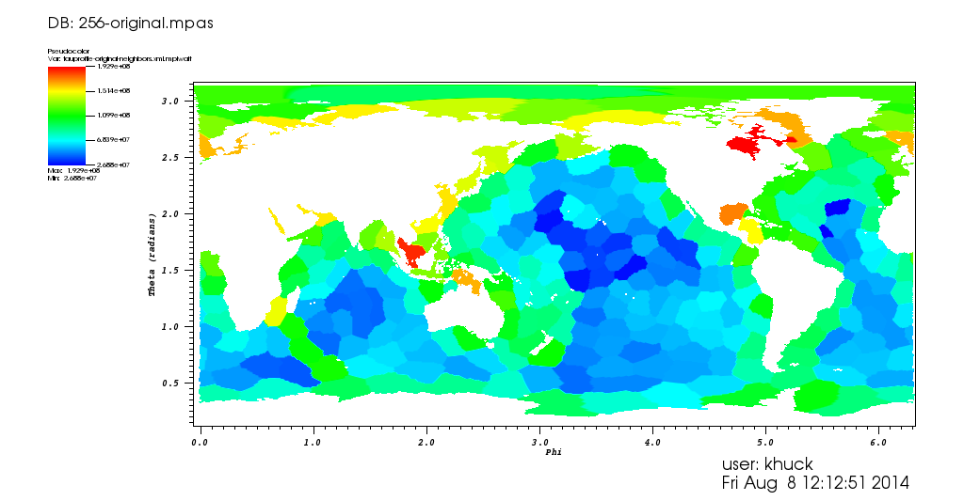

Slide 13
Experiments
Visualize original partitioning of 60km data distributed into 240 blocks
Evaluate Hindsight partitioner
Optimizing Heuristic:
  Partition with Metis
  Compute properties of partitions (i.e. #cells in partition + #cells in halo) to use as cell weights
  Assign weights to cells and update graph
  Iterate until balance can’t be improved
Analysis suggests 2-12% reduction in execution time, depending on quality of initial partition (based on size of largest partition)
TAU profile measurement shows 12-15% reduction in execution time
  ~45% reduction in mean MPI_Wait() times for 240 process example on Edison
Reduction in communication routines due to better balance

Slide 14
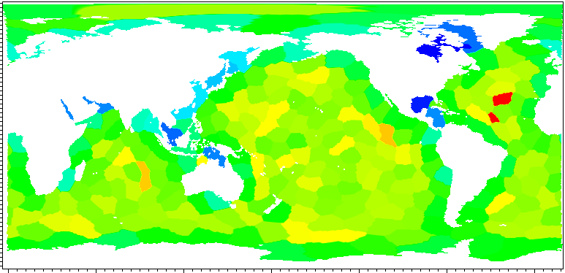
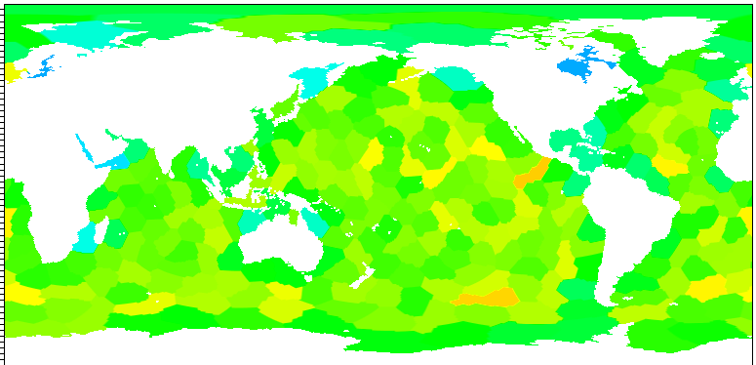
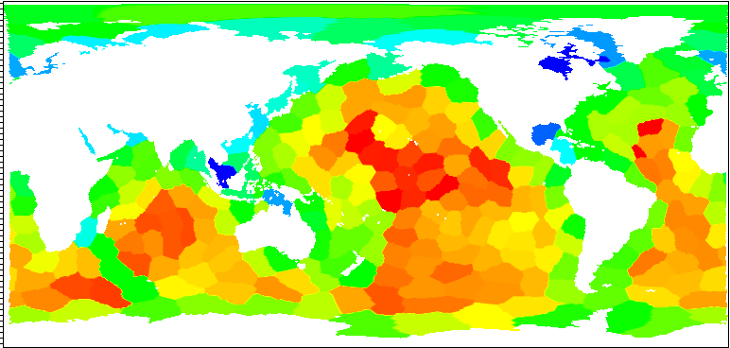
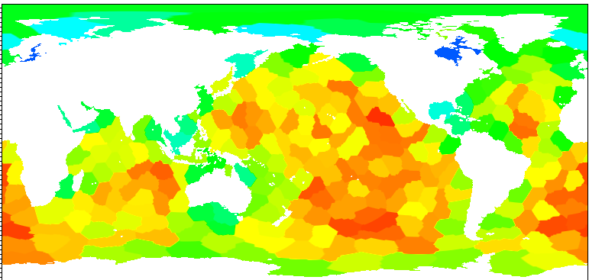
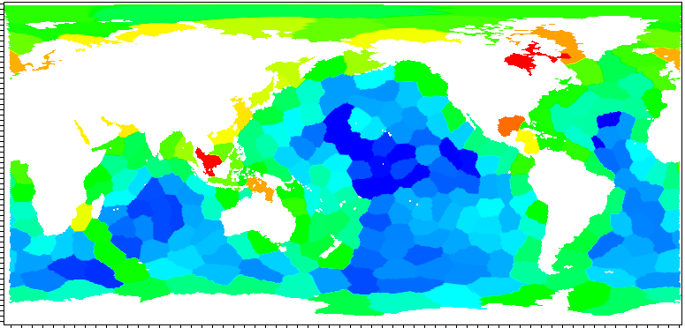
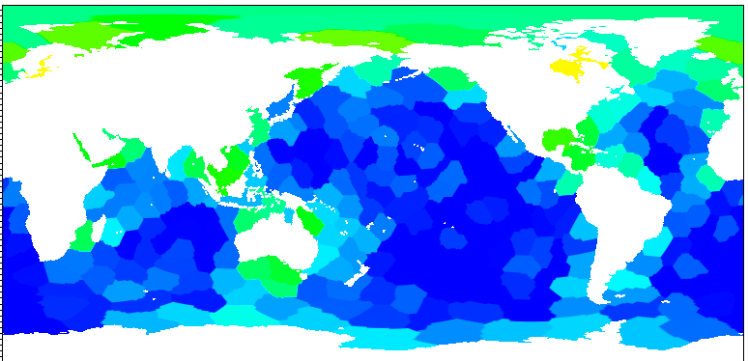
Results Validation
Total cells per block
min:
473  535
max:
846  771
Time spent
computing
min:
8.3e7  9.8e7
max:
2.5e8  2.4e8
Time spent in
MPI_Wait
min:
2.7e7  9.0e6
max:
1.9e8  1.5e8

Slide 15
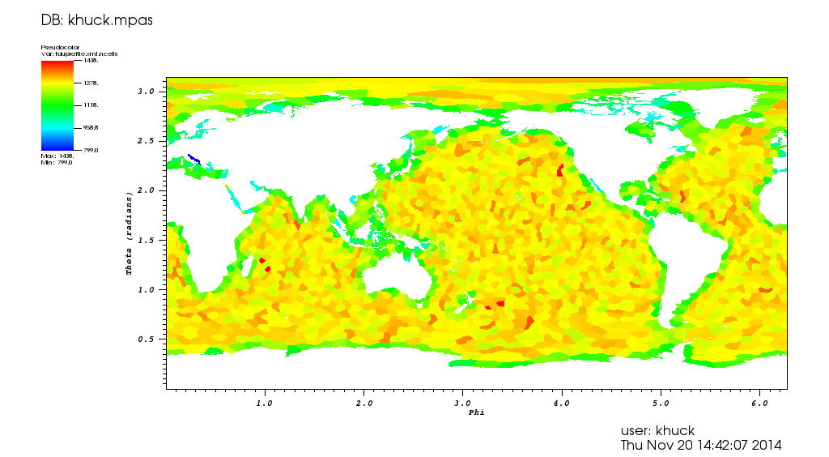
Problem Diagnosis : 2048 cells, 15km
Before refinement… couldn’t improve?
Notes:
The future is now…

Slide 16
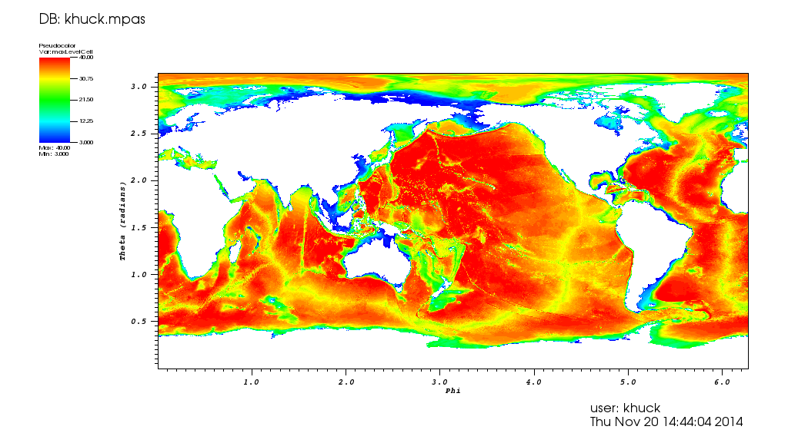
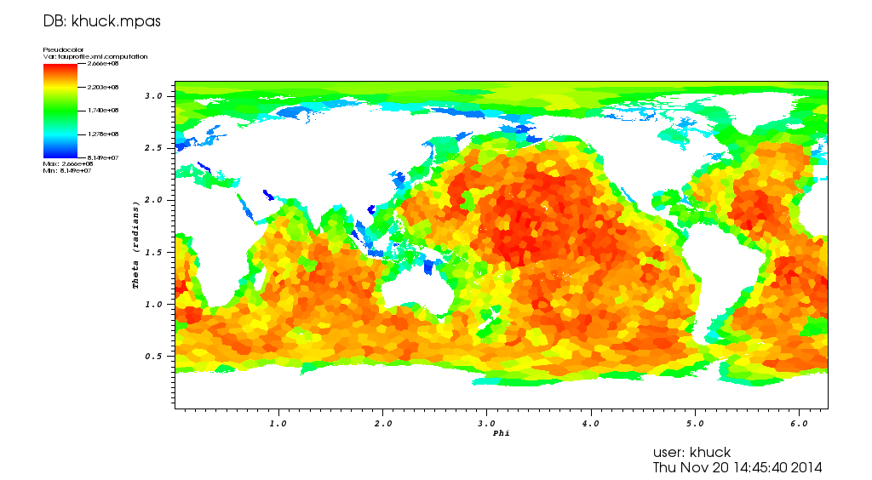
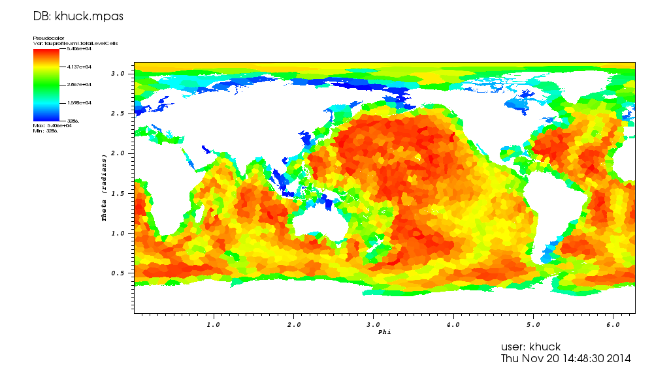
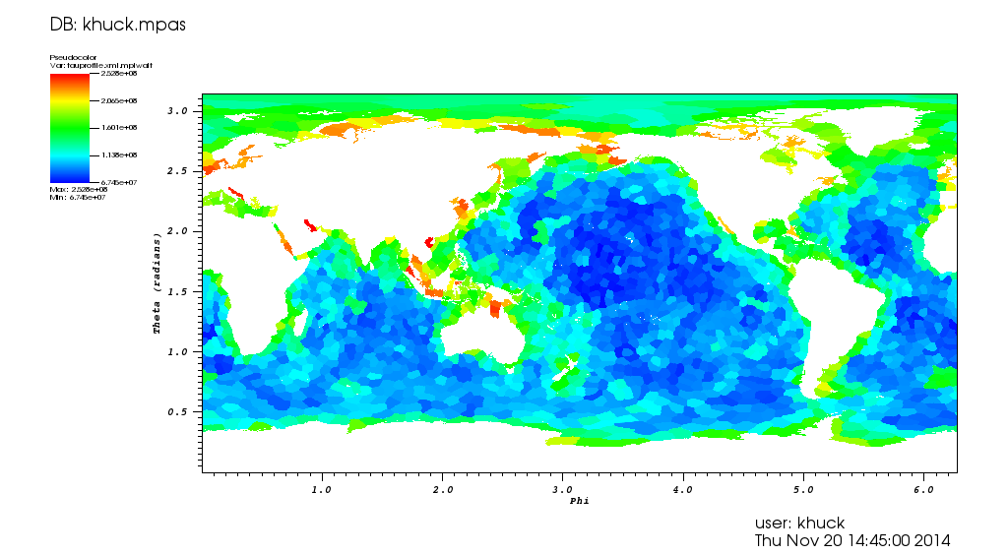
2048/15km data: correlations
Science data: ocean depth (per cell)
Computation (per block)
Metadata: total_level_cells (per block)
MPI_Wait (per block)

Slide 17
2048/15km data: original partitions
Metadata: nCells (per block)
Computation (per block)
Metadata: total_level_cells (per block)
MPI_Wait (per block)

Slide 18
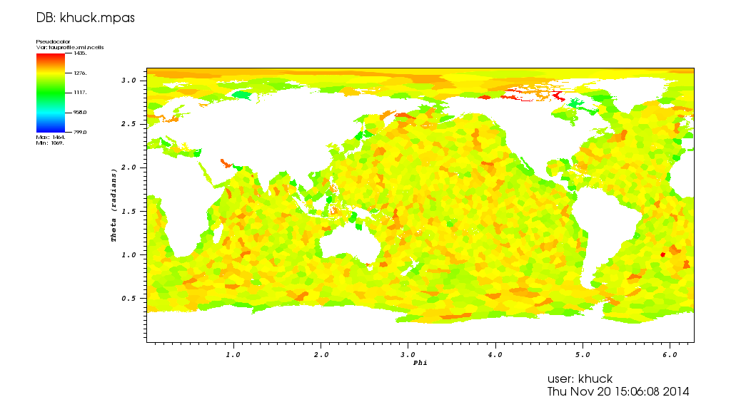
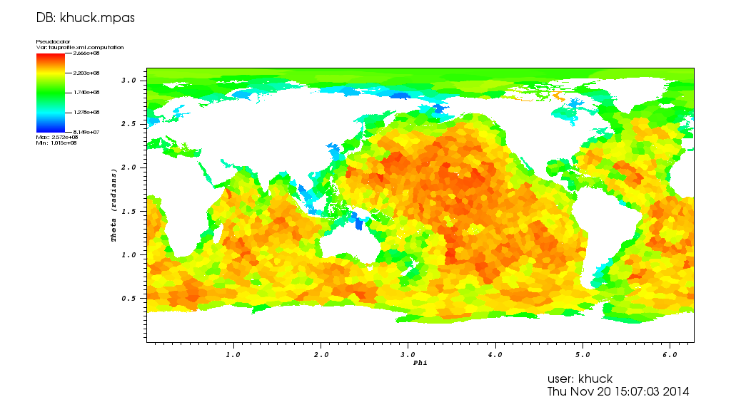

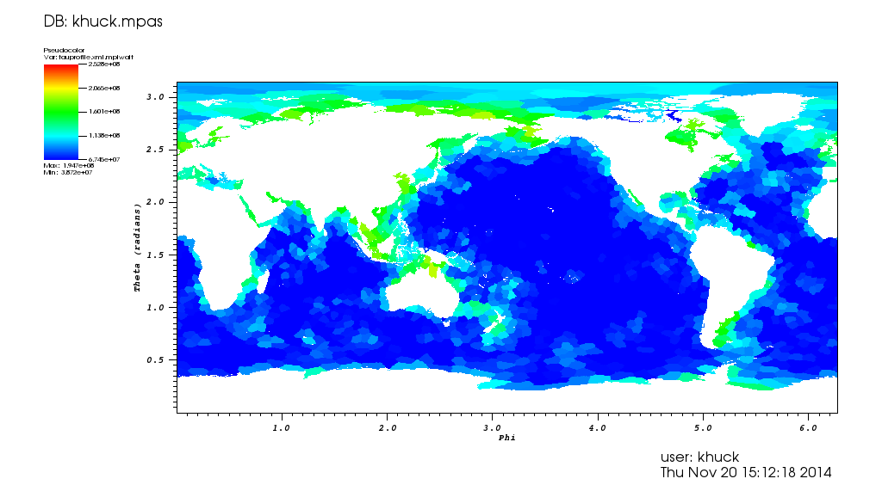
Modify Hindsight to bias on depth
Partition using cell depth as initial weights
bias weight with total cell depth in block
Metadata: nCells (per block)
Computation (per block)
MPI_Wait (per block) – 30% less,
11% reduction in execution time
Metadata: total_level_cells (per block)

Slide 19
Ensemble Visualization
Time series data
Parametric studies
Example: evolution of block membership during 5 iterations of Hindsight

Slide 20
Summary
Visualization in science domain helped understand and confirm load imbalances in MPAS-Ocean domain data
Techniques broadly applicable to other applications (just need to add support)
Any performance data & metadata can be mapped to the science domain – even could be (should be?) included in output file from simulation

Slide 21


Acknowledgements
US DOE SciDAC
  SUPER
  SDAV
  MULTISCALE
US DOE Office of Science Biological and Environmental Research Program

