Slide 1



An Early Prototype of an Autonomic Performance Environment for Exascale
Kevin Huck, Sameer Shende,Allen Malony
University of Oregon
Hartmut Kaiser
Louisiana State University
Allan Porterfield, Rob Fowler
RENCI
Ron Brightwell
Sandia National Labs

Slide 2
Outline
Introduction/Motivation
XPRESS Overview
Relevant Components
HPX Runtime
APEX Concepts
APEX Prototype
Experimental Results
Future Work

Slide 3
Introduction/Motivation
Extreme-scale computing requires a new perspective on the role of performance observation in the Exascale system software stack
High concurrency and dynamic operation
Post-mortem performance measurement and analysis is not good enough
Requirements:
first- and third-person observation
In situ analysis
Introspection across stack layers
Dynamic feedback and adaptation
Notes:
Motivation for an Autonomic Performance Environment for Exascale

Slide 4





XPRESS
Runtime system implementing ParalleX, co-designed with an Operating System.
Sandia National Laboratories (Ron Brightwell)
Indiana University (Thomas Sterling, Andrew Lumsdane)
Lawrence Berkeley National Laboratory (Alice Koniges)
Louisiana State University (Hartmut Kaiser)
Oak Ridge National Laboratory (Chris Baker)
University of Houston (Barbara Chapman)
University of North Carolina (Allan Porterfield, Rob Fowler)
University of Oregon (Allen Malony)
http://xstack.sandia.gov/xpress/
Notes:
XPRESS also includes a framework to translate MPI and Open MP legacy codes.

Slide 5
OpenX
Integrated Exascale software stack for ParalleX
“APEX”
Notes:
XPRESS will design an integrated Exascale software stack for ParalleX, called “OpenX”, and implement a critical proof-of-concept prototype to validate its concepts for achieving high levels of parallelism and resource efficiency.

Slide 6
XPRESS: Exascale System Software
HPX-4: runtime based on OpenX modular software architecture
HPX-3: Current ParalleX implementation
LXK: lightweight kernel OS
Based on the Kitten OS
Notes:
HPX-4 is based on the OpenX modular software architecture
LXK will accommodate billion-way concurrency, introspective management of faults and power, future directions of OS while dealing with current/near-term HW, management of protected and dynamic global virtual name space.
Don’t go into detail at this point

Slide 7
XPRESS: Programming Models and Languages
XPI – low-level imperative programming interface
Meta-programming framework to support rapid deployment of future embedded DSL formalisms
Example DSL using meta-DSL toolkit
Legacy mitigation through MPI & OpenMP programming interfaces to the OpenX software stack
Notes:
XPI will expose the semantic constructs compromising the ParalleX execution model as embodied in HPX
Legacy – develop and demonstrate interfaces to XPI for legacy code execution, provide interoperability, provide means for extending parallelism incrementally within the MPI and OpenMP frameworks

Slide 8
XPRESS: Applications
Climate Science
Community Earth System Model (CESM)
Nuclear Energy
Denovo
Plasma Physics
GTC (HPX implementation)
Trilinos libraries
Notes:
CESM and Denovo will be used to verify the ability to transition smoothly from MPI+OpenMP to XPRESS runtime

Slide 9
XPRESS: Crosscutting Issues
Automatic control and introspection
Resilience
In memory checkpointing, compute-validate-commit cycle that defers side-effects (isolating error propagation)
Power management
Greater resource utilization per Joule while reducing data movement through active locality management
Heterogeneity

Slide 10
HPX
First open-source implementation of ParalleX
Modular runtime system for conventional architectures (NUMA machines, clusters)
Supports all key ParalleX paradims
Parcels & parcel transport layer
PX-threads and management
Local Control Objects (LCO)
Active Global Address Space (AGAS)
Notes:
ParalleX model aims to avoid SLOW – starvation, latency, overhead, waiting/contention

Slide 11
HPX-3 architecture
Thread queue length, PAPI, etc.
Notes:
Parcels & parcel transport layer, PX-threads and management, Local Control Objects (LCO), Active Global Address Space (AGAS)
Important to note that HPX already has performance counters, we want to tie into them.

Slide 12
APEX: Autonomic Performance Environment for eXascale
Node, core count, heterogeneity all increasing
Cores interacting through shared resources
Manifested by bottlenecks and queuing at scarce resources both on chip (node) and between nodes
Measurement and analysis need to be available in real time to all levels of software stack
Notes:
Performance is no longer constrained primarily by the throughput of individual cores or the behavior of the code executing in a single pipeline.

Slide 13
APEX: Autonomic Performance Environment for eXascale
Performance observation requirements had been satisfied by local measurements and offline optimization (focus on first person)
Inadequate for exascale
Shared resources operate independently of the cores that have hardware monitors built in
Requirement for third person observation
Make node-wide resource utilization data and analysis, energy consumption, health available in real time

Slide 14
Autonomic Performance
Top down and bottom up performance mapping
OS (LXK) tracks system resource assignment, utilization, job contention, overhead
Runtime (HPX) tracks threads, queues, concurrency, remote operations, parcels, memory management
ParalleX, DSLs and Legacy codes allow language-level performance semantics to be measured

Slide 15
Bottom-Up Development Approach
Performance introspection across layers to enable dynamic, adaptive operation and decision control
Extends previous work on building decision support instrumentation (RCRToolkit) for introspective adaptive scheduling
Resource Centric Reflection
Daemon monitors shared, non-core resources
Real-time analysis, raw/processed data published to shared memory region, clients subscribe
Display/logging tool, adaptive thread scheduler
Notes:
RCR cases: prevent performance degradation under high load in commercial database system
RCR cases: MAESTRO scheduler throttles thread/core concurrency to reduce power consumption without degrading performance, and increase throughput
RCR cases: distingush cache miss difference between memory bandwidth bottleneck and lightly utilized

Slide 16
Top-Down Development Approach
Couples first person and third person performance views by translating application context down the OpenX stack
Associates the execution performance state back up
TAU Performance System used as base for measurement in HPX
Wrapper interposition libraries for legacy measurement, XPI measurement

Slide 17
APEX: monitoring and writing to RCR
Profiles,
Traces
APEX
TAU
RCR client
RCR Blackboard
DSL or
Legacy
State
XPI
State
HPX
State
OS
State
HW State
APEX:
- “broadcasts” performance state
- monitors performance state
- “triggers” an action
RCR Daemon

Slide 18
APEX: Prototype Implementation
Mapping of HPX performance counters to APEX (TAU) counters
Intel® ITT Instrumentation of HPX runtime (thread scheduler) mapped to APEX timers
APEX as RCR client to observe power use
RCR / HPX thread scheduler integration underway

Slide 19
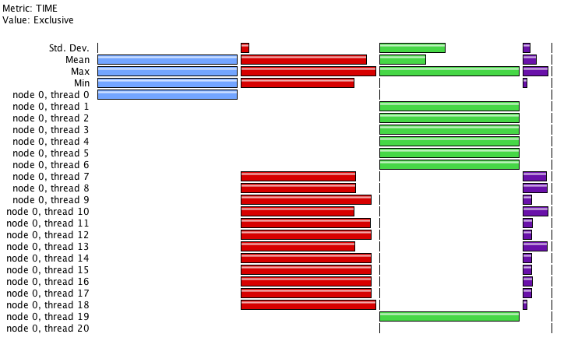
HPX Profile Example
HPX user level
HPX “main”
HPX thread scheduler loop
GTCX on 1 node of ACISS cluster at UO
* 21 / 84 OS threads * 12 cores (user)
HPX “helper” OS threads
Notes:
While not the end-goal of the project, generating performance profiles for offline analysis is still useful for HPX development. This is a view of 1 of 4 nodes on ACISS, running an application.
Helper threads: parcel-thread-tcp (2), io-thread (2), timer-thread (2), main-thread#wait-helper, main-thread#0,

Slide 20
GTC Profile with 32 threads, 1 node
15.24-19.43% of time spent in the thread scheduler

Slide 21
gtc_partition_loop_action
thread_scheduler_loop
Notes:
“synchronization” points where lots of small tasks are scheduled (partition_loop_action has about 5ms of work to do per call, others are 21-181us per call. Clearly, lots of small lightweight tasks are fine, as long as there isn’t data dependencies…

Slide 22
Future Work
Distinguish between HPX task execution and preemption/migration
Performance data not stored in ParalleX model
Instrumentation of HPX parcel transport, local control objects, global address space
Expanded information sharing between components
Runtime analysis and distillation of wide-scale performance data
Integration with Kitten/LXK OS
Event based model for triggering runtime corrections

Slide 23

Acknowledgements
Support for this work was provided through Scientific Discovery through Advanced Computing (SciDAC) program funded by U.S. Department of Energy, Office of Science, Advanced Scientific Computing Research (and Basic Energy Sciences/Biological and Environmental Research/High Energy Physics/Fusion Energy Sciences/Nuclear Physics) under award numbers DE-SC0008638, DE-SC0008704, DE- FG02-11ER26050 and DE-SC0006925.
The ACISS cluster is supported by a Major Research Instrumentation grant from the National Science Foundation (NSF), Office of Cyber Infrastructure, grant number OCI-0960354.
Sandia National Laboratories is a multi-program laboratory managed and operated by Sandia Corporation, a wholly owned subsidiary of Lockheed Martin Corporation, for the U.S. DOE’s National Nuclear Security Administration under contract DE- AC04-94AL85000.

