Slide 1
XPRESS Progress Report:
University of Oregon
PI: Allen D. Malony, Sameer Shende
Staff: Kevin Huck
Ph.D. Student: David Ozog

Slide 2
Tasks and Status for Year 1
Design methodology and development approach for APEX performance instrumentation and measurement integration with OS and runtime layers
  APEX prototyped with TAU performance system
Develop initial version of measurement wrapper libraries for XPI
Implement performance observation support in HPX-3 and evaluate
  HPX-3 counters captured in profiles
  HPX-3 instrumentation started
Identify HPX-4 performance observation requirements based on HPX-3 evaluation and HPX-4 design
  Understanding of ParalleX data model
Notes:
Major bullets are our deliverables for Y1, the minor bullets are what we have done so far.

Slide 3
Progress on APEX Prototype
Built on existing TAU measurement technology
  Provides initial infrastructure for data collection, performance measurement output
  TAU configured with pthread support
Integrate seamlessly with HPX-3 build process
  Easy integration with HPX-3 configuration
  C++ library, configured with Cmake
  Define APEX_ROOT, TAU_ROOT, pass to HPX-3 configuration, build HPX-3 as usual
    If APEX variables are not defined, normal HPX-3 build
  Execute HPX-3 application with tau_exec
    Needed to preload pthread wrapper library
    Eventually get rid of with link parameters
Notes:
The UO team has made solid progress with respect to design of the APEX performance measurement infrastructure, performance measurement of the HPX-3 runtime system, and beginning the transition from first-person performance reporting to third-person performance observation. The XPRESS team has implemented an APEX prototype using TAU as the core measurement infrastructure. The APEX instrumentation interface provides access to TAU performance timers and counters.
The APEX prototype has been developed with the HPX-3 build process in mind, and is designed to integrate seamlessly into the HPX-3 build. If the APEX variables are not defined, HPX-3 is configured and compiled as normal. If the APEX variables are defined with a reference to the local APEX installation, the HPX-3 build system will enable APEX support.
Tau_exec is required in order to preload the pthread wrapper library. I am currently working on making that unnecessary, by defining the wrappers in the link parameters for hpx, but I might need some help from the hpx team.

Slide 4
HPX-3 Performance Counters
HPX-3 has support for performance counters
  --hpx:print-counter <counter name>
  --hpx:print-counter-interval <period>
  Counter Examples:
    Thread queue length, thread counts, thread idle rate
  Periodically sampled and/or reported at termination
  Need to make available to APEX
HPX-3 modified to record counters to APEX
  Counter values captured at interval and exit
  Required a new TAU counter type: context user event
Conventional process/OS thread dimensions
  No ParalleX model specific measurements yet
Notes:
HPX-3 previously provided support for various performance counters that could be periodically sampled and/or reported at program termination. Some examples of these counters include the runtime thread queue length, various thread counts, and the thread idle rate. As these counters were only output to the user terminal, the counters were not easily machine readable, nor in a form that could leverage existing analysis tools. HPX-3 was modified so that when the counters were reported they were also recorded by the APEX prototype, and subsequently stored in performance profiles at program termination. This initial implementation will be improved, so that whenever these monitored counters are modified, they will be automatically reported to the APEX measurement library, rather than only when requested. Supporting the HPX-3 counters required a modification to TAU to create a new type of counter, a context user event.

Slide 5
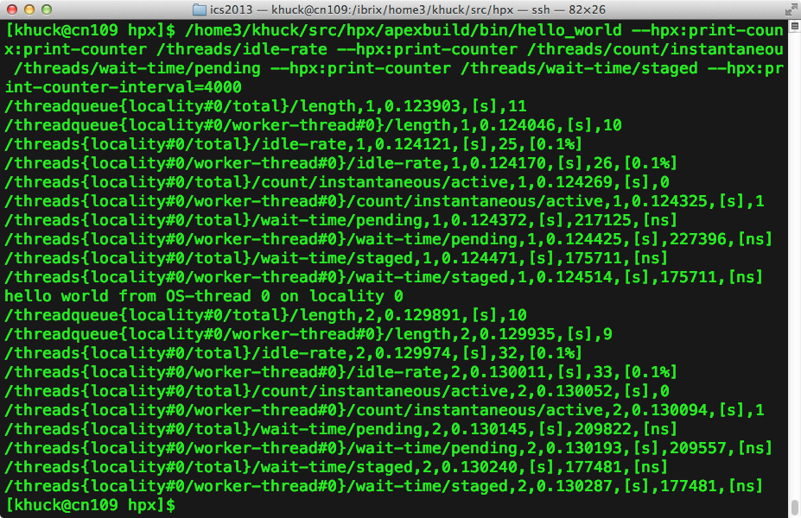
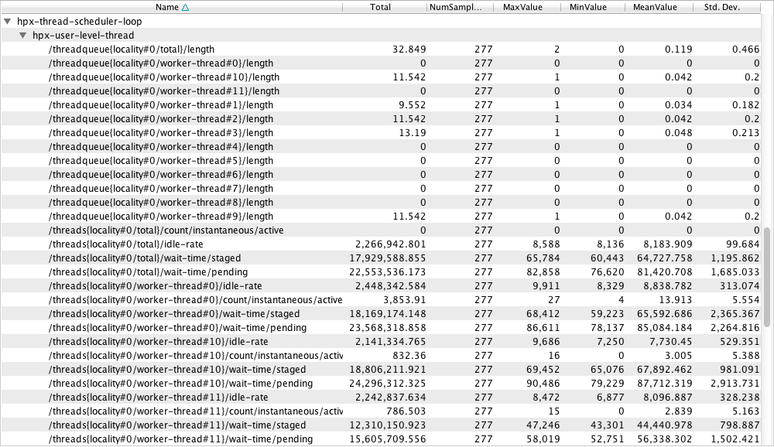
HPX-3 Performance Counters
HPX previously
output to screen
or text file
TAU profile
from APEX
integration
Notes:
HPX performance counters were previously output to screen or a text file. By integrating them with APEX, we capture them to put in a profile, with timer data. Statistics are generated by APEX/TAU automatically.

Slide 6
Instrumenting HPX-3
Initial objective
  High-level observation of productivity in HPX
  Instrument main scheduling loop with APEX
    Separates time spent in scheduler from time executing user-level threads
    Sameer and Hartmut did the heavy lifting
Measurement with proper context
  What is the thread doing and tracking migration
  ITT instrumentation in HPX-3 does this now
  Will be repurposed
Notes:
The HPX-3 runtime thread manager was instrumented with APEX timers. This instrumentation will provide insight into how much time is spent in runtime thread scheduling as opposed to actual application processing.

Slide 7
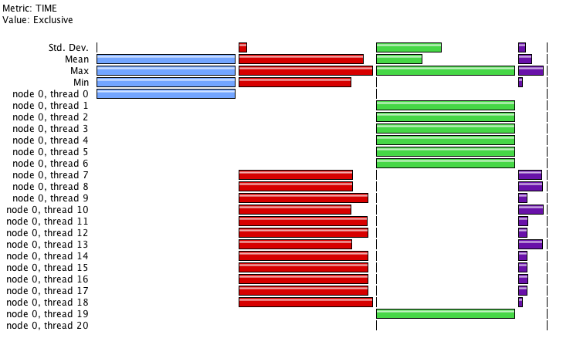
HPX-3 Timers
Instrumented the thread scheduler
Separates scheduler time from executing user-level threads
HPX user level
HPX “main”
HPX thread scheduler loop
GTCX on 1 node of ACISS cluster at UO
* 21 / 84 OS threads
* 12 cores (user)
HPX “helper” OS threads
Notes:
Showing 20 of 80 total OS (pthread) threads. The blue bar is “main” from the primary thread of each process. The green bars are .TAU application (the top level timer) for the helper threads. The purple bars are the thread scheduler loop. The red bars are the user level code, representing the overhead of the HPX runtime.
The GTCX application is a significant code example distributed with HPX. It has better scaling behavior and performance than the conventional MPI version of GTC.
The “main” OS thread and the “helper” OS threads are mostly idle during execution.

Slide 8
HPX-3 Trace Timeline View
HPX main process thread
HPX “helper” OS threads
Cyan: HPX
user level
Orange: HPX thread scheduler loop
1 node, 12 ppn job of GTCX on ACISS x86_64 cluster at UO
Notes:
20 total OS (pthread) threads shown in this trace. Same program as the profile in the previous slide, GTCX. There appears to be some implicit synchronization between the threads. That is, the blue/cyan boxes look very lined up. That could be a measurement artifact, or some other artifact, or the actual program behavior. More study is required.

Slide 9
RCR Integration Started
Objective
  Support 3rd person observation in APEX
  Incorporate system context in performance observation
  Integration started just before meeting at LSU
RCRDaemon runs and collects (non-core) HW data
  Energy, power
APEX has RCR client support
  Define RCR_ROOT at Cmake configuration step
  APEX is built with RCR
APEX queries blackboard at program termination for power, energy values
Prototype executed on elo.hpc.renci.org
Notes:
One of the key aspects of the APEX third-person observation design is to incorporate the full system context in any performance observation. With that in mind, the XPRESS team has also been working to integrate the RCRToolkit library into the APEX measurement infrastructure. RCRToolkit exposes holistic hardware and system observations that are not available in the currently executing process space through a shared memory region, called the RCRBlackboard. The APEX prototype has integrated with the RCRBlackboard as a client application, so that non-core hardware measurements such as power and energy can be taken. As the current implementation of RCRToolkit has specific hardware and execution permission requirements, the XPRESS team has established common development systems at both RENCI and LSU that meet the requirements. On the RENCI development system with an Intel Sandybridge architecture, APEX has successfully collected non-core hardware measurements such as power and energy from the RCRBlackboard, which is provided by the RCRDaemon running on that system.

Slide 10
Next Steps
HPX-3 ITT abstraction to use APEX measurement
Measurement wrapper libraries for XPI
Design measurement in APEX with full ParalleX context
More (full) integration with RCRToolkit
Develop performance data API for third-person observation of other XPRESS layers
  XPI <-> HPX <-> OS
Design an APEX event-driven performance model
Notes:
This is an overview slide of the second half of the talk – what we are planning to do. The remaining slides go into detail for each of these bullet items. For starters, we want to extend the ITT instrumentation to use APEX as the measurement. We want to start designing the wrappers for the XPI interface. We want to capture the timers and counters in HPX with the proper ParalleX model context. We want to include RCR functionality so that the runtime can start to observe the OS behavior. In order to support the querying and inserting of data to RCR, we need to design the API for APEX so that HPX and XPI can access RCR. We also want to design the event-driven performance monitoring within that framework.

Slide 11
HPX-3 ITT Abstraction
HPX-3 runtime has been instrumented with Intel Instrumentation and Tracing Technology (ITT)
  Does not support multi-node measurement
  Not freely available in open source form
Abstract ITT measurement and retarget for APEX measurement runtime
  Incorporate current APEX measurements
  Provide scalable multi-node support
  Provides open source profiling support in XPRESS
  Enable measurements with ParalleX context
    Locality, OS thread, HPX thread, HPX parent thread, preemptions, …
Notes:
The HPX-3 runtime has recently integrated Intel Instrumentation and Tracing Technology (ITT). While this measurement gives interesting and valuable insight to the runtime behavior, it does not support multi-node performance measurement, nor is it freely available in open source form. The HPX-3 and APEX developers will work together to abstract the ITT measurements, and re-target the APEX measurement runtime. This will fully incorporate the current APEX measurements with the ITT measurements and provide scalable measurement support beyond a single node. Within this effort, the APEX measurement library will capture all aspects of the observation as it relates to the ParalleX model. http://software.intel.com/sites/products/documentation/gpa/12.4/Overview.htm

Slide 12
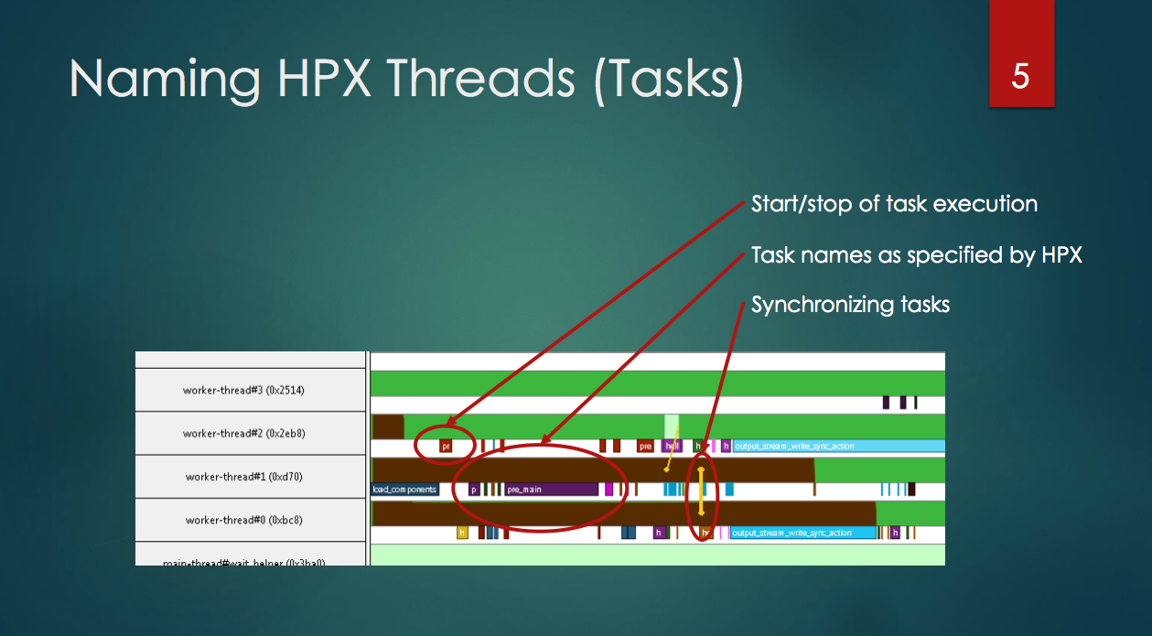
HPX Trace in Intel Tools
Understanding
No multi-node (locality) support
No explicit annotation of thread
state or preemption
No explicit annotation of “provenance”
of the HPX thread
Slide from “Instrumenting HPX”, presented at XPRESS: Collaboration on System Performance
at LSU, Feb 6-8 2013, http://stellar.cct.lsu.edu/files/xpress_csp/InstrumentingHPX.pdf
Notes:
Wanted to show that Intel tools are capturing data in conventional parallel model format. The “worker threads” are OS threads. The colored bars on the timeline are the HPX threads.
AS I UNDERSTAND IT: There is no multi-node (locality) support. There is no explicit annotation of whether an HPX thread completed its execution or was preempted and migrated to another thread (possibly on another locality!) There is no explicit annotation of the “provenance” of the HPX thread – i.e., the HPX thread which spawned it. By capturing this information we do more than HPX is doing / can do with ITT. This understanding COULD be wrong, of course…

Slide 13
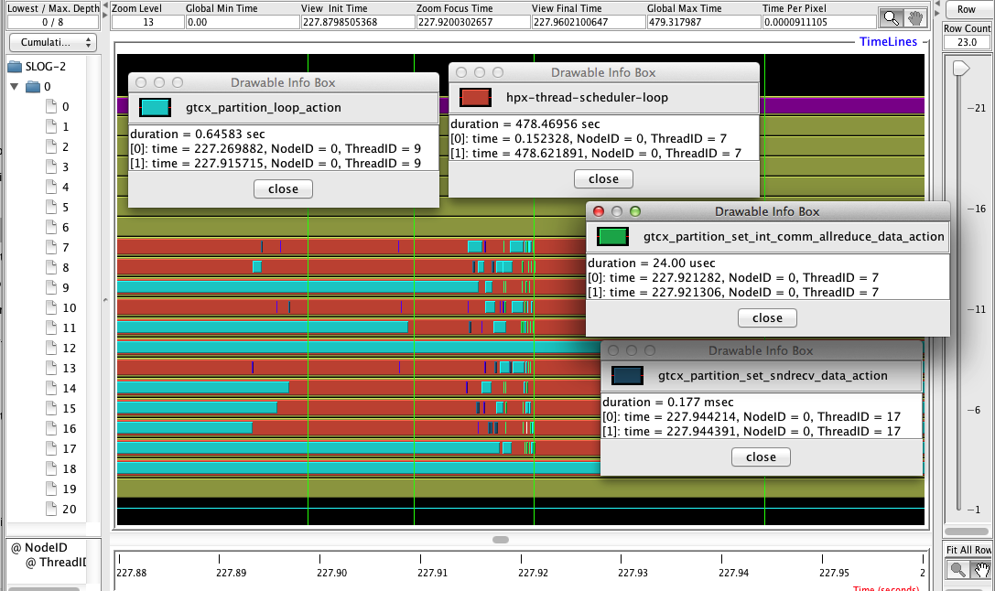
Same Data Available in APEX
Have HPX thread descriptions that
we can capture in measurements
Notes:
Because we have detailed HPX thread descriptions for the timer names, we can capture what the HPX thread task is doing!

Slide 14
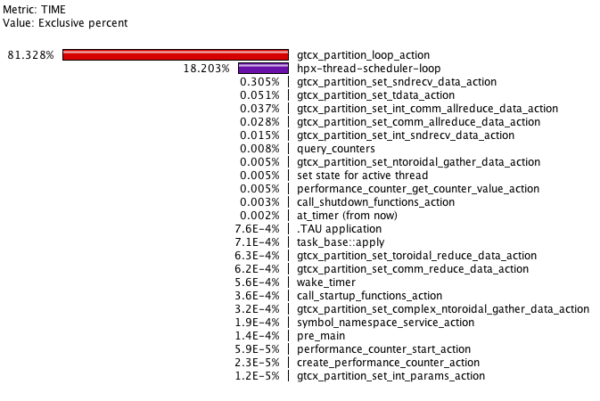
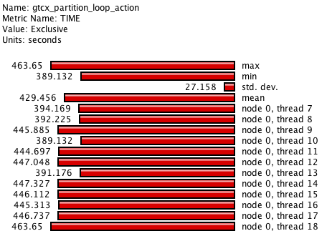
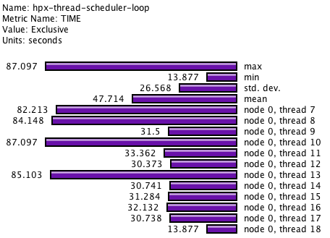
HPX Profile Data from APEX
All of the HPX tasks
scheduled are capture
in distinct timers
3-18% of total
thread runtime
Notes:
This is a profile of the same run from the previous trace timelines. You should point out that all of the HPX tasks that were scheduled are distinct timers in the profile. The thread scheduler appears to represent between 3% and 18% of the total runtime, depending on the thread. This could be a load-balancing issue when running with 12 threads. For 32 threads (running on a fatnode of ACISS) with the same input data, the thread scheduler was between 15% and 18.5% of the total runtime.

Slide 15
ParalleX “World View” Measurements
Current APEX approach uses conventional measurement dimensions
  Process, OS thread
  Timer dimension (thread context)
Want to capture additional/different dimensions
  HPX thread context
    id, parent ID, preemption, state transitions, …
  Performance properties (measurements) of:
    AGAS, LCO, Parcels, Futures
Want to distill the measurements
  To enable scalability
  To share on RCRBlackboard
  To provide introspection between layers
Utilize HPX itself to create
Notes:
While the prototype implementation of APEX provides insight into HPX applications, there are some drawbacks to our prototype approach. The most significant of these is that the performance data is not yet modeled in the ParalleX view of the world. For example, the performance model currently used in APEX uses measurement dimensions that include only the currently executing process and operating system thread, with no explicit support for capturing the HPX-3 runtime thread. However, until the ParalleX performance model is fully captured in APEX we still gain valuable insight into the application by implementing our prototype it in existing tools, running on existing systems, and mapping back to the ParalleX model. This will also include distilling the observation down to a granularity that can be shared as a scalable observation on the RCRBlackboard.
The AGAS, Local Control Objects (LCO), Parcel Transport and Future synchronization performance data are currently unmonitored. Measurement only really happens in the thread scheduler.

Slide 16
Integration with RCRToolkit
Currently only observing daemon data
  Energy, power
APEX will broadcast performance data to the blackboard
  Current HPX runtime performance state
  Timer statistics
APEX will also consume data from the blackboard
  Runtime layer will know about problems in the OS
    Contention, latency, deadlock…
  DSL layer will know about problems in the runtime
    Starvation, latency, overhead, contention…
Notes:
The current prototype integration with RCR is unavailable, as the daemon isn’t running on the RENCI machine, and Allan and Rob have started re-writing the whole thing. I would capture some sample output for you, but because of those problems, I can’t…

Slide 17
APEX: monitoring and writing to RCR
Profiles,
Traces
APEX
TAU
RCR Blackboard
DSL or
Legacy
State
XPI
State
HPX
State
OS
State
HW State
APEX:
- “broadcasts” performance state
- monitors performance state
- “triggers” an action
RCR Daemon
Notes:
This is an overview of how APEX captures and reports the system performance state. It’s the OpenX stack laid on its side. The blackboard provides information sharing between the HW, OS and the runtime. In addition to capturing the HPX and application performance state, it will report the performance state to the blackboard, and provide out-of-band performance validation and signaling of the other layers that an action needs to be taken.
The other slides show the 3 steps in sequence.

Slide 18
APEX Performance Events
APEX
RCR Blackboard
DSL or
Legacy
State
XPI
State
HPX
State
OS
State
HW State
APEX:
- “broadcasts” performance state
- monitors performance state
- “triggers” an action
RCR Daemon
Notes:
APEX broadcasts the current performance state of the HPX runtime and the application, using the blackboard. This current performance state could be currently executing timers, most recent counter values, thread states, etc.

Slide 19
APEX Performance Events
APEX
RCR Blackboard
DSL or
Legacy
State
XPI
State
HPX
State
OS
State
HW State
APEX:
- “broadcasts” performance state
- monitors performance state
- “triggers” an action
RCR Daemon
Notes:
An HPX thread triggers the observation of the blackboard, which tells APEX to read the state of all the layers. The current performance state is compared to re-configurable performance thresholds, and when one is crossed, it decides to signal the respective layers.

Slide 20
APEX Performance Events
APEX
RCR Blackboard
DSL or
Legacy
State
XPI
State
HPX
State
OS
State
HW State
APEX:
- “broadcasts” performance state
- monitors performance state
- “triggers” an action
RCR Daemon
Notes:
APEX “signals” the appropriate layers about the performance threshold crossing, and those layers respond appropriately.

Slide 21
Third-person Observation Support
Design performance data API for third-person observation of other XPRESS layers
  HPX, LXK, XPI all broadcast and listen
System-wide perspective available through HPX
  Counters already collected as third party measurement
  Communication implicit in the HPX runtime…
  APEX can use HPX to elevate performance data to system-wide perspective
Notes:
We are tasked with providing an API in APEX so that the layers can probe the state of the system.
Important to note that right now, APEX doesn’t know which locality/thread will get the responsibility of reporting HPX counters. It can happen on any thread. All counters are reported to APEX in third-person perspective. In the same way, can APEX use HPX to reduce and distribute the system-wide performance view. That should work fine for counters, but what about timers? Timers are implicitly collected in a first-person perspective… they need to be reported somehow to provide a third-person view.

Slide 22
APEX Event-driven Observation
APEX will provide out-of-band analysis of performance data
  Running concurrently with and utilizing HPX
Support introspection and active feedback
  Observation of performance anomaly leads to state requiring action
  Reconfigurable thresholds
“Signal” the other layers of the stack to take action
  HPX runtime
  Kitten/LXK OS (event-driven OS control)
Notes:
We discussed this feature at the meeting at LSU. Ron is interested in event-driven OS control, so that the Operating System can react to requirements of the program. HPX will want to react to the requirements of the application, as well as problems in the OS. The Application (XPI) might need to react to the state of HPX or the OS.

