Slide 1
RAJA vs Apollo
Benchmark comparison to find overhead sources
Used wave-eqn.cpp example
Increased solution time to T = 82.0 (from .82) just to increase test run length
Main loop iterates 371,090 times
Only one parallel region, only one size.
Executed on 36-core Intel(R) Xeon(R) Gold 6140 CPU @ 2.30GHz, using 16 OpenMP threads, auto (dynamic)

Slide 2
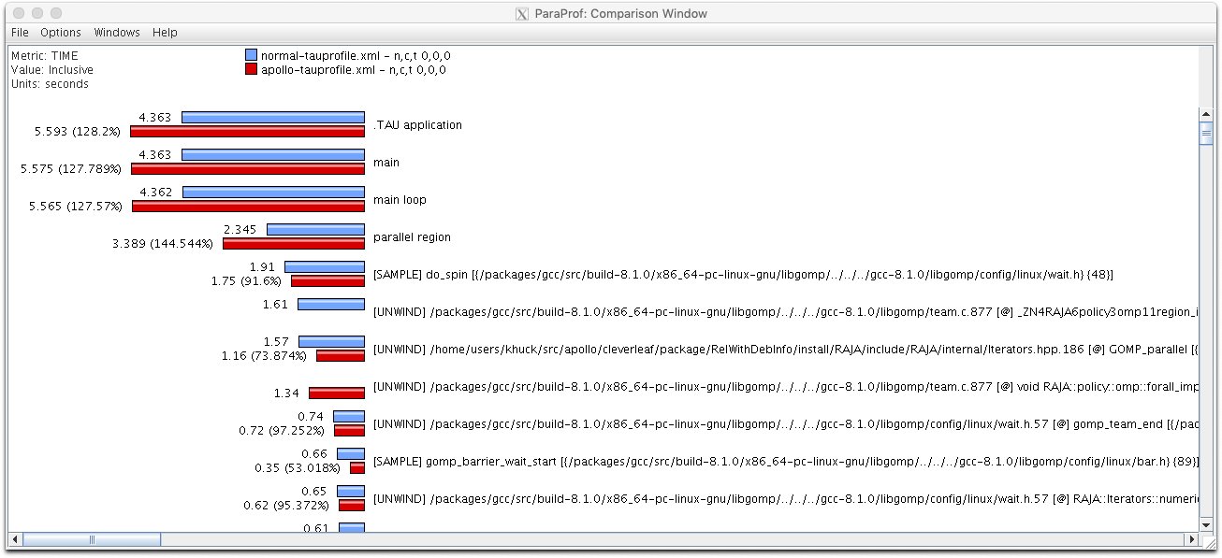
How much overhead? (RelWithDebInfo)
About 25-30%

Slide 3
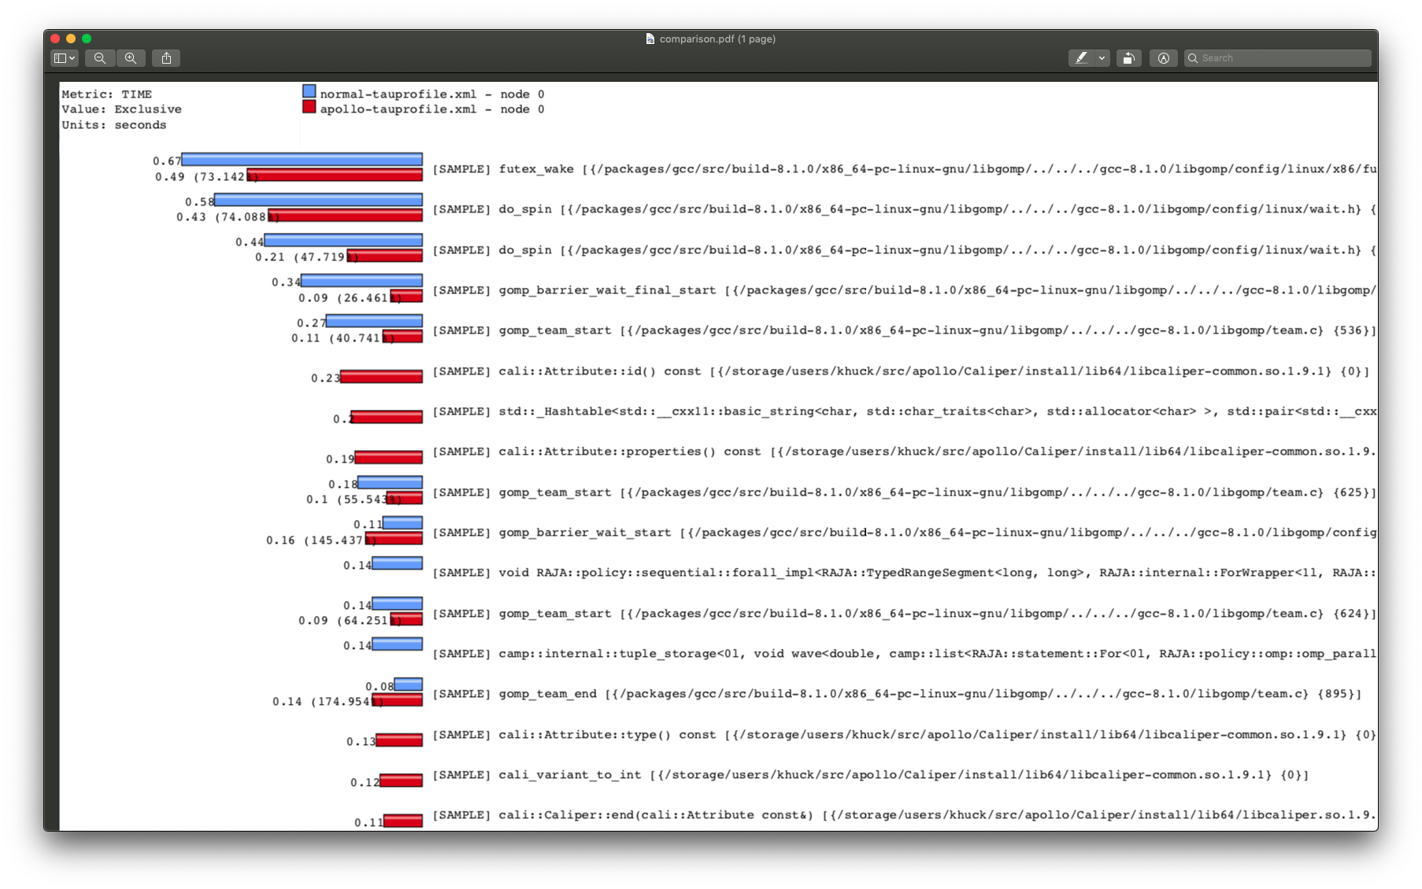
Exclusive view, samples

Slide 4
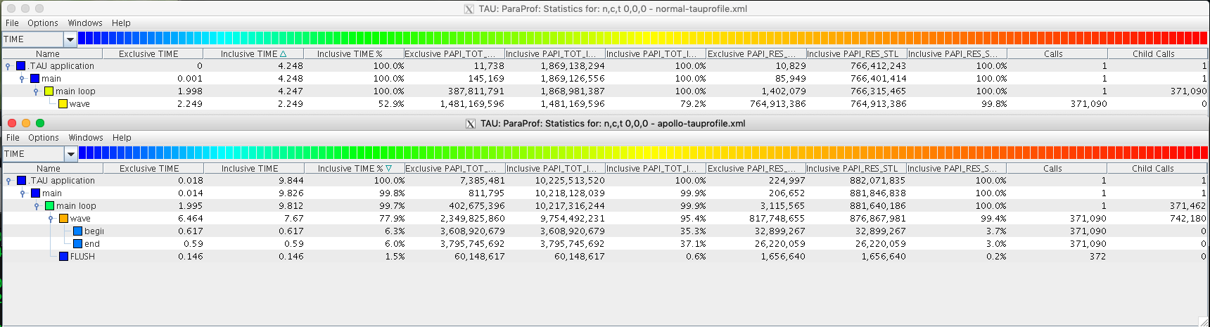
Adding instrumentation to Apollo
PAPI_TOT_INS and PAPI_RES_STL to see if overhead is more work or more synchronization
Conclusion...more work. Need to reduce code in begin/end processing...

Slide 5
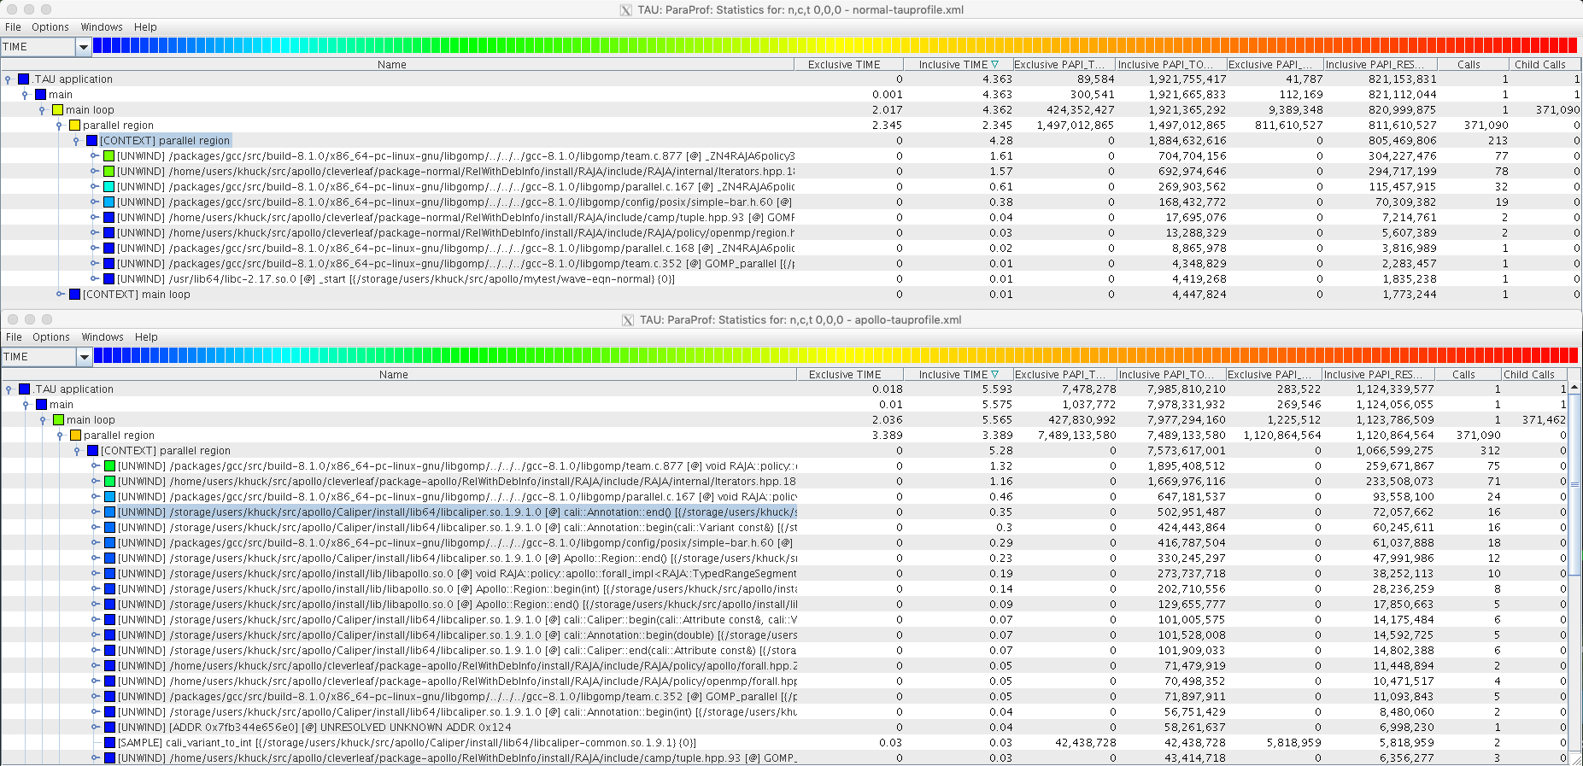
Lots of little things... (different inst.)

Slide 6
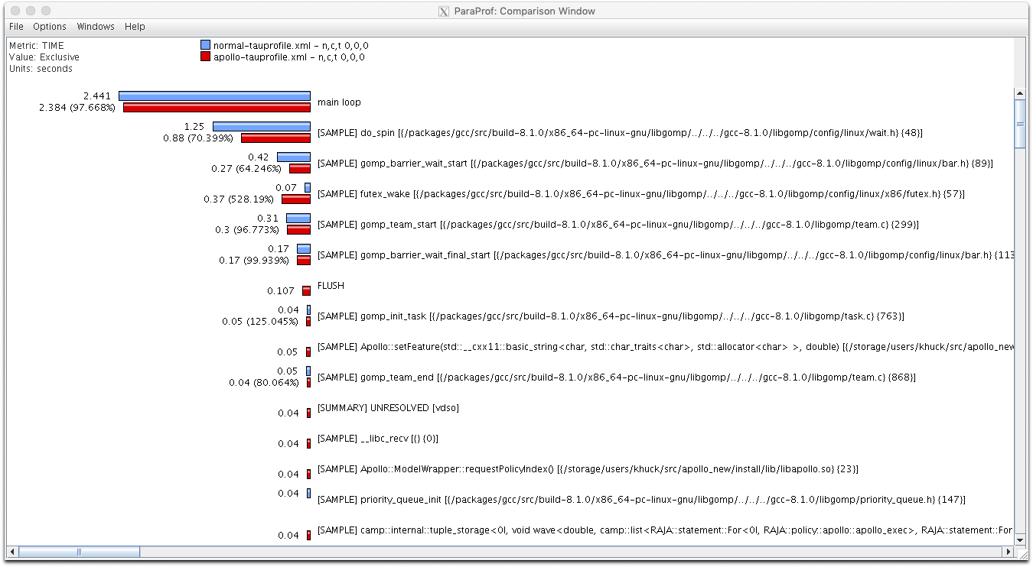
Comparing Release builds (after)...
Still penalized for constructing new teams...but small flush penalty

Slide 7
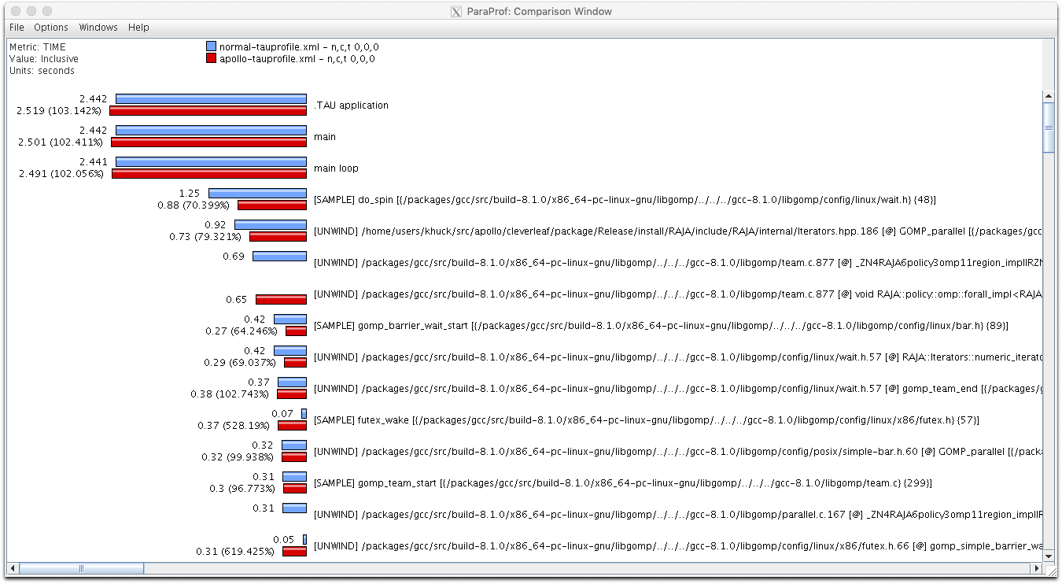
Comparing Release builds (inclusive)...
In this pathological case... ~2% overhead remains.
Team construction cost absorbed elsewhere

