Slide 1

General Hybrid Parallel Profiling
Allen D. Malony¹, Kevin Huck²
¹Department of Computer and Information Science
²Performance Research Laboratory

Slide 2
General Hybrid Parallel Profiling
Two types of measurement approaches
  Sampling-based measurement (SBM)
    measure performance by statistical observation
    a.k.a. statistical sampling or event-based sampling
  Probe-based measurement (PBM)
    measure performance by insertion of code into a program
Is it possible to combine approaches?
Idea is to investigate a hybrid approach
  Integrate sampling-based and probe-based methodology
  Improve performance observability
A. Morris, A. Malony, S. Shende, K. Huck, “Design and Implementation of a Hybrid Parallel Performance Measurement Systems,” International Conference on Parallel Processing (ICPP), San Diego, Septemer 2010.
A. Malony, K. Huck, “General Hybrid Parallel Profiling,” International Conference on Parallel,
Distributed, and Network-based Processing (PDP), Turin, Italy, February 2014.

Slide 3
Approach Assumptions
SBM can measure/attribute performance accurately if:
  Code segments are executed repeatedly
  Execution is long enough to collect a large # of samples
  Sampling frequency is uncorrelated with execution
  SBM is grounded in statistical sampling theory
PBM can measure performance accurately if:
  Overhead of executing the measurement code is sufﬁciently small relative to the size of the entity being measured
  Intrusion due to measurement overhead in one thread does not affect the performance of any other threads
  PBM is grounded in measurement theory

Slide 4
Hybrid Performance Measurement
Combine SBM and PBM techniques
  Look for opportunities for synergies
Alternatives
1) Just use both at the same time, but independently
- works fine (as long as measurements tools are compatible)
- lose benefit of integration between SBM and PBM data
2) Base combined system on SBM
- Dynamic statistical sampling of PBM data
- Example: mpiP (MPI communication), HPCToolkit, ...
3) Base combined systems on PBM
- Augment PBM view with SBM data
- Dynamic measures with event correlation from PBM

Slide 5
Hybrid Trace Measurement (TAUebs)
Inspired by Barcelona Supercomputing Center (BSC) work
Combines TAU, PerfSuite, and HPCToolkit
  TAU for probe-based instrumentation and measurement
  PerfSuite technology for timer-based sampling
  HPCToolkit for call stack unwinding on fully-optimized codes
Foundation is TAU (PBM) with linked SBM capabilities
  Synergy through "context" linking
  Determination of dynamic offset from event start (BSC)
Tradeoff of degree of instrumentation versus SBM type
  Utilize SBM to observe fine-grained performance
  Use SBM to sample performance not easily obtained
Augment PBM with SBM performance views

Slide 6
The Notion of Context in TAUebs
SBM methods capture context on interrupts (traps)
  Program counter (PC) and possibly PC call path
    walk the call stack to see all active routines
  Performance data and other state information
  Together it gives the sample context (PC context)
PBM methods also have context
  Current event and possibly a TAU event path
    any instrumented event (routine or user-defined)
    walk the event stack to see all active events (TAU event path)
  Performance data and other state information
  Together it forms the event context (TAU context)

Slide 7
Context Merging
Get more information if can merge contexts
At interrupt, SBM can “reach over” into PBM
  Current TAU context contains event state
  PC context can be qualified with TAU context
    think about "sampling" TAU context and save with PC context
There may be overlap in PC call path and TAU event path
  Offers opportunity to optimize retention of context information
  Need to figure out how to resolve overlap
  Alternative 1: store both
    problems: handle C++ name mangling, non-routines not handled
  Alternative 2: walk PC call stack to event at top of event stack
    problem: need to make efficient at runtime

Slide 8
TAU Event Stack and PC Callstack
Call stack snippets
. . .
interrupt!
. . .
D
C
Loop2
Bar
Loop1
B
PCkey
TAUkey
Bar
Foo
Foo
A
Main
Main
TAU
Event Stack
PC
Call Stack
Loop1 and Loop2 are not routines!

Slide 9
TAUebs Measurement
What measurement is made with each sample?
Capture a trace of EBS samples
Each TAUebs sample contains:
  Timestamp
  TAUkey (key to current TAU event stack)
  PCkey (key to current PC call stack)
  Hardware counters
  Delta (optional)
    subtract start time of top TAU event from timestamp
    support BSC code folding analysis

Slide 10
TAUebs Data Analysis (Trace)
EBS to OTF trace converter
Analyze EBS trace with trace analysis tools
For each sample
  Place timestamp in trace record
  Merge TAU event stack and PC call stack
    merged call path
  Create event ID for merged call path
    put in trace record
  Put collected PAPI metrics in trace record
  Can store PC locations in trace record as well

Slide 11
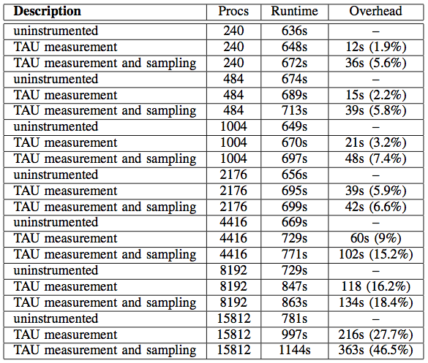
TAUebs FLASH Experiments on IBM BG/P
FLASH is a nuclear astrophysics simulation
Compare
measurement
overhead
  TAU only
  Hybrid
Adding EBS
tracing leads to
high overhead at
high core counts

Slide 12
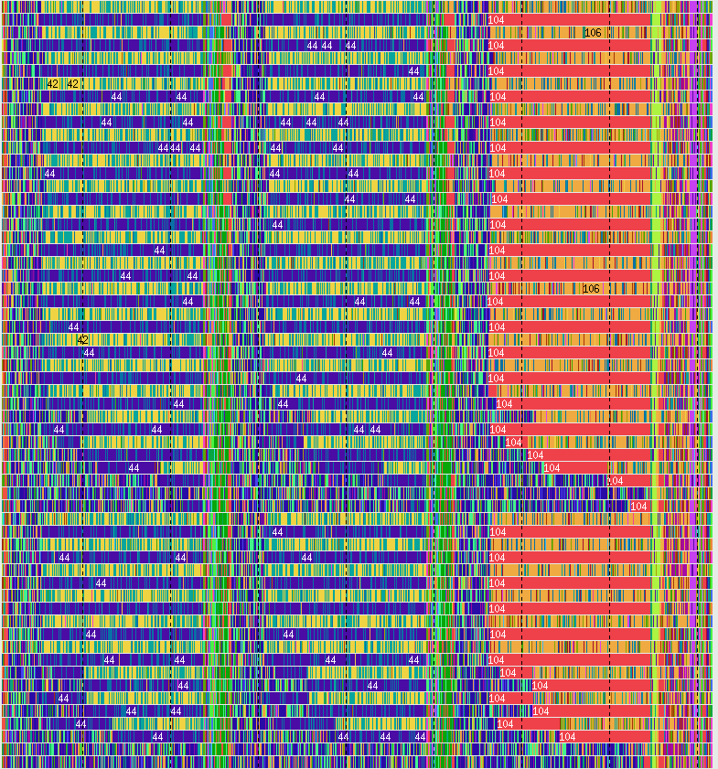
TAUebs Trace for FLASH (240 processes)
Color-coded by filename
Alternating patterns
due to dual mode
40 secs

Slide 13
Hybrid Profiling
Hybrid tracing with TAUebs is not scalable
  Need to have a parallel profiling methodology
However, hybrid profiling is more challenging
  Online analysis to is more complex
Can leverage the hybrid ideas in TAUebs
  Associate samples with the active probe context
Goal is to capture all of the performance information possible at runtime to produce equivalent profile results from trace-based analysis

Slide 14
Approach
TAU profiling
EBS at 100ms
  Per thread
  Determine PC
  Unwind callstack
  Use Linux backtrace facility
Sample mapping
  Determine event context (TAU context)
  Update hybrid profile for every unique tuple:
  {event context, PC, call path}
  Done for every thread of execution

Slide 15
Hybrid Profile Generation
At the end of application’s execution
  Sample addresses are resolved to symbolic names
    use GNU binutils (if fail, display as “UNRESOLVED” + address)
  Profile metric statistics are calculated
  Hybrid profiles are written to files
For each probed event context for each thread
  Profile entry created to represent samples in the context
    each unique sample represented as “SAMPLE” event
    “SUMMARY” entry aggregates across samples
  “context events” share the name of probed parent
    labeled as “CONTEXT” in the profile
  “UNWIND” event nodes are call sites that eventually end with a sample event

Slide 16
A Simple Hybrid Profiling Example
Sequential matrix multiplication
  3 matrix sizes: 128x128, 256x256, 512x512
  Use small routines that are hard to probe
Insert probes to record phases and parameters
  PHASE_START
  PHASE_STOP
  PARAM_PROFILE_START
  PARAM_PROFILE_STOP
Compare sampling-only, probe-only, and hybrid
Machine: Intel Xeon X5650, 2.67 GHz, 72 GB

Slide 17
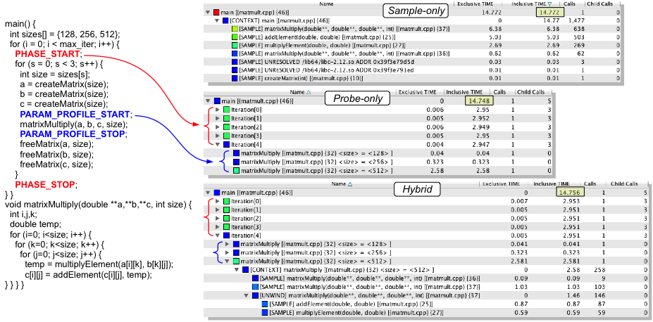
Sequential Matrix Multiplication

Slide 18
Benefits of Hybrid Profiling
PBM can not be used observe small events
  Overhead of measurement affects accuracy
  High-frequency probes also accumulate overhead and can intrude on code behavior
  Disabling events is necessary
Hybrid profiling uses sampling to see lightweight code execution performance
Probe context allows richer sample projection performance on program regions and semantics
TAU’s unique event naming allows semantics to be extended to hybrid profiling data

Slide 19
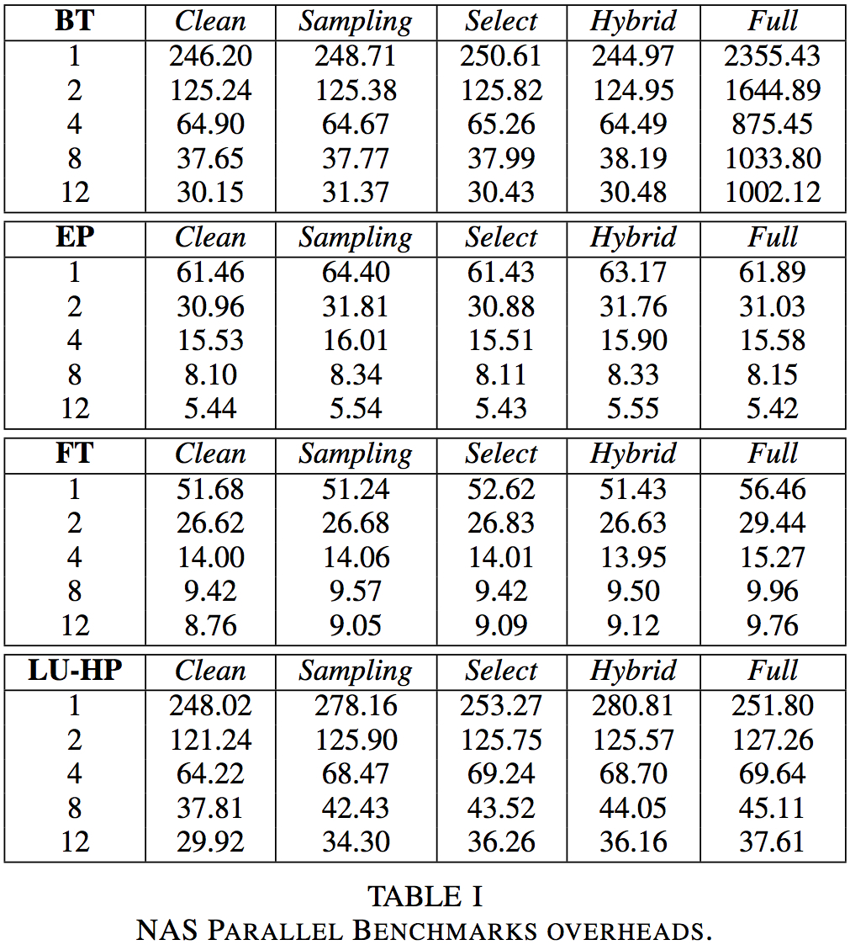
Evaluation of Hybrid Profiling Overhead
Test on OpenMP
version of NAS
parallel benchmarks
Characterize overhead
against uninstrumented
runs (Clean):
  Full / Select (probe)
  Sampling
  Hybrid
Interested in relative
overhead of hybrid

Slide 20
NPB BT Experiments
Naïve full instrumentation has high overhead
Want to see hybrid data with respect to X,Y,Z phases
phases

Slide 21
Merged Stack From NPB 3.2.1 BT.B
Program Function Stack:
binvcrhs_ {x_solve.f, 573}
x_solve_.omp_fn.0 {x_solve.f, 354}
x_solve_ {x_solve.f, 41}
adi_ {adi.f, 9}
MAIN__ {bt.f, 159}
main
__libc_start_main
SAMPLE
Merged Stack:
[SAMPLE] binvcrhs_ {x_solve.f, 573}
[SUMMARY] binvcrhs_
[UNWIND] x_solve_.omp_fn.0 {x_solve.f, 354}
[CONTEXT] OpenMP_PARALLEL_REGION
OpenMP_PARALLEL_REGION
X_SOLVE [x_solve.f]
ADI [adi.f]
BT [bt.f]
UNWIND
COMMON
TAU Event Stack:
OpenMP_PARALLEL_REGION
X_SOLVE [x_solve.f]
ADI [adi.f]
BT [bt.f]
CONTEXT
COMMON

Slide 22

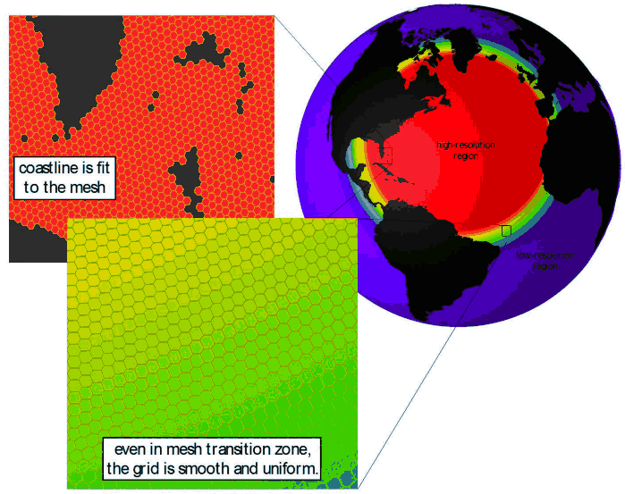
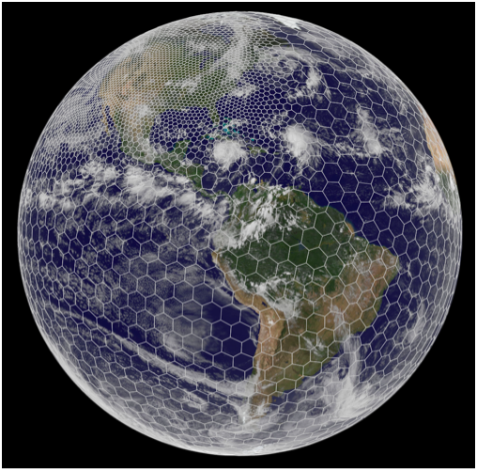
MPAS-Ocean Engagement
Use multiscale methods for accurate, efficient, and scale-aware models
of the earth system
MPAS-O uses a variable resolution irregular mesh of hexagonal grid cells
Cells assigned to MPI processes as “blocks”
  Each cell has 1-40 vertical layers, depending on ocean depth
MPAS-O has demonstrated scaling limits when using MPI alone
Look at increasing concurrency
  OpenMP
  Vectorization
Use hybrid profiling to better understand performance behavior
Experiments performed on Hopper
  Cray XE6

Slide 23
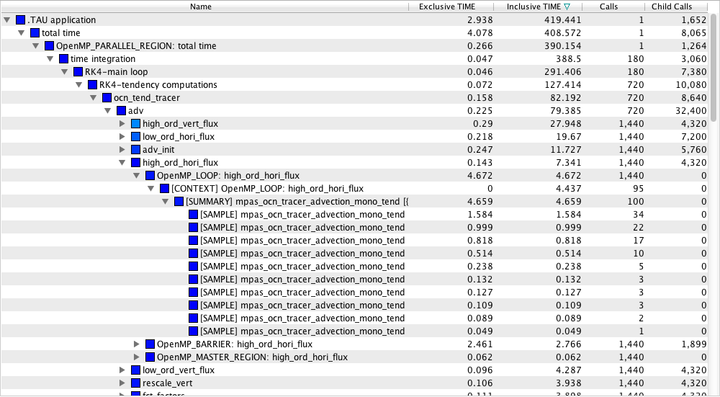
MPAS Hybrid Profile
OpenMP probes
Samples

Slide 24
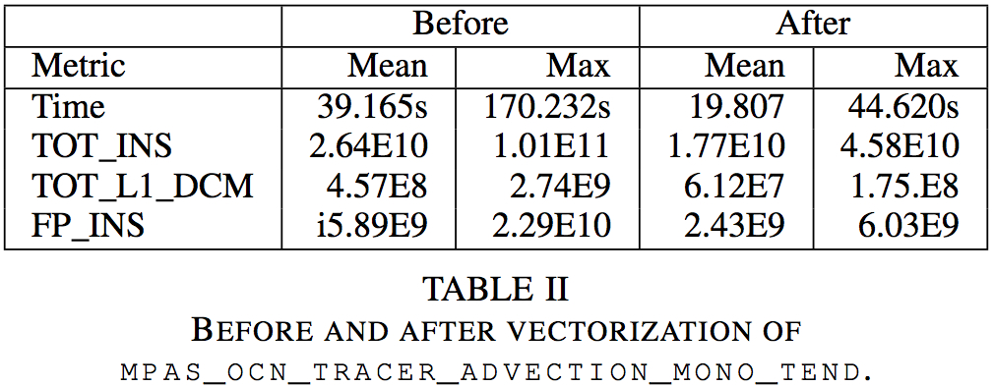
Hybrid Profiling to Measure Vectorization
Solver vectorization gave ~20s reduction (mean)
Worst case solver performance went from 170s to 44s
Subsequent ~52s reduction in MPI_Wait time! Why?

Slide 25
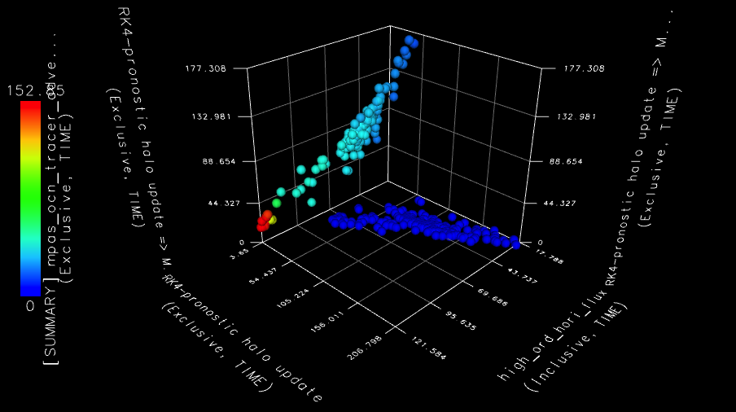
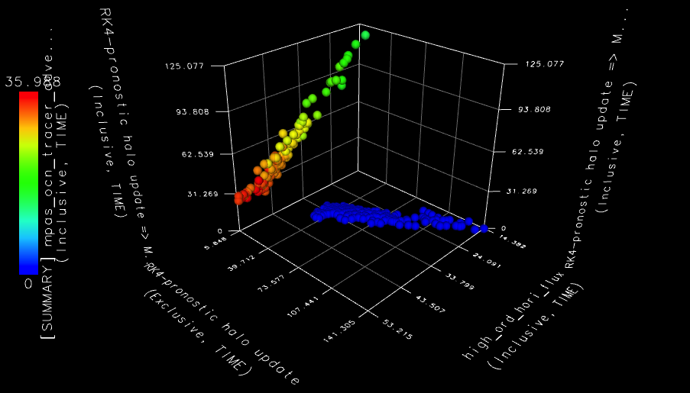
Vectorization Analysis with Hybrid Data
Computation and synchronization are correlated
Load imbalances seen in larger MPI wait (unvectorized)
Vectorization tightens the imbalances
  Depth + color show vectorization effect (faster, more uniform)
  Smaller communication waiting (height and width)
non-vectorized
vectorized

Slide 26
Samples in Contexts – before…
~346 samples
Sample locations
~936 samples
Timer Contexts
Notes:
Here’s a heat map, showing the timer contexts on the X axis and the sample locations on the Y axis. The map is limited to the top 10 contexts and top 10 sample locations. The high_ord_vert_flux (high order vertical flux) computation was vectorized, reducing the time spent in the mpas_ocn_tracer_advection_mono_tend function. The pronostic_halo_update is when the worker threads are waiting on the master threads to do the MPI exchange after the high order vertical flux.

Slide 27
Samples in Contexts – after vectorization
~181 samples
Sample locations
~330 samples
Timer Contexts
Notes:
Because the computation in mpas_ocn_tracer_advection_mono_tend time is reduced overall, the time spent in the subsequent pronostic halo update is also reduced significantly.

Slide 28
Next Steps in Hybrid Parallel Profiling
Hybrid parallel profiling provides the user with various options to control measurement
  Probing: select events, enable event paths and depth
  Sampling: interrupt period, call stack unwinding depth
  Capture of timing information and hardware counters
These are also dynamic hybrid controls
  Unwinding of call stack to last probed event
    reduces time spent unwinding
  Need to determine an event’s parent quickly
  Useful for event contextualization and callsite profiling
Hybrid techniques can be used to implement “folding”
  Collect samples with counters for a region to create a statistical model of performance

