Slide 1
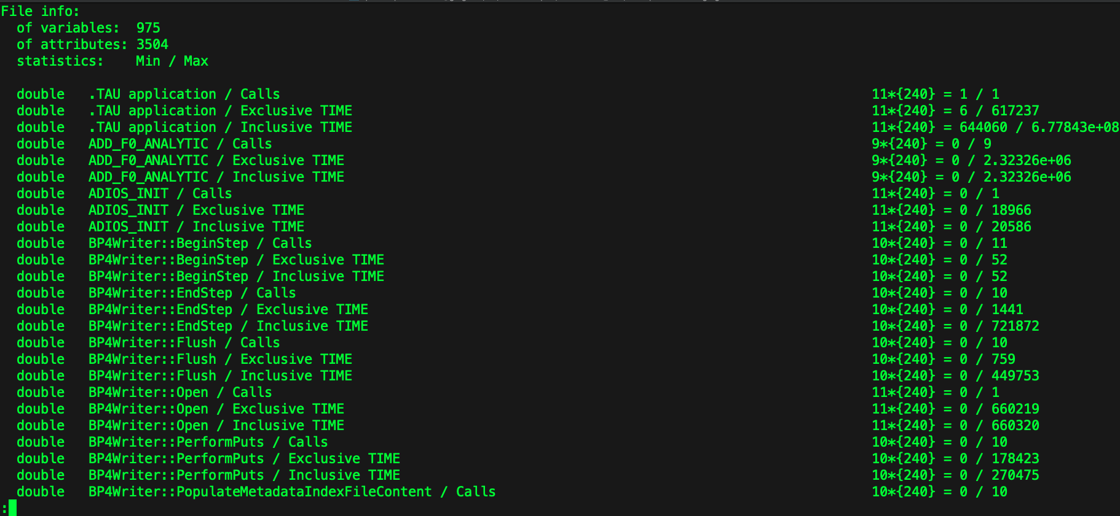
TAU data model: timers
XGC CAMtimers
ADIOS2 timers
Not shown: MPI, Kokkos, OpenACC, etc. timers
Notes:
The data is currently written at the same frequency that CAMtimers writes the XGC data, which is configured to be each timestep.
Timer data is stored as ADIOS2 variables.

Slide 2
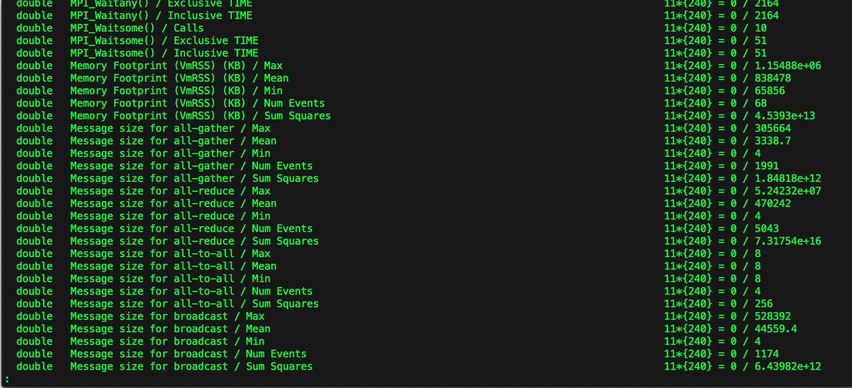
TAU data model: counters
Monitoring counters
TAU counter data also stored as ADIOS2 variables
MPI counters

Slide 3
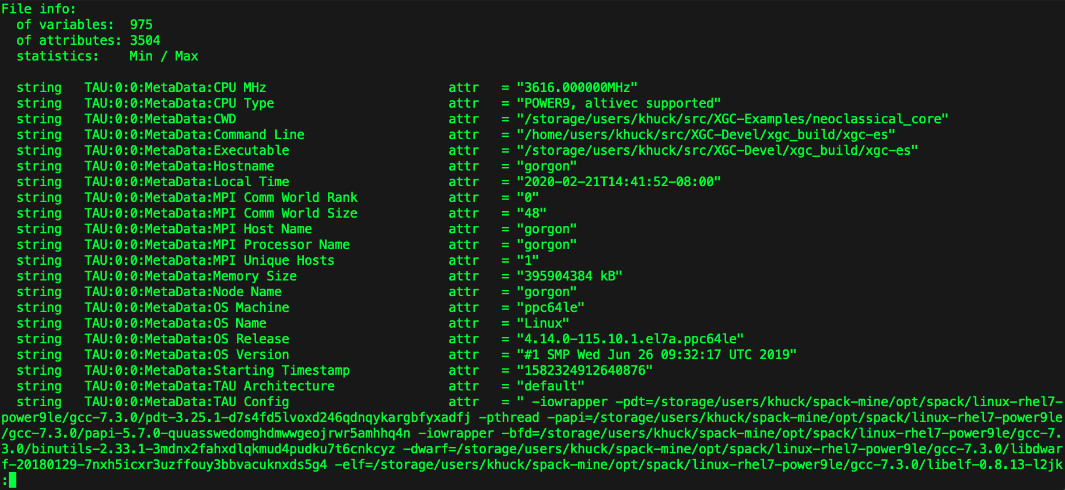
TAU data model: metadata
TAU metadata stored as ADIOS2 attributes

Slide 4
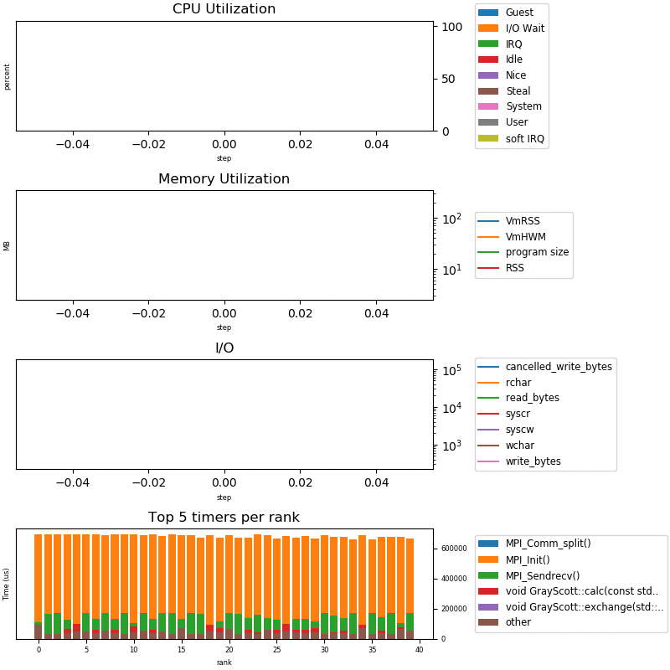
Visualization of TAU data for EFFIS
Example: ADIOS2 gray-scott tutorial example running on 1 POWER9 node for 1000 iterations, performance data output every 10 iterations
Time series graphs of utilization stats (can add gpu data, too)
Per-rank performance view of top 5 functions (configurable)
Python3 script to read ADIOS2 BP/SST data into numpy/pandas and viz with matplotlib
Could be configurable/customizable
Could integrate data from all apps
Notes:
The figure is an animated gif, it will only run in presenter mode
This was a quick implementation in python, currently hard-coded but could be configurable with json/yaml input parameters

