Slide 1
Kokkos Tools:
Kokkos support in the TAU and APEX portable performance measurement tools
Kevin A. Huck
Oregon Advanced Computing Institute for Science and Society (OACISS)

Slide 2
TAU Performance System

Slide 3
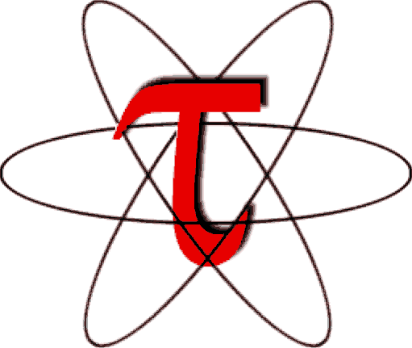
TAU Performance System
Tuning and Analysis Utilities (29+ year project)
Integrated performance toolkit:
  Multi-level performance instrumentation
  Highly configurable
  Widely ported performance profiling / tracing system
  Portable (java, python) visualization / exploration / analysis tools
Supports all major HPC programming models
MPI/SHMEM, OpenMP, OpenACC, CUDA, HIP, SYCL/OneAPI, Kokkos...
Support for ML/AI frameworks: TensorFlow, pyTorch, Horovod
Integrated with PAPI, LIKWID for hardware counter support
https://tau.uoregon.edu or https://github.com/UO-OACISS/tau2 (public mirror)

Slide 4
Performance Measurement
Timers
  Requires instrumentation of some kind
    Manual, automated
    Source, compiler provided, binary
    Library callbacks, API wrappers, weak symbol replacement
  Simple to implement
Sampling
  Requires specialized system libraries / support
    Periodic signals, signal handler
    Call stack unwinding
  No modification to executable/library needed
  Potential to interfere with system support (signal handlers)
  Can mix with timers to generate a hybrid profile

Slide 5
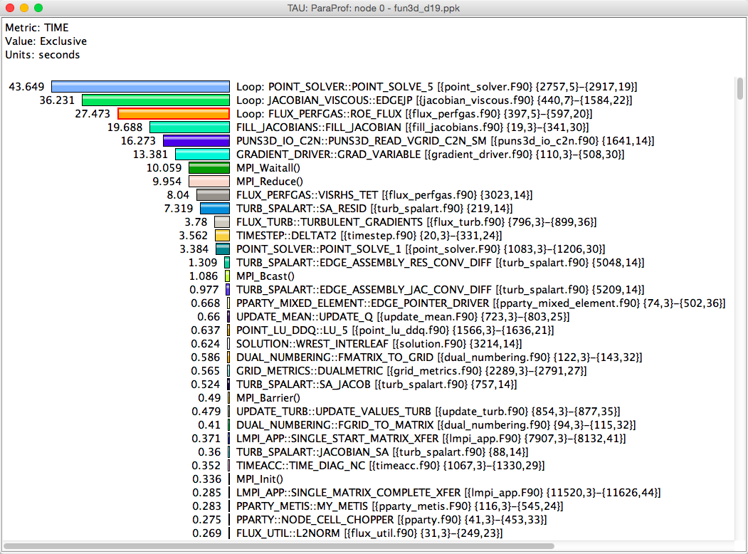
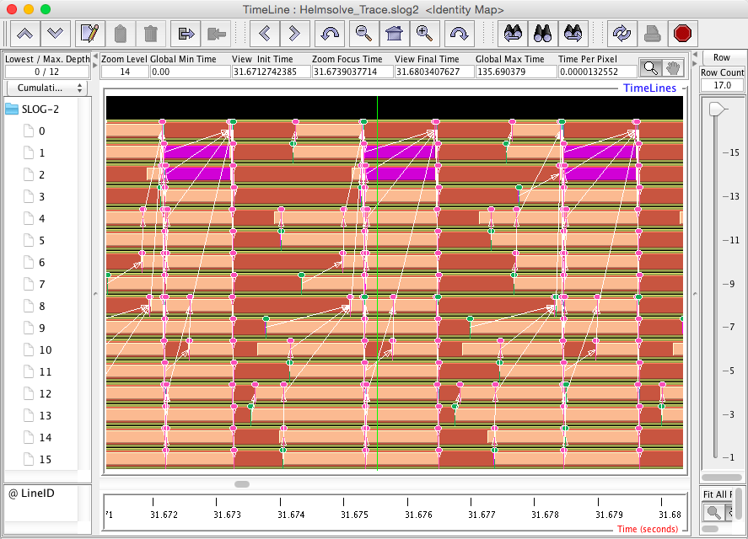
Profiling and Tracing
Profiling: how much time was spent in each measured function on each thread in each process?
  Collapses the time axis
  No ordering or causal event information
  Small summary per thread/process, regardless of execution time – only grows with number of timers & threads/processes
Tracing: record all function entry & exit events on a timeline
  Detailed view of what happened
  The longer the program runs, the bigger the trace

Slide 6
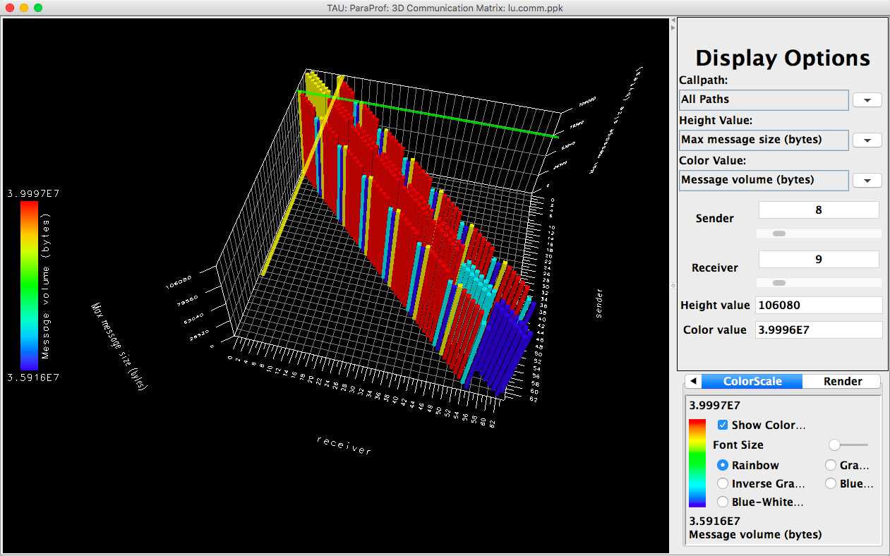
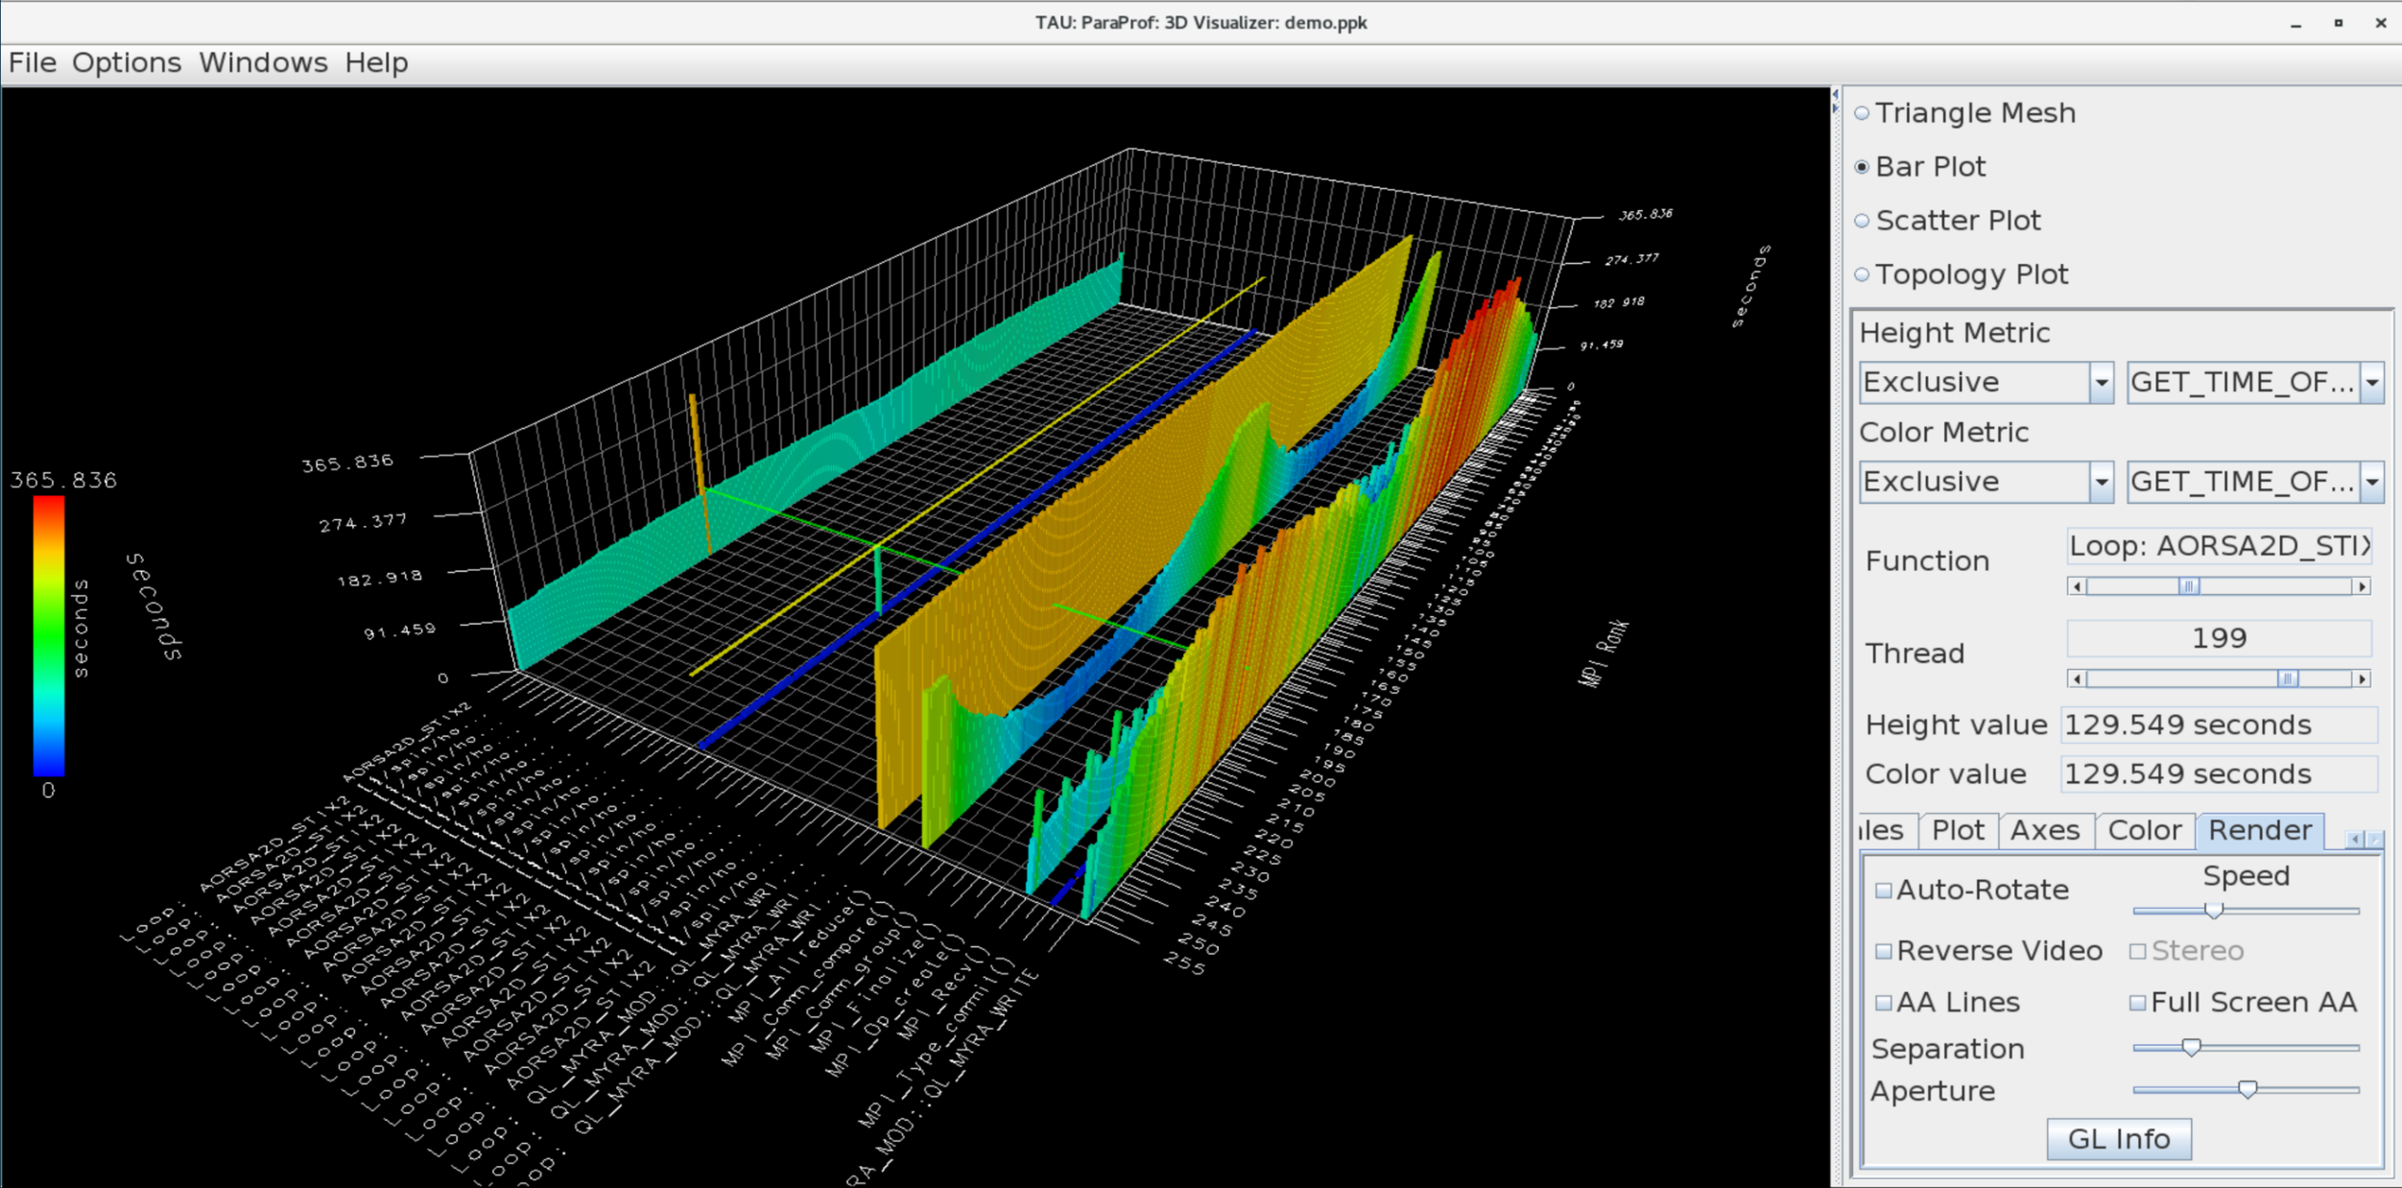
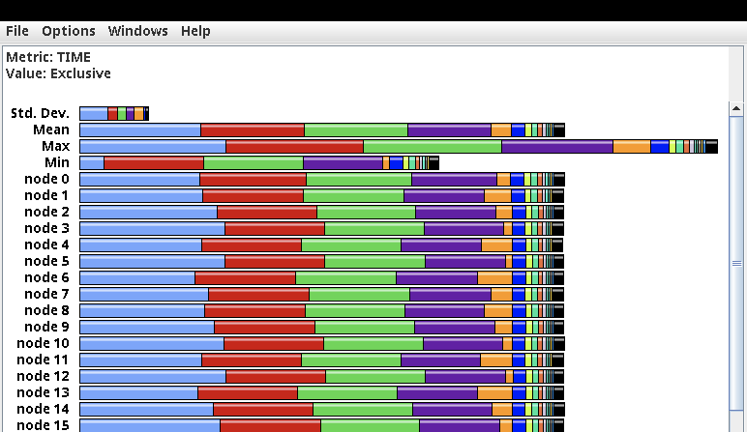
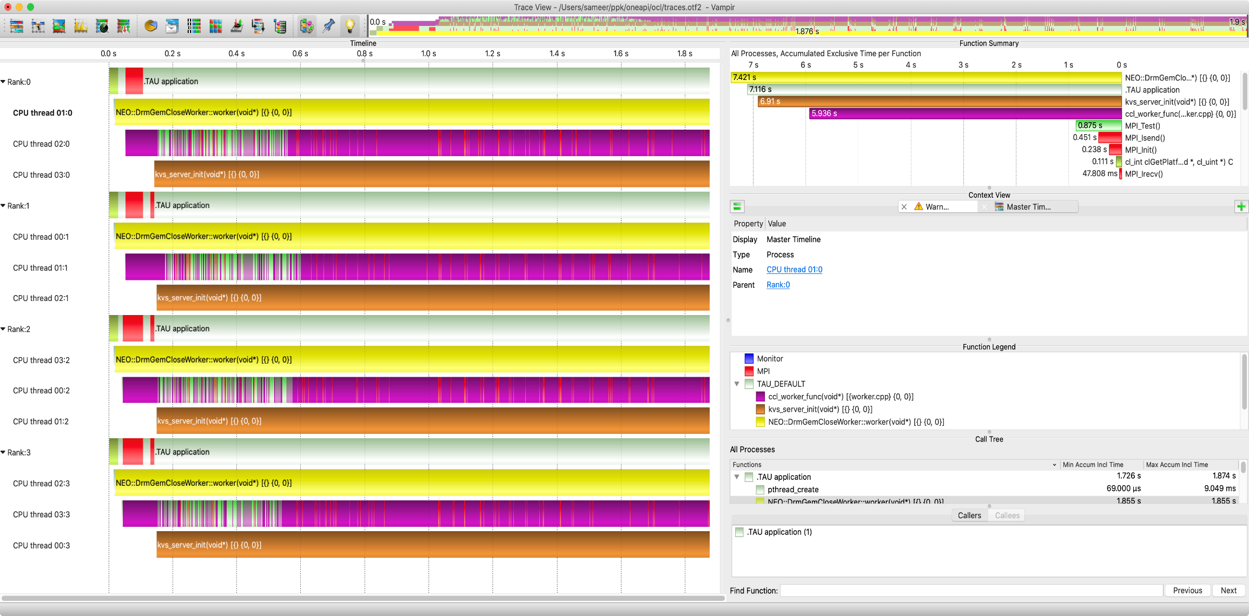
TAU Analysis Tools: ParaProf, Vampir
MPI Communication Matrix
3D Profile view
Vampir: https://vampir.eu
Profile view
Vampir trace viewer

Slide 7
Kokkos support in TAU – since February, 2017
TAU implements the Kokkos Profiling API (Kokkos_Profiling_C_Interface.h)
TAU sets an environment variable KOKKOS_PROFILE_LIBRARY to tell Kokkos that it should enable profiling and enable function callbacks to the TAU implementations
TAU implements
  kokkosp_[init|finalize]_library
  kokkosp_[begin|end]_parallel_[for|scan|reduce]
  kokkosp_[push|pop]_profile_region
Names for regions are passed to the tools to provide intelligent labels
In addition, TAU also implements support for native Pthreads, OpenMP, OpenACC, CUDA, HIP, SYCL back-end measurement – no code changes necessary
Fun fact: if you have a Raja application, and Raja is configured with -DRAJA_ENABLE_RUNTIME_PLUGINS, Raja implements the same callback API!

Slide 8
TAU Example – Kokkos Lulesh (from kokkos-miniapps)
Main thread launching kernels
Virtual thread with CUDA activity
Intel Xeon system with NVIDIA A100, size 256, 100 iterations, one rank

Slide 9
PerfStubs side note…
PerfStubs is a “frictionless” instrumentation library
  https://github.com/UO-OACISS/perfstubs
  One source file, three headers
  Provides a plugin interface for performance tools
  Can be compiled away if desired
Integrated into several libraries (so far) as a git submodule
  CAMTIMERS
  PETSc
  Ginkgo
  ADIOS2
  Others?
Provides runtime integration with TAU & APEX
Boehme, Huck, Madsen, Weidendorfer,
“The Case for a Common Instrumentation Interface for HPC Codes”
https://doi.org/10.1109/ProTools49597.2019.00010, 2019

Slide 10
APEX

Slide 11

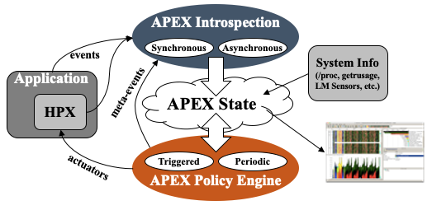
Autonomic Performance Environment for Exascale (APEX)
Autonomic Performance Environment for eXascale
Performance Measurement
Runtime Adaptation
Designed for AMT runtimes (HPX)
  but works with conventional parallel models
Focus on task dependency graph, not calling context graph
Supports HPX, C/C++ threads, OpenMP, OpenACC, Kokkos, Raja, CUDA, HIP, SYCL, StarPU... Working on YAKL, Iris
https://github.com/UO-OACISS/apex and https://github.com/khuck/apex-tutorial
Active Harmony* (Nelder Mead), Simulated Annealing, Genetic Search, hill climbing for parametric search methods, as well as exhaustive and random
https://doi.org/10.1109/ESPM256814.2022.00008 : “Broad Performance Measurement Support for Asynchronous Multi-Tasking with APEX”, Huck, ESPM, 2022

Slide 12
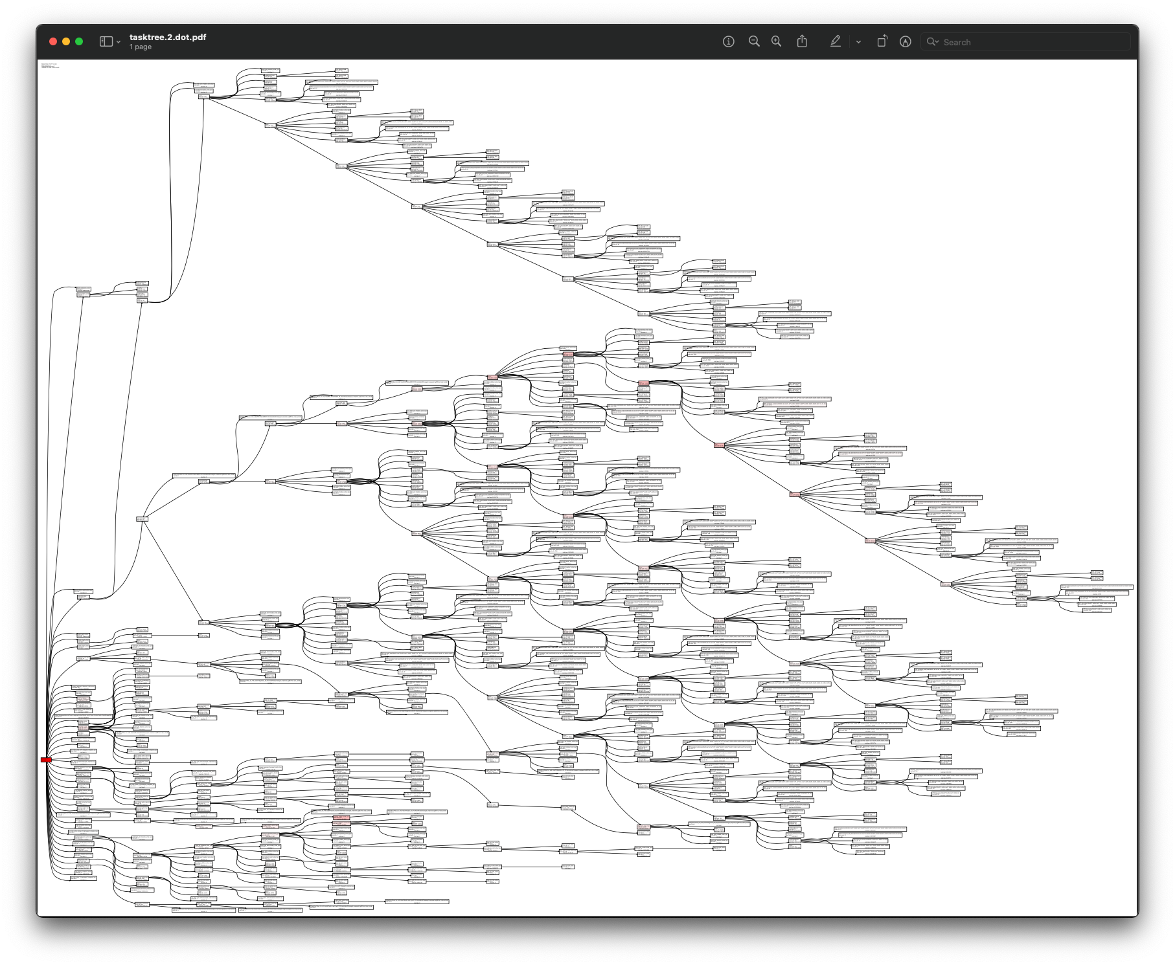
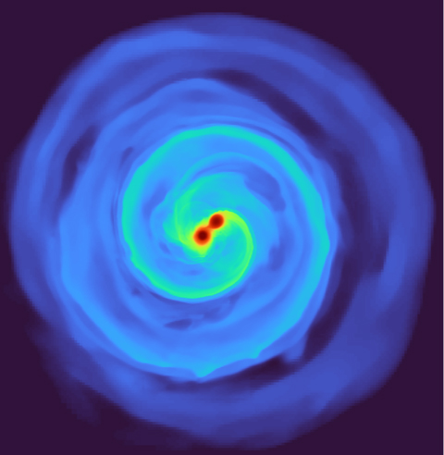
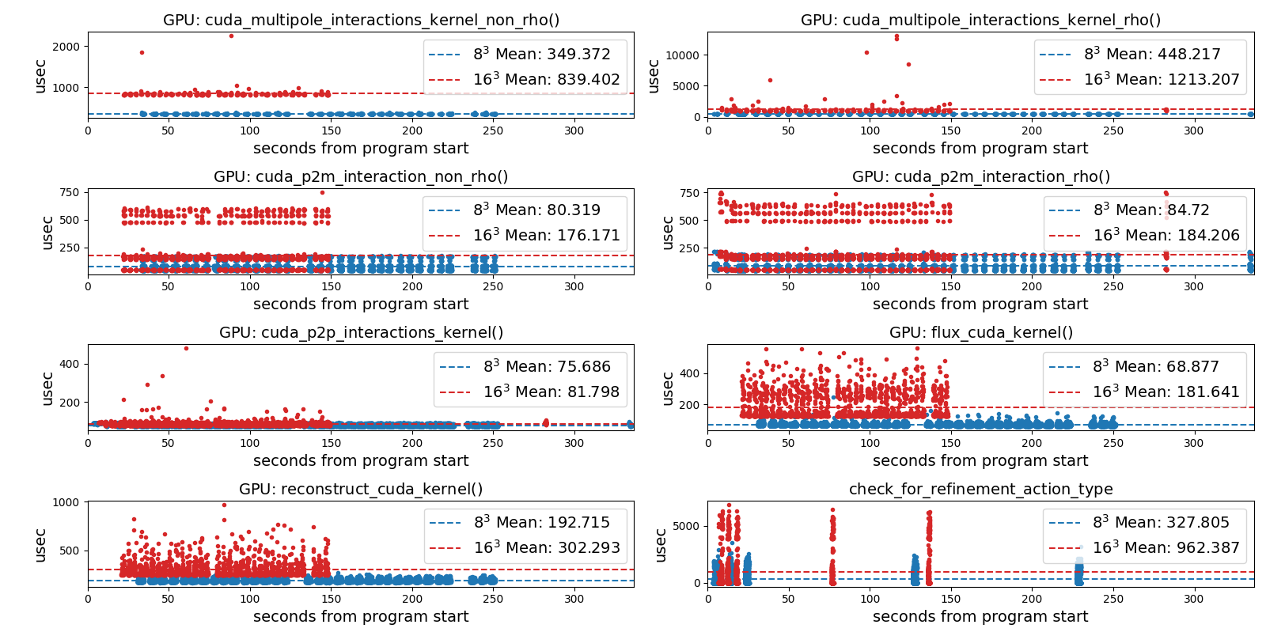
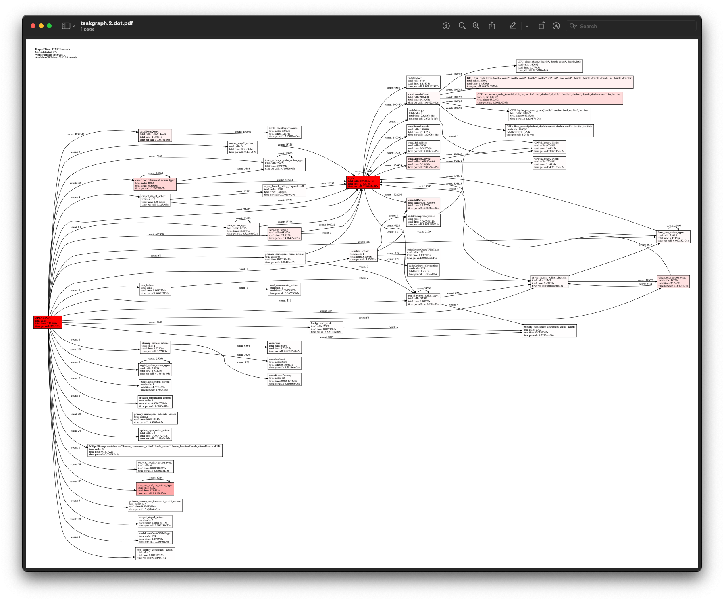
APEX example – Octo-Tiger (Octree astrophysics in HPX, Kokkos)
Tracking GPU memory usage with CUPTI
Monitoring GPU utilization with NVML library
Full task tree (above) and task graph (below) showing task dependencies
Comparing subgrid sizes and relative kernel performance with CUPTI device activity
https://github.com/STEllAR-GROUP/octotiger
https://github.com/STEllAR-GROUP/hpx

Slide 13
Octotiger on Fugaku – concurrency view from 1 node
Periodic sampling of timers scheduled by the HPX runtime

Slide 14
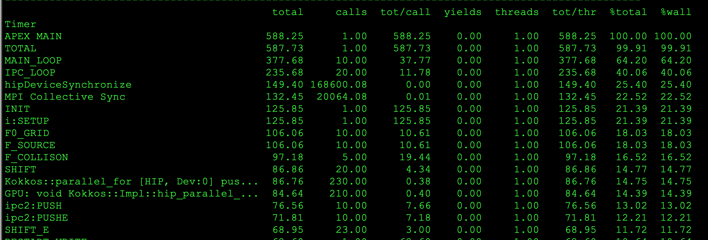
Example: XGC (tokamak plasma fusion PIC) on Frontier, 512 ranks
Uses support for MPI, OpenMP-Tools, PerfStubs, Kokkos, Hip, PAPI
Post-processing view of MAIN_LOOP subtree, only with accumulated times > 5.0 seconds (only 72 nodes of 6298 of full tree)
Red: MPI, blue: other, intensity = % of total subtree
OpenMP Kokkos Kernels
HIP Kokkos Kernels

Slide 15
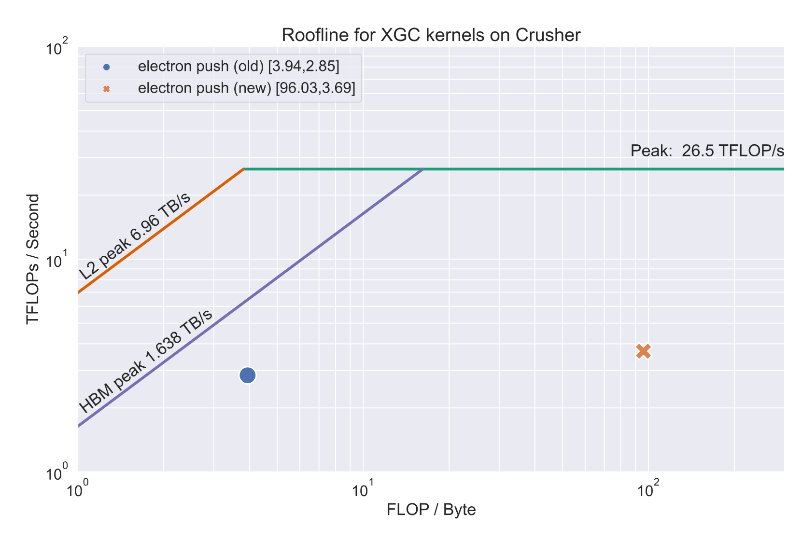
XGC: Push Kernel on Crusher/Frontier, Kokkos helped generate roofline
Kokkos + APEX + PAPI + librocprofiler = ☺
Cache | V100 | MI250X old | MI250X new
L1 | 99.8% | 87.6% | 98.7%
L2 | 95.4% | 58.8% | 94.1%
Increased computational intensity 25x, reduced time by 22% by using Kokkos launch bounds of <256,2>

Slide 16
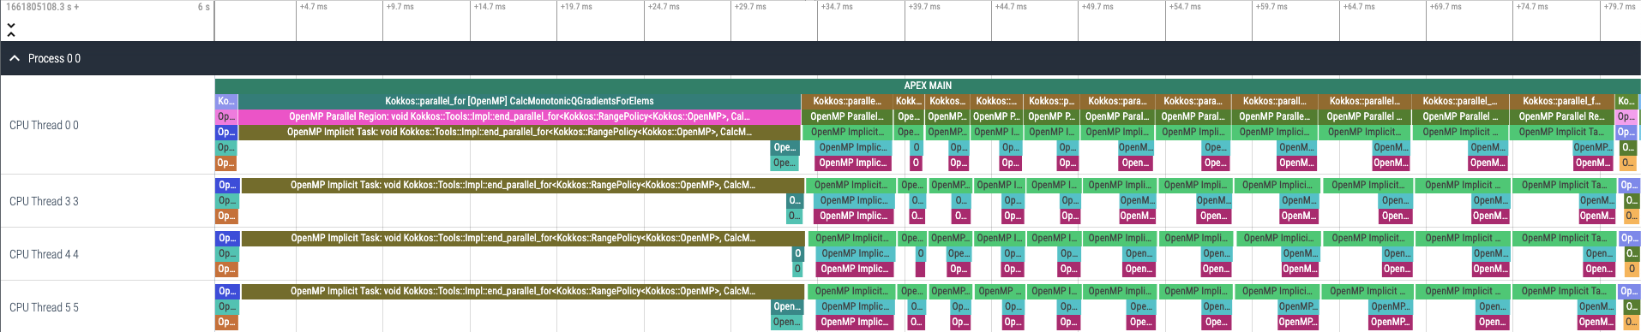
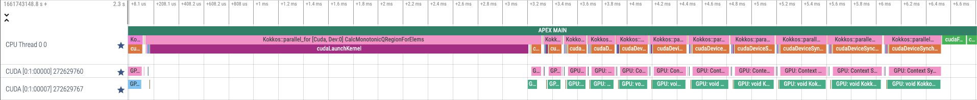
Kokkos Lulesh and APEX Tracing – OpenMP, CUDA, HIP back ends
OpenMP
CUDA
HIP

Slide 17
Kokkos Support in APEX
APEX implements the same profiling API that TAU does, and…
APEX provides autotuning (search) support
Kokkos provides the ability to autotune with (at Cmake configuration time):
-DKokkos_ENABLE_TUNING=ON
Automatically provides input and context variables for parallel_for, parallel_reduce, parallel_scan, parallel_copy.
  TeamPolicy: team size and vector length
  MDRangePolicy: X, Y tile sizes (Z stays constant)
  RangePolicy*: block size, occupancy
Custom tuning also available – see https://github.com/khuck/apex-kokkos-tuning for examples like mm2d_tiling.cpp and idk_jmm.cpp
  *(in a long-dormant development fork/branch, a new, updated PR for occupancy tuning has passed all tests and will be merged soon…would be nice to have because many kernels use RangePolicy)

Slide 18
APEX Autotuning of ExaMiniMD Neighbor2D::fill_neigh_list_full kernel
Is it worth it? …maybe?
Baseline | 17.4972s
Tuning | 17.7294s
Tuned | 17.3790s
Exploring team sizes
Only one kernel is TeamPolicy in ExaMiniMD – all of the rest of the kernels are Range policies…
Exploring vector lengths
Response (time)

Slide 19
TAU or APEX?
Use TAU when:
  Advanced MPI or SHMEM measurements
  Sampling support
  HW/OS context (per-OS thread measurements)
  Broader HW support
  Python/ML/AI support
  TAU plugin support
Use APEX when:
  Support for asynchronous tasking
  Focus on algorithmic task dependency, not HW/OS
  Runtime autotuning / feedback & control support

Slide 20

Kokkos Wishlist
Autotuning:
  Support for Range policy
  Access to non-normalized input variables (all are mapped to [0.0 … 1.0])
    I think I know why this was done, but it’s confusing/misleading without a map
Default labels with source info ☺
  Or at least a function pointer

Slide 21



Acknowledgements
Parts of this research was supported by the Exascale Computing Project (17-SC-20-SC), a joint project of the U.S. Department of Energy’s Office of Science and National Nuclear Security Administration, responsible for delivering a capable exascale ecosystem, including software, applications, and hardware technology, to support the nation’s exascale computing imperative.
This research used resources of the Oak Ridge Leadership Computing Facility at the Oak Ridge National Laboratory, which is supported by the Office of Science of the U.S. Department of Energy under Contract No. DE-AC05-00OR22725.

Slide 22
Thanks! Questions?

Slide 23
Kokkos & APEX Auto-tuning hands-on examples
Git repository:
  https://github.com/khuck/apex-kokkos-tuning
Run the “perlmutter.sh” script to build and run the examples
To run individual examples:
  ctest --test-dir build -V -R <test name>
I am on Kokkos slack, as “Kevin Huck”

