Slide 1

Autotuning Kokkos with Artemis & APEX
Kevin Huck, Chad Wood, Allen D. Malony
David Poliakof
University of Oregon
khuck@cs.uoregon.edu
Sandia National Laboratory
Notes:
The Kokkos programming model library promises a means to deliver portable performance across different back ends, including OpenMP, CUDA, HIP and OneAPI. While the Kokkos library provides reasonable defaults for mapping data Views to the different back ends, the default parameter settings are driven by heuristics that may make incorrect assumptions. For this reason, the Kokkos library provides an API for “autotuning” the parameters used in parallel algorithms. In this talk, we will discuss work in progress in which we experiment with this API, suggest improvements, and identify areas in which AI/ML expertise/software is needed to realize the goal of optimized Kokkos parameter settings.
Very much a work in progress, the Artemis work is distributed and discussed/used in Kokkos tutorials.

Slide 2
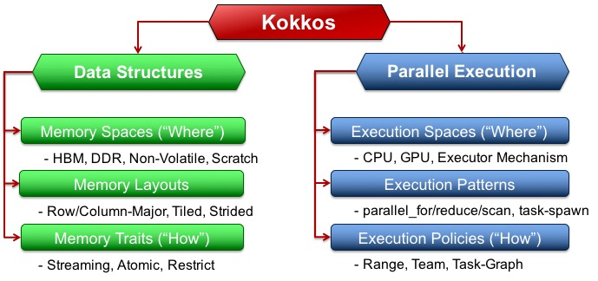
Kokkos Overview
Kokkos is a programming model for parallel algorithms that use many-core chips and share memory among those cores. The programming model includes computation abstractions for frequently used parallel computing patterns, policies that provide details for how those computing patterns are applied, and execution spaces that denote on which cores the parallel computation is performed.
(text and figure from
https://kokkos.org )
Notes:
Kokkos is an abstraction layer to provide performance portability for these different heterogeneous systems. Write once, run everywhere!

Slide 3
Kokkos Autotuning Motivation
Figuring out the ideal parameter settings (team size, vector length, block size, “other”.) for:
  NVIDIA, AMD, Intel (GPU+CPU), …
  OpenMP, OpenMPTarget, HIP, CUDA
  V100, A100, MI100, …
  Every compiler
  Every dataset
  For every kernel
Currently relies on expert heuristics - can we do better?

Slide 4
Kokkos Autotuning Interface
declare input variable(s) with kokkosp_declare_input_type()
  independent variables that describe the context for tuning (name, type, possible values)
declare output variable(s) with kokkosp_declare_output_type()
  dependent variable(s) to be tuned (name, type…)
define context with kokkosp_begin_context(), kokkosp_begin_context() for measurement
request setting with kokkosp_request_values()
  For given context, please provide output value(s) for the current input value(s)
Notes:
nice simple API.

Slide 5
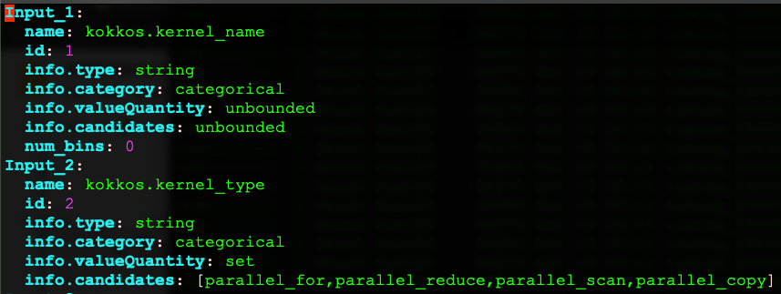
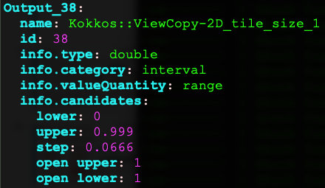
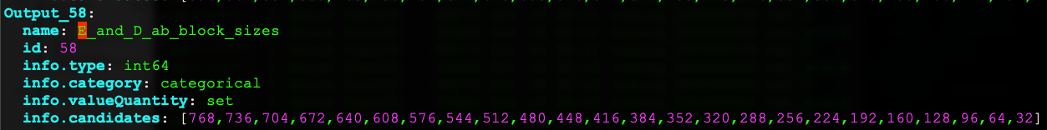
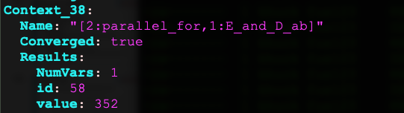
Example inputs, outputs, contexts
Input samples
“Range” output example
“Set” output example
sample context

Slide 6
Kokkos tuning status
The previous API can be used to autotune any aspect of any algorithm, but the develop branch of Kokkos provides the ability to autotune with:
-DKokkos_ENABLE_TUNING=ON
Automatically provides input and context variables for parallel_for, parallel_reduce, parallel_scan, parallel_copy.
Output variables for TeamPolicy (v3.3) with Kokkos::AUTO as the team size and/or vector length, and for MDRangePolicy (v3.4) with no specified tile size.
Notes:
Waiting on PR4365 to make this available in real kokkos. Currently in a branch of a fork.
[khuck@login2.summit kokkos_tuning]$ git branch
feature/tune-cuda-forall
* feature/tune-cuda-forall-ymmv
[khuck@login2.summit kokkos_tuning]$ git remote -v
origin git@github.com:DavidPoliakoff/kokkos.git (fetch)
origin git@github.com:DavidPoliakoff/kokkos.git (push)

Slide 7
Artemis overview/history
Motivation: Applications should operate optimally across a range of current and future systems without the need for costly code interventions in each new deployment.
Apollo: Reusable Models for Fast, Dynamic Tuning of Input-Dependent Code, Beckingsale et al., IPDPS 2017. Online autotuning of Raja Kernel choices using models generated offline.
Artemis: Automatic Runtime Tuning of Parallel Execution Parameters Using Machine Learning, Wood et al., ISC 2021.
  Avoid the need to re-run comprehensive model training campaigns with every new code change, input deck, app configuration, scale, or deployment location.
Notes:
Here we introduce the first tool, and discuss the history of the project. Artemis is Apollo’s twin sister. Raja and Kokkos both supported.

Slide 8
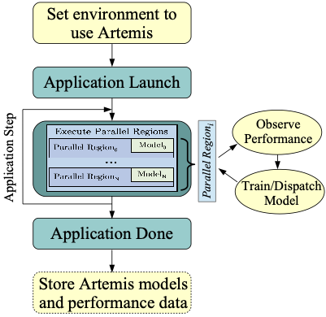
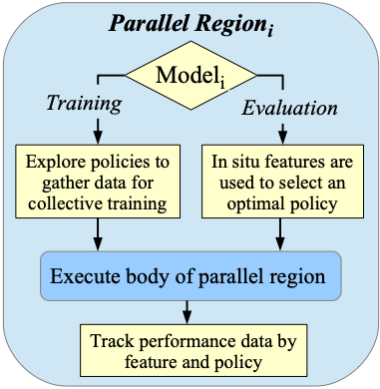
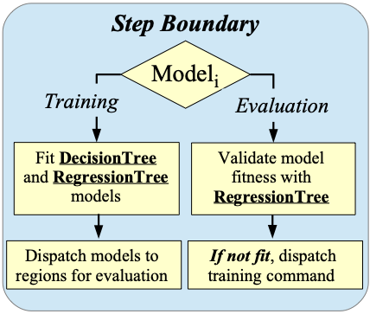
Artemis - what does it do
Overall Flow:
Entering a parallel region:
Concluding each simulation timestep / iteration
(done for each region):
Notes:
Entering a parallel region (every time):
utilize the model, either training or evaluation
training models explore different tuning choices to generate data sets for learning - model is random forest
evaluation models are the result of the training, and they make policy recommendations after observing values for which there are trained results
performance is tracked to ensure model fitness over time
Concluding each step (Basically, there's a point at which you tell Artemis "hey, process what you've seen," and for RAJA that's the main iteration boundary, for Kokkos it's just done every N kernels):
Any regions that have training models attached will have an evaluation model constructed for it
If a region has an evaluation model, the observed features/performance from within the step are used to make performance predictions with the built-in regression tree
poorly performing models will result in a new training model being dispatched for this region, handling either new inputs (insufficient data) or stale model (no longer representative of the overall situation)

Slide 9
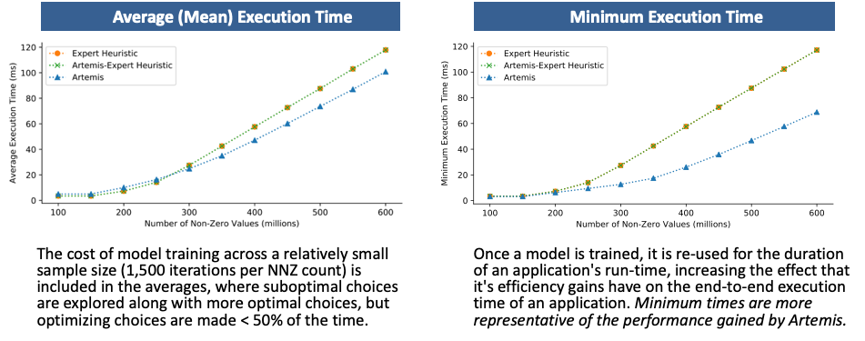
Artemis - Kokkos results
Training SPMV (Kokkos Kernels), tuning team size 1-1024, vector size 1-32, rows per thread 1-4096.
CUDA Experiments: NVIDIA V100 (Volta), IBM Power9 architecture, CUDA version 10
Notes:
inputs: kernel_name, kernel_type, spmv.num_rows, spmv.nnz
outputs: spmv.rows_per_thread (and others listed)
Also used to tune Kokkos Kernels within real applications, publication TBD.

Slide 10

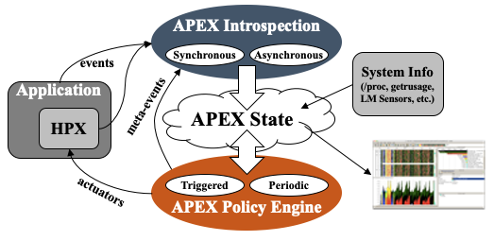
APEX: Autonomic Performance Environment for eXascale
Performance Measurement
Runtime Adaptation
Designed for AMT runtimes
Focus on task dependency graph, not calling context graph
Profile (text, CSV, TAU), trace (OTF2, Google Trace Events)
Natively supports HPX, C/C++ threads, OpenMP, OpenACC, Kokkos, Raja, CUDA, HIP, Argobots
Notes:
HPX is in the figure, but that was from the original design. The task data can come from anything - in fact, the Kokkos integration doesn’t use the Kokkos profiling interface at all - it uses counters/timers recorded at the context begin/end steps.

Slide 11
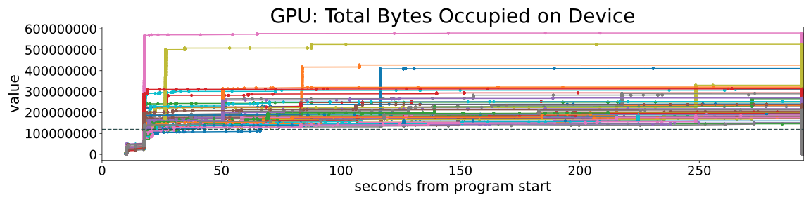
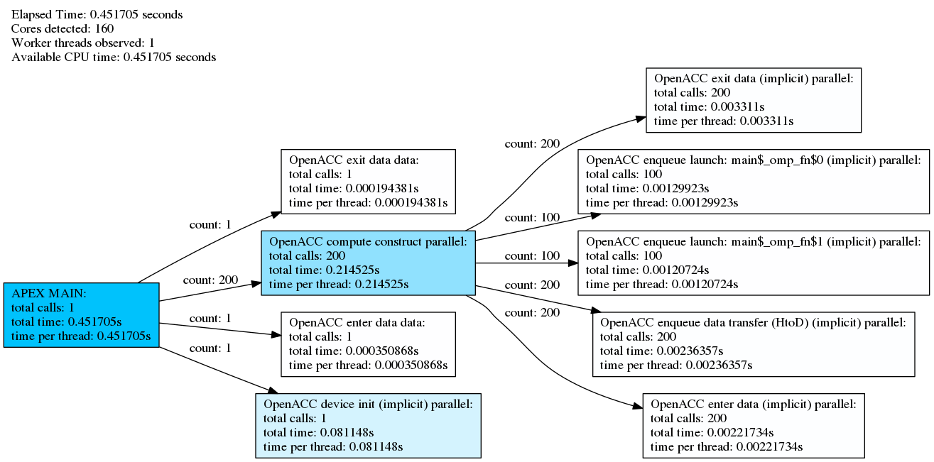
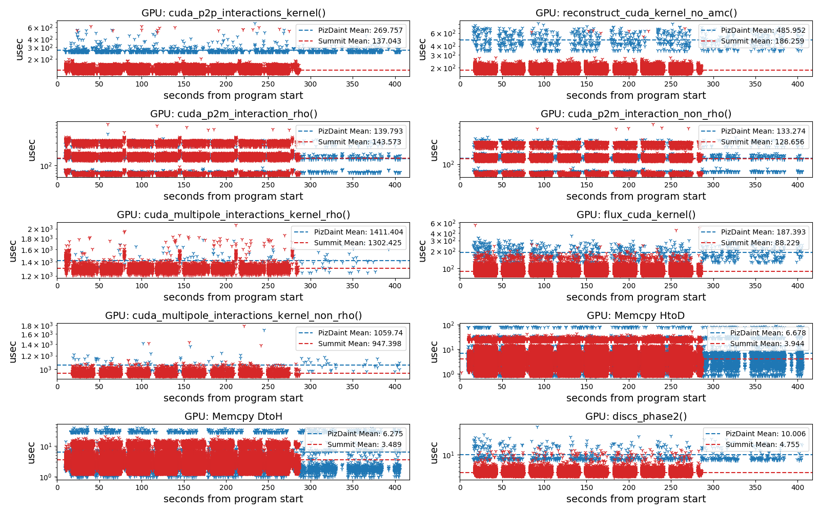
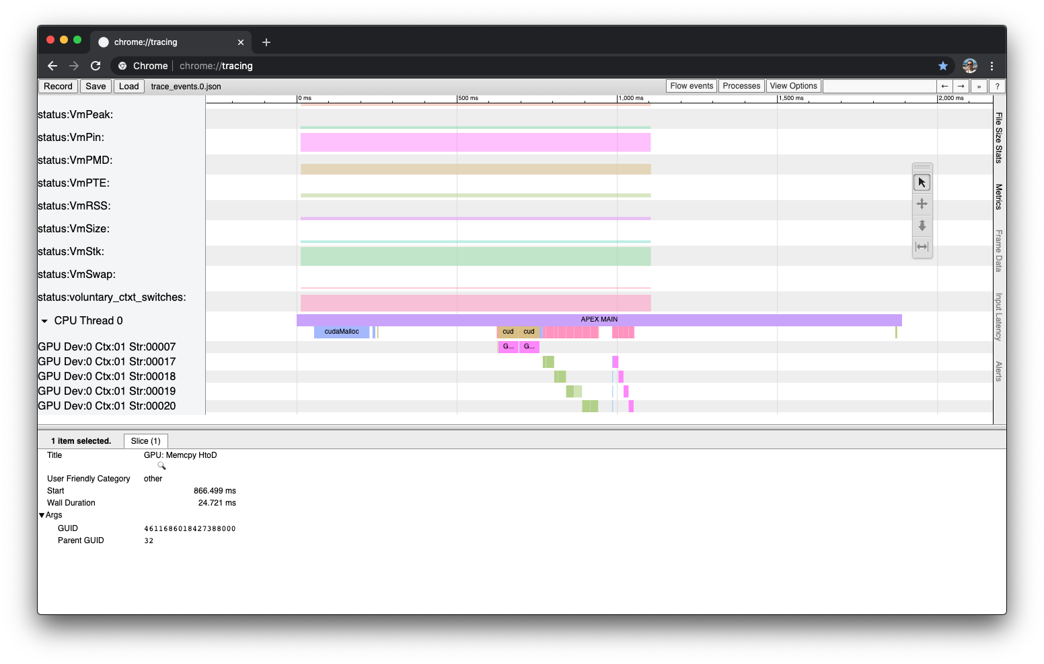
APEX Measurement Output
Task graphs, trees
Counter, timer scatterplots
Traces

Slide 12
APEX policy search methods
Active Harmony
  Nelder Mead (default)
  Parallel Rank Order
  Exhaustive
  Random
APEX native
  Simple hill climbing (used for concurrency/power)
  Simulated Annealing (naive, but works)
Cached results
Notes:
Cached results can be used to jump start a future tuning, or provide static settings for all configs for a larger run (assuming parameters don’t change).

Slide 13
Previous APEX Autotuning Results
Huck, et al., An Autonomic Performance Environment for Exascale (Supercomputing Frontiers and Innovations), 2015: Concurrency throttling to maximize throughput of SSSP benchmark, Concurrency throttling to stay under a soft power cap - 12% energy savings without increase in runtime of Lulesh
Bari, et al., Arcs: Adaptive Runtime Configuration Selection for Power-constrained OpenMP Applications, 2016: Controlling OpenMP parameters (num_threads, schedule, chunk size) to optimize performance under a hard power cap
Monil, et al., Adaptive Auto-tuning in HPX using APEX (Poster), 2018: Tuning network coalescing parameters to minimize communication overhead
Wagle, et al., Runtime Adaptive Task Inlining on Asynchronous Multitasking Runtime Systems, 2019: Task inlining / scheduling decision at runtime

Slide 14
Focus of APEX tuning
Another branch of Kokkos provides the ability to autotune RangePolicy block size…
Notes:
Waiting on PR4365 to make this available in real kokkos. Currently in a branch of a fork.
[khuck@login2.summit kokkos_tuning]$ git branch
feature/tune-cuda-forall
* feature/tune-cuda-forall-ymmv
[khuck@login2.summit kokkos_tuning]$ git remote -v
origin git@github.com:DavidPoliakoff/kokkos.git (fetch)
origin git@github.com:DavidPoliakoff/kokkos.git (push)

Slide 15
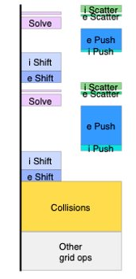
XGC Example: HBPS SciDAC Project
Validation test configuration (very small scale)
56 unique Kokkos CUDA RangePolicy kernels
  All parallel_for loops (some internal, like copying View data to the GPU)
  Iterate over a 1D range
Input parameters:
  Kernel type (parallel_for, parallel_reduce, parallel_scan, parallel_copy)
  Kernel name (unbounded)
Output parameter: block size
9 of them converged in a 10 iteration run...but the results are confusing
CPU GPU
One Timestep
Notes:
tuning of RangePolicy allows us to test with XGC.

Slide 16
Inputs, outputs, contexts
Input samples
“Range” output example
“Set” output example
sample context
Notes:
Repeat, but these are actual values from XGC

Slide 17
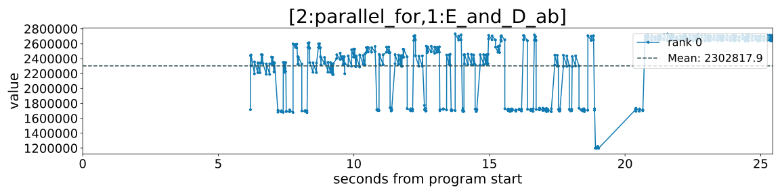
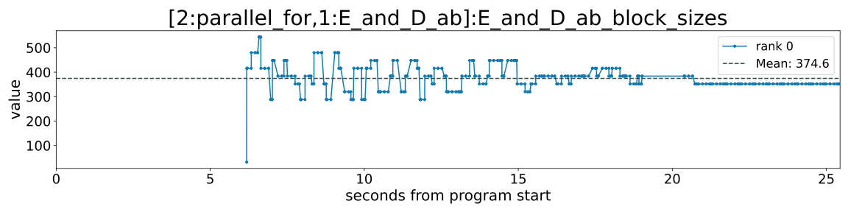
Multi-modal results...
This example actually has 5 different “bins” that are getting lumped together
nanoseconds
~3 main iterations

Slide 18
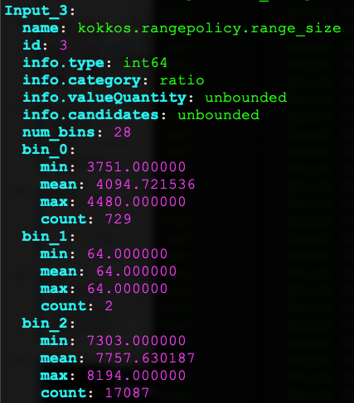
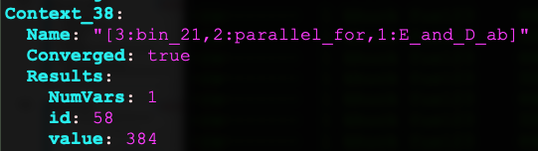
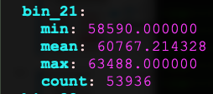
Need another Input...
Before...
...After
27 total bins, this kernel had 4 bins (~11k, ~22k, ~34k, ~60k), only 1 converged

Slide 19
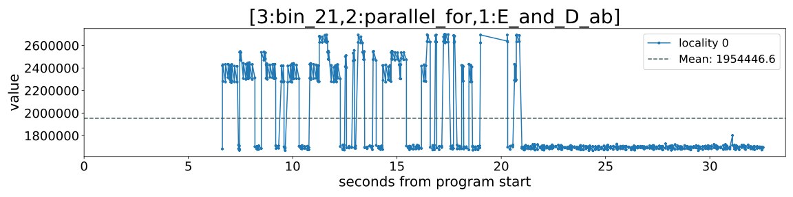
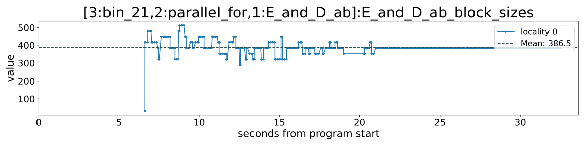
Segregating the data
nanoseconds
~5 main iterations
Notes:
Probably 512 is ideal for this range length

Slide 20
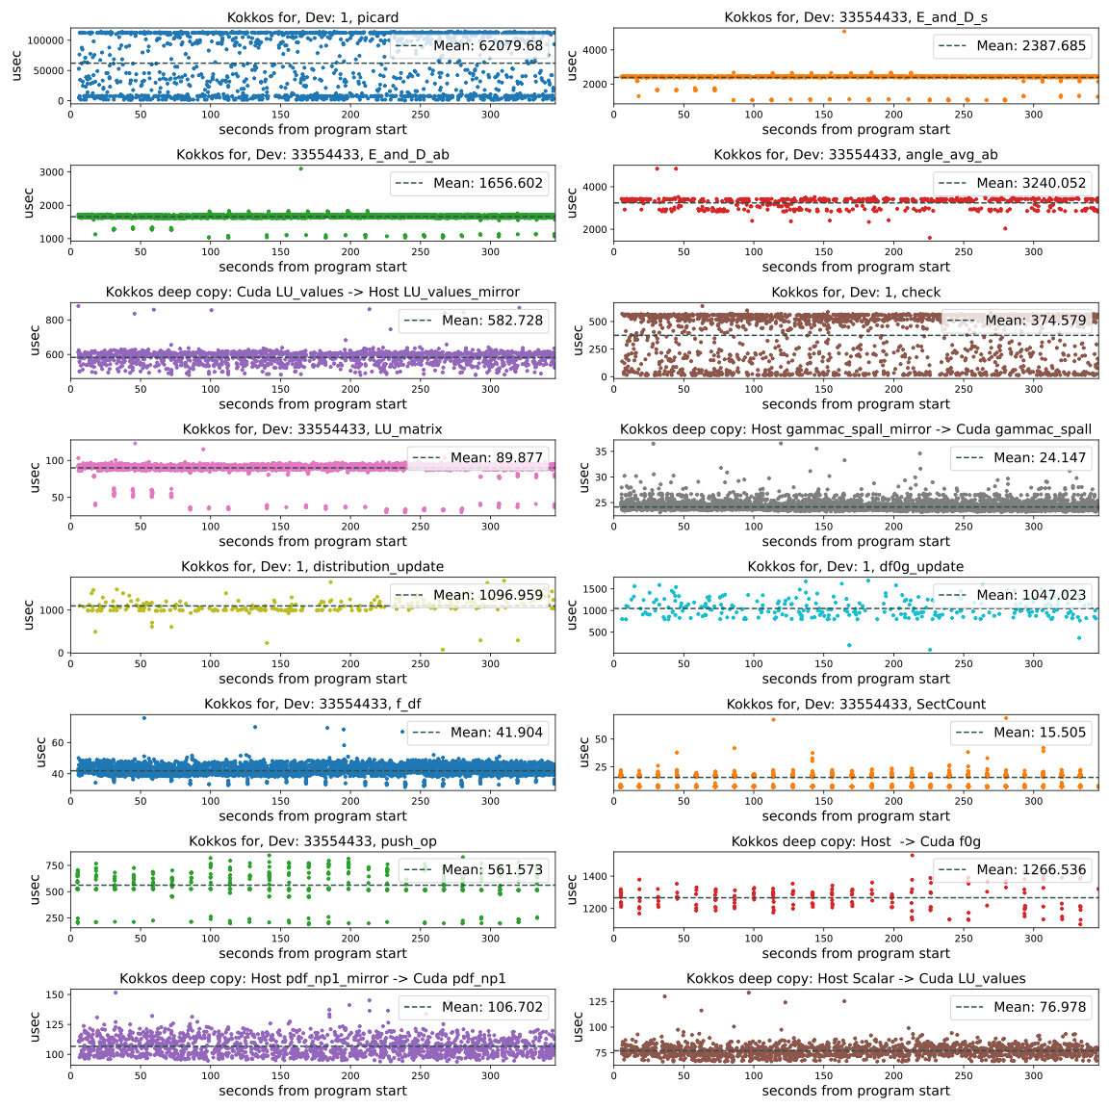
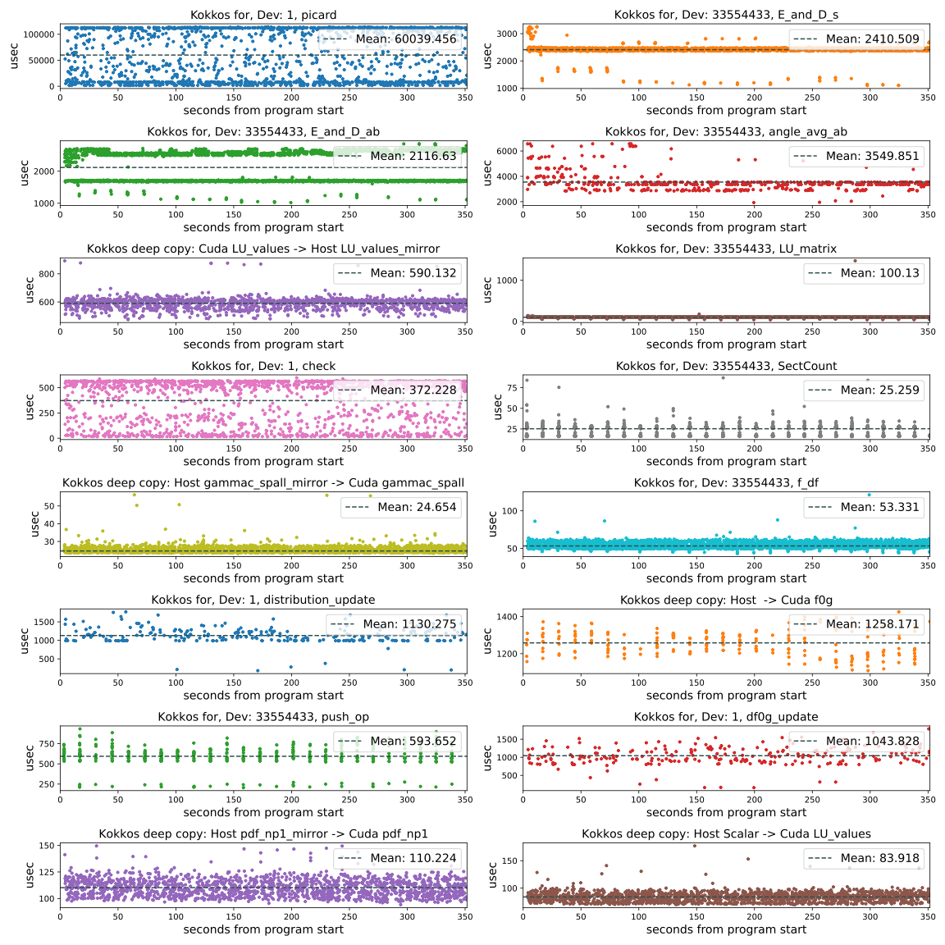
Overall benefit? No(t yet?)
No tuning
Tuned
Ugh!
meh.
0.1 (10%) of kernels sampled
A longer run *might* show amortization, and cached results don’t yet support bins (just added Monday)
Notes:
E_and_D_ab / s are part of the scatter operations. They don’t dominate at scale.
The push_op kernel dominates at scale.

Slide 21
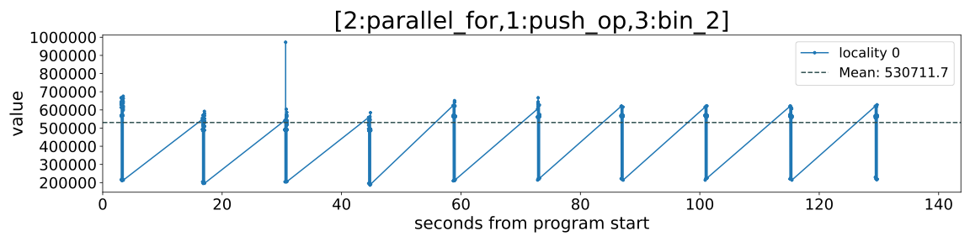
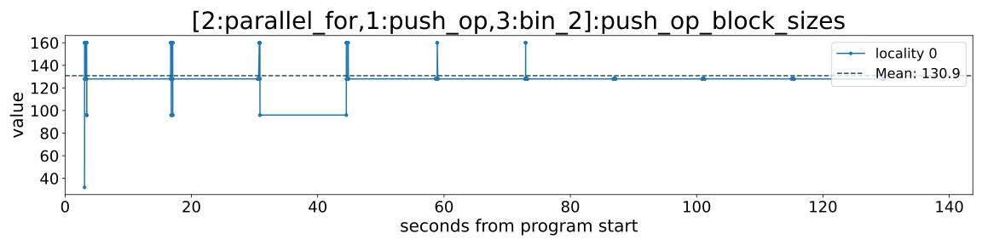
Other data issues...
nanoseconds
The same kernel is used for both electron and ion push - electron push is ~3x more effort (in this config)
For successful tuning, we need another input variable…
Notes:
Likely, we are seeing a mix of electron push and ion push. The electron push takes much more effort, but the same kernel is used for both. Unfortunately, we don’t know if we can trust these results…
Pushing a range as additional context would be helpful.

Slide 22
APEX: Open Issues/questions
Complex hierarchical searches - no solution yet
  Nested contexts
  choose between 2+ algorithms
  for each algorithm, tune available parameters
  find the “optimal” settings
Active Harmony launches a “session” (fork/exec and then sockets) rather than a thread… per search - needs redesign/mods
Segregating the data by Range size blew up the context search from 56 unique contexts to 2885 over 50 timesteps!
  Binning the data reduced that to 150 (average of 3/region)
  ...but the binning algorithm is naive (read: slow)
“Is the juice worth the squeeze?” - doesn’t appear so yet...for APEX
Notes:
Complex searches - research problem, or engineering problem?
Active Harmony approach is not great. It works fine for the project’s larger goals, but for a simple search in this executable, not ideal. Lots of things can and do go wrong, it’s not production quality for always-on tuning

Slide 23
Future Work
Artemis: Automated C++ code generation, allowing for offline integration and use of models trained online - in progress
APEX: Need “better” search options
  Active Harmony search works, but implementation is not ideal
  Simulated Annealing has fixed # iterations, other search methods are better
  What about multiple (2+) outputs?
  What about multi-objective searches?
  What about hierarchical searches?
  Best way to bin unbounded data?
  Artemis & APEX integration? Just use Artemis?
ML/AI library options? (Artemis uses OpenCV 4.3 https://opencv.org)
  Which algorithms are the right approach?
  Who else is working on something similar?
Notes:
Artemis: “We take a learned model and "export it as C++", like an oracle function that can take the same inputs in the same order as were sent to Artemis for training, and returns a policy index, but there is no Artemis at runtime. Version 1 sacrifices the regression tree and retraining capbility but that's fine, per the Sandia spec.”
Let’s work together! I need help!

