Slide 1

Autotuning of Execution Parameters and Autonomic Response: The Performance Analysis Tool Perspective
Kevin Huck , Chad Wood*, Allen D. Malony
University of Oregon, *Cerebras
khuck@cs.uoregon.edu
Notes:
The Kokkos programming model library promises a means to deliver portable performance across different back ends, including OpenMP, CUDA, HIP and OneAPI. While the Kokkos library provides reasonable defaults for mapping data Views to the different back ends, the default parameter settings are driven by heuristics that may make incorrect assumptions. For this reason, the Kokkos library provides an API for “autotuning” the parameters used in parallel algorithms. In this talk, we will discuss work in progress in which we experiment with this API, suggest improvements, and identify areas in which AI/ML expertise/software is needed to realize the goal of optimized Kokkos parameter settings.
Very much a work in progress, the Artemis work is distributed and discussed/used in Kokkos tutorials.

Slide 2

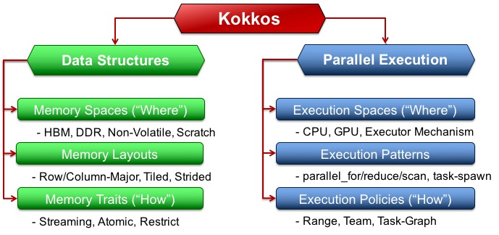
“Kokkos is a programming model for parallel algorithms that use many-core chips and share memory among those cores. The programming model includes computation abstractions for frequently used parallel computing patterns, policies that provide details for how those computing patterns are applied, and execution spaces that denote on which cores the parallel computation is performed.”
(above text and figure from https://kokkos.org)
Most importantly: Kokkos allows C++ programmers to write 1 set of source code that can be compiled to target one or more of several concurrent back ends – Serial, C++ threads, OpenMP (including target offload), CUDA, HIP, SYCL, HPX…
Notes:
Kokkos is an abstraction layer to provide performance portability for these different heterogeneous systems. Write once, run everywhere!

Slide 3
Kokkos Autotuning Motivation
Programmer writes the “what”, Kokkos determines the “how”, both at compile time and at runtime
Performance portability requires figuring out “good” parameter settings for:
  NVIDIA, AMD, Intel (GPU+CPU), …
  OpenMP, OpenMPTarget, HIP, CUDA, SYCL, …
  V100, A100, MI100, MI200, …
  Every dataset
  For every kernel
Currently relies on expert heuristics / pretty good (reasonable) defaults… but can we do better?
Notes:
(team size, vector length, block size, “other”)

Slide 4
Kokkos Autotuning Interface
declare input variable(s) with kokkosp_declare_input_type()
  independent variables that describe the context for tuning (name, type, set/range of valid values)
declare output variable(s) with kokkosp_declare_output_type()
  dependent variable(s) to be tuned (same properties as input)
define context with kokkosp_begin_context(), kokkosp_begin_context() for measurement extents
  Some tuple of input types
request setting with kokkosp_request_values()
  For given context, please provide and evaluate output value(s), until converge on a (hopefully optimal) solution
Notes:
nice simple API.

Slide 5
Kokkos tuning status
The previous API can be used to autotune any aspect of any algorithm, but Kokkos provides the ability to autotune with:
-DKokkos_ENABLE_TUNING=ON
Automatically provides input and context variables for parallel_for, parallel_reduce, parallel_scan, parallel_copy.
TeamPolicy: team size and vector length
MDRangePolicy: tile sizes
RangePolicy*: block size *(not merged yet)
Notes:
Waiting on PR4365 to make this available in real kokkos. Currently in a branch of a fork.
[khuck@login2.summit kokkos_tuning]$ git branch
feature/tune-cuda-forall
* feature/tune-cuda-forall-ymmv
[khuck@login2.summit kokkos_tuning]$ git remote -v
origin git@github.com:DavidPoliakoff/kokkos.git (fetch)
origin git@github.com:DavidPoliakoff/kokkos.git (push)

Slide 6
Artemis (Apollo) overview/history
Motivation: Applications should operate optimally across a range of current and future systems without the need for costly code interventions in each new deployment.
Apollo: Reusable Models for Fast, Dynamic Tuning of Input-Dependent Code, Beckingsale et al., IPDPS 2017. Online autotuning of Raja Kernel choices using models generated offline.
Artemis: Automatic Runtime Tuning of Parallel Execution Parameters Using Machine Learning, Wood et al., ISC 2021.
  Avoid the need to re-run comprehensive model training campaigns with every new code change, input deck, app configuration, scale, or deployment location.
Notes:
Here we introduce the first tool, and discuss the history of the project. Artemis is Apollo’s twin sister. Raja and Kokkos both supported.

Slide 7
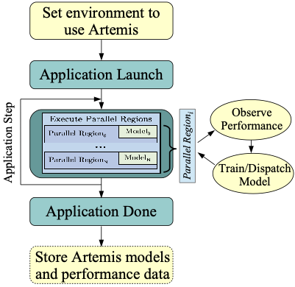
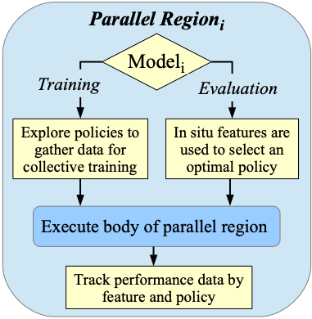
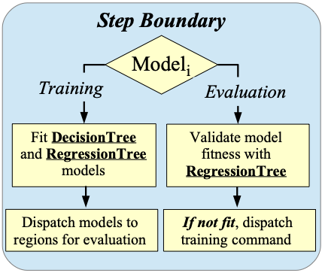
Artemis - what does it do
Overall Flow:
Concluding each simulation timestep / iteration
(done for each region):
Executed for each parallel region:
Notes:
Entering a parallel region (every time):
utilize the model, either training or evaluation
training models explore different tuning choices to generate data sets for learning - model is random forest
evaluation models are the result of the training, and they make policy recommendations after observing values for which there are trained results
performance is tracked to ensure model fitness over time
Concluding each step (Basically, there's a point at which you tell Artemis "hey, process what you've seen," and for RAJA that's the main iteration boundary, for Kokkos it's just done every N kernels):
Any regions that have training models attached will have an evaluation model constructed for it
If a region has an evaluation model, the observed features/performance from within the step are used to make performance predictions with the built-in regression tree
poorly performing models will result in a new training model being dispatched for this region, handling either new inputs (insufficient data) or stale model (no longer representative of the overall situation)

Slide 8
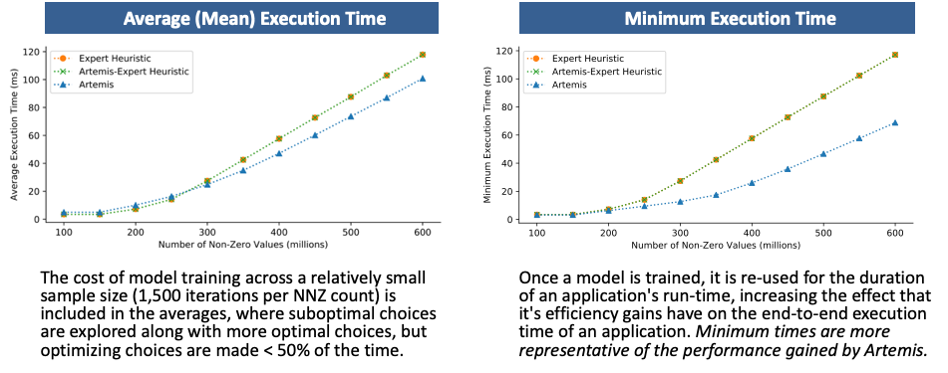
Artemis - Kokkos results
Training SPMV (Kokkos Kernels), tuning team size 1-1024, vector size 1-32, rows per thread 1-4096.
CUDA Experiments: NVIDIA V100 (Volta), IBM Power9 architecture, CUDA version 10
Notes:
inputs: kernel_name, kernel_type, spmv.num_rows, spmv.nnz
outputs: spmv.rows_per_thread (and others listed)
Also used to tune Kokkos Kernels within real applications, publication TBD.

Slide 9

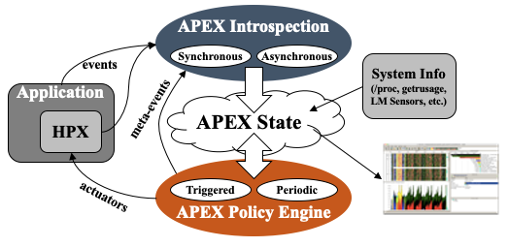
APEX: Autonomic Performance Environment for eXascale
Performance Measurement
Runtime Adaptation
Designed for AMT runtimes
Focus on task dependency graph, not calling context graph
Natively supports HPX, C/C++ threads, OpenMP, OpenACC, Kokkos, Raja, CUDA, HIP, Argobots…
Active Harmony* (Nelder Mead), Simulated Annealing for parametric search
https://github.com/UO-OACISS/apex
*https://www.dyninst.org/harmony
Notes:
HPX is in the figure, but that was from the original design. The task data can come from anything - in fact, the Kokkos integration doesn’t use the Kokkos profiling interface at all - it uses counters/timers recorded at the context begin/end steps.

Slide 10
Previous APEX Autotuning Results
Huck, et al., An Autonomic Performance Environment for Exascale (Supercomputing Frontiers and Innovations), 2015: Concurrency throttling to maximize throughput of SSSP benchmark, Concurrency throttling to stay under a soft power cap - 12% energy savings without increase in runtime of Lulesh
Bari, et al., Arcs: Adaptive Runtime Configuration Selection for Power-constrained OpenMP Applications, 2016: Controlling OpenMP parameters (num_threads, schedule, chunk size) to optimize performance under a hard power cap
Monil, et al., Adaptive Auto-tuning in HPX using APEX (Poster), 2018: Tuning network coalescing parameters to minimize communication overhead
Wagle, et al., Runtime Adaptive Task Inlining on Asynchronous Multitasking Runtime Systems, 2019: Task inlining or scheduling decision at runtime

Slide 11
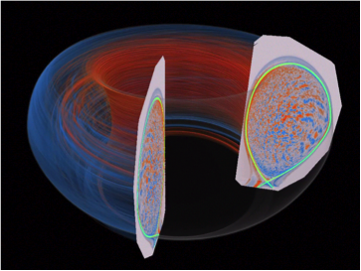
Example: HBPS SciDAC Project
Application: XGC (https://epsi.pppl.gov)
Validation test configuration (very small scale)
56 unique Kokkos CUDA RangePolicy kernels
  All Kokkos::parallel_for loops (some internal, like copying View data to the GPU)
  Iterate over a 1D range using Kokkos::RangePolicy
Input parameters:
  Kernel type (parallel_for, parallel_reduce, parallel_scan, parallel_copy)
  Kernel name (unbounded)
  Range length
Output parameter: block size, search with simulated annealing
This figure shows an electrostatic potential perturbation from a petascale simulation of full-function gyrokinetic ion temperature gradient turbulence in realistic global DIII-D geometry. The magnetic separatrix surface is highlighted in the edge region. (source: https://epsi.pppl.gov)
Notes:
tuning of RangePolicy allows us to test with XGC.

Slide 12
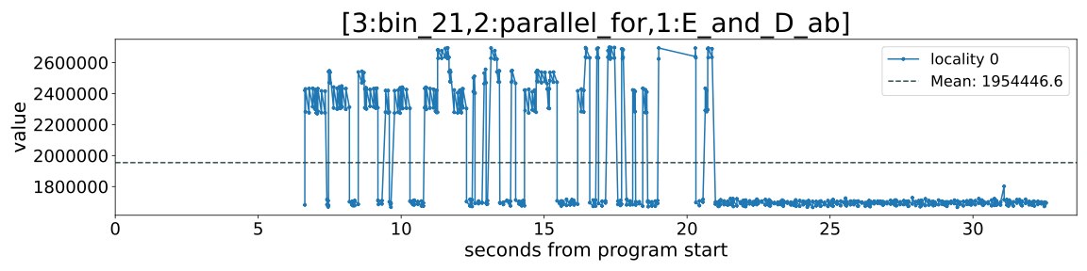
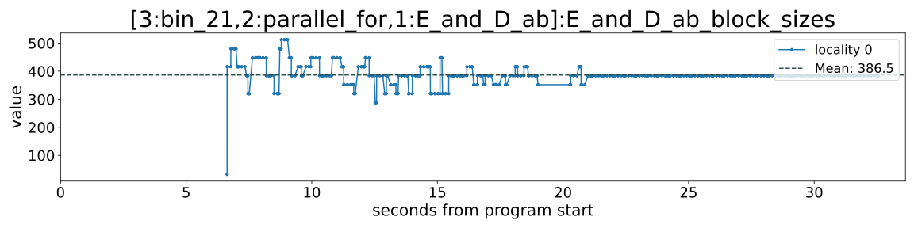
Tuning one kernel over time
nanoseconds
~5 main iterations
Notes:
Converged on 384. This was before we started looking at the launch bounds.

Slide 13
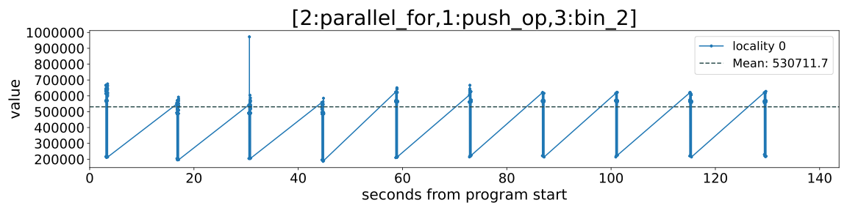
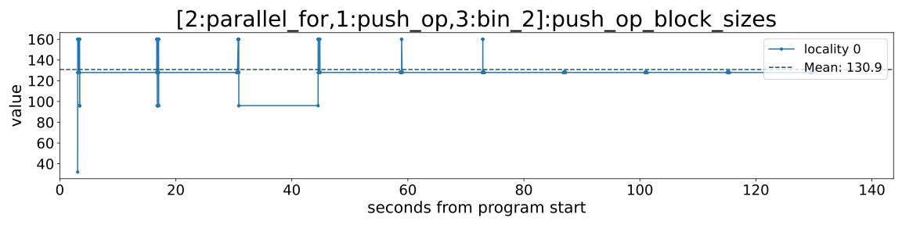
Multimodal results from code reuse
nanoseconds
The same kernel is used for both electron and ion push - electron push is ~3x more effort (in this config)
For successful tuning, we need another input variable (node in context/dependency graph)
Notes:
Likely, we are seeing a mix of electron push and ion push. The electron push takes much more effort, but the same kernel is used for both. Unfortunately, we don’t know if we can trust these results…
Pushing a range as additional context would be helpful.

Slide 14
APEX: Open Issues/questions
Complex hierarchical searches - no solution yet
  Nested contexts
    choose between 2+ algorithms
    for each algorithm, tune available parameters
    find the “optimal” settings
Need to do some code refactoring on Active Harmony to enable complex searches
Need to add additional context variable(s)
“Is the juice worth the squeeze?” overhead [>?<] gains?
Notes:
Complex searches - research problem, or engineering problem?
Active Harmony approach is not great. It works fine for the project’s larger goals, but for a simple search in this executable, not ideal. Lots of things can and do go wrong, it’s not production quality for always-on tuning

Slide 15
Future Work
Artemis: Automated C++ code generation, allowing for offline integration, modeling of launch bounds, use of models trained online - in progress
APEX: Need improved search options
  Active Harmony search works, but integration needs refactoring
  What about multi-objective searches?
  What about hierarchical searches?
Other ML/AI library options? (Artemis currently uses OpenCV 4.3 https://opencv.org)
  Which algorithms are the right approach?
Notes:
Artemis: “We take a learned model and "export it as C++", like an oracle function that can take the same inputs in the same order as were sent to Artemis for training, and returns a policy index, but there is no Artemis at runtime. Version 1 sacrifices the regression tree and retraining capbility but that's fine, per the Sandia spec.”
Let’s work together! I need help!

Slide 16



Acknowledgements
Artemis work was performed under the auspices of the U.S. Department of Energy by Lawrence Livermore National Laboratory under Contract DE-AC52-07NA27344 (LLNL-CONF-809192). Additional support was provided by a LLNL subcontract to the University of Oregon, No. B631536.
The current APEX work was supported by the Scientific Discovery through Advanced Computing (SciDAC) program funded by U.S. Department of Energy, Office of Science, Advanced Scientific Computing Research (ASCR) and Fusion Energy Sciences (FES) Division of Materials Sciences and Engineering, as well as the RAPIDS SciDAC Institute for Computer Science and Data under subcontract 4000159855 from ORNL.
Parts of this research was supported by the Exascale Computing Project (17-SC-20-SC), a joint project of the U.S. Department of Energy’s Office of Science and National Nuclear Security Administration, responsible for delivering a capable exascale ecosystem, including software, applications, and hardware technology, to support the nation’s exascale computing imperative.
This research used resources of the Oak Ridge Leadership Computing Facility at the Oak Ridge National Laboratory, which is supported by the Office of Science of the U.S. Department of Energy under Contract No. DE-AC05-00OR22725.

