Slide 1
Scalable Performance Awareness for In Situ Scientific Applications
Matthew Wolf, Jong Choi, Greg Eisenhauer, Stéphane Ethier, Kevin Huck, Scott Klasky, Jeremy Logan, Allen Malony, Chad Wood, Julien Dominski, and Gabriele Merlo

Slide 2
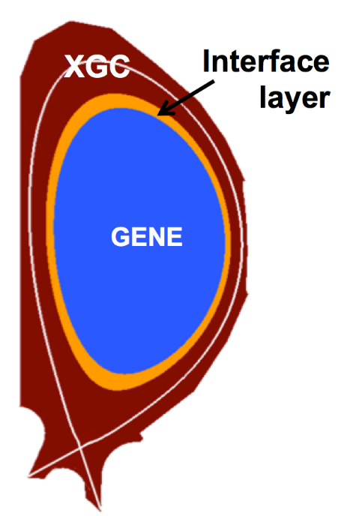
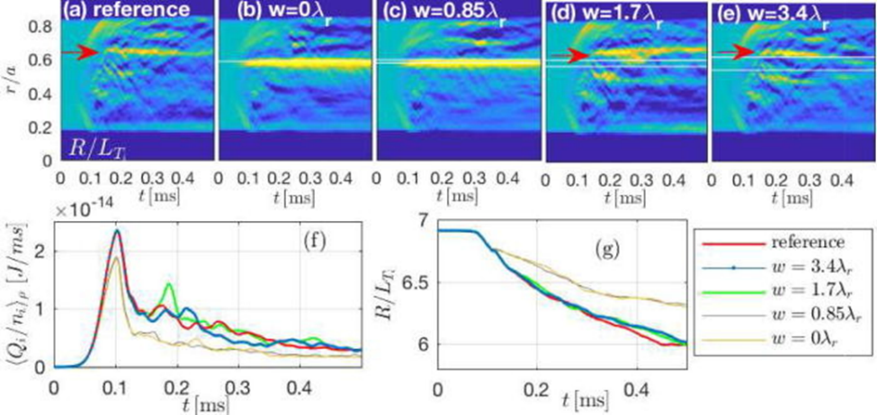
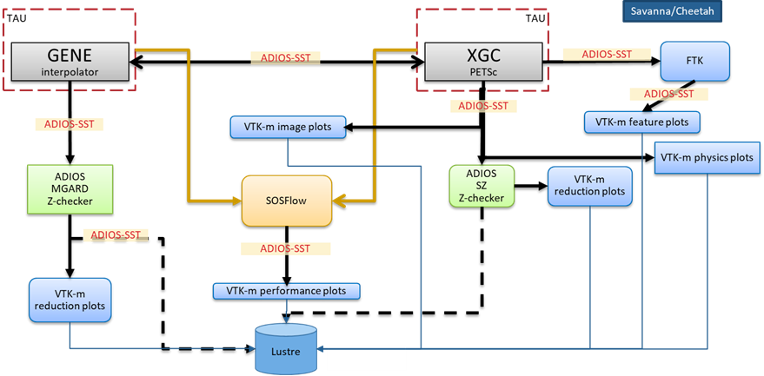
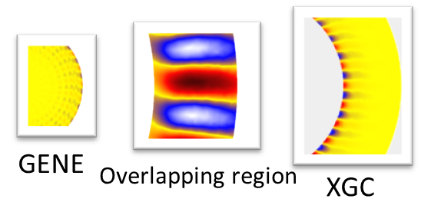
Science is Changing
High-Fidelity Whole Device Modeling of Magnetically Confined
Fusion Plasmas
Core simulation: GENE Edge simulation: XGC
Separate teams, separate codes
Recently demonstrated first-ever successful kinetic coupling of this kind
Data generated by one coupled simulation is predicted
to be > 10 PB/day on Summit
Core-edge
coupling
PI: Amitava Bhattacharjee, PPPL,
C. S. Chang, PPPL
J. Dominski; S. Ku; C.-S. Chang; J. Choi; E. Suchyta; S. Parker; S. Klasky; A. Bhattacharjee; Physics of Plasmas 2018, 25, DOI: 10.1063/1.5044707

Slide 3
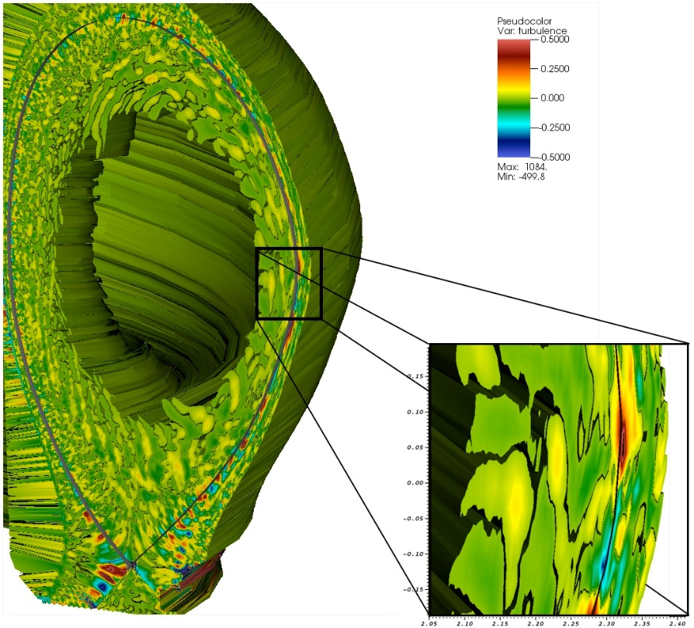
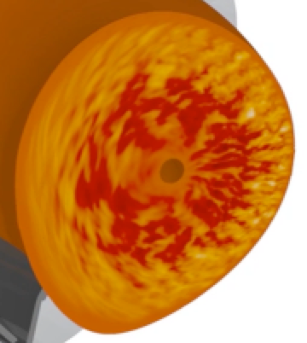
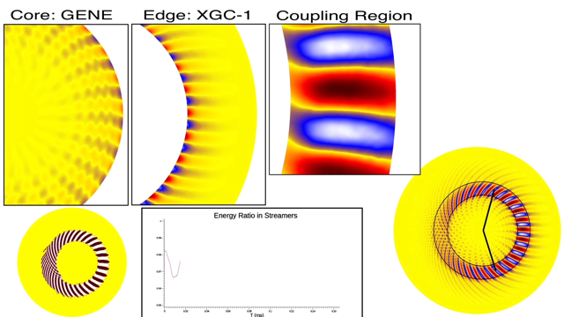
Complex Science Workflow
Coupling workflows
  Workflow of multiple simulations plus in situ analysis and visualization applications
Challenges
  Growing complexity
  Performance issues
Research issues
  Dynamic resource balance/allocation
  Flexible workflow composition
  Managing processes
  Performance monitoring
Stand-alone
XGC
XGC
Edge
GENE
Core
Complexity
XGC
Edge
GENE
Core
Analysis
coupling
XGC
Edge
GENE
Core
Analysis
Visualization
GENE-core
XGC-edge
Visualization
Analysis
WDM Coupled In Situ Analysis Workflow

Slide 4
Understanding Performance at Scale
These don’t look quite like traditional HPC, nor do they look quite like the streams and data lakes of the internet-scale community.
We need tools to support and improve these challenging problems.
  Hybridize from the knowledge bases of internet-scale and high performance computing.
And it’s even an even larger space than just simulation:

Slide 5
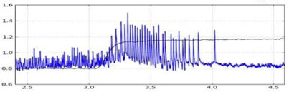
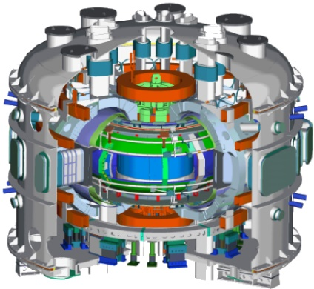
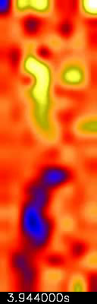
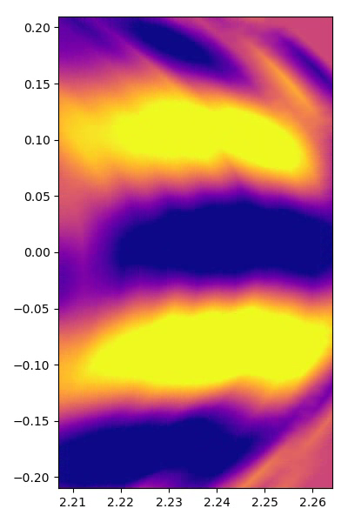
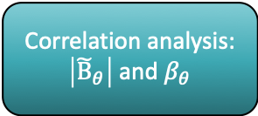
Federation of Science:
Experimental data streaming from KSTAR to OLCF/NERSC
EFIT magnetic reconstructions (0D magnetic)
Correlation analysis:
$\left|{\tilde{Β}}_{θ}\right|$ and $β_{θ}$
Parameter based, reduced model comparison
(1D ECEi)
Data access patterns analysis and prediction
ECEi Synthetic Diagnostic
Parameter based, reduced model comparison (2D ECEi)
Machine learning based data refactoring, data reduction, and prioritization
ECEi FFT/Wavelet Decomposition
Machine learning based mode classifier
Campaign Storage
KSTAR Data Stream
MCMC based integration data fusion
(2D ECEi, soft-xrays, etc.)
Fusion WDM ECP App
(XGC, GENE, M3D-C1, RF, EP)
Choi, Jong Y., et al. "Icee: Wide-area in transit data processing framework for near real-time scientific applications." 4th SC Workshop on Petascale (Big) Data Analytics: Challenges and Opportunities in conjunction with SC13. Vol. 11. 2013.
Image: Michael Churchill, PPPL

Slide 6
MONA’s Central Challenge(s)
We focused on three particular challenges:
  How can I measure and judge performance of the distributed, scalable system?
  How do I build realistic benchmarks and mini-applications to test and evaluate design, hardware, and infrastructure during construction?
  How can I extract the most efficiency from my computational resources during my experiment?

Slide 7
In Situ Everywhere:
Applying In Situ to In Situ
Addressing these means addressing the PBs of potential monitoring data
We’re familiar with this problem – it’s the same as finding features in PBs of time sequenced science data
  New types of features, but same idea.
Hence online MONitoring Analytics (MONA) is our approach to address these core challenges.

Slide 8
The MONA Approach
A pragmatic approach to increasing reliability and availability of performance feedback throughout the software development cycle.
  The coupled/in situ/online code paradigm is not easy to address piecemeal.
We need tools for extracting the data, for doing the in situ analysis, and for applying the insights back to the development cycle.
  We leverage existing tools – TAU, ADIOS, Python, etc.
  Added a tool interface to the in situ infrastructure (ADIOS) for uniform performance monitoring
  Reusable, extensible performance infrastructure

Slide 9
How can I measure and judge performance of the distributed, scalable system?
How do I build realistic benchmarks and mini-applications to test and evaluate design, hardware, and infrastructure during construction?
How can I extract the most efficiency from my computational resources during my experiment?

Slide 10
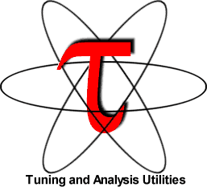
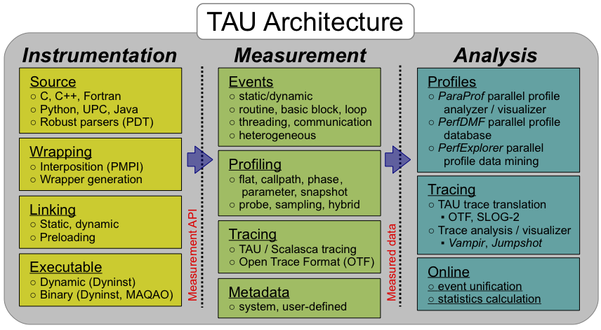
The TAU Performance System
Integrated parallel performance instrumentation, measurement, and analysis
Targets all parallel programming & execution paradigms
Portable, open source parallel profiling and tracing
Notes:
TAU overview slide. Feel free to just use this one slide, and mention the items on the following slide if you are pressed for time/space. The main message is that TAU is mature performance measurement infrastructure for all scales of parallel computing.

Slide 11

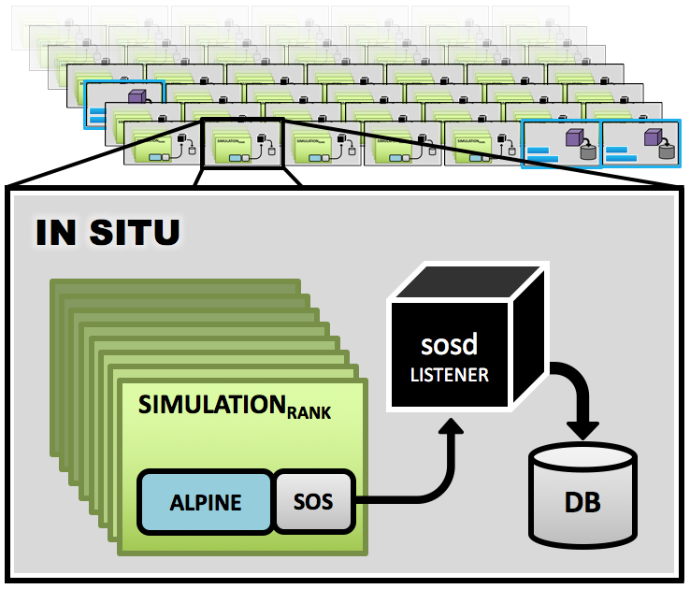
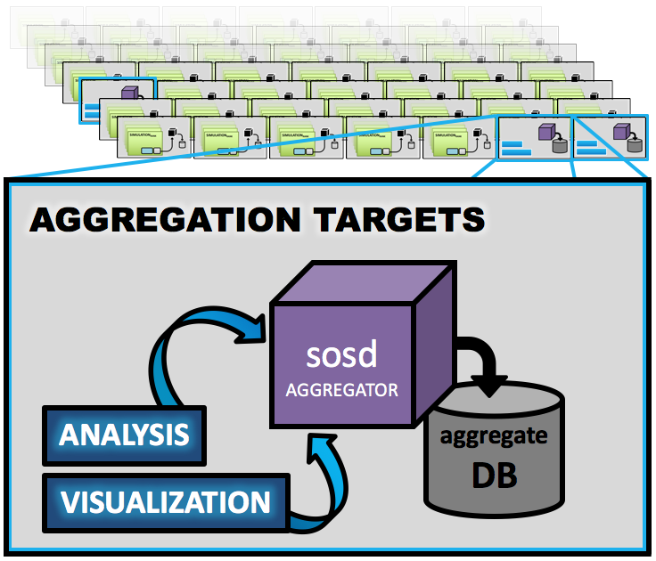
Scalable Observation System (SOS)
In situ aggregation and analysis service
Provides infrastructure for user-space monitoring, introspection, analytics, feedback / code steering, visualization
Aggregates data from heterogeneous / dynamic coupled codes, pipelines, workflows and campaigns
Designed for performance and scientific domain purposes
LIBRARY
Notes:
I’ll contact Chad for a recent SOS figure that he’d prefer to use

Slide 12
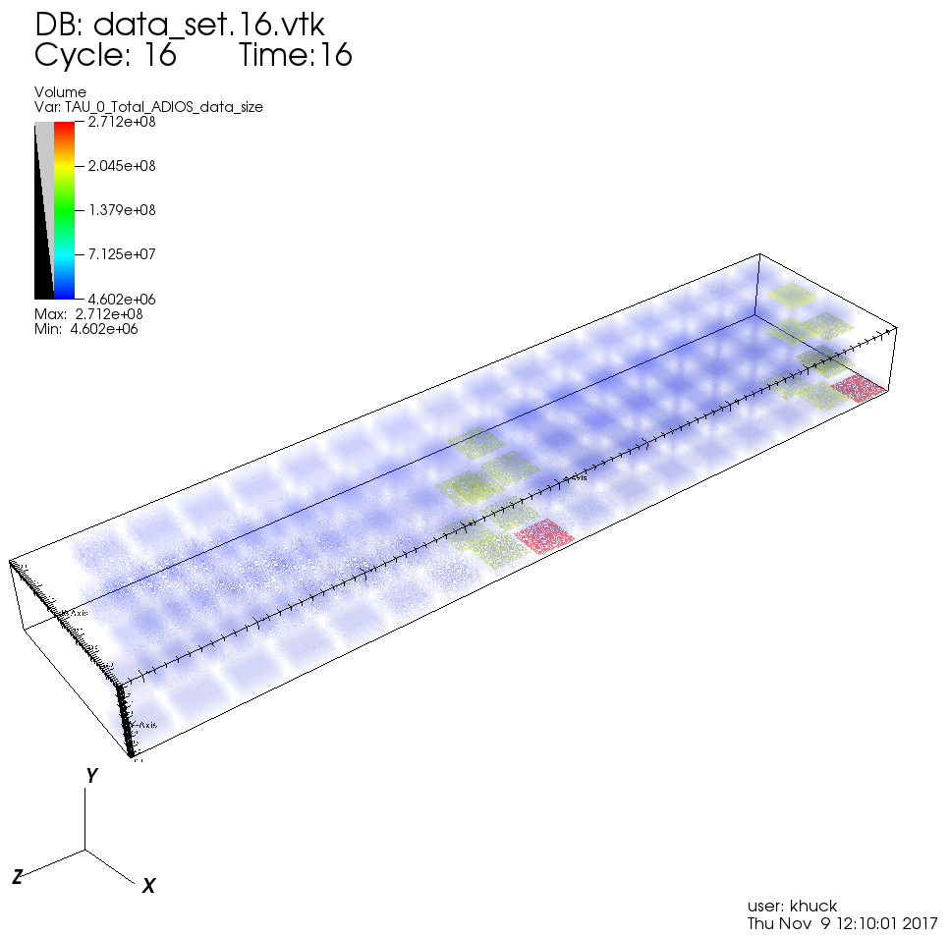
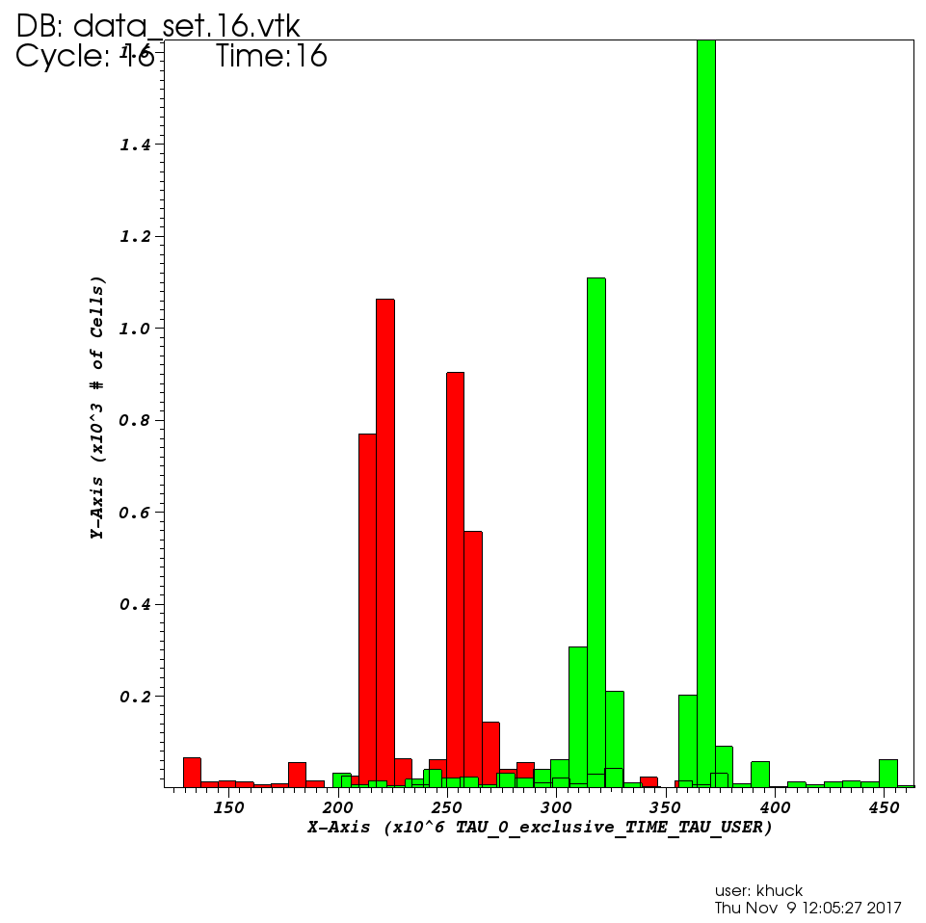
TAU - SOS Integration for Monalytics
Compute Nodes
Aggregation
Node(s)
TAU measures the executing application(s)
Periodically, TAU aggregates profile or event trace data over SOS to local listener
Local listeners forward data to remote aggregators
At runtime or post-mortem, analysis clients examine the aggregated data for reporting, computational steering
Application
Application
DB
TAU
TAU
SOS
SOS
SOS listener
SOS aggregator
Application
Application
TAU
TAU
SOS
SOS
SOS analysis
Analysis
Reports
Notes:
This is the figure from the paper, describing the integration of TAU and SOS for the purposes of Monalytics...

Slide 13
How can I measure and judge performance of the distributed, scalable system?
How do I build realistic benchmarks and mini-applications to test and evaluate design, hardware, and infrastructure during construction?
How can I extract the most efficiency from my computational resources during my experiment?

Slide 14
Exploring behavior of workflow components
We need tools to assess hardware, configuration, etc.
Specifically, it would be nice to have mini-apps that mimic the behavior of workflow components
  Such mini-apps could serve as stand-ins for more complex and unruly applications, allowing a more automated testing strategy
We care about behaviors observable from outside that may impact other components
  I/O calls and MPI Communications are important, as they can interfere and be interfered with
  Computation not important, can use sleep
However, users have different interests, so it should be easy to mimic other aspects of behavior

Slide 15
The Pookie approach
XGC coupling workflow
(XGC-f-total)
I/O skeletons allow us to use a model based on observations of our application and analysis components to automatically generate mini-app codes with the same behavior
  Accuracy of the mini-apps should be contingent on the specific details of the model
The generative programming approach allows us to use an I/O model to instantiate a set of code templates to create mini-app codes
XGC
f_total Data
F_{total}
Analysis
Coupling
In-memory
Inter-network
MONA Performance Monitoring
Performance Extraction
Pookie
mini XGC
f_total Data
mini F_{total}
Analysis

Slide 16
Pookie
Pookie uses the Cheetah template generation engine to process code templates
It supports a rich template language that includes loops and conditionals
Each template receives I/O model data that is used to instantiate the template
In addition to source codes, Pookie can also generate Makefiles, submission scripts, etc.
I/O Model
Pookie
Mini-app
Template
Makefile
Template
Job
Template
Cheetah
Mini-app
Sources
Mini-app
Sources
Makefile
Job Script

Slide 17
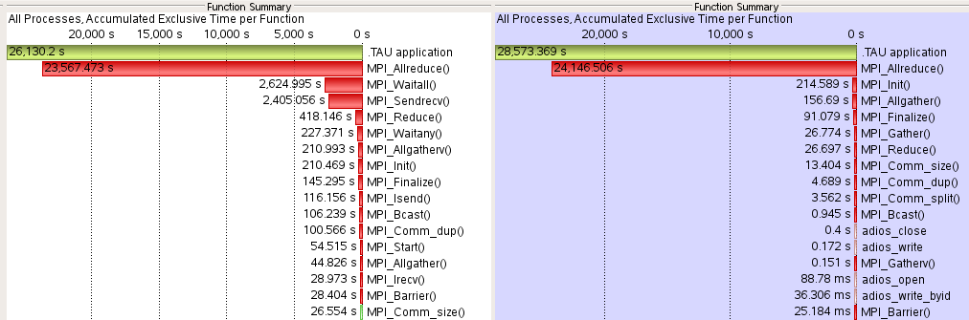
Results
Goal: Preserve the ratios of execution times for MPI collectives and in situ transfers.
Original
Mini-app

Slide 18
Next steps
Working on major rewrite, Skel3, to feature:
  Extensible models based on the ADIOS/MPI approach in Pookie
  Support for Python3 and Cheetah3
  Meta-generation (generative tools are themselves generated)
  Templates and model acquisition tools for ADIOS2
  User friendly template editing

Slide 19
How can I measure and judge performance of the distributed, scalable system?
How do I build realistic benchmarks and mini-applications to test and evaluate design, hardware, and infrastructure during construction?
How can I extract the most efficiency from my computational resources during my experiment?

Slide 20
Communication pattern monitoring for task placement
Task placement
  Maximizing data locality is a key to the performance
  Can avoid interference, jitter, bottlenecks if we have correct information
  Need to capture runtime information (e.g., communication pattern)
Use MONA to monitor and capture communication pattern
The same is true for HPC
Comm. Pattern
System Topology
Monitor
MONA
Extract
Task Placement

Slide 21
Performance monitoring of variability
Example: jitter observation
  Run a same XGC coupling workflow (xgc-f_total analysis) on Theta and Titan
  Observed performance variance at different date and time
  Performance variations can be internal or external
  Use MONA for
  performance analysis
System Performance
MONA
monitor
Auto correlation

Slide 22
Task Graph Embedding (TGE)
XGC
GENE
N4
X1
X2
A1
N1
N5
Task mapping problem ➔ Finding locality
  How to optimally place coupling processes on the allocated nodes
    Should we put application (e.g., XGC) and analysis together in a node?
    Should we separate them?
  How to minimize congestion and traffic
  MONA provides inputs (comm. pattern and system graph) to TGE
TGE takes graph theory-based approach
  Graph embedding between two graphs:
  task graph and topology graph
  General enough to apply complex
  workflow
N3
X3
X4
A1
Mapping
(Placement)
N2
N6
Coupling Workflow
System Topology
J. Y. Choi et al., "TGE: Machine Learning Based Task Graph Embedding for Large-Scale Topology Mapping," Cluster 2017
Coupled Execution
XGC
GENE
SOSflow
SOSflow
SOSD
Communication Pattern
Extraction
System Topology
Extraction
XGC
GENE
Task Graph Embedding (TGE)
New Process Placement Strategy

Slide 23
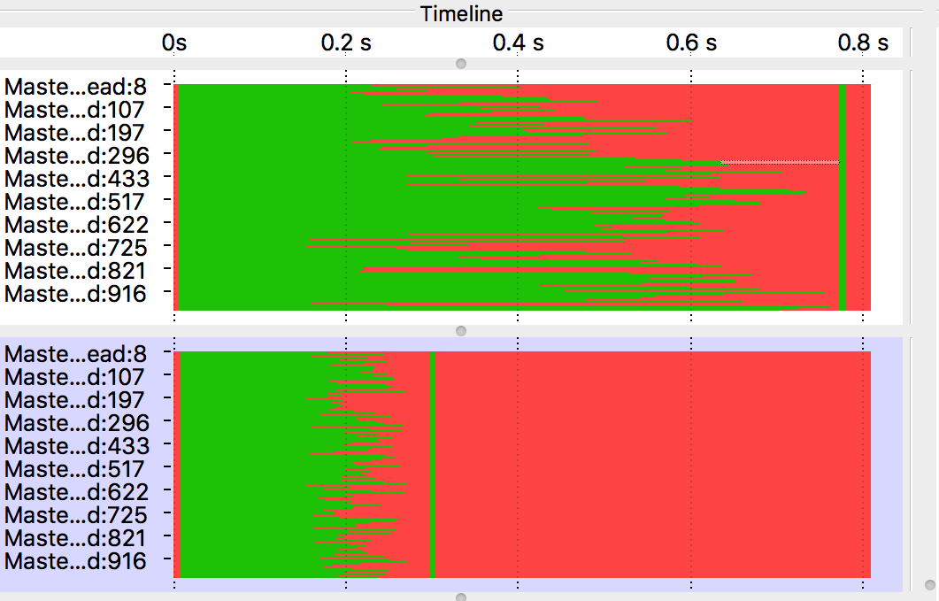
TGE with MONA
Significance and Impact
  MONA enables understanding of scalable scientific in situ workflows with dynamic extraction and interpretation of performance data.
  MONA provides feed to network/graph analysis application (e.g., TGE)
Low-overhead monitoring to improve performance by intelligently placing codes onto HPC resources
Using a coupled whole-device model of Gyrokinetic Fusion (XGC1+GENE) on 1024 cores as a test case along with the MONA performance model Task-Graph-Embedding (TGE),
Before
(Default)
Wait
Application
After
Task
Mapping
Barrier

Slide 24
Conclusions and Future Work
“In Situ Everywhere”
  When data (or metadata) is too large, you can still model, learn, compress, and analyze it in situ.
Continuous Learning from Performance
  Performance analysis gets cast as a one-time-only effort; there is value in learning light-weight, continual performance models.
MONitoring Analytics helps to deliver on both of these.
Future Work
  Exploiting monitoring analytics for even tighter control loops.
  Incorporating performance model learning in provenance.
  Developing performance policy language and engines for science data beyond simple QoS.

