Slide 1
TAU measurement of MPAS-Ocean Load Imbalance
SCVT structure,
cell/mesh neighborhood
nCells - Min(51): 893 Max(111): 1416 Avg: 1282.83
Data domain organized as unstructured meshes, typically Spherical Centroidal Voronoi Tesselations (SCVTs).
Mesh cells are arbitrary polygons, usually hexagons, decomposing the data in 2 dimensions.
Domain decomposition across MPI ranks: cells are organized into blocks, with (typically) three layers of halo cells from neighboring blocks.
Blocks are partitioned only with respect to nCellsSolve (cells in block)
TAU timers were integrated into MPAS using application timers and CAMTIMERS (CESM), and application metadata is also collected
TAU PerfExplorer correlation analysis showed high correlation of computational imbalance and MPI synchronization with nCells (cells in block + halo cells) - each process has to solve for its explicitly assigned cells and its halo cells

Slide 2
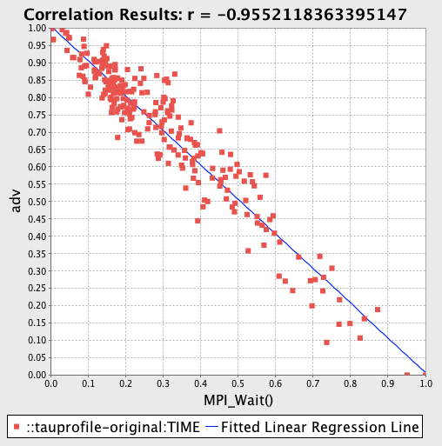
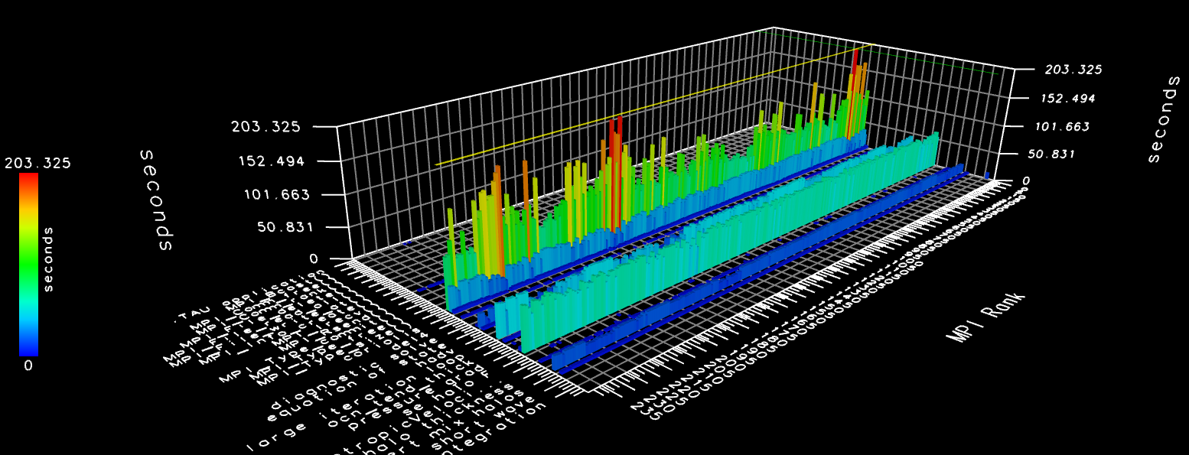
MPAS-Ocean: Load Imbalance
Load imbalance across processes
  Unusual stencil problem: halo/ghost cells lead to imbalance (3 layers)
Performance measurement in isolation is not enough
Need to combine:
  Performance measurements
  Application metadata
  Correlations between measurements and metadata
  Visualization of performance data in application domain

Slide 3
New Partition Strategy to Address Load Imbalance
“Hindsight” partition refinement strategy developed
Optimizing Heuristic:
  Partition with Metis
  Compute properties of partitions (i.e. #cells in partition + #cells in halo) to use as cell weights
  Assign weights to cells and update graph
  Iterate until balance can’t be improved
Analysis suggests 2-12% reduction in execution time, depending on quality of initial partition (based on size of largest partition)
TAU profile measurement shows 12-15% reduction in execution time
  ~45% reduction in mean MPI_Wait() times for 240 process example on Edison
Reduction in communication routines due to better balance

Slide 4
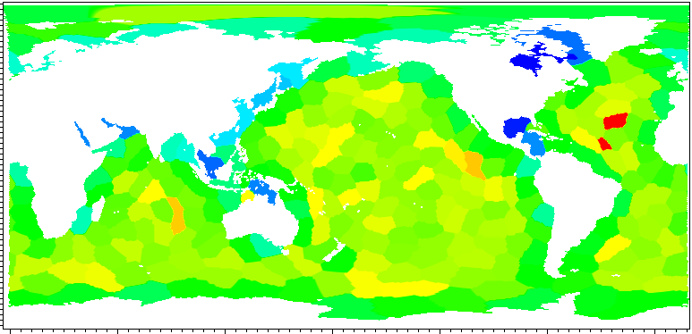
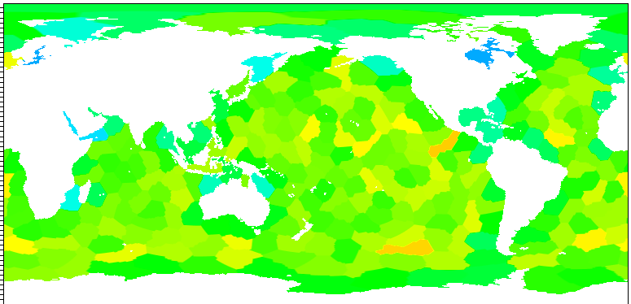
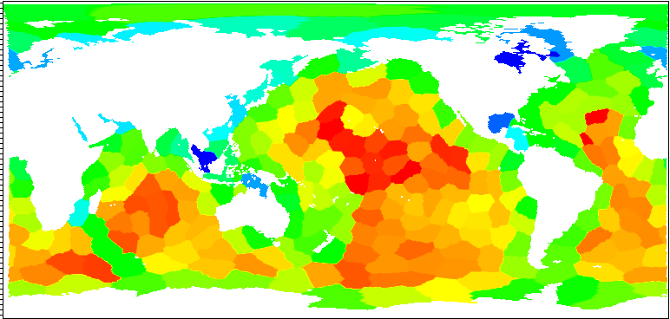
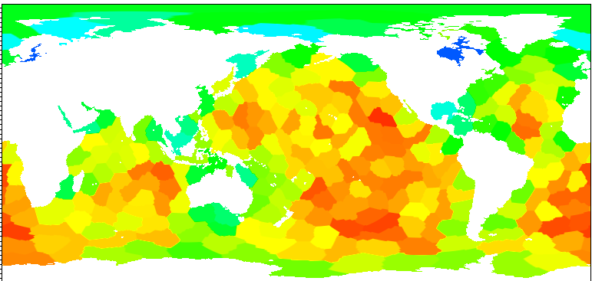
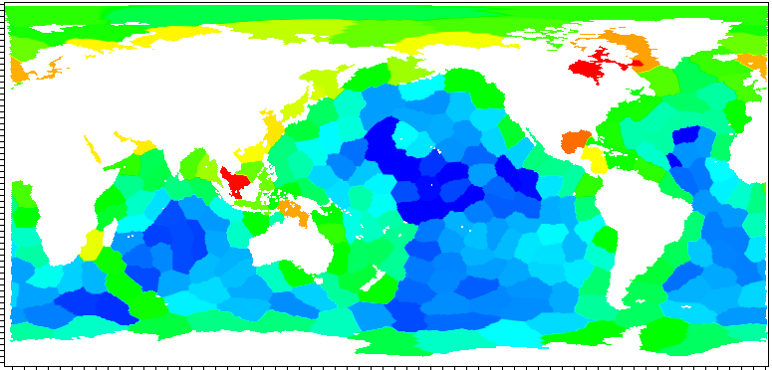
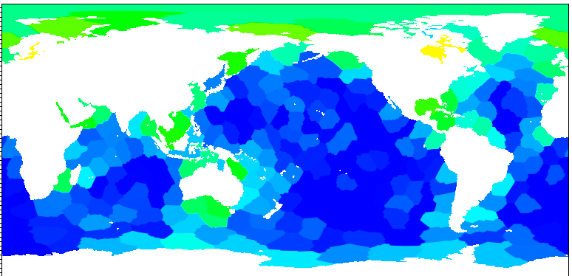
SUPER+SDAV: Visualizing Performance Data in the Application Domain
Hank Childs (U. Oregon/SDAV) wrote an MPAS-specific NetCDF, Partition and performance data/metadata reader for VisIt
TAU PerfExplorer script written to aggregate and format data for visualization
Allows visual comparison of partitioning strategies by correlating TAU data, metadata with cells and blocks
min:
473  535
max:
846  771
Total cells (explicit +
halo) per block
min:
8.3e7  9.8e7
max:
2.5e8  2.4e8
Time spent
computing
Time spent in
MPI_Wait
min:
2.7e7  9.0e6
max:
1.9e8  1.5e8

Slide 5
MPAS Scaling behavior
Scaling study on Titan (Cray XK7), Eos (Cray XC30) @ORNL
CAMTIMER data collected and visualized with TAU PerfExplorer
MPI-only scaling has limits due to increased partitioning leading to additional halo computation, communication
Increasing partitions increases total work in system, with possible diminishing returns
Other inefficiencies identified, further tests ongoing
Notes:
The Titan scaling data was collected by Pat Worley (SUPER/ORNL), similar results on EOS. CAMTIMER data is from the GPTL library incorporated into the CESM framework. It has been integrated into MPAS by Pat.

Slide 6
MPAS-Ocean: OpenMP Scaling
TAU profile data collected on Edison (Cray XC30) @NERSC
OpenMP scaling shows promise, but significant reduction in FLOPs/core offset by significant increase in cache misses
FLOP count per core is reduced by 45% at 3072 cores, but the L2 cache miss rate increased by 75%. At 6172 cores the reduction in FLOPs was even greater (65%) but cache misses for all cases increased.
Further analysis required to eliminate real/false sharing in loops
Notes:
The OpenMP scaling data was collected on Hopper by Doug Jacobsen, MPAS developer at LANL. The FLOP count per core is reduced by 45% at 3072 cores, but the L2 cache miss rate increased by 75% at 3072 cores. At 6172 cores the reduction in FLOPs was even greater (65%) but cache misses for all cases increased. The series in the graphs indicate how many threads per process were used. The Y axis is in log scale, the X axis are categories (roughly log scale).

