Slide 1
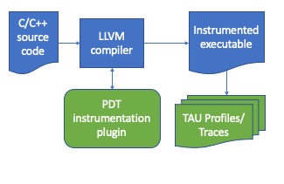
PDT: Instrumentation Plugin for LLVM Clang, Clang++
ECP Team and Funding
ECP Stakeholders: ST [LLVM], ST [PROTEAS-TUNE: TAU], [CODAR:CODAR]
FY22 ECP funding for project - $3.2M
Total ECP funding for this product - $10M
Core team members
Product description
PDT is developing open-source, production-quality, standard-conforming performance measurement support for C and C++ by extending Clang and LLVM with compiler-pass instrumentation plugins.
Post-ECP Funding for PDT
Needed | Total $?M in FY24 for status quo
Secured Pending Targeted | $0/year $0/year $0/year
Gap | $?M/year
[UO] | [C. Coti, A. Malony, S. Shende, K. Huck]
New capabilities | Enhanced instrumentation in Clang and LLVM, an increasingly popular open-source compiler platform Selective instrumentation using configuration file to further reduce overhead Configurable settings for minimum function size (instruction count)
User impact | Instrumentation plugin introduces far less overhead than standard compiler added instrumentation, especially for C++ codes Clang and LLVM provide a popular compiler platform for R&D for related optimizations and tools Many vendor compilers are based on LLVM technology and can also support plugins
Key Software Dependencies | LLVM based compiler with plugin support TAU
PDT Compiler Plugin Design
Expected future impact from PDT
Low-overhead instrumentation support in Clang/Clang++ and LLVM
Vendor support for LLVM based compilers like AMD, Intel
Potential instrumentation plugin support in Flang for future Fortran applications
Potential to transition to the new pass manager
Addition of loop-level instrumentation, or other types of basic blocks
The TAU LLVM instrumentation plugin is loaded and executed by the Clang/Clang++ compiler, and is provided the parsed AST of the input file(s). The plugin examines the AST and selectively instruments any encountered functions based on selection criteria provided by a configuration file.
PDT links: https://tau.uoregon.edu https://github.com/UO-OACISS/tau2

