Slide 1
Broad Performance Measurement Support for Asynchronous Multi-Tasking with APEX
Kevin Huck
0000-0001-7064-8417
Email: khuck@cs.uoregon.edu
GitHub: https://github.com/UO-OACISS/apex
Documentation: http://uo-oaciss.github.io/apex/

Slide 2


Broad Performance Measurement Support for Asynchronous Multi-Tasking with APEX
Kevin Huck
khuck@cs.uoregon.edu
https://github.com/UO-OACISS/apex

Slide 3
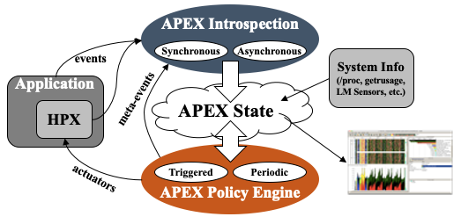

APEX Introduction
Autonomic Performance Environment for eXascale
Performance Measurement
Runtime Adaptation
Designed for AMT runtimes (HPX)
  But works with conventional parallel models
Focus on task dependency graph, not calling context graph
Supports HPX, C/C++ threads, OpenMP, OpenACC, Kokkos, Raja, CUDA, HIP, (OneAPI, StarPU in dev)...
https://github.com/UO-OACISS/apex
Active Harmony* (Nelder Mead), Simulated Annealing, hill climbing for parametric search methods
*https://www.dyninst.org/harmony

Slide 4
APEX and HPX
HPX: Asynchronous Many-Task Runtime system in C++
Data and task dependencies can be expressed with HPX futures and continuations, chained together in an execution graph.
The graph can be built asynchronously
HPX tasks are created, scheduled, executed, and usually yielded and resumed by the runtime system scheduler
This is particularly challenging because many different OS threads may have participated in the execution of the HPX task during its lifetime, and the calling context tree is meaningless to the application developer because it consists of runtime system functions, not application tasks

Slide 5
APEX and HPX
APEX is integrated into the HPX thread scheduler, uniquely identifies each task with a GUID, and tracks all state transitions for a given task.
Policy Engine used for tuning heuristic control knobs in HPX thread scheduler, networking
  Soft power caps, maximize throughput, reduce network latency, …
Baseline SSSP
Throttled to maximize throughput
Power benefit
Figures: Huck, et al. "An autonomic performance environment for exascale." Supercomputing frontiers and innovations 2.3 (2015): 49-66.
Notes:
Previous tuning policies – concurrency throttling to maximize throughput, controlling concurrency to stay under a soft power cap, parcel/packet coalescing parameters. Example: SSSP limiting adjusting concurrency to maximize throughput – has a side benefit of reducing power consumption. 10 nodes, 24 threads per node, 240 W per node, 1962 searches in 60 seconds. After, 150 W per node, 6929 searches (3.5x increase in throughput)

Slide 6
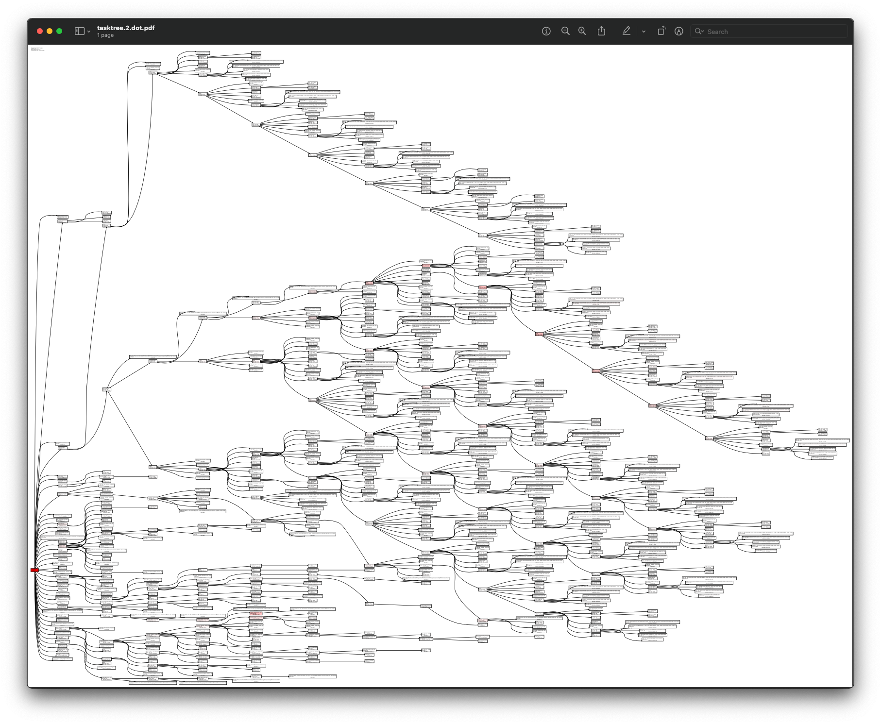
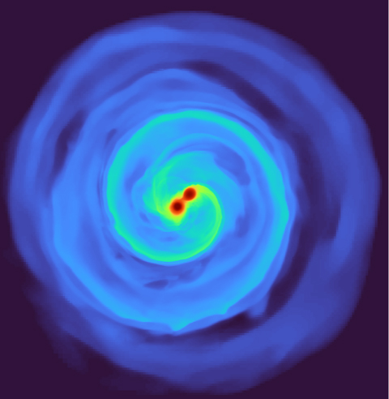
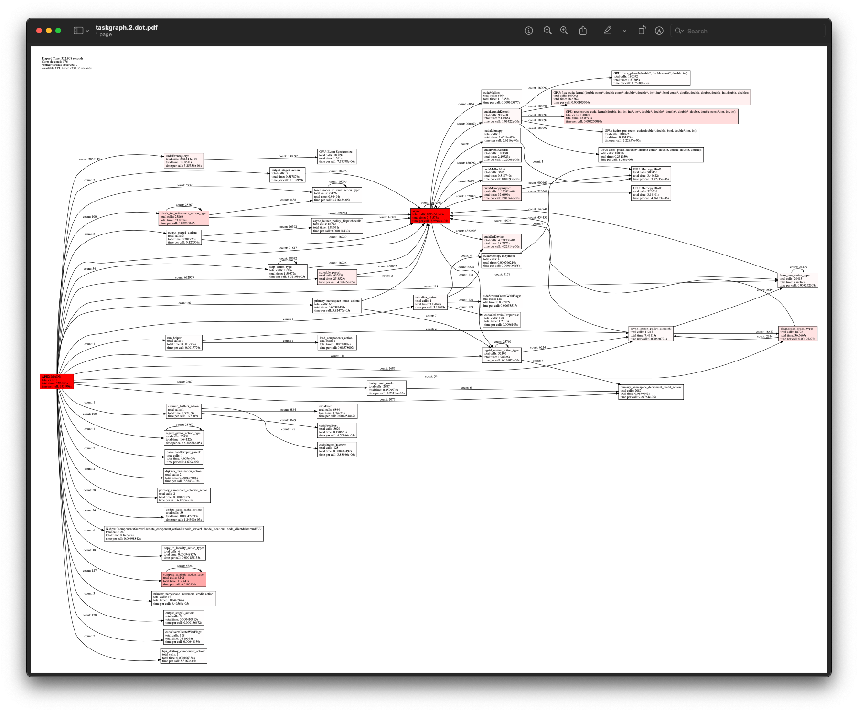
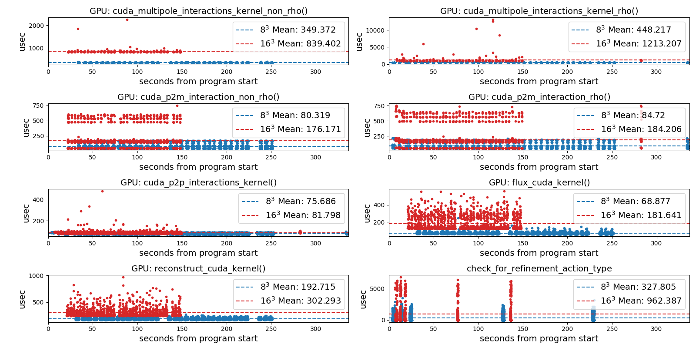
APEX example – Octo-Tiger (HPX)
Tracking GPU memory usage with CUPTI
Monitoring GPU utilization with NVML library
Full task tree (above) and task graph (below) showing task dependencies
Comparing subgrid sizes and relative kernel performance with CUPTI device activity
https://github.com/STEllAR-GROUP/octotiger
https://github.com/STEllAR-GROUP/hpx
Diehl, Patrick, et al. "Octo-Tiger’s New Hydro Module and Performance Using HPX+CUDA on ORNL’s Summit." 2021 IEEE International Conference on Cluster Computing (CLUSTER). IEEE, 2021.
Notes:
Octree based astrophysics code written with HPX that simulates the evolution of self-gravitating and rotating systems of arbitrary geometry

Slide 7
How is APEX different?
No shortage of existing performance measurement tools
  Primarily designed for post-mortem analysis
  First-person measurement of tied tasks/functions on an OS thread – not untied tasks, runtime thread control, third-person measurement, runtime control
  Not designed for permanent integration into applications
  OS-thread context can be limiting
  Vendor tools are great, but limited to each vendors’ architecture – can’t do cross-platform analysis
APEX helps address these needs

Slide 8
Measurement Capabilities
Timers – “per-process” aggregation for all timers
  Start, stop, yield, resume
  All times are inclusive (unless yielded/resumed)
Counters
  Can be associated with timed regions, e.g. MPI_Send #bytes
  Can be periodically captured and aggregated, e.g. power, utilization, hardware counters, OS counters
Task dependency chains
  Each task has a unique parent
  APEX builds graphs/trees of dependencies at runtime

Slide 9
Task Dependencies: fib(10)
Task Graph:
aggregated,
contains cycles
Task Tree:
aggregated-ish,
no cycles
Notes:
Also outputs to txt files, and json files (for input into Hatchet)

Slide 10
Better Example
Graph:
Every child node can have n parent nodes
Tree:
Every child node only has 1 parent node

Slide 11
Hardware Counters
APEX is integrated with PAPI (Performance Application Programming Interface) https://icl.utk.edu/papi/
Portable access to native hardware counters
  CPU
  GPU
  Off-core (permission dependent)
  Node/OS health
  Power/energy
  Filesystems
HW counters collected with timers, or periodically

Slide 12
GPU Measurement
CUDA
HIP/ROCm
Support provided with CUPTI library
Monitoring support provided with NVML library
Hardware counters provided CUPTI and through PAPI
Host callback and device activity dependencies linked using correlation IDs
Support provided by Roctracer and Rocprofiler libraries
Monitoring support provided by rocm-smi library
Hardware counters provided CUPTI and through PAPI
Host callback and device activity dependencies linked using correlation IDs
Intel SYCL/DPC++/OneAPI support in development…

Slide 13
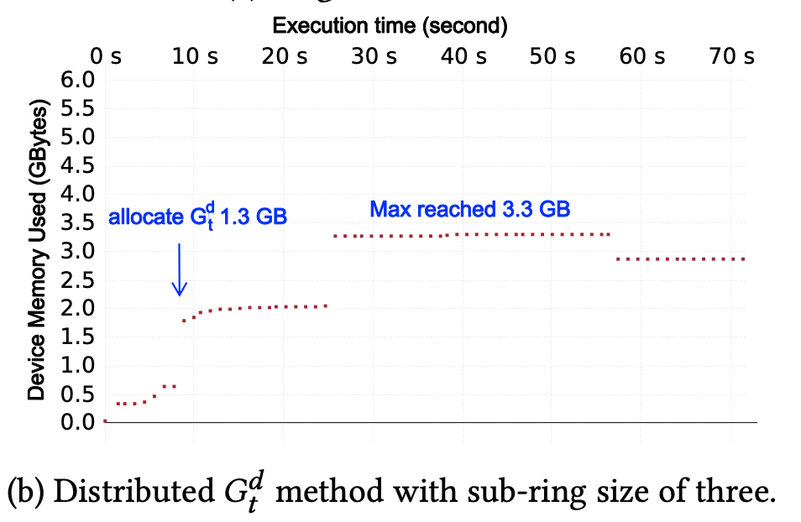
GPU Memory Tracking
For both CUDA and HIP, when memory is allocated or freed through the cuda/hip API, APEX captures:
  Allocation type (host/gpu)
  Bytes allocated
  thread ID that requested it
  Address of allocated memory
  Backtrace from when allocation happened
At application exit, any leaked allocations
are reported to the user, similar to
cuda-memcheck
…but finds leaks that it doesn’t
Counters also saved by APEX (bytes allocated/freed/total)
Motivating paper: Wei, Weile, et al. "Memory Reduction Using a Ring Abstraction Over GPU RDMA for Distributed Quantum Monte Carlo Solver." Proceedings of the Platform for Advanced Scientific Computing Conference, 2021.

Slide 14
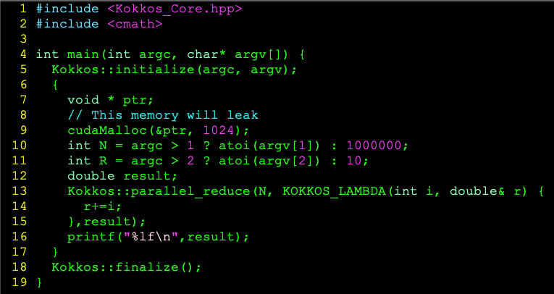
Example Program: memory error
CUDA-MEMCHECK version 11.6.124 ID:(46)
========= CUDA-MEMCHECK
========= ERROR SUMMARY: 0 errors
1024 bytes leaked at 0x1465937ea400 from task cudaMalloc on tid 0 with backtrace:
gpu_device_malloc
addr=<0x1465fa0f409b> [{(unknown)} {0x1465fa0f409b}]
addr=<0x1465fa0f43b7> [{(unknown)} {0x1465fa0f43b7}]
addr=<0x1465fa0f6c1c> [{(unknown)} {0x1465fa0f6c1c}]
addr=<0x1465fe5e3143> [{(unknown)} {0x1465fe5e3143}]
addr=<0x1465fdfb247b> [{(unknown)} {0x1465fdfb247b}]
main [{/home/khuck/polaris/test/test.cpp} {9,0}]
__libc_start_main [{/lib64/libc-2.31.so} {0x1465fb4e434d}]
_start [{/home/abuild/rpmbuild/BUILD/glibc-2.31/csu/../sysdeps/x86_64/start.S} {122,0}]

Slide 15
Concurrency Tracking
Periodically sample all the currently executing tasks
Aggregate across N timers
Example shown:
  Kokkos Lulesh with HPX back end
  Sampled 200 times per second
  10 iterations, size 256
Helps identify regions of low concurrency

Slide 16
Concurrency: OpenMP back end
Looks like higher concurrency…but barriers aren’t progress
…as evidenced by dips in power usage

Slide 17
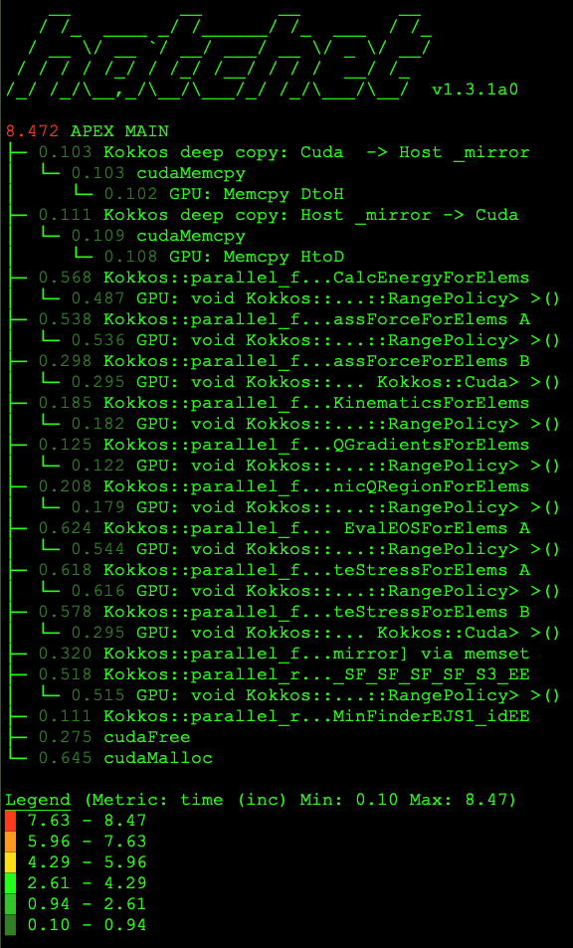
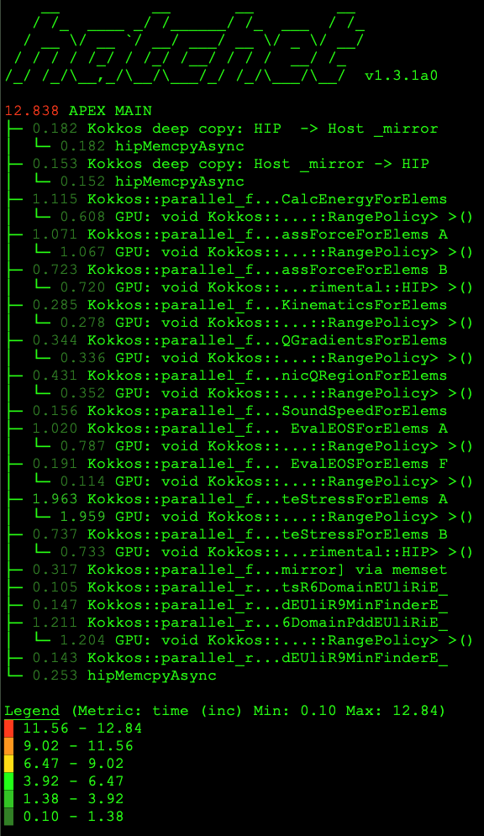
Profile Formats
All timer & counter data
Flat profile:
  Text summary to screen – all ranks merged with MPI or HPX at end of execution
  CSV (for Python ingestion)
  TAU Profiles (ParaProf)
Task graphs/trees:
  Hatchet-like JSON (still working on importer library for Hatchet) https://hatchet.readthedocs.io
  Graphviz dot files
  Txt files (similar to Trilinos profiler output)
Example: Lulesh Kokkos with CUDA, HIP back ends

Slide 18
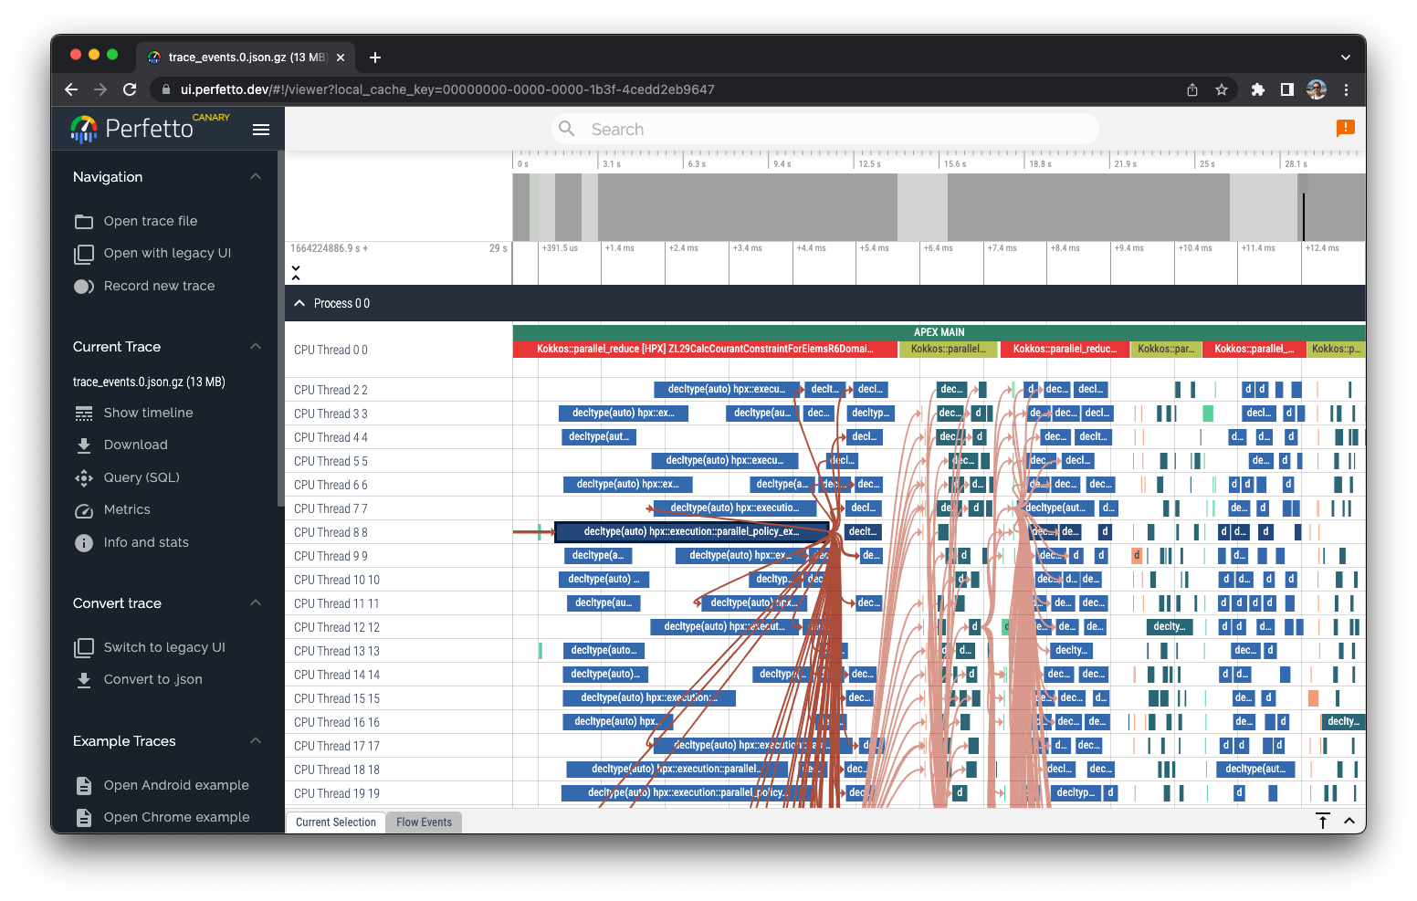
Trace Formats
OTF2 up to v 2.3
  3.0 has API changes, haven’t been incorporated yet
  Visualized with Vampir or Traveler / JetLag
Google Trace Events Format
  JSON support only (native support coming soon)
  Visualized with Perfetto
  Some scaling issues (memory limit of web browser)
Example: Lulesh Kokkos with HPX back end

Slide 19
Scatterplots
Monitoring Data (periodic)
Progress Data (events)
Example: Lulesh Kokkos with CUDA back end

Slide 20
Supported Programming Models
HPX
POSIX / C++ threads
OpenMP/OpenACC
GPU offload: CUDA, HIP, OpenMP target
Abstractions: Kokkos, Raja
MPI (subset)
In development: Intel Level0/OneAPI GPU support, StarPU

Slide 21

POSIX / C++ Threads
APEX wraps the pthread_create() call:
  Wraps target function with a proxy function
  Times target function
  Captures task dependency hierarchy between parent, child
Provides support for C++ thread activity too
  std::thread
  std::async

Slide 22


OpenMP and OpenACC
OpenMP 5.0 included OMP-Tools (OMPT) API
  Callbacks, query functions, sampling states
  Buffer processing for target offload asynchronous activity
  Tested with AMD Clang 5.0+, NVHPC 22.7+, Intel OneAPI 2022
OpenACC profiling callbacks to intercept entry/exit of all OpenACC routines
  CUDA/CUPTI provides support for device activity (see next slide)

Slide 23


Kokkos and Raja
C++ Abstraction models for performance portability
1 source code implementation to target different architectural / model back ends
  Serial, Pthreads, OpenMP, OpenACC, CUDA, HIP, SYCL, etc.
Both provide profiling callbacks for tool support
Kokkos includes a prototype “tuning” interface for tools to hook utilize at runtime
  APEX has implemented tuning policies and tested with CUDA back end tuning Range, MDRange, Team policies

Slide 24
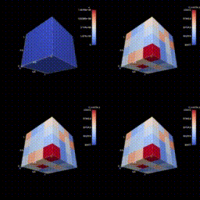
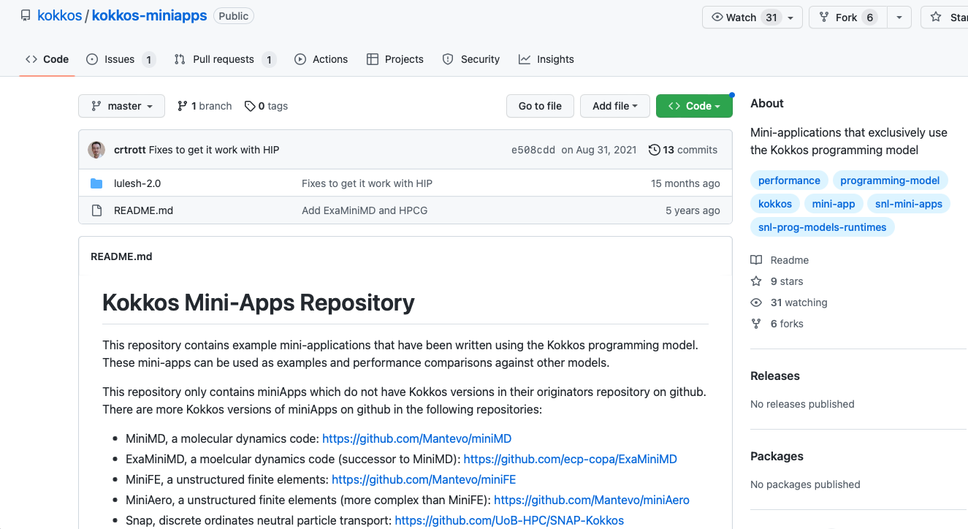
Lulesh w/ Kokkos Experiments
https://github.com/kokkos/kokkos-miniapps
Tested lulesh-2.0 mini-app (https://asc.llnl.gov/codes/proxy-apps/lulesh)
  HPX
  OpenMP
  CUDA
  HIP
Figure: LULESH 2.0.3 executed with 64 MPI ranks, measured by TAU. Time spent in main loop rendered every 100 timesteps by Alpine-Ascent. Clockwise from upper left: Computed energy, accumulated time in main loop, time in main loop during last 100 timesteps, Δ time in main loop from previous 100 time steps. Source: Malony, et al. "When Parallel Performance Measurement and Analysis Meets In Situ Analytics and Visualization." Parallel Computing: Technology Trends. IOS Press, 2020. 521-530.
Notes:
Livermore Unstructured Lagrangian Explicit Shock Hydrodynamics - The Shock Hydrodynamics Challenge Problem. LULESH is a highly simplified application, hard-coded to only solve a simple Sedov blast problem.

Slide 25
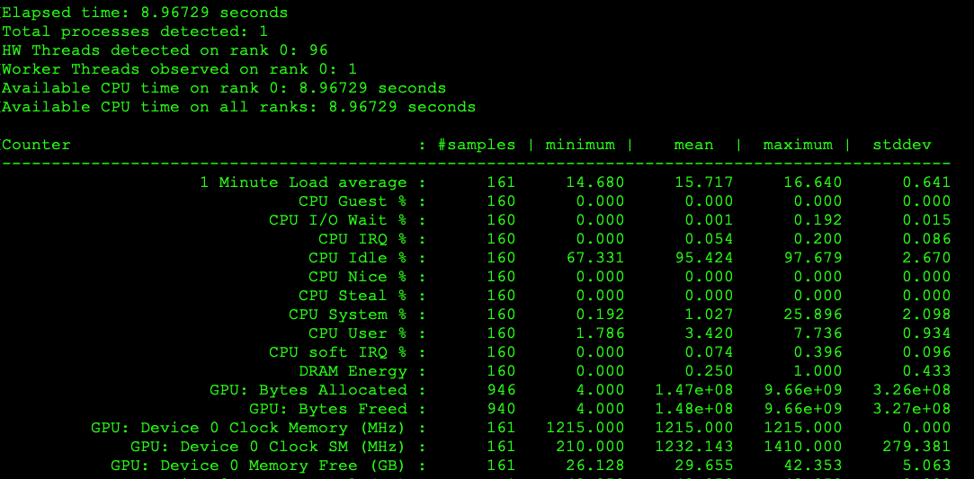
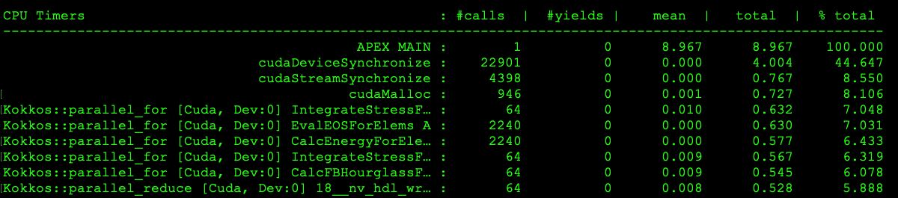
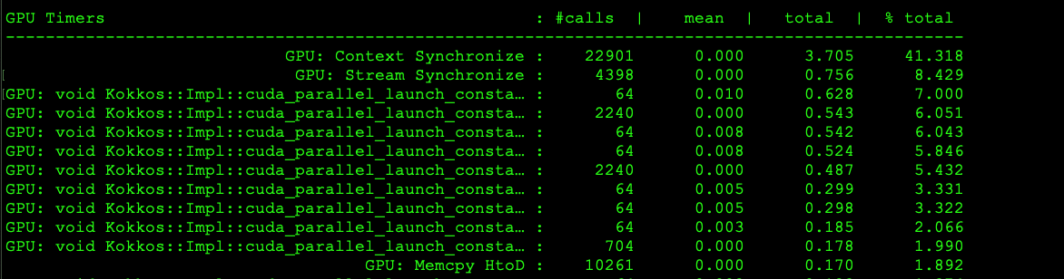
Lulesh: CUDA back end
apex_exec --apex:kokkos_fence --apex:cuda \
--apex:monitor_gpu --apex:period 5000 \
${builddir}/lulesh-cuda/lulesh.cuda -s 256

Slide 26
Lulesh: HIP back end
apex_exec --apex:kokkos_fence --apex:scatter \
--apex:hip --apex:monitor_gpu \
--apex:period 5000 ${builddir}/lulesh-hip/lulesh.hip -s 256

Slide 27
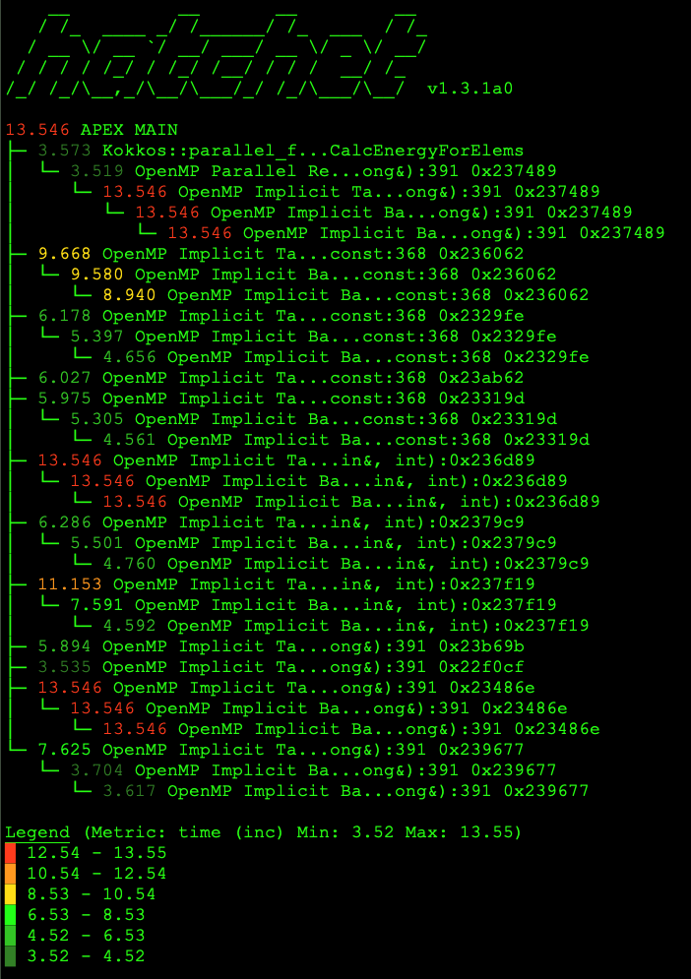
Lulesh: OpenMP back end
apex_exec --apex:kokkos_fence --apex:ompt --apex:ompt_details \
--apex:tasktree ${builddir}/lulesh-openmp/lulesh.host -s 256 -p -i 10

Slide 28
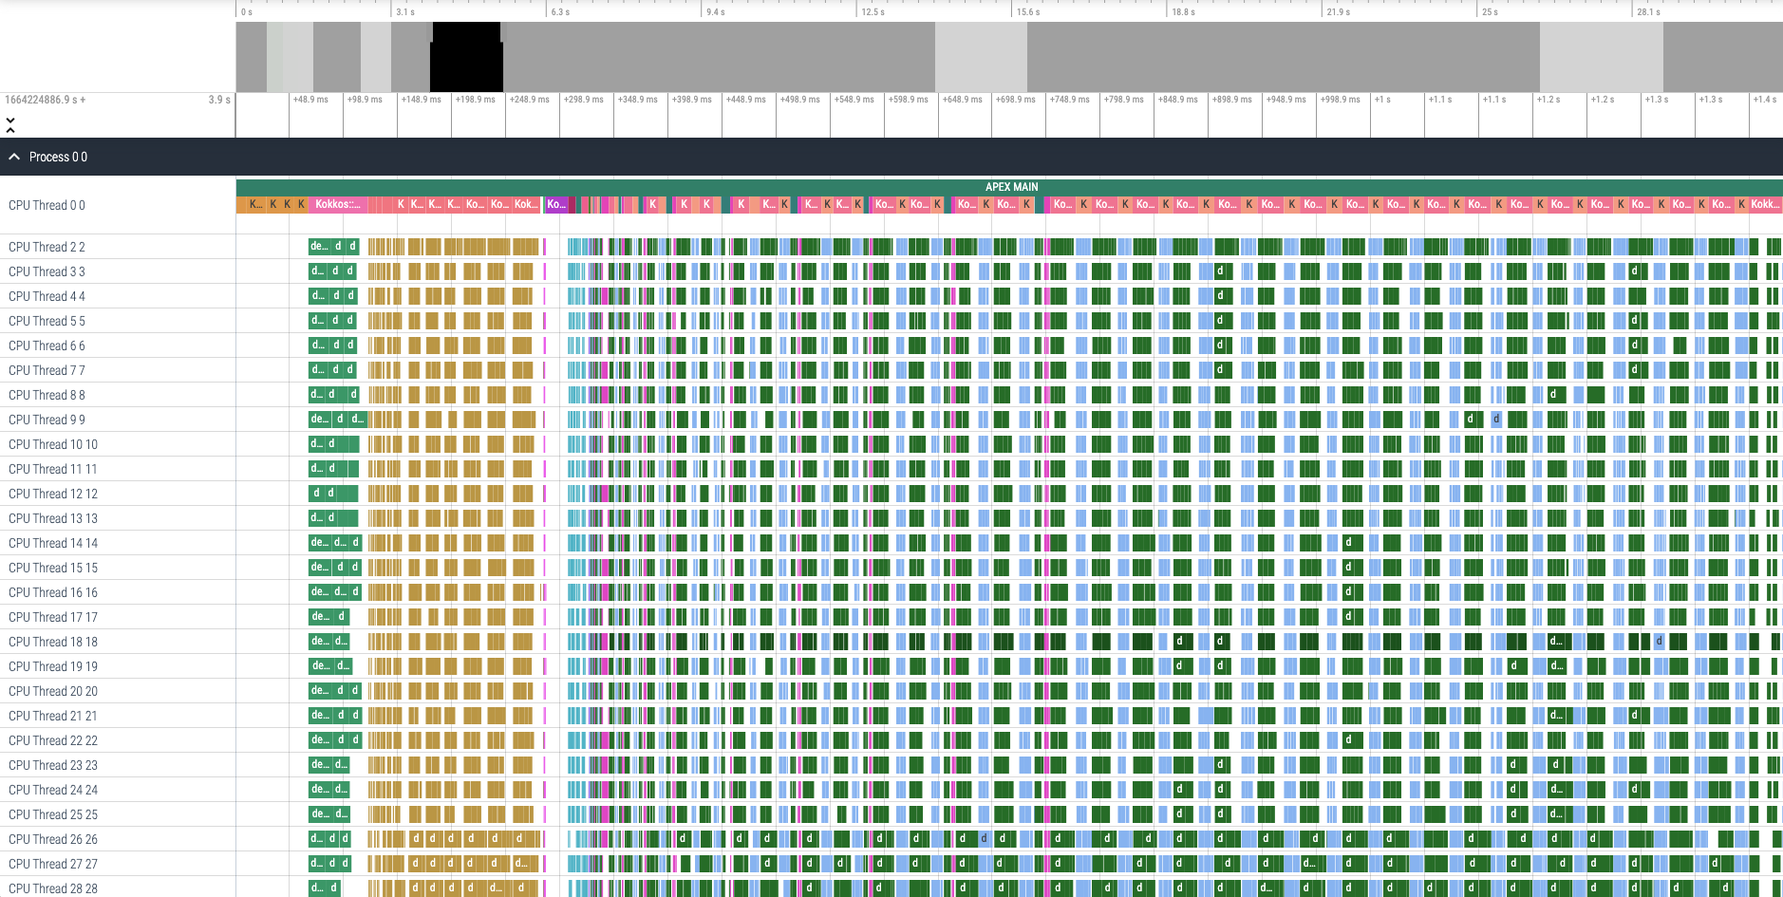
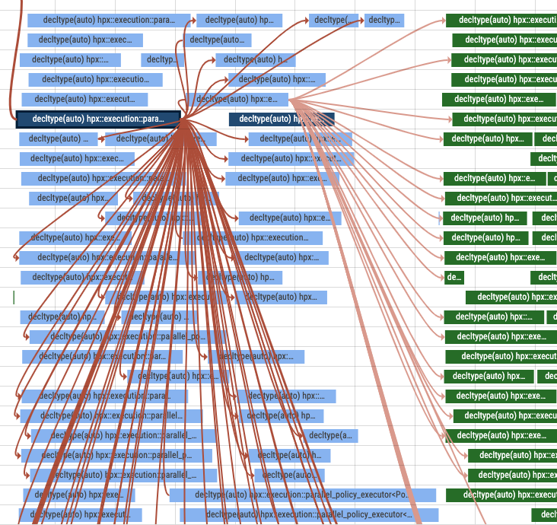
Lulesh: HPX back end
apex_exec --apex:kokkos_fence --apex:gtrace \
${builddir}/lulesh-hpx/lulesh.kk -p -i 10 -s 256

Slide 29
Future Work
Intel Level0/OneAPI support has been prototyped, but not yet merged
StarPU support added by Camille Coti, needs additional testing and tighter integration
Perfetto native trace output
PowerAPI integration for broader power/energy support
Kokkos runtime autotuning development

Slide 30



Acknowledgements
Parts of this research was supported by the Exascale Computing Project (17-SC-20-SC), a joint project of the U.S. Department of Energy’s Office of Science and National Nuclear Security Administration, responsible for delivering a capable exascale ecosystem, including software, applications, and hardware technology, to support the nation’s exascale computing imperative.
This research used resources of the Oak Ridge Leadership Computing Facility at the Oak Ridge National Laboratory, which is supported by the Office of Science of the U.S. Department of Energy under Contract No. DE-AC05-00OR22725.

