Slide 1


TAU on Crusher : Latest support and how to use it
Kevin Huck, Sameer Shende, Allen Malony
khuck@cs.uoregon.edu
http://tau.uoregon.edu

Slide 2
Crusher : Brief overview
https://docs.olcf.ornl.gov/systems/crusher_quick_start_guide.html
Early access system for Frontier
192 nodes: one 64-core AMD EPYC 7A53 (four NUMA domains), 512 GB DDR4, four AMD MI250X with two GCDs each, 26.5 TFLOP/s (dp).
2 Cabinets (64, 128 nodes each) HPE Slingshot 25 GB/s NICs
https://www.amd.com/system/files/documents/amd-cdna2-white-paper.pdf

Slide 3
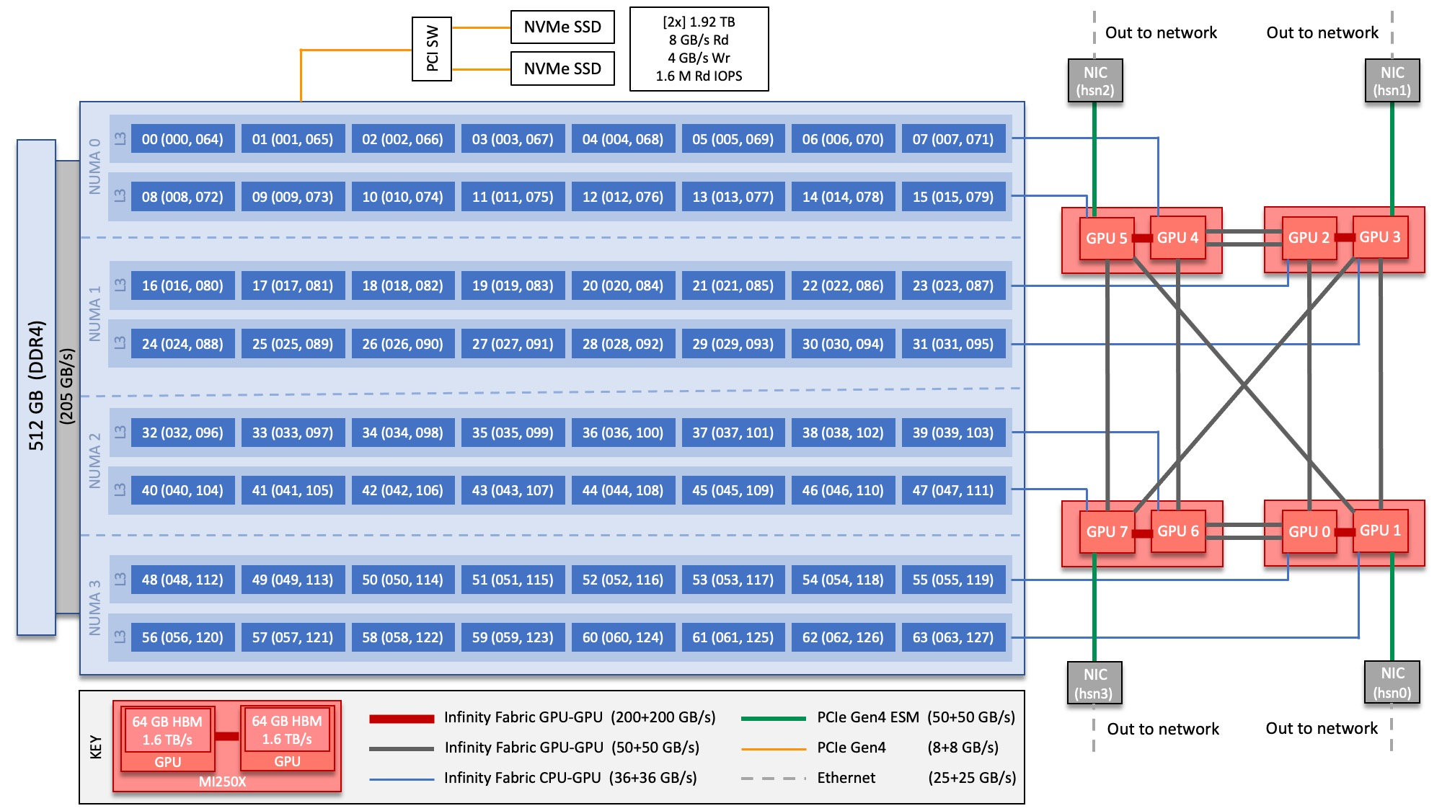
Crusher node diagram
https://docs.olcf.ornl.gov/systems/crusher_quick_start_guide.html

Slide 4

TAU : brief overview
Tuning and Analysis Utilities (28+ year project)
Integrated performance toolkit:
  Multi-level performance instrumentation (if needed)
  Highly configurable
  Widely ported performance profiling / tracing system
  Portable (java, python) visualization / exploration / analysis tools
Supports all major HPC programming models
  MPI/SHMEM, OpenMP/ACC, CUDA, HIP, OneAPI, Kokkos...

Slide 5
Platform Readiness side note
Many programming models provide “hooks” for tools
  MPI, Kokkos, OpenACC, OpenMP, CUDA, HIP, OneAPI, etc.
Often, instrumentation isn’t necessary
Instrumentation of C++ is currently discouraged
  -finstrument-functions is far too invasive, too much overhead (gets everything),
  Sampling / hybrid measurement is currently preferable
  Clang/Clang++ plugin nearly done – needs some tweaks for hipcc support – should be available soon
  PDT still works fine for Fortran and C

Slide 6
Where is TAU installed on Crusher?
/gpfs/alpine/world-shared/gen010/tau2
a.k.a. $WORLDWORK/gen010/tau2
Multiple configurations available:
  Cray, AMD, GCC compilers (not all there yet)
  ROCm 4.5.2, 5.0.2
  Cray MPICH and generic MPICH available
For ABI compatibility, make sure you choose the right one (and ask if what you need isn’t there)

Slide 7
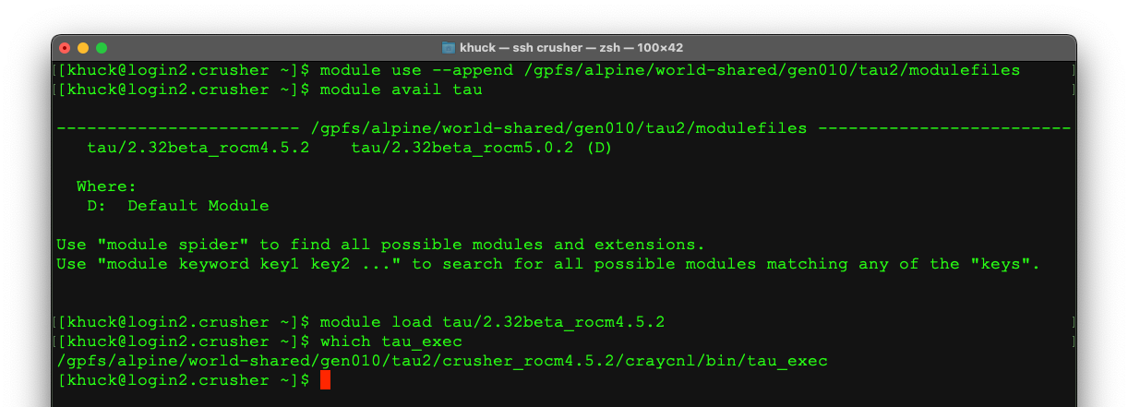
How do I use it?
Load the module path
Load the module

Slide 8
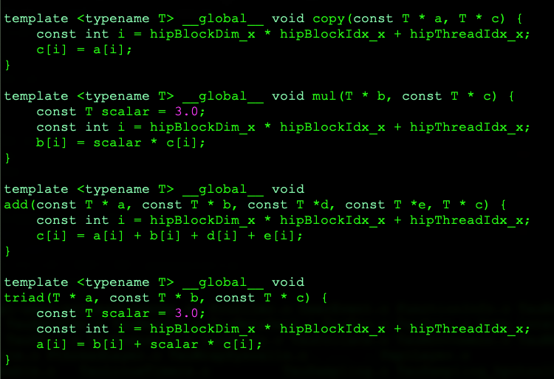
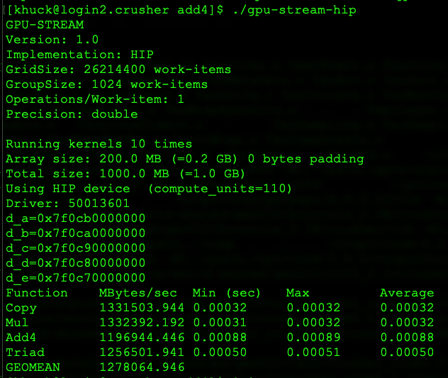
Measuring HIP kernel performance
Hip-stream – small program with 4+ kernels
Program output
HIP kernels

Slide 9
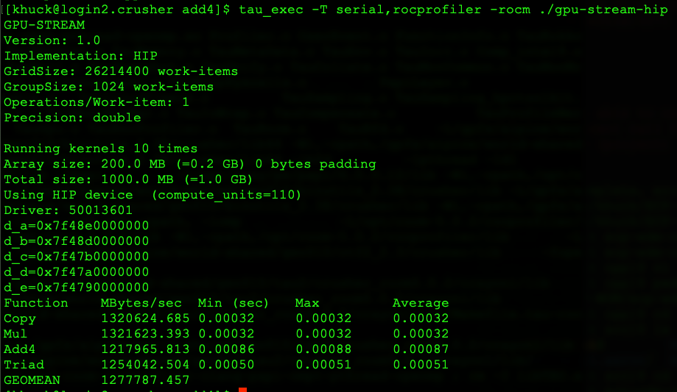
Measuring HIP kernel performance
Just add tau_exec and arguments to the command (between srun/mpirun and application when applicable)
tau-config shows available configs
“use serial,rocprofiler configuration with HIP/ROCm support enabled”

Slide 10
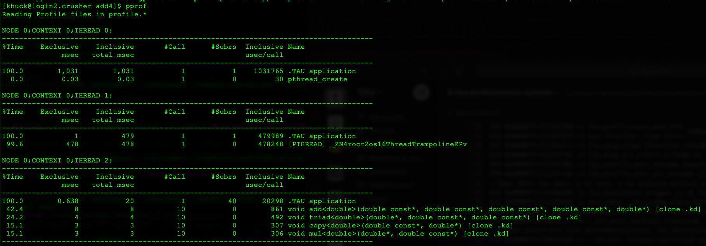
Pprof output, timers
By default, TAU writes profile.* files, can be viewed in terminal with the pprof utility
Main Thread
ROCm Thread
Device activity

Slide 11
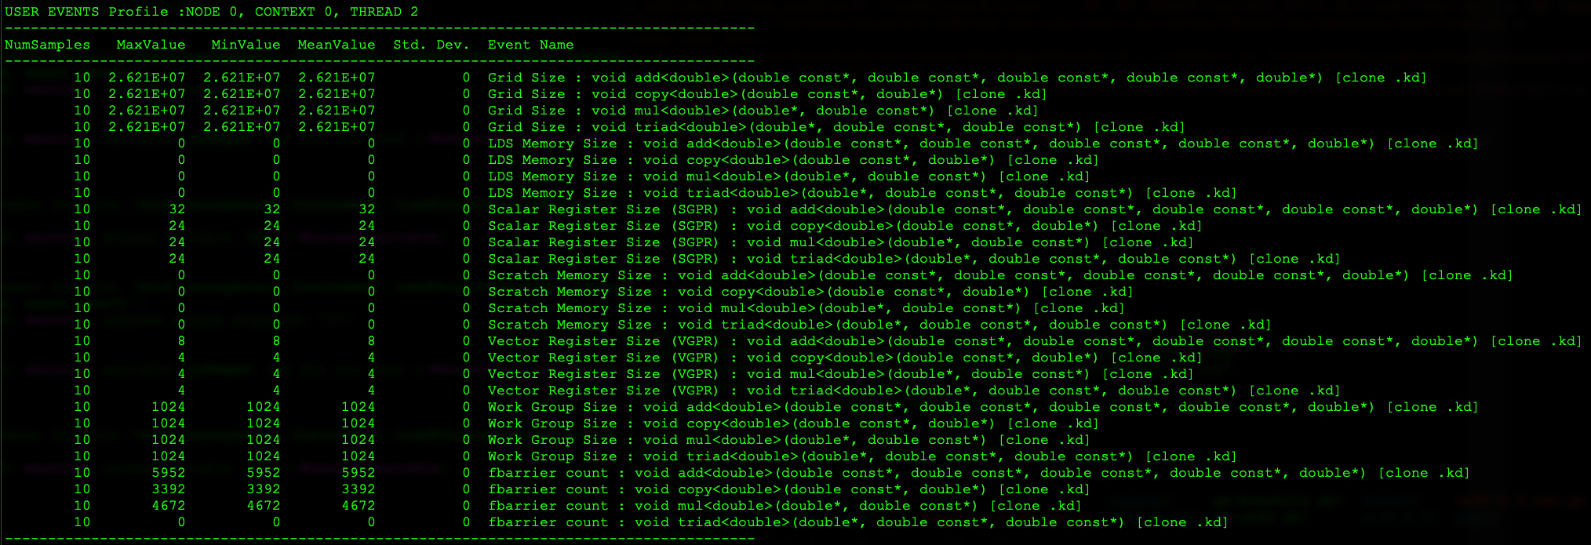
Pprof output, counters
Counters for measuring register pressure and occupancy
Notes:
Similar to Rocprofiler --stats

Slide 12
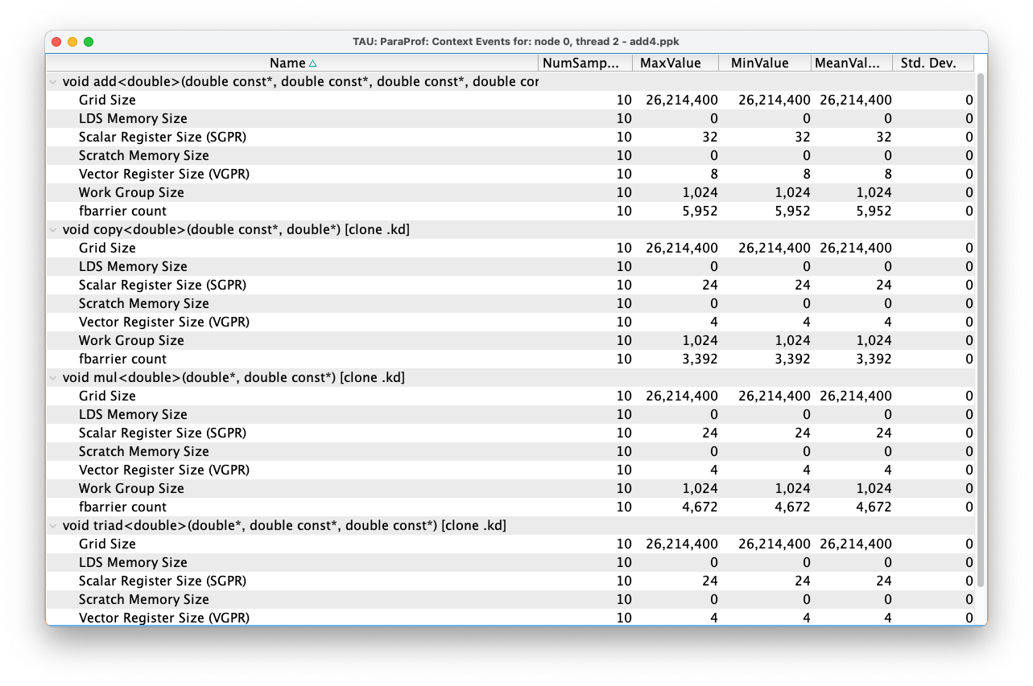
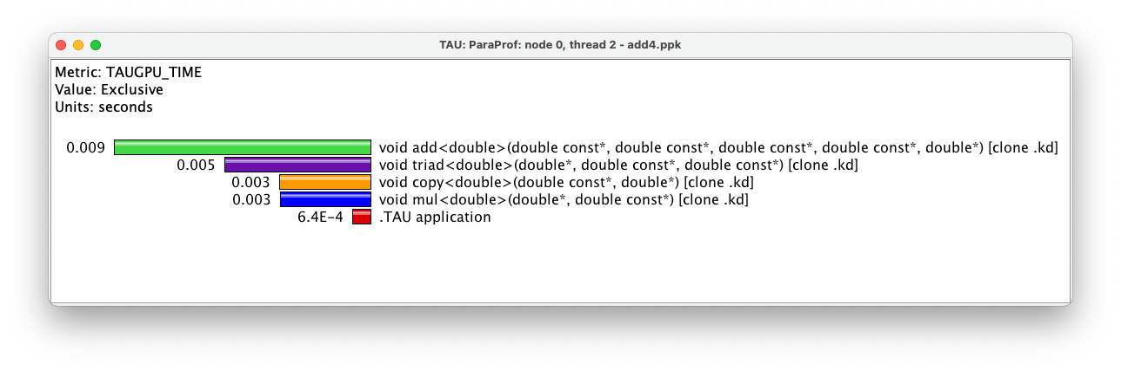
ParaProf view of same data
VERY helpful for understanding register pressure and occupancy

Slide 13
Rocprofiler : available metrics
Same metrics from rocprofiler are available from TAU, some natively (see previous) but most through PAPI (i.e. export TAU_METRICS=“PAPI_TOT_INS,PAPI_NATIVE_rocm:::L2CacheHit:device_0”)
Caveat: current PAPI support for HIP/ROCm does not work correctly for all counters – a PAPI PR is pending to correctly support available counters
Note about available counters: some useful ones are not available outside AMD. ☹ (L1, FLOP)
Can get instructions, reads/writes, L2 cache performance, etc. see https://github.com/ROCm-Developer-Tools/rocprofiler/blob/amd-master/test/tool/metrics.xml or papi_native_avail output for full list

Slide 14
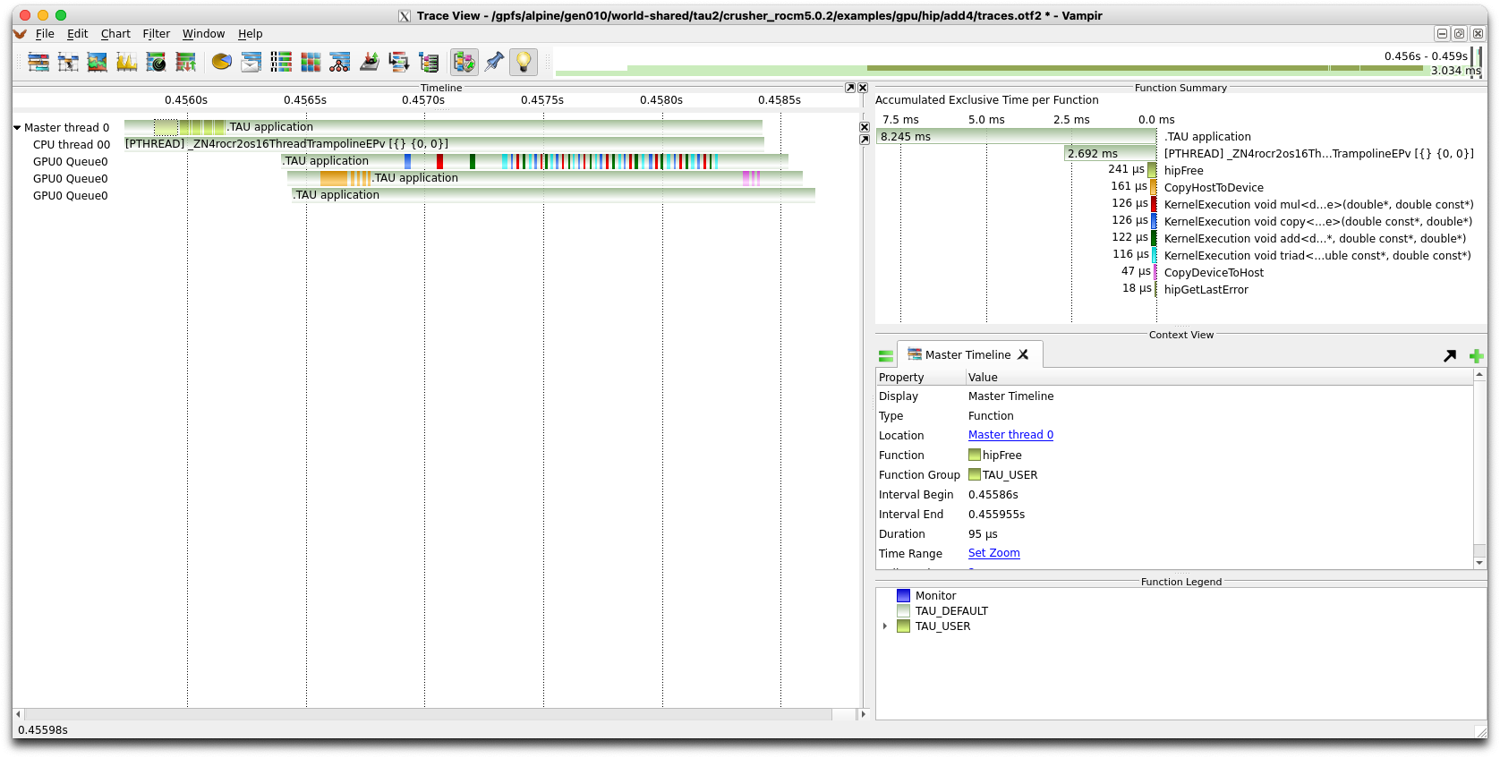
Tracing support uses RocTracer
Each device has 2-3 virtual threads:
1) kernels,
2) memory transfers
3) synchronization
(prevents overlapping timers)

Slide 15
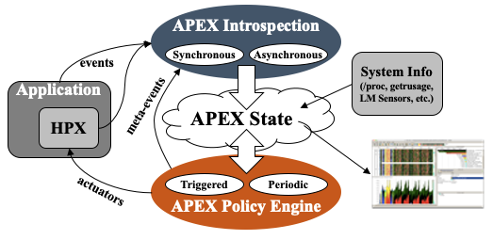

APEX : how is it different from TAU?
Autonomic Performance Environment for eXascale
Performance Measurement
Runtime Adaptation
Designed for AMT runtimes (HPX)
  but works with conventional parallel models
Focus on task dependency graph, not calling context graph
Supports HPX, C/C++ threads, OpenMP, OpenACC, Kokkos, Raja, CUDA, HIP...
https://github.com/UO-OACISS/apex
Active Harmony* (Nelder Mead), Simulated Annealing, hill climbing for parametric search methods
*https://www.dyninst.org/harmony

Slide 16
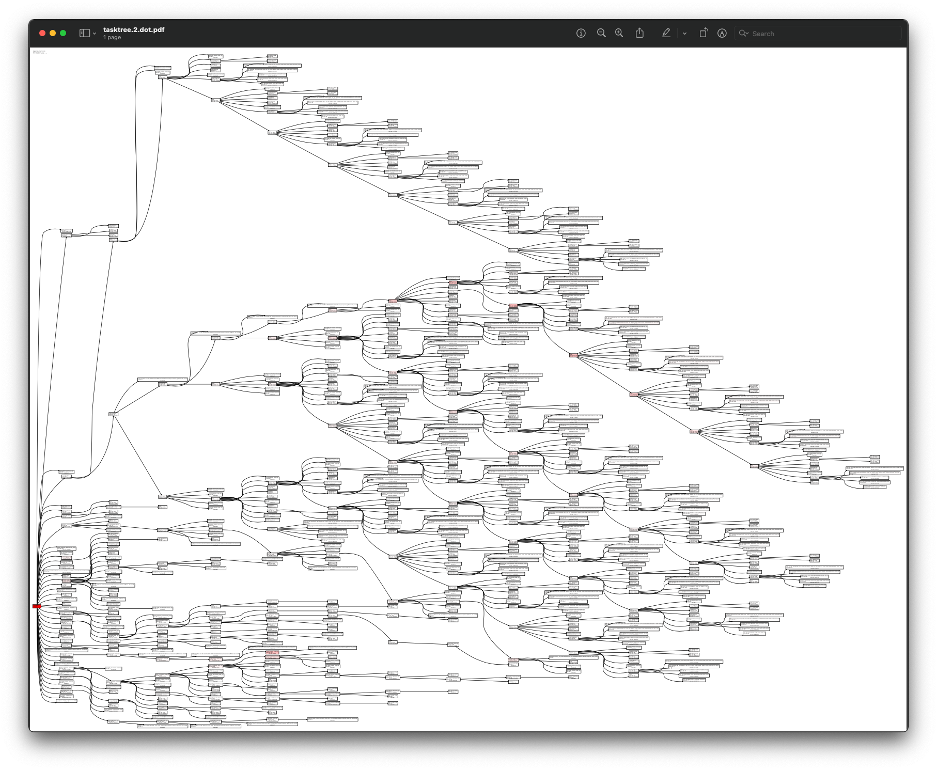
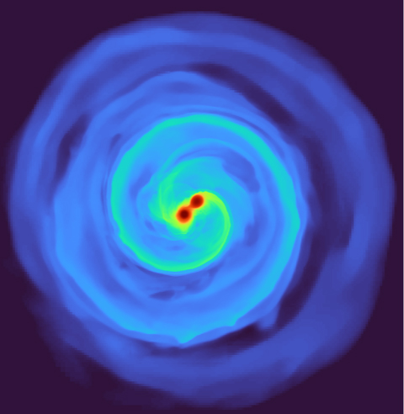
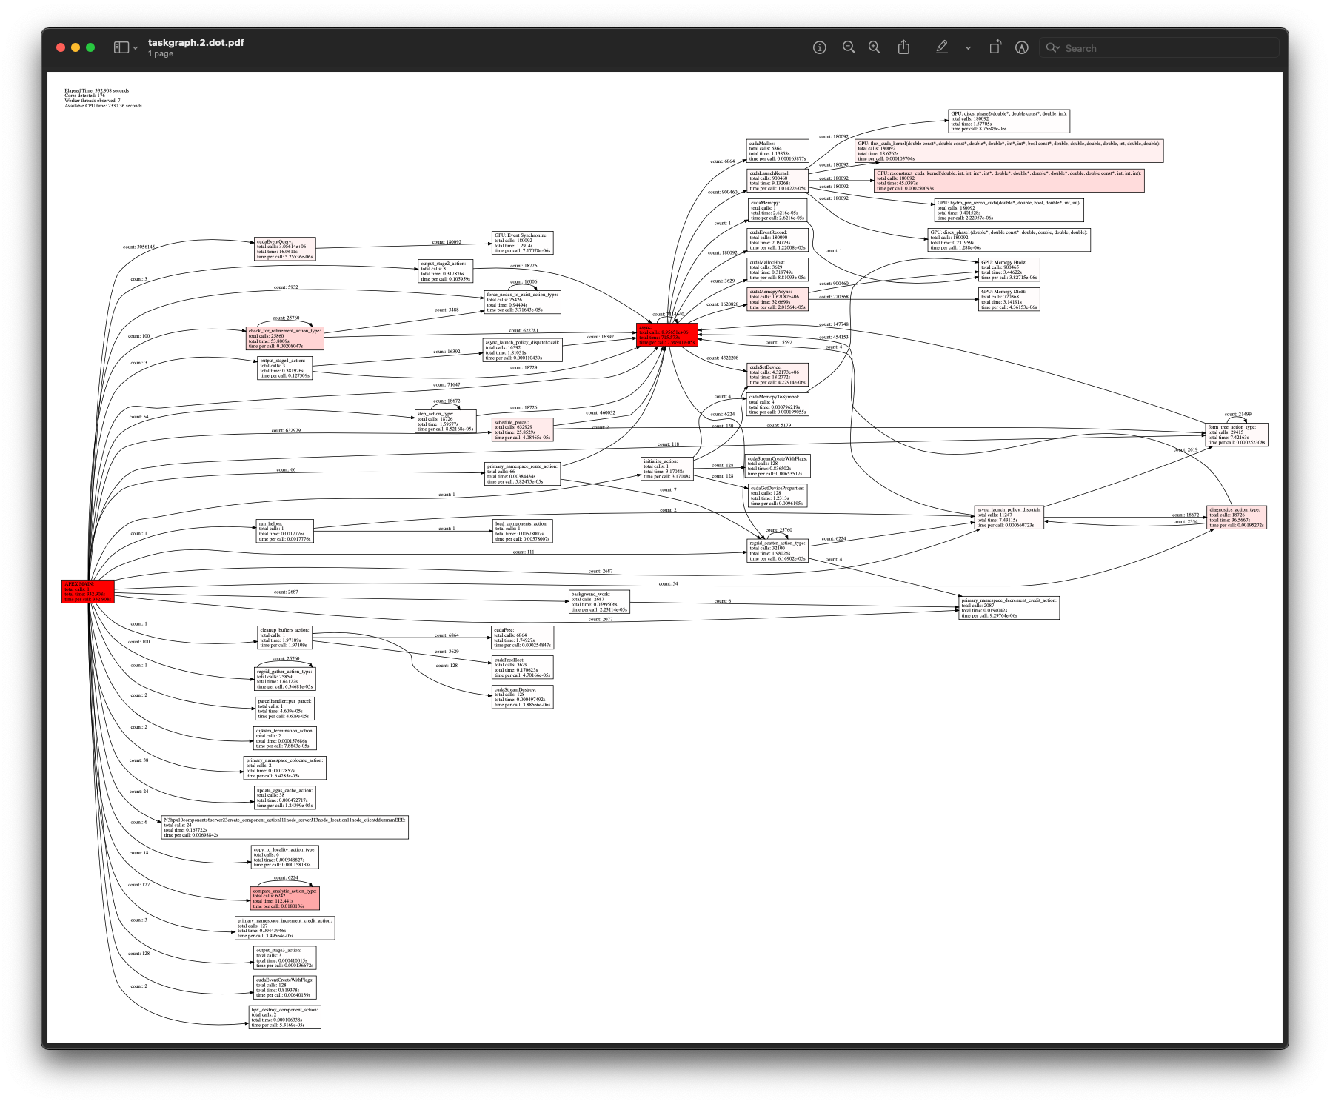
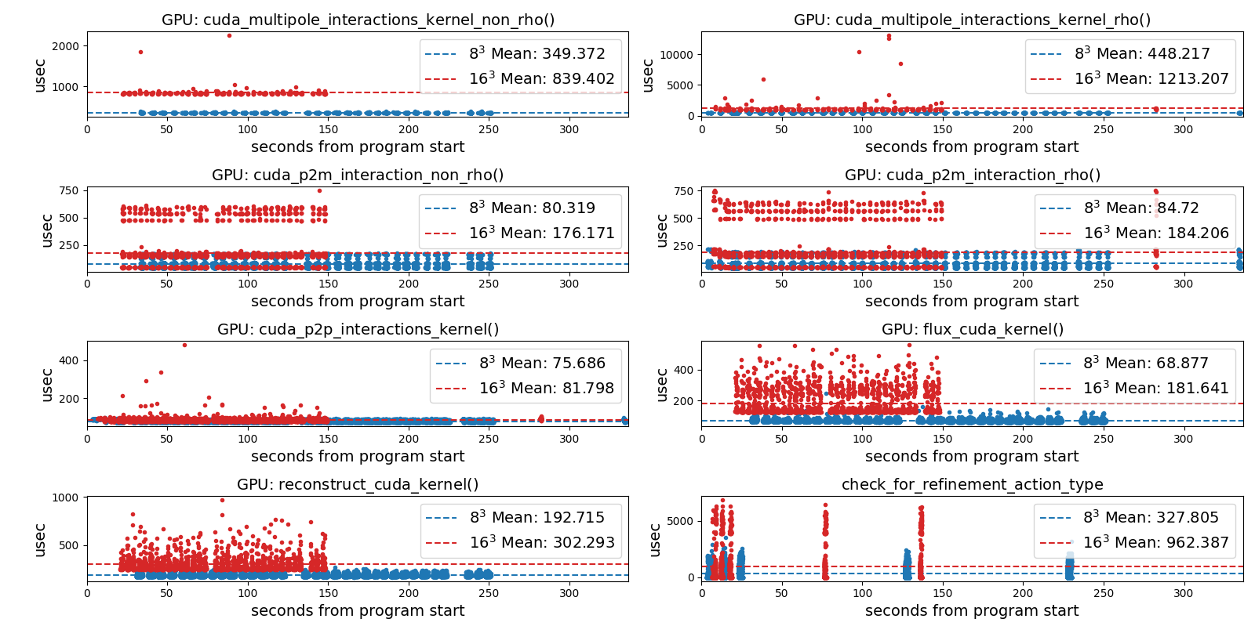
APEX examples – Octo-Tiger (HPX)
Tracking GPU memory usage with CUPTI
Monitoring GPU utilization with NVML library
Full task tree (above) and task graph (below) showing task dependencies
Comparing subgrid sizes and relative kernel performance with CUPTI device activity
https://github.com/STEllAR-GROUP/octotiger
https://github.com/STEllAR-GROUP/hpx
Diehl, Patrick, et al. "Octo-Tiger’s New Hydro Module and Performance Using HPX+CUDA on ORNL’s Summit." 2021 IEEE International Conference on Cluster Computing (CLUSTER). IEEE, 2021.
Notes:
Octree based astrophysics code written with HPX that simulates the evolution of self-gravitating and rotating systems of arbitrary geometry

Slide 17
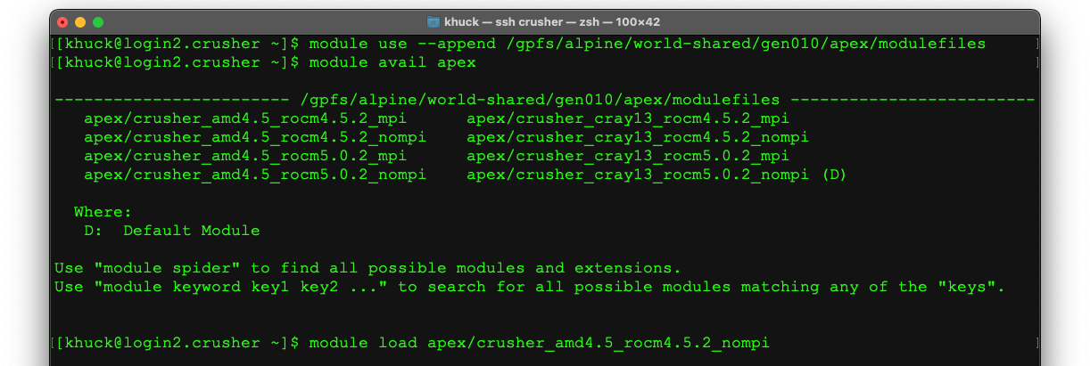
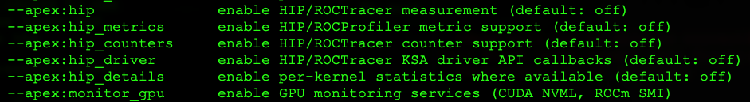
APEX usage
apex_exec
Several HIP specific options: (run without options or with --apex:help for more info)
Load the module path
Load the module

Slide 18
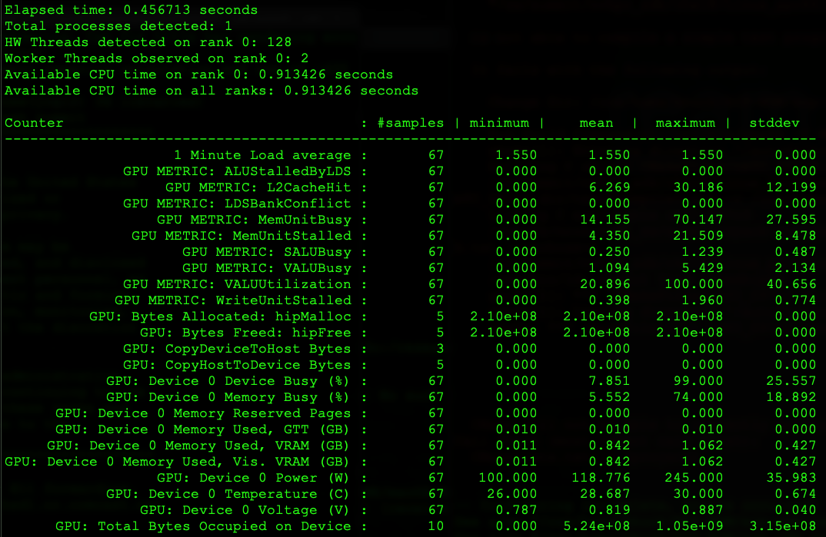
Same hip-stream example
APEX will optionally write a report to the screen at the end of execution (or periodically if desired) -
counters, GPU timers, CPU timers
CPU, GPU Monitoring data

Slide 19
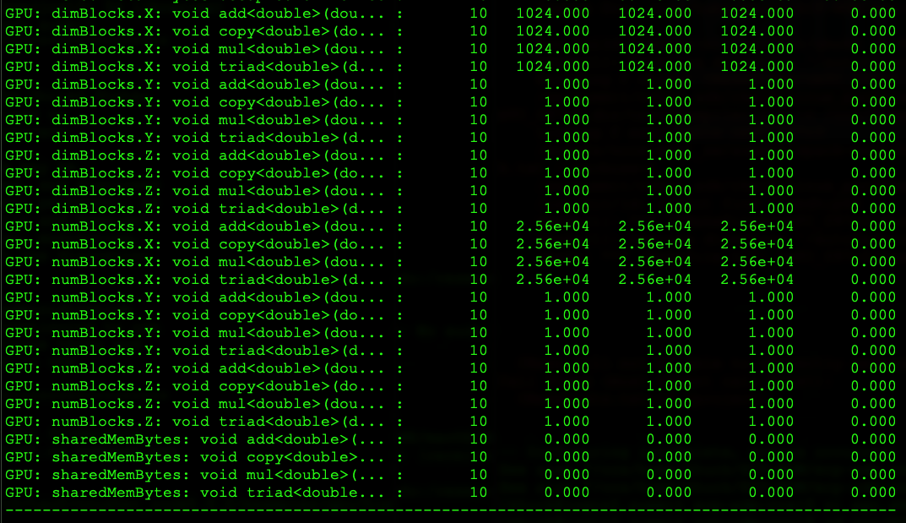
Same hip-stream example
GPU Counters from each kernel

Slide 20
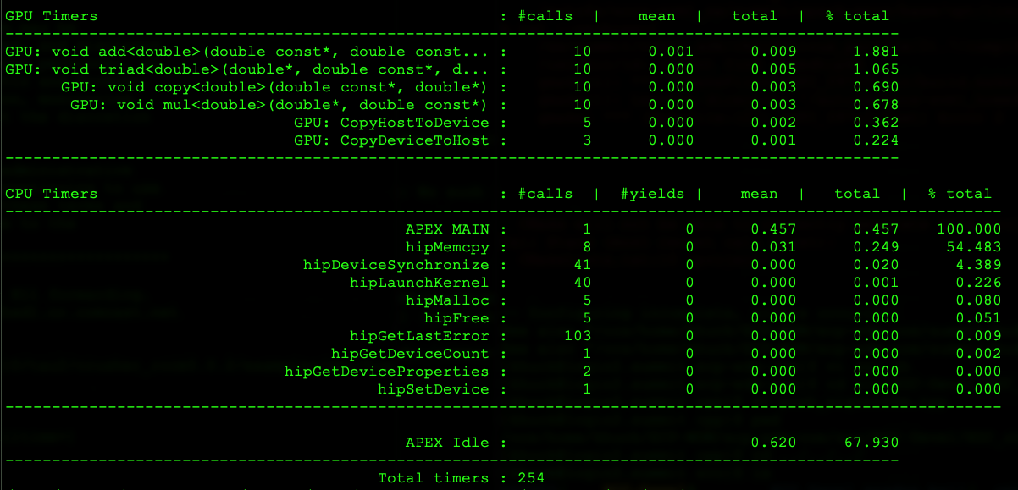
Same hip-stream example
GPU Timers
CPU timers

Slide 21
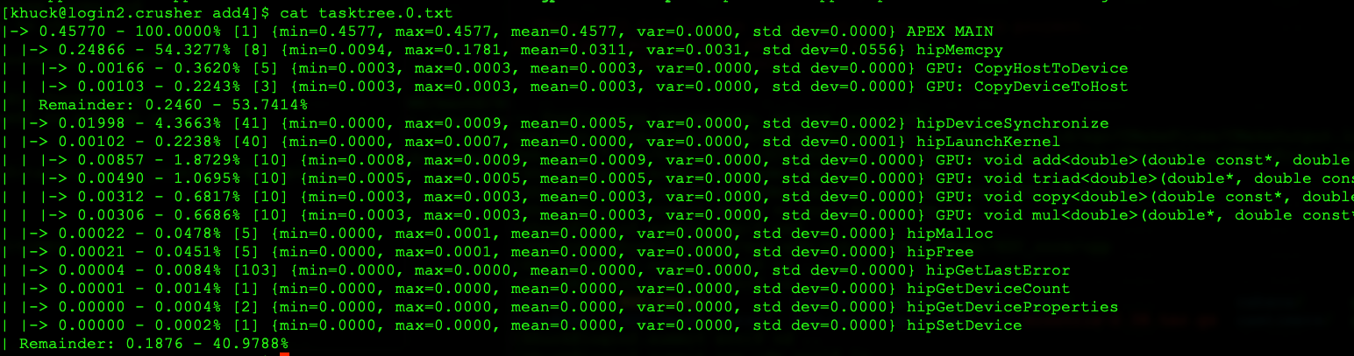
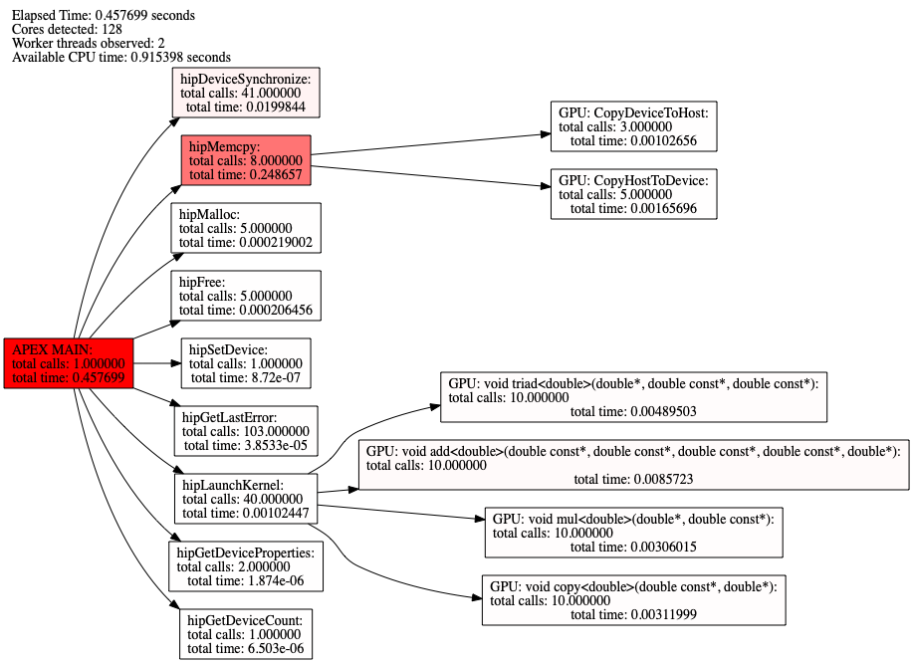
APEX task graphs, trees
Will output tasktree similar to Trilinos callpath profiling output and/or Hatchet view – but the tree is task dependency based, not strictly callpath based…
Also outputs graphviz (dot) data for all processes, either as task graph or task tree

Slide 22
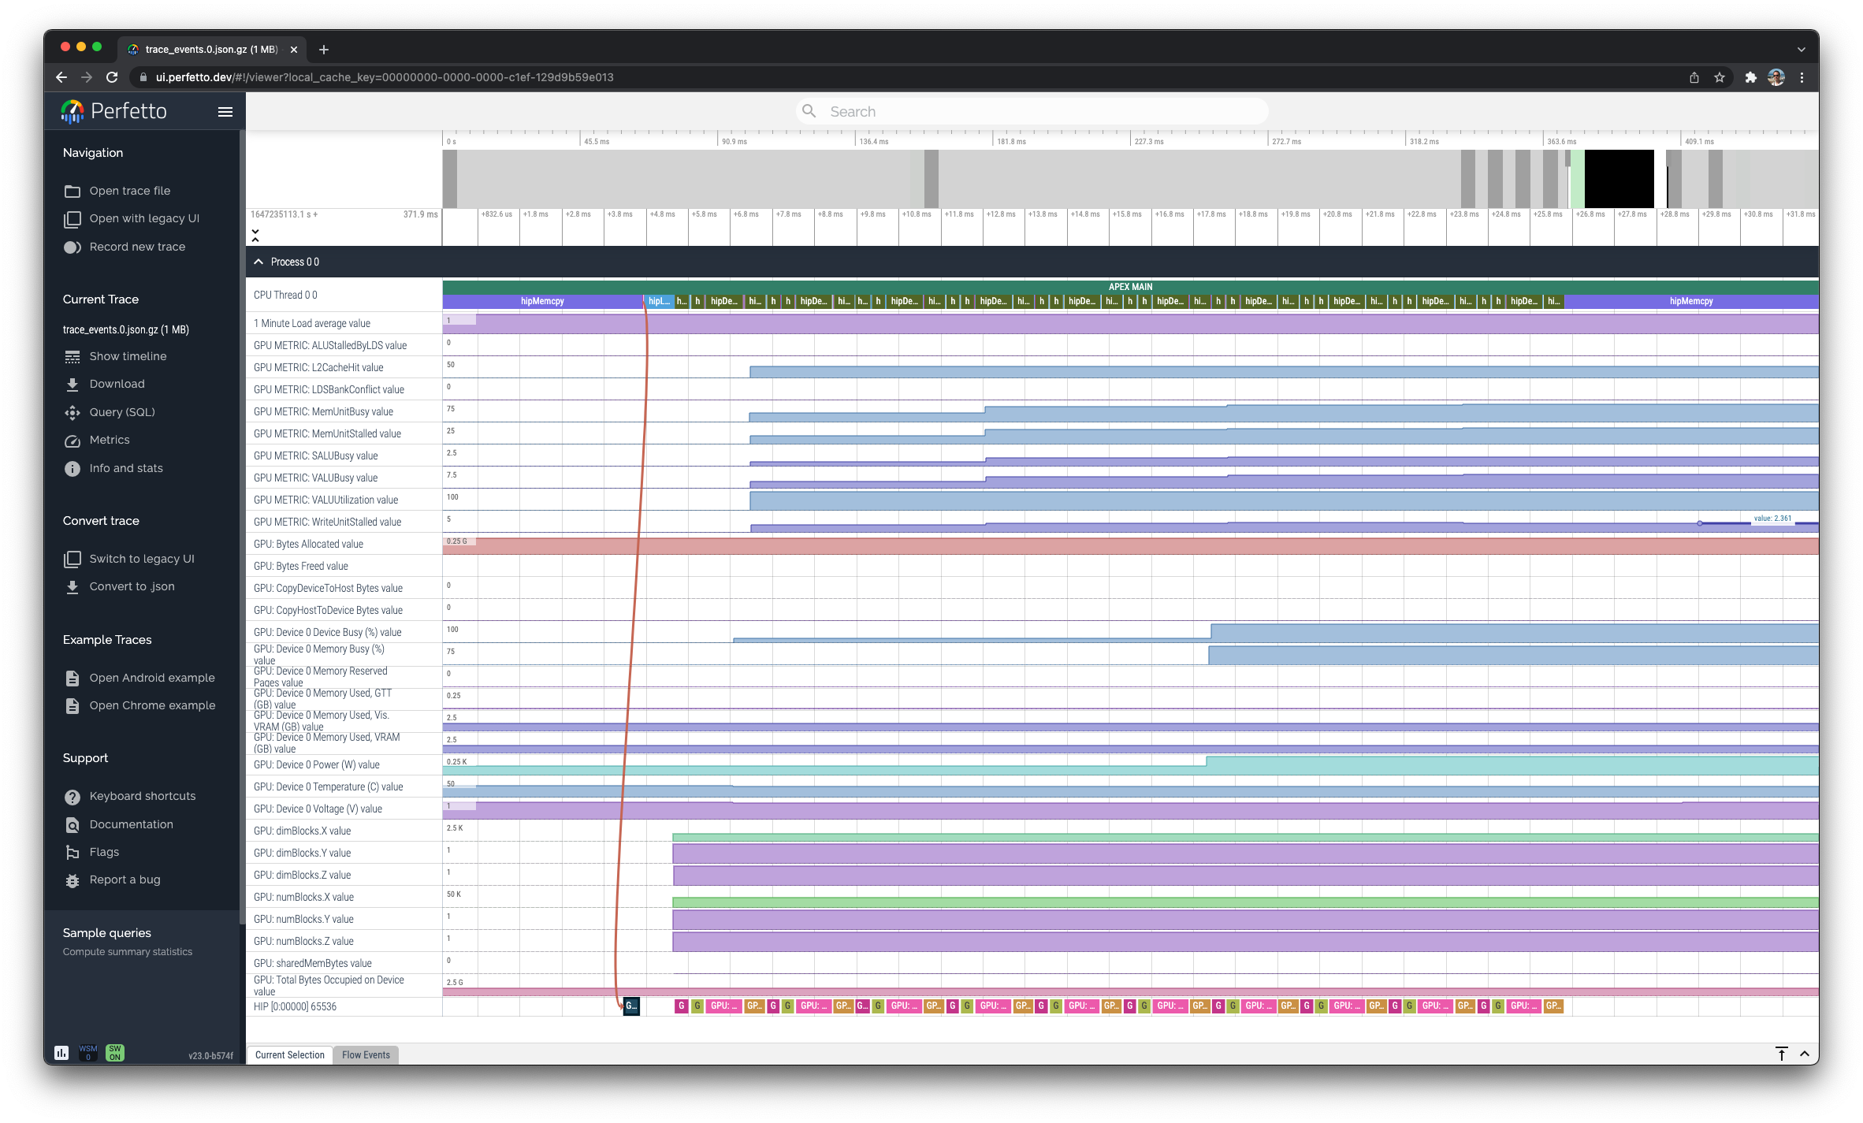
APEX tracing
Enable with:
--apex:gtrace
Traces CPU, GPU activity and shows all monitored metrics
“Flow” events show task dependency across resources
Visualized with Perfetto: https://ui.perfetto.dev/

Slide 23
APEX Monitoring Data

Slide 24
APEX Sampled Metrics

Slide 25
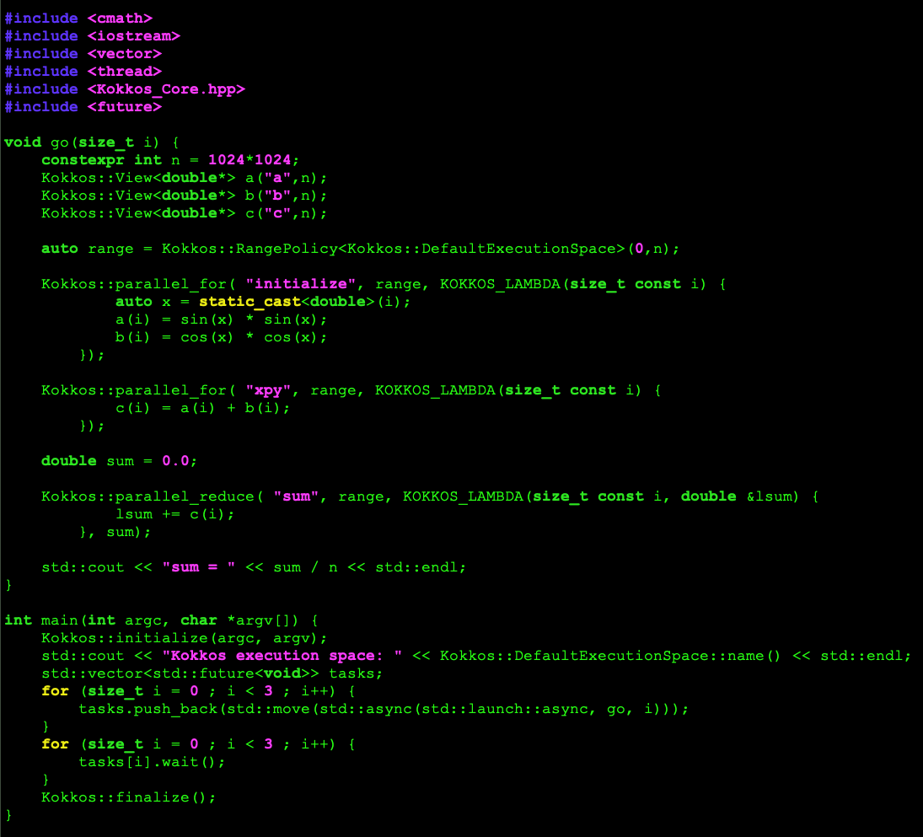
Kokkos example using HIP and C++ threads
Simple program
3 lambdas…
…launched by 3 C++ tasks with std::launch::async
What can we see?
Note: same timers available with TAU
Launched with:

Slide 26
Kokkos example : Task graph

Slide 27
Kokkos example : Task tree
Every child node only has 1 parent node

Slide 28
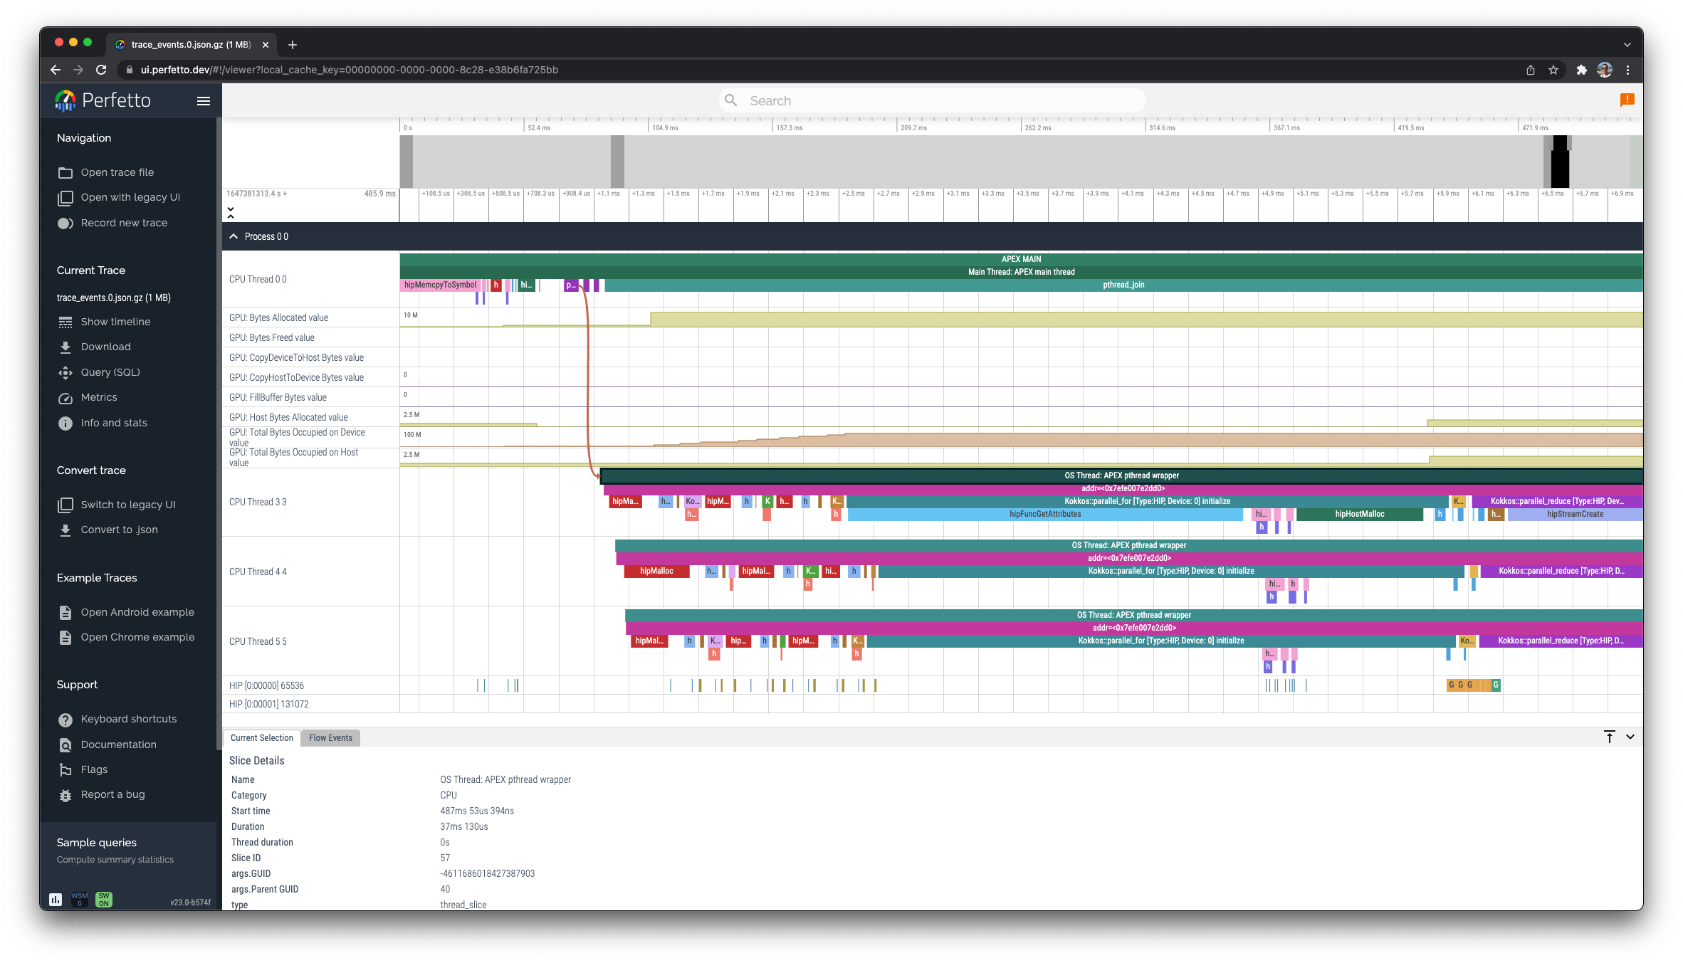
Kokkos example : Trace

Slide 29
TAU vs APEX
Use TAU when:
  Need MPI measurements
  Need insrumentation or sampling
  Need HW/OS context (per-OS thread measurements)
  Broader HW support (Fujitsu, Intel OneAPI, …)
  Need TAU plugin support
Use APEX when:
  Need support for asynchronous tasking
  Need focus on algorithmic task dependency, not HW/OS
  Need runtime autotuning support

Slide 30
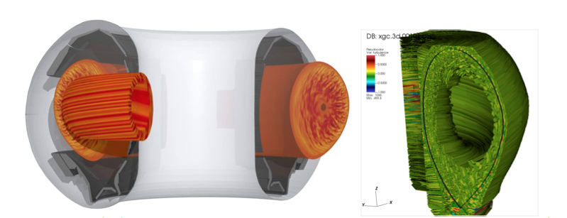
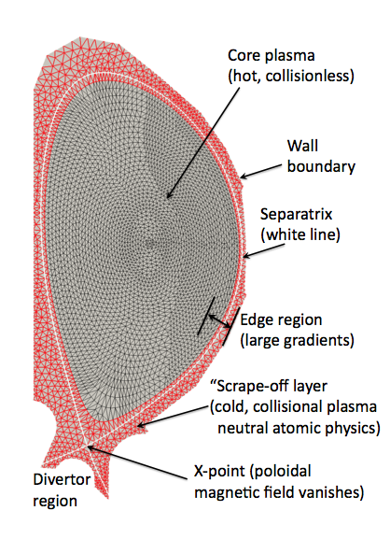
Usage in RAPIDS2
HBPS: SciDAC-4 Partnership for High-Fidelity Boundary Plasma Simulation
https://epsi.pppl.gov
Using TAU and APEX to measure XGC, GENE, GEM, ADIOS2, etc. on Crusher
Utilizes Kokkos, MPI, HIP/CUDA support in TAU
Uses perfstubs (https://github.com/khuck/perfstubs) to utilize existing timers without adding TAU as dependency
Images from https://theory.pppl.gov/news/rrseminars/033021Bhattacharjee.pdf

Slide 31
Final thoughts
TAU and APEX are available to use on Crusher now
Currently investigating:
  Rocprofiler support in APEX (only there with periodic sampling)
  Fixed PAPI metric support in TAU and APEX
  Updates to TAU and APEX as software stack is updated
  amdclang has prototype OpenMP OMPT offload event support
  Kokkos kernel autotuning
    TeamPolicy: team size and vector length
    MDRangePolicy: tile sizes
    RangePolicy*: block size
    …only for CUDA, last I checked
* In a branch of Kokkos only

Slide 32



Acknowledgements
Artemis work was performed under the auspices of the U.S. Department of Energy by Lawrence Livermore National Laboratory under Contract DE-AC52-07NA27344 (LLNL-CONF-809192). Additional support was provided by a LLNL subcontract to the University of Oregon, No. B631536.
The current APEX work was supported by the Scientific Discovery through Advanced Computing (SciDAC) program funded by U.S. Department of Energy, Office of Science, Advanced Scientific Computing Research (ASCR) and Fusion Energy Sciences (FES) Division of Materials Sciences and Engineering, as well as the RAPIDS SciDAC Institute for Computer Science and Data under subcontract 4000159855 from ORNL.
Parts of this research was supported by the Exascale Computing Project (17-SC-20-SC), a joint project of the U.S. Department of Energy’s Office of Science and National Nuclear Security Administration, responsible for delivering a capable exascale ecosystem, including software, applications, and hardware technology, to support the nation’s exascale computing imperative.
This research used resources of the Oak Ridge Leadership Computing Facility at the Oak Ridge National Laboratory, which is supported by the Office of Science of the U.S. Department of Energy under Contract No. DE-AC05-00OR22725.

