Slide 1
Iris Performance:
Performance measurement support from the APEX portable performance measurement tool
Kevin A. Huck
Oregon Advanced Computing Institute for Science and Society (OACISS)

Slide 2

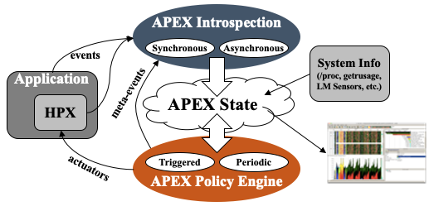
Autonomic Performance Environment for Exascale (APEX)
Autonomic Performance Environment for eXascale
Performance Measurement
Runtime Adaptation
Designed for AMT runtimes (HPX)
  but works with conventional parallel models
Focus on task dependency graph, not calling context graph
Supports HPX, C/C++ threads, OpenMP, OpenACC, Kokkos, Raja, CUDA, HIP, SYCL, StarPU... Working on PARSEc, YAKL, Iris
https://github.com/UO-OACISS/apex and https://github.com/khuck/apex-tutorial
Active Harmony* (Nelder Mead), simulated annealing, genetic search, hill climbing for parametric search methods, as well as exhaustive and random
https://doi.org/10.1109/ESPM256814.2022.00008 : “Broad Performance Measurement Support for Asynchronous Multi-Tasking with APEX”, Huck, ESPM, 2022

Slide 3
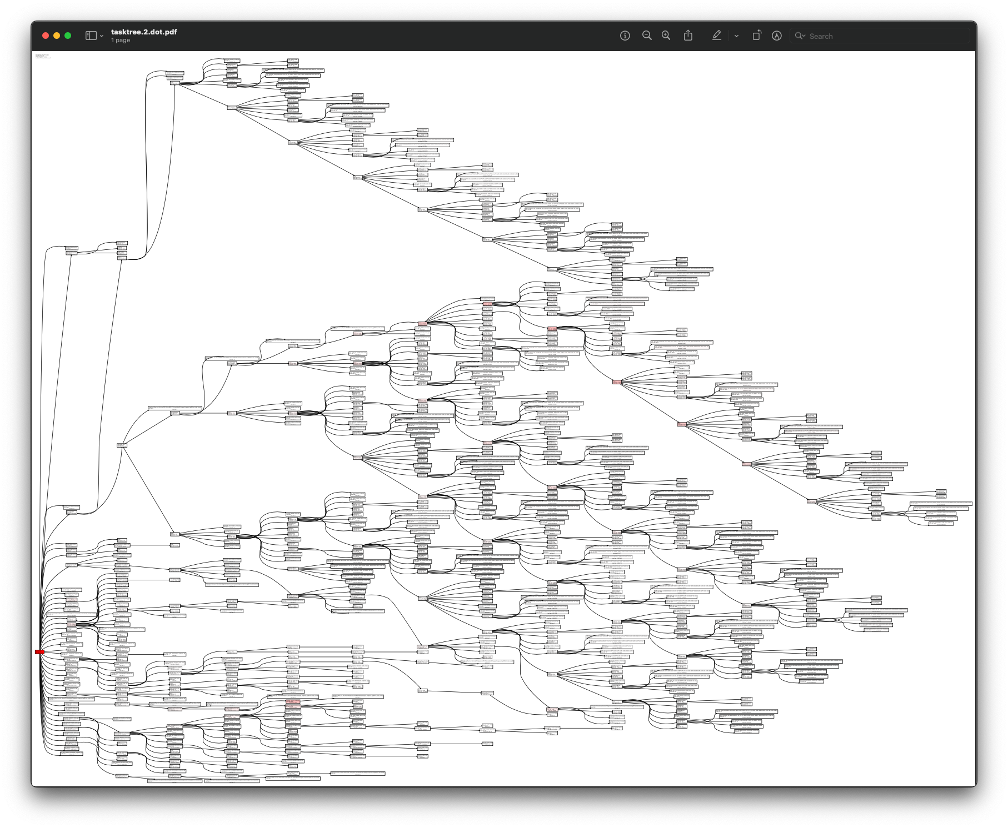
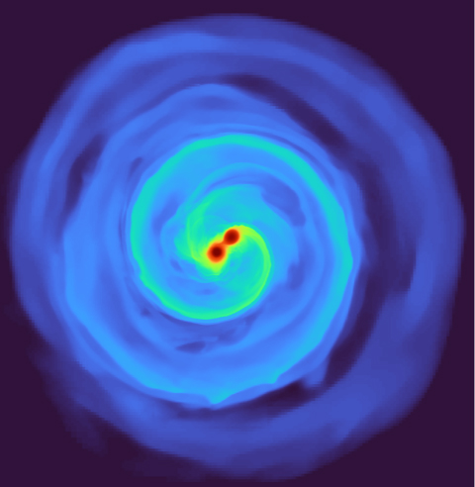
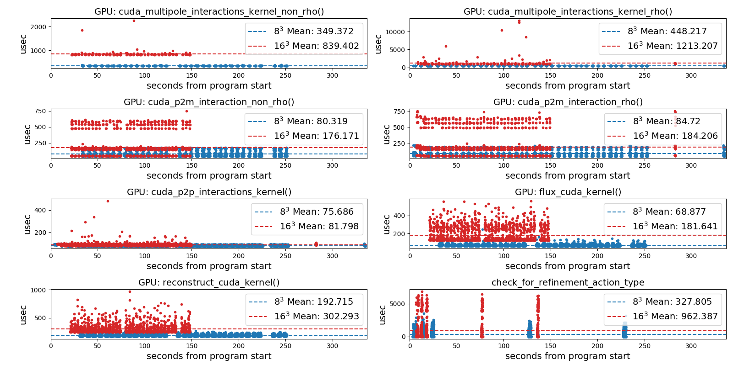
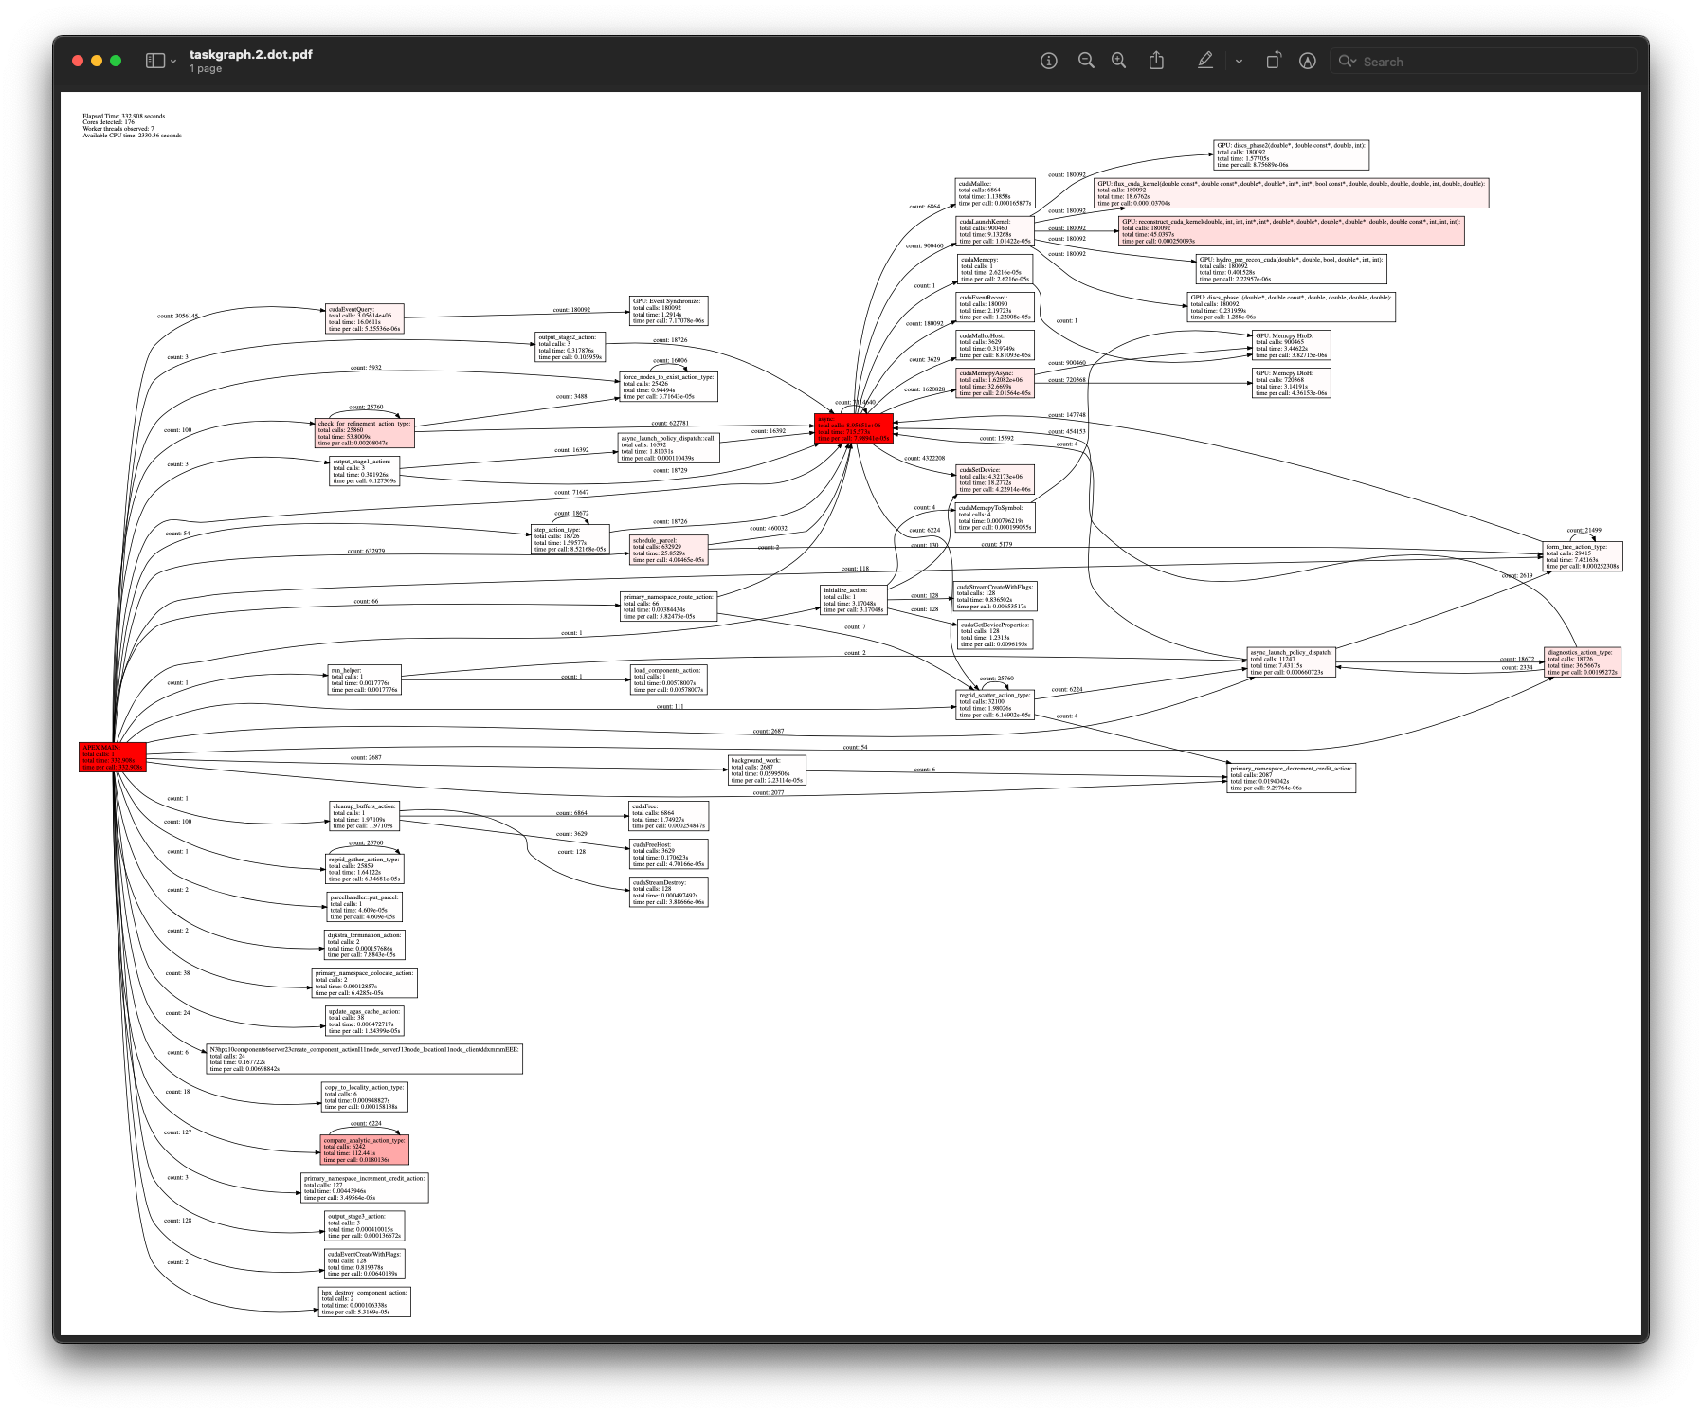
APEX example – Octo-Tiger (Octree astrophysics in HPX, Kokkos)
Tracking GPU memory usage with CUPTI
Monitoring GPU utilization with NVML library
Full task tree (above) and task graph (below) showing task dependencies
Comparing subgrid sizes and relative kernel performance with CUPTI device activity
https://github.com/STEllAR-GROUP/octotiger
https://github.com/STEllAR-GROUP/hpx

Slide 4
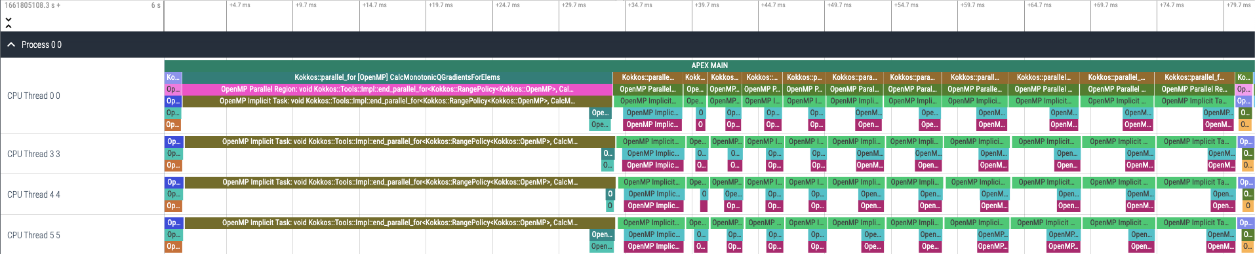
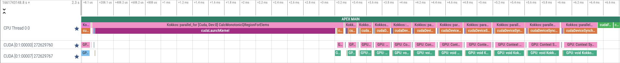
Kokkos Lulesh and APEX Tracing – OpenMP, CUDA, HIP back ends
OpenMP
CUDA
HIP
Kokkos Lulesh: https://github.com/kokkos/kokkos-miniapps
Trace visualization in Perfetto https://ui.perfetto.dev/

Slide 5
Kokkos Runtime Tuning Support in APEX
APEX implements the same profiling API that TAU does, and…
APEX provides auto-tuning (search) support
Kokkos provides the ability to auto-tune with (at Cmake configuration time):
-DKokkos_ENABLE_TUNING=ON
Automatically provides input and context variables for parallel_for, parallel_reduce, parallel_scan, parallel_copy.
  TeamPolicy: team size and vector length
  MDRangePolicy: X, Y tile sizes (Z stays constant)
  RangePolicy*: block size, occupancy
Custom tuning also available – see https://github.com/khuck/apex-kokkos-tuning for examples like mm2d_tiling.cpp and idk_jmm.cpp
  *(in a long-dormant development fork/branch, a new, updated PR for occupancy tuning has passed all tests and will be merged soon…would be nice to have because many kernels use RangePolicy)
Provides an alternative to
“heuristic” parameter choices

Slide 6
APEX Autotuning of ExaMiniMD Neighbor2D::fill_neigh_list_full kernel
Much more promising results in the apex-kokkos-tuning repository
Baseline | 17.4972s
Tuning | 17.7294s
Tuned | 17.3790s
Exploring team sizes
Only one kernel is TeamPolicy in ExaMiniMD – all of the rest of the kernels are Range policies…
Exploring vector lengths
Response (time)

Slide 7
TaskStubs
TaskStubs is a “frictionless” instrumentation library for tasking systems
  https://github.com/khuck/taskStubs
  One source file, three headers
  Provides a plugin interface for performance tools
  Can be compiled away if desired
  Related to PerfStubs: https://github.com/UO-OACISS/perfstubs
Integrating into several libraries as a git submodule
  Iris
  PARSEc
  StarPU
Provides runtime integration with APEX

Slide 8
Integration into Iris
ProfilerTaskStubs class, derived from iris::rt::Profiler
Task lifecycle:
  Construct
  Schedule
  Start
  Yield
  Resume
  Stop
  Destroy
  Add children
  Add parents

Slide 9
Iris example: saxpy with APEX, pthread support enabled
Iris tasks (internal, user)
pthread API functions

Slide 10
Iris example: saxpy with APEX, pthread and CUDA support enabled
GPU activity
Iris task

Slide 11
Current status
Created ProfilerTaskStubs class
Integrated into Platform, Task, Worker, Scheduler classes
Next steps:
  Add the other (currently) stubbed arguments
  Handle task dependencies across resources correctly
  Additional testing with MatRIS
  Work with Monil on all these items
Questions:
  Have I integrated into the right places? (probably not)
  Are there auto-tuning opportunities in Iris? (probably)

Slide 12



Acknowledgements
Parts of this research was supported by the Exascale Computing Project (17-SC-20-SC), a joint project of the U.S. Department of Energy’s Office of Science and National Nuclear Security Administration, responsible for delivering a capable exascale ecosystem, including software, applications, and hardware technology, to support the nation’s exascale computing imperative.
This research used resources of the Oak Ridge Leadership Computing Facility at the Oak Ridge National Laboratory, which is supported by the Office of Science of the U.S. Department of Energy under Contract No. DE-AC05-00OR22725.

Slide 13
Thanks! Questions?

