Slide 1
Performance debugging and analysis on Exascale systems with ZeroSum, TAU and APEX
Overview of tools available for HPC
Kevin A. Huck
Oregon Advanced Computing Institute for Science and Society (OACISS)
Notes:
Good morning! Happy to be here again. This is an updated version of a talk that I have given at both a Dagstuhl seminar (23171, Driving HPC Operations With Holistic Monitoring and Operational Data Analytics) and the HUST workshop publication at SC23.

Slide 2

Who am I (Who are we)
Senior Research Associate at University of Oregon
OACISS: Oregon Advanced Computing Institute for Science and Society https://oaciss.uoregon.edu
Performance Research Lab: focused on the analysis of applications on large-scale HPC systems

Slide 3
Projects of Interest today
HPC Application monitoring with ZeroSum
Application / library instrumentation with PerfStubs
Performance measurement with TAU
Performance measurement and runtime auto-tuning with APEX
Focusing on Frontier today:
  module load tau
  module load ums ums002/vanilla ; module load zerosum
  module load ums ums002/vanilla ; module load apex
  module load ums ums002/vanilla ; module load perfstubs
TAU, ZeroSum and APEX tied to specific MPI vendor/version, and ROCm version – see ‘module avail apex’ for example

Slide 4
ZeroSum:
User Space Monitoring of Resource Utilization and Contention on Heterogeneous HPC Systems
Kevin A. Huck
Oregon Advanced Computing Institute for Science and Society (OACISS)
Notes:
Good morning! Happy to be here again. This is an updated version of a talk that I have given at both a Dagstuhl seminar (23171, Driving HPC Operations With Holistic Monitoring and Operational Data Analytics) and the HUST workshop publication at SC23.

Slide 5
Performance Analysis Perspective on Monitoring
Three main classes of performance optimizations:
Algorithmic replacement (usually a high level of difficulty)
  E.g. replace O(n²) with O(nlogn)
  Can involve data structure changes, new dependencies, major rewrites
Code optimization (usually a medium difficulty)
  Improve cache reuse, reduce stalls (branching, instructions, I/O, etc)
Optimized launch configuration (low difficulty, high embarrassment potential)
  Misconfiguration
  Wrong assumptions from another system/application
  Changes to system policies/defaults (e.g. reserved cores)
Notes:
Skip the blah blah, jump right to the fact that many performance “bottlenecks” are misconfigurations – not research result worthy in most cases, just embarrassing

Slide 6
Behavioral Economics & Computer Science
“People aren’t dumb – the world is hard.”
– Richard Thaler, behavioral economist and co-author (with Cass Sunstein) of Nudge: Improving Decisions About Health, Wealth, and Happiness, 2008
People make bad choices for good reasons…
If you want to change behavior, change the defaults.
(not always possible – “one size fits most”)
Notes:
How does this relate to CS? Default settings are not always optimal, and are definitely not universally optimal.

Slide 7
Motivation: Why do users (want to) monitor at runtime?
Sanity check / curiosity / impatience (logging, essentially)
Check for misconfiguration
Check for efficient utilization
Confirmation of expected hardware / operating system behavior
Identify cause of failure – deadlock, crash, stalls, etc.
Adaptation / computational steering / feedback & control
Identify system failures (out of scope)
7
Notes:
Be brief – but keep in mind users don’t have root, often can’t easily fork/exec, can’t modify the kernel, etc.

Slide 8
(Mis)Configuration – what could possibly go wrong?
Process placement:
  Logical/physical mappings, resources assigned/constrained to each process
  Are there reserved core(s) for system? What is the GPU mapping?
Thread placement: Socket, NUMA domain, core, thread (HWT)
Undersubscribing: Wasted hardware, energy, time (under-utilization)
  Can provide better performance in some situations (memory-bound code)
Oversubscribing: Increased contention with no realized benefit
Imbalances
  What is the communication frequency/volume between pairwise MPI ranks?
Slurm/PBS/Alps/Torque/Flux are complicated to use
  …especially when combined with MPI, OpenMP, GPUs, or other model settings
Notes:
These are all things that experienced users know… but sometimes forget.

Slide 9
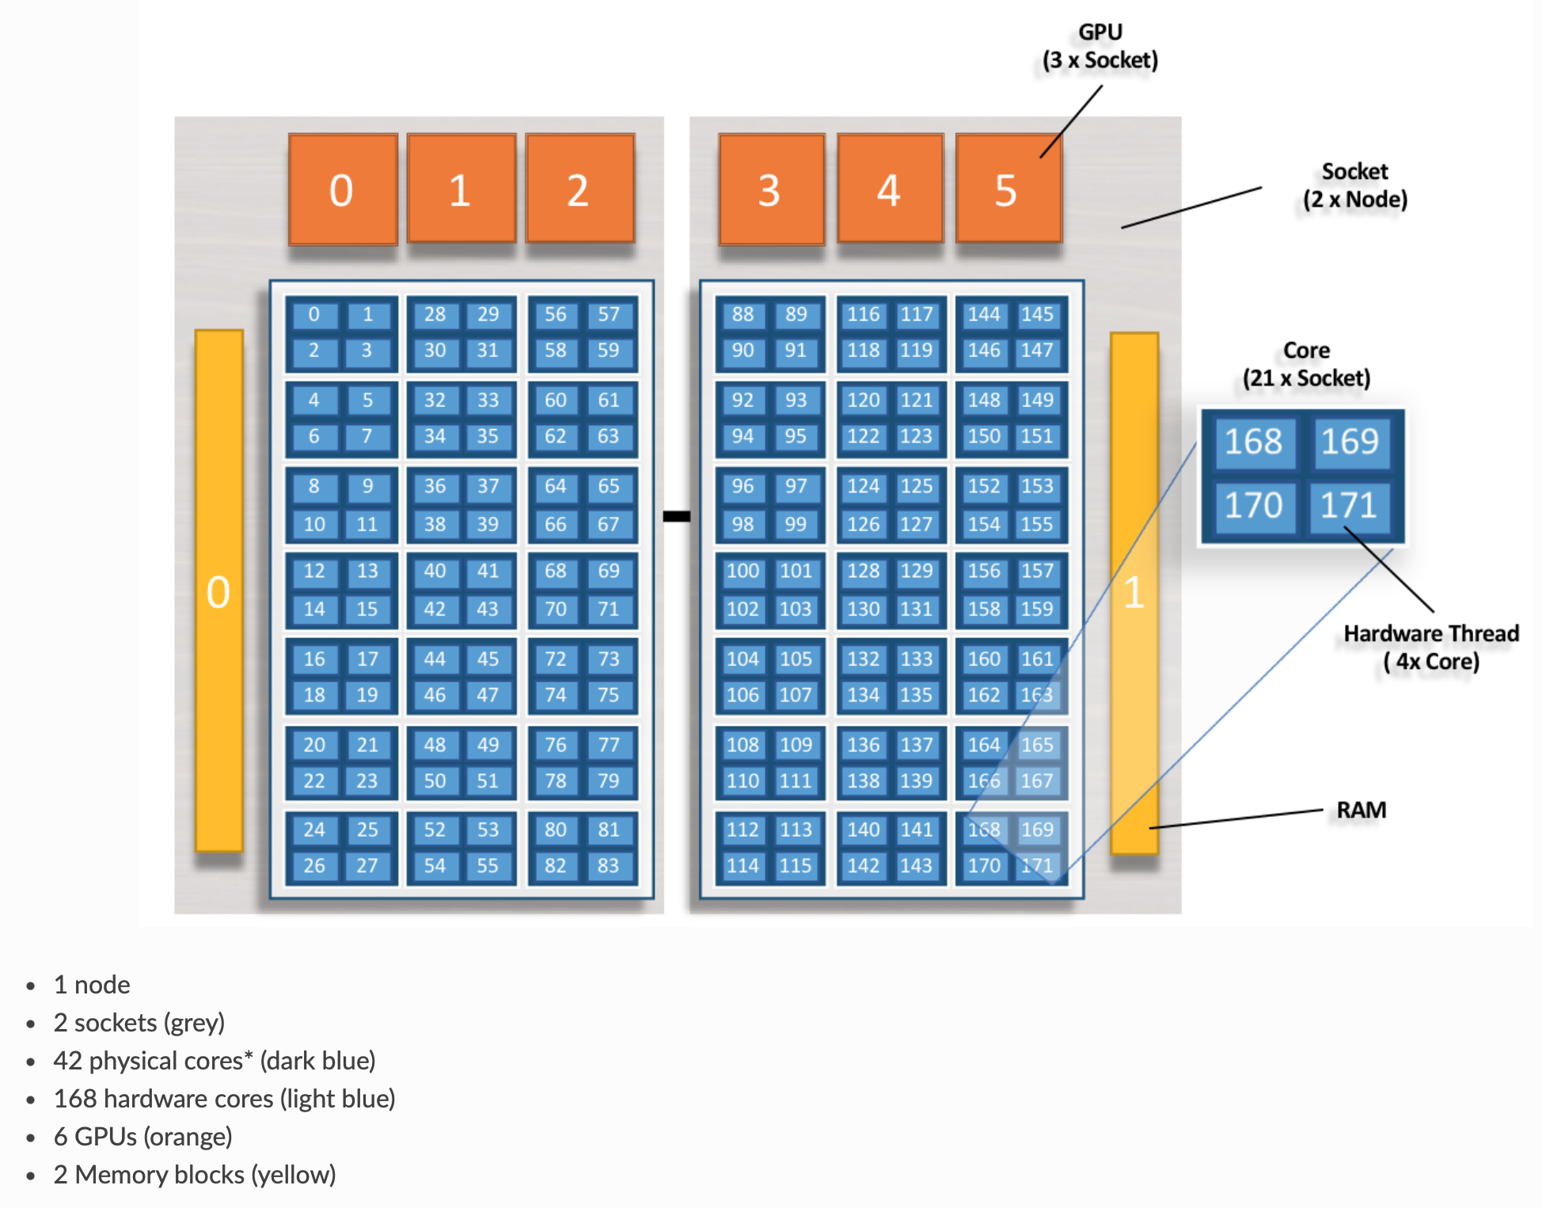
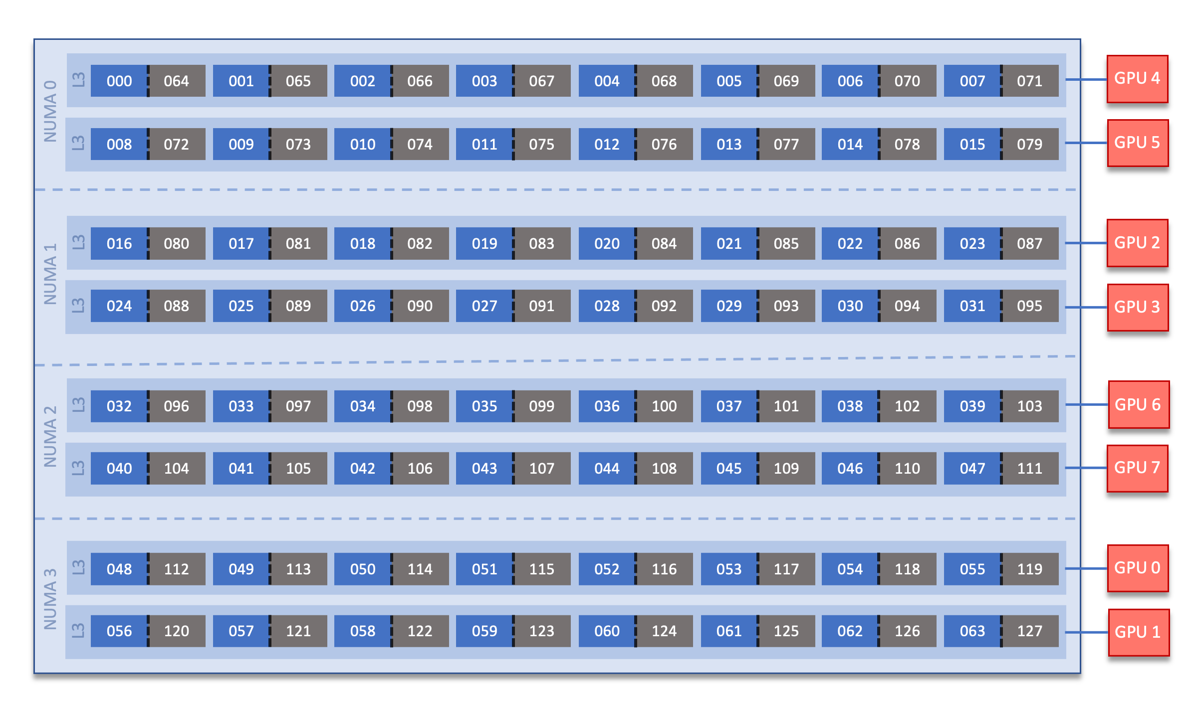
Although accurate, system documentation can be confusing
Summit:
Frontier:
Core indexing, HWT indexing, GPU mapping not universal (or even intuitive)
Sources: https://docs.olcf.ornl.gov/systems/summit_user_guide.html ,
https://docs.olcf.ornl.gov/systems/frontier_user_guide.html
Notes:
168 cores? Ok, why does the index go to 171? Where are 84-87? (in the fine print)

Slide 10
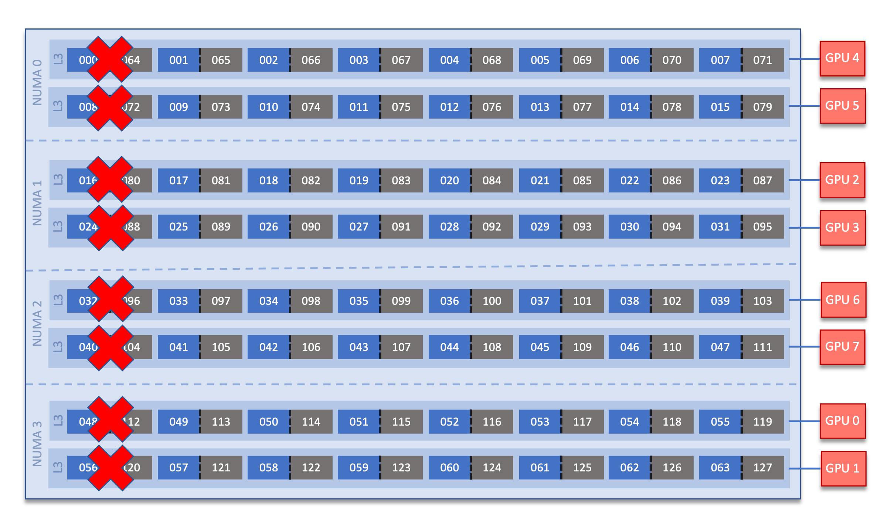
Although accurate, system documentation can be confusing
Summit:
Frontier:
Modified default: system reserves 8 cores…but user controllable
Sources: https://docs.olcf.ornl.gov/systems/summit_user_guide.html ,
https://docs.olcf.ornl.gov/systems/frontier_user_guide.html
Notes:
removing 1/8 of capability... is that really necessary? it does keep things simple.

Slide 11
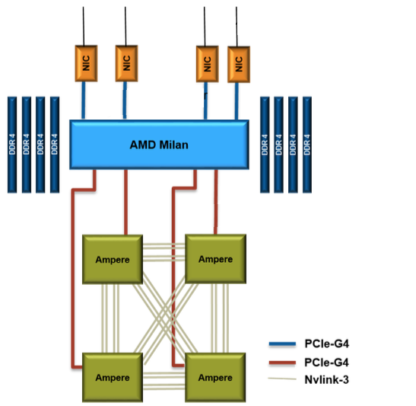
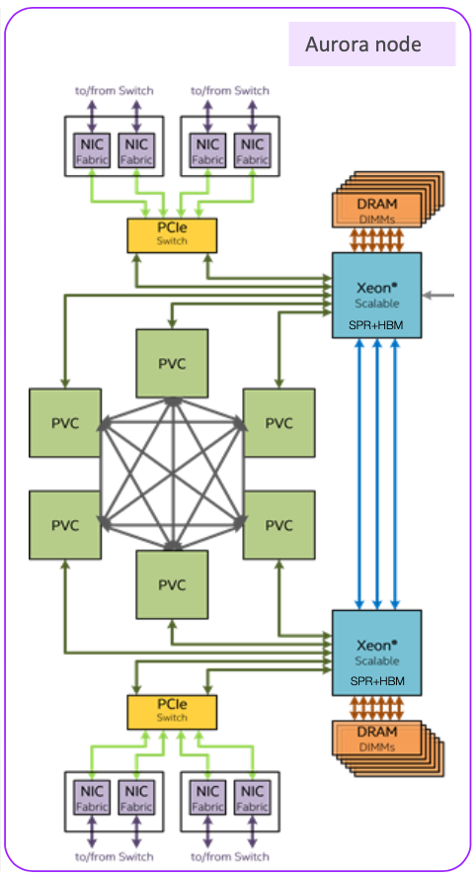
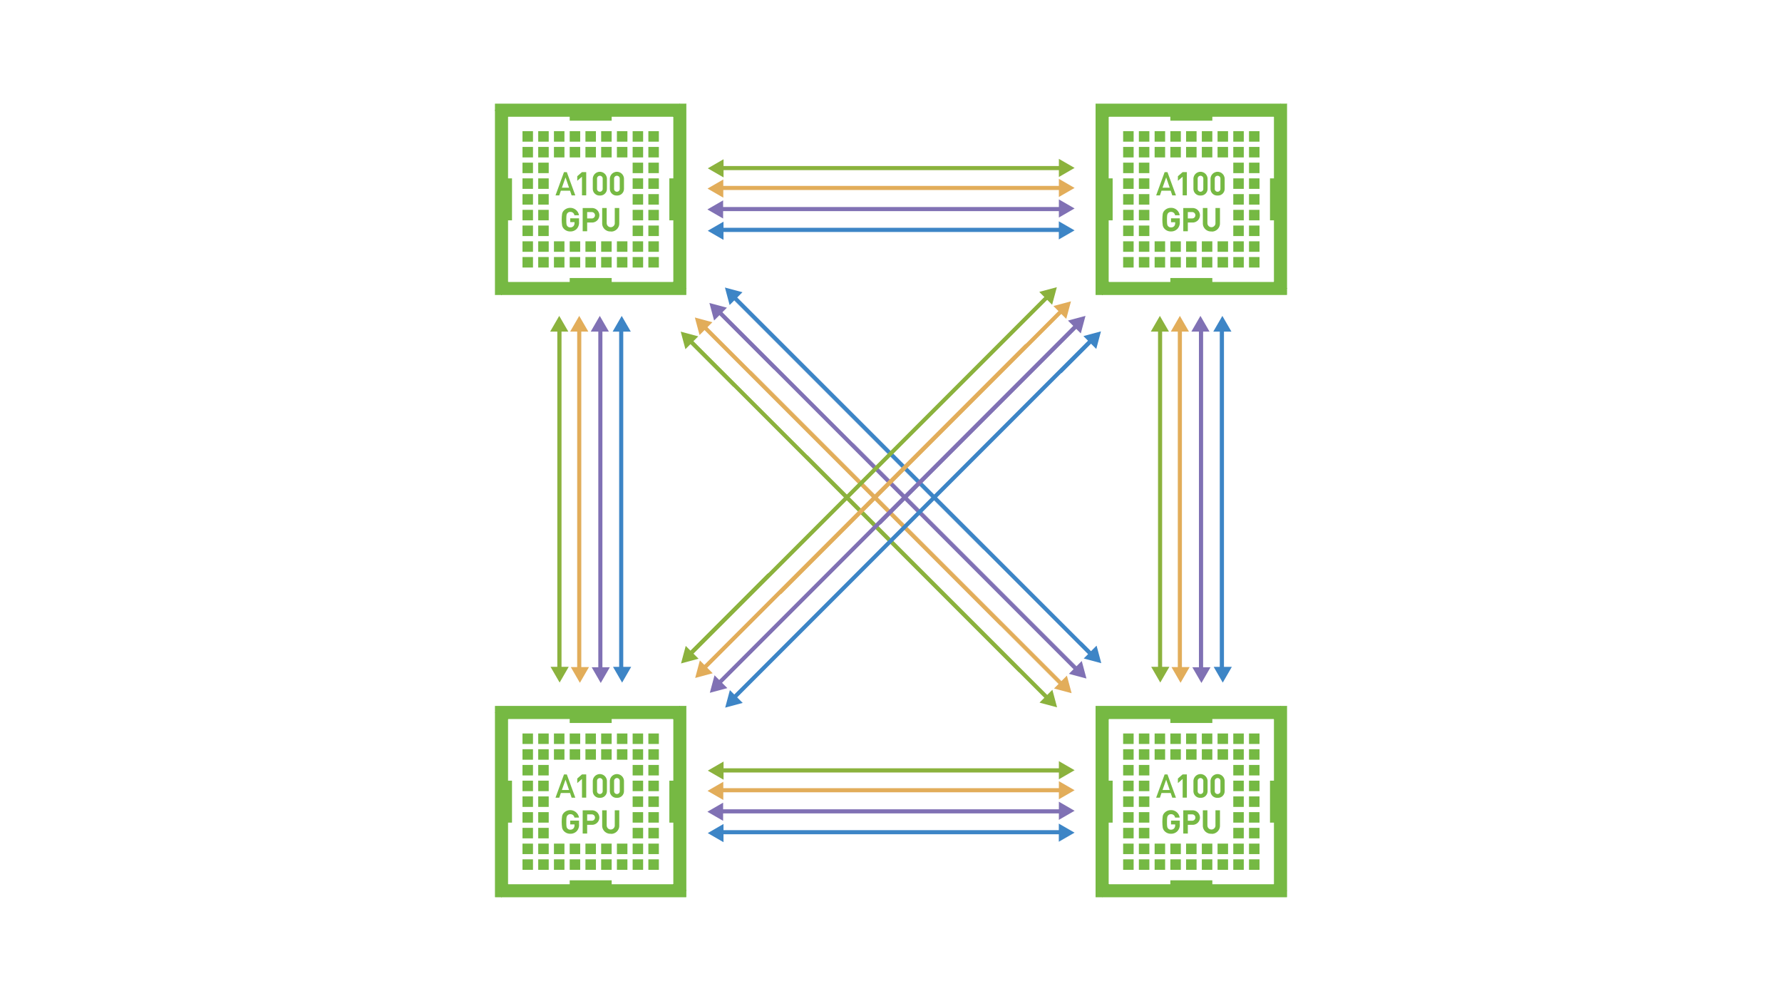
More systems – information missing
Perlmutter:
Aurora:
No physical layout information available in the documentation, no core or GPU indexing…
Sources: https://docs.nersc.gov/systems/perlmutter/architecture/
https://extremecomputingtraining.anl.gov/wp-content/uploads/sites/96/2022/11/ATPESC-2022-Track-1-Talk-9-Muralidharan-Aurora.pdf
Notes:
Would need to use hwloc or similar to get PCI bus addresses, map to indexes...

Slide 12
ZeroSum: User Space Monitoring of Resource Utilization and Contention
Inspired by the hello_jsub program from Tom Papatheodore: https://code.ornl.gov/t4p/Hello_jsrun
Why “ZeroSum”? – An benefit for one side results in an equivalent loss for the other
  the fixed number of resources available in an allocation – no elasticity
  the need to periodically use some resources to monitor
Available on GitHub: https://github.com/UO-OACISS/zerosum
Monitors application threads (LWP), CPU hardware (HWT), Memory, and GPU hardware for all processes, all nodes in the allocation
Uses hwloc library to extract node topology information
Notes:
Prototype solution to two problems:
Configuration optimization – help understand new system/software
Ongoing usage for monitoring

Slide 13
ZeroSum Functionality
Detect the initial/changing configuration of the application
Evaluate the configuration to automatically detect misconfigurations
Provide runtime feedback to the user that the program is progressing
Provide a report of how effectively the hardware was utilized
Provide a report of how much contention was identified in the execution
Provide a way to expose the observed data to other tools that can perform computational steering / runtime optimization / reconfiguration
Implemented
Future work

Slide 14
How to use ZeroSum
Wrapper script(s) – zerosum and zerosum-mpi
  Periodicity – default 1 second
  Detailed/verbose output – true/false, default false
  Heartbeat (memory consumption) – true/false, default false
  Register signal handler – true/false, default false
  Run in debugger – true/false, default false (also specify executable name)
  Detect deadlocks – true/false, default false
  Deadlock period – how many periods of “inactivity” is considered “deadlock”
  HWT/Core for async thread – defaults to last core/HWT in affinity list for process
Preloads the library, wraps __libc_start_main or creates global static constructor/destructor functions

Slide 15
What does it do? …Configuration Detection
Query /proc/[self|pid]/status to get the allowable cores
Query /proc/meminfo to get total memory available
Query MPI rank, size, hostname (after MPI_Initialized() returns true)
If available, use hwloc to query hardware topology (lstopo)
Asynchronous background thread is started, it periodically queries:
  /proc/[self|pid]/status to get process thread count, memory usage
  /proc/[self|pid]/task directory to get all thread IDs
  For each thread, query the affinity list for that thread (it may change!), utilization, state, core/HWT it’s running on, context switches, other metrics
  /proc/stat to query core utilization of all cores
OMP-Tools (v5.0+) callback used to identify OpenMP threads at creation*
NVML/ROCm-SMI/SYCL libraries used to query/monitor GPU(s)
Notes:
The answer to all your questions is ”/proc”
* OMPT not universally supported, only used for attribution of thread purpose

Slide 16
Utilization Report
Rank 0 writes a summary report to the screen
All ranks write a report to a log file – including full time series data as CSV
All observed threads (LWP) are reported – user/system/idle, context switches, affinity list
All assigned cores (HWT) are reported – user/system/idle
All assigned GPUs stats are reported
Notes:
Be brief on this one

Slide 17
Example Output – miniQMC (OpenMP target offload) on Frontier (OLCF)
Process Summary
LWP (thread) Summary
Note: times are in jiffies – typically 0.01 seconds. For final summaries they are percentages.
Notes:
Spend a little time here

Slide 18
Example Output – miniQMC (OpenMP target offload) on Frontier (OLCF)
HWT (core/thread) Summary
Note: times are in jiffies
GPU Summary
Logs have full time series of all samples
Notes:
There are static (metadata) attributes also captured for each device.

Slide 19
Contention Detection Support
Voluntary/non-voluntary context switches (analysis todo)
Minor/major page faults, pages swapped (analysis todo)
System time analysis (analysis todo)
Comparing affinity lists – across threads and across processes (todo)
Memory consumption (analysis todo)
GPU memory consumption (analysis todo)
However, can detect deadlocks – both active (i.e. spinning at MPI collective) and passive (i.e. waiting for mutex)
Notes:
…As you can see, “detection” currently a mostly manual process
Not automated yet – but should be straightforward… (todo)

Slide 20
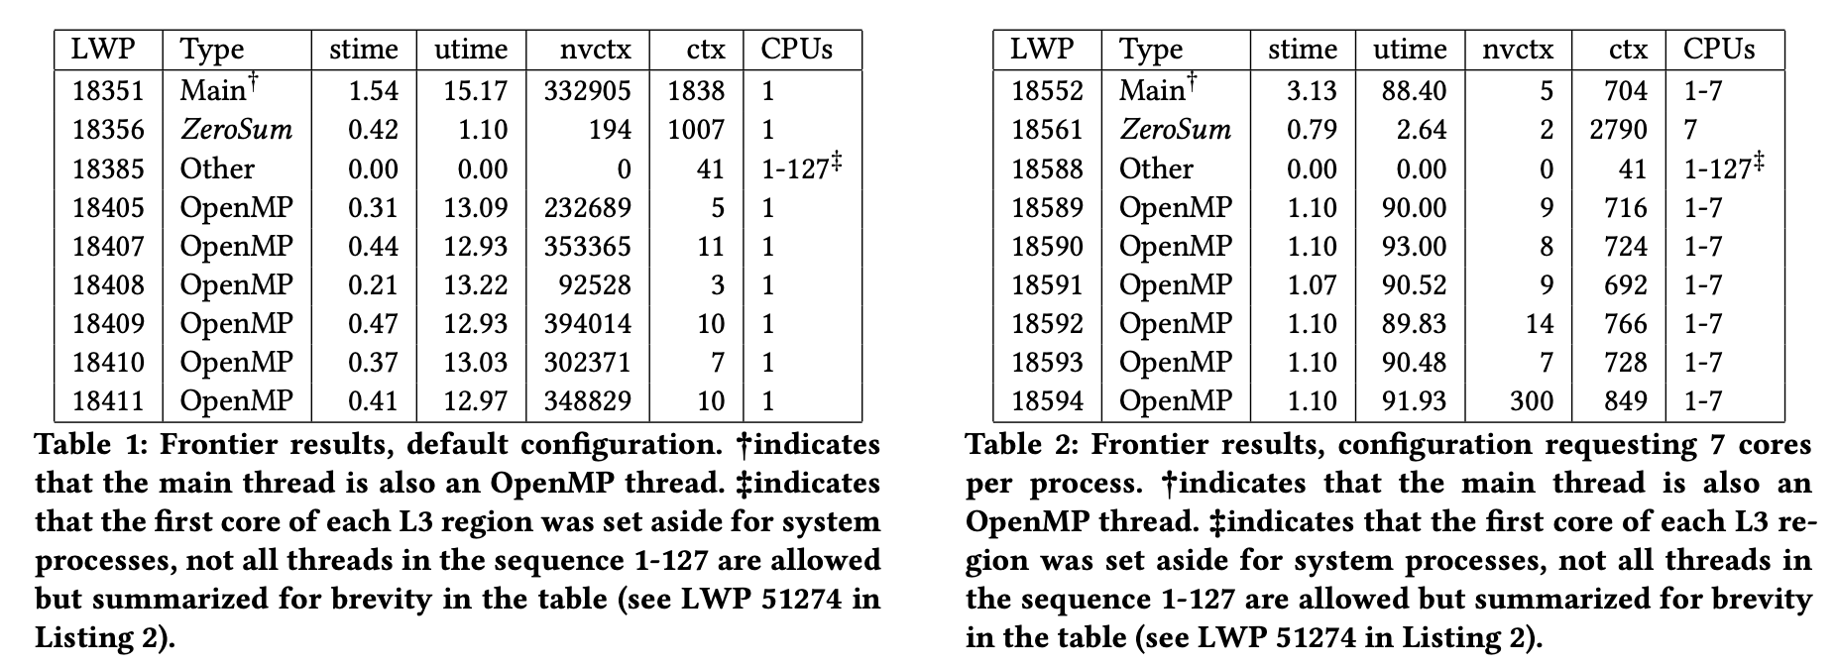
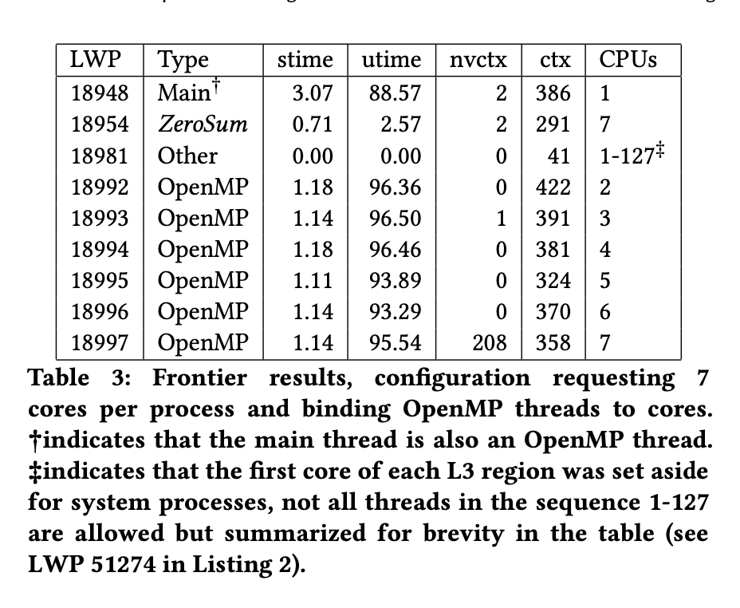
Evaluation / Example usage
MPI+OpenMP version of miniQMC on Frontier, 8 processes, 7 threads (64 cores, 1 thread per core, 8 cores reserved)
export OMP_NUM_THREADS=7
srun -n8 zerosum-mpi miniqmc
export OMP_NUM_THREADS=7
export OMP_PROC_BIND=spread
export OMP_PLACES=cores
srun -n8 –c7 zerosum-mpi miniqmc
export OMP_NUM_THREADS=7
srun -n8 –c7 zerosum-mpi miniqmc
Note: stime/utime reported as % of total time
Notes:
This is an example from the HUST paper

Slide 21
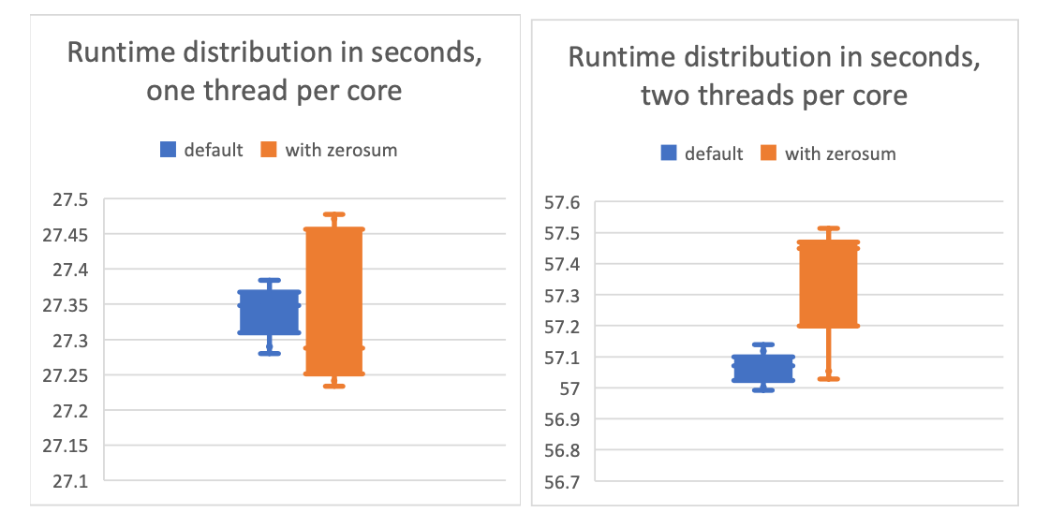
Overhead – less than 0.5% in resource constrained example
miniQMC time distributions executed 10 times using one OpenMP thread per core (left). In this comparison, the distribution of times with ZeroSum is noisier, but there is no significant observation of measurable overhead. The right figure shows the time distributions using two OpenMP threads per core. In this comparison, the distribution of times with ZeroSum is both noisier and longer tailed, and does show an observation of overhead, averaging about 0.2752 seconds, or 0.5%.
Notes:
Only one miniapp on one system, but should be representative.

Slide 22
Summary views of collected data – 64 GCDs, XGC running on Frontier
Data post-processed using Python scripts
Notes:
Let’s look at time-series data from GPUs… apologies for the small font. This shows min/mean/max and .25 and .75 quartiles across all ranks

Slide 23
Summary views of collected data – 896 HWTs, XGC running on Frontier
↙️ All hardware threads from all ranks ↘️
↖️ Only main hardware thread from all ranks ↗️
Notes:
Averaging all 17 threads drags the means. However, looking at just main threads allows comparisons across ranks. Also, what's going on with the system times at exit?

Slide 24
Summary views of collected data – 1088 LWPs, XGC running on Frontier
↙️ All process threads ↘️
↖️ Only main process thread ↗️
Notes:
User time, NVCXT and locks. Should point out that /proc is “sloppy”. Sometimes the nuber of jiffies reported are out of sync with the query time, and get shifted to the next period.

Slide 25
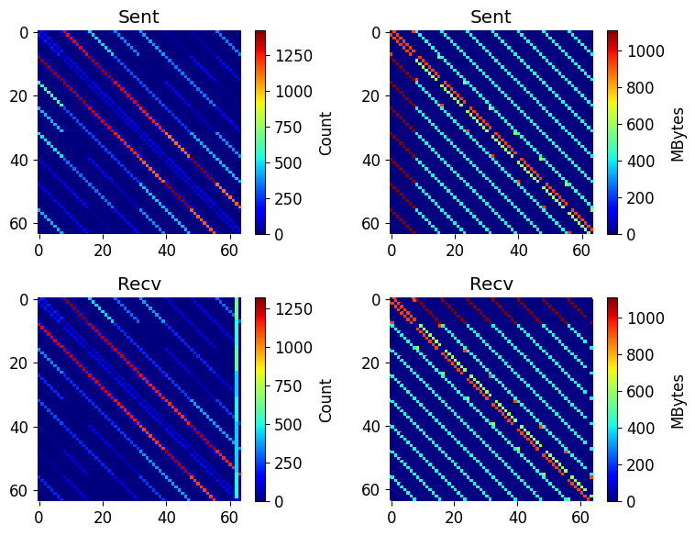
MPI P2P data
MPI implementation includes wrappers for MPI_Recv/Irecv, MPI_Sendrecv, MPI_Send/Bsend/Isend/ Rsend/Ssend to capture P2P frequency, volume
Obviously can be done by other/better performance measurement tools, but for a quick view, can be useful
Apply analysis from “Optimizing Process-to-Core Mappings for Application Level Multi-dimensional MPI Communications”, Karlsson et al. 2012. https://doi.org/10.1109/CLUSTER.2012.47

Slide 26
Successful Use Cases
Octo-Tiger (HPX) thread placement on Fugaku
  Detected unusual core indexing, needs to be mapped using hwloc information
Argobots example
  Detected that the user was running client & server on same node, with overlapping affinity lists
Grid (https://github.com/paboyle/Grid) on Frontier (lattice QCD library)
  Helped find/understand ideal resource mapping with custom bind arguments
XGC on Frontier
  Empirically demonstrated that 2 threads per core provided better performance than 1 thread per core
  Helped detect deadlock in GPU-aware libfabric/MPI implementation
  Helped detect algorithmic deadlock in MPI (application bug)
Notes:
For some weird systems (Fugaku), the first core is logically 0 but the OS sees it as 12. So there are 48 cores with logical indexes 0-47, but the OS reports them as 12-59. We need to map them so that we monitor the right CPU HWT from /proc/stat. Christopher Kelly at BNL did the Grid mapping work.

Slide 27
Deadlock detection – at scale
Runs application in gdb/cuda-gdb/rocgdb/gdb-oneapi in “batch” mode – sequence of commands are scripted
ZeroSum monitors all threads during execution:
  If all sleeping for X seconds (X is user-configurable):
    pthread_kill(SIGQUIT) the main thread
  If all but 1 sleeping for X seconds, and that thread doesn’t have at least one minor page fault during that time, it’s probably deadlocked at an MPI collective:
    pthread_kill(SIGQUIT) the main thread
Gdb will intercept the signal and is scripted to get a backtrace from all threads
Post-process the threads and make a tree (just like STAT/Cray-STAT)
  However, ZeroSum is automated - queue times on Perlmutter were around 8 hours, user didn’t want to monitor the 128 node slurm request

Slide 28
Example: XGC deadlocked on Perlmutter with 512 ranks
Only 52 of 64 in communicator participated in collective

Slide 29
Conclusions, Future Work
ZeroSum addresses the configuration optimization problem
  https://github.com/UO-OACISS/zerosum
Still need automated misconfiguration/contention detection
Output data could be better – use ADIOS2 BP5? HDF5? SQLite?
  Depends on analysis needs/wants
  Current log file “format” means analysis process is manual/ad hoc (via Python)
Streaming data to Mochi (SOMA) or other service (LDMS)?
  Enables robust monitoring approach – but likely redundant in many cases
Integration with performance tools (TAU, APEX, etc)
  Analysis of application performance data in context of system monitoring data
Input for automated feedback/control (APEX, Argobots, SOMA, application)

Slide 30
PerfStubs:
Profiling API for adding external tool instrumentation support to any project
Kevin A. Huck
Oregon Advanced Computing Institute for Science and Society (OACISS)

Slide 31
PerfStubs
PerfStubs is a “frictionless” instrumentation library
  https://github.com/UO-OACISS/perfstubs
  One source file, three headers
  Provides a plugin interface for performance tools
  Can be compiled away if desired
Integrated into several libraries (so far) as a git submodule or direct
  CAMTIMERS
  PETSc
  Ginkgo
  ADIOS2
  Others?
Provides runtime integration with TAU & APEX
Boehme, Huck, Madsen, Weidendorfer,
“The Case for a Common Instrumentation Interface for HPC Codes”
https://doi.org/10.1109/ProTools49597.2019.00010, 2019

Slide 32
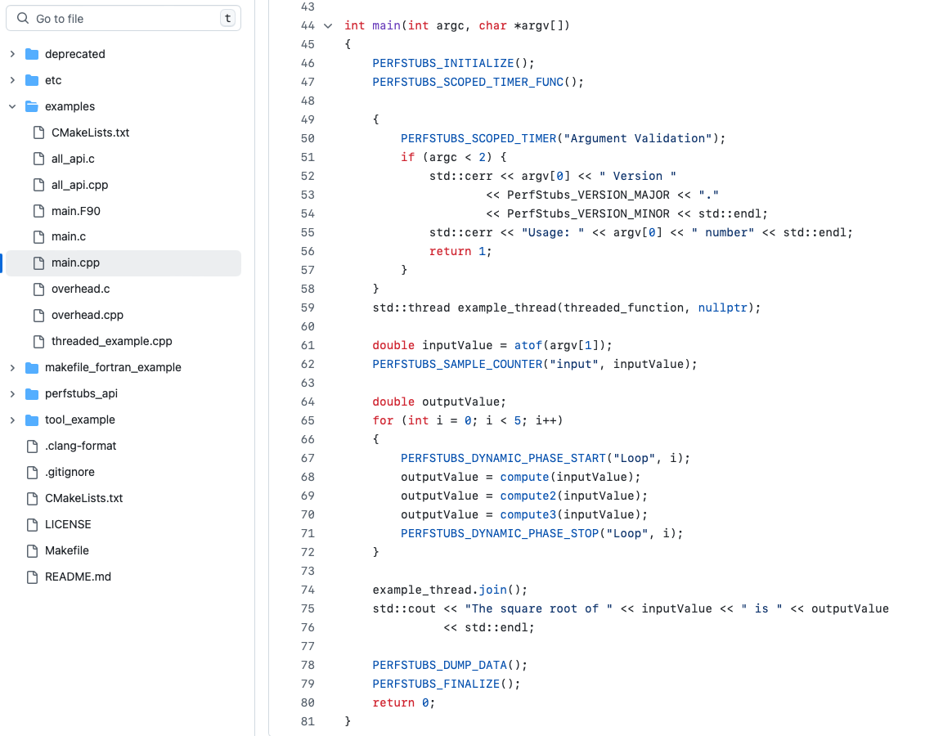
C++ example

Slide 33
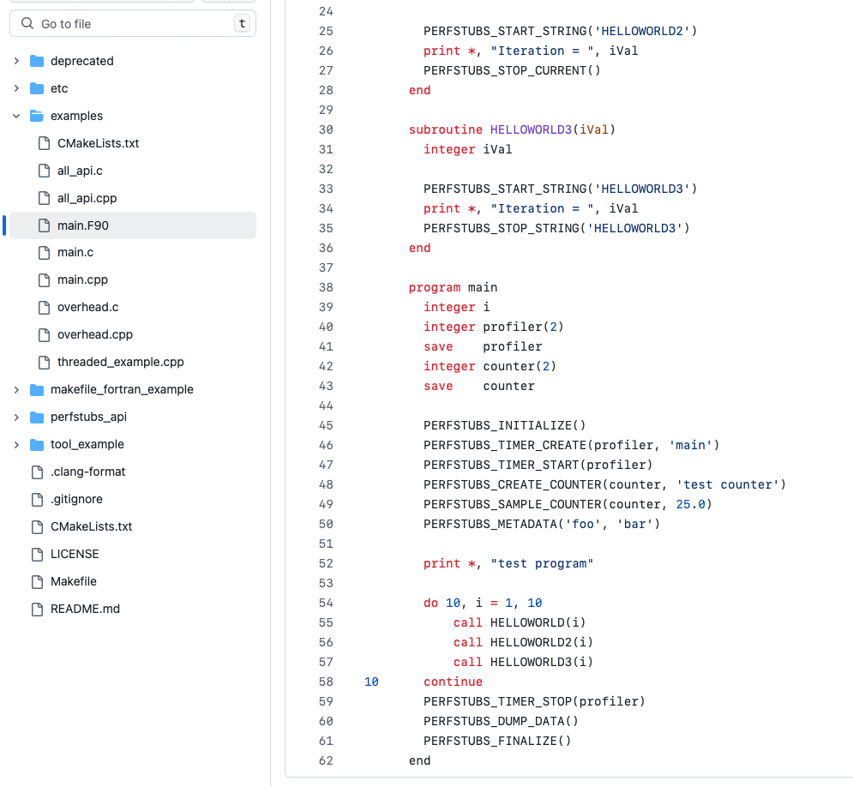
Fortran example:

Slide 34
Comparison to other instrumentation libraries
Similar to NVTX (CUDA), ROC-TX (HIP), etc. – but portable
Can be compiled away completely (macro-based)
If no tool attached, very little overhead – but that depends on how much instrumentation you add, and where (don’t put it inside tight loops, for example)
Similar library TaskStubs being developed for asynchronous tasking runtimes like PaRSEC, StarPU, IRIS
Module installed on Frontier:
  module load ums ums002/vanilla ; module load perfstubs

Slide 35
TAU:
Portable performance measurement toolkit for HPC
Kevin A. Huck
Oregon Advanced Computing Institute for Science and Society (OACISS)

Slide 36

TAU Performance System
Tuning and Analysis Utilities (29+ year project)
Integrated performance toolkit:
  Multi-level performance instrumentation
  Highly configurable
  Widely ported performance profiling / tracing system
  Portable (java, python) visualization / exploration / analysis tools
Supports all major HPC programming models
MPI/SHMEM, OpenMP, OpenACC, CUDA, HIP, SYCL/OneAPI, Kokkos...
Support for ML/AI frameworks: TensorFlow, pyTorch, Horovod, Python
Integrated with PAPI, LIKWID for hardware counter support
https://tau.uoregon.edu or https://github.com/UO-OACISS/tau2 (public mirror)

Slide 37
Performance Measurement
Timers
  Requires instrumentation of some kind
    Manual, automated
    Source, compiler provided, binary
    Library callbacks, API wrappers, weak symbol replacement
  Simple to implement
Sampling
  Requires specialized system libraries / support (nearly universal)
    Periodic signals, signal handler
    Call stack unwinding
  No modification to executable/library needed
  Potential to interfere with system support (signal handlers)
  Can mix with timers to generate a hybrid profile

Slide 38
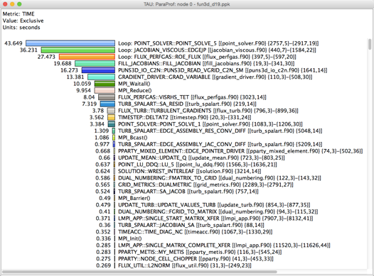
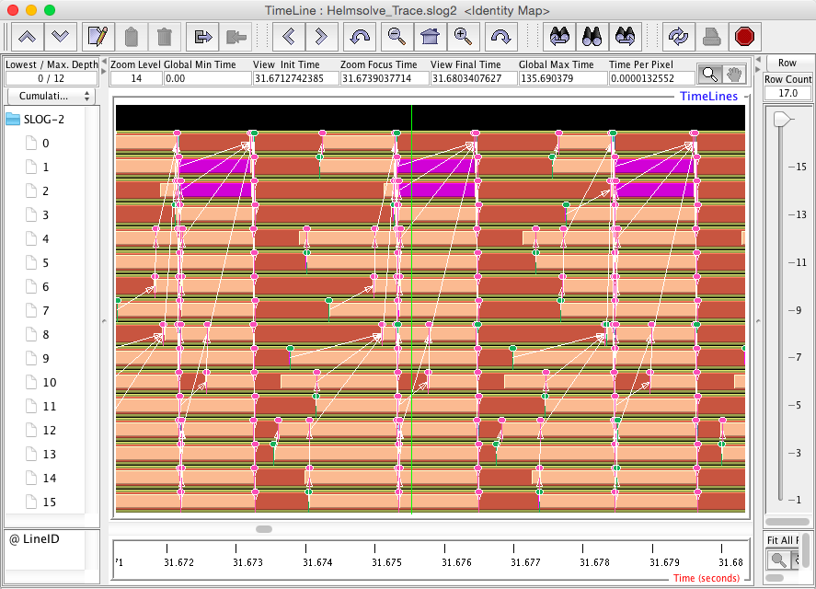
Profiling and Tracing
Profiling: how much time was spent in each measured function on each thread in each process?
  Collapses the time axis
  No ordering or causal event information
  Small summary per thread/process, regardless of execution time – only grows with number of timers & threads/processes
Tracing: record all function entry & exit events on a timeline
  Detailed view of what happened
  The longer the program runs, the bigger the trace
ParaProf profile viewer
JumpShot trace viewer

Slide 39
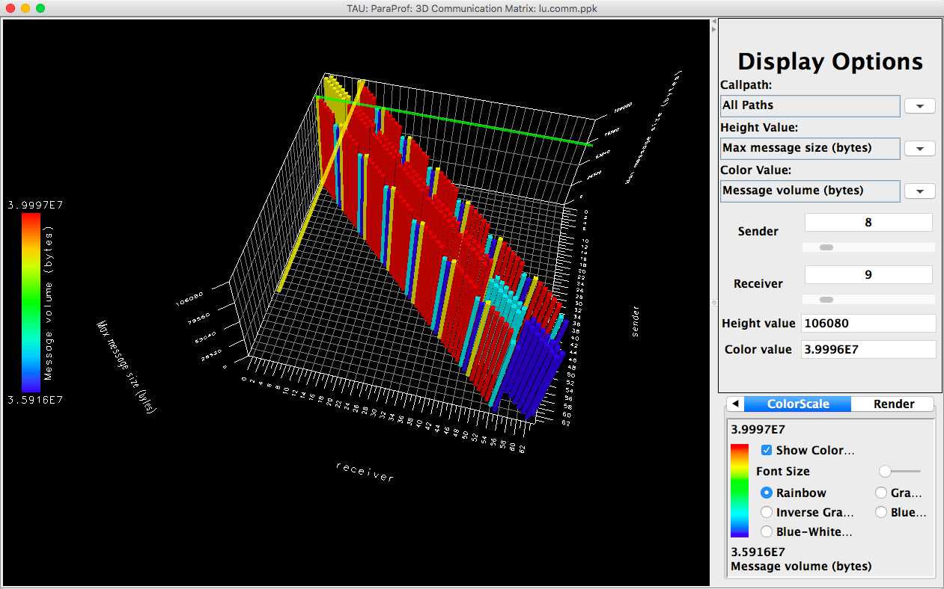
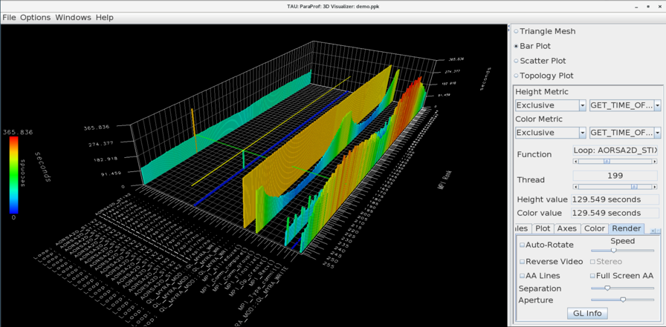
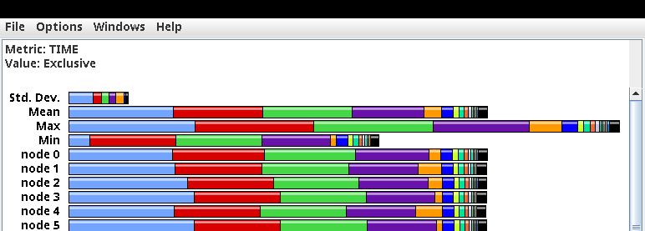
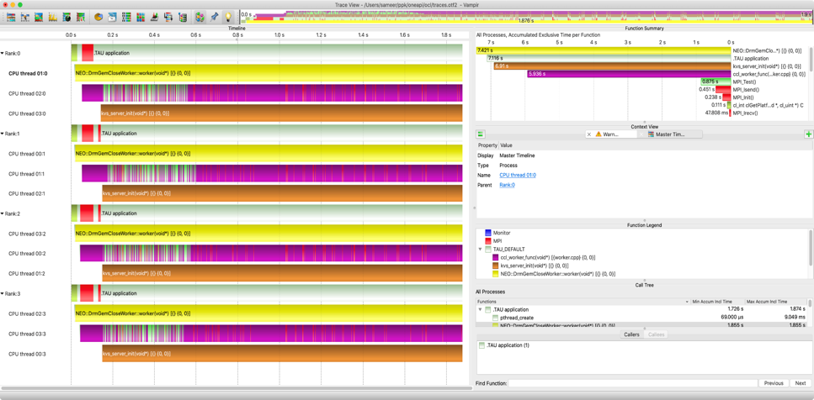
TAU Analysis Tools: ParaProf, Vampir
MPI Communication Matrix
3D Profile view
Vampir: https://vampir.eu
Profile view
Vampir trace viewer

Slide 40
Programming Model Support in TAU
MPI, SHMEM – interposition library to intercept all MPI calls
OpenMP – OMPT support (provided by all compilers except GCC), including target offload support
OpenACC – callback API similar to OpenMP
CUDA – measurement support through CUPTI, NVML libraries
HIP – measurement support through Rocprofiler, Roctracer, Rocm-SMI libraries
SYCL/Level0 – support provided through SYCL, Level0 APIs
Python – integration with cProfile, updated support in development for Python 3.12+

Slide 41
Using TAU on Frontier
module load tau
srun <srun options> tau_exec -T <config> <options> your_executable
Useful options:
  -io : track I/O operations
  -rocm : enables HIP profiling support
  -cuda : enables CUDA profiling support
  -ompt : enables OpenMP Tools support (most compilers, not GCC)
  -ebs : enables sampling support
  -ebs_period=<count> : Sampling period in microseconds (default 10000)
  -ebs_resolution=<file|function|line> : choose sampling granularity
  -monitoring : enables periodic monitoring of system resources (a la ZeroSum)
tau-config --list-matching : shows installed TAU configurations

Slide 42
Kokkos support in TAU
TAU implements the Kokkos Profiling API (Kokkos_Profiling_C_Interface.h)
TAU sets an environment variable KOKKOS_TOOLS_LIBS to tell Kokkos that it should enable profiling and enable function callbacks to the TAU implementations
TAU implements
  kokkosp_[init|finalize]_library
  kokkosp_[begin|end]_parallel_[for|scan|reduce]
  kokkosp_[push|pop]_profile_region
Names for regions are passed to the tools to provide intelligent labels
In addition, TAU also implements support for native Pthreads, OpenMP, OpenACC, CUDA, HIP, SYCL back-end measurement – no code changes necessary
Raja support: if you have a Raja application, and Raja is configured with -DRAJA_ENABLE_RUNTIME_PLUGINS, Raja implements the same callback API

Slide 43
TAU Example – Kokkos Lulesh (from kokkos-miniapps)
Main thread launching kernels
Virtual thread with CUDA activity
Intel Xeon system with NVIDIA A100, size 256, 100 iterations, one rank

Slide 44
APEX:
APEX performance measurement and runtime auto tuning
Kevin A. Huck
Oregon Advanced Computing Institute for Science and Society (OACISS)

Slide 45

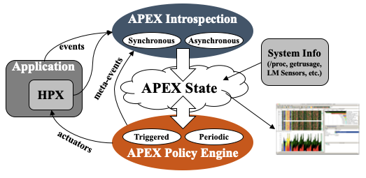
Autonomic Performance Environment for Exascale (APEX)
Autonomic Performance Environment for eXascale
Performance Measurement
Runtime Adaptation
Designed for AMT runtimes (originally HPX)
  but works with conventional parallel models
Focus on task dependency graph, not calling context graph
Supports HPX, C/C++ threads, OpenMP, OpenACC, Kokkos, Raja, CUDA, HIP, SYCL, StarPU... Working on Iris, PaRSEC
https://github.com/UO-OACISS/apex and https://github.com/khuck/apex-tutorial
Active Harmony* (Nelder Mead), simulated annealing, genetic search, hill climbing, native Nelder-Mead for parametric search methods
https://doi.org/10.1109/ESPM256814.2022.00008 : “Broad Performance Measurement Support for Asynchronous Multi-Tasking with APEX”, Huck, ESPM, 2022

Slide 46
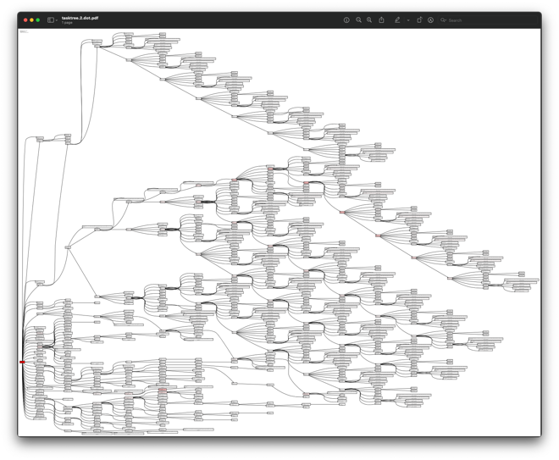
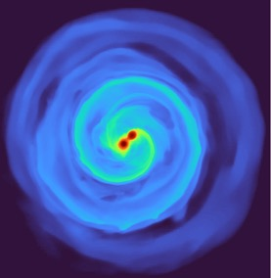
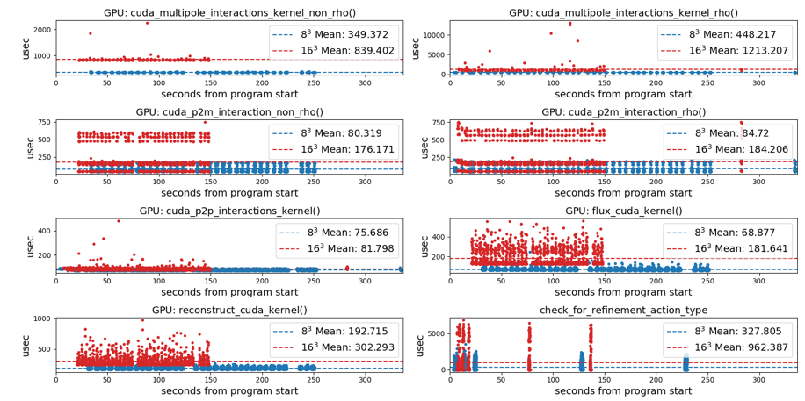
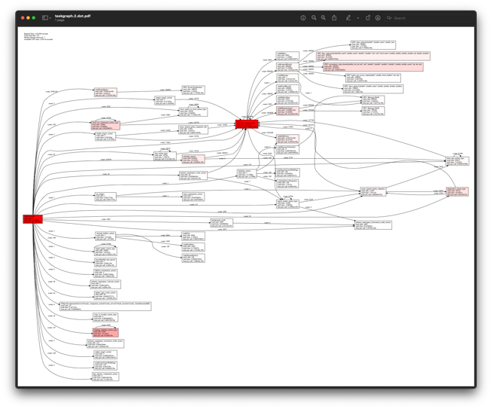
APEX example – Octo-Tiger (Octree astrophysics in HPX, Kokkos)
Tracking GPU memory usage with CUPTI
Monitoring GPU utilization with NVML library
Full task tree (above) and task graph (below) showing task dependencies
Comparing subgrid sizes and relative kernel performance with CUPTI device activity
https://github.com/STEllAR-GROUP/octotiger
https://github.com/STEllAR-GROUP/hpx

Slide 47
Octotiger (HPX) on Fugaku – concurrency sampling
Periodic sampling of active timers scheduled by the HPX runtime

Slide 48
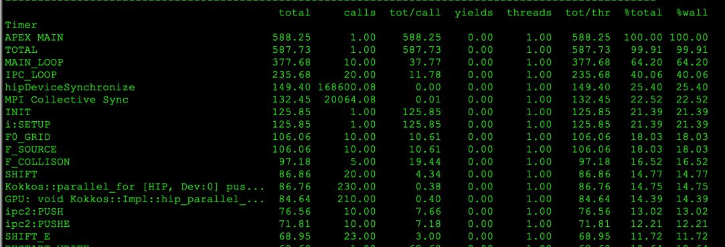
Example: XGC (tokamak plasma fusion PIC) on Frontier, 512 ranks
Uses support for MPI, OpenMP-Tools, PerfStubs, Kokkos, Hip
Post-processing view of MAIN_LOOP subtree, only with accumulated times > 5.0 seconds (only 72 nodes of 6298 of full task tree)
Red: MPI, blue: other, intensity = % of total subtree
OpenMP Kokkos Kernels
HIP Kokkos Kernels
Profiles collected with apex_exec, then post-processed with Python

Slide 49
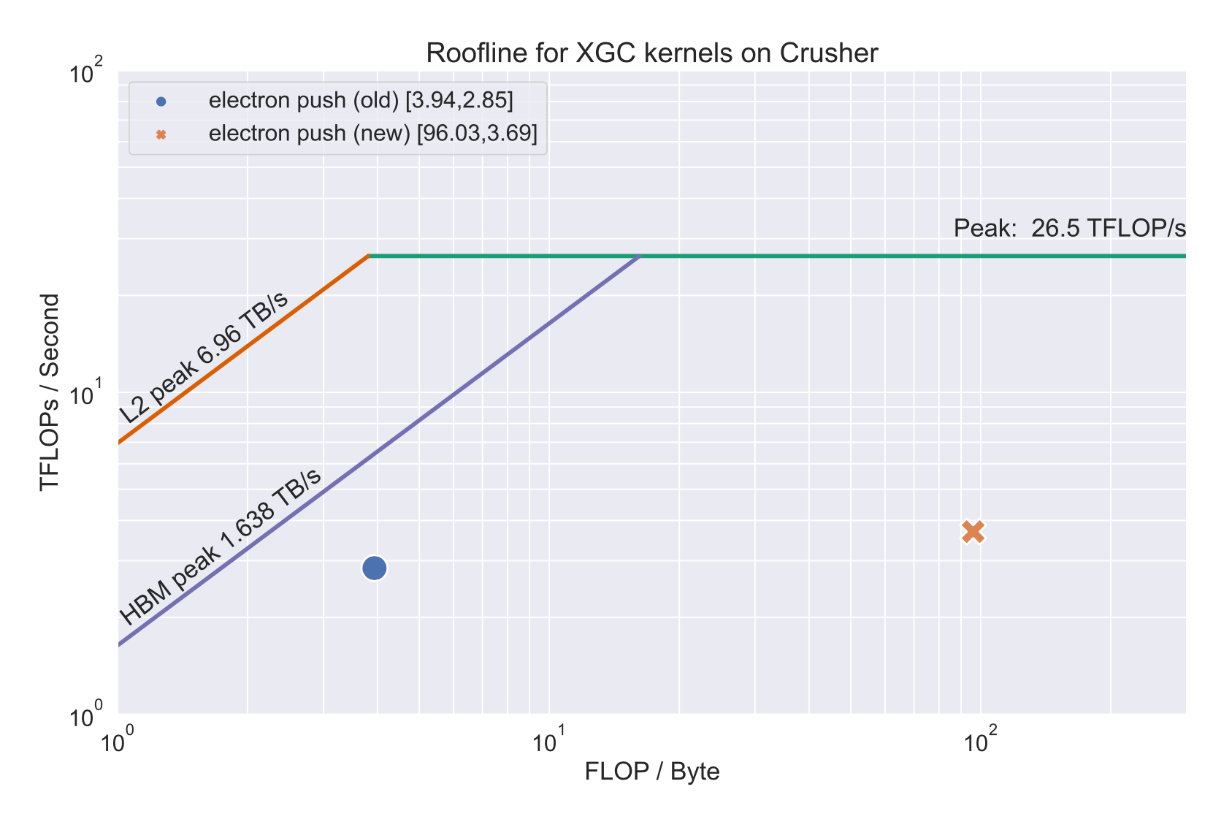
XGC: Push Kernel on Crusher/Frontier, Kokkos helped generate roofline
Kokkos + APEX + PAPI + rocprofiler = ☺
Cache | V100 | MI250X old | MI250X new
L1 | 99.8% | 87.6% | 98.7%
L2 | 95.4% | 58.8% | 94.1%
Increased computational intensity 25x, reduced time by 22% by using Kokkos launch bounds of <256,2>
Profiles collected with apex_exec, then post-processed with Python

Slide 50
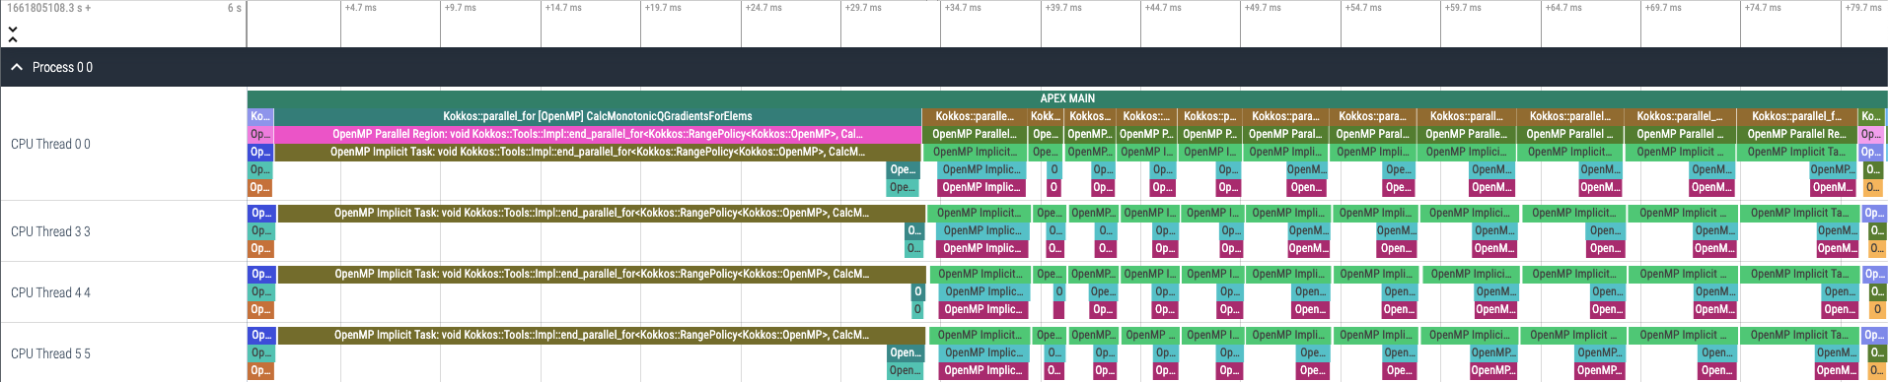
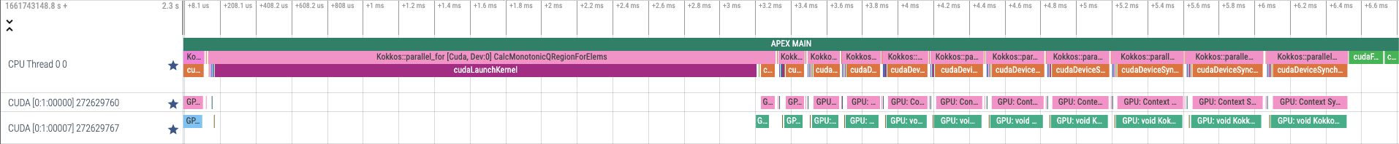
Kokkos Lulesh and APEX Tracing – OpenMP, CUDA, HIP back ends
OpenMP
CUDA
HIP
apex_exec --apex:gtrace --apex:[ompt,cuda,hip] …
Perfetto trace viewer: https://ui.perfetto.dev/

Slide 51
Using APEX on Frontier
module load ums ums002/vanilla ; module load apex
srun <srun-options> apex_exec <apex-options> executable <args>
Run ‘apex_exec’ without arguments for full list of options
For demo exercises: https://github.com/khuck/apex-tutorial
For runtime auto-tuning examples: https://github.com/khuck/apex-kokkos-tuning

Slide 52
Kokkos Support in APEX
APEX implements the same profiling API that TAU does, and…
APEX provides runtime auto-tuning (parametric search) support
Kokkos provides the ability to autotune with:
-DKokkos_ENABLE_TUNING=ON
Automatically provides input and context variables for parallel_for, parallel_reduce, parallel_scan, parallel_copy.
  TeamPolicy: team size and vector length
  MDRangePolicy: tile sizes (block.x, block.y, block.z), 2 through 6 dimensions
  RangePolicy*: block size
  All policies: occupancy
  *(in a long-dormant development fork/branch…working on new integration because many kernels use RangePolicy)

Slide 53
APEX Autotuning of ExaMiniMD Neighbor2D::fill_neigh_list_full kernel
Is it worth it? …maybe?
Baseline | 17.4972s
Tuning | 17.7294s
Tuned | 17.3790s
Exploring team sizes
Only one kernel is TeamPolicy in ExaMiniMD – all of the rest of the kernels are Range policies…
Exploring vector lengths
Response (time)

Slide 54
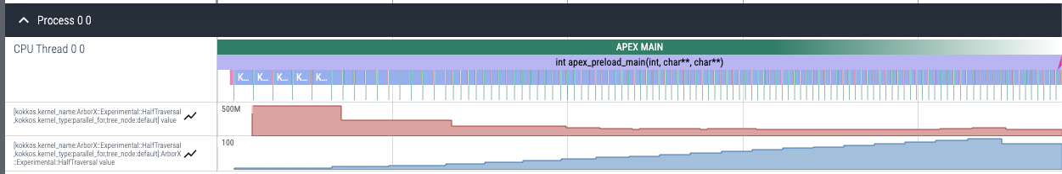
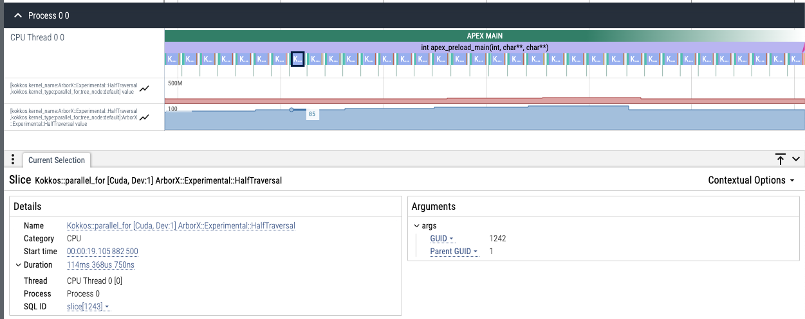
APEX Auto-tuning of ArborX DBScan with exhaustive search
Response (time)
Exploring occupancy %
Using window size of 5 (take at least 5 samples of each setting), occupancy converges on 85% (offline tuning showed convergence between ~45% and 90%), runtime reduced from 22 to 19.6 seconds (11% faster)
converges

Slide 55
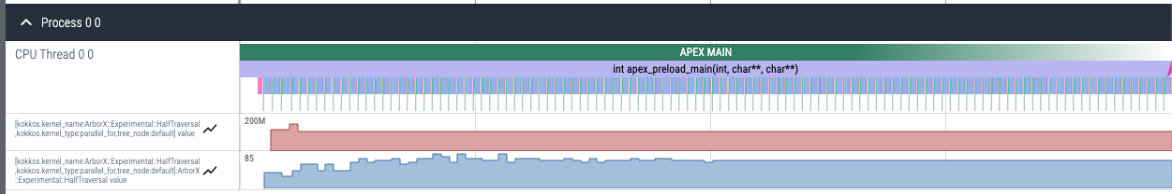
APEX Auto-tuning of ArborX DBScan with simulated annealing search
Response (time)
Exploring occupancy %
Using window size of 1, occupancy converges on 70% (offline tuning showed convergence between ~45% and 90%), runtime reduced from 22 to 19.6 seconds (11% faster)
converges

Slide 56
Auto-Tuning test cases / examples
https://github.com/khuck/apex-kokkos-tuning
  mdrange_gemm – demonstrates tuning of tiling parameters for MDRangePolicy
  mdrange_gemm_occupancy – demonstrates occupancy tuning for MDRangePolicy
  occupancy – demonstrates occupancy tuning for RangePolicy
  mm2d_tiling – complex explicit tuning example for OpenMP parameters
    Thread count, schedule, chunk size
  idk_jmm – elegant, complex example that selects between two matrix multiplication implementations (TeamPolicy or MDRangePolicy), while tuning internals each for best configuration.
  1d_stencil, 2d_stencil, deep_copy examples
Configure & Build:
  See README.md for latest info (https://github.com/khuck/apex-kokkos-tuning/)

Slide 57
Building apex-kokkos-tuning
generic-cuda.sh or perlmutter.sh for CUDA examples
frontier.sh for ROCm example
General idea: this is just a CMake compound project including the Kokkos and APEX projects. Any CMake variables you would pass in to those projects you pass in to this one. With specific notes:
  -DKokkos_ENABLE_TUNING=ON is required for tuning

Slide 58
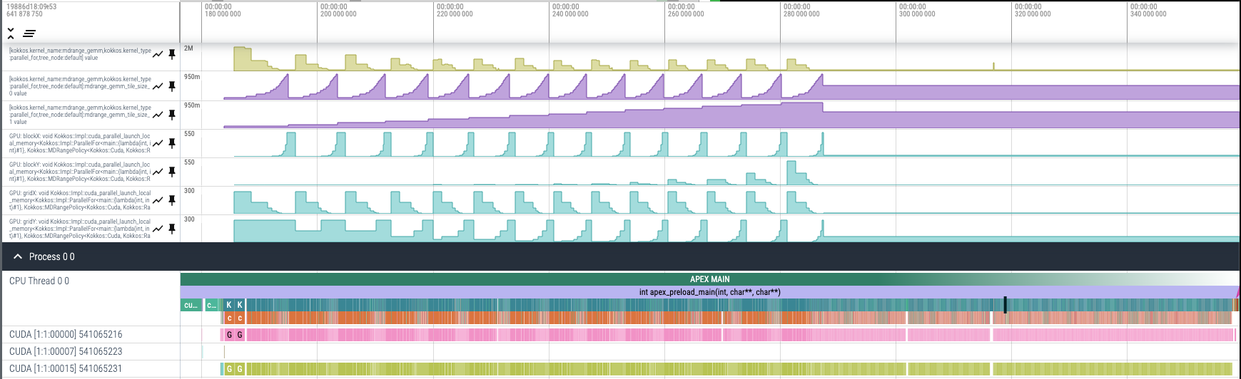
Example: testing mdrange_gemm 256x256 with exhaustive search
Response (time)
The tuning knobs (tiling factors)
32
Exploring block, grid sizes
4
8
64
Using window size of 2, tiling converges on block dimensions of (32,4,1) and grid dimensions (8,64,1), the defaults are (16,2,1) and (16,128,1) respectively – simulated annealing converges to the same values
converges

Slide 59
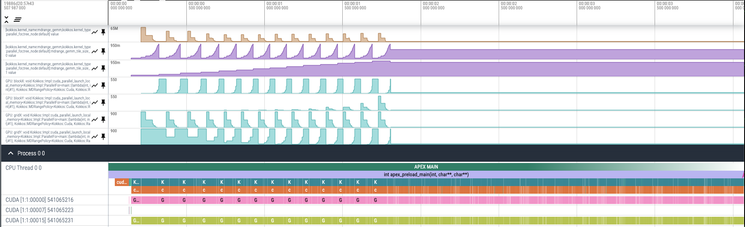
Example: testing mdrange_gemm 900x900 with exhaustive search
Response (time)
The tuning knobs (tiling factors)
32
Exploring block, grid sizes
16
29
57
Using window size of 2, tiling converges on block dimensions of (32,16,1) and grid dimensions (29,57,1), the defaults are (16,2,1) and (57,450,1) respectively. The runtime improved from a baseline of 3.95 seconds to 3.04 seconds using cached tuning results!
converges

Slide 60
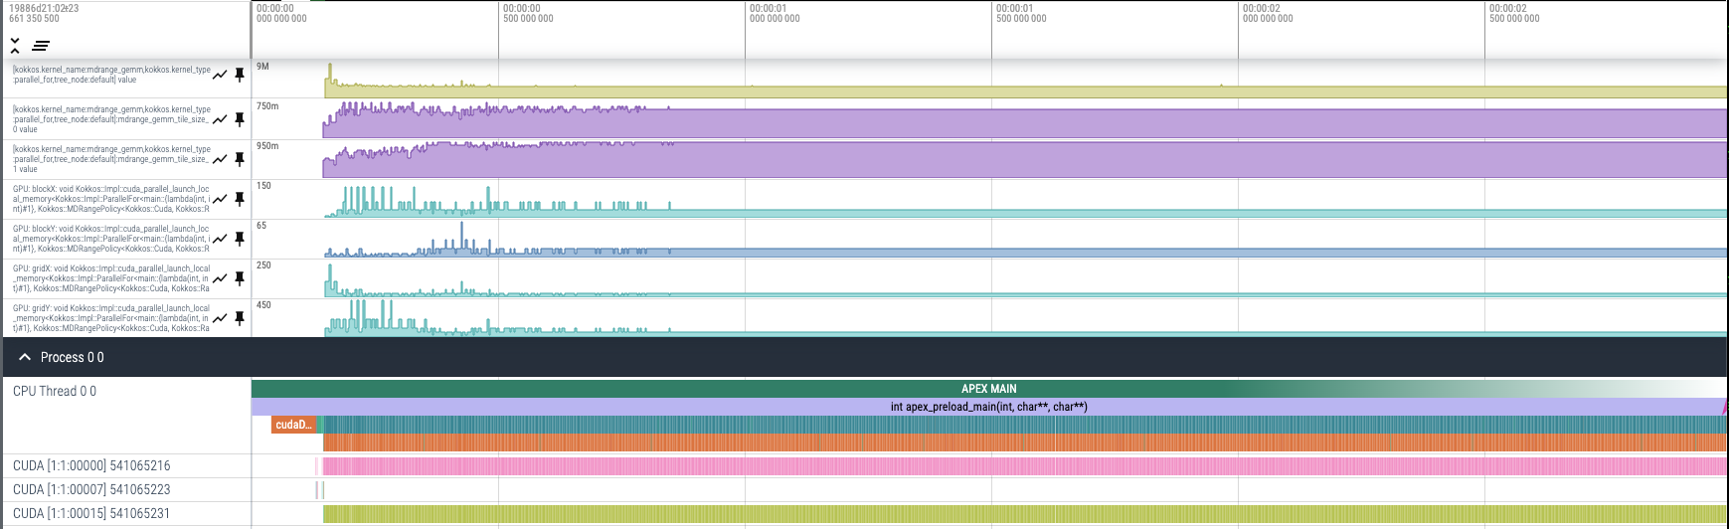
Example: testing mdrange_gemm 900x900 with simulated annealing
Response (time)
The tuning knobs (tiling factors)
32
Exploring block, grid sizes
16
29
57
Using window size of 2, tiling converges on block dimensions of (32,16,1) and grid dimensions (29,57,1), the defaults are (16,2,1) and (57,450,1) respectively. The runtime improved from a baseline of 3.95 seconds to 3.17 seconds using runtime simulated annealing!
Converges sooner

Slide 61



Acknowledgements
Parts of this research was supported by the Exascale Computing Project (17-SC-20-SC), a joint project of the U.S. Department of Energy’s Office of Science and National Nuclear Security Administration, responsible for delivering a capable exascale ecosystem, including software, applications, and hardware technology, to support the nation’s exascale computing imperative.
This research used resources of the Oak Ridge Leadership Computing Facility at the Oak Ridge National Laboratory, which is supported by the Office of Science of the U.S. Department of Energy under Contract No. DE-AC05-00OR22725.

Slide 62
Thanks! Questions?

Slide 63
Extra slides

Slide 64
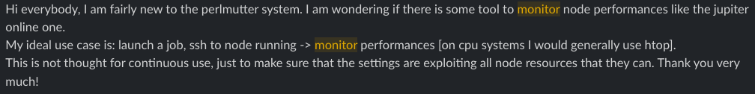
Users need help…
NERSC slack:
ALCF slack:

Slide 65
Quick quiz:
Where does MPI rank 0 of the following get allocated/scheduled on 1 Frontier node?
salloc -N 1 --threads-per-core=1 …
srun -n1 -c7 …
srun -n1 -c7 --gpus-per-task=1 --gpu-bind=closest
srun -n8 -c7 --gpus-per-task=1 --gpu-bind=closest

Slide 66
Caveat: Monitoring != Explicit Measurement
Monitoring Data (periodic)
Progress Data (events)
Example: APEX data from Lulesh Kokkos with CUDA back end, visualized with Python – clear need for GPU HWM

Slide 67
What is the hardware / operating system doing?
Kernel monitoring is popular and useful (strace, ptrace, dtrace, dtruss, ftrace, KUtrace, kprobe, system-tap, KTAU, STaKTAU, eBPF, bpftrace, BCC, …)
Nataraj, Morris, Malony, Sottile, and Beckman. "The Ghost in the Machine: Observing the Effects of Kernel Operation on Parallel Application Performance." In SC2007, pp. 1-12. 2007.
Subsystem monitoring (Darshan)
Did I ask for the right thing?
Will I run out of a limited resource?
Are there alternatives?
Can I get this information without being root? Without spawning another process to monitor my process? Without kernel patches/support? Low/no overhead?

Slide 68

What (we think) users DON’T want:
(BTW, I am happy to
ask for some help
visualizing/simplifying
the data…sparklines
aren’t going to cut it)
Sources: https://www.space.com/22652-nasa-redesigns-mission-control.html

Slide 69
Sparklines: 64 MPI Ranks on Frontier – need better

Slide 70
Sparklines: 64 MPI Ranks on Frontier

Slide 71
Sparklines: 64 MPI Ranks on Frontier

Slide 72
Sparklines: 64 MPI Ranks on Frontier

Slide 73
Sparklines: 64 MPI Ranks on Frontier – OMP_BIND=cores
User
System
Idle
User
System

Slide 74
Sparklines: 64 MPI Ranks on Frontier – OMP_BIND=threads
User
System
Idle
User
System

