Slide 1
ZeroSum:
User Space Monitoring of Resource Utilization and Contention on Heterogeneous HPC Systems
Kevin A. Huck
Oregon Advanced Computing Institute for Science and Society (OACISS)
For more information:
khuck@uoregon.edu
https://github.com/UO-OACISS/zerosum
Notes:
Good morning! Happy to be here again. This is an updated version of a talk that I have given at both a Dagstuhl seminar (23171, Driving HPC Operations With Holistic Monitoring and Operational Data Analytics) and the HUST workshop publication at SC23.

Slide 2
Who am I?
Working in HPC space since ~2003
Mostly performance tools for US DOE grants/projects
  SciDAC Institutes (PERC, PERI, SUPER, RAPIDS, RAPIDS2)
  X-Stack program
  ECP
Developing / maintaining TAU https://tau.uoregon.edu
  Highly portable, scalable measurement/analysis for HPC
Designer / Developer of APEX https://github.com/UO-OACISS/apex
  Highly portable, scalable measurement/analysis for asynchronous HPC
Designer / Developer of ZeroSum (today’s talk)
  User space monitoring

Slide 3

How did this project start?
April 2023, I was invited to the Dagstuhl seminar: “Driving HPC Operations With Holistic Monitoring and Operational Data Analytics”
https://www.dagstuhl.de/23171
Mostly facility/sysadmin focus
I presented the performance analysis perspective on monitoring (users)
  Why do users monitor?
  How do users monitor?
  What do users want to monitor?
  What is lacking?
Advocating for the user space
Discussion inspired ZeroSum
me

Slide 4
Performance Analysis Perspective on Monitoring
Three main classes of performance optimizations:
Algorithmic replacement (usually a high level of difficulty)
  E.g. replace O(n²) with O(nlogn)
  Can involve data structure changes, new dependencies, major rewrites
Code optimization (usually a medium difficulty)
  Improve cache reuse, reduce stalls (branching, instructions, I/O, etc)
Optimized launch configuration (low(?) difficulty, high embarrassment potential)
  Misconfiguration
  Wrong assumptions from another system/application
  Changes to system policies/defaults (e.g. reserved cores)
Notes:
Skip the blah blah, jump right to the fact that many performance “bottlenecks” are misconfigurations – not research result worthy in most cases, just embarrassing

Slide 5
Motivation: Why do users (want to) monitor at runtime?
Sanity check / curiosity / impatience (logging, essentially)
Check for misconfiguration
Check for efficient utilization
Confirmation of expected hardware / operating system behavior
Identify cause of failure – deadlock, crash, stalls, etc.
Adaptation / computational steering / feedback & control
Identify system failures (out of scope)
Debugging/correctness/validation, essentially.
5
Notes:
Be brief – but keep in mind users don’t have root, often can’t easily fork/exec, can’t modify the kernel, etc.

Slide 6
(Mis)Configuration – what could possibly go wrong?
Process placement:
  Logical/physical mappings, resources assigned/constrained to each process
  Are there reserved core(s) for system? GPU mapping?
Thread placement: Socket, NUMA domain, core, thread (HWT)
Undersubscribing: Wasted hardware, energy, time (under-utilization)
  Can provide better performance in some situations (memory-bound code)
Oversubscribing: Increased contention with no realized benefit
Imbalances
  What is the communication frequency/volume between pairwise MPI ranks?
Slurm/PBS/Alps/Torque/Flux are complicated to use
  …especially when combined with MPI, OpenMP, GPUs, or other model settings
Notes:
These are all things that experienced users know… but sometimes forget.

Slide 7
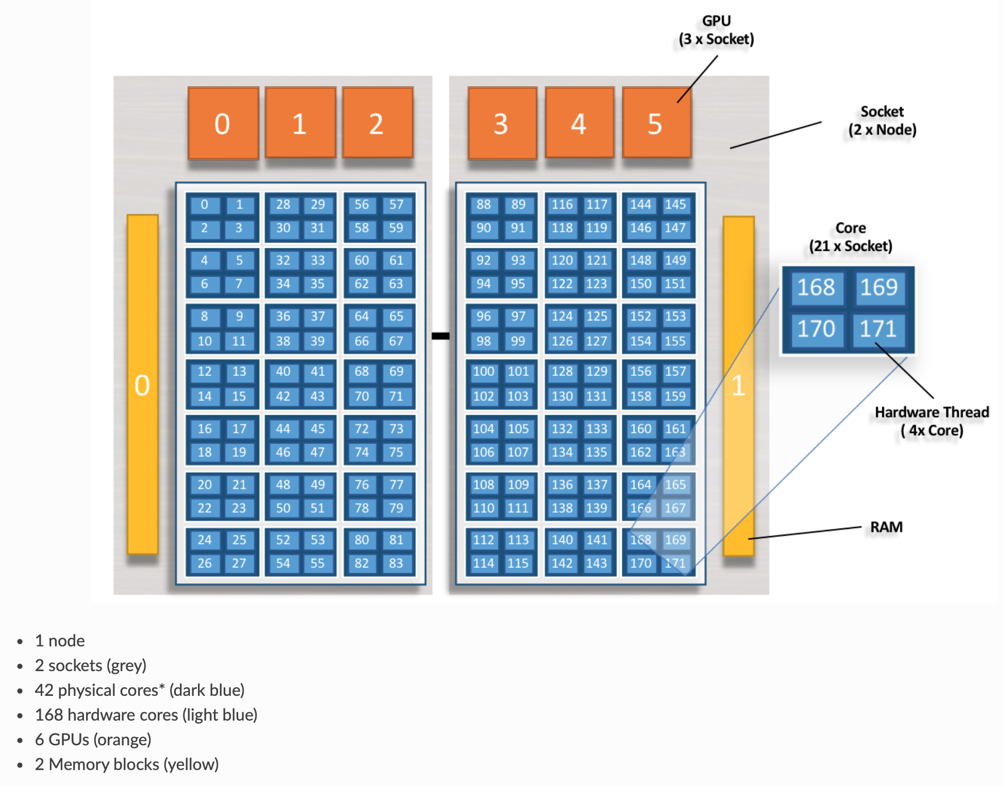
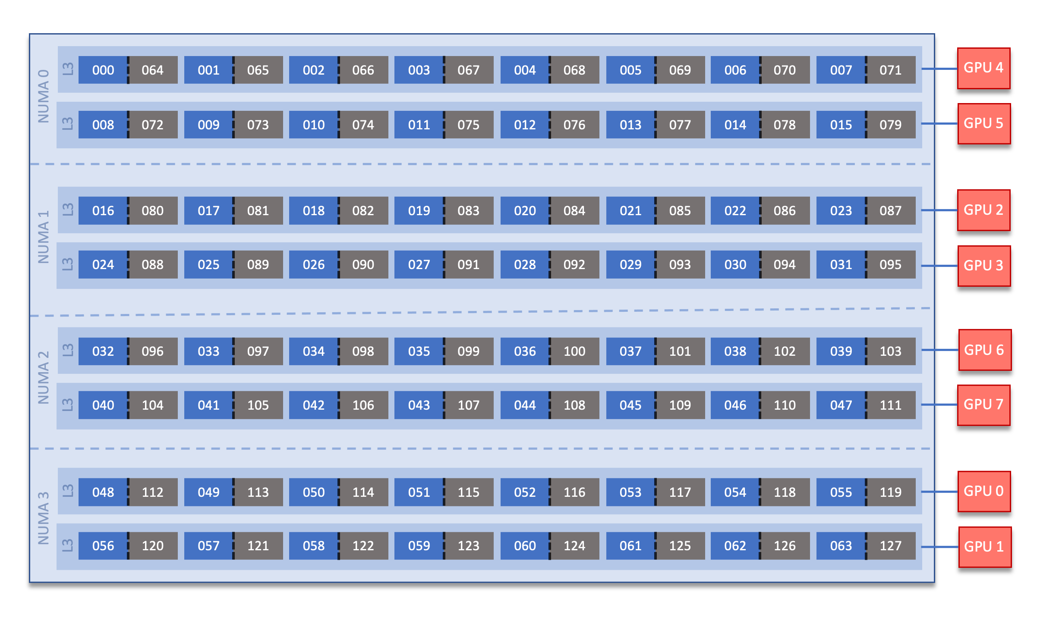
Although accurate, system documentation can be confusing
Summit:
Frontier:
Core indexing, HWT indexing, GPU mapping not universal (or even intuitive)
Sources: https://docs.olcf.ornl.gov/systems/summit_user_guide.html ,
https://docs.olcf.ornl.gov/systems/frontier_user_guide.html
Notes:
168 cores? Ok, why does the index go to 171? Where are 84-87? (in the fine print)

Slide 8
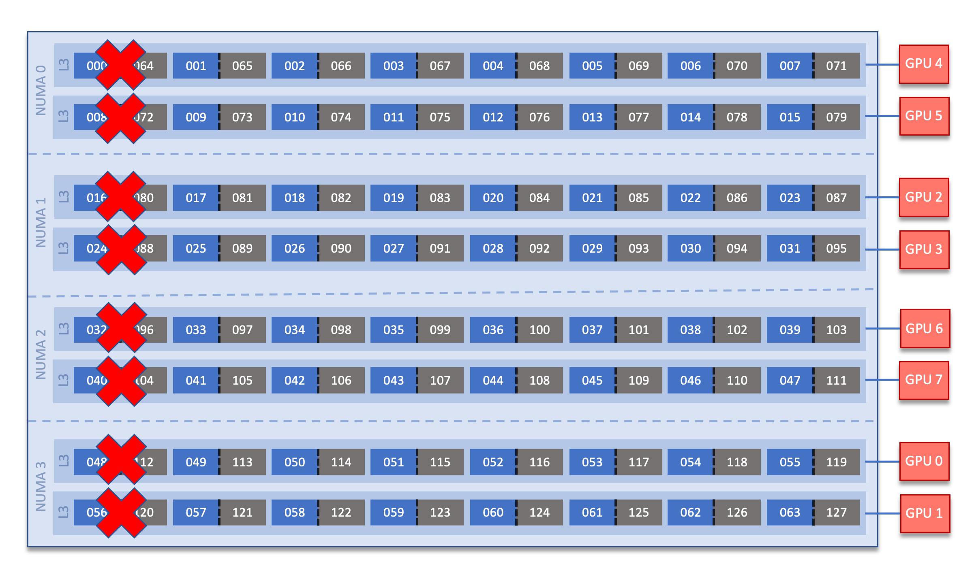
Although accurate, system documentation can be confusing
Summit:
Frontier:
Modified default: system reserves 8 cores…but user controllable
Sources: https://docs.olcf.ornl.gov/systems/summit_user_guide.html ,
https://docs.olcf.ornl.gov/systems/frontier_user_guide.html
Notes:
removing 1/8 of capability... is that really necessary? it does keep things simple.

Slide 9
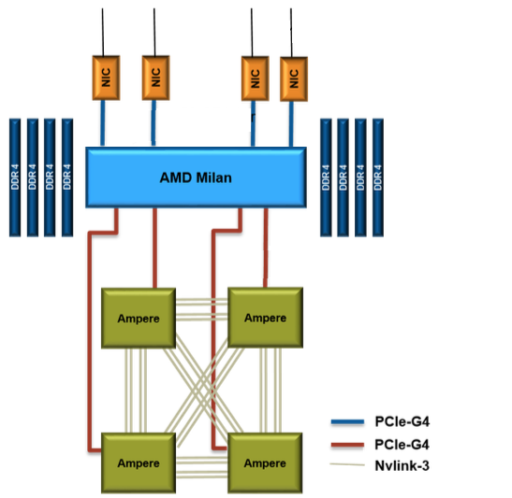
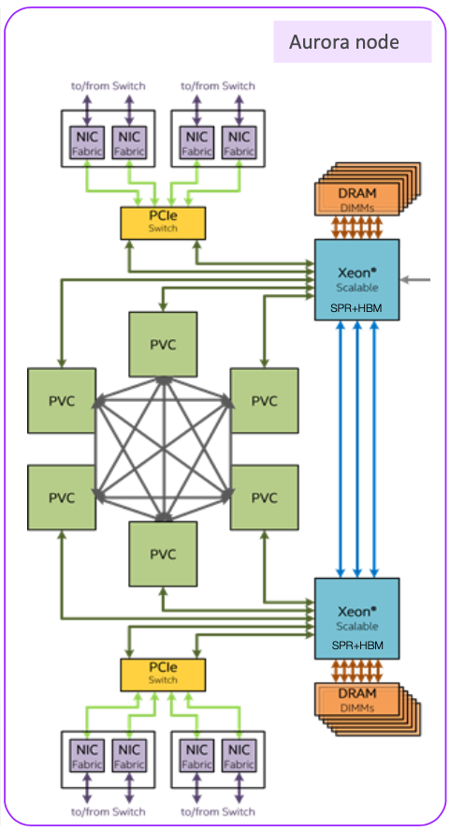
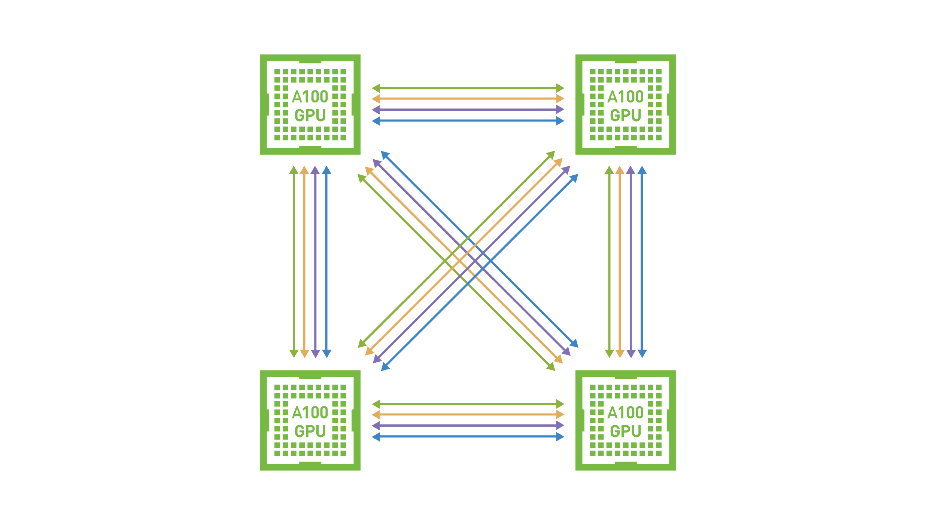
More systems – information missing
Perlmutter:
Aurora:
No physical layout information available in the documentation, no core or GPU indexing…
Sources: https://docs.nersc.gov/systems/perlmutter/architecture/
https://extremecomputingtraining.anl.gov/wp-content/uploads/sites/96/2022/11/ATPESC-2022-Track-1-Talk-9-Muralidharan-Aurora.pdf
Notes:
Would need to use hwloc or similar to get PCI bus addresses, map to indexes...

Slide 10
ZeroSum: User Space Monitoring of Resource Utilization and Contention
Inspired by the hello_jsub program from Tom Papatheodore: https://code.ornl.gov/t4p/Hello_jsrun
Why “ZeroSum”? – An advantage for one side results in an equivalent loss for the other
  the fixed number of resources available in an allocation – no elasticity
  the need to periodically use some resources to monitor
Available on GitHub: https://github.com/UO-OACISS/zerosum
Monitors application threads (LWP), CPU hardware (HWT), Memory, and GPU hardware for all processes, all nodes in the allocation
SC2023 HUST workshop paper: https://doi.org/10.1145/3624062.3624145
Notes:
Prototype solution to two problems:
Configuration optimization – help understand new system/software
Ongoing usage for monitoring

Slide 11
ZeroSum Functionality
Detect the initial/changing configuration of the application
Evaluate the configuration to automatically detect misconfigurations
Provide runtime feedback to the user that the program is progressing
Provide a report of how effectively the hardware was utilized
Provide a report of how much contention was identified in the execution
Provide a way to expose the observed data to other tools that can perform computational steering / runtime optimization / reconfiguration
Implemented
Future work

Slide 12
How to use ZeroSum
Wrapper script(s) – zerosum and zerosum-mpi
  Periodicity – default 1 second
  Detailed/verbose output – true/false, default false
  Heartbeat (memory consumption) – true/false, default false
  Register signal handler – true/false, default false
  Run in debugger – true/false, default false (also specify executable name)
  Detect deadlocks – true/false, default false
  Deadlock period – how many periods of “inactivity” is considered “deadlock”
  HWT/Core for async thread – defaults to last core/HWT in affinity list for process
Preloads the library, wraps __libc_start_main or creates global static constructor/destructor functions

Slide 13
What does it do? …Configuration Detection
Query /proc/[self|pid]/status to get the allowable cores
Query /proc/meminfo to get total memory available
Query MPI rank, size, hostname (after MPI_Initialized() returns true)
If available, use hwloc to query hardware topology (lstopo)
Asynchronous background thread is started, it periodically queries:
  /proc/[self|pid]/status to get process thread count, memory usage
  /proc/[self|pid]/task directory to get all thread IDs
  For each thread, query the affinity list for that thread (it may change!), utilization, state, core/HWT it’s running on, context switches, other metrics
  /proc/stat to query core utilization of all cores
OMP-Tools (v5.0+) callback used to identify OpenMP threads at creation*
NVML/ROCm-SMI/SYCL libraries used to query GPU(s)*
Now also queries /sys/cray/pm_counters/* for power/energy
Notes:
The answer to all your questions is ”/proc”
OMPT not universally supported, only used for attribution of thread purpose
Branch of ZeroSum supports LIKWID for hardware counter measurement, too

Slide 14
Utilization Report
Rank 0 writes a summary report to the screen
All ranks write a report to a log file – including full time series data as CSV
All observed threads (LWP) are reported – user/system/idle, context switches, affinity list
All assigned cores (HWT) are reported – user/system/idle
All assigned GPUs stats are reported
Extensive hwloc hierarchy written as JSON file
Post-processing:
  combine JSON data with CSV data for sunburst
  Time-series charts of performance data
Notes:
Be brief on this one

Slide 15
Example Output – miniQMC (OpenMP target offload) on Frontier (OLCF)
Process Summary
LWP (thread) Summary
Note: times are in jiffies
Notes:
Spend a little time here

Slide 16
Example Output – miniQMC (OpenMP target offload) on Frontier (OLCF)
HWT (core/thread) Summary
Note: times are in jiffies
GPU Summary
Logs have full time series of all samples
Notes:
There are static (metadata) attributes also captured for each device.

Slide 17
Contention Detection Support
Voluntary/non-voluntary context switches (analysis todo)
Minor/major page faults, pages swapped (analysis todo)
System time analysis (analysis todo)
Comparing affinity lists – across threads and across processes (todo)
Memory consumption (analysis todo)
GPU memory consumption (analysis todo)
Analysis: Reinforcement learning? Or just heuristics?
However, can detect deadlocks – both active (i.e. spinning at MPI collective) and passive (i.e. waiting for mutex)
Notes:
…As you can see, “detection” currently a mostly manual process
Not automated yet – but should be straightforward… (todo)

Slide 18
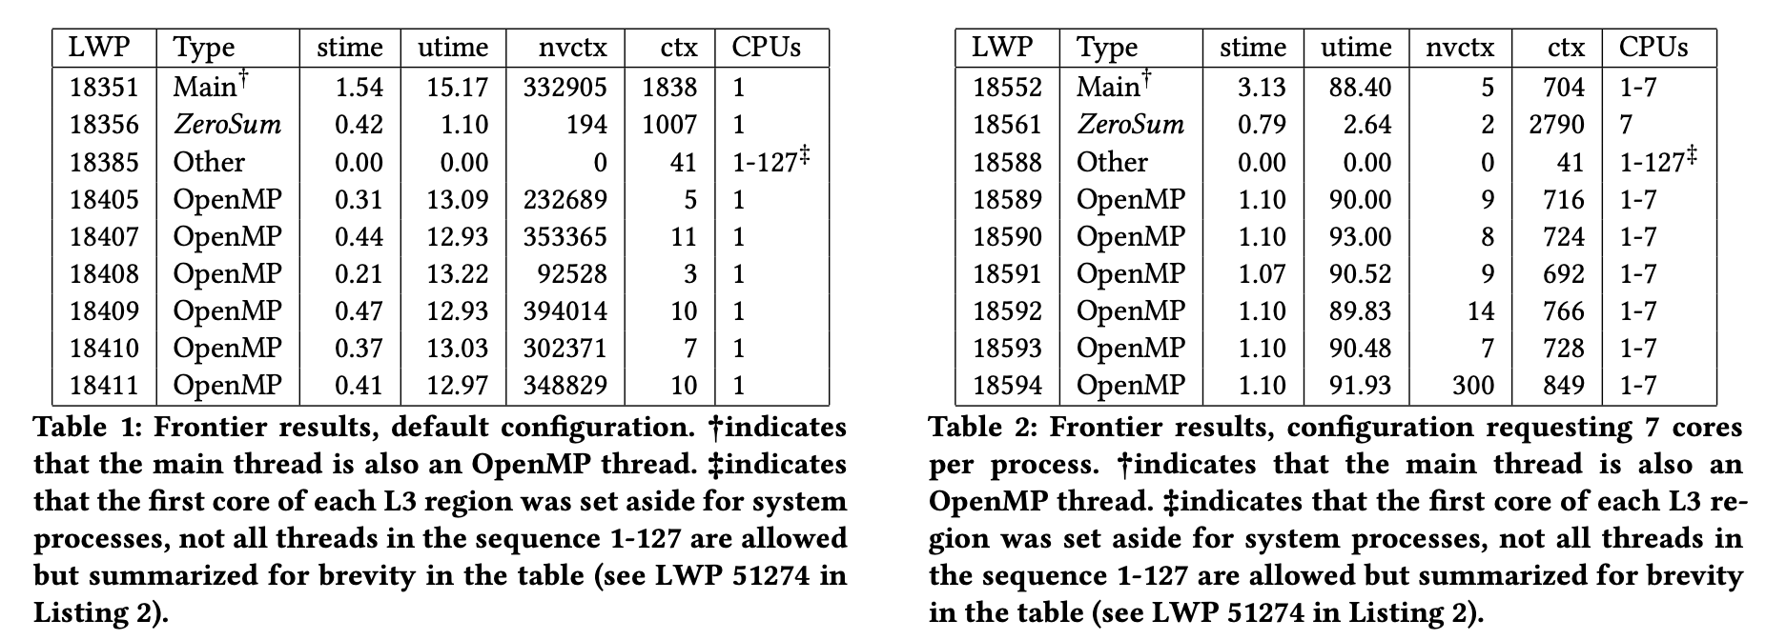
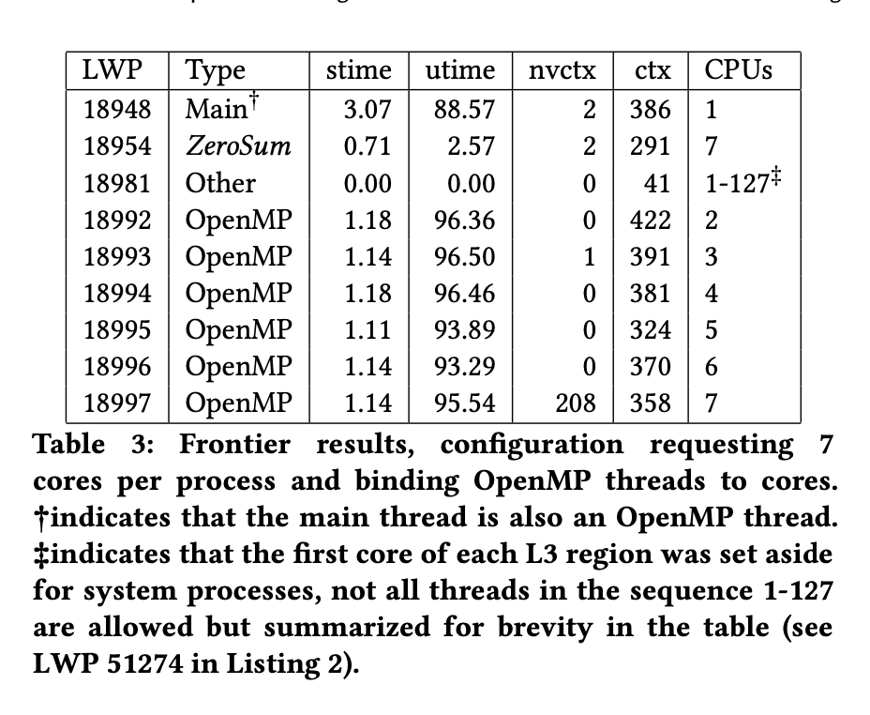
Evaluation / Example usage
MPI+OpenMP version of miniQMC on Frontier, 8 processes, 7 threads (64 cores, 1 thread per core, 8 cores reserved)
export OMP_NUM_THREADS=7
srun -n8 zerosum-mpi miniqmc
export OMP_NUM_THREADS=7
srun -n8 –c7 zerosum-mpi miniqmc
export OMP_NUM_THREADS=7
export OMP_PROC_BIND=spread
export OMP_PLACES=cores
srun -n8 –c7 zerosum-mpi miniqmc
Note: stime/utime reported as % of total time
Notes:
This is an example from the HUST paper

Slide 19
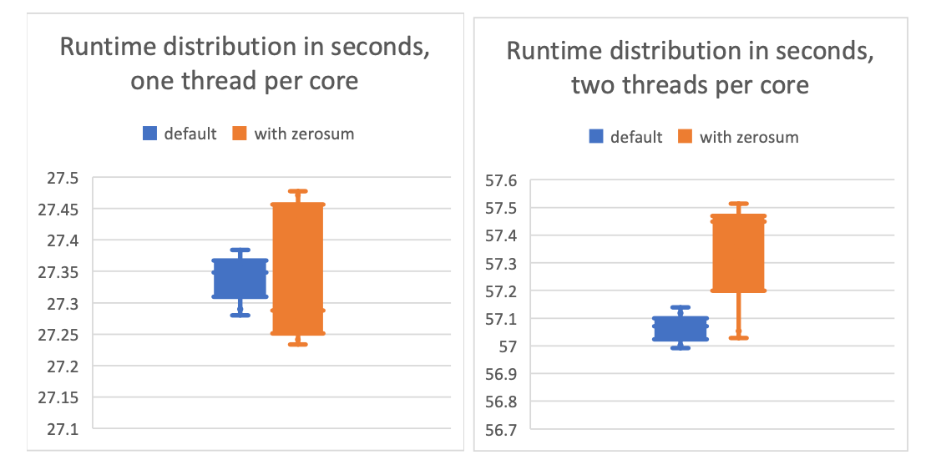
Overhead – less than 0.5% in resource constrained example
miniQMC time distributions executed 10 times using one OpenMP thread per core (left). In this comparison, the distribution of times with ZeroSum is noisier, but there is no significant observation of measurable overhead. The right figure shows the time distributions using two OpenMP threads per core. In this comparison, the distribution of times with ZeroSum is both noisier and longer tailed, and does show an observation of overhead, averaging about 0.2752 seconds, or 0.5%.
Notes:
Only one miniapp on one system, but should be representative.

Slide 20
Summary views of collected data – 64 GCDs, XGC running on Frontier
Notes:
Let’s look at time-series data from GPUs… apologies for the small font. This shows min/mean/max and .25 and .75 quartiles across all ranks

Slide 21
Summary views of collected data – 896 HWTs, XGC running on Frontier
↙️ All hardware threads from all ranks ↘️
↖️ Only main hardware thread from all ranks ↗️
Notes:
Averaging all 17 threads drags the means. However, looking at just main threads allows comparisons across ranks. Also, what's going on with the system times at exit?

Slide 22
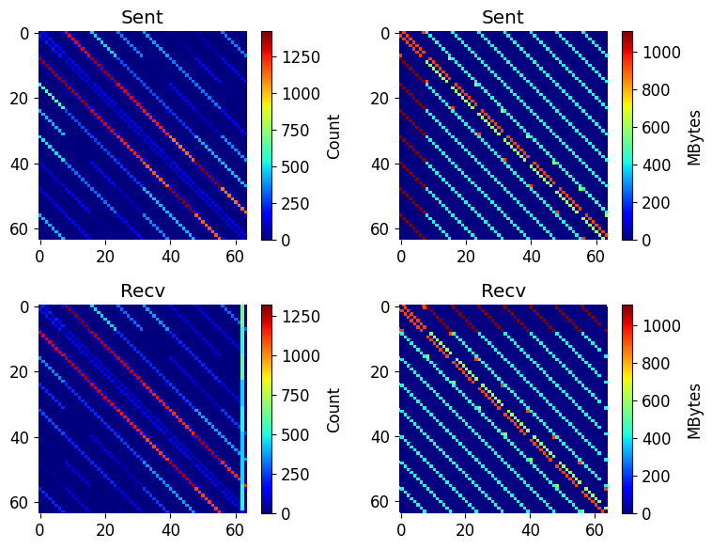
MPI P2P data
MPI implementation includes wrappers for MPI_Recv/Irecv, MPI_Sendrecv, MPI_Send/Bsend/Isend/ Rsend/Ssend to capture P2P frequency, volume
Obviously can be done by other/better performance measurement tools, but for a quick view, can be useful

Slide 23
Successful Use Cases
Octo-Tiger (HPX) thread placement on Fugaku
  Detected unusual core indexing, needs to be mapped using hwloc information
Argobots example
  Detected that the user was running client & server on same node with overlapping affinity lists
Grid (https://github.com/paboyle/Grid) on Frontier (lattice QCD library)
  Helped find/understand ideal resource mapping with custom bind arguments
XGC on Frontier
  Empirically demonstrated that 2 threads per core provided better performance than 1 thread per core
  Helped detect deadlock in GPU-aware libfabric/MPI implementation
  Helped detect algorithmic deadlock in MPI (application bug)
Notes:
For some weird systems (Fugaku), the first core is logically 0 but the OS sees it as 12. So there are 48 cores with logical indexes 0-47, but the OS reports them as 12-59. We need to map them so that we monitor the right CPU HWT from /proc/stat. Christopher Kelly at BNL did the Grid mapping work.

Slide 24
Deadlock detection – at scale
Runs application in gdb/cuda-gdb/rocgdb/gdb-oneapi in “batch” mode – sequence of commands are scripted
ZeroSum monitors all threads during execution:
  If all threads sleeping for N seconds (N is user-configurable):
    pthread_kill(SIGQUIT) the main thread
  If all but 1 sleeping for N seconds, and that thread doesn’t have at least one minor page fault during that time, it’s probably deadlocked at an MPI collective:
    pthread_kill(SIGQUIT) the main thread
Gdb will intercept the signal and is scripted to get a backtrace from all threads
Post-process the threads and make a tree (just like STAT/Cray-STAT)
  However, ZeroSum is automated - queue times on Perlmutter were around 8 hours, user didn’t want to babysit the slurm request

Slide 25
Example: XGC deadlocked on Perlmutter with 512 ranks
Only 52 of 64 in communicator participated in collective

Slide 26
HTML/SVG/JS interface: Aurora example
Network devices
Reserved cores
for system
GPU devices
Cores assigned to
MPI rank 0
Cores assigned to
MPI rank 1
…
Sunburst HTML template with support from https://d3js.org populated by Python script with JSON and CSV data
No GUI to install!
Inspired by MemAXES:
https://github.com/LLNL/MemAxes
Sockets
Resource
properties,
metrics
Shared caches
(exclusive caches
are hidden)
GPU devices
Tile assigned to
MPI rank 0
Network devices
Tile assigned to
MPI rank 1

Slide 27
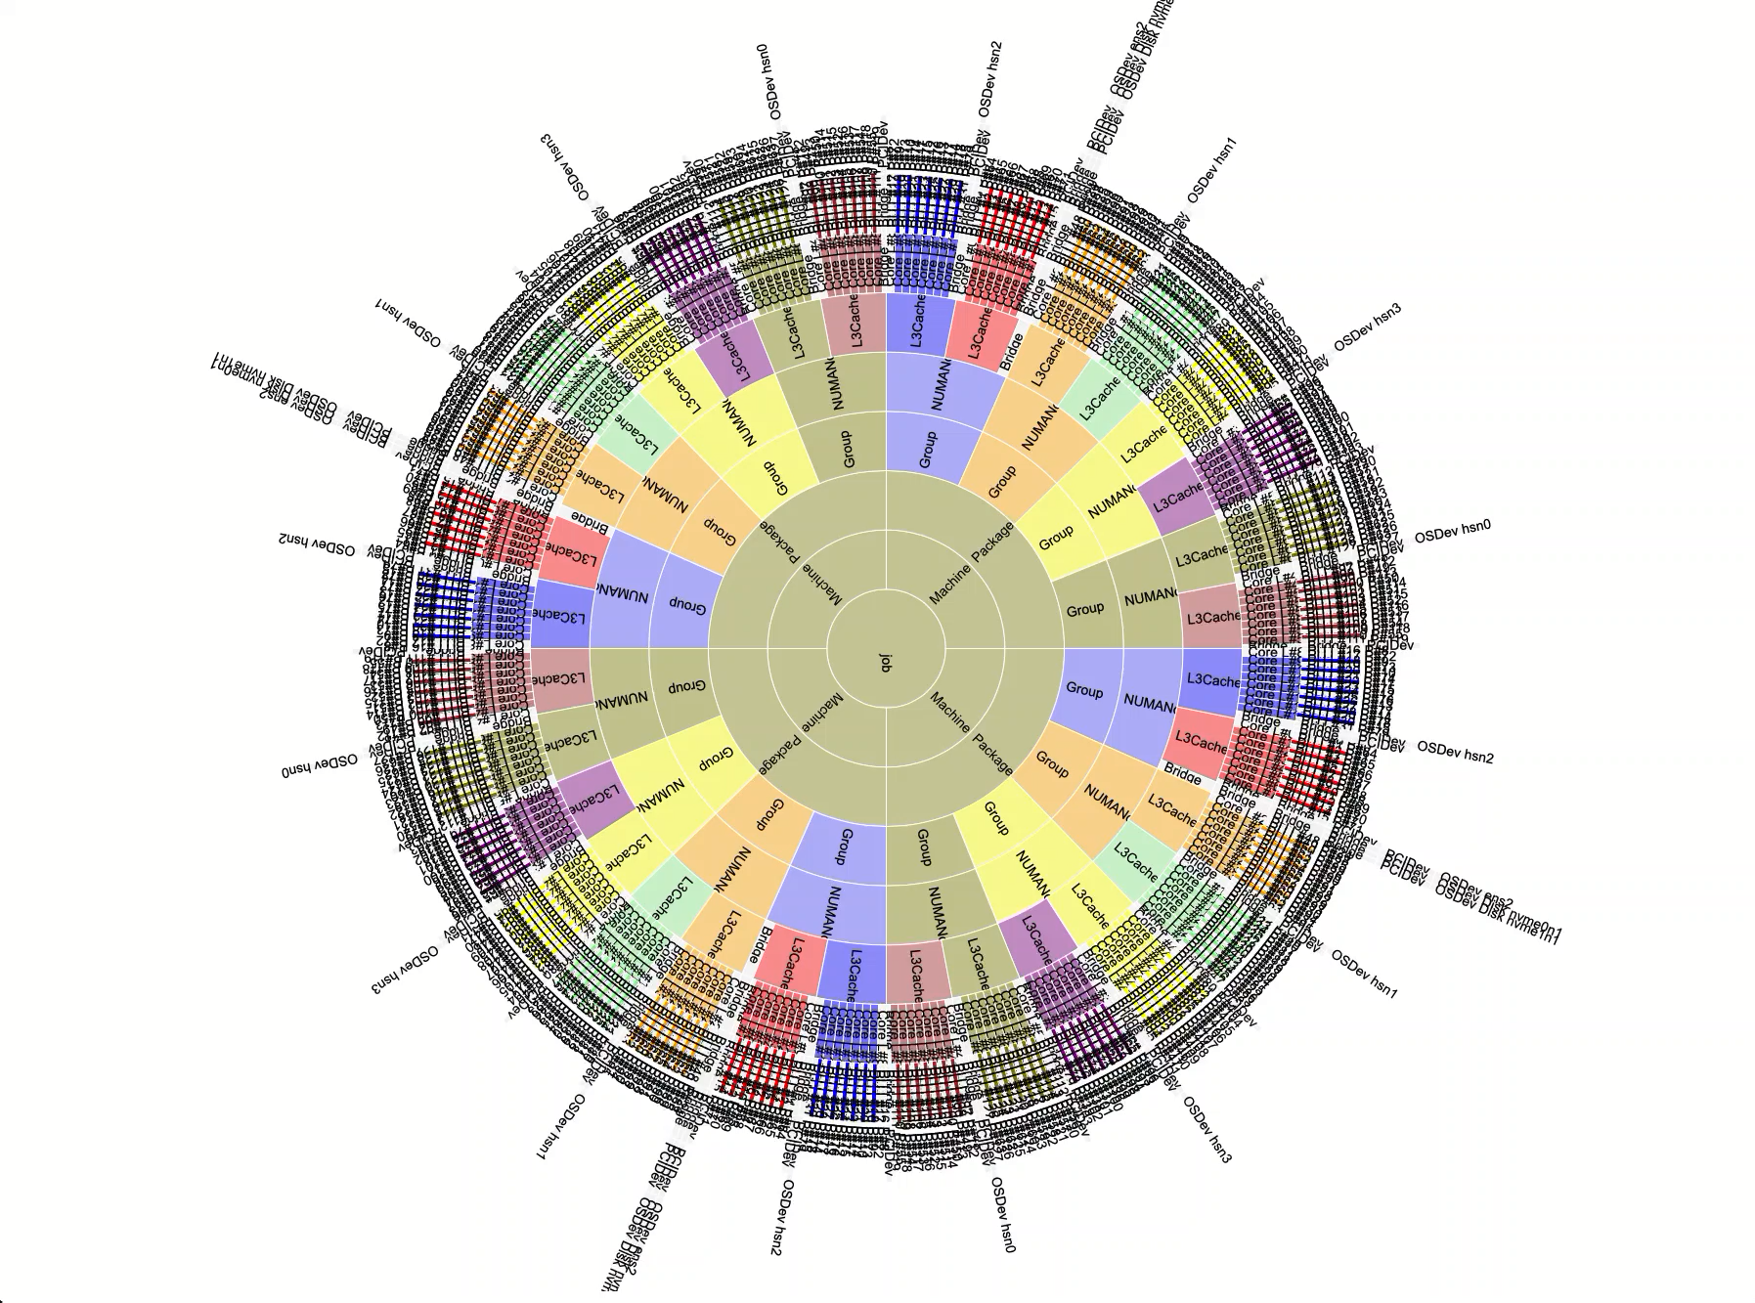
HWLOC integration with utilization data
32 rank, 4 node job on Frontier
14 threads per process, color coded by shmrank (local rank per node)
Segment color intensity relative to utilization
Validates that process threads are pinned where requested

Slide 28
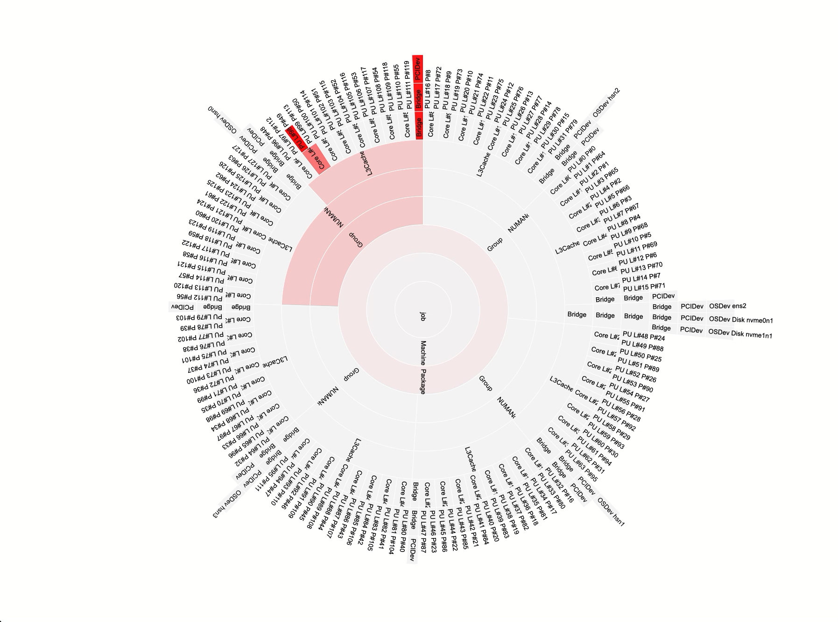
HWLOC integration with utilization data – GPU data
1 rank, 1 node Kokkos test on Frontier
1 GPU
Utilization data from ROCm-SMI mapped to device using PCI Bus ID
Segment color intensity relative to utilization
Validates that the process got the correct GPU (same L3 Cache region)

Slide 29
Live Demo (time permitting)
Jump to web browser:
  http://www.nic.uoregon.edu/~khuck/viz2/frontier-1-thread-per-core.html
  http://www.nic.uoregon.edu/~khuck/viz2/frontier-2-threads-per-core.html
Correct mapping for rank 7
Cores assigned to
rank 1
GCD assigned to rank 7
Cores
assigned to
rank 0
Threads
assigned to
rank 7

Slide 30
Conclusions, Future Work
ZeroSum addresses the configuration optimization problem
  https://github.com/UO-OACISS/zerosum
Still need automated misconfiguration/contention analysis
Output data could be better – use ADIOS2 BP5? HDF5? SQLite?
  Depends on analysis needs/wants
  Current log file “format” means analysis process is manual/ad hoc (via Python)
Streaming data to Mochi (SOMA) or other service (LDMS)?
  Enables robust monitoring approach – but likely redundant in many cases
  Working with students to implement SiMon (Simple Monitor)
Integration with performance tools (TAU, APEX, etc)
  Analysis of application performance data in context of system monitoring data
Input for automated feedback/control (APEX, Argobots, SOMA, application)

Slide 31



Acknowledgements
This work was supported by the Scientific Discovery through Advanced Computing (SciDAC) program funded by U.S. Department of Energy, Office of Science, Advanced Scientific Computing Research (ASCR) under contract DE-SC0021299.
Parts of this research was supported by the Exascale Computing Project (17-SC-20-SC), a joint project of the U.S. Department of Energy’s Office of Science and National Nuclear Security Administration, responsible for delivering a capable exascale ecosystem, including software, applications, and hardware technology, to support the nation’s exascale computing imperative.
This research used resources of the Oak Ridge Leadership Computing Facility at the Oak Ridge National Laboratory, which is supported by the Office of Science of the U.S. Department of Energy under Contract No. DE-AC05-00OR22725.

